Slide 1
Warmup
What are the steps to creating a law in Congress?

Slide 2
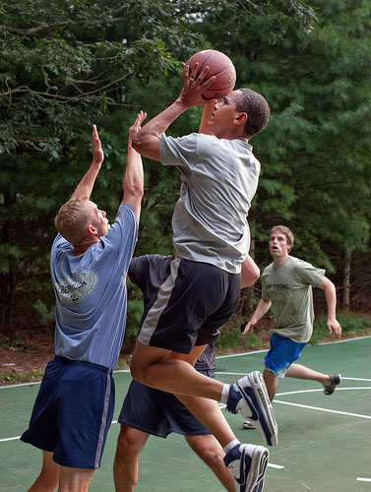
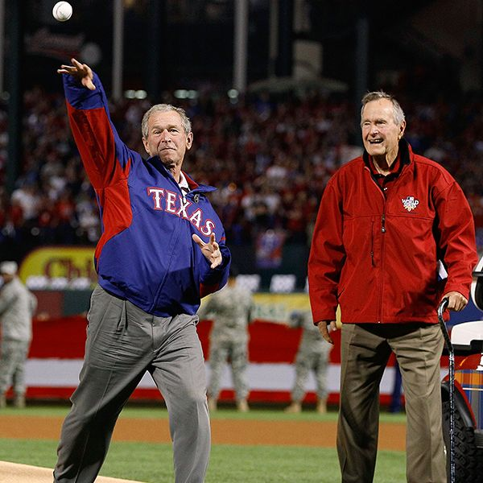
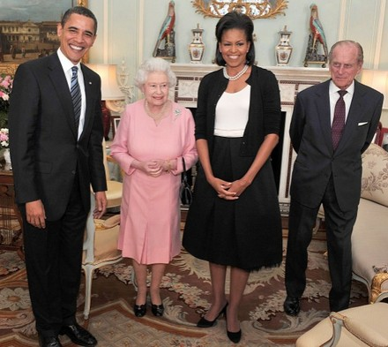
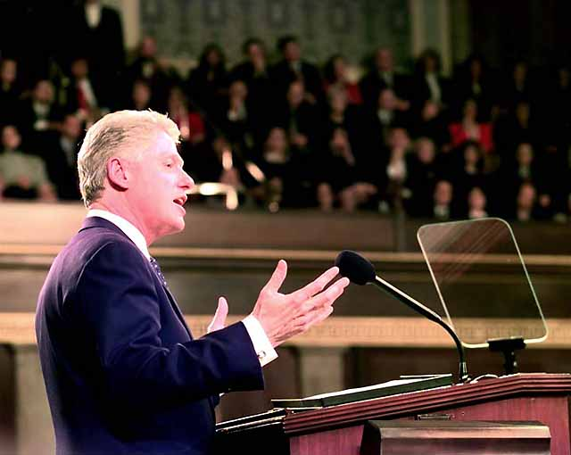
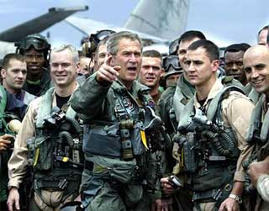
Based on these pictures, make a list of the different duties you believe the President has to fulfill during his term in office.

Slide 3
Unit 4 Part II
The Executive Branch

Slide 4
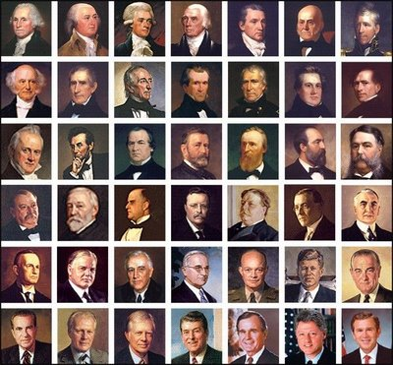
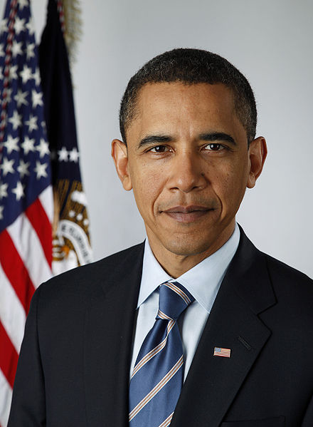
Leader of The Executive Branch

Slide 5
Requirements to be President and Vice President
President
35 Years Old
Native Born
14 Year Resident
Vice President
“I am Vice President. In this I am nothing, but I may be everything.” John Adams 1789
The same

Slide 6
How are the Pres and VP elected?
By the Electoral College

Slide 7
Each state has as many electoral votes as the number of U.S. Senators and Representatives it has in Congress.

Slide 8
The Electoral College System
Identify how many electoral college votes each state has from its membership in the House of Representatives:
Florida = 25 members in HOR
NC = 13 members in HOR
Alaska = 1 member in HOR

Slide 9
There is a total of 538 electoral votes: 435 members in the House of Representatives + 100 members in the Senate + 3 electoral votes for
Washington D.C. = 538

Slide 10

To Win requires a majority of electoral votes
270

Slide 11
If No Candidate wins a majority then the House of Representatives votes to determine the winner

Slide 12
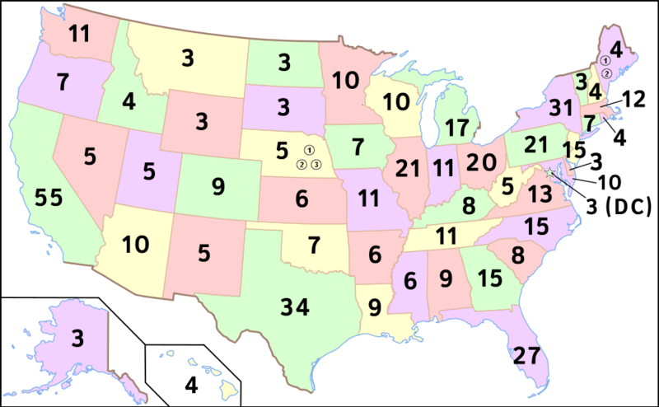

Slide 13
Winner-Take-All System
In every state except Nebraska and Maine which ever candidate wins the popular vote wins all of the states electoral vote.
One criticism of this system is that a candidate can win the election by winning only 11 states

Slide 14
How long are terms for Pres and VP
4 Years

Slide 15
Presidential Term Limits
2 Terms
10 Years

Slide 16
22nd Amendment
2 terms
10 Years

Slide 17
Vice President
No term limits

Slide 18
Presidential Succession
Vice President
Speaker Of House
President Pro-Tempore
Secretary of State – first non-elected position

Slide 19
25th Amendment
Officially makes the Vice President the President
New Pres then chooses another VP
New VP needs approval by both the Senate and House of Reps

Slide 20
Chief Executive
Carries out the nations laws
IN CHARGE OF
  of 15 Cabinet departments
  3 million government workers

Slide 21
EXECUTIVE ORDER
Command from President that has the force of law

Slide 22
APPOINT OFFICIALS
President is responsible with appointing federal court judges and other government officials

Slide 23
ISSUE
PARDONS – to forgive someone for a crime and free them from punishment
REPRIEVES – order to delay a person’s punishment
AMNESTY – a pardon given to a group of people

Slide 24
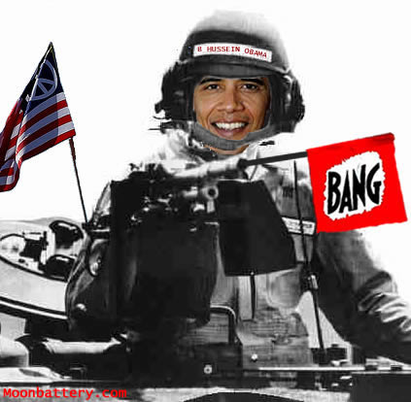
COMMANDER IN CHIEF

Slide 25
War Making
Only Congress can declare war but only the President can send troops into battle

Slide 26
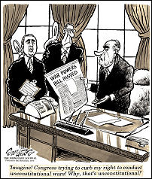
War Powers Act of 1973

Slide 27
War Powers Act
President must notify Congress within 48 hours of sending troops into battle
Troops must come home after 60 days unless Congress grants approval to remain

Slide 28
Legislative Leader
Only members of Congress can propose and write bills but the President is expected to propose laws he wants

Slide 29
Head of State
The Living Symbol of the nation. The President carries out ceremonial functions for the United States

Slide 30
Economic Leader
Propose the nation’s budget
OMB – Office of Management and Budget: helps Pres prepare
Two Step Process:
  President Proposes
  Congress Approves

Slide 31
Diplomatic Leader
The President is in charge of our foreign policy
Foreign Policy – plan for dealing with other nations

Slide 32
Goals of Foreign Policy
National Security – primary concern, keep the country safe from attack or harm
Encourage International Trade
Promote World Peace
Promote Democracy around the world

Slide 33
Foreign Policy Bureaucracy
State Department
Defense Department
Central Intelligence Agency (CIA)
National Security Council (NSC)

Slide 34
Tools of Foreign Policy
Treaties – Formal agreements between governments

Slide 35
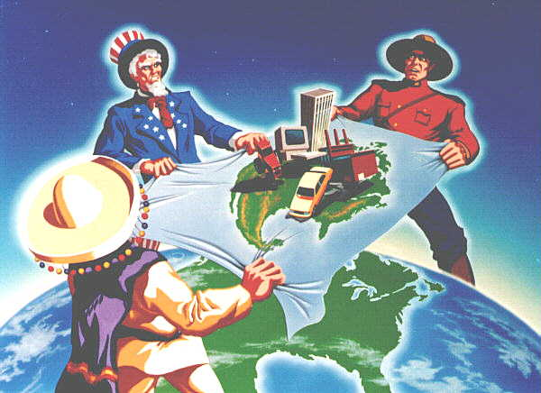
Economic Treaties
NAFTA – North American Free Trade Agreement

Slide 36
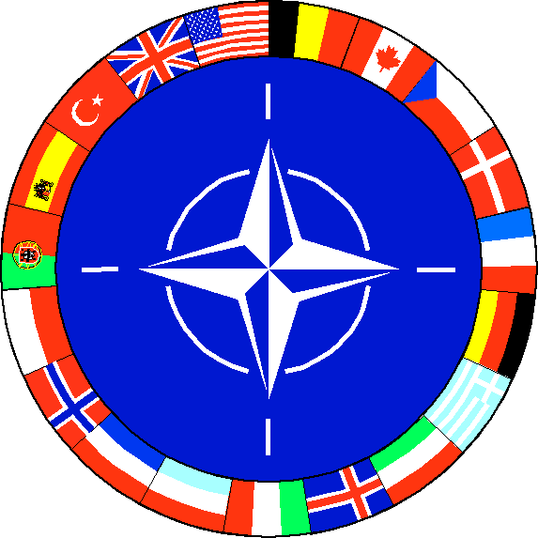
Defense Treaties
NATO – North Atlantic Treaty Organization

Slide 37
Executive Agreements
Agreement between President and leader of another country
Does not need Senate approval

Slide 38
Appointing Ambassadors
An official representative of a country’s government
Need Senate approval

Slide 39
Foreign Aid
Money, food, military assistance given to help other countries
Need Senate approval

Slide 40
Trade Sanctions
Punishing another country with trade barriers

Slide 41
Embargo
Agreement among group of nations not to trade with a target nation

Slide 42
Military Force
President may use military to carry out foreign policy

Slide 43
Warmup 2/29/2012
What role of the president is most important?
  Chief Executive
  Commander in Chief
  Foreign Policy
  Head of State
  Party Leader
  Economic Leader
What role is least important?
  Chief Executive
  Commander in Chief
  Foreign Policy
  Head of State
  Party Leader
  Economic Leader
Should the president be native born (no other elected official has to be)?

Slide 44
Organization of the Executive Branch
Pyramid
President
President

Slide 45
Warmup
What are the duties of the President?

Slide 46
The Presidents Administration
Top officials who advise and assist the President in his/her job of running the country. Get their positions base on the spoils system – rewarding people with government jobs based on their political support
  Usually replaced with each new President.

Slide 47
Executive Office of the President
Thousands of highly trained specialists, secretaries and clerks that assist the President

Slide 48
National Security Council
Helps President direct US military and foreign policy, supervises the CIA (Central Intelligence Agency)

Slide 49
Council of Economic Advisors
Advises the President on the Economy

Slide 50
The Cabinet: Composed of the Heads of Executive Departments
Advise the President on issues related to their departments

Slide 51
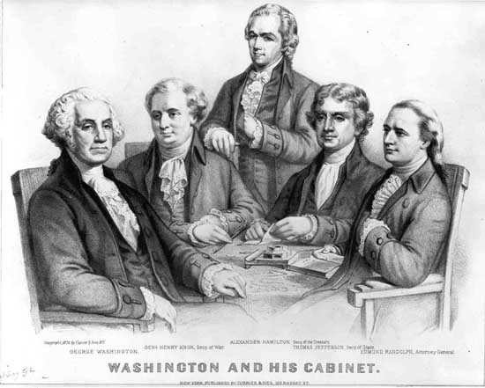

Slide 52
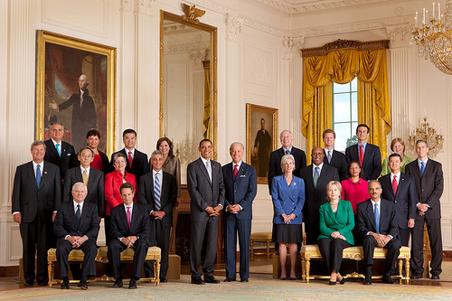

Slide 53
The Federal Bureaucracy
Around 3 million civilian workers
Civil Service Workers – range from clerks to lawyers who work for the federal government
Civil Service System – the practice of hiring government workers based on merit
The Merit System – hiring based on ability

Slide 54
What does the Federal Bureaucracy do?
Decide how to apply new laws to daily life
Administer the day to day operations of the government
Federal agencies regulate various activities

Slide 55
Identify the responsibilities of each of the executive departments using page 227 of your text

Slide 56
What are independent agencies in the executive branch?
Called independent because they are not a part of one of the executive departments

Slide 57

Executive Agencies
Deal with certain specialized areas
Example = NASA (National Aeronautics and Space Administration)

Slide 58

Government Corporations
Businesses that the government owns
Example = USPS (United States Postal Service

Slide 59
Regulatory Boards and Commissions
Protect public by enforcing rules for certain groups or industries
Members are appointed by the President but can only be removed from office by impeachment

Slide 60

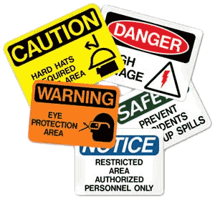
OSHA
Occupational Safety and Health Administration
Make sure the workplace is safe

Slide 61

SEC
Securities and Exchange Commission
Regulate trade, protect investors, maintain fair markets

Slide 62

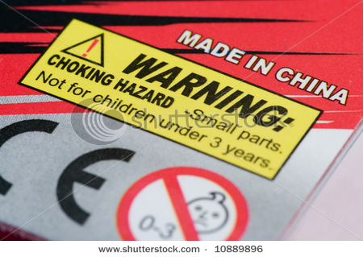
FTC
Federal Trade Commission
Maintains fair competition, regulates advertising, ensures safe products

Slide 63

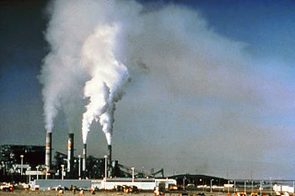
EPA
Environmental Protection Agency
Issue licenses and regulate activity to protect the environment

Slide 64

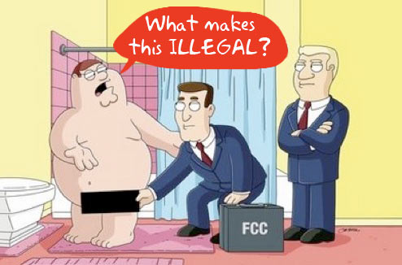
FCC
Federal Communications Commission
Makes broadcasting rules and regulates all communication networks

