Slide 1
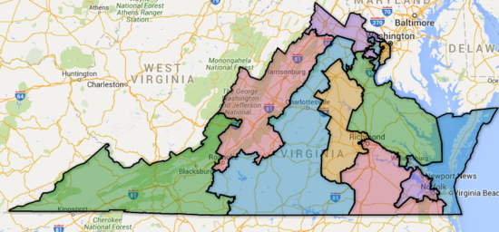
Virginia’s 11 Congressional Districts
Warm Up: Each Congressional district in Virginia elects one Congressman to the House of Representatives. Why do you think these districts are shaped the way they are?

Slide 2
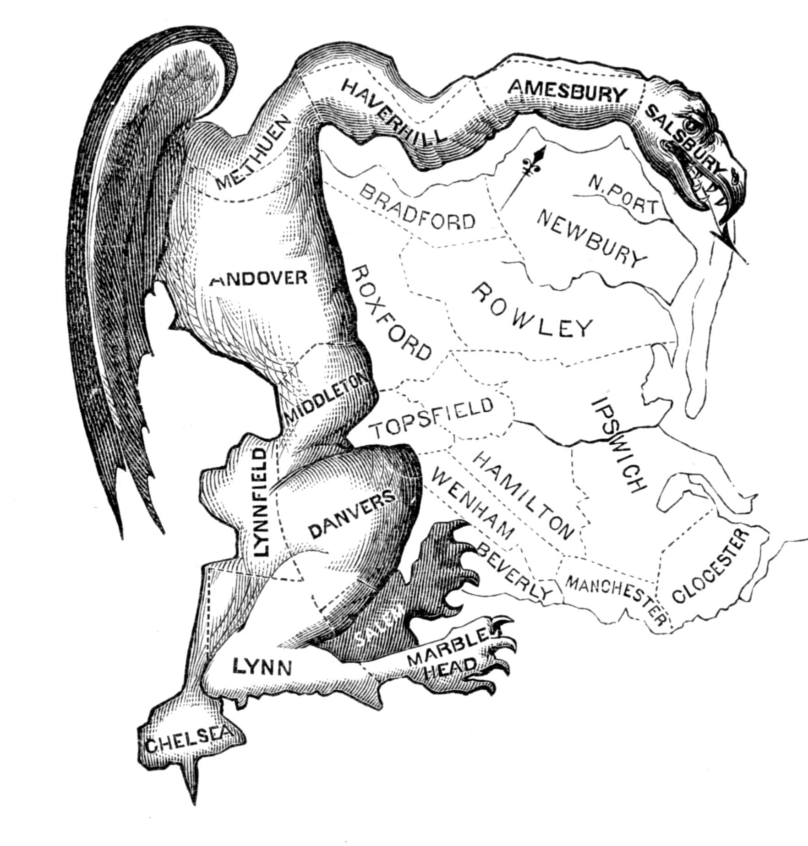


Slide 3

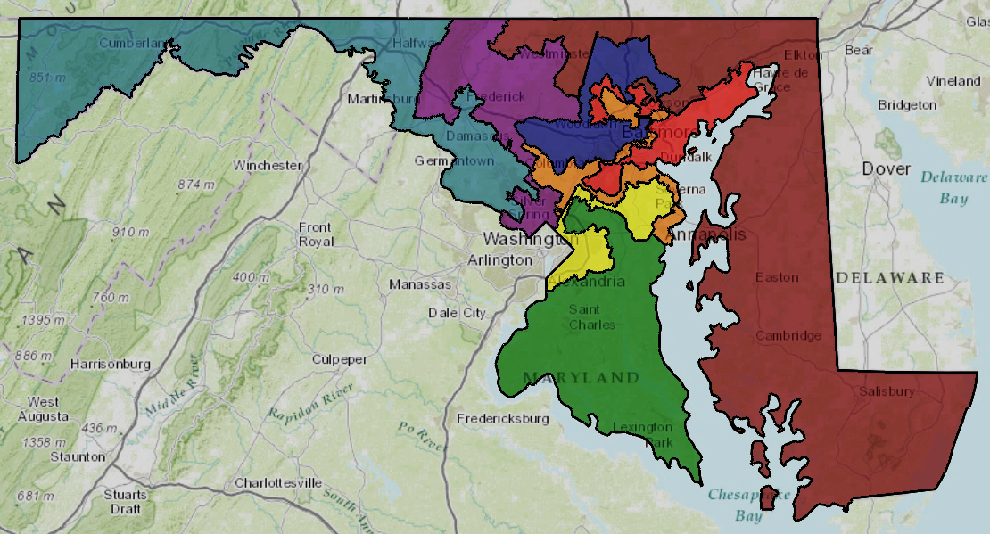
The US census is taken every 10 years and determines the number of Representatives each state gets in the House
The Congressional Act of 1929 froze the total number at 435
After the census, state legislatures can redraw districts based on the new population total
The governor signs off on the new districts
Notes:
Photo: Maryland’s Congressional districts

Slide 4

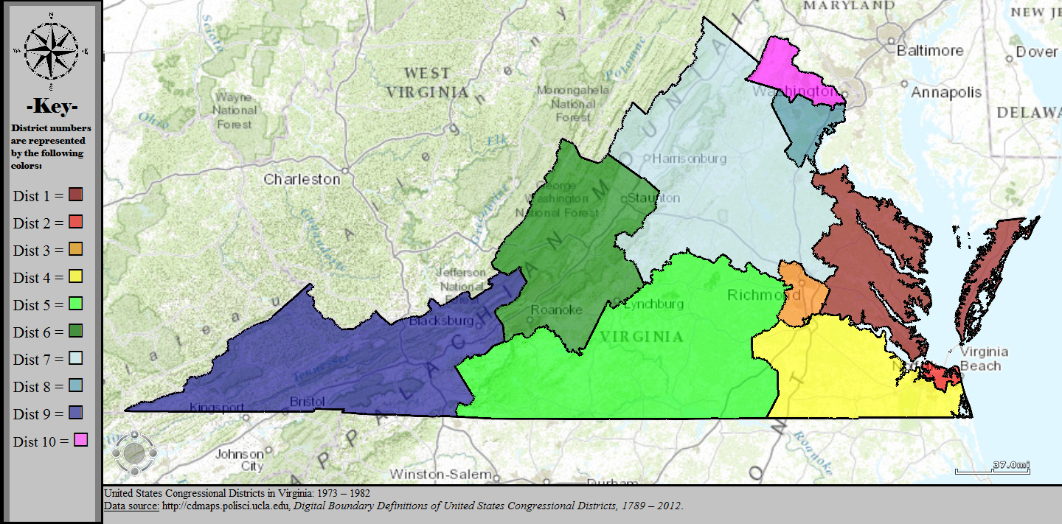
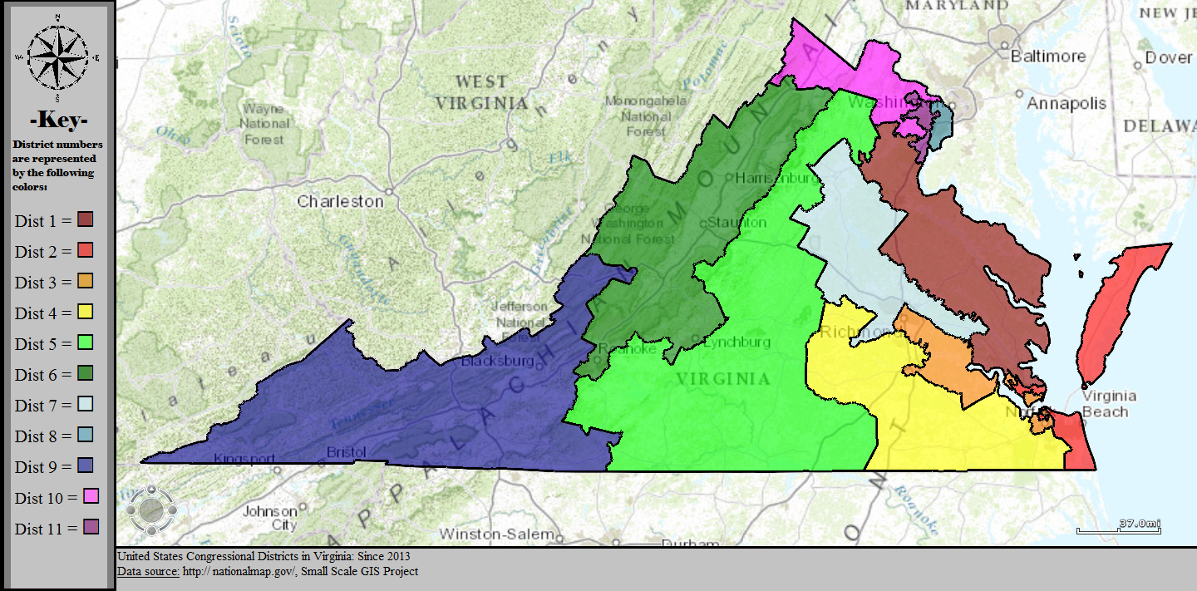
Virginia’s Districts in 1982
Virginia’s Districts in 2016

Slide 5

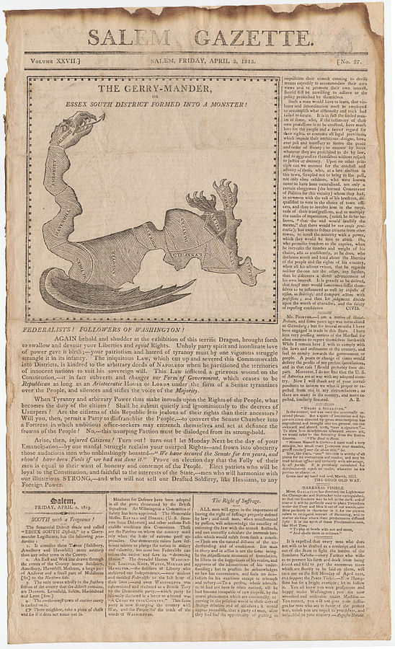
Political parties redraw the districts to their advantage
Named for Massachusetts Governor Elbridge Gerry
In 1812, he helped redistrict Massachusetts to benefit his Democratic-Republican Party
When mapped, they were said to resemble the shape of a salamander

Slide 6

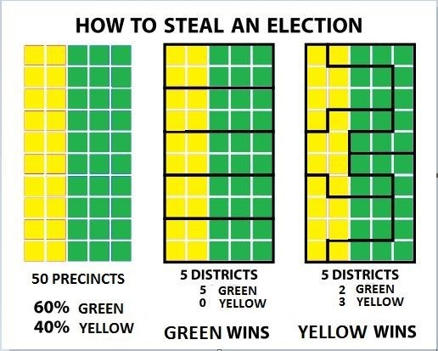
Gerrymandering helps the party in power to gain seats in the House of Representatives
Done in 2 ways:
  Packing: Putting as many members of one party into one district to limit the amount of seats they win
  Cracking: Splitting voters of the opposing party into two different districts

Slide 7
Imagine that this is a region of your state. The colors represent the political leanings of people in that region. There are more “Greens” than “Yellows”.
Can you draw the 5 Congressional district boundaries (with 10 squares in each) so that:
Green wins ALL 5?
Yellow wins more than green?

Slide 9

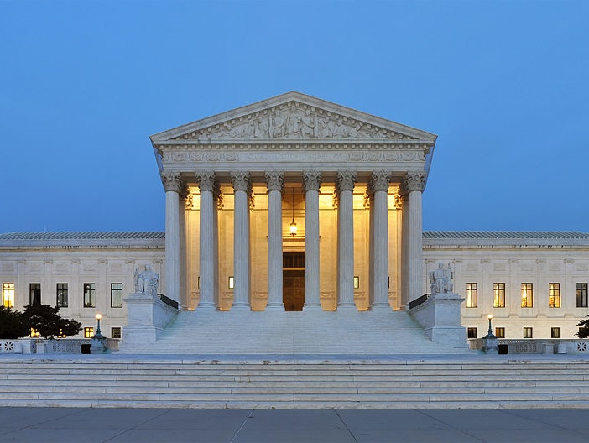
Baker v. Carr (1962): enabled federal courts to intervene in and to decide redistricting cases
Wesberry v. Sanders (1964): Districts must be of equal population
Shaw v. Reno (1993): redistricting based on race must be held to a strict standard of scrutiny
Through gerrymandering, only about 1/10 of Congressional seats are competitive
Makes a shift of more than a few seats unlikely from one election to the next

