Slide 1
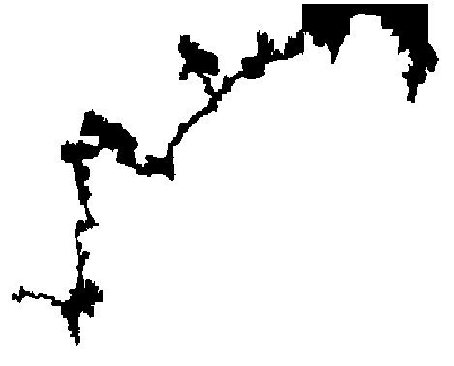
Warm-up 2/22/2012
What is this a picture of?
Where do you think this is located

Slide 2
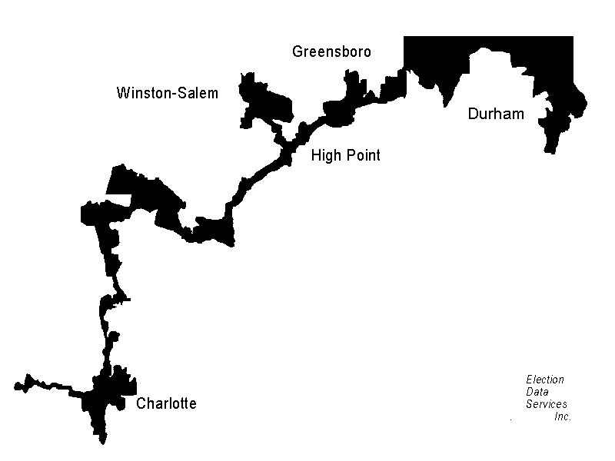

Slide 3
Unit 4 The Branches of the American Government
Part I – The Legislative Branch

Slide 4
Bicameral
Two Houses

Slide 5
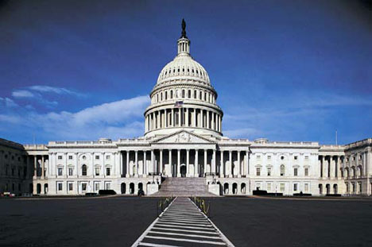
What is the US legislature called?
Congress

Slide 6
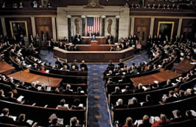
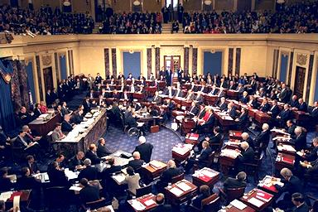
What are the two chambers of Congress?
U.S. House of Representatives
U.S. Senate

Slide 7
House of Representatives
Term Length = 2 years
Term Limits = none
Requirements = 25 years old, U.S. Citizen 7 years, resident of district they represent
Members = 435
Number per state = depends on population

Slide 8
US Senate
Term Length = 6 Years
Term Limits = None
Requirements = 30 years old, 9 year citizen, resident of state they represent
Number of members = 100
Number per state = 2

Slide 9
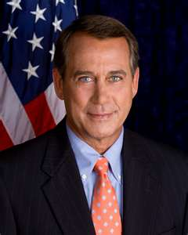
Leadership in House of Representatives
Speaker of the House
  Directs legislation to committees
  Leads floor debate

Slide 10
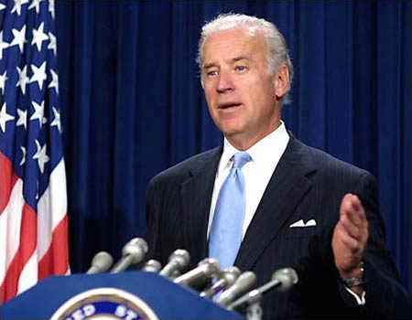
Leadership in the Senate
Vice President
  Tie break vote

Slide 11
President Pro-tempore
“For the time being” – In VPs absence
No real power
Oldest member of majority party

Slide 12
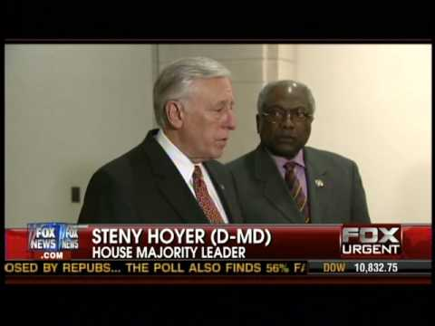
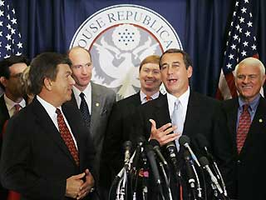
Other Congressional Officials
House and Senate Majority Leader
House and Senate Minority Leader

Slide 13
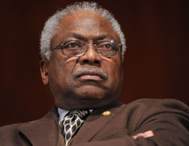
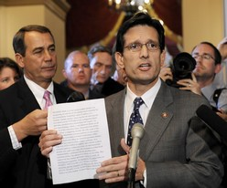
Majority and Minority Party Whips
Try to ensure everyone votes together

Slide 14
Total Members in US Congress
435 + 100 = 535

Slide 15
Constituents
The people who a member of Congress represents
Senate = entire state
House of Representative = residents of their community

Slide 16
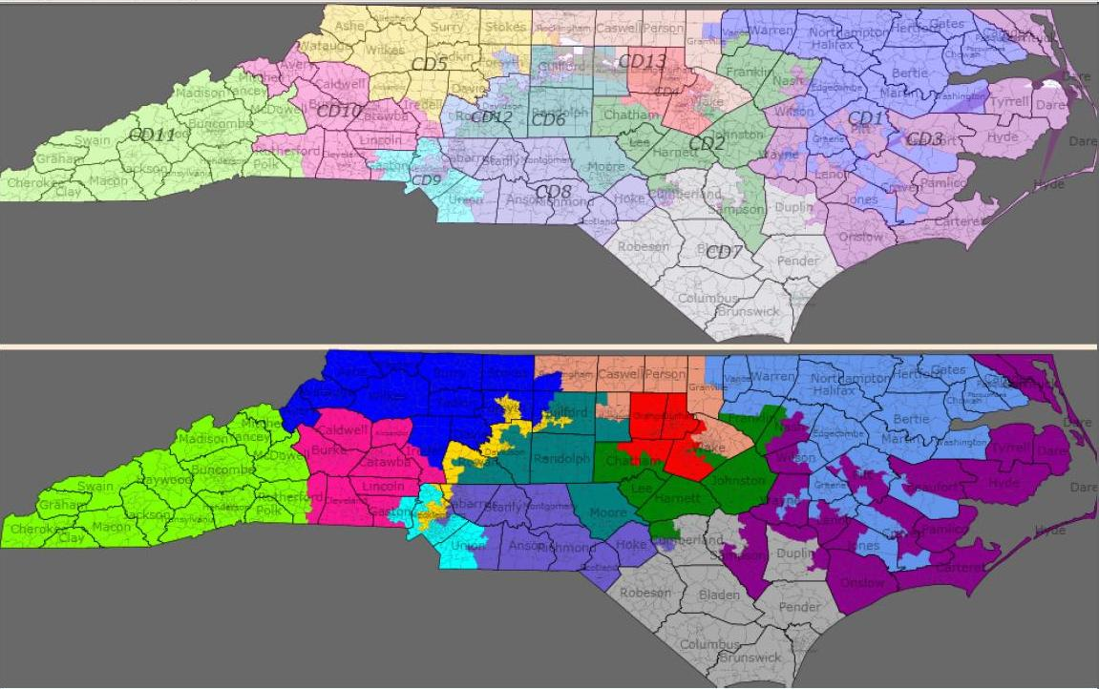

Slide 17
Census
Population Count
Happens every ten years
Impacts the House of Representatives by redistributing a states representation

Slide 18
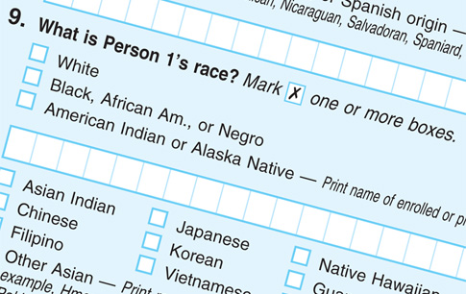

Slide 19
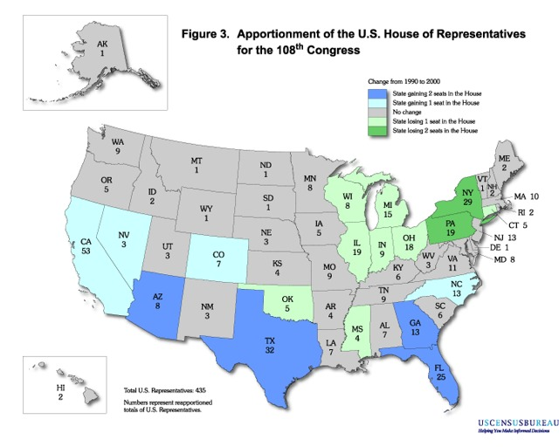

Slide 20
Who draws Congressional districts?
State legislature – each district must have roughly the same number of people

Slide 21
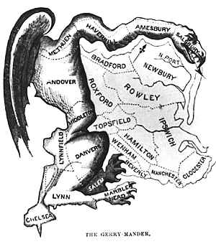
Gerrymandering

Slide 22
Gerrymandering
Drawing a Congressional district to favor a particular party

Slide 23
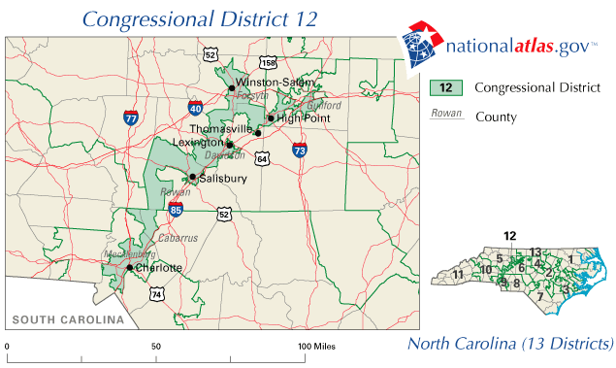

Slide 24
Warmup 2/22/12
Why do we need laws?
What kinds of things do you think we need laws to regulate?
Are there any laws we do not need?

Slide 25
Purpose of Committees
To enable each chamber to handle the many bills they have

Slide 26
Standing Committees
Permanent committees that handle reoccurring issues
i.e. Armed Services Committee, Budget Committee

Slide 27
Select Committee
Temporary committees to handle special issues.
i.e. Select Committee on 9/11

Slide 28
Joint Committee
Committees that include members of both chambers to handle special issues.

Slide 29
Conference Committee
Members of both houses that iron out the final wording of a bill before it can be sent to the President

Slide 30
How are committee assignments determined?
Party leaders select.
Consider preferences, expertise and party loyalty

Slide 31
Seniority System
Longer serving members get the better committee spots
i.e. Oldest committee member of the majority party is usually the committee chairperson

Slide 32
Warmup
How does gerrymandering allow political parties to gain increase their power in certain areas?

Slide 33
Powers of Congress
Legislate – to make laws

Slide 34
Where are the powers of Congress listed in the US Constitution
Article 1 Section 8 Paragraphs 1-18

Slide 35
How many specifically stated powers does the Constitution grant Congress?
18
Called EXPRESSED POWERS
Enumerated = numbered

Slide 36
How can Congress make laws other than those specifically mentioned in the Constitution?
By using the power granted to it by the “necessary and proper clause”

Slide 37
Necessary and Proper Clause
Congress shall have the power to do whatever is “necessary and proper” to carry out the expressed powers

Slide 38
Elastic Clause
Stretches the power of Congress to meet new needs

Slide 39
IMPLIED POWERS
Must relate to an expressed power

Slide 40
Checks and Balances
Powers over the Executive Branch
Approve Appointments and Treaties
Impeach and remove from office
Approve budget
Powers over the Judicial Branch
Approve appointment
Impeach judges and remove from office
Change the Constitution

Slide 41
IMPEACH
To Accuse an official of misconduct
House of Representatives – has the sole power to charge an official. (Draw up the Articles of Impeachment)
Senate – sole power to conduct the trial and determine punishment

Slide 42
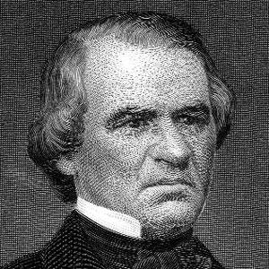
Andrew Johnson

Slide 43
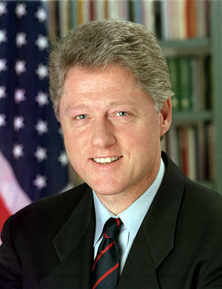
Bill Clinton

Slide 44
What is Congress’ power of oversight?
The power of Congress to make sure laws are working

Slide 45
Limits on Congressional Power
Cannot violate the freedoms protected in the Constitution
Cannot favor one State over another
Cannot tax Interstate Commerce or Exports

Slide 46
Congress cannot suspend the
Writ of Habeas Corpus
Requires police to take those arrested before a judge to explain why they are holding a person

Slide 47
Cannot pass
Bills of Attainder
Laws that punish a person without a jury trial

Slide 48
Cannot pass
Ex Post Facto Laws
Laws that punish someone for an act that was committed before it was illegal

Slide 49
Checks and Balances on Congressional Power
Checks by Executive over Congress
Pres. can veto laws
Pres. Is only one who can send troops into battle
Checks by Judicial over Congress
Supreme Court can declare acts unconstitutional

Slide 50
Special Privileges of Congress
Franking Privilege – free mail for business purposes
Immunity – legal protection from prosecution in some instances
Personal Staff – help paid for with tax dollars

Slide 51
Responsibilities of Congressmen
Be a voice for Constituents – people they represent
Casework – help constituents deal with the government
Public Works – get (appropriate) government money for local projects (dams, military bases, transit stations)

Slide 52
Responsibilities of Congressmen
Grants and Contracts – try to ensure their constituents get a share of billions in government funded projects and jobs (making military uniforms)
  Pork-barrel projects – grants that benefit just the home district. “Adding the fat” to governments budget

Slide 53
Responsibilities of Congressmen
Lawmaking – represent the wishes and opinions of their constituents in the lawmaking process

Slide 54
Warmup
What are some of the duties or obligations that Congress has?

Slide 55
A Bill
A proposed law
Anyone can have an idea for a bill

Slide 56
Purpose of Committees
To enable each chamber to handle the many bills they have

Slide 57
How a bill becomes a law
Drafted/Introduced
Goes to Committee
Committee discusses, changes, and votes on bill

Slide 58
How a bill becomes a law
If approved, goes to House/Senate for debate
Floor reading/debate
  If needed, changes are made back in committee
Full vote by House/Senate
Goes to president for approval

Slide 59
What actions can a committee take with a bill?
Pass the bill
Mark up a bill – amend it or add to it
Replace with a new bill
Pigeonhole – kill it by not letting it out of committee
Kill with a – majority vote

Slide 60
How rules for passing laws different in the House than in the Senate?

Slide 61
House of Representatives
Amendments – have to be related to the topic of the bill
Rules for Debate – there is a time limit for each member to talk, must talk about the bill

Slide 62
Senate
Amendments – do not have to be related to bill
  Riders – attachments to a bill that are not related to its subject

Slide 63
Rules for Debate
Very few Rules
Filibuster – killing a bill by talking until it is dropped
Cloture – vote to end a filibuster, 60 votes needed

Slide 64
What actions can the President take with a bill?
Sign it into law
Veto (I forbid) – Deny it
Pocket Veto – do nothing and Congress dismisses before 10 days
Pass without signature – do nothing for 10 days and Congress is still in session

Slide 65
If the President vetoes a bill what can Congress do?
Override a veto with a 2/3rds vote in both houses

Slide 66
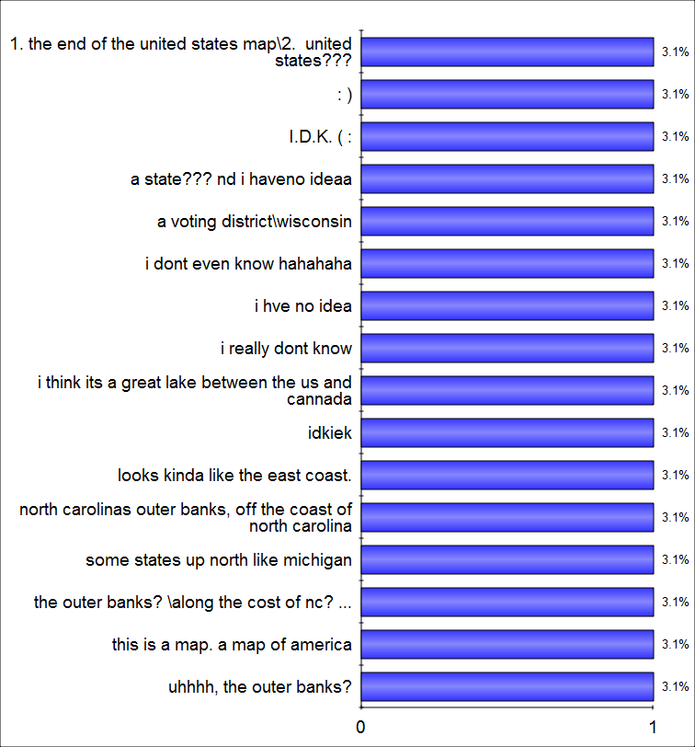
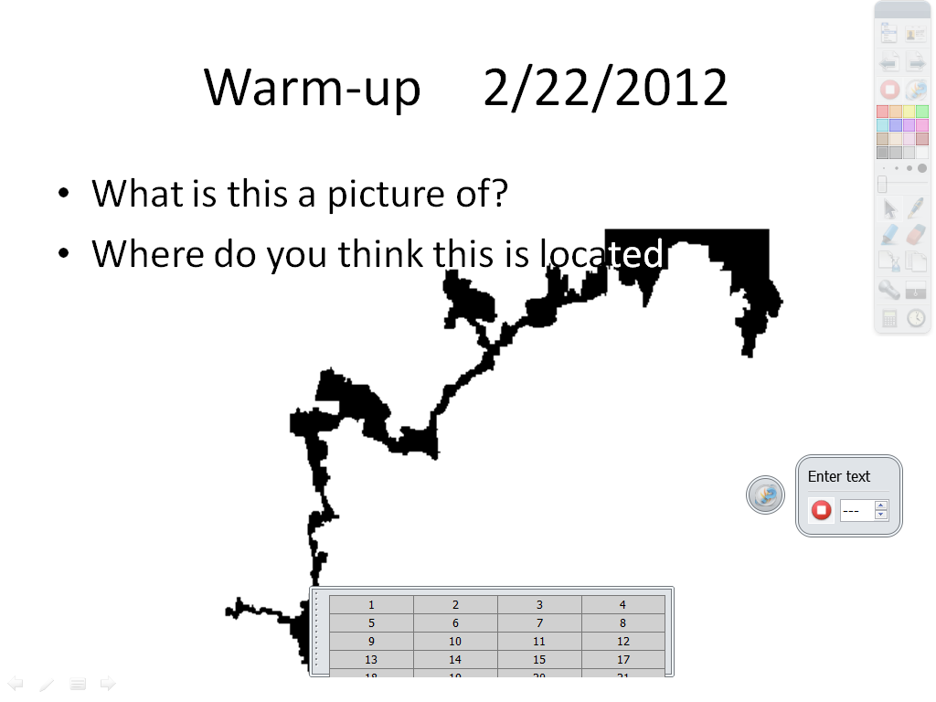
ExpressPoll 2/22/2012 10:31:56 AM

Slide 67
Reflection on Legislative activities – answer in essay form
Based on our redistricting activity last week, how would you describe the role of Congress and the effects of gerrymandering on elections.
Based on our legislative activity on Thursday and Friday, describe the process by which bills become laws. Include an example from class and any other observations you made from the activity.

Slide 68
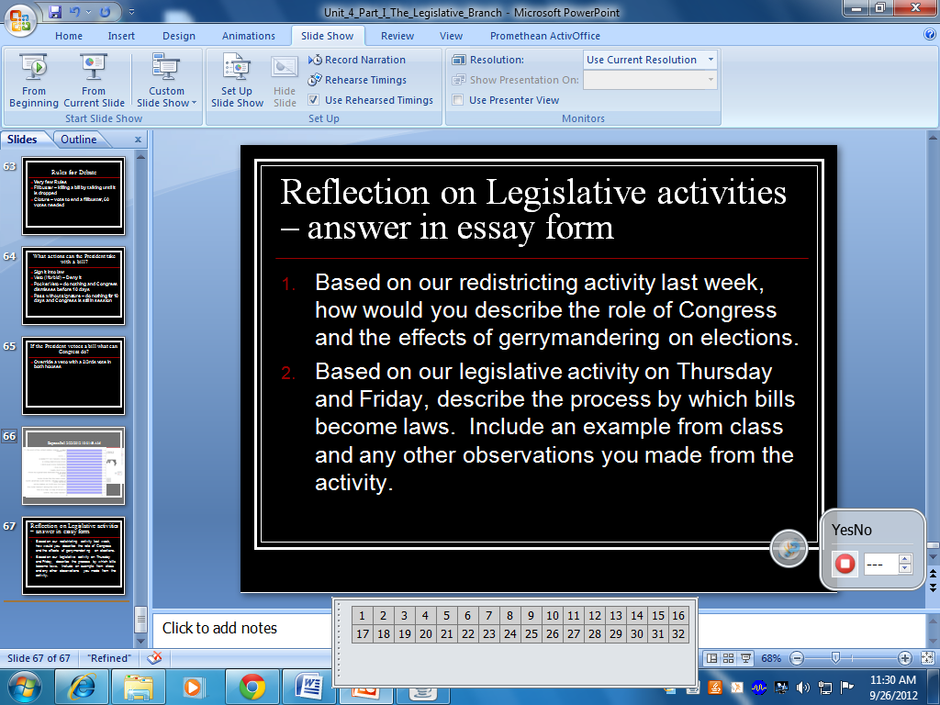

Slide 69
