Slide 1
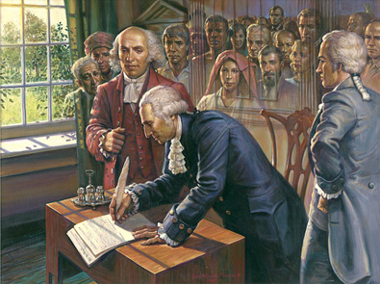
CONSTITUTIONAL
CONVENTION
May, 1787
Philadelphia, Pennsylvania
~Independence Hall~
Leader: George Washington

Slide 2
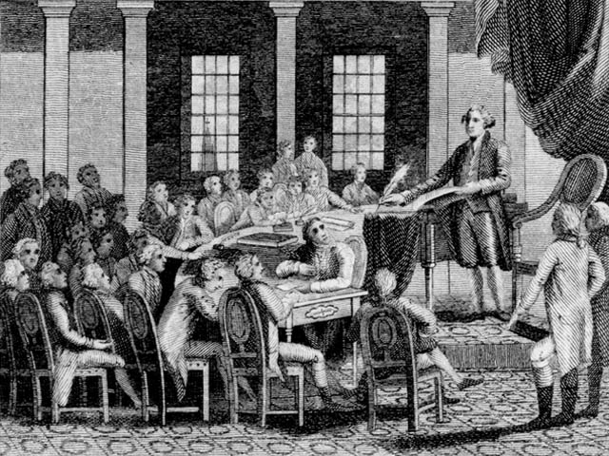
CONVENTION
-May 1787 Philadelphia
Met in Independence Hall in Philadelphia
George Washington leader
-12 of 13 states
Rhode Island absent
Feared a strong central government
-55 Delegates
Many leaders missing
In May 1787, delegates from all the states except Rhode Island gathered at the Philadelphia State House—in the same room in which the Declaration of Independence had been signed 11 years earlier. Most of the 55 delegates were lawyers, merchants, or planters. Most were rich, well-educated men in their thirties and forties. They included some of the most influential leaders at the time, such as Ben Franklin, Alexander Hamilton, and George Washington. George Washington was elected presiding officer by a unanimous vote.

Slide 3

DECISIONS MADE
-rewrite gov’t
Meant to revise articles
Threw AOC away, started over
-1 vote per state
-keep meeting a secret
Speak freely without public influence
-majority rules
Delegates divided on where power should come from - people or states?
In spite of the sweltering heat, the windows were tightly sealed to prevent outsiders from eavesdropping on the discussions. The delegates wanted to feel free to speak their minds without causing alarm or opposition among the general public. They agreed to keep whatever was said in the meeting room a secret until their work was done.

Slide 4
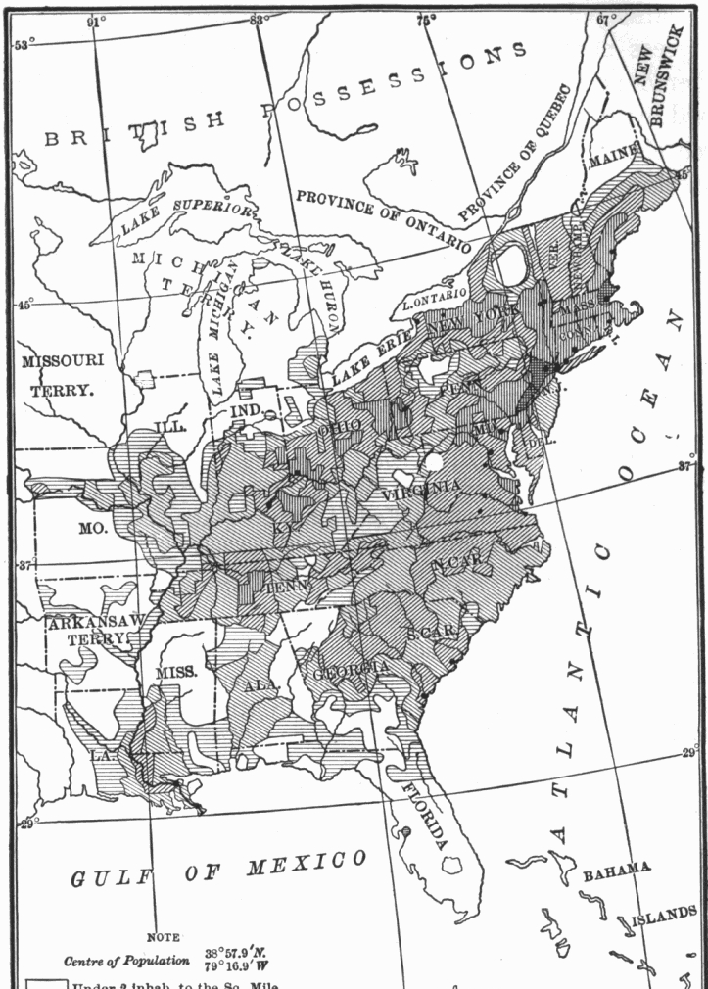
ISSUES AT DEBATE
-representation
Should representation be equal or based on population?
large states
Want rep. based on population
small states
Want equal rep. from each state
-slavery
Should the U.S. keep it?
Do slaves count in population?
-economics
Can the gov. tax?
How to pay off debts
Key Issue: Should states with more people have more representatives, or should every state be represented equally? What about slaves? Do they count?

Slide 5
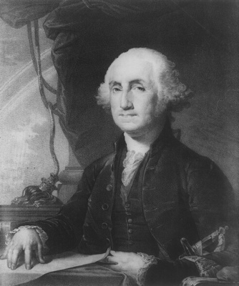
PLANS PROPOSED
-Virginia Plan
-James Madison - “Father of the Constitution”
-3 branches (strong national government)
-bicameral Congress (2 houses)
-population based
Number of lawmakers depends on states’ population
Favors LARGE states
James Madison is known as the “Father of the Constitution” not only for his proposal of the Virginia Plan, but also for his actions during the convention. He addressed the convention more than 200 times, and when he was not speaking, he took notes. Sitting near the front of the room so that he could hear everything that was said, Madison wrote down nearly every word. From this record, we know what happened at the convention every day.

Slide 6
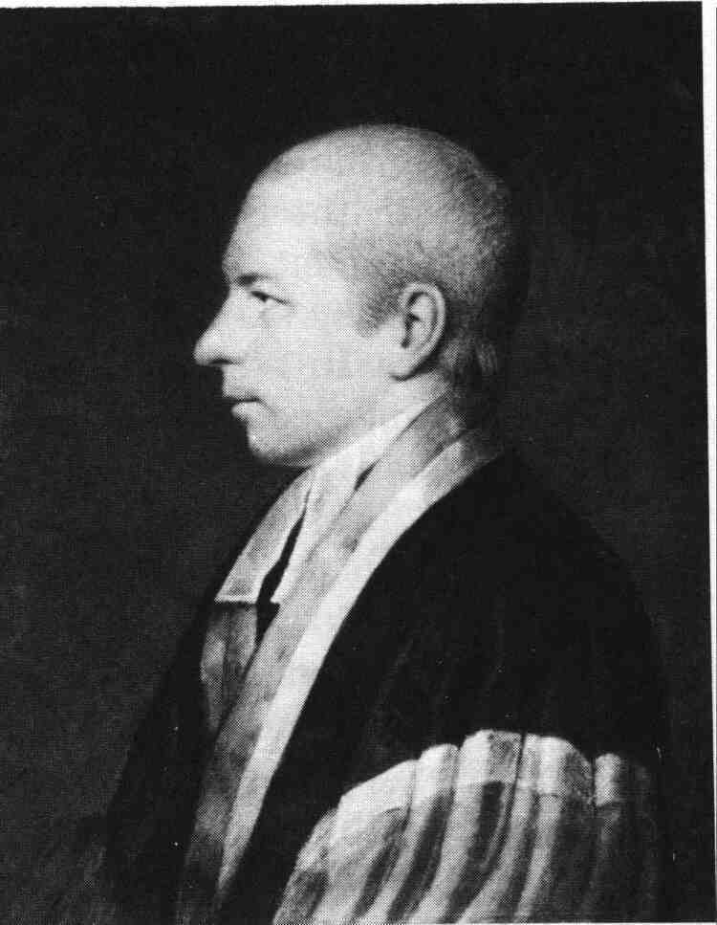
PLANS PROPOSED
-New Jersey Plan
-small state plan
3 branches, 1 house Congress
-equal voting
Keep small states from being taken over by large states
-group executive
-promoted state’s rights
William Paterson proposed the New Jersey Plan, which promoted states rights for the small states.

Slide 7
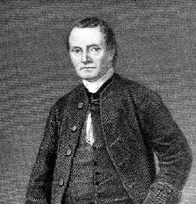
COMPROMISES
-Great Compromise
Roger Sherman (Conn.)
-Agreement made at the Convention of 1787 that created a two house legislature with one house based on population and the other based on state equality
- House
To represent people, based on population
-Senate
To represent state, equal representation
Roger Sherman proposed the Great Compromise, which became our U.S. Constitution

Slide 8
COMPROMISES
Representation based on population raised the question of whether slaves should be counted as people. Southern delegates, whose states had many slaves, wanted slaves included in the population count that determined the number of representatives in the House. Northern delegates, whose states had few slaves, disagreed. Not counting Southern slaves would give the Northern states more representatives. The delegates finally agreed to the Three-Fifths Compromise.
This settled the political issue, but not the economic issue of slavery. Slaveholders, especially in the South, worried that if Congress were given power to regulate foreign trade, it might do away with the slave trade. To resolve this issue, the convention gave Congress the power to regulate trade but prevented it from interfering with the slave trade for 20 years.
-3/5 Compromise
-Agreement made at the convention of 1787 that slaves would count as 3/5 a person for the census to determine the population of each state
3 of every 5 slaves count
-Slave Trade Compromise
-Agreement at the convention of 1787 that Congress would not tax exports and slave trading could be banned in 20 years

Slide 9
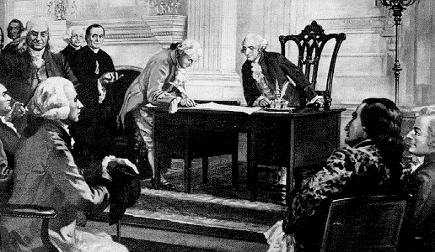
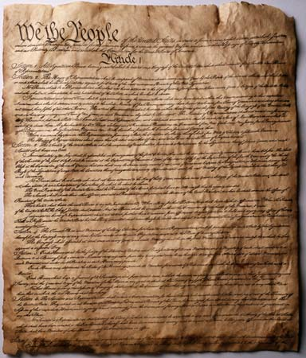
NEW GOV’T
-much stronger than Articles of Confederation
-power to tax
Congress and states
-regulate trade
Congress controls interstate trade
-strong executive
Called a President
1 term = 4 years
-needed 9 of 13 to ratify
Pass/approve
September 17, 1787, delegates at the Constitutional Convention declared the new constitution complete. Now it would be sent to the states for ratification.

Slide 10
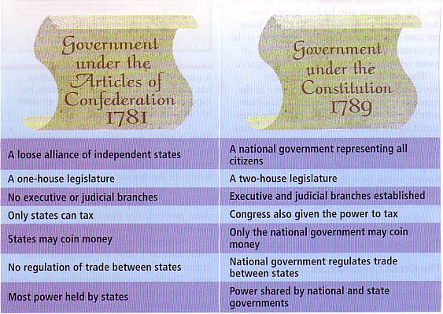

Slide 11
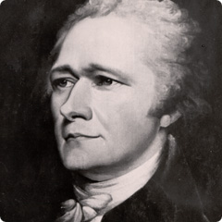
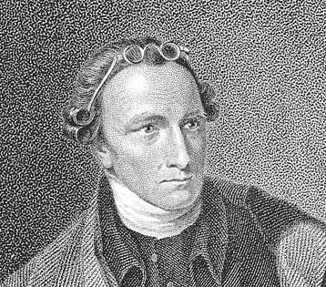
The framers set up a procedure for ratification that called for each state to hold a special convention. The voters would elect delegates to the convention, who would then vote to accept or reject the Constitution. Those in favor called themselves Federalists. Those opposed called themselves Anti-Federalists.
RATIFICATION
-Federalists
-Political group who supported the passage of the new Constitution and its stronger government
Hamilton, Madison
-Anti-Federalist
-Political group who opposed the new Constitution and thought it lacked a specific list of people’s rights
Wanted to protect the people against federal government
“They…divided the powers, that each might be a check upon the other…and I presume that every reasonable man will agree to it.”
~Federalist Alexander Hamilton
“You are not to inquire how your trade may be increased, nor how you are to become a great and powerful people, but how your liberties can be secured…”
~Anti-Federalist Patrick Henry

Slide 12
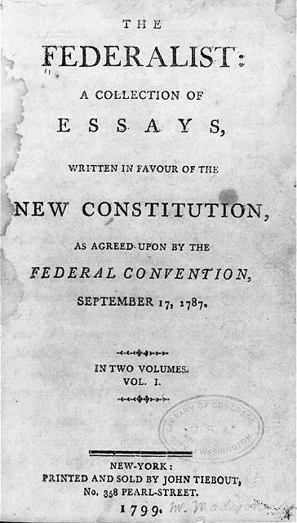
RATIFICATION
-Federalist Papers support the new government
Convince Americans to adopt the new Constitution
-written by Hamilton, Madison, and Jay
-Bill of Rights promised
Rights of the people
Bill of Rights won the states needed for ratification
Both sides waged a war of words in the public debate over ratification. The Federalist, a series of 85 essays defending the Constitution, appeared in New York newspapers between 1787 and 1788. The Federalist provided an explanation of Constitutional provisions, such as the separation of powers and limits on the power of majorities, that remain important today.

