Slide 1
Warm-up
What is a time in your life where you had to compromise with someone?

Slide 2
Unit 3: The United States Constitution and Amendments
Part I – The US Constitution

Slide 3
The Constitutional Convention
When? 1787
Where? Philadelphia
Leader? George Washington
How Conducted? Shhhh – Secretly
Original Purpose? Revise the Articles of Confederation

Slide 4
Constitution Compromises
Compromise – A way of resolving disagreements by having both sides give a little and get a little.

Slide 5
The Virginia Plan
Proposed by James Madison
Bicameral = Two House Legislature
Representation in both houses based on Population
Opposed by Small Populated States

Slide 6
The New Jersey Plan
Proposed by William Patterson
Unicameral = One House Legislature
Representation equal for all states
Opposed by Large Populated States

Slide 7
The Great (Connecticut) Compromise
Proposed by Roger Sherman
Structure of Legislature is bicameral
Senate – representation based on equality (2 per state)
The H. of Reps – representation based on population

Slide 8
What issue was the Great Compromise over?
Representation

Slide 9
Other Compromises

Slide 10
The Three-Fifths Compromise
Issue – How to count enslaved people towards population?

Slide 11
Free States
Should not count for purpose of representation but should for taxation

Slide 12
Slave States
Should count for representation but not for taxation

Slide 13
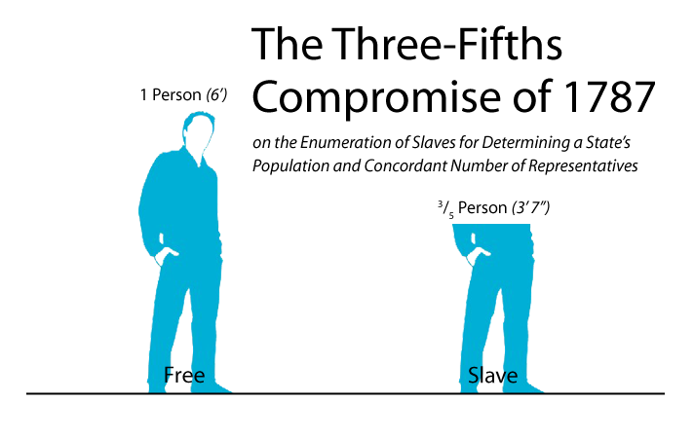
3/5ths Compromise
Every 5 slaves would count as 3 people for representation and taxation

Slide 14
The Electoral College
Issue: How should the President of the United States be elected?

Slide 15

Side 1: By the People

Slide 16
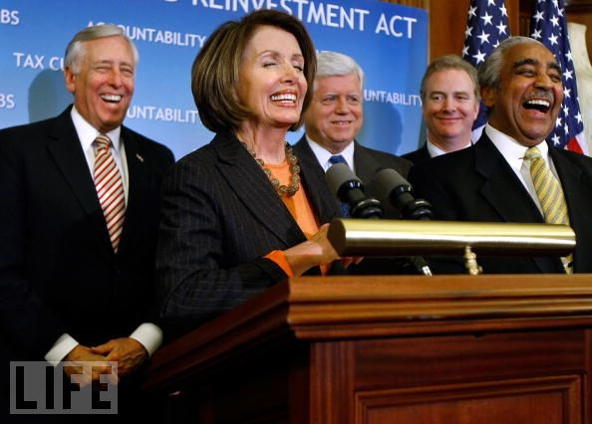
Side 2: By members of Congress

Slide 17
The Electoral College
Popular vote chooses delegates from each state to select the President and VP

Slide 18
The Commerce and Slave Trade Compromise
Issue – How much control over commerce (trade) should the national government have?

Slide 19
Northern States
Wanted national government to control trade in order to tax imports and felt slave trade should be stopped

Slide 20
Southern States
Concerned that national government would tax exports and stop slave trade if given control over commerce.

Slide 21
Compromise
National government can control trade but:
Cannot tax exports
Cannot touch slavery for 20 years

