Slide 1
Independence Declared
“When in the course of human events, it becomes necessary for one people to dissolve the political bands which have connected them with another, and to assume among the powers of the earth, the separate and equal station to which the Laws of Nature and Nature’s God entitle them, a decent respect to the opinions of mankind requires that they should declare the causes which impel them to the separation.”
~Declaration of Independence

Slide 2
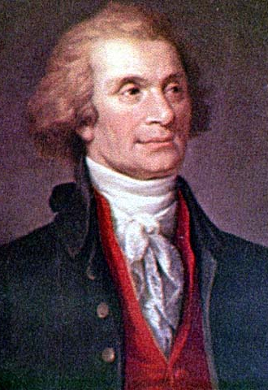
Declaration of Independence
-June 1776 Congress was debating Independence
Richard Henry Lee
The “Colonies are, and of a right ought to be, free and independent states.”
-Committee appointed to begin work on formal document
-meant to explain the reasons for independence
-mostly written by Thomas Jefferson
Young, excellent writer from Virginia
-Congress edited the final draft
Passage on slavery struck out; afraid it would offend Americans
-Issued July 4, 1776
“Independence Day”
Treason against England
By early 1776, events pushed the wavering Continental Congress toward a decision. North Carolina had declared itself independent, and a majority of Virginians told their delegates to form its own government. On June 7, 1776, Virginia delegate Richard Henry Lee moved that “these United Colonies are, and of a right ought to be, free and independent States.”

Slide 3
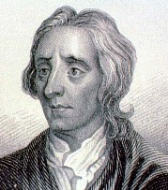
Concepts in the Declaration
-Jefferson took ideas from many Enlightenment thinkers
God-given rights to “Life, Liberty, and the pursuit of Happiness.”
-Natural Rights and Social Contract from John Locke
The power to rule comes from the “consent of the governed”
When government does not uphold rights, must “alter or abolish it”
-All men are created equal
Much different from the Loyalist view that colonists must obey the king, whose power came from God
No mention of slavery
The Declaration states flatly that “all men are created equal.” When this phrase was written, it expressed the common belief that free citizens were political equals. It did not claim that all people had the same abilities or ought to have equal wealth. It did not include women, Native Americans, or slaves--a large number of the American population. However, these words presented ideals that would later help these groups challenge traditional ideas.

Slide 4
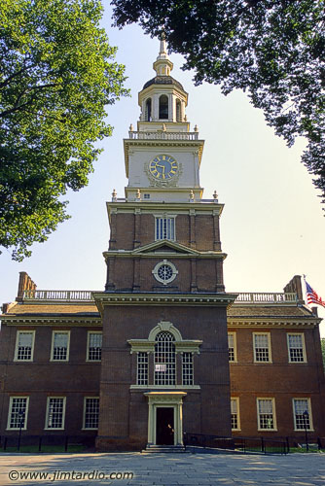
Concepts in the Declaration
-Listed specific reasons for our independence
-Grievances against King George III and the British Parliament
“Unfit to be the ruler of a free people.”
-Does not describe any particular form of government for the new nation
Only claims independence, new problem for Americans
The delegates voted unanimously that the American colonies were free, and on July 4, 1776, they adopted the Declaration of Independence. The document was read to a crowd in front of Independence Hall. A rush of pride and anxiety ran through the Patriots when they heard the closing vow:
“We mutually pledge to each other our Lives, our Fortunes, and our Sacred Honor.”

Slide 5
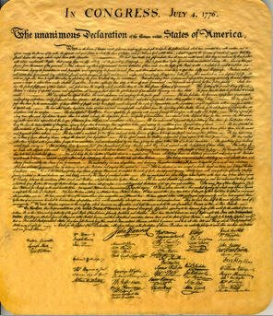
Eternal Statement
-We hold these truths to be self evident, that all men are created equal, that they are endowed by their creator with certain unalienable rights, that among these are life, liberty, and the pursuit of happiness. That to secure these rights governments are instituted among men, deriving their just powers from the consent of the governed; that whenever any form of government becomes destructive of these ends, it is the right of the people to alter or to abolish it.”

Slide 6
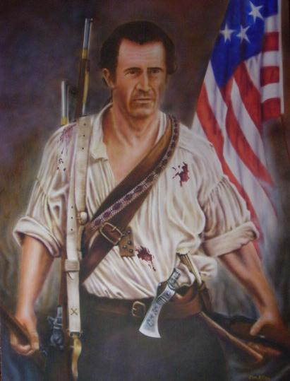
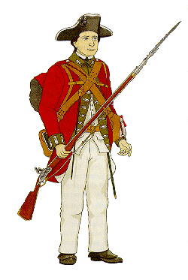
Choosing Sides
-Loyalists
those who remained loyal to the King and the British
often called Tories
Almost considered a civil war
-Patriots
those who supported the move for independence
risked everything because they could be hung as traitors
“We must all hang together…or we shall hang separately.”
-Undecided
As many as a third of the colonists were undecided as to whether independence or remaining part of England was the best decision

Slide 7

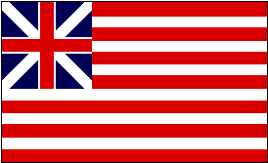
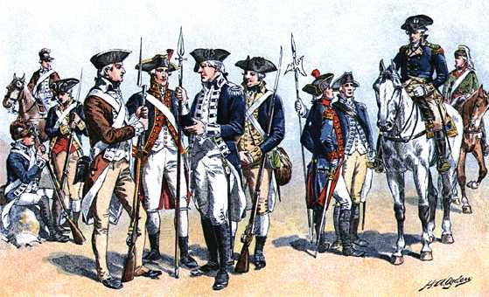
Revolutionary War

Slide 8
Early Defeats
-British capture all major colonial cities esp. ports
Poorly trained/prepared Americans losing early
New York
Philadelphia
Boston
Charleston
-Washington’s army in retreat and many desert
Morale is very low among colonists; have few supplies
As part of the plan to stop the rebellion by isolating New England, the British seized New York City. With the largest British force ever assembled (32,000 men, including German mercenaries), the British sailed into New York harbor. Washington rallied 23,000 men, but he was outnumbered with untrained troops and poor equipment. The battle for NY ended in August with an American retreat following heavy losses. By late fall, the British had pushed Washington’s army back into Pennsylvania, and many had either deserted, been killed, or been captured. Washington desperately needed a win.

Slide 9
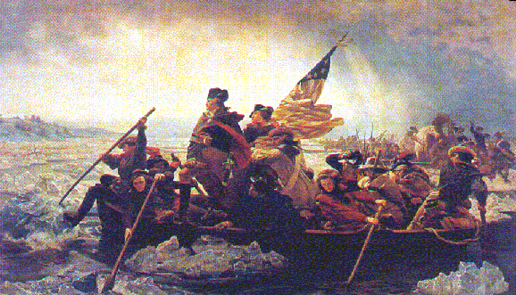
Patriot Victories
-a few victories helped keep morale up
-Dec. 1776 at Trenton
Washington surprises Hessians
Takes 900 prisoners
Jan. 1777 at Princeton
Washington takes 300 more British soldiers
Victories re-energize colonial troops and civilians to war effort
Washington resolved to risk everything on one bold stroke set for Christmas night, 1776. In the face of a fierce storm, he led 2,400 men in small rowboats across the ice-choked Delaware River. By 8:00 the next morning, the men had marched nine miles through sleet and snow to Trenton, held by a group of Hessians. Lulled into confidence by the storm, the Hessians had drunk too much the night before and were still sleeping. In a surprise attack, the Americans killed 30, took 918 captives, and 6 cannons. The Americans were rallied by another victory 8 days later at Princeton. Encouraged, they marched into winter camp.

Slide 10
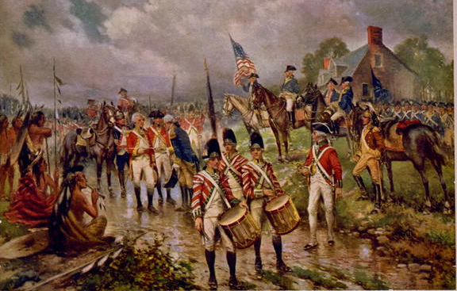
Turning Point
-large British force defeated at Saratoga Oct. 1777
British try to take Hudson River area and cut off New England to colonists
-kept British near the coastline
-helped colonists get French help in the war effort
Sent money, weapons, troops, and warships
-turning point of the war
British General Burgoyne convinced the London high command to allow him to lead an army down a route of lakes from Canada to Albany (New York) where he would meet the troops coming from New Jersey and Philadelphia. The two generals would join forces to isolate New England. Burgoyne left with 4,000 redcoats, 3,000 mercenaries, and 1,000 Mohawk with many supplies. The weight bogged down the army, and food supplies ran low. Massed American troops finally, led by Gates, surrounded Burgoyne at Saratoga, where he surrendered his army to the Americans in October 1777. From that time on, the British kept their troops close to the coast and supply bases.

Slide 11
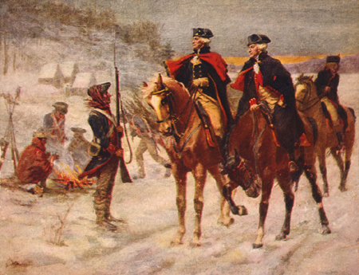
Valley Forge
-camp site of Washington’s army during winter of 1777-78.
-British forces occupied nearby cities
-many soldiers died of cold and starvation
Farmers selling goods to the British (paid in gold)
-Congress struggled to gain supplies for the army
Merchants raising prices to make money
-lack of central gov’t
Problem: no tax, no power
While the British wintered comfortably in Philadelphia, Washington and his meager Continental Army struggled to stay alive amidst bitter cold and primitive conditions at winter camp in Valley Forge, Pennsylvania. Soldiers suffered from exposure and frostbite, while surgeons tried to save arms and legs from amputation. Of the 10,000 soldiers who braved wind, snow, and hunger that winter, more than 2,000 died.

Slide 12
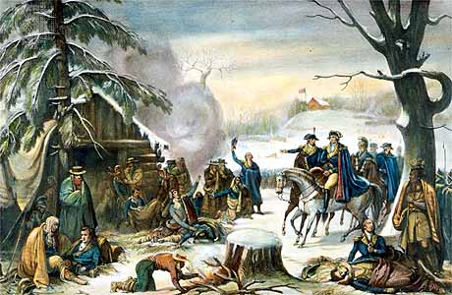
“Here comes a bowl of beef soup full of dead leaves and dirt. There comes a soldier. His bare feet are seen through his worn-out shoes—his legs nearly naked from the tattered remains of an only pair of stockings—his Breeches are not sufficient to cover his nakedness—his Shirt hanging in Strings—his hair disheveled—his face meager.”
“To see men without Clothes to cover their nakedness, without Blankets to lay on, without Shoes, by which their Marches might be traced by the blood of their feet, and almost as often without Provision…is a mark of patience and obedience which in my opinion can scarcely be pinned.”

Slide 13
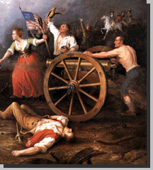
Civilian Life
-inflation
Congress had no money because they could not tax; printed worthless money
-shortage of goods
All going toward war
-women took over the work of men
Farms, shops, businesses
-some women helped the military effort
Nurses, messengers, etc.
During the American Revolution, every life was touched. The Continental Congress ran out of gold and silver, so they began printing paper money. The more they printed, the less it was worth. Profiteers began raising prices for the Continentals, and merchants would sell rancid meat, cheap shoes, and defective weapons. Every home was touched, and women helped out incredibly.

Slide 14
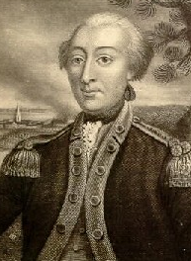
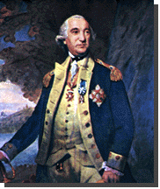
Foreign Help
-foreign military leaders offered professional training for the army
From France and Prussia
-Friedrich von Steuben
Prussian officer who trained patriot soldiers
-Marquis de Lafayette
led volunteer army from France
Called for troops from France to assist the Americans
During their winter stay at Valley Forge, two foreign diplomats helped Washington. Friedrich von Steuben, a Prussian captain and talented drillmaster, volunteered his services to General Washington. He taught the colonial soldiers to stand at attention, executive field maneuvers, fire and reload quickly, and wield bayonets. The Marquis de Lafayette joined Washington’s staff as well, and with their help, the raw Continental Army was becoming an effective fighting force.

Slide 15
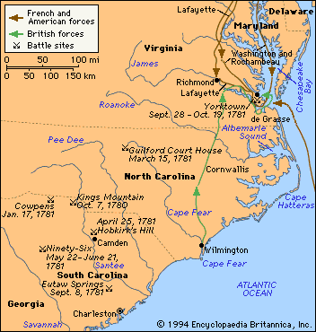
Southern Campaign
-British strategy changed to splitting the colonies
Cornwallis goes South to trap colonists
-Charleston
captured by Cornwallis
Moves north through Carolinas
Met by Nathaniel Greene
-Kings Mtn
Patriot
-Cowpens
Patriot
Colonists weaken British, but move North

Slide 16
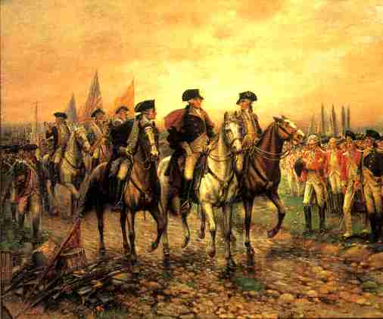
War’s End
-Guilford Courthouse
costly British victory
North Carolina battle that killed ¼ of British troops
British need rest
-retreat to Yorktown
British want to meet up with forces in the North, but are trapped by Americans
-surrounded by French and Americans
British trapped
-Cornwallis surrenders Oct, 1781
The Americans and the French closed in on Cornwallis at Yorktown. A French naval force defeated a British fleet and then blocked the entrance to the Chesapeake Bay, thereby preventing a British rescue by sea. Meanwhile, about 17,000 French and American troops surrounded the British on the Yorktown peninsula and bombarded them day and night. Three weeks later, exhausted and outnumbered, Cornwallis surrendered.

Slide 17
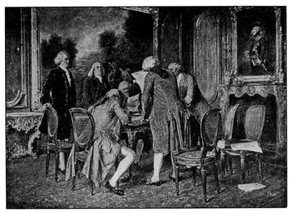
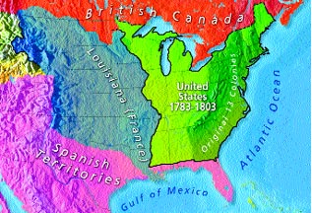
Treaty of Paris
-Treaty of Paris 1783
Officially ended American Revolution
-recognized U.S. independence
-set boundaries to Mississippi
From Canada to Florida
-some provisions of the treaty will lead to trouble later
No mention of natives; no mention of British leaving Western forts

Slide 18
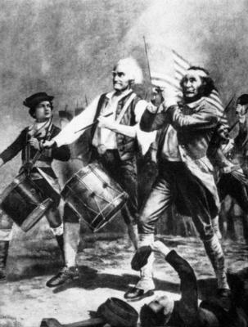
Symbol to the World
-liberty
-freedom
-equality
Some slaves freed in the North
-opportunity
-belief in a greater cause
-set a precedent for the American future

