Slide 1
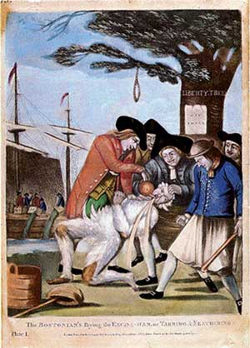
Stirrings of Rebellion
“That the only representatives of the people of these colonies, are persons chosen therein by themselves, and that no taxes ever have been, or can be constitutionally imposed on them, but by their respective legislatures.”
~Resolution of the Stamp Act Congress

Slide 2
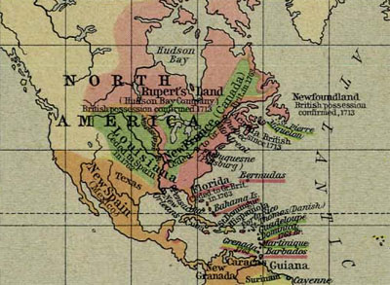
By 1754, the European population of New France had grown to only about 70,000. The French had colonized the St. Lawrence River Valley, Quebec (Canada), the Great Lakes Region, and the Louisiana territory.
Typical French colonists included fur traders and Catholic priests who wanted to convert Native Americans. Neither had a desire to build towns or raise families. For this reason, the natives were friendlier toward the French. The French also developed friendlier relations with the natives, who did most of the trapping, and then traded with them for furs. This trade relationship led to several military alliances.
By 1754, the English colonies were crowded, and the colonists wanted to expand into the Ohio River Valley. This region was claimed by both the French and the British, and the French and natives did not want the British colonists to come into their territory. The French began building forts in this region, close to the Virginia border, and they began attacking British colonists. They made an early alliance with the natives, who won easy victories against the British colonists.

Slide 3
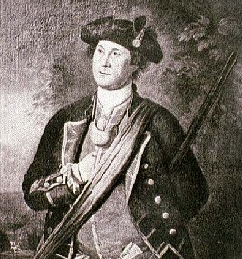
French and Indian War
-Old rivalry between France and England
Fighting for domination
-1754 conflict ignites again as French begin building forts near Virginia border
Angers British, Washington leads militia against French
-French and Indian allies won many early battles
In 7 total years of fighting
In 1754, the French-British conflict reignited when the French built a fort in the Ohio Territory. The British had granted 200,000 acres of land in the Ohio country to a group of wealthy planters. Both countries were attempting to claim the land. The Virginia governor sent a militia to evict the French. The small band, led by 22-year-old George Washington was swiftly defeated by the French, beginning the French and Indian War, a fight between France and England over control of North America.

Slide 4
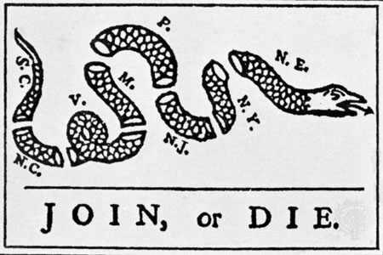
French and Indian War
-Albany Plan of Union
-colonies debate forming central government because of possible defeat in the war
-idea was proposed by Ben Franklin but never adopted
First thought of uniting colonies as one
Early in the fighting, French soldiers and their Native American allies ambushed them. The British soldiers, accustomed to enemies who marched in orderly rows rather than ones who fought from behind trees, turned and fled. The weakness of the British army surprised many colonists, who debated forming one central government to fight against the French.

Slide 5
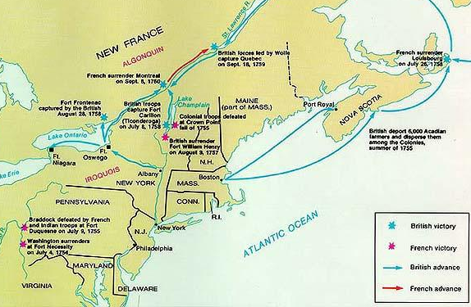
French and Indian War
-Victory at Quebec—turning point of the conflict for the British
British take over Canada
-Treaty of Paris, 1763
-France lost all lands in America
Gave England French territory
-France lost all lands in America
After their early losses, King George selected new military leaders. One of those new leaders led a surprise attack on Quebec. This was a deadly but decisive battle, and the British triumph led them to overall victory in the war. The Treaty of Paris officially ended the war, giving all land east of the Mississippi to England.

Slide 6
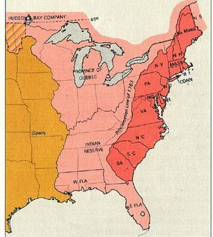
Post-War Problems
-Proclamation of 1763
- Law stated that colonists could not cross the Appalachian Mtns
Natives attacking, angers colonists
-Colonists ignored the law and continued to provoke Indians
King sent troops to enforce the law
-standing British Army in the colonies—British heavily in debt b/c of war
Worries and angers colonists
-Taxes (duties) will be established on certain goods to help pay for British expenses (war/troops)
-Smugglers tried to avoid paying taxes
-Writs of assistance—search warrants issued by British authorities to catch smugglers
Angered colonists, did not feel trusted
Ownership of the Ohio Territory brought Britain trouble. Native Americans feared that the British settlers crossing the
Appalachians would drive away the game they depended on. The natives captured eight British forts in the region and laid siege to two others. In angry response, British officers presented smallpox-infested blankets to two chiefs during peace negotiations, and the virus spread rapidly. To avoid further conflicts, King George passed the Proclamation of 1763.

Slide 7
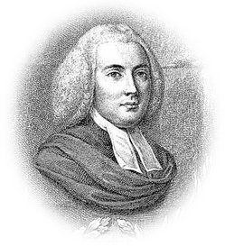
British Taxation
Passed by British Parliament
-Sugar Act
-affected merchants and traders
Expensive, angers colonists who had no say in taxation
-protests begin
-James Otis—”no taxation without representation”
“No taxation without representation!”

Slide 8
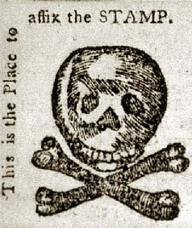
British Taxation
-Stamp Act
-required stamp on all legal documents, newspapers, license, and cards
-colonists again reacted with protests
Did not have representation in Parliament
-British reacted by sending more troops
In order to finance debts from the French and Indian War, as well as from European wars, Parliament turned hungry eyes toward the colonies. Tensions increased when Parliament passed the Stamp Act, which required colonists to purchase special stamped paper for everything made of paper. The tax reached every colonial pocket. Colonists who disobeyed the law were to be tried in the vice-admiralty courts, where convictions were probable.

Slide 9
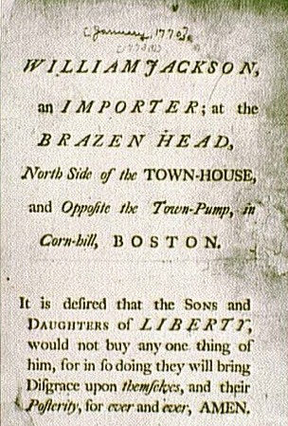
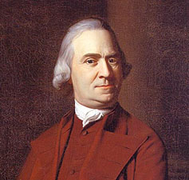
Resistance Begins
-Sons of Liberty (group of rebels)
Boston
Samuel Adams
John Adams
-no taxation w/o representation
Did not want Parliament’s taxes
-protests and boycotts were organized
Refusal to buy a product
-stamp agents were harassed
Tarred/feathered; some killed
-law eventually repealed (taken back)
-Declaratory Act– states that Parliament has the right to declare laws for British colonies
Quartering Act forced colonists to house British soldiers
Sam Adams
Bostonians organized a secret resistance group called the Sons of Liberty. They harassed the customs workers, stamp agents, and sometimes royal governors. Stamp Agents all over the colonies resigned and colonial protestors prevented any stamps from being sold. Several assemblies passed resolutions that they would not pay any taxes not enacted by their own assemblies. Eventually, Parliament repealed the Stamp Act; but on the same day, to make its power clear, Parliament issued the Declaratory Act.

Slide 10
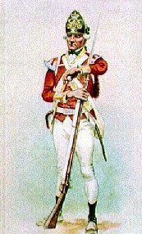
Townshend Act
-new tax placed on imports such as tea, glass, paper, paint
Making colonists pay for increased troops in America
-colonists again reacted with protests
Boycotted; determined not to pay taxes their assemblies had not voted on
-British reacted by sending more troops
Repealed all taxes except on tea
The Townshend Acts were indirect taxes placed products as they came into the colonies from Britain. The acts also imposed a three-penny tax on tea, the most popular drink in the colonies. The colonists reacted with rage and resistance. Americans protested “taxation without representation,” boycotted British goods, and attacked customs inspectors. After John Hancock’s ship was seized, riots against customs agents abound in Massachusetts. In response, the British stationed 2,000 “redcoats” in Boston.

Slide 11
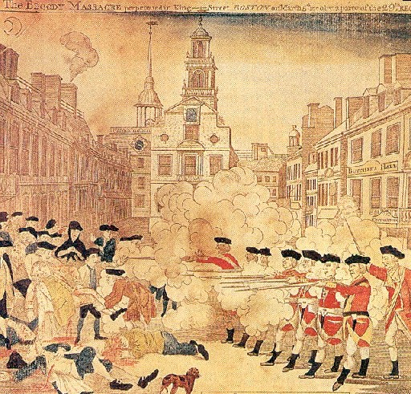
Boston Massacre
-March 1770
-protests by colonists
Protesting tax on tea
-British troops fire on crowd
Colonists harassing British troops
-5 colonists killed/10 injured
Crispus Attucks
First to die in American Revolution
-Most soldiers found not guilty at their trial for murder. Ruled they acted in self-defense
John Adams served as attorney for the soldiers
Colonists appalled
In March of 1770, a fistfight broke out between colonial settlers and British soldiers. That evening a mob gathered in front of the Customs House and taunted the guards. When Crispus Attucks and several dockhands appeared on the scene, an armed clash erupted, leaving Attucks and four others dead in the snow. Instantly, Samuel Adams and other colonial agitators labeled this confrontation the Boston Massacre, presenting it as a British attack on defenseless citizens.

Slide 12
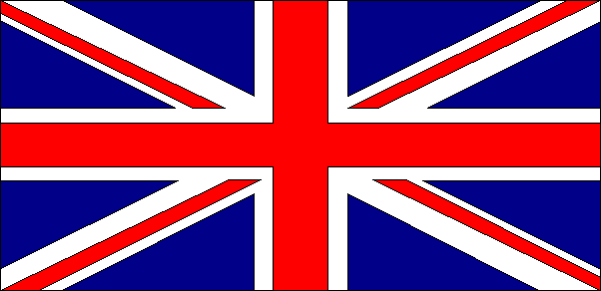
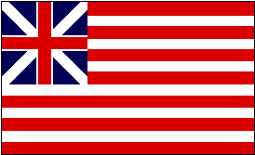
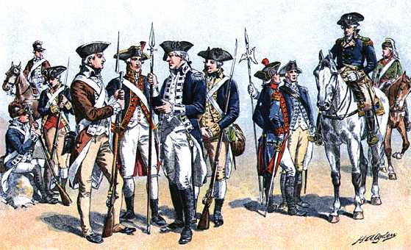
Revolution Begins

Slide 13
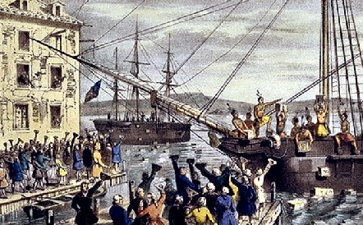
Boston Tea Party
-tax on tea still remain in effect
Townshend Act
-monopoly on tea given to British company
Colonists wondered what British would control next
-Dec. 1773 colonists raided Boston harbor and threw the tea overboard and burned the ships
Dressed like natives to fool British soldiers
18,000 pounds of tea ruined
“They muster’d…to the number of about two hundred, and proceeded…to Griffin’s wharf, where [the three ships] lay, each with 114 chests of the ill fated article…and before nine o’clock in the evening, every chest from on bound the three vessels was knock’d to pieces and flung over the sides. They say the actors were Indians. Whether they were or not,…they appear’d as such, being cloath’d in Blankets with the heads muffled, and copper color’d countenances, being each arm’d with a hatchet or axe.”
~Journals of American Independence

Slide 14
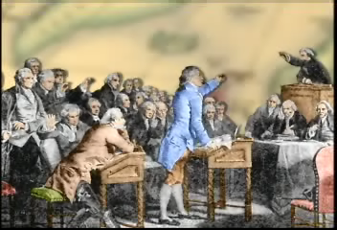
Intolerable Acts
-Parliament passes Coercive Acts to punish Boston
For Boston Tea Party
-Colonist call it the Intolerable Acts
-closed Boston Harbor
Until all tea was paid for
-suspended basic civil rights
Rights as citizens taken away
-housed troops in peoples’ homes
No privacy, no protection
-Committees of Correspondence
Colonies communicate about attacks on American freedom

Slide 15
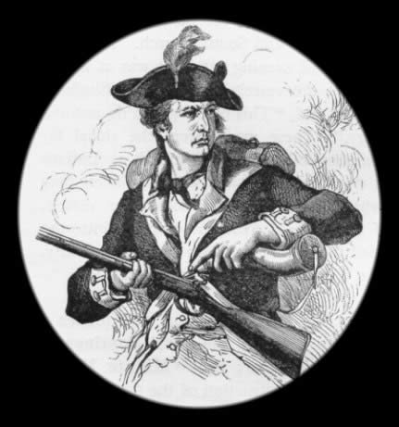
1St Continental Congress
-Committees of Correspondence had been communicating with other colonies
-militias begin to form
-minutemen: militia ready to fight in 60 seconds
-after Intolerable Acts they call for a meeting
Virginians call for a Congress
-late 1774 1st meeting held in Philadelphia (want peaceful solution)
-discussed rights of colonies
-agreed to meet again in 1 year
Sent message to King George asking him to respect rights
While the colonies were communicating through committees of correspondence, and after the First Continental Congress, colonists in many New England towns stepped up military preparations. Minutemen, or civilian soldiers, began to quietly stockpile firearms and gunpowder. General Gage soon learned about these activities and prepared to strike back.

Slide 16

Lexington & Concord
-April 1775
-British try to seize weapons stored in Concord
Tried to surprise attack, colonists had spies
-Paul Revere, William Dawes, Samuel Prescott warn colonists
“The British are coming!”
-minutemen met British at Lexington
Village on the way to Concord
British General Gage became concerned about reports brought to him concerning large amounts of arms and munitions hidden outside of Boston. In March, Gage sent agents toward Concord, a town outside of Boston, reported to be the site of one of the stockpiles. The agents returned with useful information, and Gage drew up orders for him men to march along the Lexington Road to Concord, where they would seize and destroy all munitions they could find.
A source close to the minutemen informed them of Gage’s plans, and the leader sent three men out to warn prominent leaders Hancock and Adams, as well as the towns. Before long, the countryside rang with church bells and gunshots, prearranged signals to war the population that the British Regulars were coming.

Slide 17

Lexington & Concord
-shots fired and colonists killed
-”shot heard around the world“
British victorious at Lexington
-colonist conduct guerilla battle along road to Concord
Americans prove willing to fight/die for their rights

Slide 18
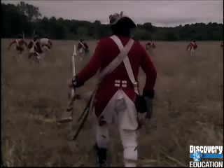
Back to Boston…

Slide 19
2nd Continental Congress
-May 1775
Met in Philadelphia
-called for an army and appointed Washington as leader
Continental Army: troops from all colonies
-some talk of compromise and some of independence
Loyalists vs. Patriots
The Second Continental Congress agreed to recognize the militiamen as the Continental Army, and they appoint as its commander 43-year-old French and Indian War veteran George Washington. The Congress, acting like an independent government, also authorized the printing of paper money to pay the troops and organized a committee to deal with foreign nations.

Slide 20
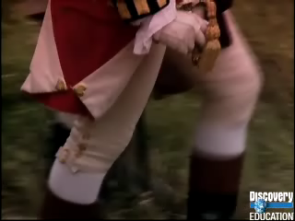
Bunker Hill
Massachusetts
-June 1775
-Colonist take hill overlooking Boston (Breed’s Hill)
Colonists built fort for protection
British have 2,000 fresh soldiers
-British charge the hill 3 times until colonists run out of ammo
British take control of the hill
-lots of casualties
deadliest battle of war
War began
-proved colonists could compete with the British army in certain situations
Cooped up in Boston, British General Thomas Gage decided to strike at militiamen who dug in on Breed’s Hill, north of the city and near Bunker Hill. On the steamy summer morning of June 17, 1775, Gage sent out nearly 2,400 British troops. The British began marching up Breed’s Hill in their customary broad lines. The colonists held their fire until the last minute, then began to shoot down the advancing redcoats. The surviving British troops made a second attack, and then a third. The third assault only succeeded because the militia ran out of ammunition.

Slide 21
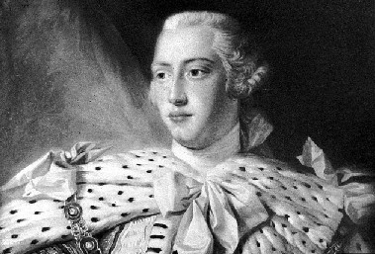

Olive Branch
-July 1775
Peace pinned on King George III
-2nd Continental Congress sends King George a petition to return to the peace of the past
Called “Olive Branch”
Ancient symbol of peace
-he refuses the petition and urges the rebellion put down
King declares colonies to be in “open and avowed rebellion” and orders the traitors to be brought to justice
The Second Continental Congress was still reading the colonies for war while hoping for peace. Most of the delegates, like most colonists, felt deep loyalty to King George III and blamed the bloodshed on the king’s ministers. On July 8, 1775, the Congress sent the Olive Branch Petition, urging a return to the “former harmony” between them.

Slide 22
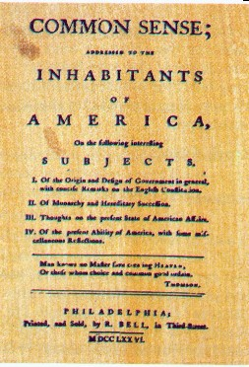
“Everything that is right or reasonable pleads for separation. The blood of the slain, the weeping voice of nature cries, ‘Tis time to part.”
~Thomas Paine
Common Sense
-many colonists had loyalties that were strong to Britain
-Loyalists
Loyal to home country of Britain
-Patriots
Loyal to America and fighting for independence
-Common Sense – pamphlet that urged independence for the colonies
-Thomas Paine
Americans owe nothing to Britain
-Jan. 1776
Stresses American independence
“I find Common Sense is working a powerful change in the minds of many men.”
~George Washington

