Slide 1
1-6
British Influence on America

Slide 2

British Influence on America
The traditions of British law and the political philosophy of the Enlightenment (Age of Reason) guided the development of the early American colonies and the founding of the United States.
The United States was directly influenced by Great Britain because, after all, we were British until July 4, 1776.

Slide 3
Majority Rule
French philosopher Jean-Jacques Rousseau promoted this idea in the late 1700s.
According to this theory, when differences of opinion arise, the people will agree to do what the most people want.
At the same time, the majority respects the rights of the minority.
The majority is officially 50% + 1 of those who voted.

Slide 4
British Influence
Parliament
  The law making body in England.
  American colonials were not allowed to be represented in Parliament even though they paid taxes.
  “No Taxation without Representation!”
Republic
  Elected representatives represent the people’s wants.
  A republic is a country that has no monarch.
  The head of the country is usually an elected president.

Slide 5
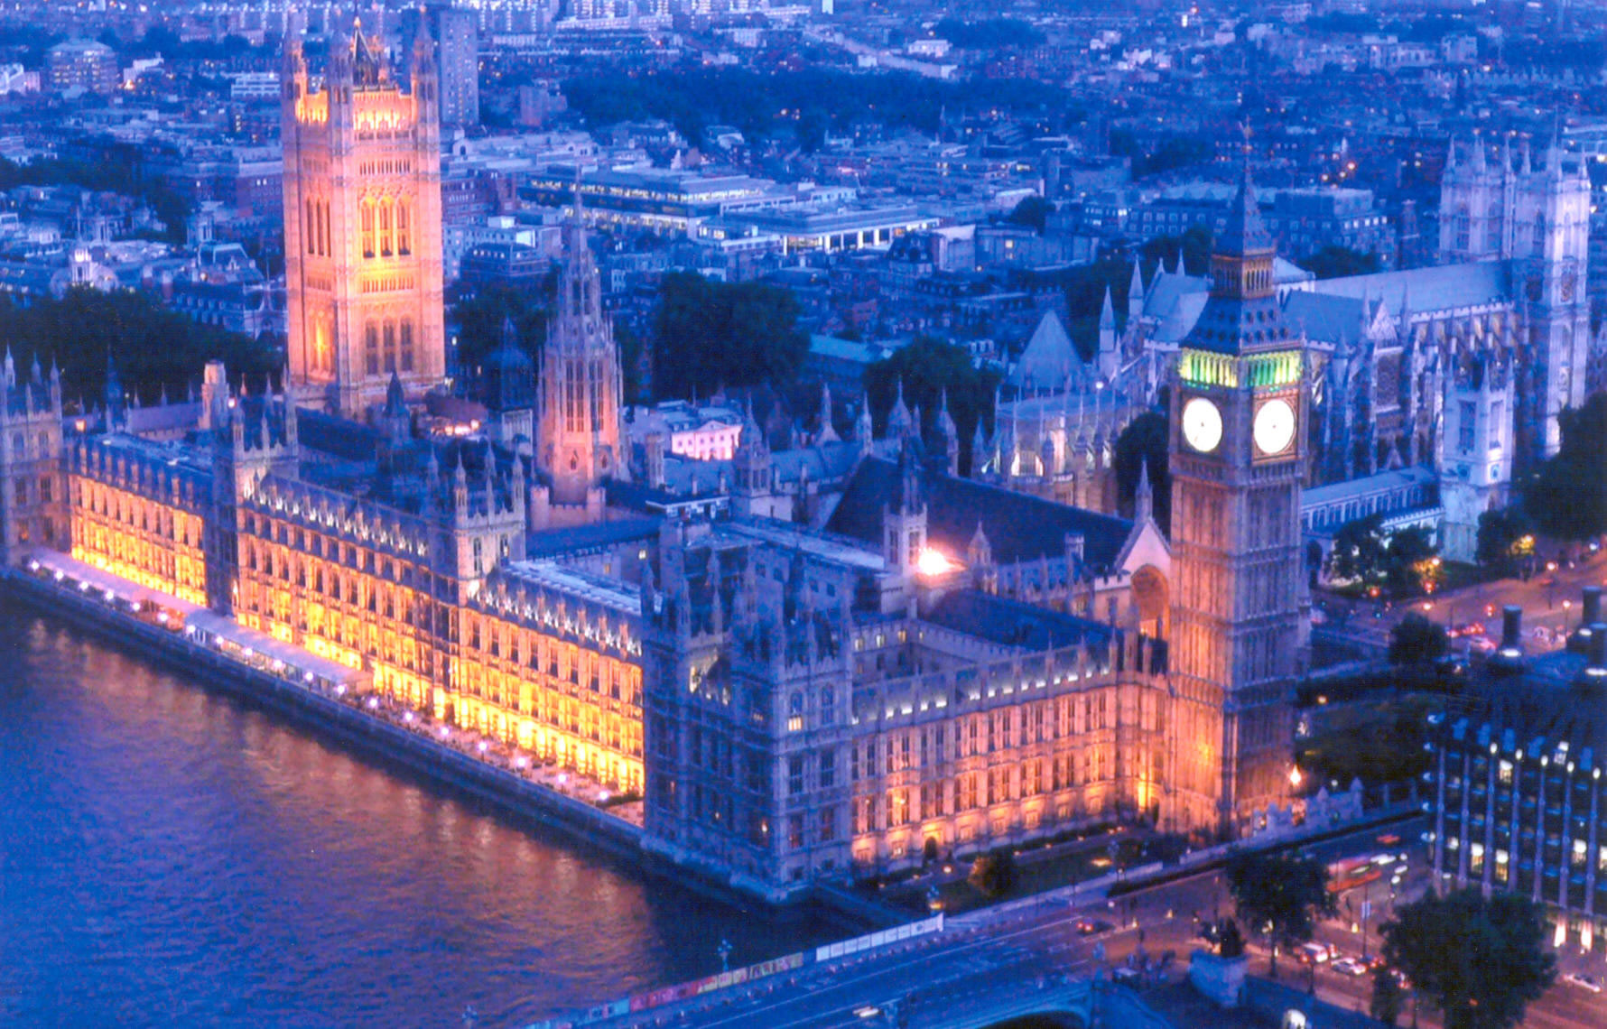
Parliament

Slide 6
Self-Government in America
Remember, the American colonies still were part of Great Britain even though there was an increasing division between the 2.
The American colonies were allowed to govern themselves because England was so far away.
Because of this, and their lack of representation back in England’s Parliament, the colonists set up their own legislatures like the House of Burgesses in Virginia and the Mayflower Compact in Massachusetts.
It was not until the end of the French and Indian War that the British began to pay closer attention to the colonies.

Slide 7
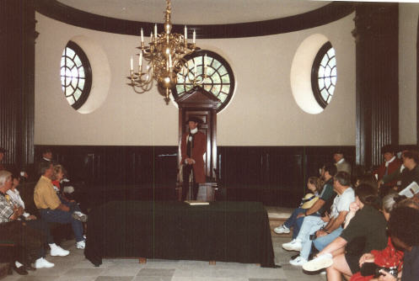
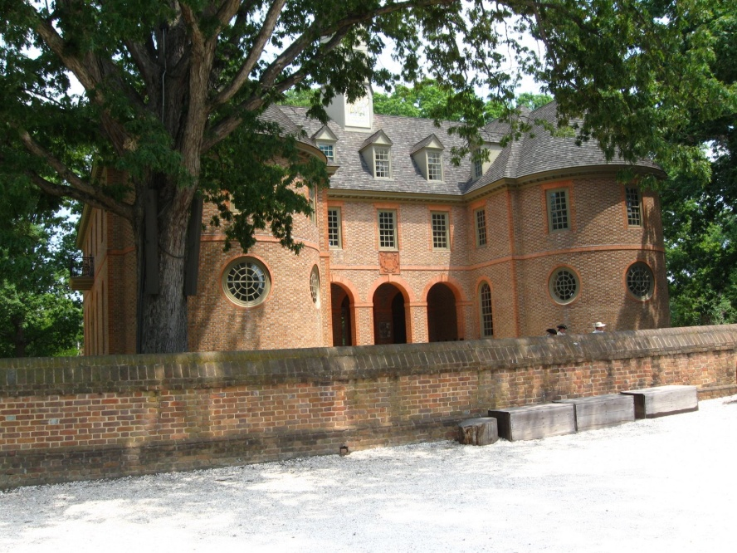
House of Burgesses
Established in Jamestown, Virginia in the 1619.
1st elected legislative assembly in the New World (Virginia) and was based from the British Parliament.
It was a representative assembly.
In other words, the people elected people to represent their interests.
Does that sound like our Congress today?

Slide 8
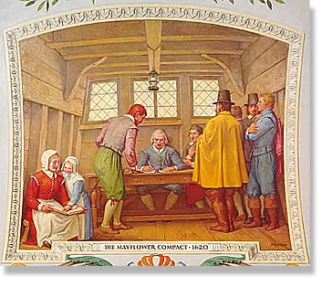
Mayflower Compact
1st governing document in the Plymouth colony (Massachusetts)
Drafted by the Pilgrims in 1620
The government would get its power from the consent of the governed.
This is known as popular sovereignty.
The Mayflower Compact was different from the House of Burgesses because it had direct, not representative democracy.
In other words, people could go to meetings without elections and speak their mind directly and be heard.

Slide 9
Limited Government
Magna Carta/Great Charter
Social Contract theory
Common Law
English Bill of Rights

Slide 10
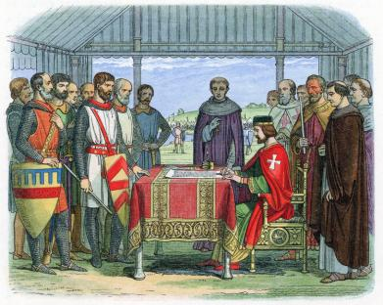
Magna Carta
Latin for the Great Charter (1215)
Most significant early influence on constitutional law
Limited the King of England’s power
Influenced common law and the US Constitution
One of the most important legal documents in the history of democracy.

Slide 11
The Social Contract
The idea that the people should decide how to be governed (popular sovereignty)
Everyone is born with certain “natural rights”
Hobbes, Locke, & Rousseau were the most famous philosophers of this idea
Inspired democracy & Thomas Jefferson

Slide 12
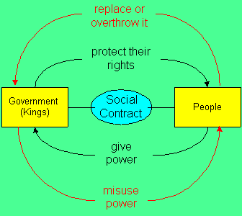
The Social Contract Theory

Slide 13
British Common Law
In its earliest days, England had no written laws
People developed rules to live by and these rules and customs came to have the force of law
As a system of courts arose, the courts’ decisions became the basis of law.
When the judges would look to decide cases, they would look for a precedent, or a ruling in an earlier case that was similar.

Slide 14
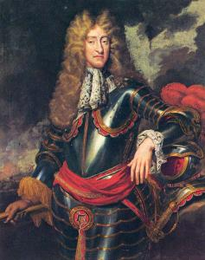
Divine Right Theory
Monarchs in Europe believed they received their power from God.
And they were only responsible to God, so they could pretty much do whatever they wanted.
They had absolute power.
King James II

Slide 15
The Glorious Revolution (1689)
After the signing of the Magna Carta, officials grew into a lawmaking body called Parliament.
England’s Parliament removed King James II from the thrown in 1688 because of a religious and power dispute.
This event was called the Glorious Revolution because there was no bloodshed.
William and Mary were asked to be king and queen, but they first had to sign the English Bill of Rights.
This gave most of the power in England to the Parliament.

Slide 16
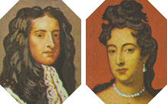
William and Mary
Mary was the Protestant daughter of James II.
Her husband William was King of Scotland.
Their joint reign began in February, 1689, when they were called to the throne by Parliament, replacing James II, who was "deemed to have fled" the country in the Glorious Revolution
The new king and queen signed the English Bill of Rights giving much more power to Parliament.

Slide 17
English Bill of Rights
In 1689, following the overthrow of King James II and the Glorious Revolution, the Parliament passed the English Bill of Rights.
This document recognized a number of natural rights, or rights people have by simply being people.
Some natural rights are life, liberty, and property.
The English Bill of Rights also guaranteed the right to a fair jury trial and the freedom of speech.
Many of these rights were included in the US Bill of Rights.

Slide 18
Democracy
Timeline
Magna
Carta
1215
English
Bill of Rights
1689
Declaration of
Independence
1776

Slide 19
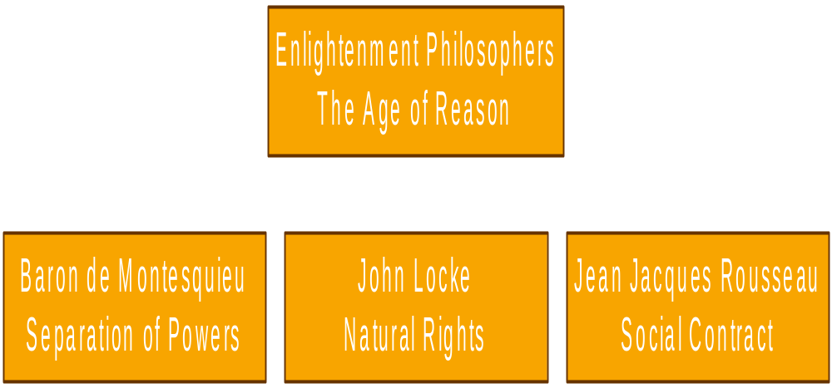
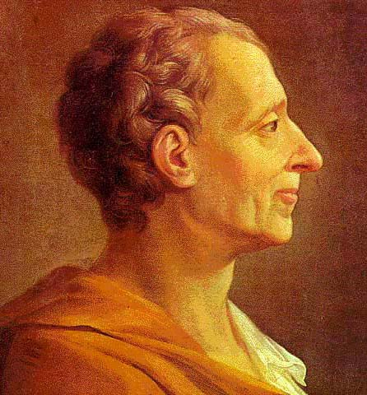
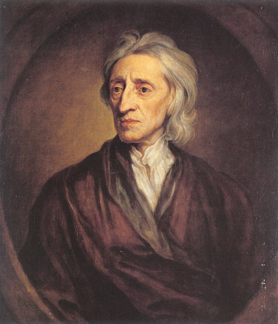
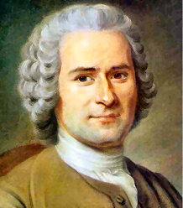
Enlightenment Philosophers

Slide 20
Enlightenment Philosophers
John Locke – Famous for his ideas of Natural Rights (rights that you are born with). Inspired Thomas Jefferson and the writing of the Declaration of Independence.
Charles Montesquieu – Most famous for his thoughts on Separation of Powers
Jean Jacques Rousseau – He believed if you give up some freedom to live in a society and be controlled by the government, you will have a better society (Social Contract).

