Slide 1
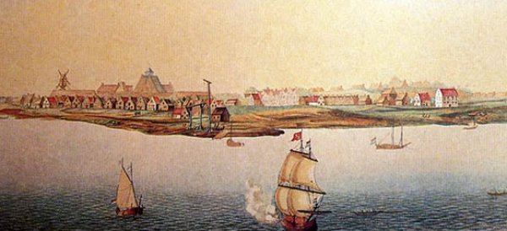
Colonial Life

Slide 2
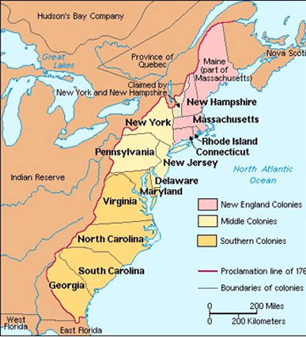
Three Regions
-New England – mostly involved in subsistence farming and trade
-Middle Colonies – mostly involved in staple food production
-Southern Colonies – centered around production of cash crops such as tobacco
Because England’s colonies developed into three distinct regions with three distinct economies, life in each region varied accordingly. This will eventually push the new country “America” apart in the 1860s.

Slide 3
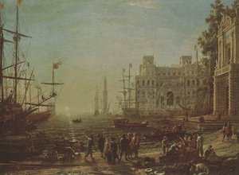
Mercantalism
-system of nations increasing their wealth and power through trade with colonies
Money makes empire strong
-English wanted a favorable balance of trade which meant they sold more than they imported from colonies
Sell more than you buy
Parent countries, like Great Britain, build empires with colonies to compete in the system of mercantilism, where you measure your country’s worth in gold and silver. To do this, the parent country makes money from the colony by buying its raw materials for very cheap, then selling them the finished products for very expensive.
SELL MORE (finished goods), BUY LESS (raw goods)

Slide 4
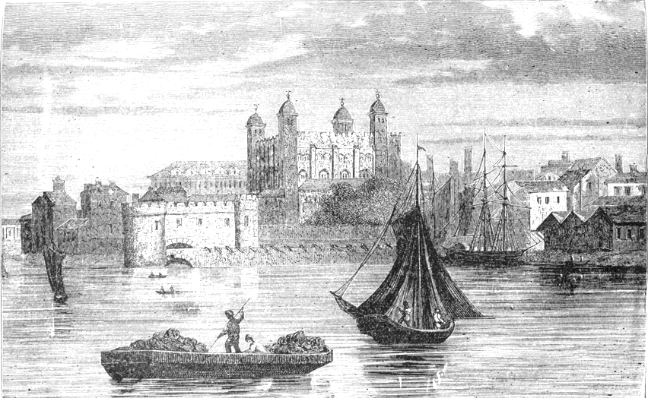
English Control
-colonies successful traders
Made British lots of money; British want full control
-Parliament passes the Navigation Acts, 1649
-Restricted how colonists could do business
-Could only trade with England and only use English ships
Kept money going only to England
Colonists angry
The colonies were exporting raw goods, like lumber, furs, fish, grain, and tobacco to Europe. Then, the colonists would purchase finished products from Europe. Not all products the colonists produced for export ended up on English docks. Some went to Spain, France, and Holland. With European nations fighting for American goods, many colonial merchants wanted to make more money. England viewed this pursuit of foreign markets as an economic threat. Any wealth flowing from the colonies to another nation came at the expense of England. As a result, England’s Parliament (the lawmaking body) passed the Navigation Acts, which restricted the colonists to trading ONLY with Britain.

Slide 5
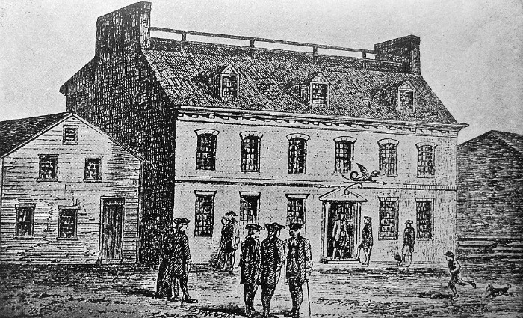
Seeds of Independence
-Glorious Revolution in England, 1688
People have more power, king less
-English Bill of Rights, 1689
Colonists English citizens
-salutary neglect
very loose supervision of the colonies
Colonies successful, English focus elsewhere
-lack of control led to self government
-John Peter Zenger Trial – colonist put on trial over basic freedoms such as freedom of the press
As long as raw materials came into and the colonists continued to buy English-produced goods, Parliament did not supervise the colonies closely. In nearly every colony, a governor appointed by the king served as the highest authority. The governor presided over a structure that included an advisory council and a local assembly, which usually paid the governor’s salary. Using their “power of the purse,” the colonists influenced the governor. Under England’s less-than-watchful eye, the colonies developed a taste for self-government that became a condition for rebellion.

Slide 6
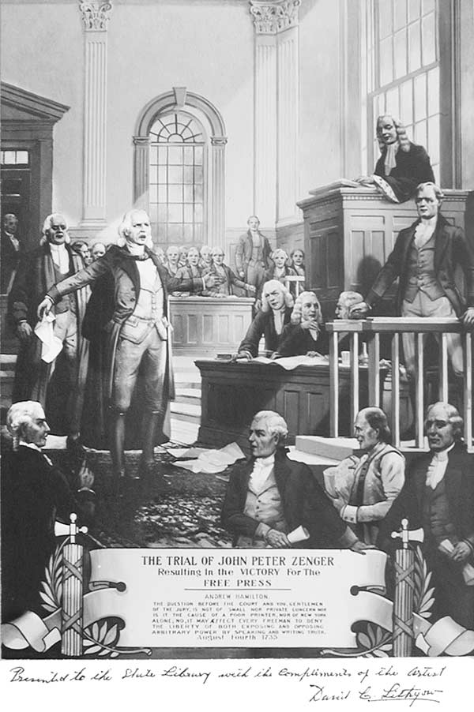
John Peter Zenger began publishing a newspaper in New York to voice opposition to the newly-appointed colonial governor William Cosby.
Upon his arrival, fought with the colony’s council over his salary, and unable to control the state's court, he removed colonial officials and replaced them with members of the royal party.
Zenger's continued to publish articles critical of the governor. Finally, Cosby issued a proclamation condemning the newspaper's "divers scandalous, virulent, false and seditious reflections." Zenger was arrested and charged with seditious libel.
After more than eight months in prison, Zenger went to trial, with the case at fever-pitch with public interest. After the arguments for both sides were finished, the jury was retired, only to return shortly with a verdict of not guilty, upholding freedom of the press.

Slide 7
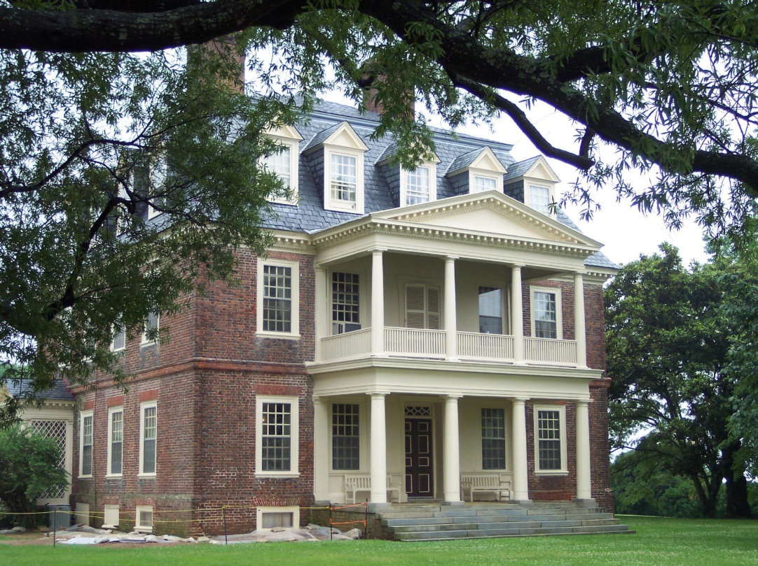
Colonial Society
-plantation owners were top of society
Rich, socially powerful
-small farmers were most of the population
90% of population
Hard work, not rich
-second class role of women
No legal/social rights, little education
-indentured servants
Endured hard times once free
Throughout the South, plantations developed instead of towns. While small farmers were the majority of the Southern population, the planters controlled much of the South’s economy. They also controlled its political and social institutions. By the mid-1700s, life was good for many southern colonists, especially the tobacco-producing planters.

Slide 8
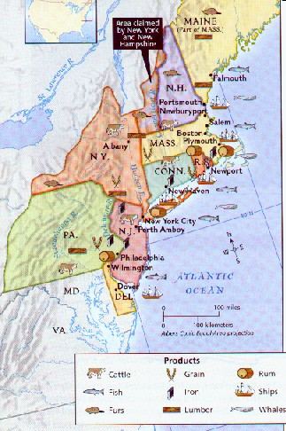
In the most fertile areas of the middle colonies, farmers raised a variety of crops and livestock, including wheat, corn, cattle, and hogs. They produced so much that they sold their surplus food to the West Indies, where raising sugar cane produced so much profit that the planters did not want to waste land growing food for slaves who worked in their fields.
A diverse commercial economy also developed in the New England and Middle Colonies. Grinding wheat, harvesting fish, sawing lumber, making ships, and sawing lumber also became thriving industries.

Slide 9
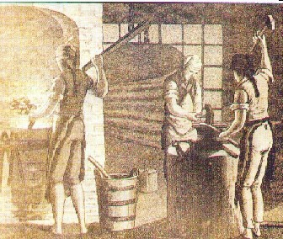
Industrial North
-more diversified economy than the south
More cities and urban areas
-not as much slavery
-harsher weather conditions
Subsistence farming, sell extra goods
-food exports, lumber industry
Cattle, grain, bread
-ship building, iron making
Major money-maker
Colonists manufactured impressive numbers of ships and quantities of iron. By 1760, the colonists had built one-third of all British ships and were producing more iron than England was. This expansion in trade caused port cities to grow, including the major ports of Boston, Philadelphia, and New York City.

Slide 10
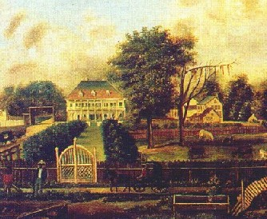
Agricultural South
-growth of cash crops – tobacco, rice, indigo
NC/VA – tobacco
SC/GA – rice/indigo
-large plantations dominate economy
Needed more slaves
-many small farms also
-few towns and cities because of the agricultural lifestyle
Only ports, like Charles Town
Because the long and deep rivers allowed access for ocean-going vessels, planters (plantation owners) could ship their goods directly to the northern colonies and Europe without the need for city docks and warehouses. Because plantation owners produced most of what they needed on their property, they had little use for shops, bakeries, and markets. On the whole, the South developed as a rural and self-sufficient society.

Slide 11
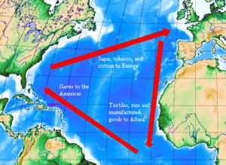

Slavery In America
-slaves would replace Indians and indentured servants
Every colony in North and South, more in the South
-Triangular Trade
slaves-sugar-rum
Africa, West Indies, America
-Middle Passage
African slaves come to America on slave ships, many died
The English settlers found it difficult to enslave natives, and the price for indentured servants was rising. Therefore, they turned to the African slave trade. A slave worked for life and brought a much larger return on the planter’s investment. Black Africans were thought of as better able to endure the harsh physical demands of plantation labor in hot climates. By 1690, nearly 13,000 black slaves toiled in the Southern colonies. By 1750, that number increased to almost 200,000.

Slide 12
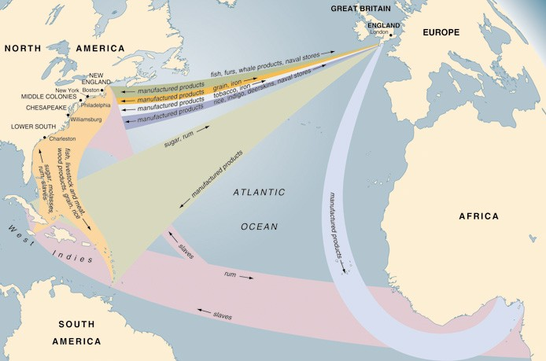
Triangular Trade

Slide 13
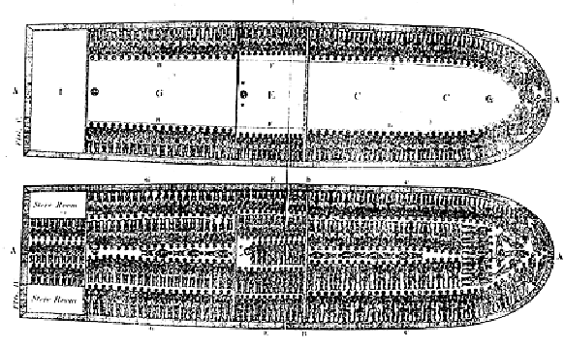
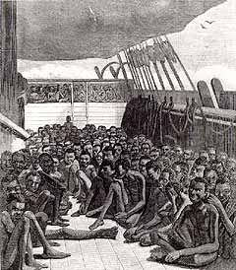
The voyage that brought Africans to the West Indies and later to the Americas was known as the Middle Passage. Sickening cruelty characterized this journey. European traders branded Africans with red-hot irons for identification and packed them into the dark holds of large ships. On board a slave ship, Africans fell victim to whippings and beatings, and diseases, blood, sweat, and excrement swept through the vessel as the passengers lived in their own vomit and waste. Whether they died from disease, cruel treatment, or suicide, up to 20 percent or more of those on slave ships perished on the Middle Passage.

Slide 14

“Slave Ship”

Slide 15
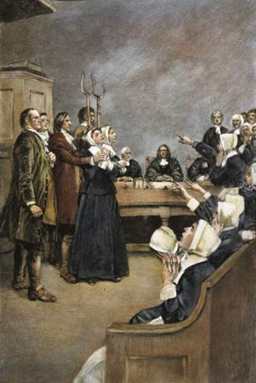
The strict limitations on women’s roles, combined with social tensions, the strained relations with the Native Americans, and religious fanaticism, contributed to one of the most bizarre episodes in American history. In February 1692, several Salem girls accused a West Indian slave woman, Tituba, or practicing witchcraft. In this Puritan New England town of Salem, where the constant fear of Native American attacks encouraged a preoccupation with violence and death, the girls’ accusations drew a great deal of attention. When the girls accused others of witchcraft, the situation grew out of control, as those who were accused tried to save themselves by naming other “witches.”

Slide 16
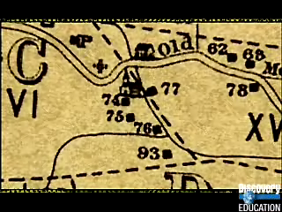
Salem Witch Trials

Slide 17
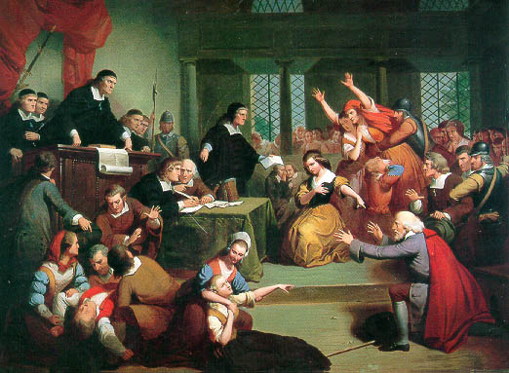
Witch Trials
-1692 - Salem , Massachusetts
Social tension, religious fanaticism
-young girls accused people of being witches
-witches were often executed unless they exposed other “witches”
-trials later suspended due to poor evidence
Hysteria gripped the town as more and more people made false accusations. Many of the accusers were poor and brought charges against richer residents. In addition, a high portion of victims were women who might be considered too independent. The accusations continued until the girls dared to charge such prominent citizens as the governor’s wife. Finally realizing they had been hearing false evidence, officials closed the court. The witchcraft hysteria ended—but not before 19 persons had been hanged, 5 died in jail, and 150 were imprisoned.

Slide 18
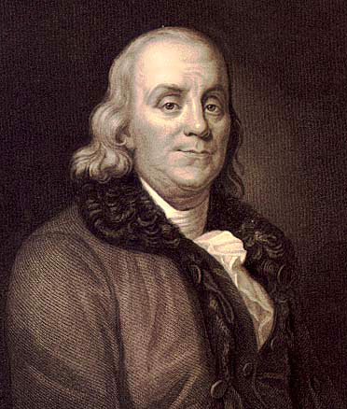
Enlightenment
-stresses the use of reason and scientific method
Not all done by God
-Benjamin Franklin became most famous early American scientist
-Enlightenment also led to increasing educational levels
Challenged Puritan ideals
-Led to the founding of colleges—many for religious training
Benjamin Franklin was one of the leading champions of Enlightenment ideals in America. Like other Enlightenment scientists and philosophers, Franklin believed that human beings could use their intellectual powers to better their lot in life. Franklin’s observations and experiments led to a number of inventions, including lightning rods, bifocals, and a new kind of heating system that became known as the Franklin stove. Inventions like these proved that knowledge derived from scientific experiment could be put to practical use.

Slide 19

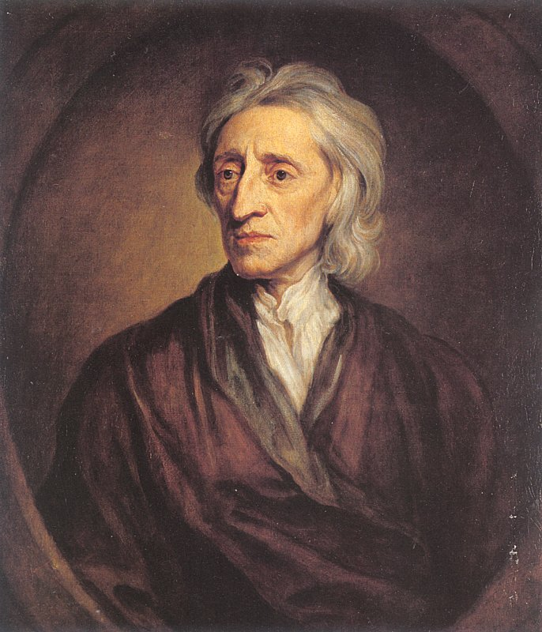
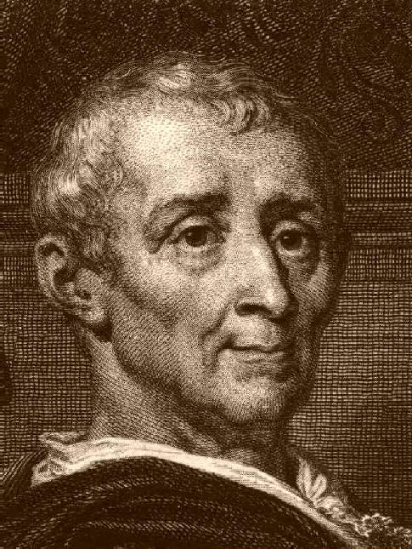
Philosophy
-John Locke – Natural Rights
life, liberty, property
Enlightenment thinker
God-given rights
-Social Contract
an agreement between a people and their gov’t to protect their rights
Government makes laws, people follow them
-Baron Montesquieu
separation of powers in government
Limits government’s powers

Slide 20
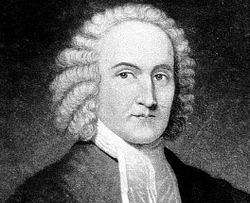
Great Awakening
-a revival of the Puritan faith
Preachers hosted revivals
-Jonathan Edwards
“Sinners in the Hands of an Angry God”
-new religious denominations
More minorities participate
Increased education
“The God that holds you over the pit of hell, much as one holds a spider, or some loathsome insect over the fire, abhors [hates] you, and is dreadfully provoked: His wrath towards you burns like fire; He looks upon you as worthy of nothing else but to be cast into the fire;…and yet is nothing but His hand that holds you from falling into the fire every moment.”
~Jonathan Edwards “Sinners in the Hands of an Angry God”

