Slide 1
Warm-up
List 3 weaknesses of the Articles of Confederation

Slide 2
The Age of Enlightenment
1600’s
Urged reason and logic for figuring out nature’s laws
Natural law could be applied to society
Promoted democracy over monarchy

Slide 3
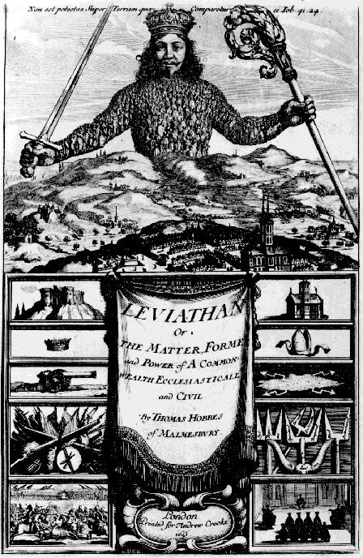
Thomas Hobbes
(1588-1679)
People could not rule themselves
Give up rights to absolute monarch for fear of a violent death

Slide 4
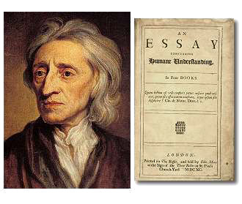
John Locke
(1632-1704)
Natural Rights – all people are born with basic rights (Life, Liberty, Property)
Social Contract – Relation between government and the people is a contract
  People obey laws
  Government protects rights
Right to rebel – if the government does not protect rights it is the right of the people to destroy that government

Slide 5
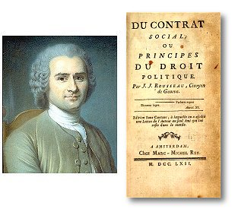
Jean-Jacques Rousseau
(1712-1778)
Everywhere gov. is oppressing the people
The only just gov. is one the people create

Slide 6
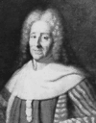
Baron de Montesquieu
(1689-1755)
Gov. needs power but power corrupts
Protect the people by separating the powers of gov. into three branches
  Write the laws
  Enforce the laws
  Interpret the laws

Slide 7
Answer the EQ
Using two examples of from your notes on Our English Heritage answer the essential question:
What characteristics of their English heritage influenced the founding fathers in the development of American democracy?

Slide 8
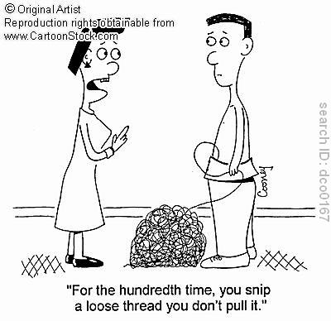
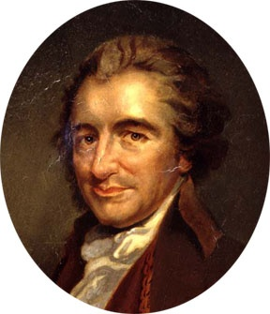
Who wrote Common Sense and what was its purpose?
Thomas Paine
Purpose was to encourage revolution

Slide 9
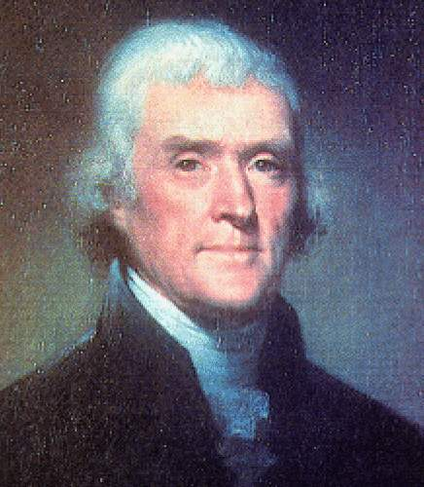
Who wrote the
Declaration of Independence
Thomas Jefferson

Slide 10
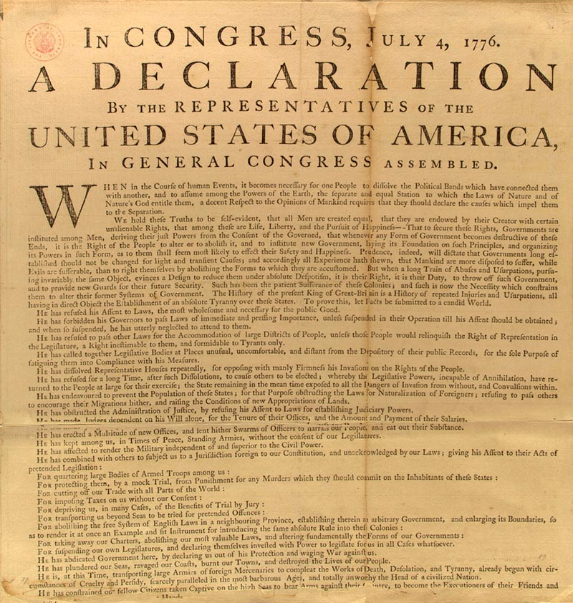

Two Purposes of Declaration
Declare independence
State the reasons why

Slide 11

John Locke’s Influence on Declaration of Independence
All men equal
All men entitled to rights
Government power comes from the people
Right to abolish an oppressive government

Slide 12
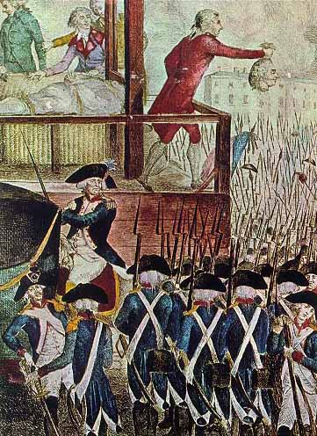
John Locke’s Social Contract
Government is created to secure rights of people and when it fails to do this the people have the right to abolish it.

