Slide 1
Warm-Up
Why do you think we need government?

Slide 2
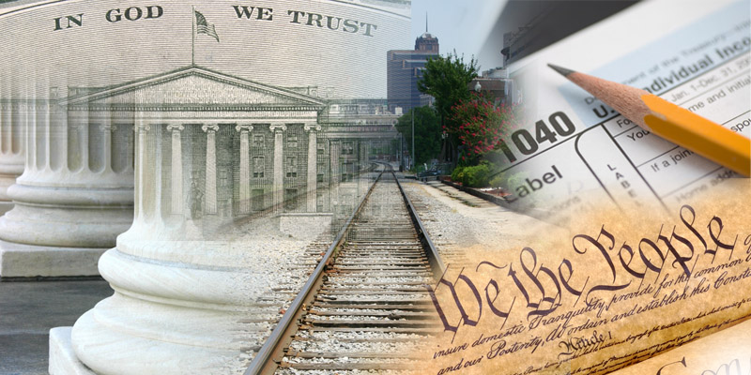
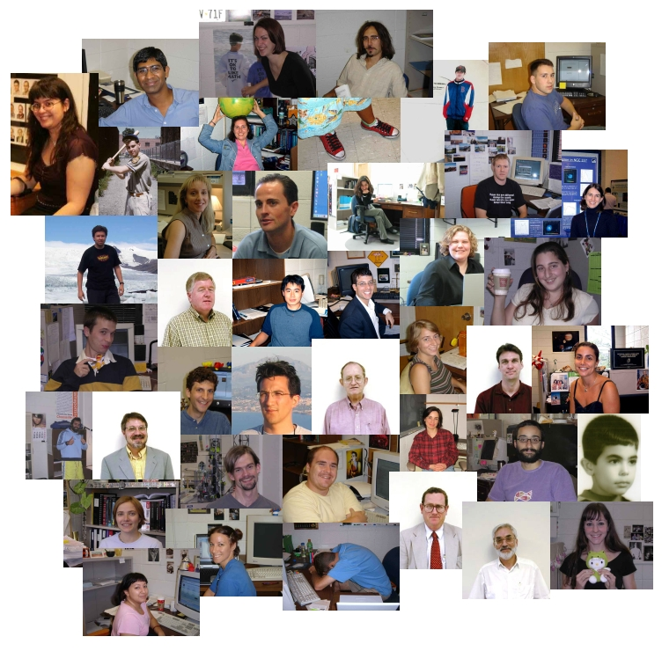
Unit 1 Part III: The Government and the People

Slide 3
Government
The Ruling authority for a community

Slide 4
Why do communities need government?
To make it possible for people to live together peacefully

Slide 5
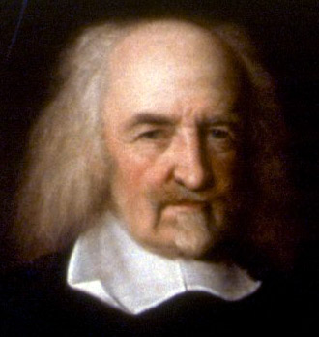
Thomas Hobbes
Scottish political philosopher (1588-1679)

Slide 6
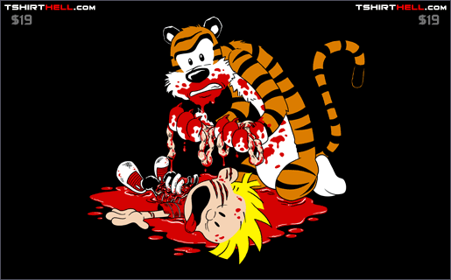
Life without government would be “nasty, brutish, and short.”

Slide 7
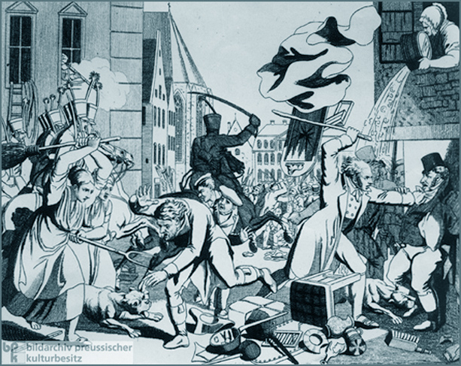
What do governments do?

Slide 8
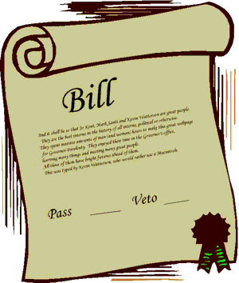
Provide Laws

Slide 9
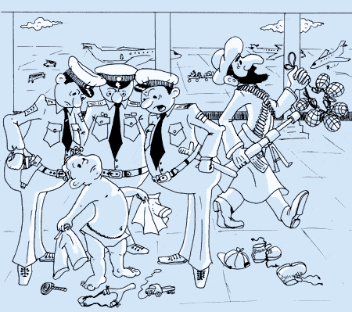
Provide Security

Slide 10





Slide 11
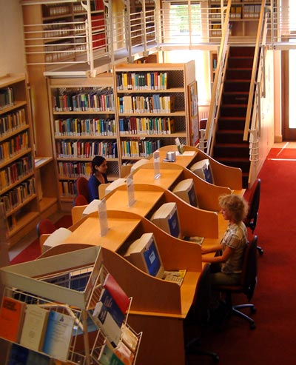
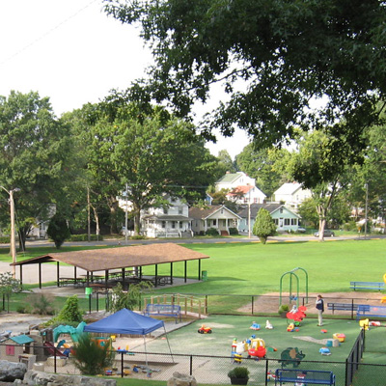
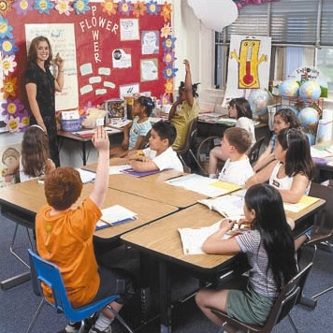
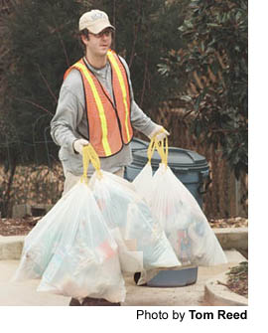
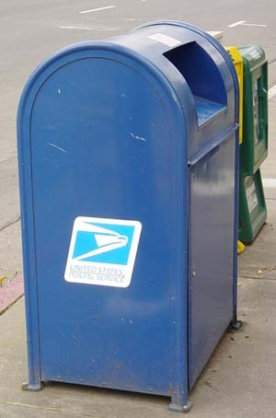
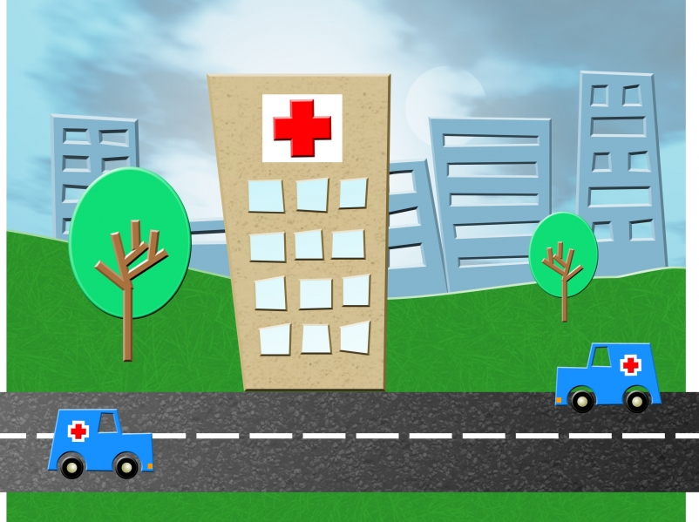
Provide Services

Slide 12
Guide the Community
Help shape public policy – the course of action to achieve community goals

Slide 13
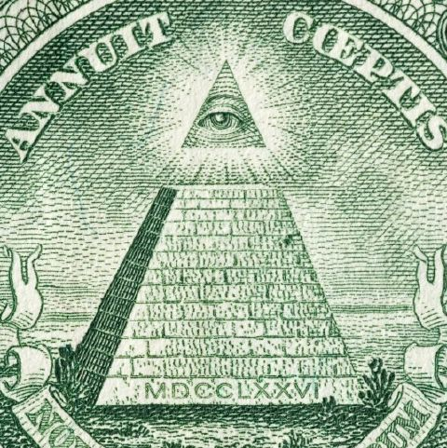
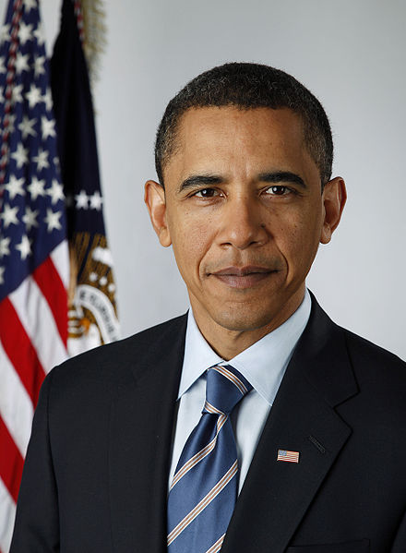
Levels of Government
National Government
  The government of the entire country

Slide 14
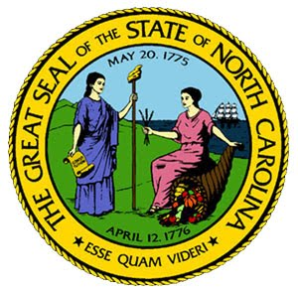
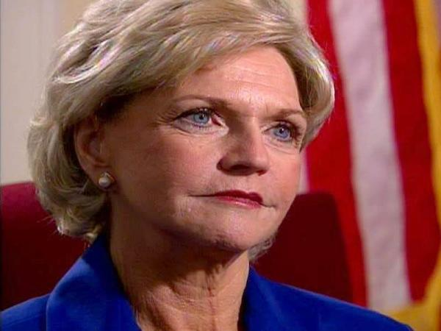
State Government
Decides matters for people in the state

Slide 15
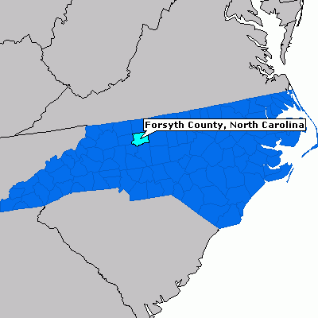

Local Government
Counties, cities and towns
Closest gov. to the people

Slide 16
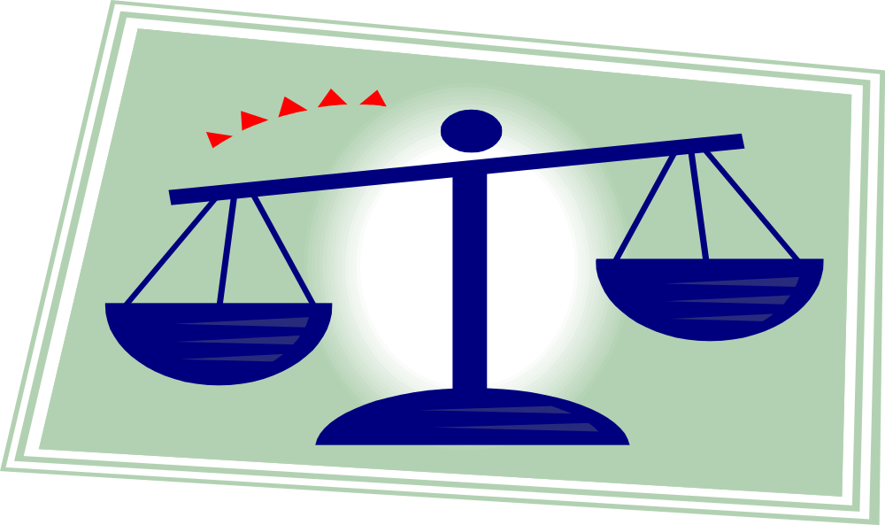
Principles of American Democracy

Slide 17
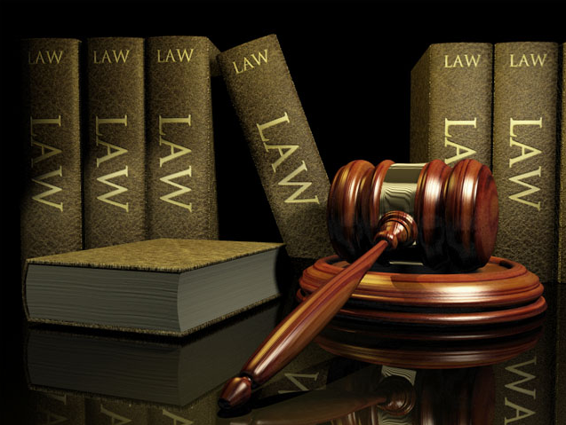
Rule of Law
All people are bound by the law

Slide 18
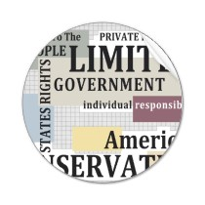
Limited Government
The government can only do the things that the people have given it power to do.

Slide 19
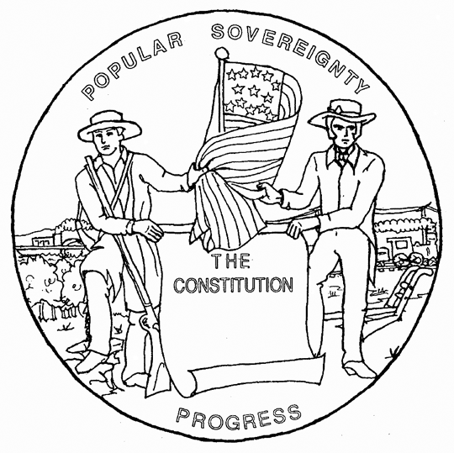
Consent of the Governed
American citizens are the source of all government power
  Popular Sovereignty – “The People Rule”

Slide 20
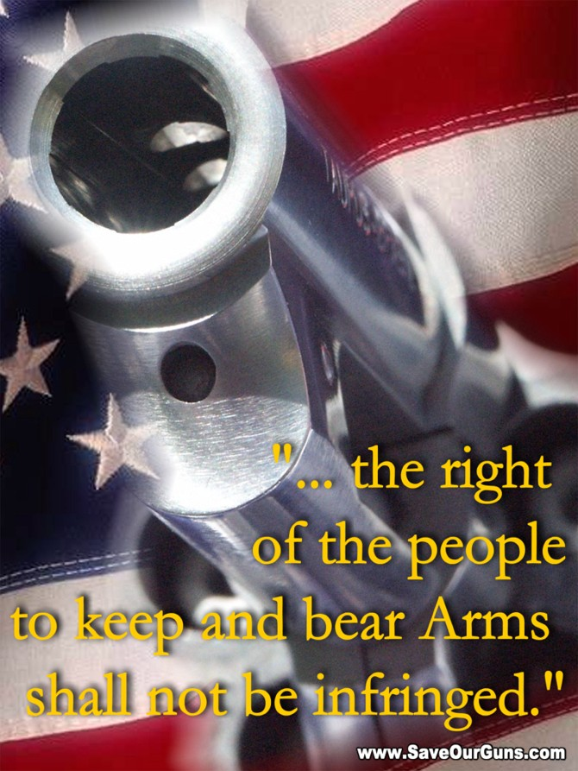
Individual Rights
Individual rights, even of those not popular with the majority, are protected by the government.

Slide 21
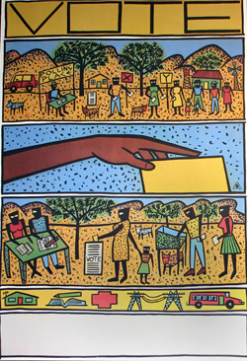
Representative Government
People elect leaders to make the laws and govern on their behalf.

Slide 22
