Slide 1
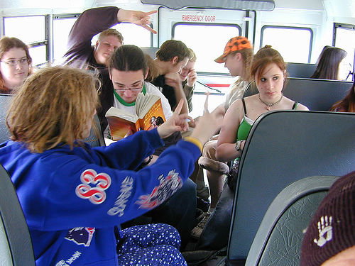
Rights of Citizens
Do you, as a teenage high-school student, have any rights? What are some of those rights? What would you do if they were taken away?
_______________________________________________________________________________________________________________________________________________________________________________________________________________________________________________________________________________________________________

Slide 2
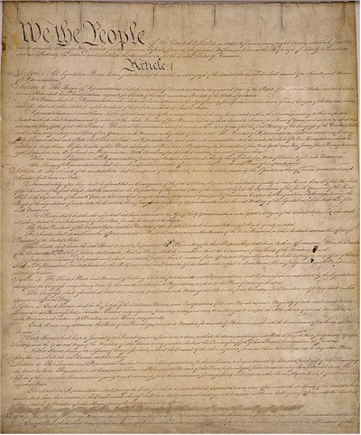
Sources of Our Rights
-Written Documents
Written documents include the Constitution, the Bill of Rights, Declaration of Independence and State Constitutions
-Laws Passed by Government
these could be laws passed by Federal, State, or Local governments
-Rulings by the Courts
decisions of the courts interpret the meaning of the laws passed by government
The U.S. Constitution is the main source of rights for citizens of the United States.

Slide 3
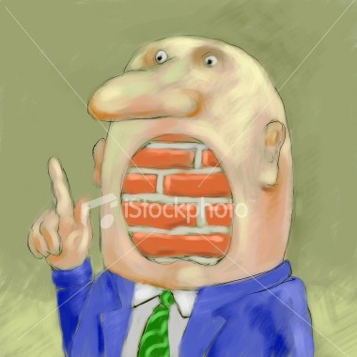
Security Rights
-Protect us from the Government
Some of our rights are based on denying certain powers to our government
-Article One denies certain powers to Congress
-The Bill of Rights contains many limitations to government’s power
Cannot deny your freedoms, enter your home without a warrant, etc.
The federal government of the United States cannot deny citizens their rights. How can the right demonstrated above help protect citizens against their government? Can the government take this away?

Slide 4
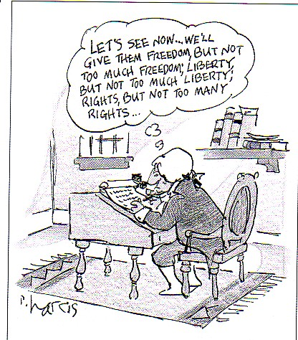
Liberty Rights
-Protect Our Freedoms
-First Amendment Rights are a prime example of rights protecting basic freedoms
Speech, Press, Religion, Assembly, and Petition
Those rights are limited; you cannot endanger others
Certain rights given to accused persons protects your personal liberty unless proven guilty in court
Guaranteed a lawyer, fair trial
What do you think this cartoonist is trying to say? Is it okay for the government to put limitations on our liberty rights? When? Why?

Slide 5
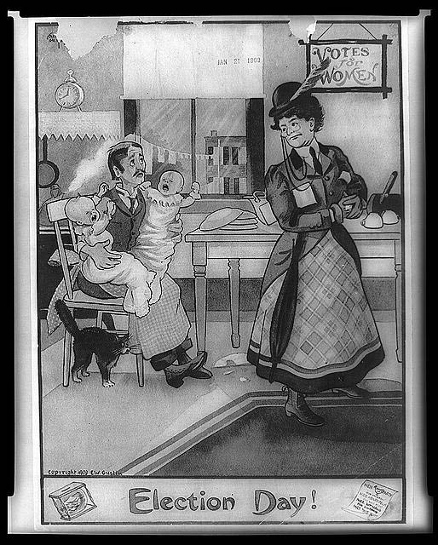
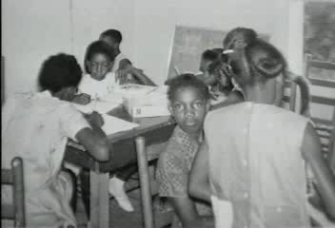
Equality Rights
Historically, what groups of people have not always been treated equally? Why? Has that changed? Are there still groups not treated equally?
-Requires that all persons are treated the same
-the 14th Amendment is the primary example of equality rights as it requires all persons to be given due process and equal protection
All citizens must be treated equally; that has not always been the case
-Amendments like the 15th and 19th made voting an equal right for all citizens

Slide 6
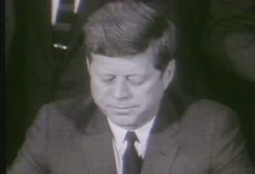
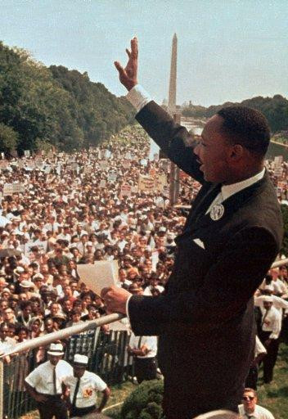
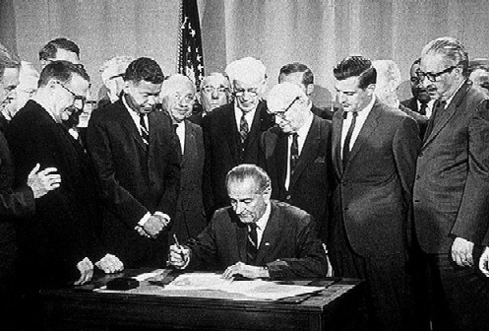

Testing Our Rights
-Prejudice
-unfair thoughts about a group of people
-Discrimination
-unfair actions toward a group of people
-14th Amendment
All citizens treated equally
-Civil Rights Movement (1950s and 1960s)
-non-violent protests
-Civil Rights Act, 1964
-Voting Rights Act, 1965
“Are we to say to the world—and much more importantly to each other—that this is the land of the free, except for the Negroes?”
~JFK

Slide 7


Rights Debated
-Affirmative Action
-Gov’t project that gives special preference to women and minorities in gov’t jobs and contracts
-”Glass Ceiling”
-Term used to describe the limitations many women and minorities face in job advancement
-Reverse Racism
Idea that special efforts made to make up for past racism are in fact discriminating against others
-some people have begun to debate the effectiveness of Affirmative Action and the goal of equal treatment of all citizens
How do you think affirmative action can be a “dividing line”?

Slide 8
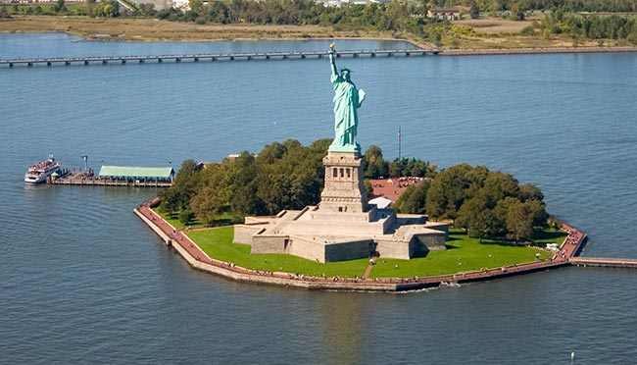
Who Are Americans?
Why do you think foreign people choose to immigrate to the United States? Do you think life as an immigrant is hard? How do Americans treat immigrants? Do you think that will ever change?
___________________________________________________________________________________________________________________________________________________________________________________________________________

Slide 9
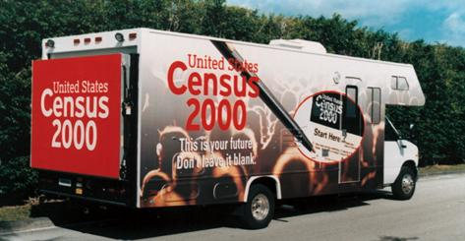
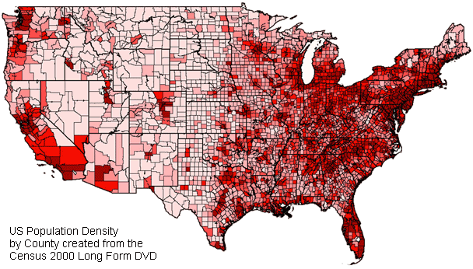
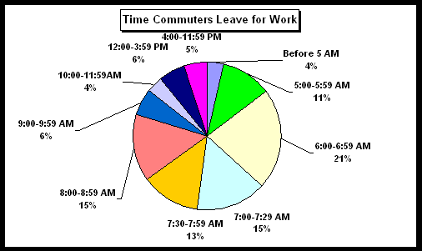
Census
-Census
Population count
-Started in 1790
needed to know population to determine representation in Congress
-completed every ten years
-asks many other questions to find out information about the lives of Americans
Want to determine the overall make-up of the American population

Slide 10

E Pluribus Unum
This is the motto of the USA.
It is Latin for “Out of Many, One”
In other words, we are many different states, but one country.
It also refers to all the different cultures in the USA making one united country.

Slide 11
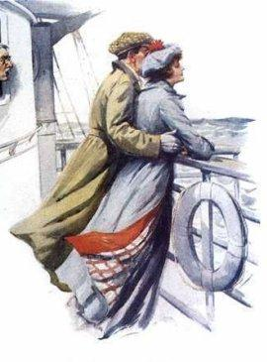
Nation of Immigrants
-All Americans are either immigrants or the descendants of an immigrant
-Native Americans
Walked across the land bridge
All others came through colonization, immigration, and slavery
-Spanish
-English, French, Africans
-Other Europeans
-Asians
-Latinos

Slide 12
Immigration Limits
-mid 1800’s some discrimination begins against immigrants
Nativism: favoring native-born Americans over immigrants
-fear of jobs and land being lost by those already here
-1920’s saw National Origins Act which limited immigration based on nationality
-1960 saw modern quota system implemented
Limits the number of people allowed into the U.S. per year
-refugees are the exception to the immigration quotas
-People who have fled their homes because of war or famine
Do you think treatment toward immigrants has changed much in the last century? Why or why not?
Immigration Act of 1990: limited the number of people coming to U.S. from Latin America; benefits those with money, education, and special talents

Slide 13
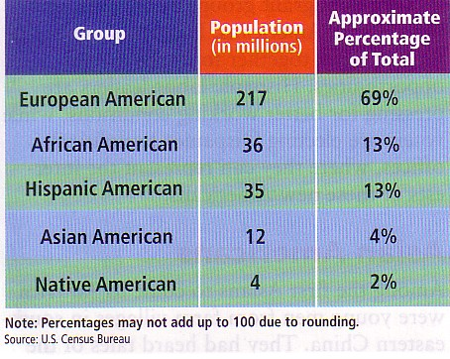
Population Growth
-Early population growth
-large influx of immigrants
Seeking opportunity
-naturally high birthrates
For farming
-Today
-declining birthrate
Disease, personal expectations, overcrowding, war
-fastest growing part of our population
Hispanic-American

Slide 14
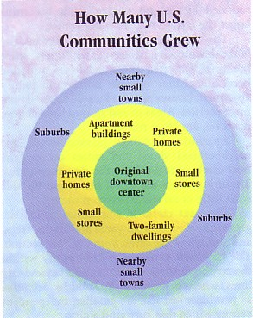
Where We Live
-4 great shifts in our population
-mid 1800’s saw people move from farms(rural) to cities (urban)
More opportunities
-late 1800’s, early 1900’s saw African Americans moving into northern areas
-late 1900’s saw shift toward the south and southwest U.S.
Cheaper to live
-late 1900’s saw move toward living in suburbs of cities
Most people live in suburbs

Slide 15
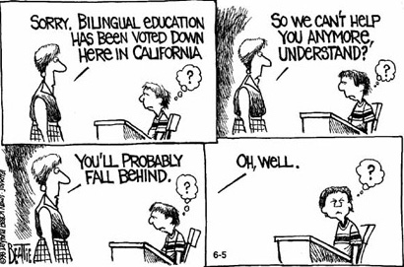
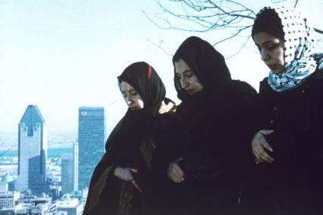
Changing Nation
-The United States changes with every Census
-Language barriers
Particularly Spanish
bi-lingual areas
Speaking more than one language
-cultural barriers
-religious barriers
-aging population

Slide 16
Members of Many Groups
-Many Americans play roles in most of these groups
-Family
-Friends
-Religion
-Education
-Economics
-Government

Slide 17

Values We Share
-American Dream
-Legacy of freedoms
-Government by the People
-equality of all persons
-Justice
-Imperfect Society in reality
Does EVERY American have access to the American dream?
Is it true for ALL Americans?

