Slide 1
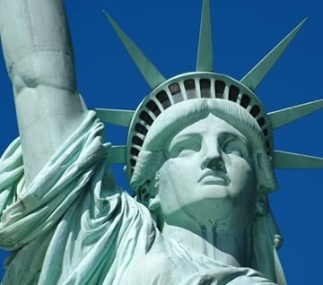
Citizenship
Who is allowed to be a citizen of the United States? Do you think there should be specific standards for U.S. citizenship? Why? Should there be a cap on the number of people they let in the United States? Why or why not?
_________________________________________________________________________________________________________________________________________________________________________________________________________________________________________________________________________________________________________________

Slide 2
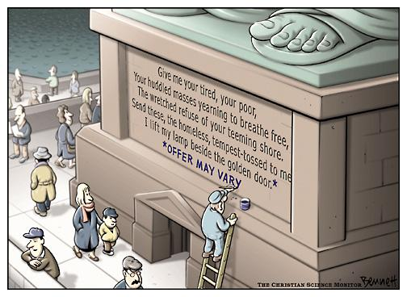
American Population
-late 1700’s
less than 4 million people
-today
nearly 320 million
-what caused the growth?
immigration
More people want to move to America for various reasons
birthrate
More Americans having children
Why is the worker painting “Offer may Vary” on the Statue of Liberty? Do some people think the population is getting too big? How? Why? What can be done? Should it be done?

Slide 3
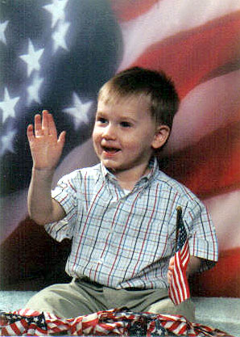
Citizenship
-What is a citizen?
14th Amendment states that “any person born or naturalized” is a citizen of the U.S.
-two ways to become a citizen
-born a citizen
-through naturalization

Slide 4
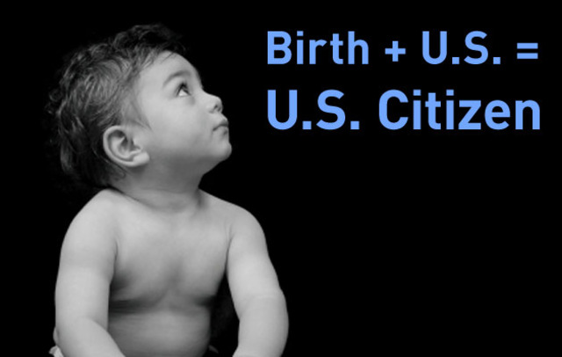
Citizen By Birth
-Citizenship by Birth
-born anywhere in any part of the United States
-If your parents are citizens no matter where you were born
-possible to be a dual citizen at birth
Holding citizenship in more than one country

Slide 5
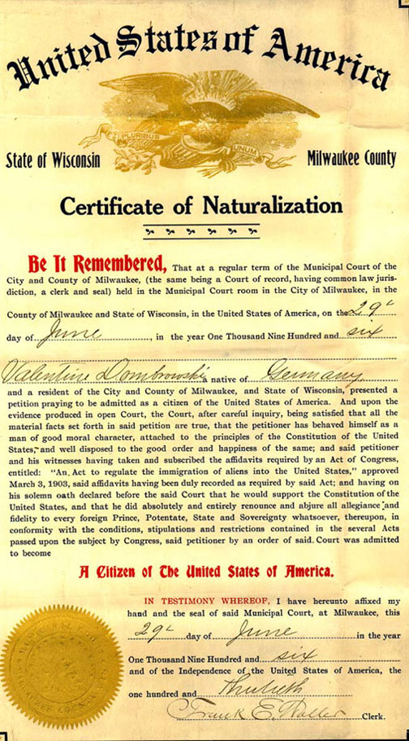
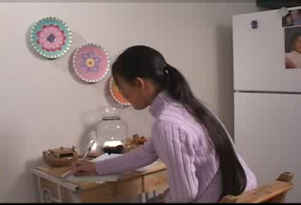
Naturalization
-naturalization – process of becoming a citizen
-5 requirements
-file an intent form
Filed with I.N.S.
-live in U.S. for 5 years
-be 18 years old
-take naturalization test
-take citizenship oath

Slide 6
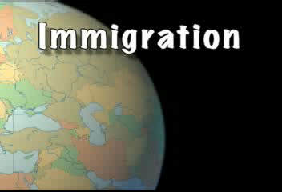
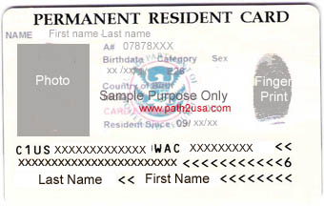
Legal Aliens
-Legal alien
Comes to America to work, study, or visit with relatives
-immigrant
Moves to America permanently
-have written permission to be in the U.S.
Visa / Green Card- Formal permission for a non-citizen to be in a nation
Must be current
-can’t vote or hold public office
-have same legal rights as citizens

Slide 7
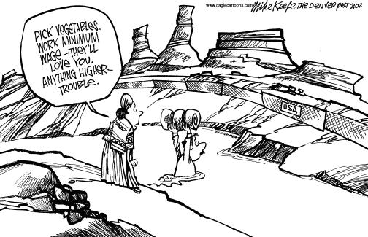
What is the cartoonist saying about migrant workers and seemingly illegal aliens? How do you know?

Slide 8
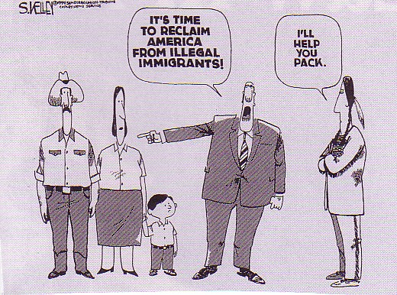
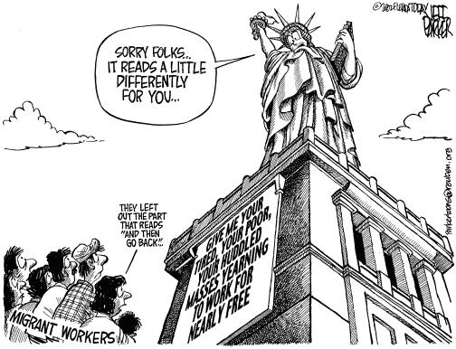
Illegal Aliens
-Illegal Aliens
11-12 million in the U.S. today
-cannot do anything legally in the U.S.
vote, hold office, work
-can be deported if found
-The process of being expelled from a nation
-why would someone come here if they would be an illegal alien???

Slide 9
Duties are things you MUST do.
What sorts of things do you think citizens MUST do?
____________________________________
____________________________________
____________________________________
Duties as Citizens

Slide 10
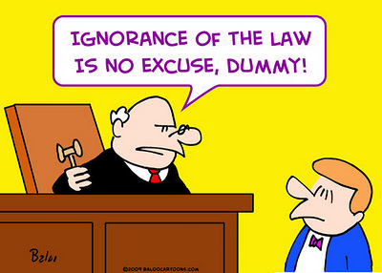
Obey the Laws
Social Order: keeping everyone safe and secure
Prevents anarchy (chaos)
“Ignorance is no excuse”

Slide 11
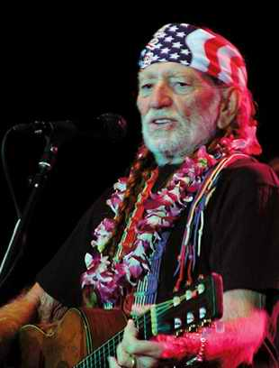
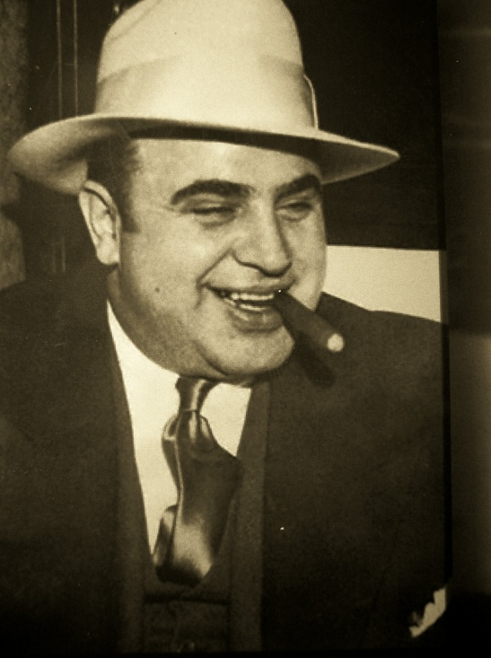
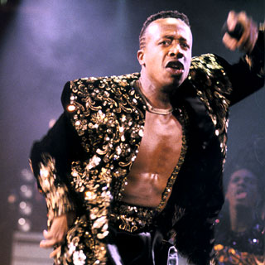
Pay Your Taxes
Everyone must pay federal and state income taxes
Helps provide services
Tax evasion – crime for not paying taxes

Slide 12

Defend the Nation
Men between the ages of 18-25 are required to register for the draft. Failure to do so is a felony.

Slide 13
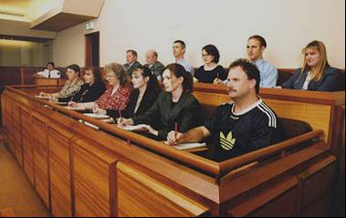
All citizens are subject to jury duty, and if called, you MUST attend.
Subpoena: must show up to testify in court
Serve in Court

Slide 14
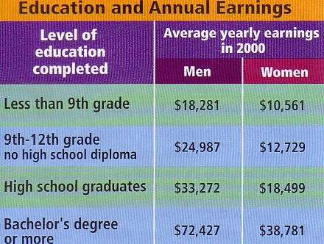
Go to School
All people must attend school through the age of 16.
Truancy – not attending school

Slide 15
Responsibilities
as Citizens
Responsibilities are things you SHOULD do.
What sorts of things do you think citizens SHOULD do?
____________________________________
____________________________________
____________________________________
____________________________________
____________________________________

Slide 16
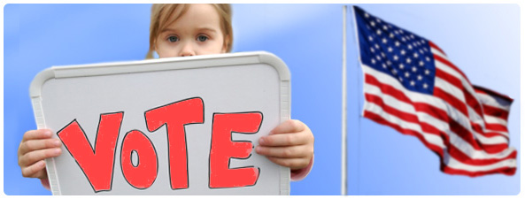
Be Informed
All citizens should know what is going on with their community, their lawmakers, and their personal rights.

Slide 17
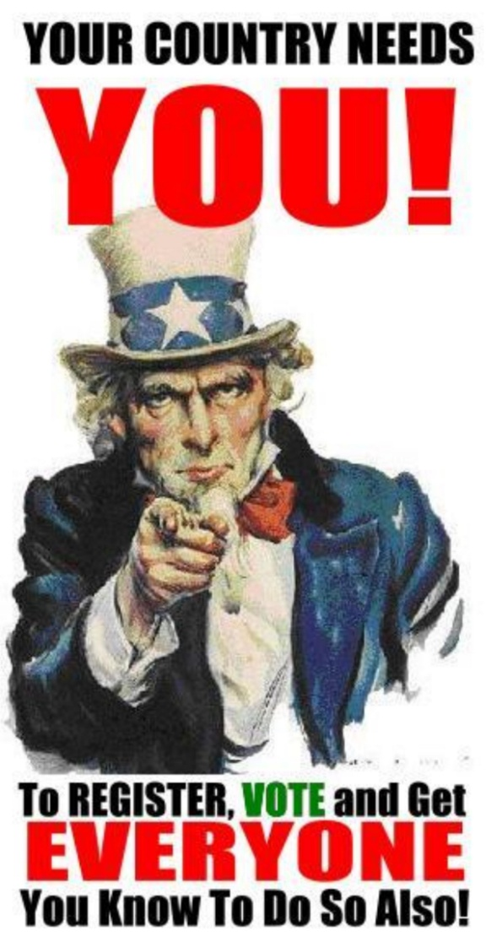
Vote in Elections
Every person SHOULD participate in a democracy.
Consent of the governed: when you vote, you give the government permission to rule you and to make laws

Slide 18
Participate
Every person SHOULD care about the welfare of their community.
Volunteerism: offering your time and services to others without payment.

Slide 19
Respect for Property
Every person SHOULD respect other people’s personal property and community property.
Vandalism: destruction of property (a crime)

Slide 20
Respect for Others
Every person SHOULD respect each other.
Tolerance: respecting and accepting others, regardless of their beliefs, practices, or differences.

