Slide 1

2026-27 Budget HEARING PRESENTATION
MAY 6, 2026 board of education business meeting

Slide 2

The Intersection of Three Critical Challenges:
DECLINING STUDENT ENROLLMENT
STATE AID REDUCTION
SIGNIFICANT COST INCREASES

Slide 3

Our student investments: instruction, supports & operations
(Not an all-inclusive list)
Small class sizes, relative to declining enrollment trends
Multiple pathways for graduation and Advanced/Honors coursework
Robust music, art and athletics programs for 5,600 students
Social and emotional support for 5,600 students
Bi-lingual elementary program at Edson
In-District Universal Pre-Kindergarten for 200 students
1:1 Chromebooks for 5,600 students
Transportation for 5,600 students over 98 square miles in-district
Investments in Math for K-8 students
Investments in Reading curriculum for K-5 students
Professional Development for faculty and staff
Operations and Maintenance for 11 buildings (1,000,000 sq.ft.)

Slide 4
DECLINING ENROLLMENT

Slide 5
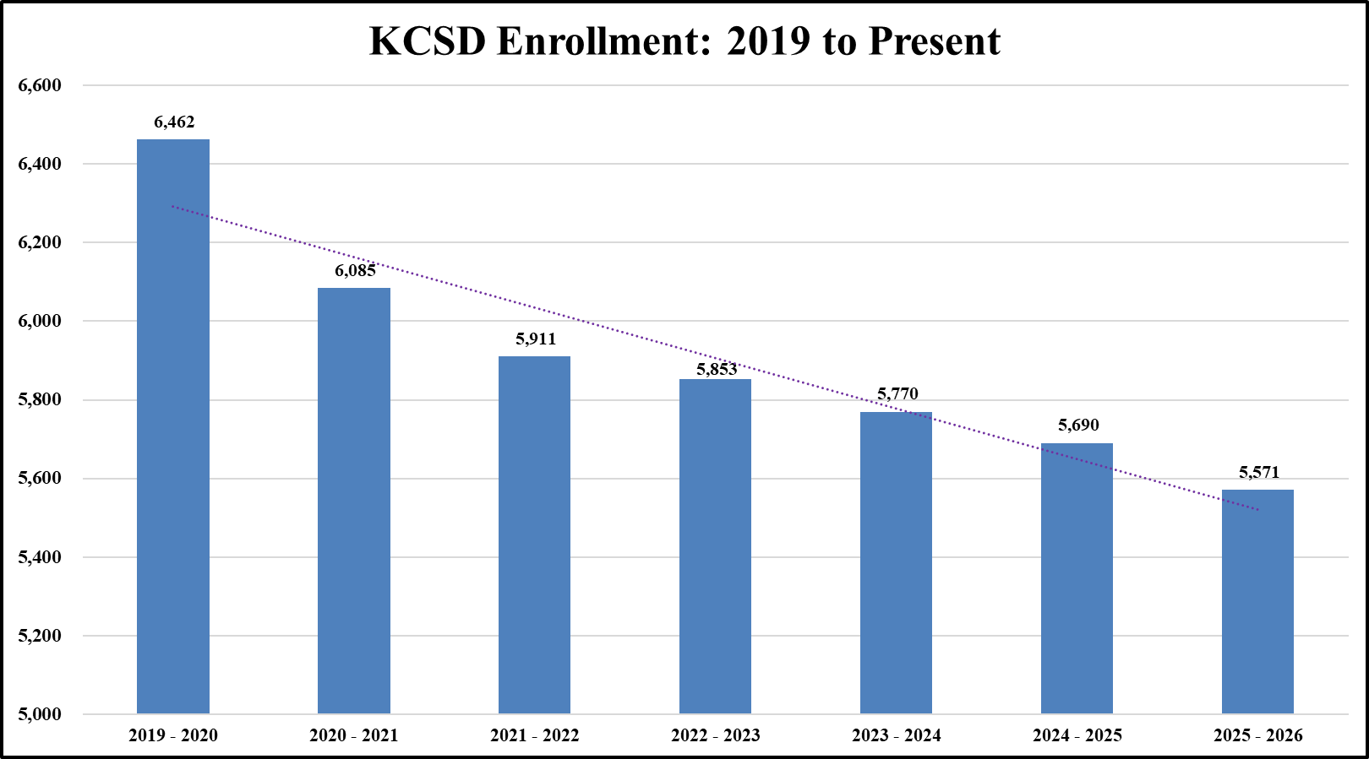
Declining enrollment:
IMPACTS STATE AID AND CLASS SIZES
KCSD currently has 891 fewer students than in the 2019-20 school year.

Slide 6
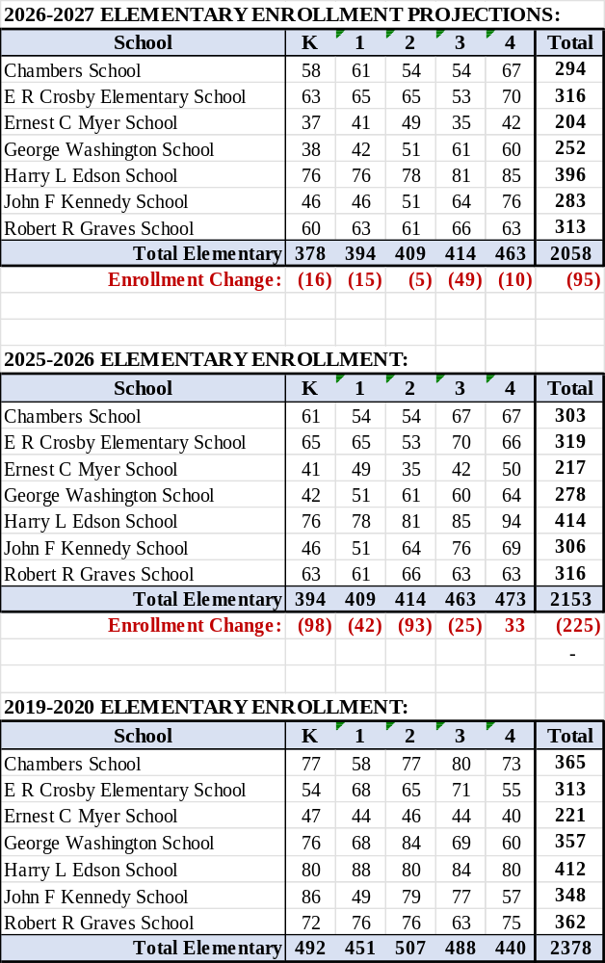
KCSD Elementary School Enrollment:
2019-2020
2025-2026
2026-2027 Projections

Slide 7
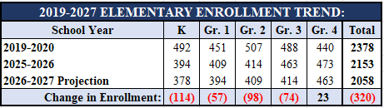
KCSD Elementary School Enrollment:
2019-2020
2025-2026
2026-2027 Projections
320 students is the equivalent of one KCSD elementary school

Slide 8
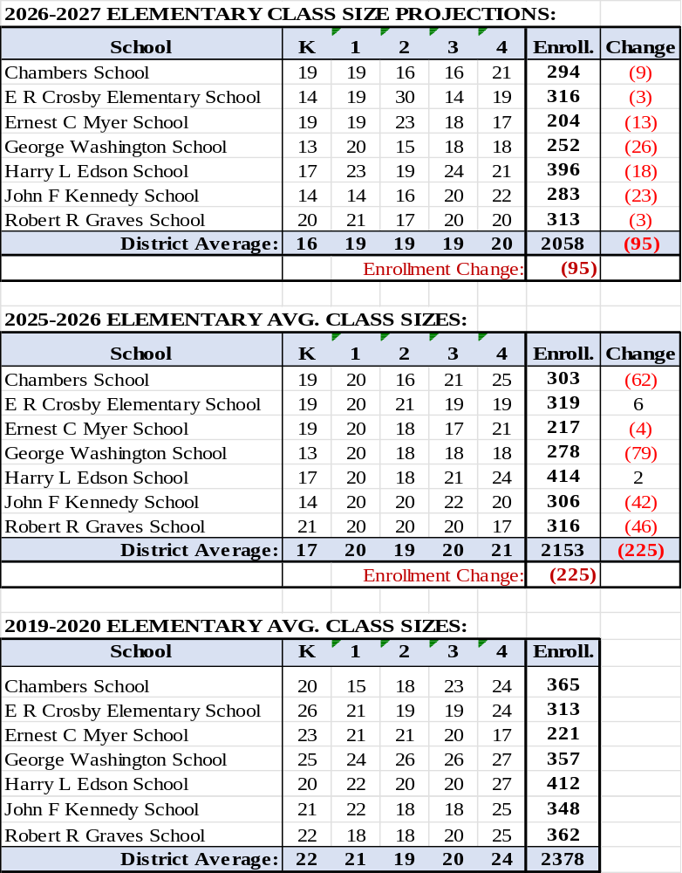
KCSD Elementary School Enrollment:
Average Class Sizes
2019-2020
2025-2026
2026-2027 Projections

Slide 9
Declining enrollment kcsd MIDDLE SCHOOL ENROLLMENT:
2019-20 VS. 2025-26
The decline of 233 students = 11.8% of 2019-2020 middle school enrollment

Slide 10
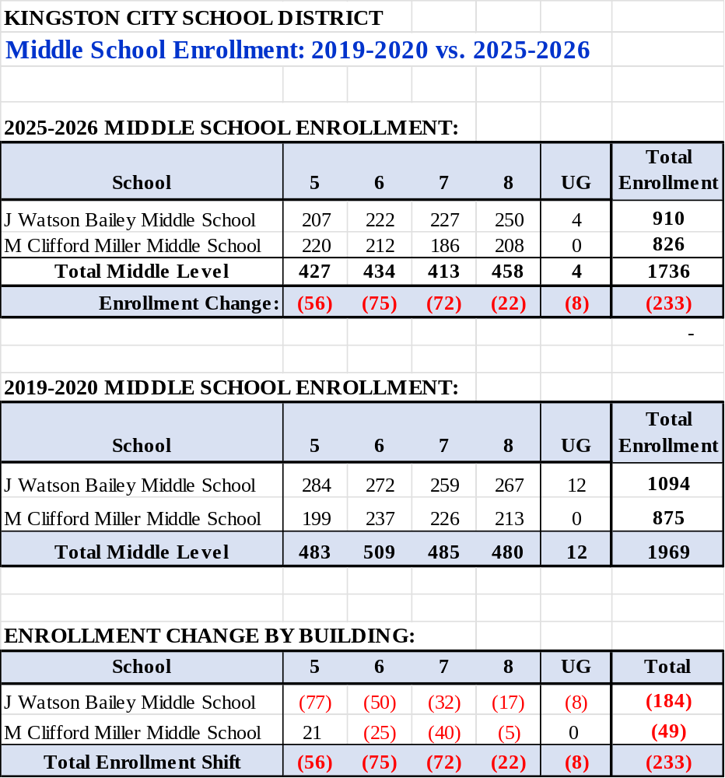
KCSD Middle School Enrollment:

Slide 11
Declining enrollment
KINGSTON HIGH SCHOOL ENROLLMENT:
2019-20 VS. 2025-26
KHS currently has 270 fewer students than in the 2019-20 school year.

Slide 12
Our student investments: instruction, supports & operations
(Not an all-inclusive list)
Smaller class sizes, relative to declining enrollment trends
Multiple pathways for graduation
Robust music, art and athletic programs for 5,900 students
Social and emotional support for 5,900 students
Bi-lingual elementary program at Edson
In-District Universal Pre-Kindergarten for 300 students
1:1 Chromebooks for 5,900 students
Transportation for 5,600 students over 98 square miles in-district
Investments in Math for K-8 students
Investments in Reading curriculum for K-5 students
Professional Development for faculty and staff
Operations and Maintenance for 11 buildings (1,000,000 sq.ft.)

Slide 13
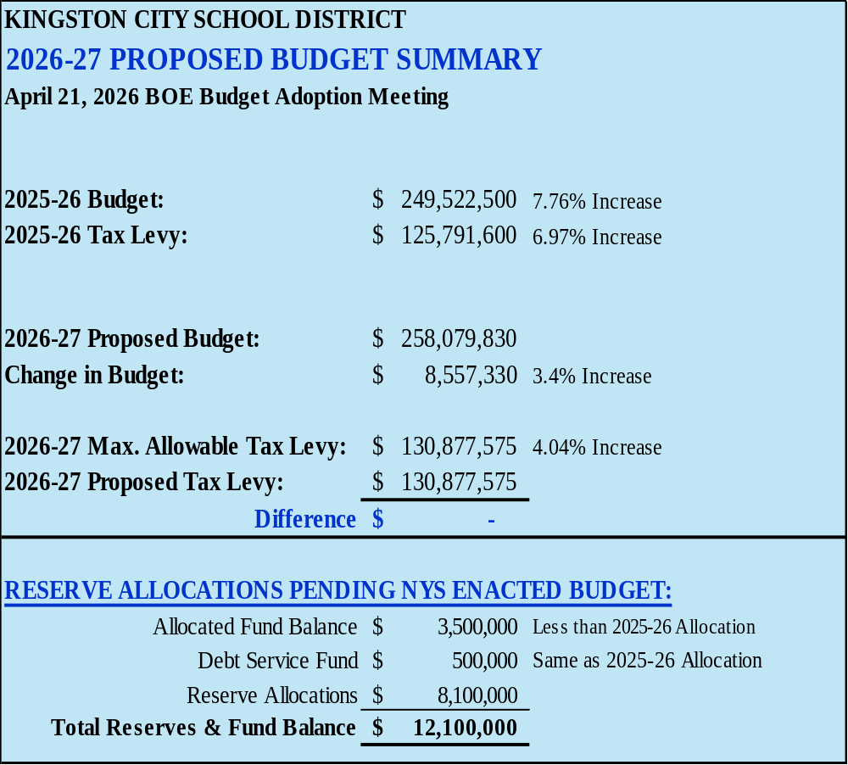
*Reserve balances reflect rounding.

Slide 14
2026-27
REVENUE BUDGET
REVENUE SOURCE | 2026-27 BUDGET | % TO TOTAL
PROPERTY TAX REVENUES | $ 132,577,500 | 51.4%
MISCELLANEOUS REVENUES | $ 2,988,000 | 1.2%
INTEREST INCOME | $ 2,500,000 | 1.0%
STATE AID | $ 107,935,775 | 41.8%
FB & RESERVE ALLOCATIONS | $ 12,078,555 | 4.7%
TOTAL REVENUES | $ 258,079,830 | 100.0%

Slide 15
2026-27 PROPOSED revenueS major CHANGES
Tax Levy Increase $5,085,900
TOTAL REVENUE INCREASE $8,557,330
State Aid Increase $2,842,475
Interest Income Increase $ 850,000
*Other Revenue Changes ($ 221,045)
*Net of smaller revenue decreases.

Slide 17
TAX CAP CALCULATION:
5 KEY FACTORS
Current Year Tax Levy
Tax Base Growth Factor
CPI (Inflation)
PILOT Payments
Exclusions: Capital & Retirement
Proposed Tax Levy:
$130,877,575
4.04% Increase
(Maximum Allowable)

Slide 18
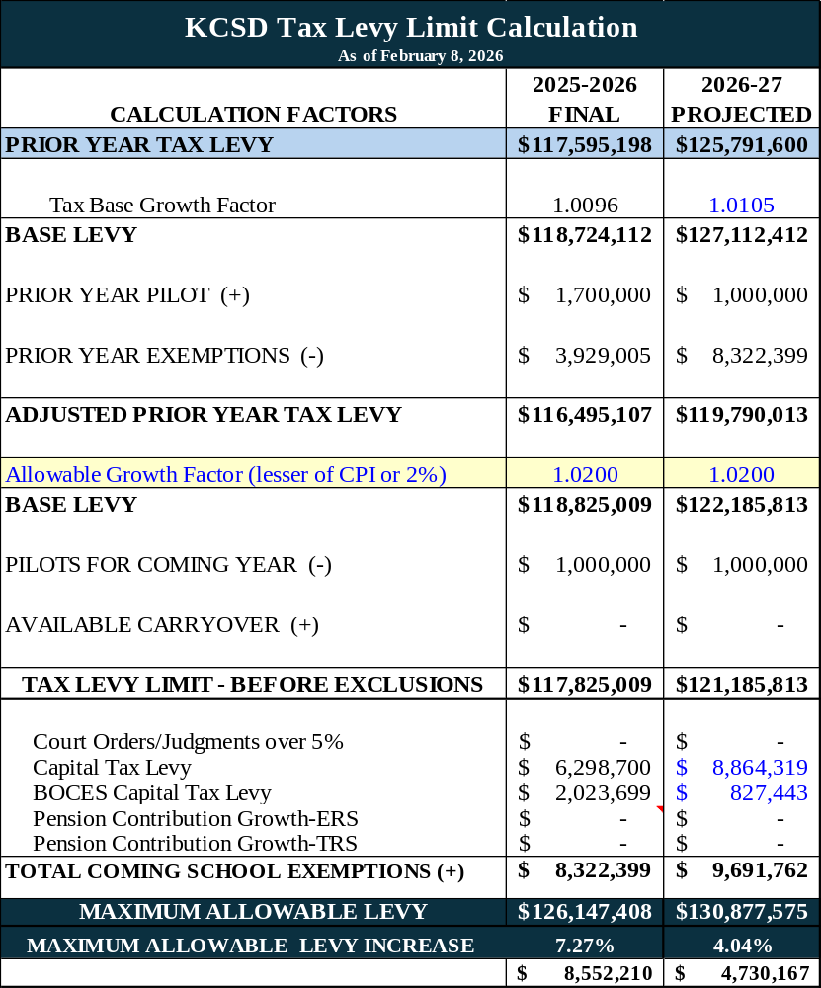
2026-2027
TAX LEVY LIMIT CALCULATION

Slide 19
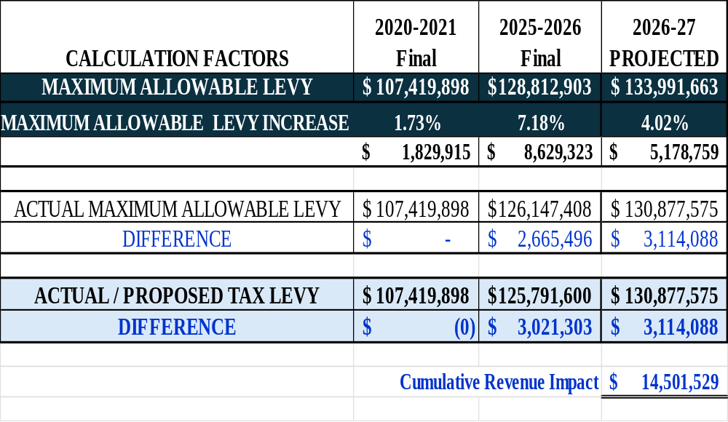
TAX CAP: long-term impact of levying 0%

Slide 20
State aid revenues:
5 MAIN CATEGORIES
Foundation Aid (Enrollment)
Transportation Aid
Special Education Services
BOCES Aid
Building Aid (Capital Projects)

Slide 22
2026-27
EXPENSE BUDGET

Slide 23
KCSD PRIMARY EXPENSE DRIVERS
Staff Salaries
Employee Benefits
Transportation
Costs for Students with Disabilities
Debt Service
Contractual Expenses
Textbooks, Equipment, Supplies
Operations & Maintenance

Slide 25
SHIFTING WEALTH MEASUREMENTS:
Impacts TO SPECIAL ED & TRANSPORTATION COSTS

Slide 26
2026-27 PROPOSED EXPENSES major CHANGES
Debt Service $6,958,300
Special Education Tuition ($1,801,400)
TOTAL EXPENSE INCREASE $8,557,330
Salaries ($ 200,000)
Transportation $ 208,400
Other Contractual Expenses $ 232,030
Employee Benefits $3,160,000

Slide 27
Tax Levy Changes vs.
Budget Changes

Slide 28

Budget vote:
Tuesday, May 19th
^{SEE KCSD WEBSITE FOR DETAILS}
^{www.kingstoncityschools.org}

Slide 29
WHAT IF THE BUDGET DOES NOT PASS?
3 OPTIONS
Revise the budget on June 16th
Propose this budget again on June 16th
Contingency Budget

Slide 30
Operational, Administrative & PROGRMMATIC
Impact of a Contingency Budget
Area | Impact Under Contingency Budget
Spending Authority | Teacher salaries and ordinary contingent expenses. Non-mandated programs could be impacted.
Tax Levy | No increase allowed; the budget would be reduced by $5,085,900
Administrative Spending | Capped at of prior year (8.2% vs. 8.48%)
Community Use of Facilities | Allowed only if fully cost-reimbursed
Transportation | Only legally mandated transportation services
Notes:
---
This slide references information from the following file: https://p12.nysed.gov/mgtserv/budgeting/handbook/appendixF.html,https://law.justia.com/codes/new-york/edn/title-2/article-41/part-1/2023/
In addition to the 0% tax levy limitation, a contingency budget imposes strict controls on the administrative component of a school district’s budget. Under NYS law and NYSED guidance, the administrative component of a contingency budget may not exceed the lesser of: (1) the percentage the administrative component represented in the prior year’s budget, exclusive of the capital component, or (2) the percentage represented in the last defeated budget for the upcoming year. This cap is intended to prevent growth in administrative spending when voters have not approved a proposed budget, even if administrative costs are contractually or operationally increasing.
Operationally, contingency budgets prohibit or significantly restrict several categories of spending that districts often rely on to maintain program quality and facilities. New equipment purchases are generally not permitted unless they are necessary to address health, safety, or legal compliance issues. Non-essential maintenance and most capital projects must be deferred, which can compound future costs and accelerate facility deterioration. Community use of school buildings is restricted unless all costs, including custodial and utility expenses, are fully reimbursed, limiting partnerships and extracurricular opportunities that rely on shared facilities.
Staffing and compensation are also affected. While teachers’ salaries may continue under a contingency budget, salary increases for non-instructional, non-union employees are typically prohibited. This can create challenges in recruitment, retention, and internal equity, particularly in administrative and operational roles. Programmatically, districts may be forced to reduce or eliminate field trips, certain extracurricular activities, and instructional enhancements that do not clearly qualify as ordinary contingent expenses, even if they are valued by the community and support student engagement.
From a governance perspective, adopting a contingency budget places the Board of Education in a difficult position, balancing statutory compliance with educational priorities under severe fiscal constraints. NYSED guidance emphasizes that contingency budgets are not intended to be sustainable long-term financial plans but rather a mechanism to ensure minimal operations in the absence of voter approval. For this reason, districts consistently communicate that passage of a proposed budget is critical to preserving programs, addressing rising costs, and maintaining facilities. Understanding these impacts helps the community appreciate both the legal structure and the real-world consequences of a contingency budget.

Slide 31
Operational, Administrative & PROGRMMATIC
Impact of a Contingency Budget
Area | WHAT DOES THIS MEAN?
Non-Mandated Programs | Programs not required by NYS Education Law. In KCSD, this includes: Pre-K, Kindergarten, Athletics, Music, Art, Extracurricular Programs, AP/Advanced/Honors classes, KALP, among other programs.
Transportation – Mandated Services | Home to School transportation, at the mileage limits set by NYS. This does not include after school programs or sports transportation.
Administrative Spending | Supports district leadership, financial management, human resources, legal and central office, operations, and system-wide planning and reporting.
Community Use of Facilities | Costs include cost of overtime and/or security coverage.
Notes:
---
This slide references information from the following file: https://p12.nysed.gov/mgtserv/budgeting/handbook/appendixF.html,https://law.justia.com/codes/new-york/edn/title-2/article-41/part-1/2023/
In addition to the 0% tax levy limitation, a contingency budget imposes strict controls on the administrative component of a school district’s budget. Under NYS law and NYSED guidance, the administrative component of a contingency budget may not exceed the lesser of: (1) the percentage the administrative component represented in the prior year’s budget, exclusive of the capital component, or (2) the percentage represented in the last defeated budget for the upcoming year. This cap is intended to prevent growth in administrative spending when voters have not approved a proposed budget, even if administrative costs are contractually or operationally increasing.
Operationally, contingency budgets prohibit or significantly restrict several categories of spending that districts often rely on to maintain program quality and facilities. New equipment purchases are generally not permitted unless they are necessary to address health, safety, or legal compliance issues. Non-essential maintenance and most capital projects must be deferred, which can compound future costs and accelerate facility deterioration. Community use of school buildings is restricted unless all costs, including custodial and utility expenses, are fully reimbursed, limiting partnerships and extracurricular opportunities that rely on shared facilities.
Staffing and compensation are also affected. While teachers’ salaries may continue under a contingency budget, salary increases for non-instructional, non-union employees are typically prohibited. This can create challenges in recruitment, retention, and internal equity, particularly in administrative and operational roles. Programmatically, districts may be forced to reduce or eliminate field trips, certain extracurricular activities, and instructional enhancements that do not clearly qualify as ordinary contingent expenses, even if they are valued by the community and support student engagement.
From a governance perspective, adopting a contingency budget places the Board of Education in a difficult position, balancing statutory compliance with educational priorities under severe fiscal constraints. NYSED guidance emphasizes that contingency budgets are not intended to be sustainable long-term financial plans but rather a mechanism to ensure minimal operations in the absence of voter approval. For this reason, districts consistently communicate that passage of a proposed budget is critical to preserving programs, addressing rising costs, and maintaining facilities. Understanding these impacts helps the community appreciate both the legal structure and the real-world consequences of a contingency budget.

Slide 32

Thank you!!!

