Slide 1

NJSLA Results
Spring 2025 Administration
New Jersey Student Learning Assessments
South Hackensack October 2025
To protect student privacy, data for cohorts with fewer than ten students are excluded from this report.

Slide 2


Table of Contents
Section 1: District Analysis
Section 2: School Analysis
Section 3: Demographic Analysis
Section 4: Trend Analysis
Section 5: Intervention Strategies

Slide 3
Section 1
District Analysis

Slide 4
NJSLA PERFORMANCE LEVELS
Level 1 – not yet meeting grade level expectations
Level 2 – Partially meeting grade level expectations
Level 3 – Approaching grade level expectations
Level 4 – Meeting grade level expectations
Level 5 – Exceeding grade level expectations

Slide 5
South Hackensack 2024-25 Spring NJSLA Language Arts
Grade | % Not Meeting (Level 1) |  |  | % Partially Meeting (Level 2) |  |  | % Approaching (Level 3) |  |  | % Meeting (Level 4) |  |  | % Exceeding (Level 5) |  |  | Change in Levels 1, 2, & 3 (2024 to 2025) | Change in Level 4 & Level 5 (2024 to 2025)
 | 2023 | 2024 | 2025 | 2023 | 2024 | 2025 | 2023 | 2024 | 2025 | 2023 | 2024 | 2025 | 2023 | 2024 | 2025
 | % | % | % | % | % | % | % | % | % | % | % | % | % | % | %
3 | 14.3% | 11.1% | 12.5% | 3.6% | 25.9% | 8.3% | 10.7% | 14.8% | 25.0% | 46.4% | 40.7% | 29.2% | 25.0% | 7.4% | 25.0% | -6.0% | +6.0%
4 | 11.8% | 7.4% | 7.1% | 5.9% | 11.1% | 10.7% | 29.4% | 18.5% | 25.0% | 29.4% | 37.0% | 39.3% | 23.5% | 25.9% | 17.9% | +5.8% | -5.8%
5 | 12.0% | 5.9% | 10.0% | 4.0% | 5.9% | 20.0% | 0.0% | 5.9% | 23.3% | 76.0% | 52.9% | 33.3% | 8.0% | 29.4% | 13.3% | +35.7% | -35.7%
6 | 0.0% | 0.0% | 0.0% | 3.8% | 0.0% | 6.3% | 26.9% | 4.8% | 6.3% | 34.6% | 19.0% | 37.5% | 34.6% | 76.2% | 50.0% | +7.7% | -7.7%
7 | 8.6% | 3.7% | 3.8% | 0.0% | 3.7% | 7.7% | 14.3% | 3.7% | 7.7% | 54.3% | 33.3% | 30.8% | 22.9% | 55.6% | 50.0% | +8.1% | -8.1%
8 | 12.5% | 0.0% | 7.7% | 4.2% | 11.8% | 0.0% | 16.7% | 0.0% | 7.7% | 37.5% | 64.7% | 38.5% | 29.2% | 23.5% | 46.2% | +3.6% | -3.6%
All Grades | 9.7% | 4.6% | 7.3% | 3.2% | 10.5% | 9.3% | 15.5% | 7.8% | 16.7% | 47.7% | 42.5% | 34.7% | 23.9% | 34.6% | 32.0% | +10.5% | -10.5%
Percentages may not total 100 due to rounding.

Slide 6
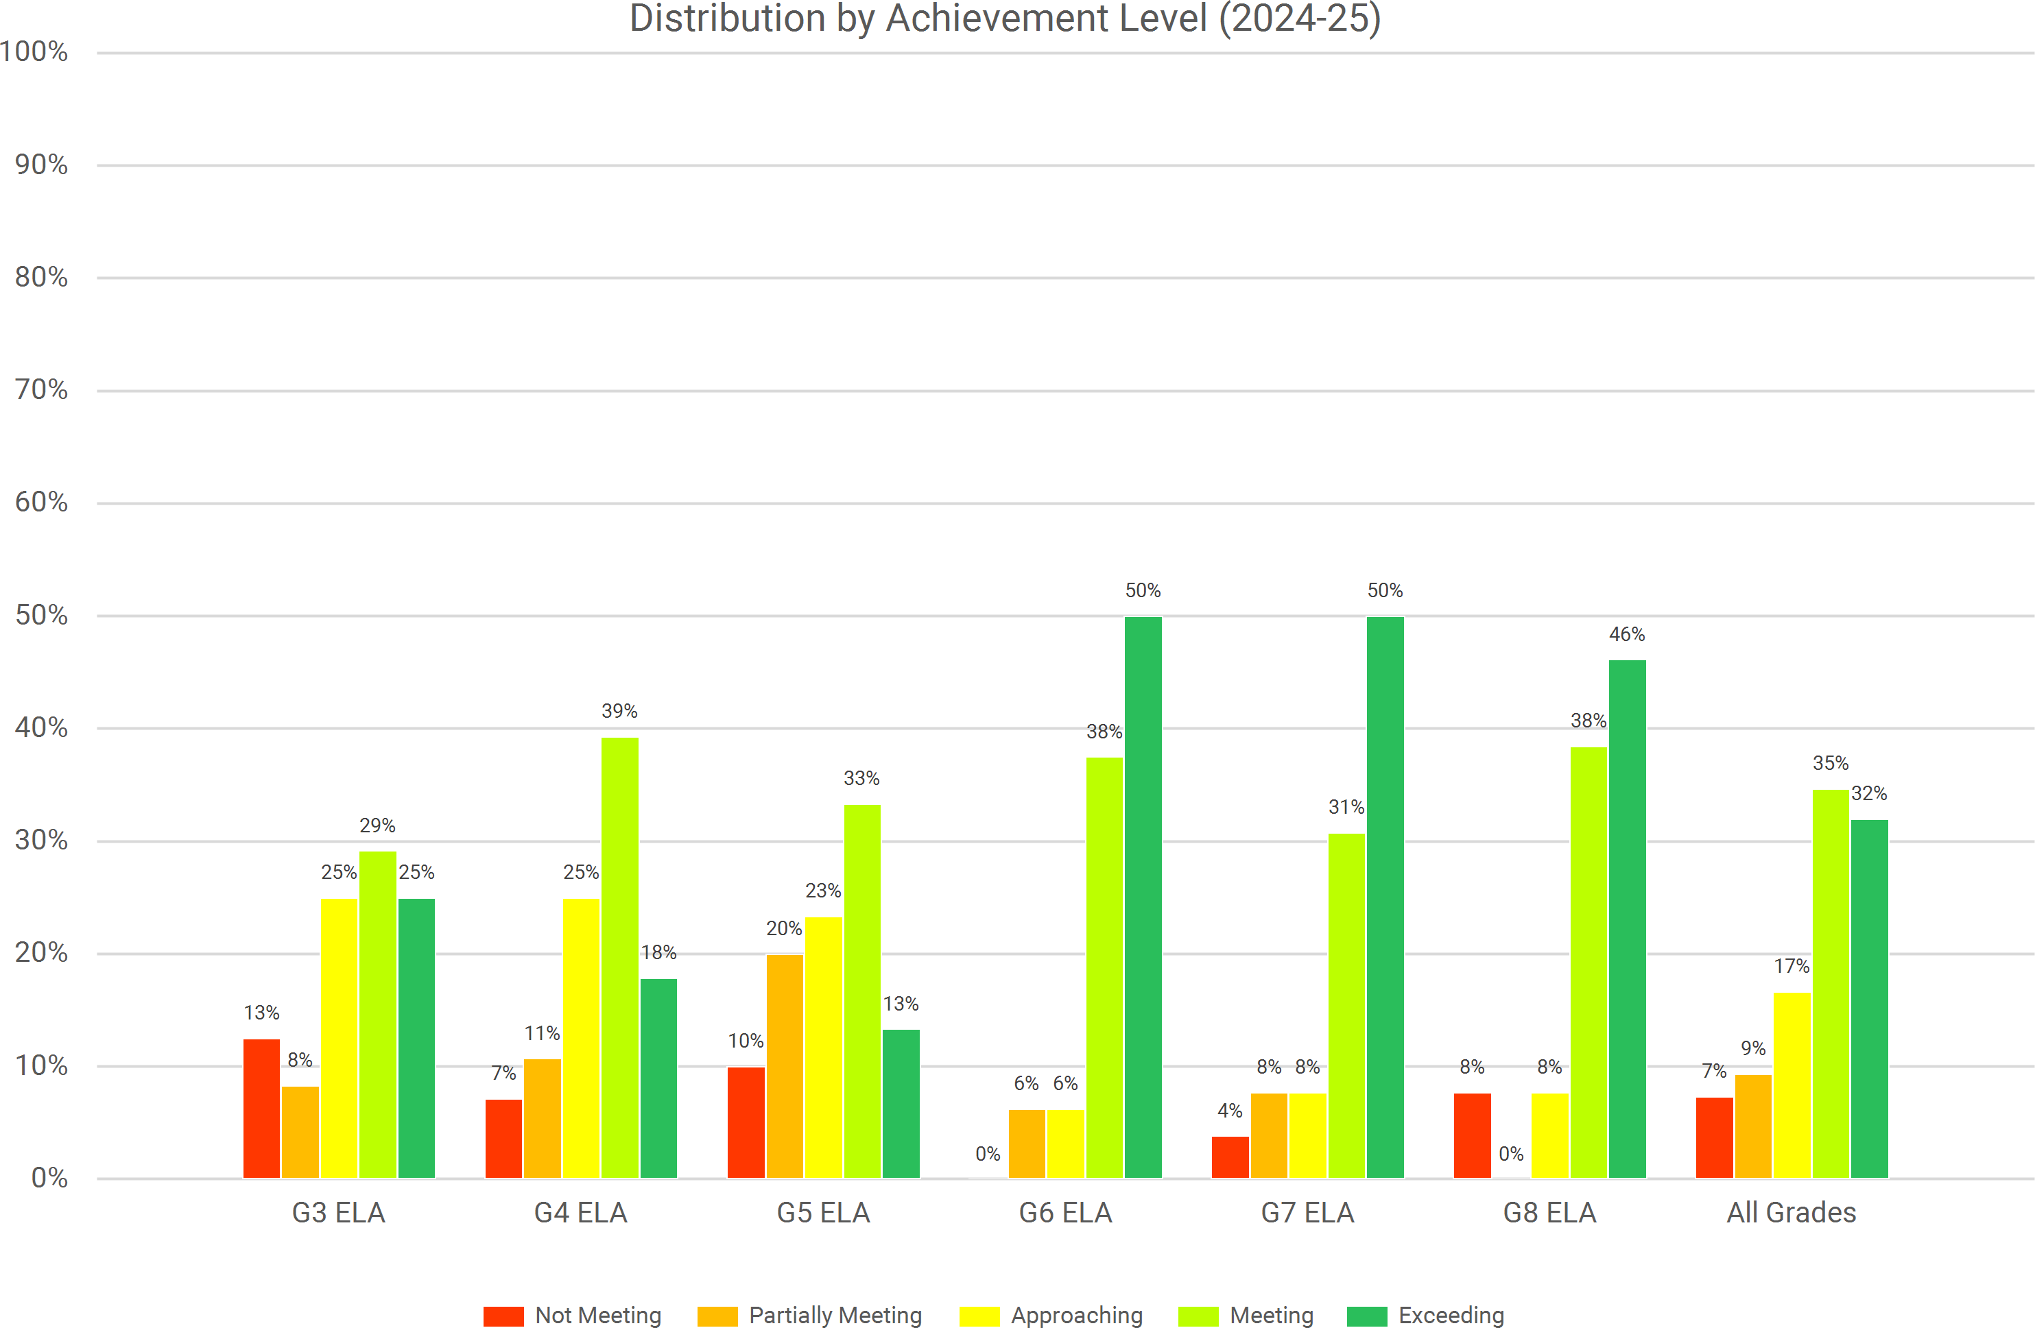
South Hackensack 2024-25 Spring NJSLA
Language Arts

Slide 7
South Hackensack 2024-25 Spring NJSLA Math
Grade | % Not Meeting (Level 1) |  |  | % Partially Meeting (Level 2) |  |  | % Approaching (Level 3) |  |  | % Meeting (Level 4) |  |  | % Exceeding (Level 5) |  |  | Change in Levels 1, 2, & 3 (2024 to 2025) | Change in Level 4 & Level 5 (2024 to 2025)
 | 2023 | 2024 | 2025 | 2023 | 2024 | 2025 | 2023 | 2024 | 2025 | 2023 | 2024 | 2025 | 2023 | 2024 | 2025
 | % | % | % | % | % | % | % | % | % | % | % | % | % | % | %
3 | 0.0% | 14.8% | 4.2% | 21.4% | 18.5% | 20.8% | 35.7% | 22.2% | 33.3% | 25.0% | 40.7% | 33.3% | 17.9% | 3.7% | 8.3% | +2.8% | -2.8%
4 | 6.3% | 0.0% | 10.7% | 6.3% | 37.9% | 14.3% | 31.3% | 24.1% | 35.7% | 50.0% | 37.9% | 39.3% | 6.3% | 0.0% | 0.0% | -1.4% | +1.4%
5 | 4.3% | 11.8% | 0.0% | 4.3% | 5.9% | 32.3% | 34.8% | 23.5% | 35.5% | 52.2% | 47.1% | 32.3% | 4.3% | 11.8% | 0.0% | +26.6% | -26.6%
6 | 3.8% | 9.1% | 5.6% | 30.8% | 18.2% | 11.1% | 26.9% | 13.6% | 33.3% | 30.8% | 59.1% | 33.3% | 7.7% | 0.0% | 16.7% | +9.1% | -9.1%
7 | 11.8% | 7.4% | 11.5% | 14.7% | 22.2% | 11.5% | 44.1% | 22.2% | 34.6% | 29.4% | 40.7% | 38.5% | 0.0% | 7.4% | 3.8% | +5.8% | -5.8%
8 | 40.0% | 16.7% | 35.3% | 16.0% | 33.3% | 23.5% | 20.0% | 27.8% | 17.6% | 24.0% | 22.2% | 23.5% | 0.0% | 0.0% | 0.0% | -1.3% | +1.3%
Alg I (MS) | N/A | N/A | 0.0% | N/A | N/A | 10.0% | N/A | N/A | 10.0% | N/A | N/A | 80.0% | N/A | N/A | 0.0% | N/A | N/A
All Grades | 11.2% | 10.1% | 9.1% | 16.4% | 24.7% | 18.8% | 32.9% | 22.8% | 31.2% | 33.6% | 39.2% | 37.0% | 5.9% | 3.2% | 3.9% | +1.5% | -1.5%
Percentages may not total 100 due to rounding.

Slide 8
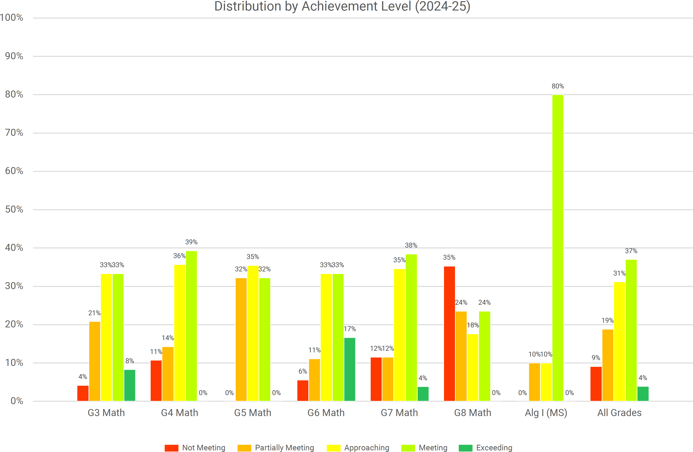
South Hackensack 2024-25 Spring NJSLA
Math

Slide 9
South Hackensack 2024-25 Spring NJSLA Science
Grade | % Below Proficiency (Level 1) |  |  | % Near Proficiency (Level 2) |  |  | % Proficient (Level 3) |  |  | % Advanced Proficiency (Level 4) |  |  | Change in Level 1 & Level 2 (2024 to 2025) | Change in Level 3 & Level 4 (2024 to 2025)
 | 2023 | 2024 | 2025 | 2023 | 2024 | 2025 | 2023 | 2024 | 2025 | 2023 | 2024 | 2025
 | % | % | % | % | % | % | % | % | % | % | % | %
5 | 13.6% | 23.5% | 26.7% | 36.4% | 23.5% | 56.7% | 50.0% | 47.1% | 16.7% | 0.0% | 5.9% | 0.0% | +36.3% | -36.3%
8 | 45.8% | 27.8% | 22.2% | 45.8% | 61.1% | 66.7% | 8.3% | 11.1% | 11.1% | 0.0% | 0.0% | 0.0% | 0.0% | 0.0%
All Grades | 30.4% | 26.4% | 24.6% | 41.3% | 49.1% | 61.4% | 28.3% | 22.6% | 14.0% | 0.0% | 1.9% | 0.0% | +10.5% | -10.5%
Percentages may not total 100 due to rounding.

Slide 10
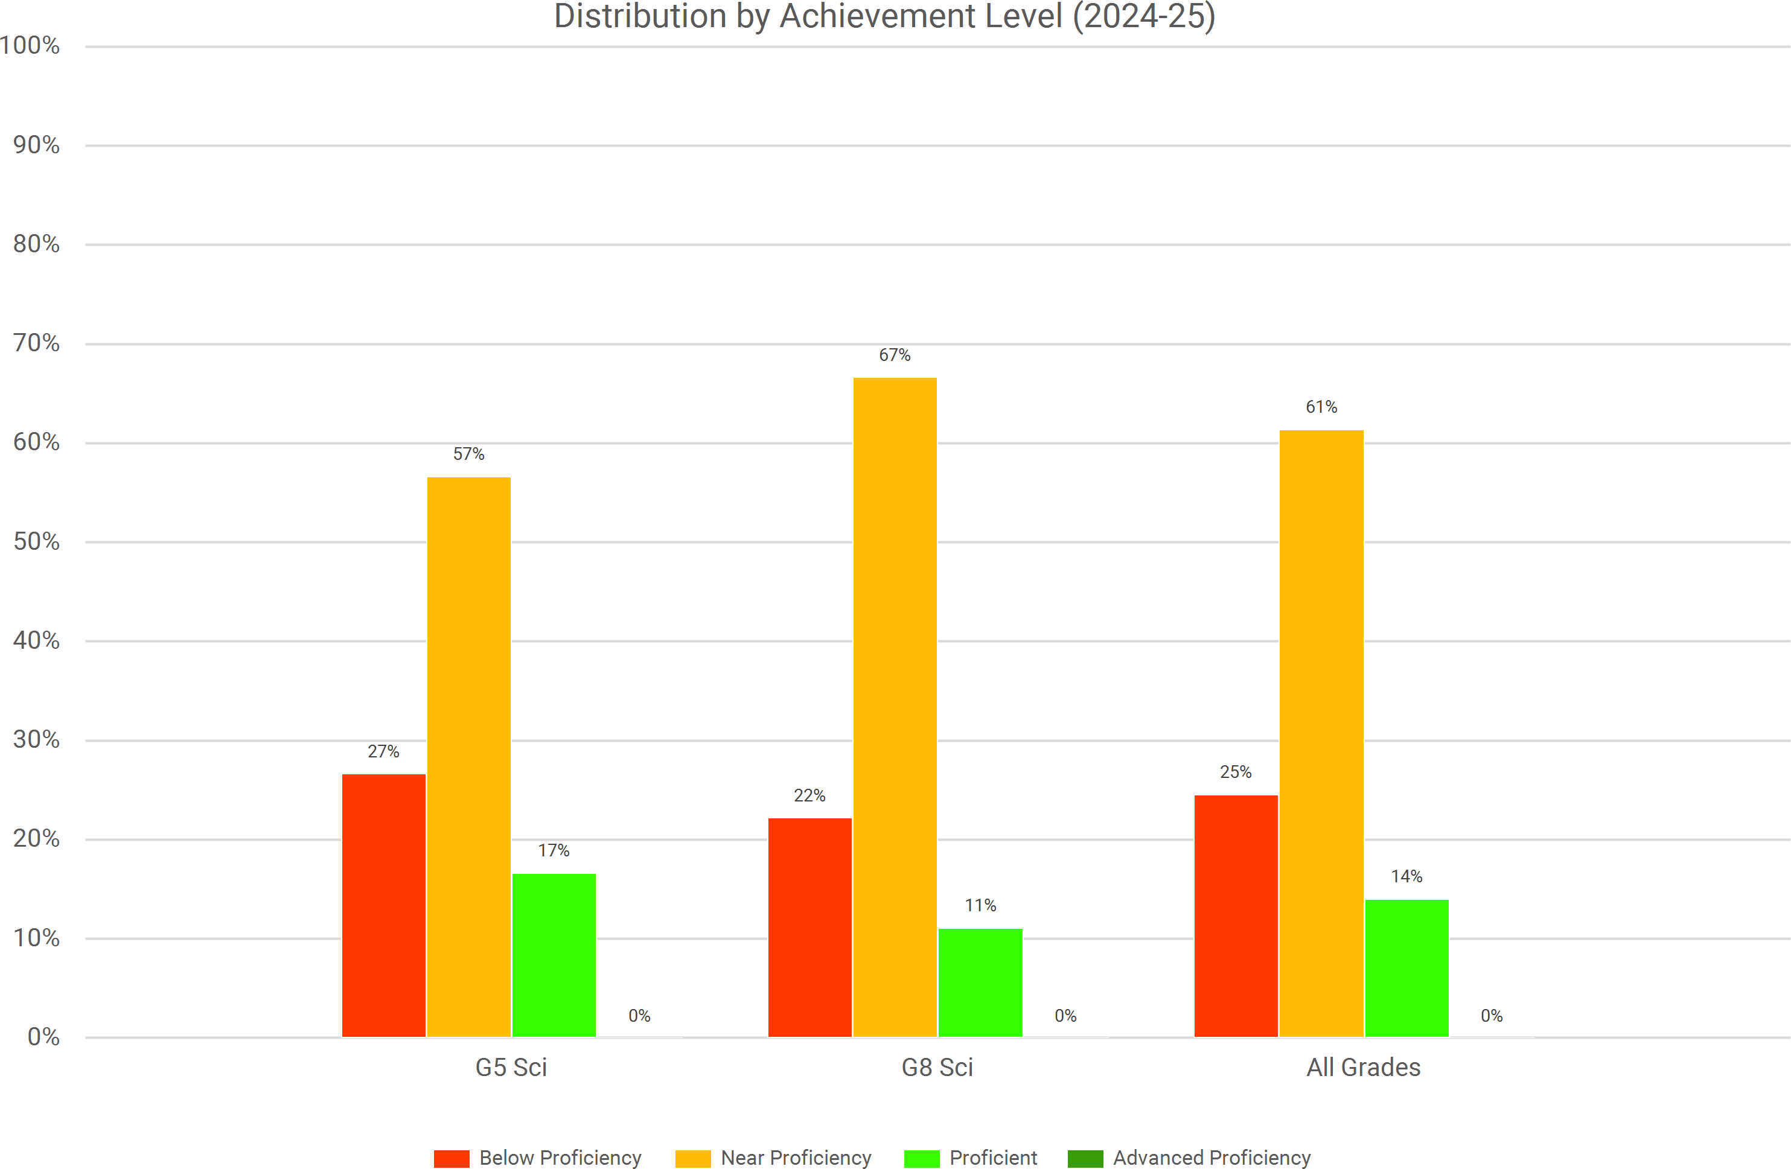
South Hackensack 2024-25 Spring NJSLA
Science

Slide 11
South Hackensack 2024-25 Spring NJSLA Language Arts
Grade | Change in Levels 1, 2, & 3 (2024 to 2025) |  | Change in Level 4 & Level 5 (2024 to 2025)
 | South Hackensack | State | South Hackensack | State
3 | -6.0% | -1.3% | +6.0% | +1.3%
4 | +5.8% | -2.8% | -5.8% | +2.8%
5 | +35.7% | -0.5% | -35.7% | +0.5%
6 | +7.7% | -2.9% | -7.7% | +2.9%
7 | +8.1% | -3.1% | -8.1% | +3.1%
8 | +3.6% | -4.2% | -3.6% | +4.2%
All Grades | +10.5% |  | -10.5%
Percentages may not total 100 due to rounding.

Slide 12
South Hackensack 2024-25 Spring NJSLA Math
Grade | Change in Levels 1, 2, & 3 (2024 to 2025) |  | Change in Level 4 & Level 5 (2024 to 2025)
 | South Hackensack | State | South Hackensack | State
3 | +2.8% | -2.2% | -2.8% | +2.2%
4 | -1.4% | -1.8% | +1.4% | +1.8%
5 | +26.6% | -4.1% | -26.6% | +4.1%
6 | +9.1% | -3.5% | -9.1% | +3.5%
7 | +5.8% | -1.3% | -5.8% | +1.3%
8 | -1.3% | -1.2% | +1.3% | +1.2%
Alg I (MS) | N/A | +1.5% | N/A | -1.5%
All Grades | +1.5% |  | -1.5%
Percentages may not total 100 due to rounding.

Slide 13
South Hackensack 2024-25 Spring NJSLA Science
Grade | Change in Level 1 & Level 2 (2024 to 2025) |  | Change in Level 3 & Level 4 (2024 to 2025)
 | South Hackensack | State | South Hackensack | State
5 | +36.3% | -2.5% | -36.3% | +2.5%
8 | 0.0% | -0.2% | 0.0% | +0.2%
All Grades | +10.5% |  | -10.5%
Percentages may not total 100 due to rounding.

Slide 14
South Hackensack 2024-25 Spring NJSLA Language Arts
Grade | Number of Students Tested 2023 | Number of Students Tested 2024 | Number of Students Tested 2025 | Difference 2024-2025
3 | 28 | 27 | 24 (out of 24) | -3
4 | 17 | 27 | 28 (out of 28) | +1
5 | 25 | 17 | 30 (out of 31) | +13
6 | 26 | 21 | 16 (out of 18) | -5
7 | 35 | 27 | 26 (out of 26) | -1
8 | 24 | 34 | 26 (out of 27) | -8
All Grades | 155 | 153 | 150 (out of 150 eligible, 154 total) | -3

Slide 15
South Hackensack 2024-25 Spring NJSLA Math
Grade | Number of Students Tested 2023 | Number of Students Tested 2024 | Number of Students Tested 2025 | Difference 2024-2025
3 | 28 | 27 | 24 (out of 24) | -3
4 | 16 | 29 | 28 (out of 28) | -1
5 | 23 | 17 | 31 (out of 31) | +14
6 | 26 | 22 | 18 (out of 18) | -4
7 | 34 | 27 | 26 (out of 26) | -1
8 | 25 | 36 | 17 (out of 17) | -19
Alg I (MS) | <10 | <10 | 10 (out of 10) | N/A
All Grades | 152 | 158 | 154 (out of 154) | -4

Slide 16
South Hackensack 2024-25 Spring NJSLA Science
Grade | Number of Students Tested 2023 | Number of Students Tested 2024 | Number of Students Tested 2025 | Difference 2024-2025
5 | 22 | 17 | 31 (out of 31) | +14
8 | 24 | 36 | 27 (out of 27) | -9
All Grades | 46 | 53 | 58 (out of 58) | +5

Slide 17
South Hackensack 2024-25 Spring NJSLA Language Arts
Grade | % Not Meeting (Level 1) 2023 |  | % Not Meeting (Level 1) 2024 |  | % Not Meeting (Level 1) 2025 |  | % Partially Meeting (Level 2) 2023 |  | % Partially Meeting (Level 2) 2024 |  | % Partially Meeting (Level 2) 2025
 | District | State | District | State | District | State | District | State | District | State | District | State
3 | 14.3% | 20.7% | 11.1% | 19.8% | 12.5% | 19.0% | 3.6% | 14.9% | 25.9% | 15.2% | 8.3% | 16.0%
4 | 11.8% | 12.8% | 7.4% | 13.0% | 7.1% | 13.6% | 5.9% | 14.6% | 11.1% | 14.3% | 10.7% | 13.2%
5 | 12.0% | 12.3% | 5.9% | 13.0% | 10.0% | 13.2% | 4.0% | 14.1% | 5.9% | 13.8% | 20.0% | 13.3%
6 | 0.0% | 12.0% | 0.0% | 10.7% | 0.0% | 10.6% | 3.8% | 14.4% | 0.0% | 14.0% | 6.3% | 12.7%
7 | 8.6% | 11.7% | 3.7% | 13.0% | 3.8% | 12.3% | 0.0% | 12.7% | 3.7% | 12.3% | 7.7% | 11.2%
8 | 12.5% | 12.9% | 0.0% | 13.7% | 7.7% | 12.9% | 4.2% | 11.6% | 11.8% | 13.6% | 0.0% | 11.9%
All Grades | 9.7% | 13.7% | 4.6% | 13.8% | 7.3% | 13.6% | 3.2% | 13.7% | 10.5% | 13.8% | 9.3% | 13.0%

Slide 18
South Hackensack 2024-25 Spring NJSLA Language Arts
Grade | % Approaching (Level 3) 2023 |  | % Approaching (Level 3) 2024 |  | % Approaching (Level 3) 2025 |  | % Meeting (Level 4) 2023 |  | % Meeting (Level 4) 2024 |  | % Meeting (Level 4) 2025
 | District | State | District | State | District | State | District | State | District | State | District | State
3 | 10.7% | 22.5% | 14.8% | 21.4% | 25.0% | 20.1% | 46.4% | 36.7% | 40.7% | 37.2% | 29.2% | 37.0%
4 | 29.4% | 21.3% | 18.5% | 21.9% | 25.0% | 19.7% | 29.4% | 36.5% | 37.0% | 34.6% | 39.3% | 37.8%
5 | 0.0% | 20.3% | 5.9% | 21.0% | 23.3% | 20.8% | 76.0% | 43.3% | 52.9% | 40.4% | 33.3% | 41.4%
6 | 26.9% | 24.6% | 4.8% | 22.2% | 6.3% | 20.6% | 34.6% | 37.6% | 19.0% | 37.4% | 37.5% | 41.4%
7 | 14.3% | 19.9% | 3.7% | 20.7% | 7.7% | 19.5% | 54.3% | 32.5% | 33.3% | 31.5% | 30.8% | 31.9%
8 | 16.7% | 20.1% | 0.0% | 19.8% | 7.7% | 18.1% | 37.5% | 35.8% | 64.7% | 35.2% | 38.5% | 36.4%
All Grades | 15.5% | 21.4% | 7.8% | 21.1% | 16.7% | 19.8% | 47.7% | 37.0% | 42.5% | 36.0% | 34.7% | 37.6%

Slide 19
South Hackensack 2024-25 Spring NJSLA Language Arts
Grade | % Exceeding (Level 5) 2023 |  | % Exceeding (Level 5) 2024 |  | % Exceeding (Level 5) 2025
 | District | State | District | State | District | State
3 | 25.0% | 5.3% | 7.4% | 6.4% | 25.0% | 7.9%
4 | 23.5% | 14.8% | 25.9% | 16.2% | 17.9% | 15.8%
5 | 8.0% | 9.9% | 29.4% | 11.9% | 13.3% | 11.3%
6 | 34.6% | 11.4% | 76.2% | 15.8% | 50.0% | 14.7%
7 | 22.9% | 23.2% | 55.6% | 22.4% | 50.0% | 25.1%
8 | 29.2% | 19.5% | 23.5% | 17.7% | 46.2% | 20.7%
All Grades | 23.9% | 14.1% | 34.6% | 15.2% | 32.0% | 16.0%

Slide 20
South Hackensack 2024-25 Spring NJSLA Math
Grade | % Not Meeting (Level 1) 2023 |  | % Not Meeting (Level 1) 2024 |  | % Not Meeting (Level 1) 2025 |  | % Partially Meeting (Level 2) 2023 |  | % Partially Meeting (Level 2) 2024 |  | % Partially Meeting (Level 2) 2025
 | District | State | District | State | District | State | District | State | District | State | District | State
3 | 0.0% | 12.5% | 14.8% | 11.8% | 4.2% | 10.3% | 21.4% | 16.7% | 18.5% | 16.0% | 20.8% | 16.2%
4 | 6.3% | 13.1% | 0.0% | 11.6% | 10.7% | 9.4% | 6.3% | 17.8% | 37.9% | 19.0% | 14.3% | 19.3%
5 | 4.3% | 13.1% | 11.8% | 12.2% | 0.0% | 11.0% | 4.3% | 21.4% | 5.9% | 22.3% | 32.3% | 18.5%
6 | 3.8% | 14.2% | 9.1% | 14.2% | 5.6% | 11.3% | 30.8% | 23.2% | 18.2% | 23.5% | 11.1% | 22.7%
7 | 11.8% | 12.7% | 7.4% | 10.7% | 11.5% | 10.3% | 14.7% | 22.8% | 22.2% | 23.9% | 11.5% | 20.5%
8 | 40.0% | 33.9% | 16.7% | 30.2% | 35.3% | 30.2% | 16.0% | 26.9% | 33.3% | 28.9% | 23.5% | 26.6%
Alg I (MS) | N/A | 15.8% | N/A | 17.0% | 0.0% | 13.1% | N/A | 25.8% | N/A | 21.4% | 10.0% | 25.8%
All Grades | 11.2% | 15.7% | 10.1% | 14.7% | 9.1% | 12.9% | 16.4% | 22.0% | 24.7% | 21.8% | 18.8% | 21.2%

Slide 21
South Hackensack 2024-25 Spring NJSLA Math
Grade | % Approaching (Level 3) 2023 |  | % Approaching (Level 3) 2024 |  | % Approaching (Level 3) 2025 |  | % Meeting (Level 4) 2023 |  | % Meeting (Level 4) 2024 |  | % Meeting (Level 4) 2025
 | District | State | District | State | District | State | District | State | District | State | District | State
3 | 35.7% | 24.8% | 22.2% | 24.6% | 33.3% | 23.8% | 25.0% | 34.0% | 40.7% | 34.6% | 33.3% | 37.0%
4 | 31.3% | 24.7% | 24.1% | 24.5% | 35.7% | 24.6% | 50.0% | 37.2% | 37.9% | 37.5% | 39.3% | 39.0%
5 | 34.8% | 25.5% | 23.5% | 25.3% | 35.5% | 26.3% | 52.2% | 31.4% | 47.1% | 31.0% | 32.3% | 34.1%
6 | 26.9% | 28.3% | 13.6% | 26.1% | 33.3% | 26.2% | 30.8% | 27.7% | 59.1% | 29.0% | 33.3% | 31.0%
7 | 44.1% | 30.7% | 22.2% | 28.0% | 34.6% | 30.5% | 29.4% | 29.0% | 40.7% | 31.0% | 38.5% | 31.6%
8 | 20.0% | 21.4% | 27.8% | 21.5% | 17.6% | 22.5% | 24.0% | 16.7% | 22.2% | 17.9% | 23.5% | 19.6%
Alg I (MS) | N/A | 23.2% | N/A | 22.2% | 10.0% | 23.2% | N/A | 29.8% | N/A | 35.6% | 80.0% | 31.3%
All Grades | 32.9% | 25.7% | 22.8% | 24.7% | 31.2% | 25.4% | 33.6% | 30.0% | 39.2% | 31.6% | 37.0% | 32.5%

Slide 22
South Hackensack 2024-25 Spring NJSLA Math
Grade | % Exceeding (Level 5) 2023 |  | % Exceeding (Level 5) 2024 |  | % Exceeding (Level 5) 2025
 | District | State | District | State | District | State
3 | 17.9% | 11.9% | 3.7% | 13.0% | 8.3% | 12.8%
4 | 6.3% | 7.1% | 0.0% | 7.5% | 0.0% | 7.7%
5 | 4.3% | 8.7% | 11.8% | 9.1% | 0.0% | 10.1%
6 | 7.7% | 6.6% | 0.0% | 7.2% | 16.7% | 8.8%
7 | 0.0% | 4.8% | 7.4% | 6.5% | 3.8% | 7.2%
8 | 0.0% | 1.1% | 0.0% | 1.5% | 0.0% | 1.1%
Alg I (MS) | N/A | 5.3% | N/A | 3.9% | 0.0% | 6.6%
All Grades | 5.9% | 6.7% | 3.2% | 7.1% | 3.9% | 8.0%

Slide 23
South Hackensack 2024-25 Spring NJSLA Science
Grade | % Below Proficiency (Level 1) 2023 |  | % Below Proficiency (Level 1) 2024 |  | % Below Proficiency (Level 1) 2025 |  | % Near Proficiency (Level 2) 2023 |  | % Near Proficiency (Level 2) 2024 |  | % Near Proficiency (Level 2) 2025
 | District | State | District | State | District | State | District | State | District | State | District | State
5 | 13.6% | 38.4% | 23.5% | 35.3% | 26.7% | 30.6% | 36.4% | 34.8% | 23.5% | 37.1% | 56.7% | 39.3%
8 | 45.8% | 40.0% | 27.8% | 36.1% | 22.2% | 33.8% | 45.8% | 41.5% | 61.1% | 45.2% | 66.7% | 47.2%
All Grades | 30.4% | 39.2% | 26.4% | 35.7% | 24.6% | 32.2% | 41.3% | 38.2% | 49.1% | 41.2% | 61.4% | 43.3%

Slide 24
South Hackensack 2024-25 Spring NJSLA Science
Grade | % Proficient (Level 3) 2023 |  | % Proficient (Level 3) 2024 |  | % Proficient (Level 3) 2025 |  | % Advanced Proficiency (Level 4) 2023 |  | % Advanced Proficiency (Level 4) 2024 |  | % Advanced Proficiency (Level 4) 2025
 | District | State | District | State | District | State | District | State | District | State | District | State
5 | 50.0% | 21.1% | 47.1% | 21.1% | 16.7% | 22.2% | 0.0% | 5.7% | 5.9% | 6.4% | 0.0% | 7.9%
8 | 8.3% | 14.2% | 11.1% | 13.9% | 11.1% | 14.1% | 0.0% | 4.4% | 0.0% | 4.9% | 0.0% | 4.9%
All Grades | 28.3% | 17.6% | 22.6% | 17.4% | 14.0% | 18.1% | 0.0% | 5.0% | 1.9% | 5.7% | 0.0% | 6.4%

Slide 25
Section 2
School Analysis

Slide 26
South Hackensack 2024-25 Spring NJSLA Language Arts Grade 3 School Comparison
School | Total Tested 2025 | % Not Meeting (Level 1) |  |  | % Partially Meeting (Level 2) |  |  | % Approaching (Level 3) |  |  | % Meeting (Level 4) |  |  | % Exceeding (Level 5)
 |  | 2023 | 2024 | 2025 | 2023 | 2024 | 2025 | 2023 | 2024 | 2025 | 2023 | 2024 | 2025 | 2023 | 2024 | 2025
 |  | % | % | % | % | % | % | % | % | % | % | % | % | % | % | %
Memorial | 24 | 14.3% | 11.1% | 12.5% | 3.6% | 25.9% | 8.3% | 10.7% | 14.8% | 25.0% | 46.4% | 40.7% | 29.2% | 25.0% | 7.4% | 25.0%

Slide 27
South Hackensack 2024-25 Spring NJSLA Language Arts Grade 4 School Comparison
School | Total Tested 2025 | % Not Meeting (Level 1) |  |  | % Partially Meeting (Level 2) |  |  | % Approaching (Level 3) |  |  | % Meeting (Level 4) |  |  | % Exceeding (Level 5)
 |  | 2023 | 2024 | 2025 | 2023 | 2024 | 2025 | 2023 | 2024 | 2025 | 2023 | 2024 | 2025 | 2023 | 2024 | 2025
 |  | % | % | % | % | % | % | % | % | % | % | % | % | % | % | %
Memorial | 28 | 11.8% | 7.4% | 7.1% | 5.9% | 11.1% | 10.7% | 29.4% | 18.5% | 25.0% | 29.4% | 37.0% | 39.3% | 23.5% | 25.9% | 17.9%

Slide 28
South Hackensack 2024-25 Spring NJSLA Language Arts Grade 5 School Comparison
School | Total Tested 2025 | % Not Meeting (Level 1) |  |  | % Partially Meeting (Level 2) |  |  | % Approaching (Level 3) |  |  | % Meeting (Level 4) |  |  | % Exceeding (Level 5)
 |  | 2023 | 2024 | 2025 | 2023 | 2024 | 2025 | 2023 | 2024 | 2025 | 2023 | 2024 | 2025 | 2023 | 2024 | 2025
 |  | % | % | % | % | % | % | % | % | % | % | % | % | % | % | %
Memorial | 30 | 12.0% | 5.9% | 10.0% | 4.0% | 5.9% | 20.0% | 0.0% | 5.9% | 23.3% | 76.0% | 52.9% | 33.3% | 8.0% | 29.4% | 13.3%

Slide 29
South Hackensack 2024-25 Spring NJSLA Language Arts Grade 6 School Comparison
School | Total Tested 2025 | % Not Meeting (Level 1) |  |  | % Partially Meeting (Level 2) |  |  | % Approaching (Level 3) |  |  | % Meeting (Level 4) |  |  | % Exceeding (Level 5)
 |  | 2023 | 2024 | 2025 | 2023 | 2024 | 2025 | 2023 | 2024 | 2025 | 2023 | 2024 | 2025 | 2023 | 2024 | 2025
 |  | % | % | % | % | % | % | % | % | % | % | % | % | % | % | %
Memorial | 16 | 0.0% | 0.0% | 0.0% | 3.8% | 0.0% | 6.3% | 26.9% | 4.8% | 6.3% | 34.6% | 19.0% | 37.5% | 34.6% | 76.2% | 50.0%

Slide 30
South Hackensack 2024-25 Spring NJSLA Language Arts Grade 7 School Comparison
School | Total Tested 2025 | % Not Meeting (Level 1) |  |  | % Partially Meeting (Level 2) |  |  | % Approaching (Level 3) |  |  | % Meeting (Level 4) |  |  | % Exceeding (Level 5)
 |  | 2023 | 2024 | 2025 | 2023 | 2024 | 2025 | 2023 | 2024 | 2025 | 2023 | 2024 | 2025 | 2023 | 2024 | 2025
 |  | % | % | % | % | % | % | % | % | % | % | % | % | % | % | %
Memorial | 26 | 8.6% | 3.7% | 3.8% | 0.0% | 3.7% | 7.7% | 14.3% | 3.7% | 7.7% | 54.3% | 33.3% | 30.8% | 22.9% | 55.6% | 50.0%

Slide 31
South Hackensack 2024-25 Spring NJSLA Language Arts Grade 8 School Comparison
School | Total Tested 2025 | % Not Meeting (Level 1) |  |  | % Partially Meeting (Level 2) |  |  | % Approaching (Level 3) |  |  | % Meeting (Level 4) |  |  | % Exceeding (Level 5)
 |  | 2023 | 2024 | 2025 | 2023 | 2024 | 2025 | 2023 | 2024 | 2025 | 2023 | 2024 | 2025 | 2023 | 2024 | 2025
 |  | % | % | % | % | % | % | % | % | % | % | % | % | % | % | %
Memorial | 26 | 12.5% | 0.0% | 7.7% | 4.2% | 11.8% | 0.0% | 16.7% | 0.0% | 7.7% | 37.5% | 64.7% | 38.5% | 29.2% | 23.5% | 46.2%

Slide 32
South Hackensack 2024-25 Spring NJSLA Math Grade 3 School Comparison
School | Total Tested 2025 | % Not Meeting (Level 1) |  |  | % Partially Meeting (Level 2) |  |  | % Approaching (Level 3) |  |  | % Meeting (Level 4) |  |  | % Exceeding (Level 5)
 |  | 2023 | 2024 | 2025 | 2023 | 2024 | 2025 | 2023 | 2024 | 2025 | 2023 | 2024 | 2025 | 2023 | 2024 | 2025
 |  | % | % | % | % | % | % | % | % | % | % | % | % | % | % | %
Memorial | 24 | 0.0% | 14.8% | 4.2% | 21.4% | 18.5% | 20.8% | 35.7% | 22.2% | 33.3% | 25.0% | 40.7% | 33.3% | 17.9% | 3.7% | 8.3%

Slide 33
South Hackensack 2024-25 Spring NJSLA Math Grade 4 School Comparison
School | Total Tested 2025 | % Not Meeting (Level 1) |  |  | % Partially Meeting (Level 2) |  |  | % Approaching (Level 3) |  |  | % Meeting (Level 4) |  |  | % Exceeding (Level 5)
 |  | 2023 | 2024 | 2025 | 2023 | 2024 | 2025 | 2023 | 2024 | 2025 | 2023 | 2024 | 2025 | 2023 | 2024 | 2025
 |  | % | % | % | % | % | % | % | % | % | % | % | % | % | % | %
Memorial | 28 | 6.3% | 0.0% | 10.7% | 6.3% | 37.9% | 14.3% | 31.3% | 24.1% | 35.7% | 50.0% | 37.9% | 39.3% | 6.3% | 0.0% | 0.0%

Slide 34
South Hackensack 2024-25 Spring NJSLA Math Grade 5 School Comparison
School | Total Tested 2025 | % Not Meeting (Level 1) |  |  | % Partially Meeting (Level 2) |  |  | % Approaching (Level 3) |  |  | % Meeting (Level 4) |  |  | % Exceeding (Level 5)
 |  | 2023 | 2024 | 2025 | 2023 | 2024 | 2025 | 2023 | 2024 | 2025 | 2023 | 2024 | 2025 | 2023 | 2024 | 2025
 |  | % | % | % | % | % | % | % | % | % | % | % | % | % | % | %
Memorial | 31 | 4.3% | 11.8% | 0.0% | 4.3% | 5.9% | 32.3% | 34.8% | 23.5% | 35.5% | 52.2% | 47.1% | 32.3% | 4.3% | 11.8% | 0.0%

Slide 35
South Hackensack 2024-25 Spring NJSLA Math Grade 6 School Comparison
School | Total Tested 2025 | % Not Meeting (Level 1) |  |  | % Partially Meeting (Level 2) |  |  | % Approaching (Level 3) |  |  | % Meeting (Level 4) |  |  | % Exceeding (Level 5)
 |  | 2023 | 2024 | 2025 | 2023 | 2024 | 2025 | 2023 | 2024 | 2025 | 2023 | 2024 | 2025 | 2023 | 2024 | 2025
 |  | % | % | % | % | % | % | % | % | % | % | % | % | % | % | %
Memorial | 18 | 3.8% | 9.1% | 5.6% | 30.8% | 18.2% | 11.1% | 26.9% | 13.6% | 33.3% | 30.8% | 59.1% | 33.3% | 7.7% | 0.0% | 16.7%

Slide 36
South Hackensack 2024-25 Spring NJSLA Math Grade 7 School Comparison
School | Total Tested 2025 | % Not Meeting (Level 1) |  |  | % Partially Meeting (Level 2) |  |  | % Approaching (Level 3) |  |  | % Meeting (Level 4) |  |  | % Exceeding (Level 5)
 |  | 2023 | 2024 | 2025 | 2023 | 2024 | 2025 | 2023 | 2024 | 2025 | 2023 | 2024 | 2025 | 2023 | 2024 | 2025
 |  | % | % | % | % | % | % | % | % | % | % | % | % | % | % | %
Memorial | 26 | 11.8% | 7.4% | 11.5% | 14.7% | 22.2% | 11.5% | 44.1% | 22.2% | 34.6% | 29.4% | 40.7% | 38.5% | 0.0% | 7.4% | 3.8%

Slide 37
South Hackensack 2024-25 Spring NJSLA Math Grade 8 School Comparison
School | Total Tested 2025 | % Not Meeting (Level 1) |  |  | % Partially Meeting (Level 2) |  |  | % Approaching (Level 3) |  |  | % Meeting (Level 4) |  |  | % Exceeding (Level 5)
 |  | 2023 | 2024 | 2025 | 2023 | 2024 | 2025 | 2023 | 2024 | 2025 | 2023 | 2024 | 2025 | 2023 | 2024 | 2025
 |  | % | % | % | % | % | % | % | % | % | % | % | % | % | % | %
Memorial | 17 | 40.0% | 16.7% | 35.3% | 16.0% | 33.3% | 23.5% | 20.0% | 27.8% | 17.6% | 24.0% | 22.2% | 23.5% | 0.0% | 0.0% | 0.0%

Slide 38
South Hackensack 2024-25 Spring NJSLA Alg I (MS) School Comparison
School | Total Tested 2025 | % Not Meeting (Level 1) |  |  | % Partially Meeting (Level 2) |  |  | % Approaching (Level 3) |  |  | % Meeting (Level 4) |  |  | % Exceeding (Level 5)
 |  | 2023 | 2024 | 2025 | 2023 | 2024 | 2025 | 2023 | 2024 | 2025 | 2023 | 2024 | 2025 | 2023 | 2024 | 2025
 |  | % | % | % | % | % | % | % | % | % | % | % | % | % | % | %
Memorial | 10 | N/A | N/A | 0.0% | N/A | N/A | 10.0% | N/A | N/A | 10.0% | N/A | N/A | 80.0% | N/A | N/A | 0.0%

Slide 39
South Hackensack 2024-25 Spring NJSLA Science Grade 5 School Comparison
School | Total Tested 2025 | % Below Proficiency (Level 1) |  |  | % Near Proficiency (Level 2) |  |  | % Proficient (Level 3) |  |  | % Advanced Proficiency (Level 4)
 |  | 2023 | 2024 | 2025 | 2023 | 2024 | 2025 | 2023 | 2024 | 2025 | 2023 | 2024 | 2025
 |  | % | % | % | % | % | % | % | % | % | % | % | %
Memorial | 31 | 13.6% | 23.5% | 26.7% | 36.4% | 23.5% | 56.7% | 50.0% | 47.1% | 16.7% | 0.0% | 5.9% | 0.0%

Slide 40
South Hackensack 2024-25 Spring NJSLA Science Grade 8 School Comparison
School | Total Tested 2025 | % Below Proficiency (Level 1) |  |  | % Near Proficiency (Level 2) |  |  | % Proficient (Level 3) |  |  | % Advanced Proficiency (Level 4)
 |  | 2023 | 2024 | 2025 | 2023 | 2024 | 2025 | 2023 | 2024 | 2025 | 2023 | 2024 | 2025
 |  | % | % | % | % | % | % | % | % | % | % | % | %
Memorial | 27 | 45.8% | 27.8% | 22.2% | 45.8% | 61.1% | 66.7% | 8.3% | 11.1% | 11.1% | 0.0% | 0.0% | 0.0%

Slide 41
Section 3
Demographic Analysis

Slide 42
South Hackensack 2024-25 Spring NJSLA by Subgroup Race Language Arts
Grade Band | Race | Total Tested 2025 | % of Tested 2025 | Not Meeting (Level 1) |  |  | Partially Meeting (Level 2) |  |  | Approaching (Level 3) |  |  | Meeting (Level 4) |  |  | Exceeding (Level 5)
 |  |  |  | % 2023 | % 2024 | % 2025 | % 2023 | % 2024 | % 2025 | % 2023 | % 2024 | % 2025 | % 2023 | % 2024 | % 2025 | % 2023 | % 2024 | % 2025
ES (G3-G5) | Black | <10 | 1% | N/A | N/A | N/A | N/A | N/A | N/A | N/A | N/A | N/A | N/A | N/A | N/A | N/A | N/A | N/A
 | Hispanic | 57 | 70% | 14% | 6% | 5% | 6% | 17% | 12% | 14% | 17% | 32% | 51% | 47% | 37% | 14% | 13% | 14%
 | Multiple | <10 | 4% | N/A | N/A | N/A | N/A | N/A | N/A | N/A | N/A | N/A | N/A | N/A | N/A | N/A | N/A | N/A
 | White | 21 | 26% | 8% | 7% | 19% | 0% | 14% | 19% | 0% | 7% | 5% | 62% | 36% | 29% | 31% | 36% | 29%
 | All Students | 82 |  | 13% | 8% | 10% | 4% | 15% | 13% | 11% | 14% | 24% | 53% | 42% | 34% | 19% | 20% | 18%
MS (G6- G8) | Asian | <10 | 6% | N/A | N/A | N/A | N/A | N/A | N/A | N/A | N/A | N/A | N/A | N/A | N/A | N/A | N/A | N/A
 | Black | <10 | 6% | N/A | N/A | N/A | N/A | N/A | N/A | N/A | N/A | N/A | N/A | N/A | N/A | N/A | N/A | N/A
 | Hispanic | 45 | 66% | 7% | 0% | 2% | 2% | 6% | 7% | 18% | 4% | 9% | 45% | 50% | 36% | 27% | 40% | 47%
 | Multiple | <10 | 3% | N/A | N/A | N/A | N/A | N/A | N/A | N/A | N/A | N/A | N/A | N/A | N/A | N/A | N/A | N/A
 | Other | <10 | 1% | N/A | N/A | N/A | N/A | N/A | N/A | N/A | N/A | N/A | N/A | N/A | N/A | N/A | N/A | N/A
 | White | 12 | 18% | 5% | 6% | 17% | 0% | 6% | 0% | 15% | 0% | 0% | 50% | 24% | 33% | 30% | 65% | 50%
 | All Students | 68 |  | 7% | 1% | 4% | 2% | 6% | 4% | 19% | 2% | 7% | 44% | 43% | 35% | 28% | 48% | 49%
All Grades | Asian | <10 | 3% | - | - | - | - | - | - | - | - | - | - | - | - | - | - | -
 | Black | <10 | 3% | - | - | - | - | - | - | - | - | - | - | - | - | - | - | -
 | Hispanic | 102 | 68% | 11% | 3% | 4% | 4% | 11% | 10% | 16% | 10% | 22% | 48% | 49% | 36% | 21% | 27% | 28%
 | Multiple | <10 | 3% | - | - | - | - | - | - | - | - | - | - | - | - | - | - | -
 | Other | <10 | 1% | - | - | - | - | - | - | - | - | - | - | - | - | - | - | -
 | White | 33 | 22% | 6% | 6% | 18% | 0% | 10% | 12% | 9% | 3% | 3% | 55% | 29% | 30% | 30% | 52% | 36%
 | All Students | 150 |  | 10% | 5% | 7% | 3% | 10% | 9% | 15% | 8% | 17% | 48% | 42% | 35% | 24% | 35% | 32%

Slide 43
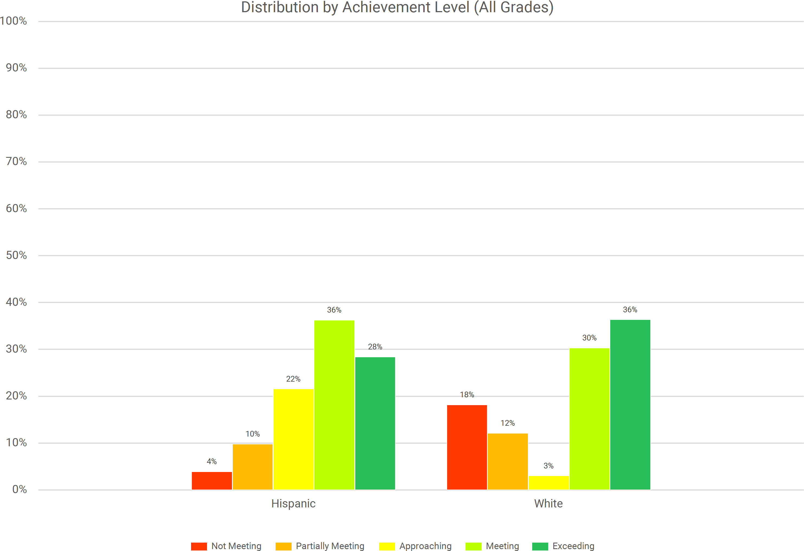
South Hackensack
2024-25 Spring NJSLA by Subgroup Race Language Arts

Slide 44
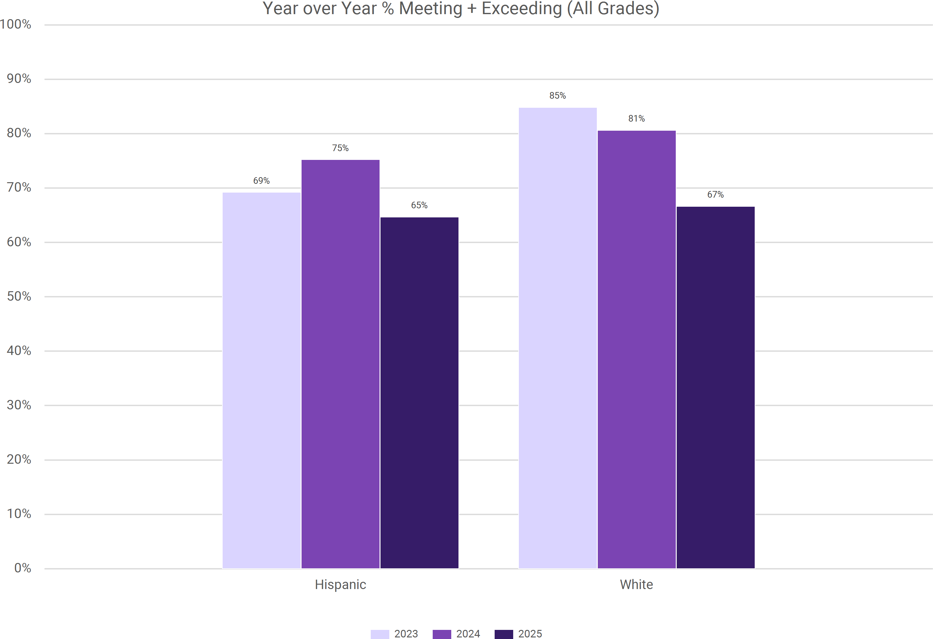
South Hackensack
2024-25 Spring NJSLA by Subgroup Race Language Arts

Slide 45
South Hackensack 2024-25 Spring NJSLA by Subgroup Race Math
Grade Band | Race | Total Tested 2025 | % of Tested 2025 | Not Meeting (Level 1) |  |  | Partially Meeting (Level 2) |  |  | Approaching (Level 3) |  |  | Meeting (Level 4) |  |  | Exceeding (Level 5)
 |  |  |  | % 2023 | % 2024 | % 2025 | % 2023 | % 2024 | % 2025 | % 2023 | % 2024 | % 2025 | % 2023 | % 2024 | % 2025 | % 2023 | % 2024 | % 2025
ES (G3-G5) | Black | <10 | 1% | N/A | N/A | N/A | N/A | N/A | N/A | N/A | N/A | N/A | N/A | N/A | N/A | N/A | N/A | N/A
 | Hispanic | 58 | 70% | 2% | 4% | 3% | 15% | 27% | 26% | 41% | 27% | 36% | 37% | 40% | 33% | 4% | 2% | 2%
 | Multiple | <10 | 4% | N/A | N/A | N/A | N/A | N/A | N/A | N/A | N/A | N/A | N/A | N/A | N/A | N/A | N/A | N/A
 | White | 21 | 25% | 0% | 14% | 5% | 8% | 14% | 19% | 15% | 14% | 33% | 46% | 50% | 38% | 31% | 7% | 5%
 | All Students | 83 |  | 3% | 8% | 5% | 12% | 23% | 23% | 34% | 23% | 35% | 40% | 41% | 35% | 10% | 4% | 2%
MS (G6- G8) | Asian | <10 | 6% | N/A | N/A | N/A | N/A | N/A | N/A | N/A | N/A | N/A | N/A | N/A | N/A | N/A | N/A | N/A
 | Black | <10 | 6% | N/A | N/A | N/A | N/A | N/A | N/A | N/A | N/A | N/A | N/A | N/A | N/A | N/A | N/A | N/A
 | Hispanic | 48 | 68% | 20% | 13% | 17% | 16% | 24% | 10% | 29% | 22% | 27% | 33% | 39% | 44% | 2% | 2% | 2%
 | Multiple | <10 | 3% | N/A | N/A | N/A | N/A | N/A | N/A | N/A | N/A | N/A | N/A | N/A | N/A | N/A | N/A | N/A
 | Other | <10 | 1% | N/A | N/A | N/A | N/A | N/A | N/A | N/A | N/A | N/A | N/A | N/A | N/A | N/A | N/A | N/A
 | White | 12 | 17% | 10% | 11% | 17% | 15% | 22% | 17% | 50% | 28% | 25% | 25% | 39% | 25% | 0% | 0% | 17%
 | All Students | 71 |  | 18% | 12% | 14% | 20% | 26% | 14% | 32% | 22% | 27% | 28% | 38% | 39% | 2% | 2% | 6%
All Grades | Asian | <10 | 3% | - | - | - | - | - | - | - | - | - | - | - | - | - | - | -
 | Black | <10 | 3% | - | - | - | - | - | - | - | - | - | - | - | - | - | - | -
 | Hispanic | 106 | 69% | 12% | 8% | 9% | 16% | 26% | 19% | 35% | 25% | 32% | 35% | 39% | 38% | 3% | 2% | 2%
 | Multiple | <10 | 3% | - | - | - | - | - | - | - | - | - | - | - | - | - | - | -
 | Other | <10 | 1% | - | - | - | - | - | - | - | - | - | - | - | - | - | - | -
 | White | 33 | 21% | 6% | 13% | 9% | 12% | 19% | 18% | 36% | 22% | 30% | 33% | 44% | 33% | 12% | 3% | 9%
 | All Students | 154 |  | 11% | 10% | 9% | 16% | 25% | 19% | 33% | 23% | 31% | 34% | 39% | 37% | 6% | 3% | 4%

Slide 46
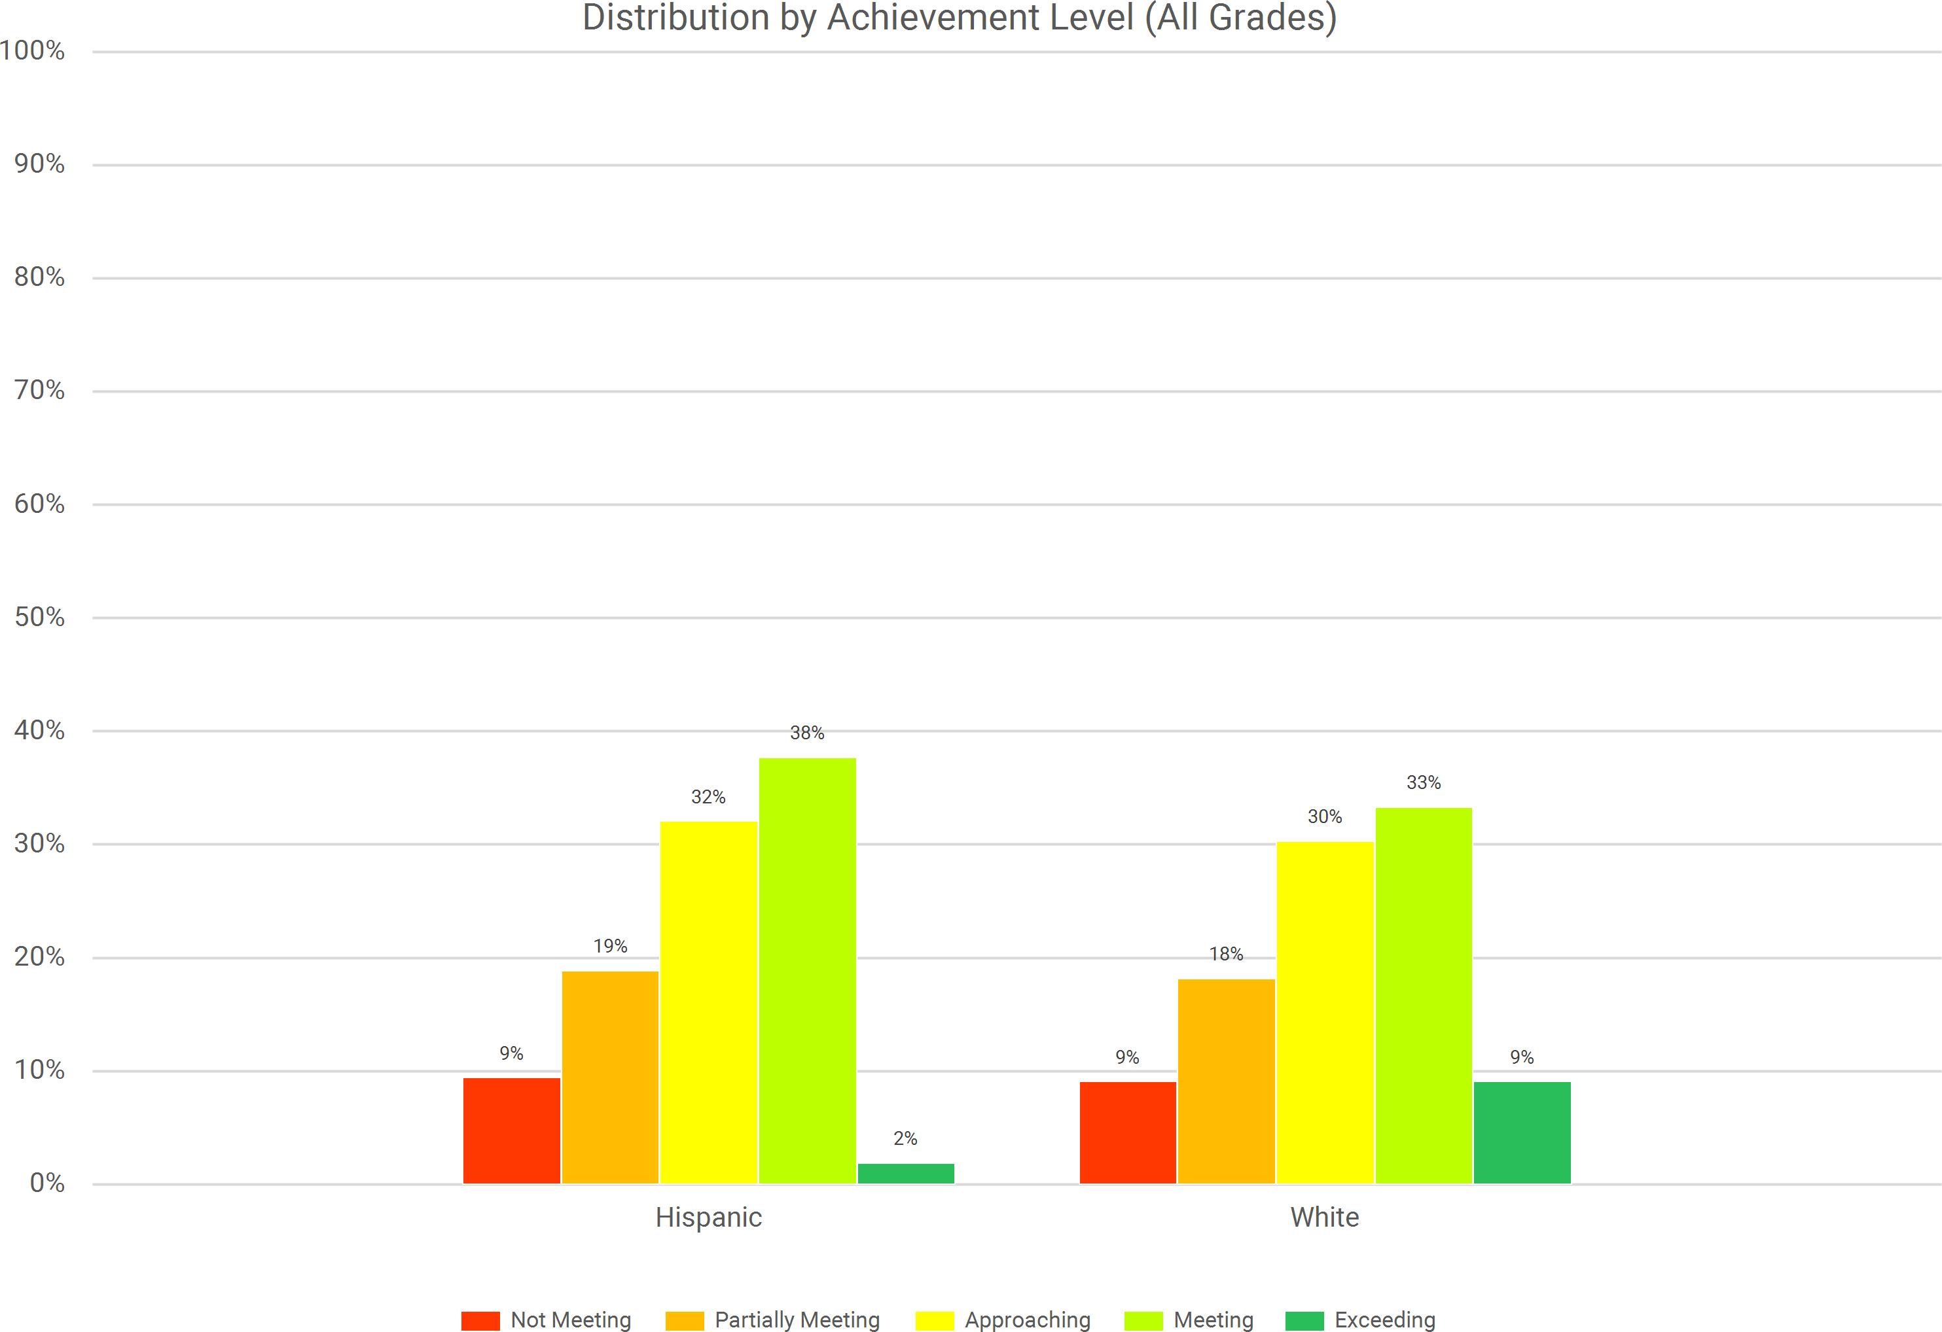
South Hackensack
2024-25 Spring NJSLA by Subgroup Race Math

Slide 47
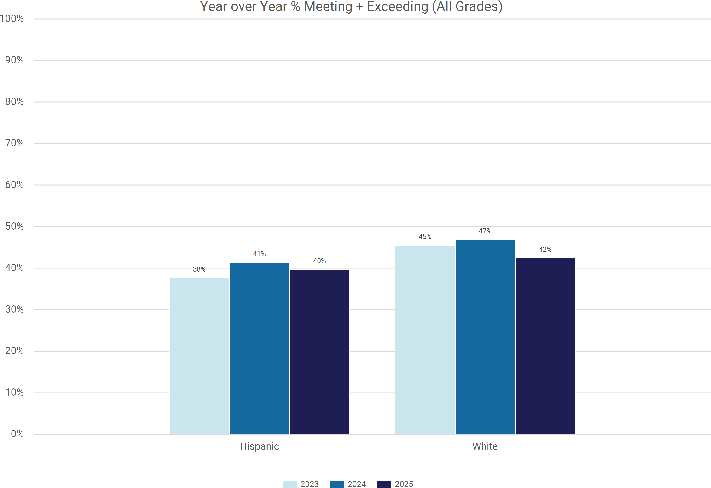
South Hackensack
2024-25 Spring NJSLA by Subgroup Race Math

Slide 48
South Hackensack 2024-25 Spring NJSLA by Subgroup Race Science
Grade Band | Race | Total Tested 2025 | % of Tested 2025 | Below Proficiency (Level 1) |  |  | Near Proficiency (Level 2) |  |  | Proficient (Level 3) |  |  | Advanced Proficiency (Level 4)
 |  |  |  | % 2023 | % 2024 | % 2025 | % 2023 | % 2024 | % 2025 | % 2023 | % 2024 | % 2025 | % 2023 | % 2024 | % 2025
ES (G5) | Hispanic | 20 | 67% | 13% | 21% | 35% | 47% | 29% | 50% | 40% | 50% | 15% | 0% | 0% | 0%
 | Multiple | <10 | 3% | N/A | N/A | N/A | N/A | N/A | N/A | N/A | N/A | N/A | N/A | N/A | N/A
 | White | <10 | 30% | N/A | N/A | N/A | N/A | N/A | N/A | N/A | N/A | N/A | N/A | N/A | N/A
 | All Students | 30 |  | 14% | 24% | 27% | 36% | 24% | 57% | 50% | 47% | 17% | 0% | 6% | 0%
MS (G8) | Asian | <10 | 7% | N/A | N/A | N/A | N/A | N/A | N/A | N/A | N/A | N/A | N/A | N/A | N/A
 | Black | <10 | 4% | N/A | N/A | N/A | N/A | N/A | N/A | N/A | N/A | N/A | N/A | N/A | N/A
 | Hispanic | 15 | 56% | 44% | 27% | 20% | 50% | 62% | 67% | 6% | 12% | 13% | 0% | 0% | 0%
 | Multiple | <10 | 4% | N/A | N/A | N/A | N/A | N/A | N/A | N/A | N/A | N/A | N/A | N/A | N/A
 | Other | <10 | 4% | N/A | N/A | N/A | N/A | N/A | N/A | N/A | N/A | N/A | N/A | N/A | N/A
 | White | <10 | 26% | N/A | N/A | N/A | N/A | N/A | N/A | N/A | N/A | N/A | N/A | N/A | N/A
 | All Students | 27 |  | 46% | 28% | 22% | 46% | 61% | 67% | 8% | 11% | 11% | 0% | 0% | 0%
All Grades | Asian | <10 | 4% | - | - | - | - | - | - | - | - | - | - | - | -
 | Black | <10 | 2% | - | - | - | - | - | - | - | - | - | - | - | -
 | Hispanic | 35 | 61% | 29% | 25% | 29% | 48% | 50% | 57% | 23% | 25% | 14% | 0% | 0% | 0%
 | Multiple | <10 | 4% | - | - | - | - | - | - | - | - | - | - | - | -
 | Other | <10 | 2% | - | - | - | - | - | - | - | - | - | - | - | -
 | White | 16 | 28% | 30% | - | 25% | 30% | - | 69% | 40% | - | 6% | 0% | - | 0%
 | All Students | 57 |  | 30% | 26% | 25% | 41% | 49% | 61% | 28% | 23% | 14% | 0% | 2% | 0%

Slide 49
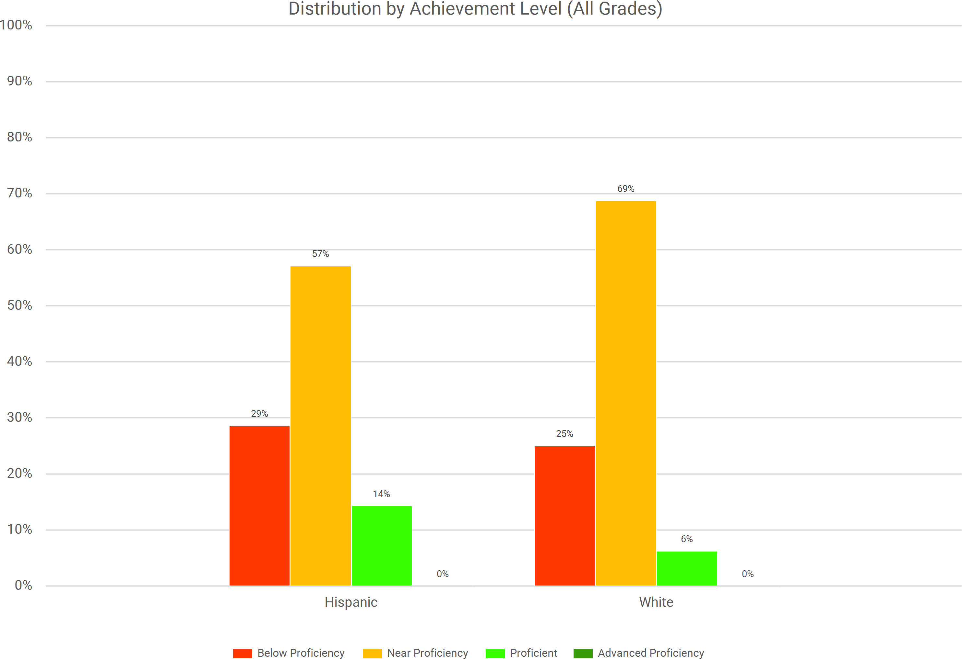
South Hackensack
2024-25 Spring NJSLA by Subgroup Race Science

Slide 50
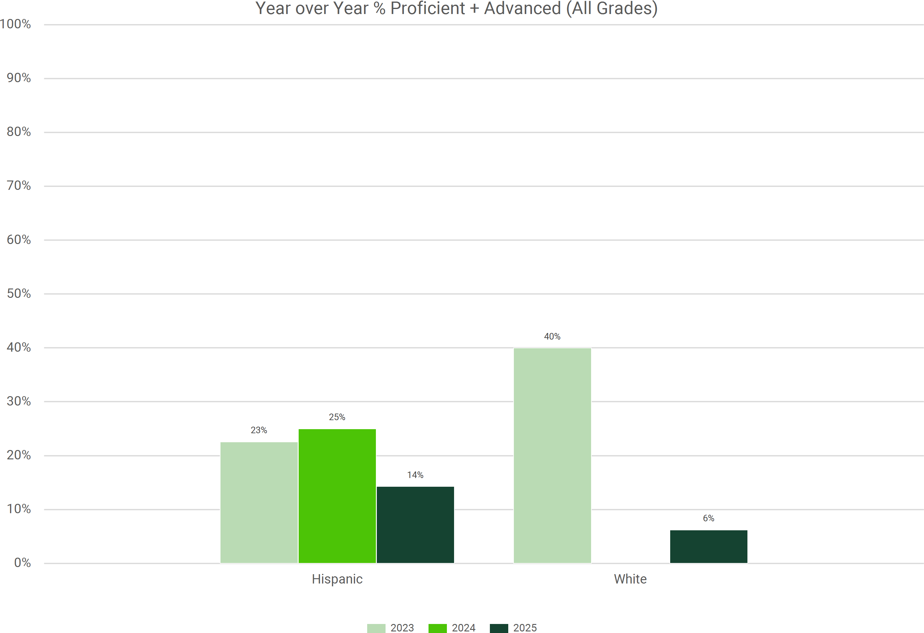
South Hackensack
2024-25 Spring NJSLA by Subgroup Race Science

Slide 51
South Hackensack 2024-25 Spring NJSLA by Subgroup Gender Language Arts
Grade Band | Gender | Total Tested 2025 | % of Tested 2025 | Not Meeting (Level 1) |  |  | Partially Meeting (Level 2) |  |  | Approaching (Level 3) |  |  | Meeting (Level 4) |  |  | Exceeding (Level 5)
 |  |  |  | % 2023 | % 2024 | % 2025 | % 2023 | % 2024 | % 2025 | % 2023 | % 2024 | % 2025 | % 2023 | % 2024 | % 2025 | % 2023 | % 2024 | % 2025
ES (G3-G5) | Female | 36 | 44% | 7% | 6% | 8% | 7% | 10% | 8% | 10% | 26% | 28% | 53% | 26% | 39% | 23% | 32% | 17%
 | Male | 46 | 56% | 18% | 10% | 11% | 3% | 20% | 17% | 13% | 5% | 22% | 53% | 55% | 30% | 15% | 10% | 20%
 | All Students | 82 |  | 13% | 8% | 10% | 4% | 15% | 13% | 11% | 14% | 24% | 53% | 42% | 34% | 19% | 20% | 18%
MS (G6- G8) | Female | 29 | 43% | 3% | 0% | 3% | 3% | 3% | 10% | 15% | 5% | 0% | 38% | 33% | 28% | 41% | 59% | 59%
 | Male | 39 | 57% | 11% | 2% | 5% | 2% | 9% | 0% | 22% | 0% | 13% | 48% | 51% | 41% | 17% | 37% | 41%
 | All Students | 68 |  | 7% | 1% | 4% | 2% | 6% | 4% | 19% | 2% | 7% | 44% | 43% | 35% | 28% | 48% | 49%
All Grades | Female | 65 | 43% | 4% | 3% | 6% | 4% | 6% | 9% | 13% | 14% | 15% | 45% | 30% | 34% | 33% | 47% | 35%
 | Male | 85 | 57% | 14% | 6% | 8% | 2% | 14% | 9% | 17% | 2% | 18% | 50% | 53% | 35% | 16% | 24% | 29%
 | All Students | 150 |  | 10% | 5% | 7% | 3% | 10% | 9% | 15% | 8% | 17% | 48% | 42% | 35% | 24% | 35% | 32%

Slide 52
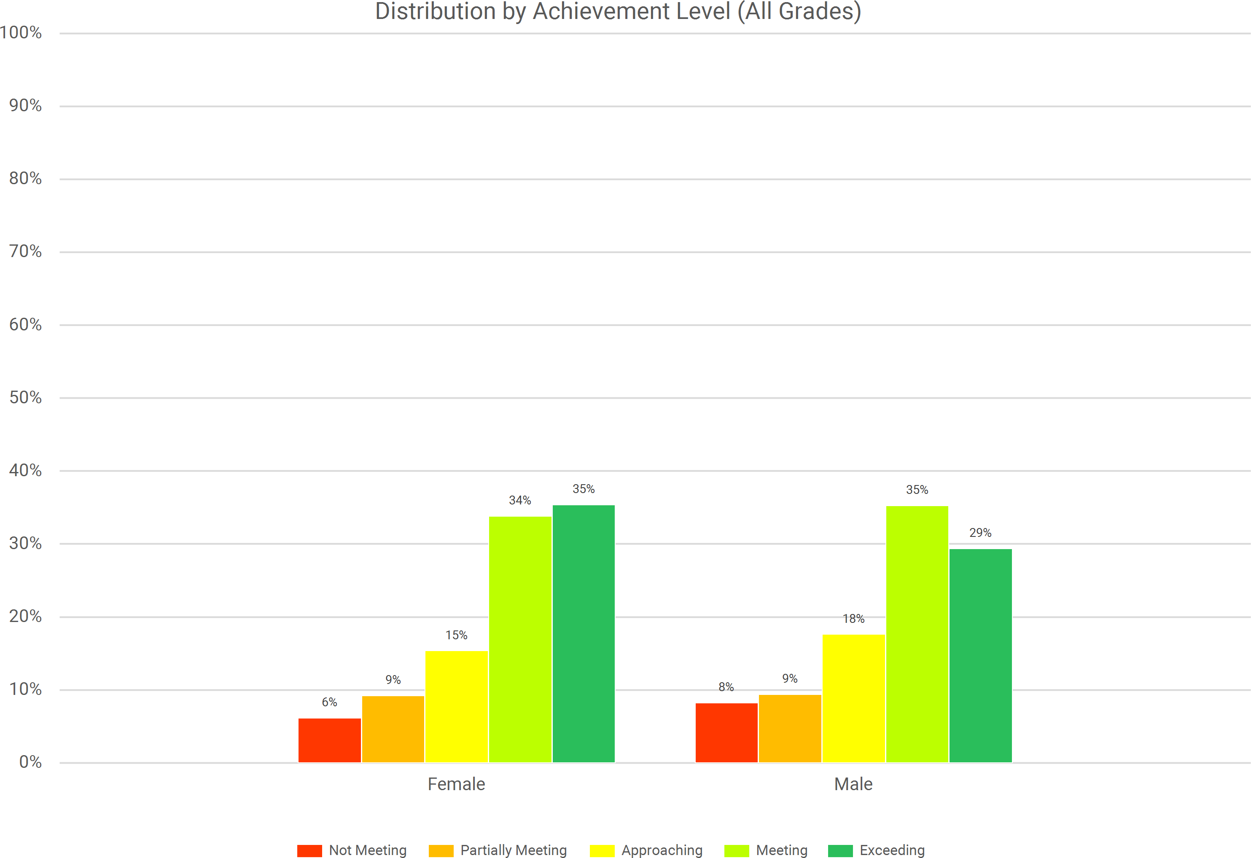
South Hackensack
2024-25 Spring NJSLA by Subgroup Gender Language Arts

Slide 53
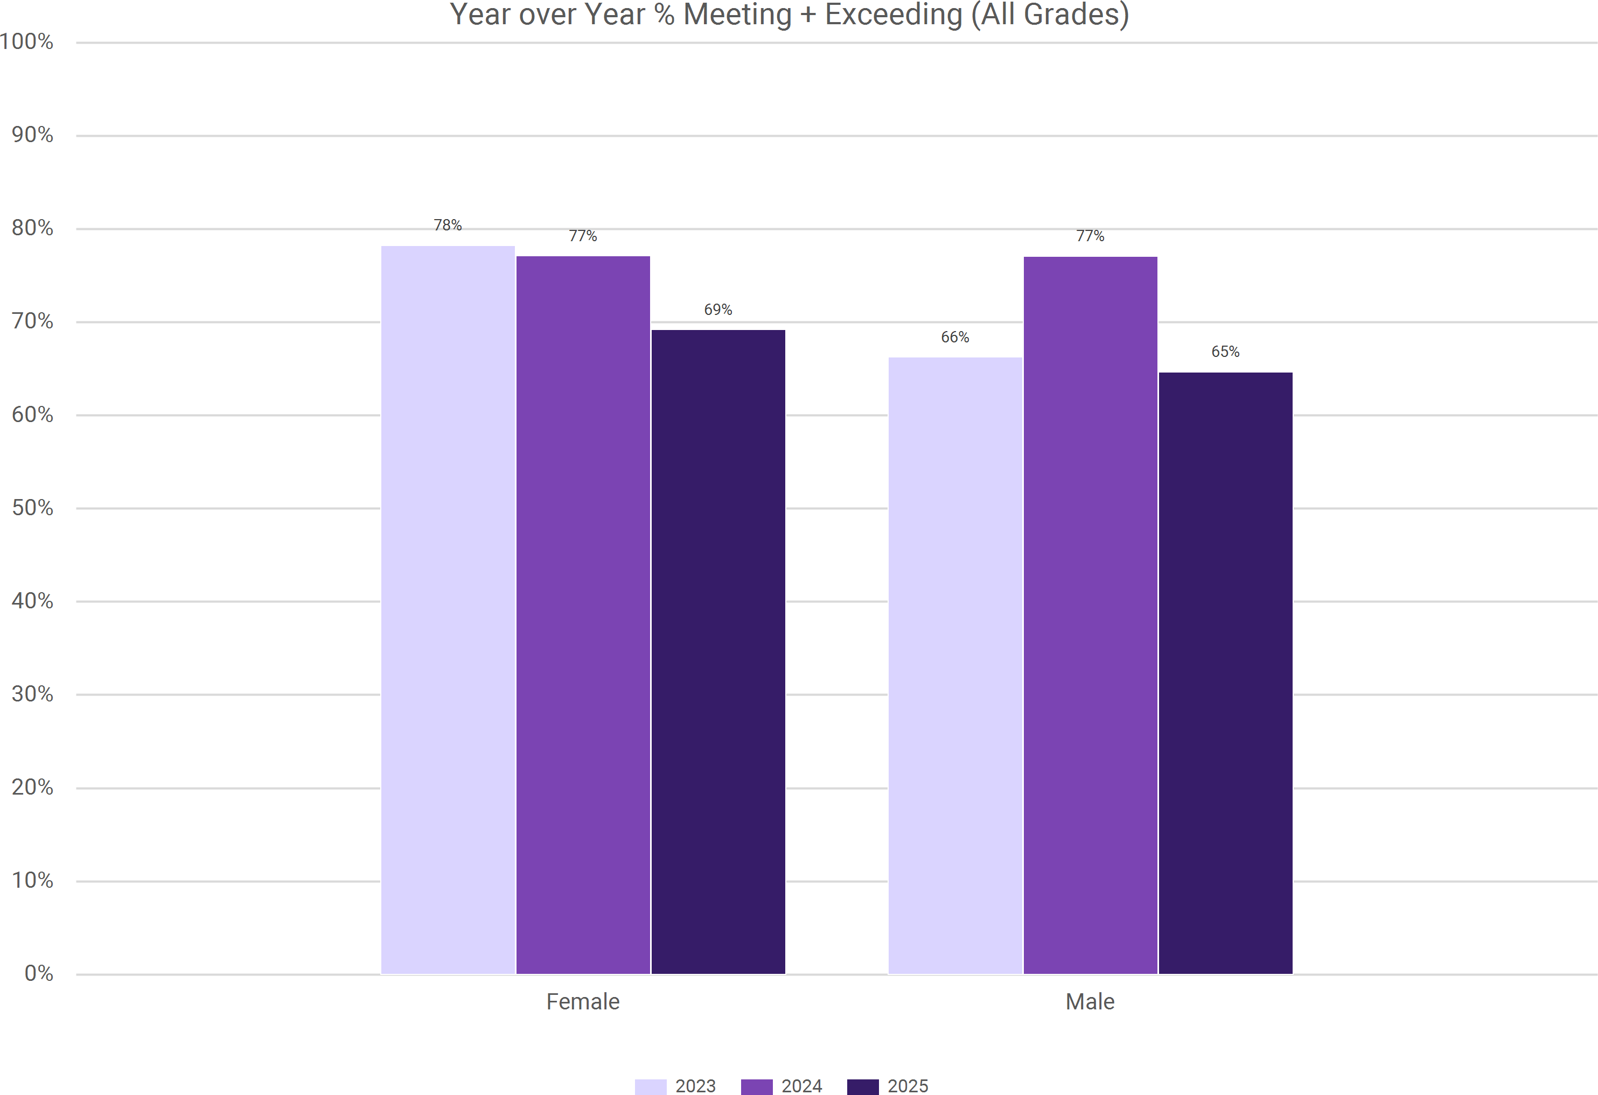
South Hackensack
2024-25 Spring NJSLA by Subgroup Gender Language Arts

Slide 54
South Hackensack 2024-25 Spring NJSLA by Subgroup Gender Math
Grade Band | Gender | Total Tested 2025 | % of Tested 2025 | Not Meeting (Level 1) |  |  | Partially Meeting (Level 2) |  |  | Approaching (Level 3) |  |  | Meeting (Level 4) |  |  | Exceeding (Level 5)
 |  |  |  | % 2023 | % 2024 | % 2025 | % 2023 | % 2024 | % 2025 | % 2023 | % 2024 | % 2025 | % 2023 | % 2024 | % 2025 | % 2023 | % 2024 | % 2025
ES (G3-G5) | Female | 37 | 45% | 0% | 9% | 11% | 17% | 19% | 22% | 27% | 22% | 38% | 47% | 47% | 27% | 10% | 3% | 3%
 | Male | 46 | 55% | 5% | 7% | 0% | 8% | 27% | 24% | 41% | 24% | 33% | 35% | 37% | 41% | 11% | 5% | 2%
 | All Students | 83 |  | 3% | 8% | 5% | 12% | 23% | 23% | 34% | 23% | 35% | 40% | 41% | 35% | 10% | 4% | 2%
MS (G6- G8) | Female | 29 | 41% | 8% | 10% | 10% | 21% | 23% | 10% | 33% | 25% | 31% | 33% | 38% | 45% | 5% | 5% | 3%
 | Male | 42 | 59% | 26% | 13% | 17% | 20% | 29% | 17% | 30% | 20% | 24% | 24% | 38% | 36% | 0% | 0% | 7%
 | All Students | 71 |  | 18% | 12% | 14% | 20% | 26% | 14% | 32% | 22% | 27% | 28% | 38% | 39% | 2% | 2% | 6%
All Grades | Female | 66 | 43% | 4% | 10% | 11% | 19% | 21% | 17% | 30% | 24% | 35% | 39% | 42% | 35% | 7% | 4% | 3%
 | Male | 88 | 57% | 17% | 10% | 8% | 14% | 28% | 20% | 35% | 22% | 28% | 29% | 37% | 39% | 5% | 2% | 5%
 | All Students | 154 |  | 11% | 10% | 9% | 16% | 25% | 19% | 33% | 23% | 31% | 34% | 39% | 37% | 6% | 3% | 4%

Slide 55
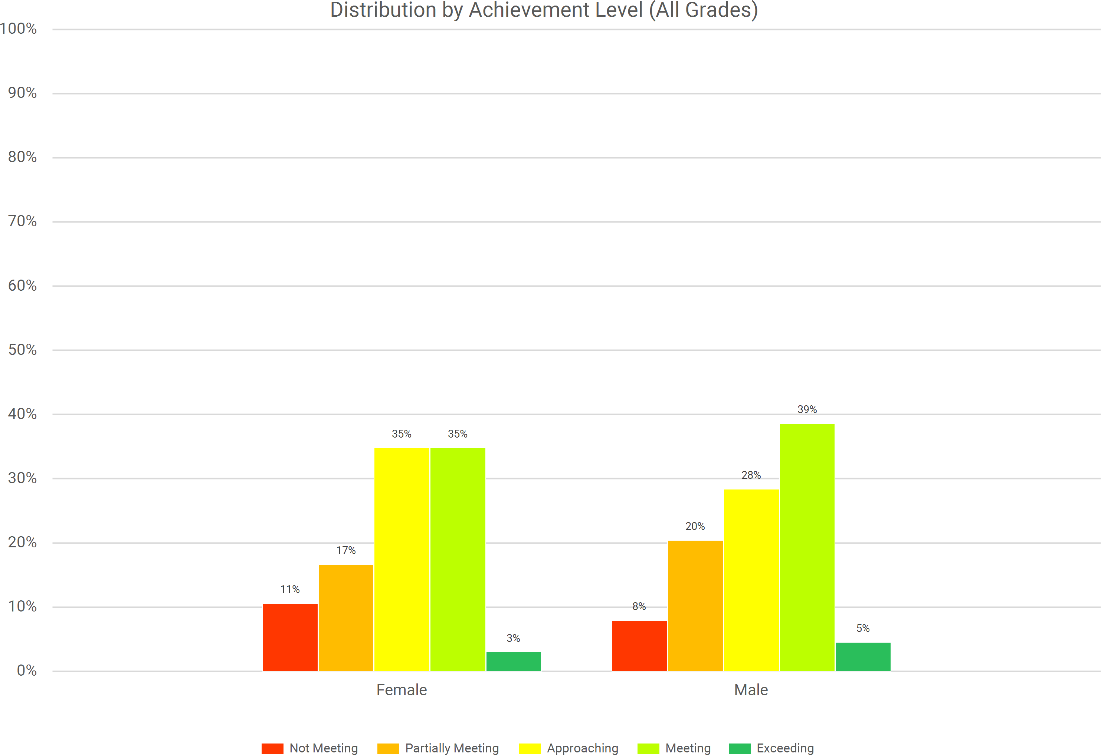
South Hackensack
2024-25 Spring NJSLA by Subgroup Gender Math

Slide 56
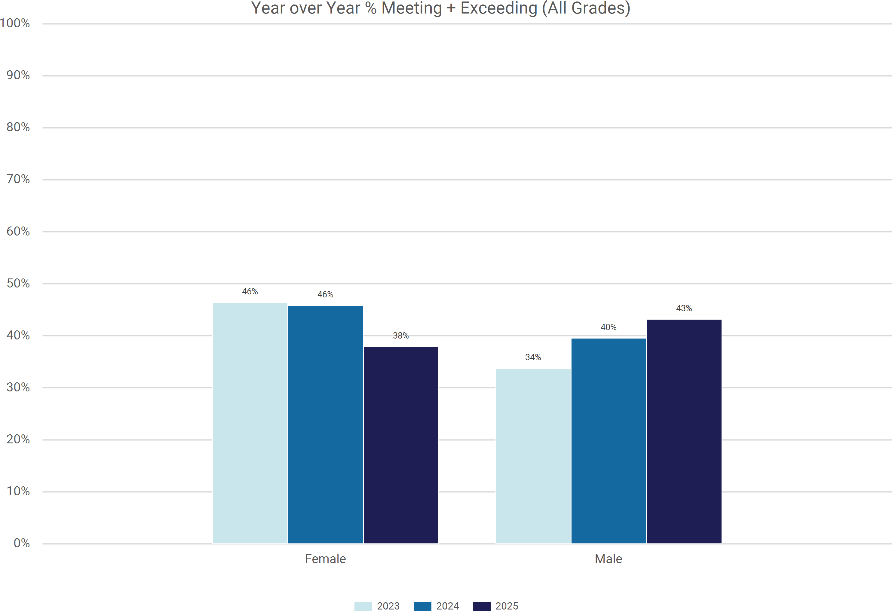
South Hackensack
2024-25 Spring NJSLA by Subgroup Gender Math

Slide 57
South Hackensack 2024-25 Spring NJSLA by Subgroup Gender Science
Grade Band | Gender | Total Tested 2025 | % of Tested 2025 | Below Proficiency (Level 1) |  |  | Near Proficiency (Level 2) |  |  | Proficient (Level 3) |  |  | Advanced Proficiency (Level 4)
 |  |  |  | % 2023 | % 2024 | % 2025 | % 2023 | % 2024 | % 2025 | % 2023 | % 2024 | % 2025 | % 2023 | % 2024 | % 2025
ES (G5) | Female | 13 | 43% | N/A | N/A | 23% | N/A | N/A | 62% | N/A | N/A | 15% | N/A | N/A | 0%
 | Male | 17 | 57% | 13% | N/A | 29% | 33% | N/A | 53% | 53% | N/A | 18% | 0% | N/A | 0%
 | All Students | 30 |  | 14% | 24% | 27% | 36% | 24% | 57% | 50% | 47% | 17% | 0% | 6% | 0%
MS (G8) | Female | 12 | 44% | N/A | 24% | 17% | N/A | 59% | 67% | N/A | 18% | 17% | N/A | 0% | 0%
 | Male | 15 | 56% | 50% | 32% | 27% | 50% | 63% | 67% | 0% | 5% | 7% | 0% | 0% | 0%
 | All Students | 27 |  | 46% | 28% | 22% | 46% | 61% | 67% | 8% | 11% | 11% | 0% | 0% | 0%
All Grades | Female | 25 | 44% | 23% | 24% | 20% | 38% | 48% | 64% | 38% | 28% | 16% | 0% | 0% | 0%
 | Male | 32 | 56% | 33% | 29% | 28% | 42% | 50% | 59% | 24% | 18% | 13% | 0% | 4% | 0%
 | All Students | 57 |  | 30% | 26% | 25% | 41% | 49% | 61% | 28% | 23% | 14% | 0% | 2% | 0%

Slide 58
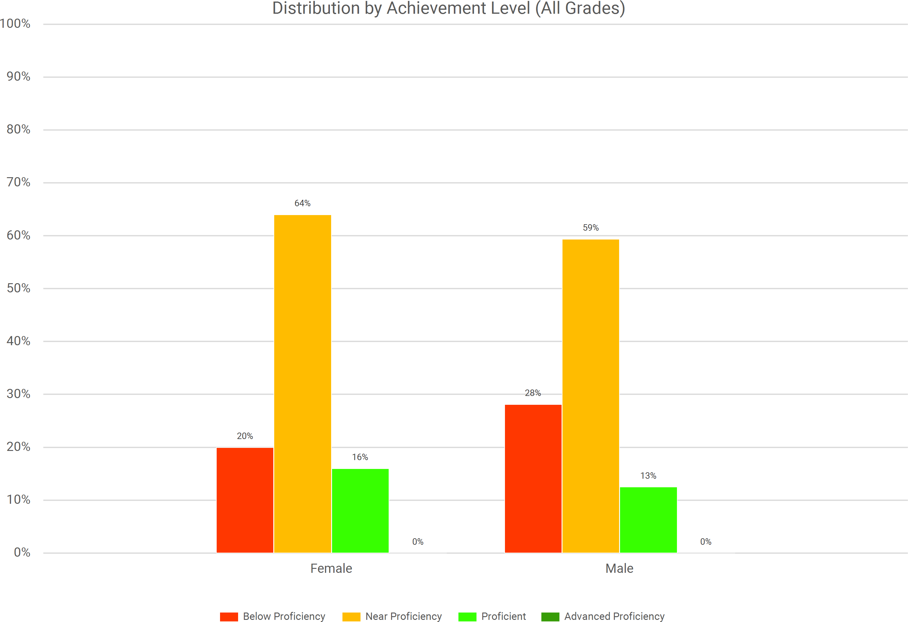
South Hackensack
2024-25 Spring NJSLA by Subgroup Gender Science

Slide 59
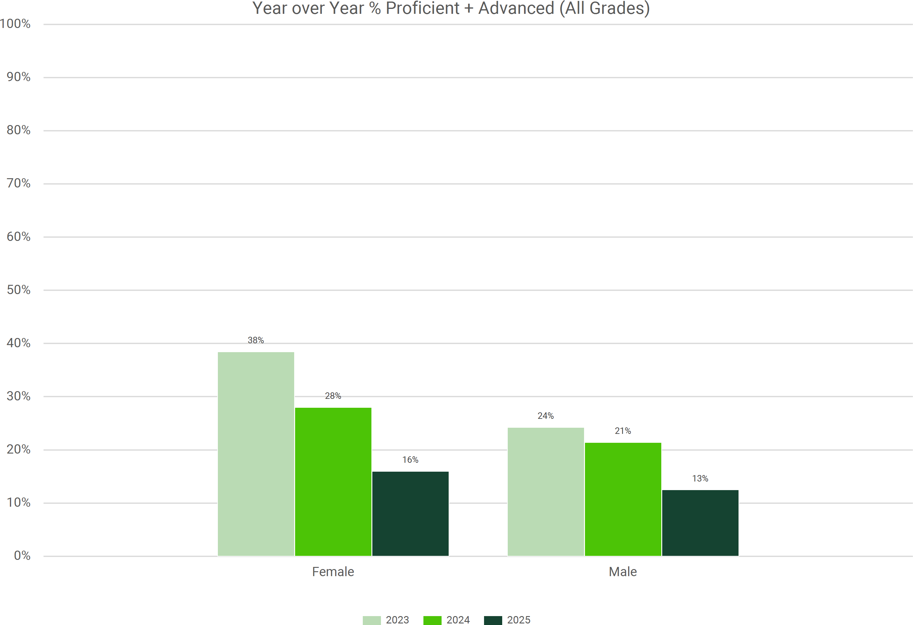
South Hackensack
2024-25 Spring NJSLA by Subgroup Gender Science

Slide 60
South Hackensack 2024-25 Spring NJSLA by Subgroup Program Language Arts
Grade Band | Program | Total Tested 2025 | % of Tested 2025 | Not Meeting (Level 1) |  |  | Partially Meeting (Level 2) |  |  | Approaching (Level 3) |  |  | Meeting (Level 4) |  |  | Exceeding (Level 5)
 |  |  |  | % 2023 | % 2024 | % 2025 | % 2023 | % 2024 | % 2025 | % 2023 | % 2024 | % 2025 | % 2023 | % 2024 | % 2025 | % 2023 | % 2024 | % 2025
ES (G3-G5) | ML | 20 | 24% | 14% | 6% | 20% | 14% | 44% | 10% | 29% | 28% | 35% | 29% | 22% | 25% | 14% | 0% | 10%
 | F/R Lunch | 44 | 54% | 15% | 8% | 14% | 7% | 23% | 11% | 19% | 15% | 25% | 52% | 42% | 34% | 7% | 12% | 16%
 | Section 504 | <10 | 2% | N/A | N/A | N/A | N/A | N/A | N/A | N/A | N/A | N/A | N/A | N/A | N/A | N/A | N/A | N/A
 | SpecEd | 23 | 28% | 46% | 50% | 22% | 15% | 40% | 22% | 0% | 0% | 30% | 23% | 10% | 13% | 15% | 0% | 13%
 | GenEd | 44 | 54% | 6% | 0% | 0% | 0% | 4% | 9% | 9% | 11% | 20% | 66% | 54% | 45% | 19% | 30% | 25%
 | All Students | 82 |  | 13% | 8% | 10% | 4% | 15% | 13% | 11% | 14% | 24% | 53% | 42% | 34% | 19% | 20% | 18%
MS (G6- G8) | ML | <10 | 6% | N/A | N/A | N/A | N/A | N/A | N/A | N/A | N/A | N/A | N/A | N/A | N/A | N/A | N/A | N/A
 | F/R Lunch | 32 | 47% | 15% | 0% | 3% | 4% | 8% | 3% | 15% | 8% | 13% | 46% | 28% | 25% | 19% | 56% | 56%
 | Section 504 | <10 | 6% | N/A | N/A | N/A | N/A | N/A | N/A | N/A | N/A | N/A | N/A | N/A | N/A | N/A | N/A | N/A
 | SpecEd | <10 | 10% | 30% | N/A | N/A | 10% | N/A | N/A | 30% | N/A | N/A | 20% | N/A | N/A | 10% | N/A | N/A
 | GenEd | 59 | 87% | 3% | 0% | 2% | 0% | 1% | 2% | 13% | 0% | 5% | 51% | 43% | 37% | 33% | 55% | 54%
 | All Students | 68 |  | 7% | 1% | 4% | 2% | 6% | 4% | 19% | 2% | 7% | 44% | 43% | 35% | 28% | 48% | 49%
All Grades | ML | 24 | 16% | 14% | 4% | 21% | 14% | 39% | 13% | 36% | 26% | 33% | 23% | 30% | 25% | 14% | 0% | 8%
 | F/R Lunch | 76 | 51% | 15% | 4% | 9% | 6% | 16% | 8% | 17% | 12% | 20% | 49% | 35% | 30% | 13% | 33% | 33%
 | Section 504 | <10 | 4% | - | - | - | - | - | - | - | - | - | - | - | - | - | - | -
 | SpecEd | 30 | 20% | 39% | 32% | 20% | 13% | 37% | 23% | 13% | 11% | 30% | 22% | 16% | 13% | 13% | 5% | 13%
 | GenEd | 103 | 69% | 4% | 0% | 1% | 0% | 3% | 5% | 11% | 4% | 12% | 57% | 48% | 41% | 27% | 45% | 42%
 | All Students | 150 |  | 10% | 5% | 7% | 3% | 10% | 9% | 15% | 8% | 17% | 48% | 42% | 35% | 24% | 35% | 32%

Slide 61
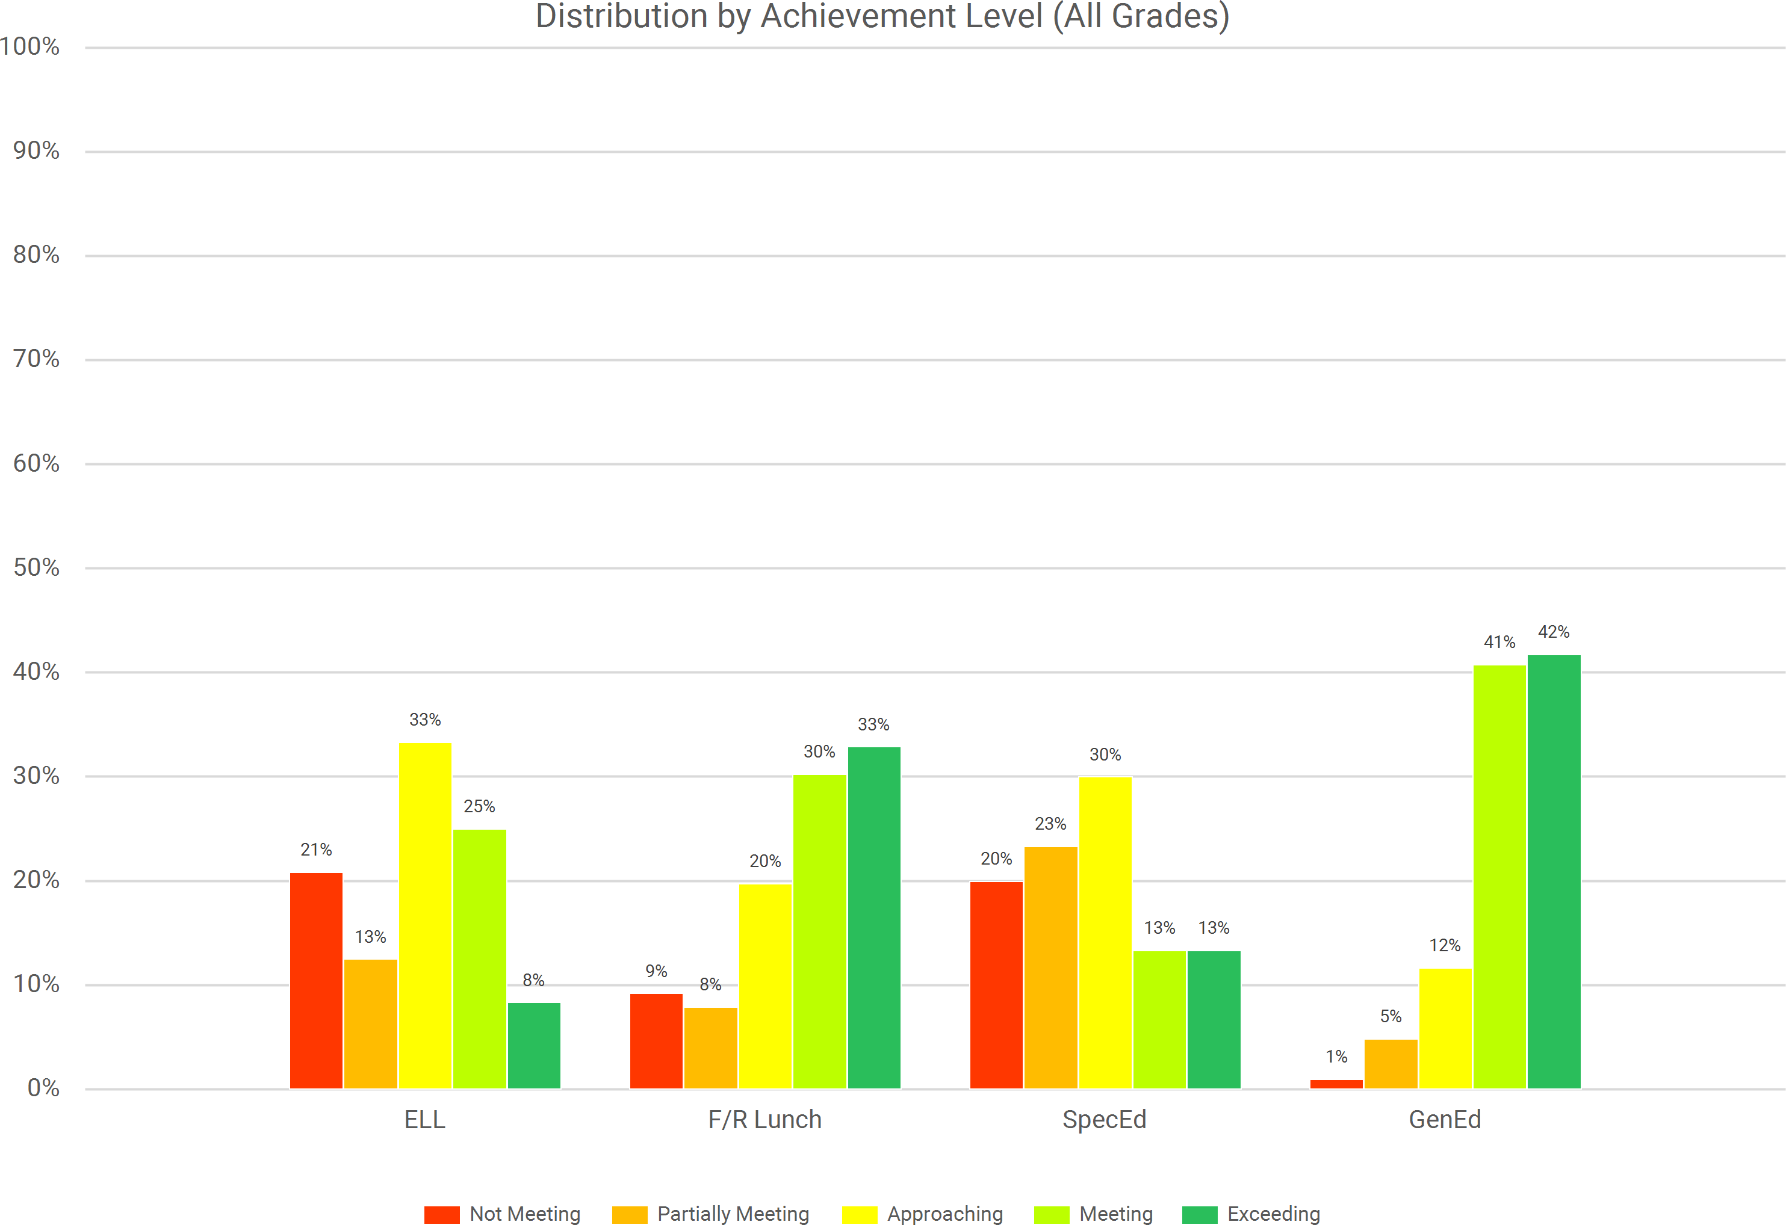
South Hackensack
2024-25 Spring NJSLA by Subgroup Program Language Arts
ML

Slide 62
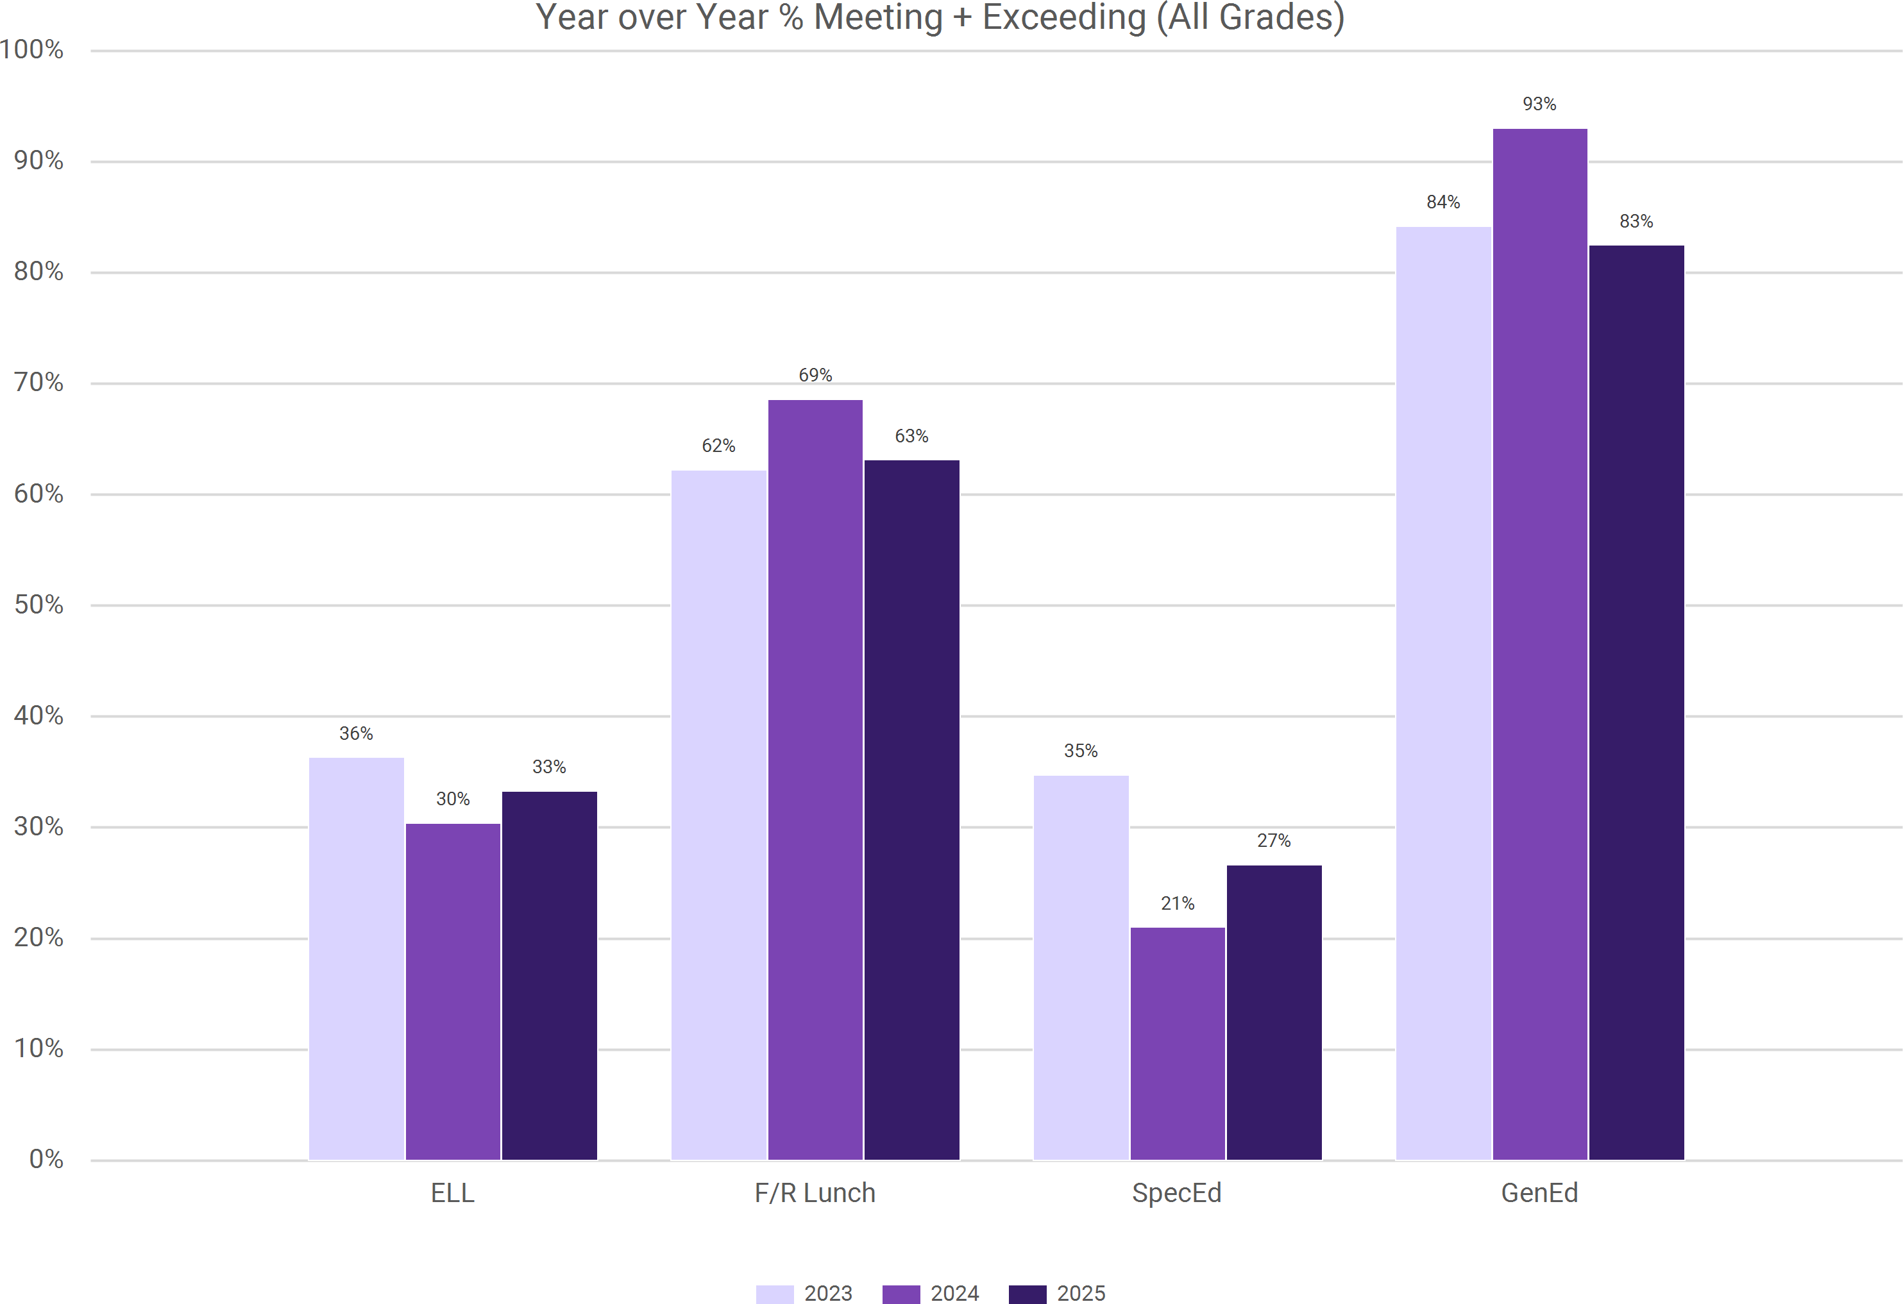
South Hackensack
2024-25 Spring NJSLA by Subgroup Program Language Arts
ML

Slide 63
South Hackensack 2024-25 Spring NJSLA by Subgroup Program Math
Grade Band | Program | Total Tested 2025 | % of Tested 2025 | Not Meeting (Level 1) |  |  | Partially Meeting (Level 2) |  |  | Approaching (Level 3) |  |  | Meeting (Level 4) |  |  | Exceeding (Level 5)
 |  |  |  | % 2023 | % 2024 | % 2025 | % 2023 | % 2024 | % 2025 | % 2023 | % 2024 | % 2025 | % 2023 | % 2024 | % 2025 | % 2023 | % 2024 | % 2025
ES (G3-G5) | ELL | 21 | 25% | 7% | 5% | 10% | 21% | 42% | 33% | 50% | 37% | 29% | 21% | 16% | 29% | 0% | 0% | 0%
 | F/R Lunch | 44 | 53% | 0% | 11% | 7% | 16% | 26% | 16% | 48% | 22% | 43% | 36% | 41% | 34% | 0% | 0% | 0%
 | Section 504 | <10 | 2% | N/A | N/A | N/A | N/A | N/A | N/A | N/A | N/A | N/A | N/A | N/A | N/A | N/A | N/A | N/A
 | SpecEd | 23 | 28% | 15% | 45% | 13% | 38% | 45% | 39% | 23% | 0% | 26% | 15% | 9% | 17% | 8% | 0% | 4%
 | GenEd | 44 | 53% | 0% | 2% | 0% | 5% | 13% | 11% | 32% | 22% | 41% | 50% | 57% | 45% | 14% | 7% | 2%
 | All Students | 83 |  | 3% | 8% | 5% | 12% | 23% | 23% | 34% | 23% | 35% | 40% | 41% | 35% | 10% | 4% | 2%
MS (G6- G8) | ELL | <10 | 10% | N/A | N/A | N/A | N/A | N/A | N/A | N/A | N/A | N/A | N/A | N/A | N/A | N/A | N/A | N/A
 | F/R Lunch | 33 | 46% | 24% | 15% | 9% | 24% | 27% | 6% | 44% | 19% | 39% | 8% | 38% | 39% | 0% | 0% | 6%
 | Section 504 | <10 | 6% | N/A | N/A | N/A | N/A | N/A | N/A | N/A | N/A | N/A | N/A | N/A | N/A | N/A | N/A | N/A
 | SpecEd | <10 | 10% | 80% | N/A | N/A | 10% | N/A | N/A | 0% | N/A | N/A | 10% | N/A | N/A | 0% | N/A | N/A
 | GenEd | 59 | 83% | 5% | 1% | 5% | 20% | 28% | 14% | 39% | 26% | 29% | 33% | 42% | 46% | 3% | 3% | 7%
 | All Students | 71 |  | 18% | 12% | 14% | 20% | 26% | 14% | 32% | 22% | 27% | 28% | 38% | 39% | 2% | 2% | 6%
All Grades | ELL | 28 | 18% | 22% | 22% | 25% | 26% | 37% | 32% | 35% | 26% | 21% | 17% | 15% | 21% | 0% | 0% | 0%
 | F/R Lunch | 77 | 50% | 12% | 13% | 8% | 20% | 26% | 12% | 46% | 21% | 42% | 22% | 40% | 36% | 0% | 0% | 3%
 | Section 504 | <10 | 4% | - | - | - | - | - | - | - | - | - | - | - | - | - | - | -
 | SpecEd | 30 | 19% | 43% | 45% | 23% | 26% | 35% | 30% | 13% | 5% | 27% | 13% | 15% | 17% | 4% | 0% | 3%
 | GenEd | 103 | 67% | 3% | 2% | 3% | 14% | 22% | 13% | 36% | 24% | 34% | 40% | 48% | 46% | 7% | 4% | 5%
 | All Students | 154 |  | 11% | 10% | 9% | 16% | 25% | 19% | 33% | 23% | 31% | 34% | 39% | 37% | 6% | 3% | 4%

Slide 64
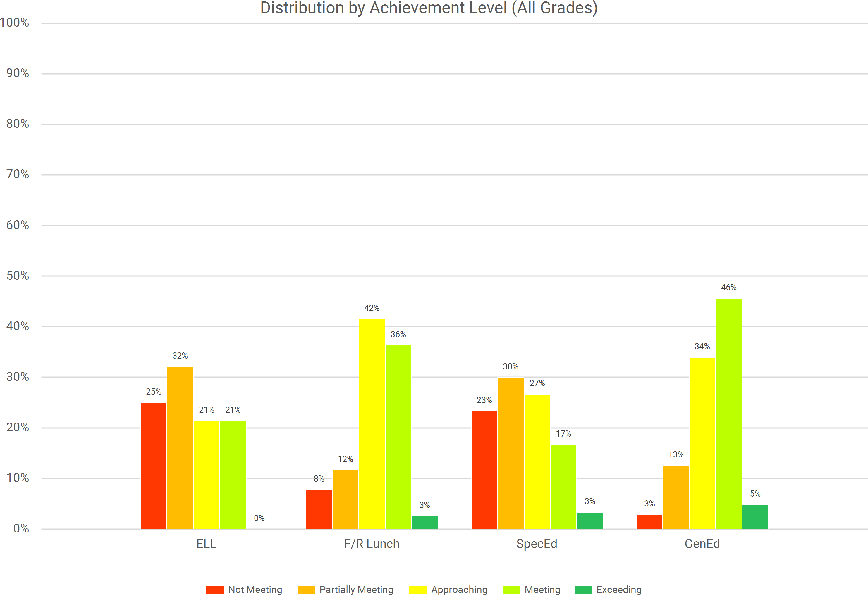
South Hackensack
2024-25 Spring NJSLA by Subgroup Program Math
ML

Slide 65
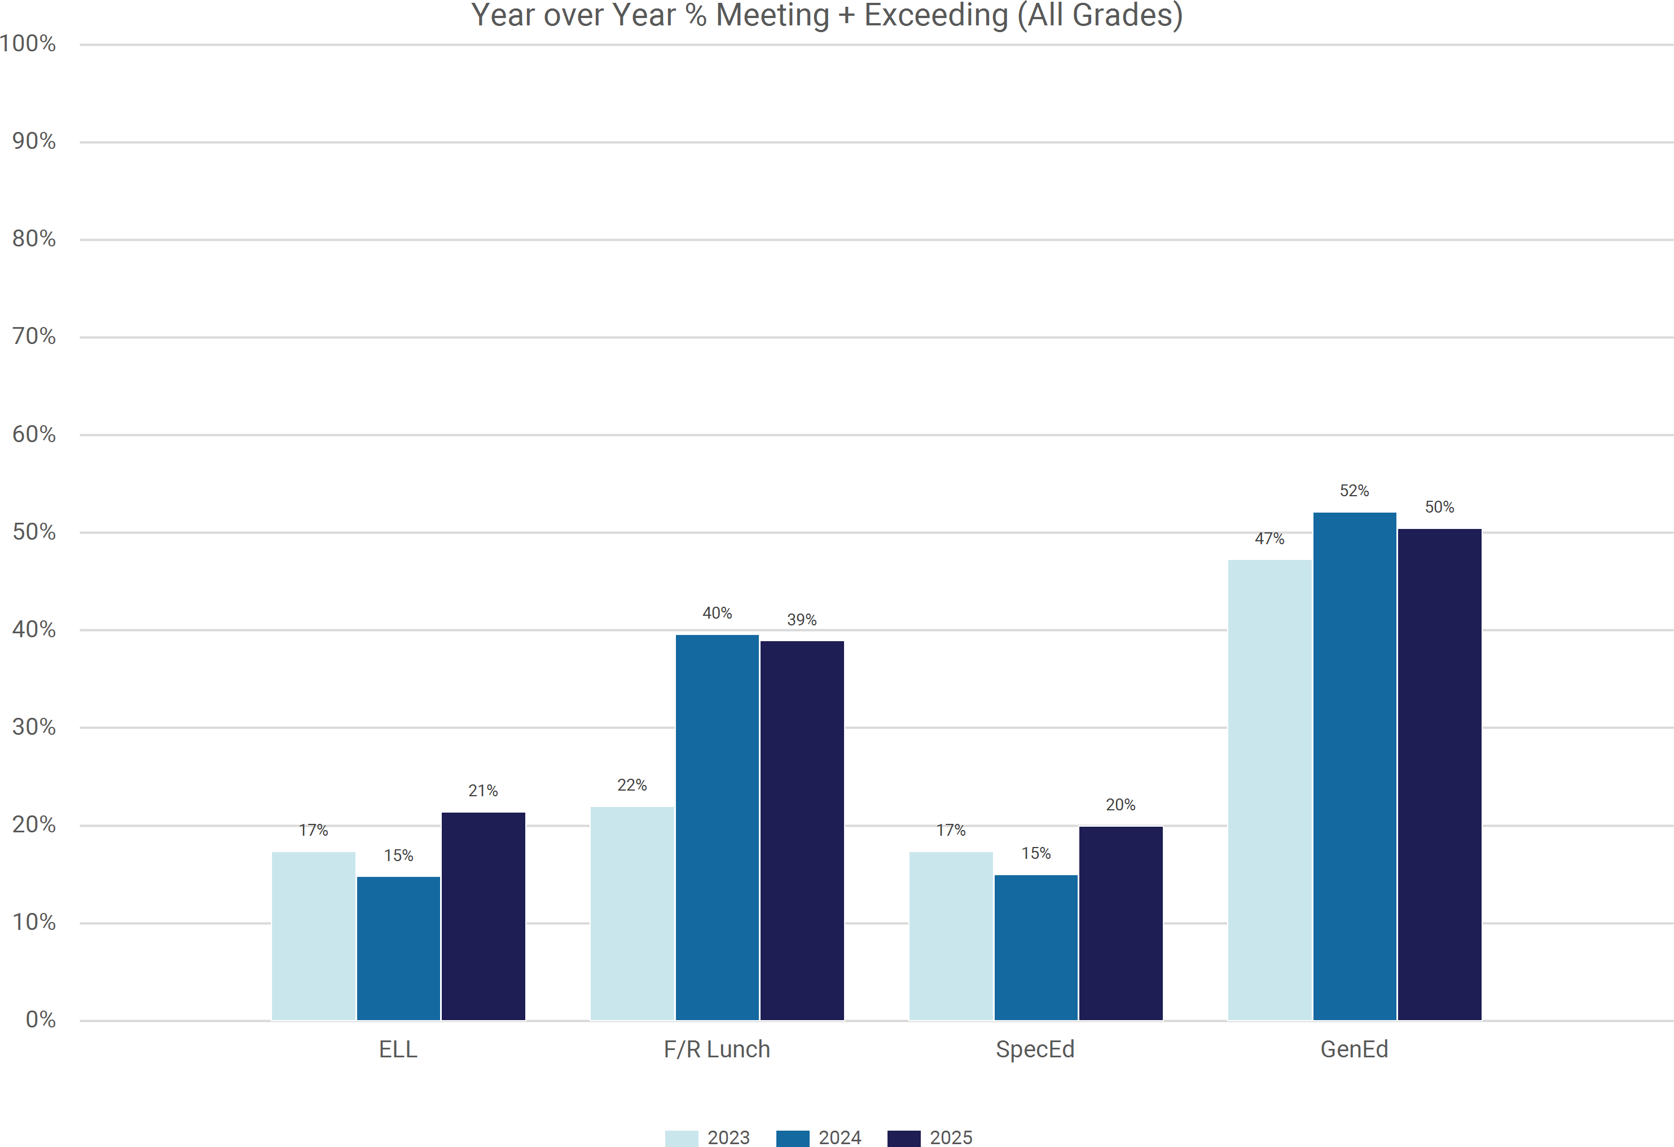
South Hackensack
2024-25 Spring NJSLA by Subgroup Program Math
ML

Slide 66
South Hackensack 2024-25 Spring NJSLA by Subgroup Program Science
Grade Band | Program | Total Tested 2025 | % of Tested 2025 | Below Proficiency (Level 1) |  |  | Near Proficiency (Level 2) |  |  | Proficient (Level 3) |  |  | Advanced Proficiency (Level 4)
 |  |  |  | % 2023 | % 2024 | % 2025 | % 2023 | % 2024 | % 2025 | % 2023 | % 2024 | % 2025 | % 2023 | % 2024 | % 2025
ES (G5) | ML | <10 | 13% | N/A | N/A | N/A | N/A | N/A | N/A | N/A | N/A | N/A | N/A | N/A | N/A
 | F/R Lunch | 15 | 50% | N/A | N/A | 27% | N/A | N/A | 53% | N/A | N/A | 20% | N/A | N/A | 0%
 | Section 504 | <10 | 3% | N/A | N/A | N/A | N/A | N/A | N/A | N/A | N/A | N/A | N/A | N/A | N/A
 | SpecEd | <10 | 27% | N/A | N/A | N/A | N/A | N/A | N/A | N/A | N/A | N/A | N/A | N/A | N/A
 | GenEd | 19 | 63% | 11% | 14% | 16% | 32% | 21% | 58% | 58% | 57% | 26% | 0% | 7% | 0%
 | All Students | 30 |  | 14% | 24% | 27% | 36% | 24% | 57% | 50% | 47% | 17% | 0% | 6% | 0%
MS (G8) | ML | <10 | 7% | N/A | N/A | N/A | N/A | N/A | N/A | N/A | N/A | N/A | N/A | N/A | N/A
 | F/R Lunch | 12 | 44% | 70% | 25% | 17% | 30% | 67% | 67% | 0% | 8% | 17% | 0% | 0% | 0%
 | Section 504 | <10 | 4% | N/A | N/A | N/A | N/A | N/A | N/A | N/A | N/A | N/A | N/A | N/A | N/A
 | SpecEd | <10 | 15% | N/A | N/A | N/A | N/A | N/A | N/A | N/A | N/A | N/A | N/A | N/A | N/A
 | GenEd | 21 | 78% | 40% | 14% | 10% | 47% | 72% | 76% | 13% | 14% | 14% | 0% | 0% | 0%
 | All Students | 27 |  | 46% | 28% | 22% | 46% | 61% | 67% | 8% | 11% | 11% | 0% | 0% | 0%
All Grades | ML | <10 | 11% | - | - | - | - | - | - | - | - | - | - | - | -
 | F/R Lunch | 27 | 47% | 44% | 33% | 22% | 38% | 48% | 59% | 19% | 19% | 19% | 0% | 0% | 0%
 | Section 504 | <10 | 4% | - | - | - | - | - | - | - | - | - | - | - | -
 | SpecEd | 12 | 21% | - | - | 50% | - | - | 50% | - | - | 0% | - | - | 0%
 | GenEd | 40 | 70% | 24% | 14% | 13% | 38% | 56% | 68% | 38% | 28% | 20% | 0% | 2% | 0%
 | All Students | 57 |  | 30% | 26% | 25% | 41% | 49% | 61% | 28% | 23% | 14% | 0% | 2% | 0%

Slide 67
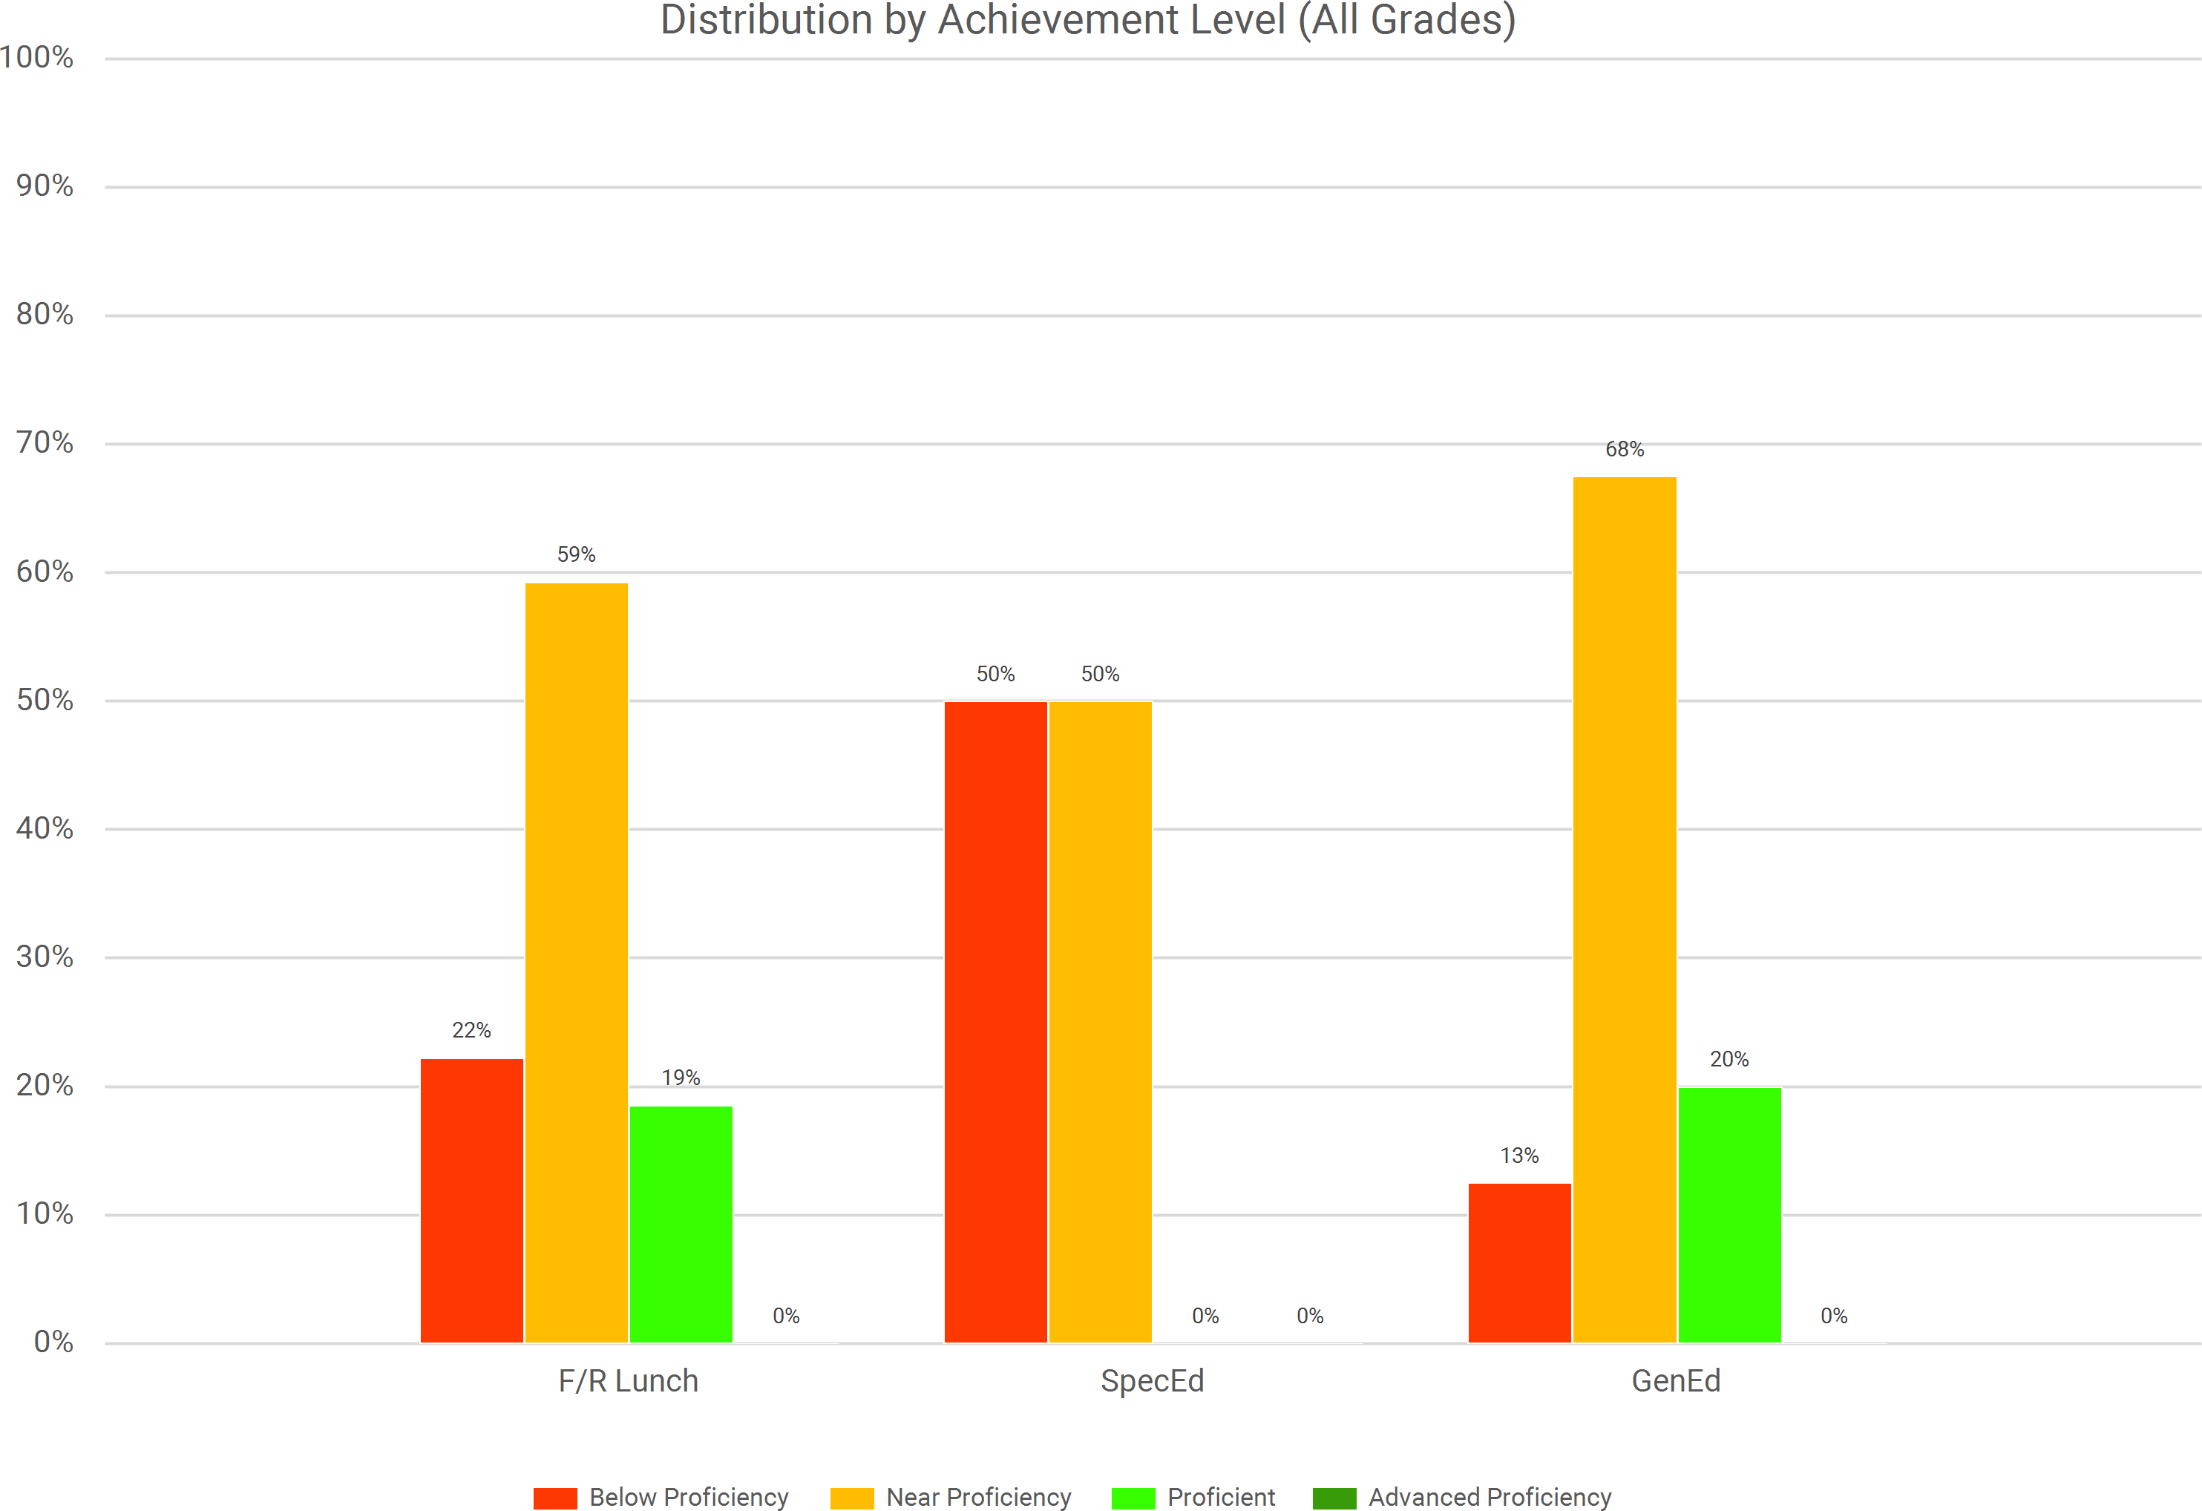
South Hackensack
2024-25 Spring NJSLA by Subgroup Program Science

Slide 68
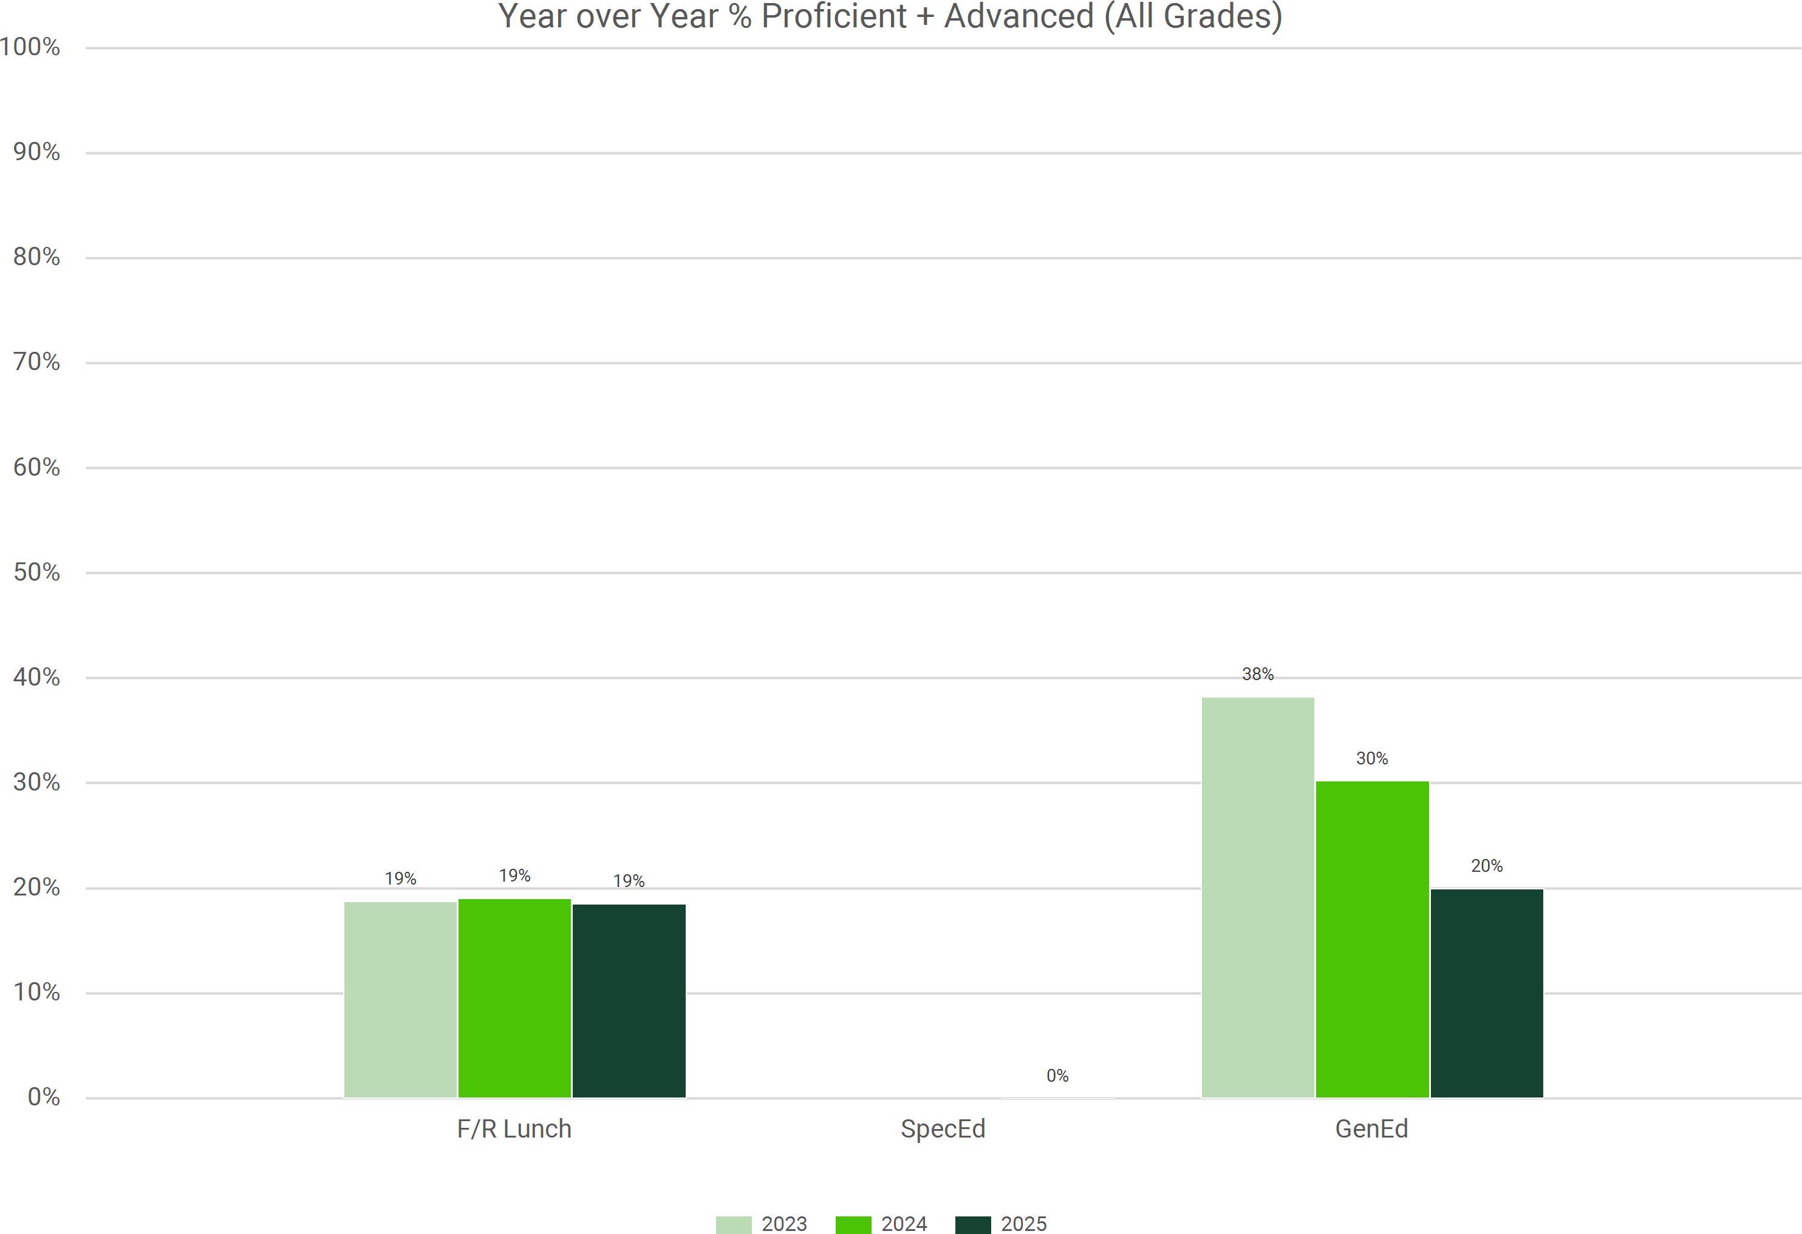
South Hackensack
2024-25 Spring NJSLA by Subgroup Program Science

Slide 69
QUESTIONS TO GUIDE DATA REFLECTION
How will we use NJSLA data to identify strengths and opportunities for growth in curriculum and instruction?
    What specific NJSLS are areas of opportunity and concern?
    What are the subscores of opportunity and concern?
How will we use NJSLA data to inform the conversations of our educators?
Which students moved up one or more levels?
Which students maintained achievement?
Which students moved down one or more levels?
Is there a subgroup of students who could benefit from additional opportunities for mastery, and if so – is there a trend to which standards need such opportunities?

Slide 70
TREND ANALYSIS
ELA
Growth in Top Grades: Grade 6 (87.5% proficient/advanced) and Grade 8 (84.7%) showed strong performance. Grade 8 saw a +22.7% increase in "Exceeding Expectations" (Level 5).
Opportunity for growth in grade 5 ELA, significant increase in students scoring levels 1-3
Opportunity for growth among special education, ML, and free/reduced lunch status
MATH
Algebra Success: Middle school Algebra I students achieved an 80.0% proficiency rate
Opportunity for growth in grade 8 math, significant number of students needing foundational support
Opportunity for growth among special education, ML, and free/reduced lunch status
SCIENCE
Opportunity for growth overall
Opportunity for growth among special education, ML, and free/reduced lunch status

Slide 71
INTERVENTIONS BY SUB GROUP
MULTI LANGUGE LEARNERS
Creation of lunch bunch support groups to assist with assimilation to the new educational system
Continuation of ML PLC
Scheduling supports, especially during writing periods
Lexia, Raz Kids, and Elli to assist with independent work connect to content areas
Use of AI to create lessons that reflect specific language proficiency
Review of ML grading
SPECIAL EDUCATION
Increased opportunities for inclusion
Increased targeted interventions during pull out
FREE AND REDUCED LUNCH
          Use the tiered attendance approach to prioritize outreach for F/R Lunch families and collaborate on specific needs is essential to ensure they don't miss core instruction. Special emphasis is placed on the breakfast program.

Slide 72
INTERVENTIONS
ELA
Literacy Coaching & Screeners: Utilize the Title-funded Literacy Coach to support teachers in interpreting DIBELS data for grades K-3. This early identification ensures that students are on track before reaching the Grade 5 benchmark where recent declines were noted. Additional periods with the Literacy Coach scheduled for current grade 6.
Targeted ML Support: The Multi-Lingual (ML) teacher will provide direct ELA instruction to ML students, ensuring specialized language acquisition strategies are embedded within core literacy content
Benchmark Data Analysis: Use Link It training to perform item analysis on ELA benchmarks. Teachers will specifically map these results to District Evidence Statements to specific standards of concern
Implementation of flex period in elementary grades
MATH
Curriculum & Intervention Refresh: Proceed with the purchase of a new math program to address the achievement gaps in middle school
Intervention Management: Implement Link It Intervention Manager PD to streamline the I&RS process. This will help identify students at Level 1 and provide them with additional support focused on the specific items they missed during class diagnostics
Grouping Strategies: Use Link It’s class diagnostics and grouping tools to create flexible instructional targeting students currently "Partially Meeting" expectations to move them toward proficiency
Implementation of flex period in elementary grades

Slide 73
INTERVENTIONS CONTINUED
SCIENCE
Science PLC: Focus the Science Professional Learning Community (PLC) on non-fiction literacy skills. This addresses the 61.4% of students district-wide who are only "Near Proficiency" in Science by helping them better navigate complex technical texts. Collaboration among middle school science staff and elementary staff, utilizing middle school lab environment to create authentic lab experiences for elementary grades.
Middle School Benchmarks: Implement new science benchmark assessments in middle school to provide real-time data on student progress, moving away from relying solely on annual NJSLA-S results.
Implementation of flex period in elementary grades
CULTURE AND ATTENDANCE (FOUNDATIONAL)
Tiered attendance rigor for all students
Tiered tardiness rigor for all students
Attendance awards and celebrations to promote regular and timely attendance
The combination of highly trained coaching staff, benchmark assessment training, and a rigorous attendance culture creates a sustainable model for growth.

Slide 74
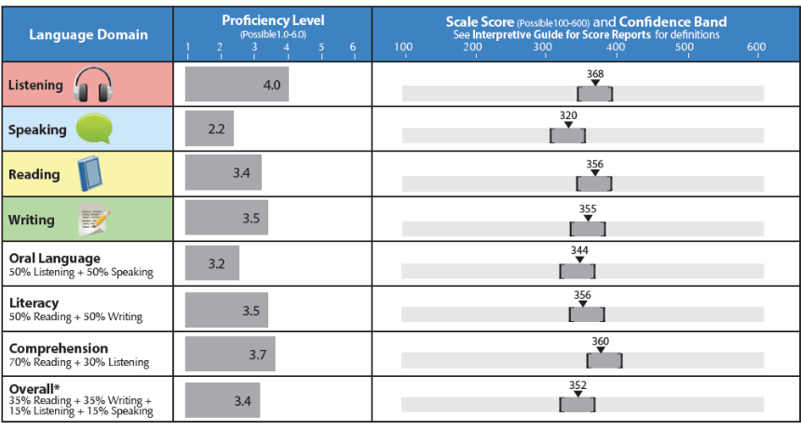
ACCESS FOR ELLS (ML) 2.0
English Language Proficiency Test
Performance Levels:
Level 1 – Entering
Level 2 – Emerging
Level 3 – Developing
Level 4 – Expanding
Level 5 – Bridging
Level 6 – Reaching
Minimum score to exit – 4.5

Slide 75
 | 22-23 Administration | 23-24 Administration | 24-25 Administration
Number of students testing | 53 | 58 | 56 (out of 56)
Percent achieving 4.5 or greater | 21% | 19% | 29%
Sheltered Instruction Intervention
  Develop English skills while learning subject matter content
  All staff have been trained (September 5, 2024), new staff trained this year
  Ensures ML services for all those who apply and are accepted into the program
  Coordinated and delivered by our ML coordinator and Sheltered Instruction certified trainer, Ms. Mary Gould.
Sheltered English instruction is a research based instructional approach that engages MLs above the beginner level in developing grade-level content-area knowledge, academic skills, and increased English proficiency.
Our teachers are trained to use strategies, techniques, and materials for creating grade-level curriculum content (Reading, Science, Social Studies, Math) more accessible for ML students while promoting their English language development. Teachers use clear, direct, simple English and a wide range of scaffolding strategies to communicate meaningful input in the content area to students.
We continue to work with families to provide support for continued learning at home.

Slide 76
DYNAMIC LEARNING MAPS
The DLM Alternate Assessment System helps educators facilitate student success by illustrating the interrelation among the knowledge, skills, and understandings necessary to meet academic content standards in a learning map model.
Participation less than 10.

Slide 77

THANK YOU:
Students for your hard work, perseverance, and dedication to growth and improvement.
Teachers for your exemplary ability to analyze data, your commitment to professional learning, and your enthusiasm towards teaching the whole child
Families, including parent led organizations, for your constant involvement and support
District administration for your leadership and thoughtful decision making relative to student needs
Board of Education members for your support of all district initiatives.

