Slide 1

Welcome!
Strategic Plan 2033:
Community Engagement
May 12, 2026

Slide 2
Welcome
SPPS 2033 Strategic Plan
Priority Areas
Key Topics & Proposals
  Activity
Closing

Slide 3

SPPS 2033
2026-27 to 2032-33 Strategic Plan launching
our new strategic direction

Slide 4





SPPS 2033 Roadmap
The goal of our strategic planning process is to make decisions and take actions that shape and guide what SPPS is, what we do, and why we do it.
Who is involved?
Students
Families
Staff
Community

Slide 5
SPPS 2033: Three Priority Areas & 10 Key Topics
Priority Areas | Key Topics
Excellence in Instruction Ensuring every student receives high-quality, culturally responsive instruction that accelerates their growth | Achievement Gap Reduction & Academic Acceleration Initiative Continuous Improvement Infrastructure Literacy Consistency and Coherence
Deliberate Inclusion Creating schools where every student and staff member experiences dignity, connection and comprehensive support | Discipline and Belonging Review Family Communication and Language Access Standards Special Education Programming Enhancement Staff Retention and Recruitment Strategy
Sustainable Infrastructure Purposeful analysis of how we allocate funding for facilities, staff and programs through a lens of equity | Analysis of Current Resource Allocation Models Facility Equity Assessment & Longitudinal Plan Marketing and Enrollment Recovery Campaign

Slide 6
SPPS 2033 Timeline
Final plan
Finalize strategies
Engagement - May
Draft strategies
Engagement - March survey
Strategy formation teams
Engagement - February
Advisory taskforce
100-day report

Slide 7



How we have built the strategic plan so far
Action
Teams
9 teams of SPPS staff
developing proposals
Community
Engagement
88 focus groups
3 online surveys
2,852 people engaged
Advisory
Taskforce
34 community members
Meet monthly since January
Advise on process and ideas
Notes:
Why these supports are so highly valued: Participants noted that these methods are essential because they allow for immediate feedback, the ability to reteach specific skills, and the fostering of stronger relationships between students and staff, which are seen as the foundation for all learning.

Slide 8
What we’ve heard from you so far
Families shared that for multilingual students, dignity is closely tied to respecting their language
School and district leaders suggest strengthening magnet schools to increase enrollment
Staff mentioned that small group instruction and individualized attention are powerful supports for students
Students shared that discipline and belonging should start with teachers

Slide 9
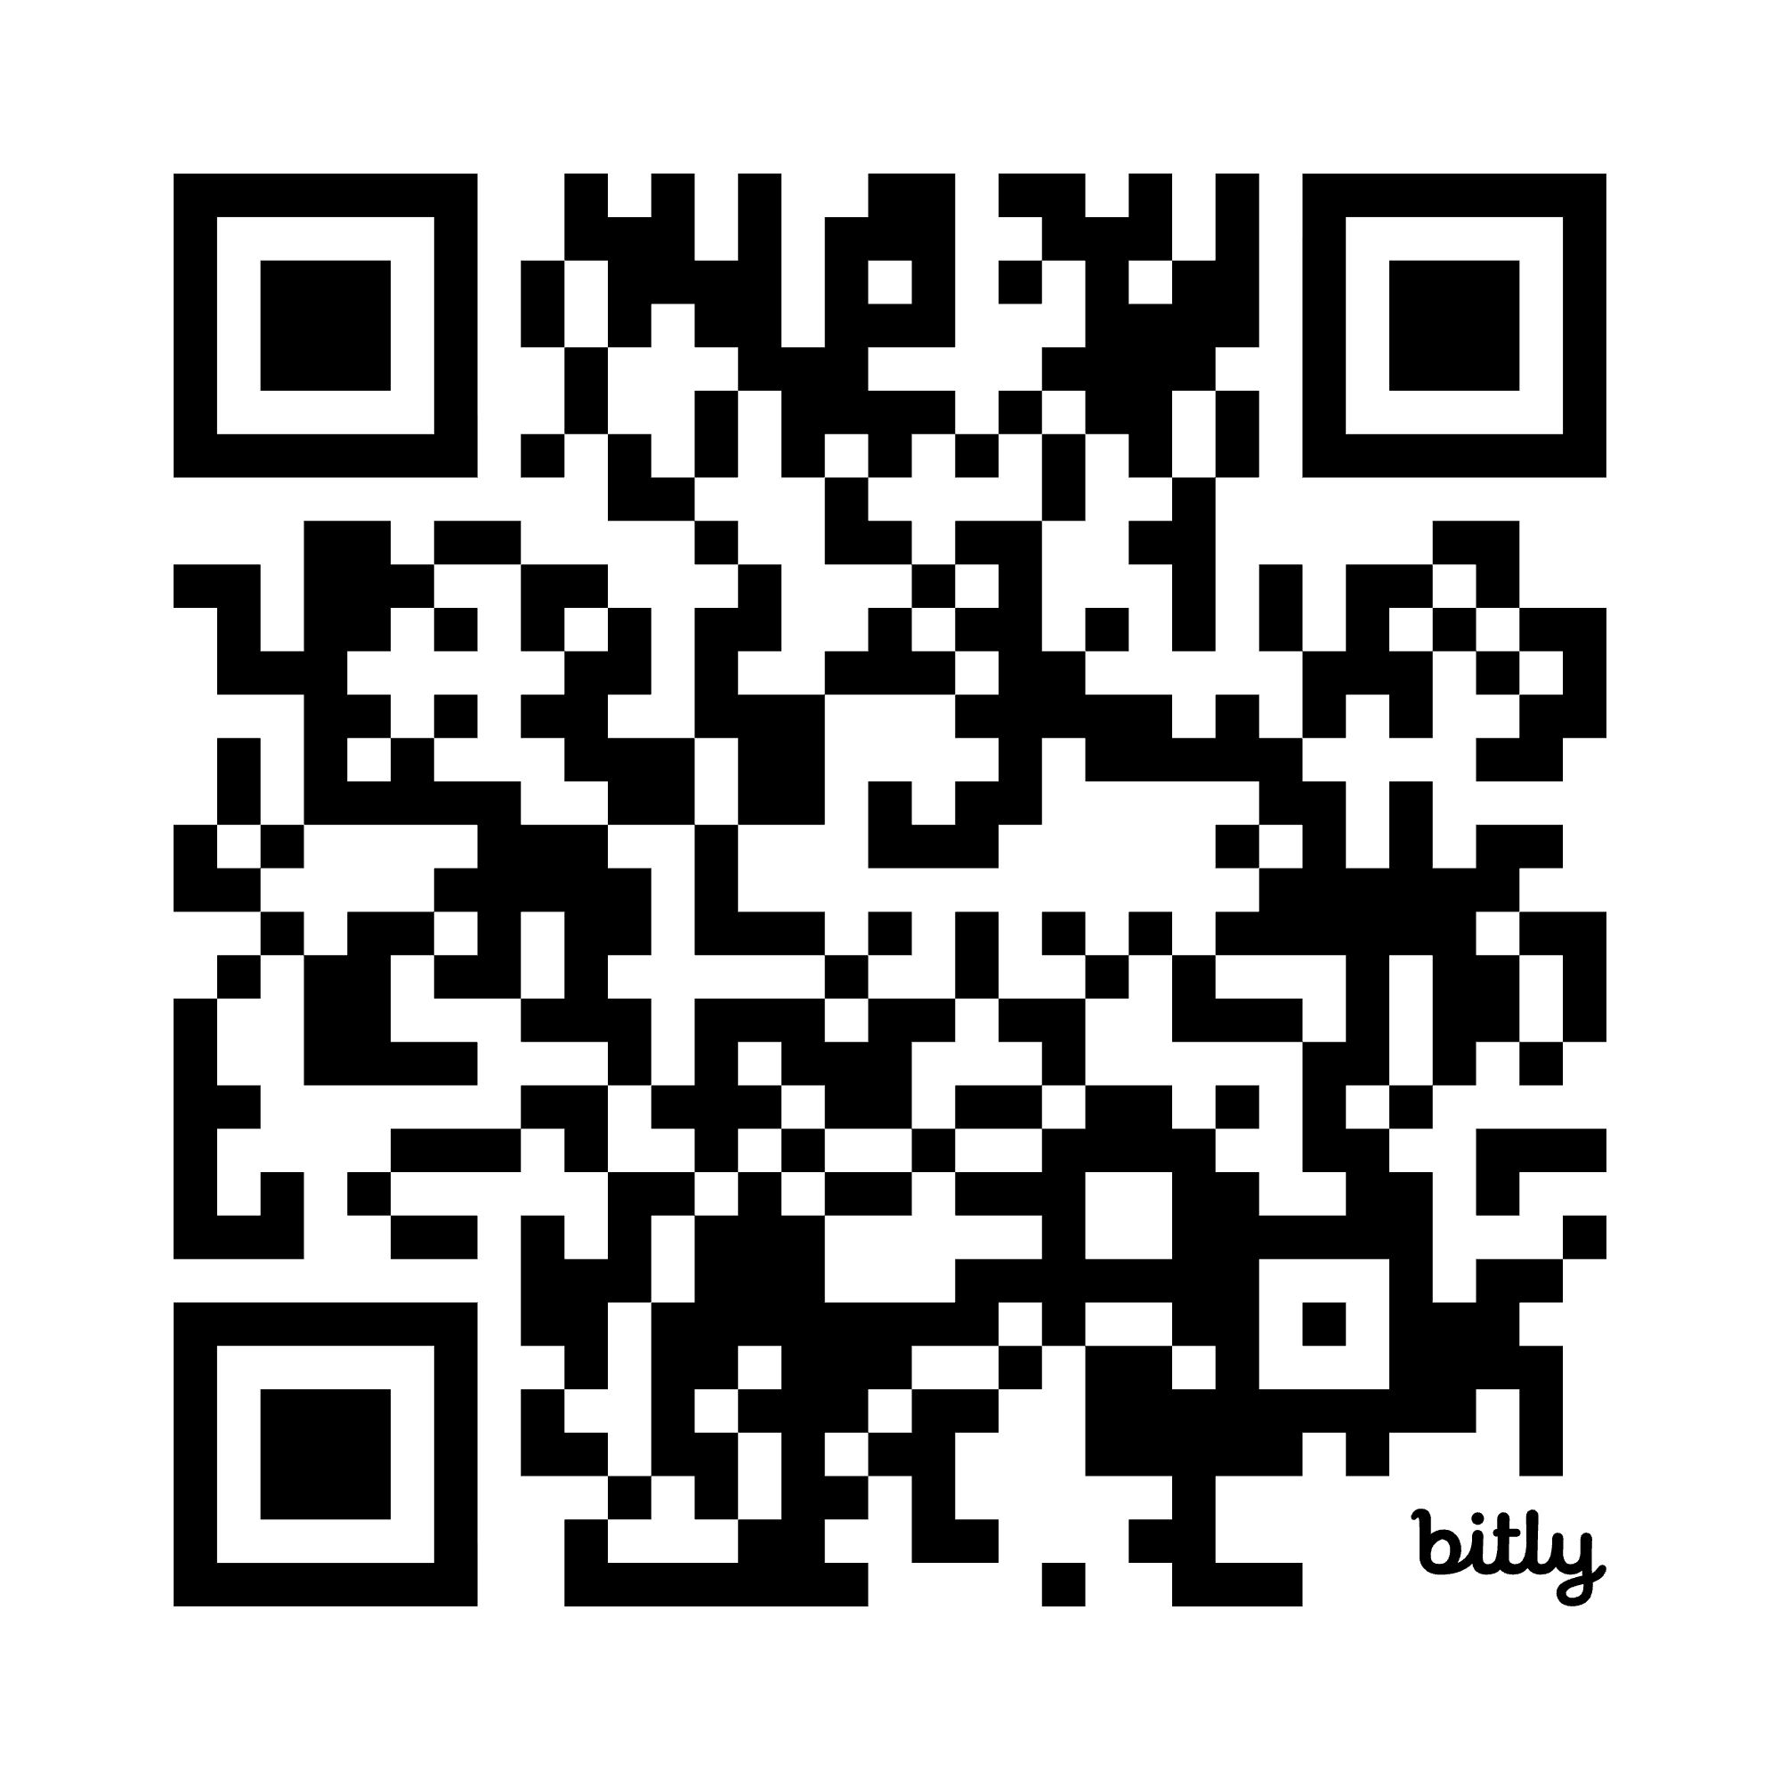
Here are the key topics to learn about and provide feedback on:
Achievement Gap Reduction & Academic Acceleration Initiative
Continuous Improvement Infrastructure
Literacy Consistency and Coherence
Discipline and Belonging Review
Family Communication and Language Access Standards
Special Education Programming Enhancement
Staff Retention and Recruitment Strategy
Analysis of Current Resource Allocation Models
Marketing and Enrollment Recovery Campaign
Notes:
(Link breakout rooms here)

Slide 10
Activity
Where do you see the strategies addressing the challenge? Where are there gaps? What is missing?
Use stickers: Green for “This works”
Yellow for “This MIGHT work”
Red for “This won’t work”

Slide 11
Thank You!

