Slide 1

Mitchell High School
Annual Title I Parent Meeting
2025-2026 School Year
Partnering with families for student success
The School Where CHAMPIONS Are MADE: Academically, Athletically, and Socially
Mitchell High School • Home of the Mighty Tigers

Slide 2


Welcome, Mitchell Families
Thank you for partnering with us this school year.
We are excited to work alongside our families as we support academic achievement, student growth, and a strong school-home partnership. Tonight’s meeting shares the key parts of our Title I program, the supports available to students, and the many ways families can stay involved.
"Good communication is such an important part of any great relationship. Here at Mitchell High School, we are committed to assisting our families and students in all the best ways possible."
Tonight we will review:
• How Title I supports students and teachers at Mitchell High School
• Family engagement opportunities and parent rights
• School plans, funding, and upcoming events
Kelvin M. Meeks, Principal
Kenya N. Minor, Vice Principal
Mitchell High School • Annual Title I Parent Meeting • 2025–2026
Notes:
[Sources]
- Adapted from the user-provided presentation template: 2024 Title I Parent Meeting UPDATED.pptx
[/Sources]

Slide 3
AGENDA
• Welcome & Introductions
• What is the Title I Program?
• Parents’ Right to Know
• Family Engagement Plan & School-Parent Compact
• Assessment, Curriculum & Instruction
• Opportunities for Parent Engagement
• How Parents Can Support Learning at Home
• School Improvement Goals & Student Achievement
• Questions & Contact Information
Mitchell High School • Home of the Mighty Tigers

Slide 4
What is the Title I Program?
Federal funds that help schools strengthen academic support and family engagement.
Title I is part of the Every Student Succeeds Act (ESSA).
It is federally funded to support students at risk of not mastering academic
and state standards.
Title I supports schoolwide improvement so that every student has access to a
high-quality learning experience and timely help when needed.
Identifying students who need extra academic support
• providing supplemental staff, materials, and programs
• creating opportunities for family engagement without barriers
• supporting a well-rounded education in core content areas
Mitchell High School • Home of the Mighty Tigers

Slide 5
What is the Title I Program?
How Can Title I Funds Be Used?
Federal funds that help schools strengthen academic support and family engagement.
Title I funds may be used for:
Instructional support for struggling learners
Teacher professional learning and classroom resources
Family workshops, conferences, and engagement activities
Targeted interventions that align to state standards
Goal: Increase student achievement through strong teaching, targeted support, and meaningful family partnership.
Mitchell High School • Home of the Mighty Tigers

Slide 6
Mitchell High School is a Title I School
Mitchell High School receives Title I funding to strengthen instruction,
intervention, academic resources, and student achievement initiatives.
Mitchell High School • Home of the Mighty Tigers

Slide 7
Components of Our Title I Program
1
Increase academic achievement
2
Provide direct instructional support
Focused instruction and support that help students meet grade-level expectations.
Interventions, supplemental resources, and targeted help for students who need it most.
3
Strengthen teacher practice
4
Promote parent education and engagement
Professional development that helps teachers meet student needs more effectively.
Clear communication, training, and opportunities for families to stay involved.
Mitchell High School • Annual Title I Parent Meeting • 2025–2026
Notes:
[Sources]
- Adapted from the user-provided presentation template: 2024 Title I Parent Meeting UPDATED.pptx
[/Sources]

Slide 8
Parents' Right to Know
Under ESSA, parents have the right to request professional qualifications
of their child’s teachers and instructional staff.
Mitchell High School • Home of the Mighty Tigers

Slide 9
Parent Right to Know Qualifications of Personnel
Families have the right to know about the qualifications of their child’s teachers and paraprofessionals in a school receiving Title I funds.
How to request qualifications
• Whether the teacher has met state qualification and licensing criteria
• Whether the teacher is working under emergency or provisional status
• Whether the teacher is teaching in the certified field of discipline
• Whether paraprofessionals provide services and what their qualifications are
• Send an email or parent note to the school
• Ask the school office for the qualifications request form
• The completed information can then be sent home to your family
Questions are welcome. We want families to feel informed and confident about the people serving their children.
ESSA Section 1112(e)(1)(A)
Mitchell High School • Annual Title I Parent Meeting • 2025–2026
Notes:
[Sources]
- Adapted from the user-provided presentation template: 2024 Title I Parent Meeting UPDATED.pptx
[/Sources]

Slide 10
Family Engagement Plan & School Compact
The Family Engagement Plan explains how families and the school
work together. The School-Parent Compact outlines shared responsibilities
for student success.
Mitchell High School • Home of the Mighty Tigers

Slide 11
School-Parent Compact & Family Engagement Plan
School-Parent Compact
Parent & Family Engagement Plan
A written agreement among families, staff, and students
Explains how each group shares responsibility for student achievement
Describes how the school and families build a partnership around high standards
Developed with parents in an organized, ongoing, and timely way
Explains how families can be involved in planning, review, and improvement
Outlines training, information sharing, and evidence-based engagement strategies
Supports family involvement without barriers
Why it matters
The compact keeps expectations clear and helps everyone work toward the same student goals.
A copy of the plan should be available on the school website and at school events.
Mitchell High School • Annual Title I Parent Meeting • 2025–2026
Notes:
[Sources]
- Adapted from the user-provided presentation template: 2024 Title I Parent Meeting UPDATED.pptx
[/Sources]

Slide 12
School Improvement & Student Achievement
Mitchell High School is committed to improving literacy, mathematics
achievement, graduation readiness, and college & career preparation.
Mitchell High School • Home of the Mighty Tigers

Slide 13
School Improvement Plan & Parent Voice
The Tennessee School Improvement Plan (TSIP) is our continuous improvement roadmap.
How families can help shape the plan
Needs Assessment and Summary of Data
Reading and Math goals, Strategies, and Action Steps
Climate and culture goals that support student learning
Professional development priorities
Coordination of resources and funding decisions
Serve on parent advisory groups
Give input on school goals and family engagement priorities
Share feedback on how funds should support students and families
Participate in meetings, conferences, and surveys
Parent input is essential to a successful Title I program.
Mitchell High School • Annual Title I Parent Meeting • 2025–2026
Notes:
[Sources]
- Adapted from the user-provided presentation template: 2024 Title I Parent Meeting UPDATED.pptx
[/Sources]

Slide 14
Opportunities for Parent Engagement
• Open House
• Parent Surveys
• Parent-Teacher Conferences
• Literacy & Math Curriculum Nights
• Workshops & CCR Training Sessions
Mitchell High School • Home of the Mighty Tigers

Slide 15
Assessment, Curriculum & Instruction
Families receive information regarding academic standards, curriculum
expectations, student progress, and state assessments.
Mitchell High School • Home of the Mighty Tigers

Slide 16
How Parents Can Help at Home
Encourage reading and writing-DAILY
Discuss current events and nonfiction texts
Monitor assignments and grades
Maintain communication with teachers
Mitchell High School • Home of the Mighty Tigers

Slide 17

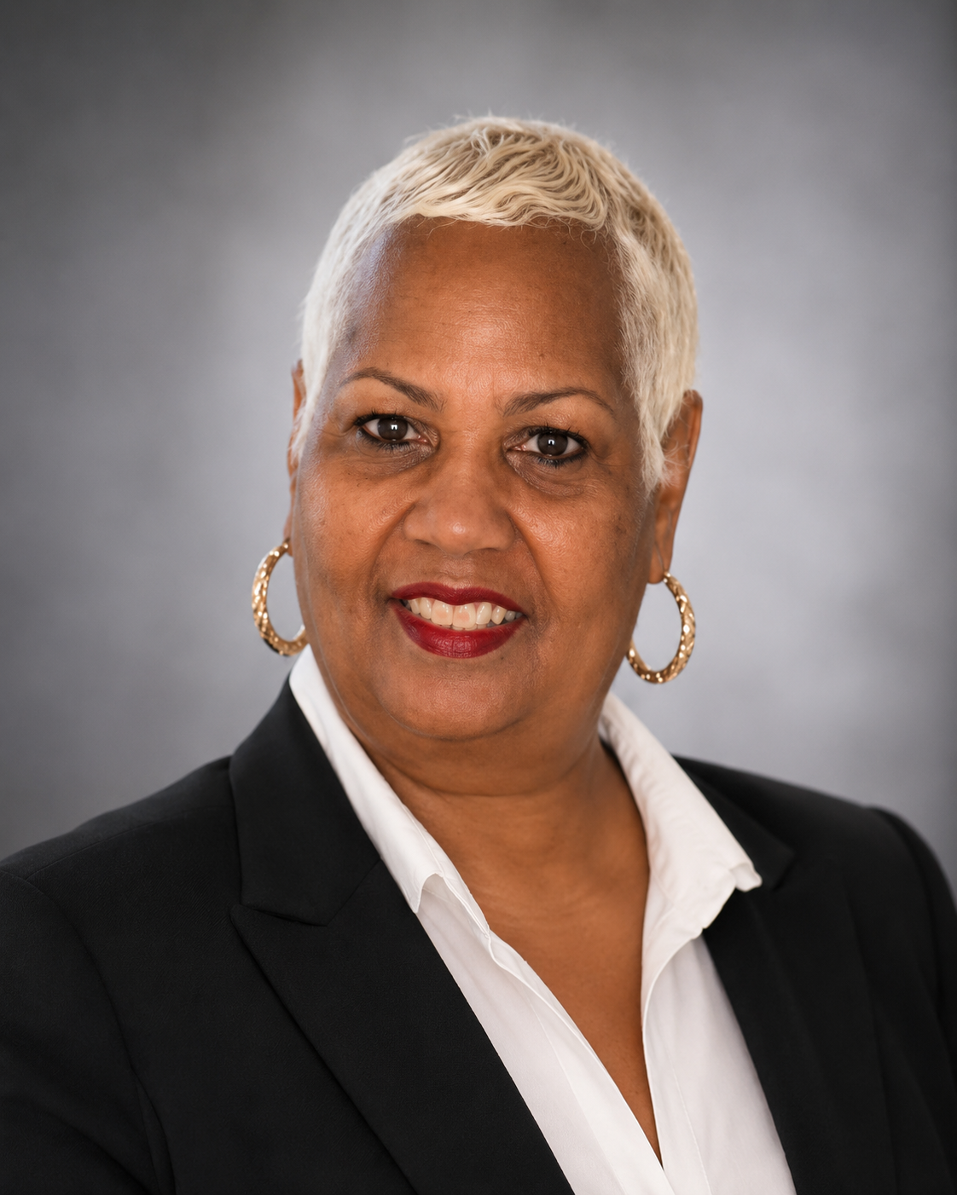
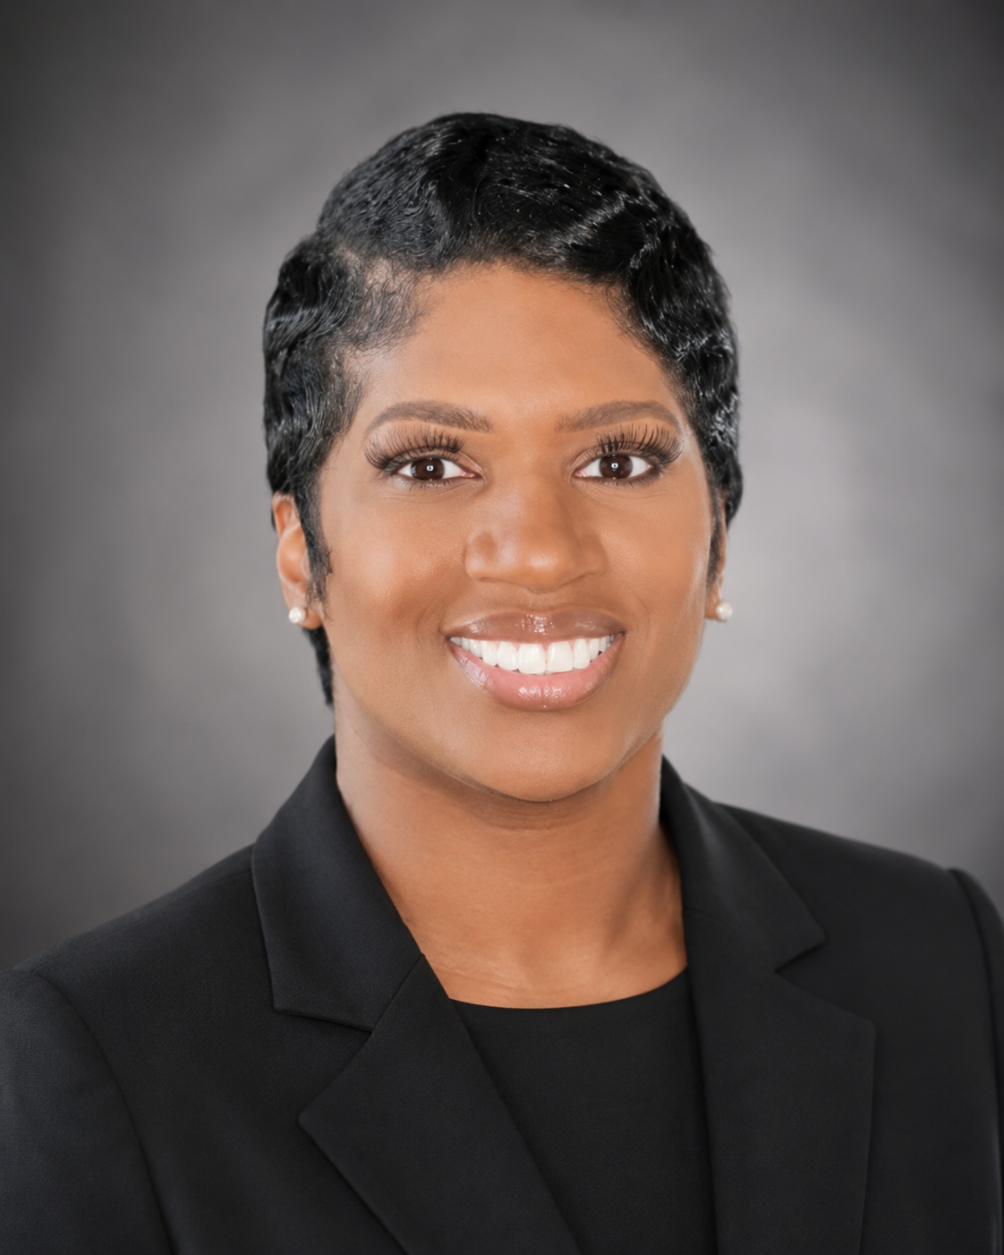
Student Support Contacts
Mitchell High School
Tiger Pride • Tiger Strong
Crystal Cooper
Tonya Pryor
Precious Chapman
Professional Learning Communities
Coach
Family Engagement Specialist
Attendance Truancy Liaison
Need help for your student? Mitchell families can reach out to our support team for attendance questions, behavior support, counseling services, family engagement opportunities, and school-home communication.
Mitchell High School • Annual Title I Parent Meeting • 2025–2026
Notes:
[Sources]
- Adapted from the user-provided presentation template: 2024 Title I Parent Meeting UPDATED.pptx
[/Sources]

Slide 18

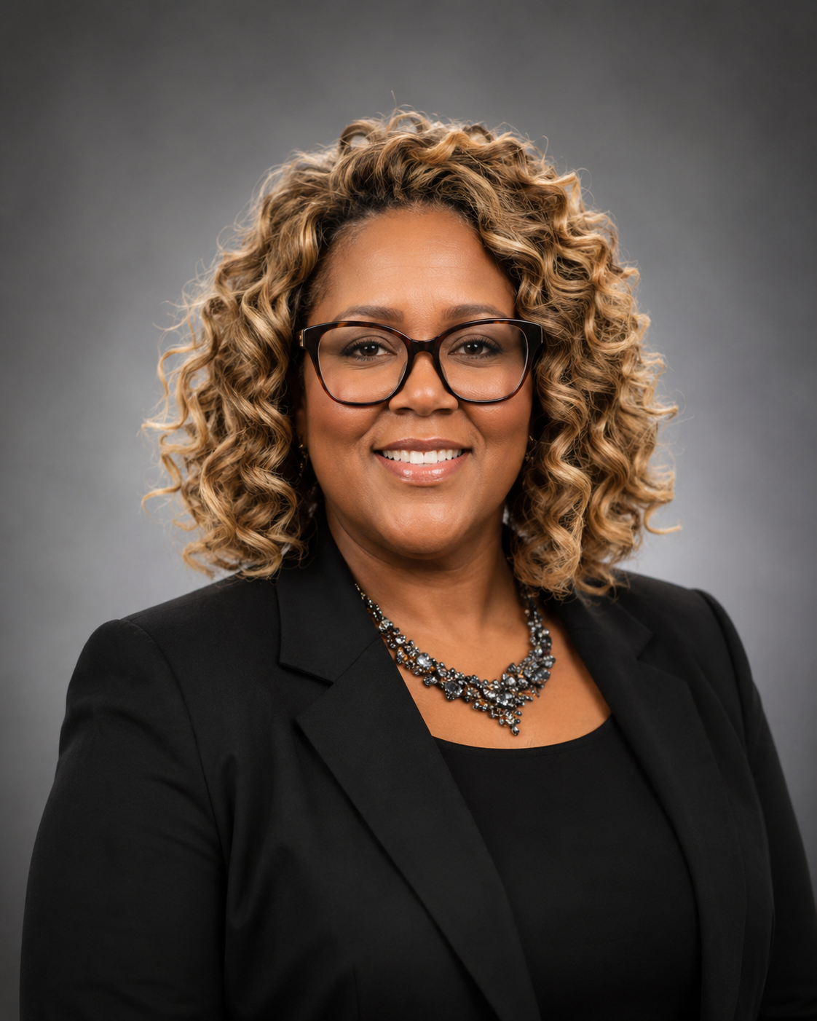
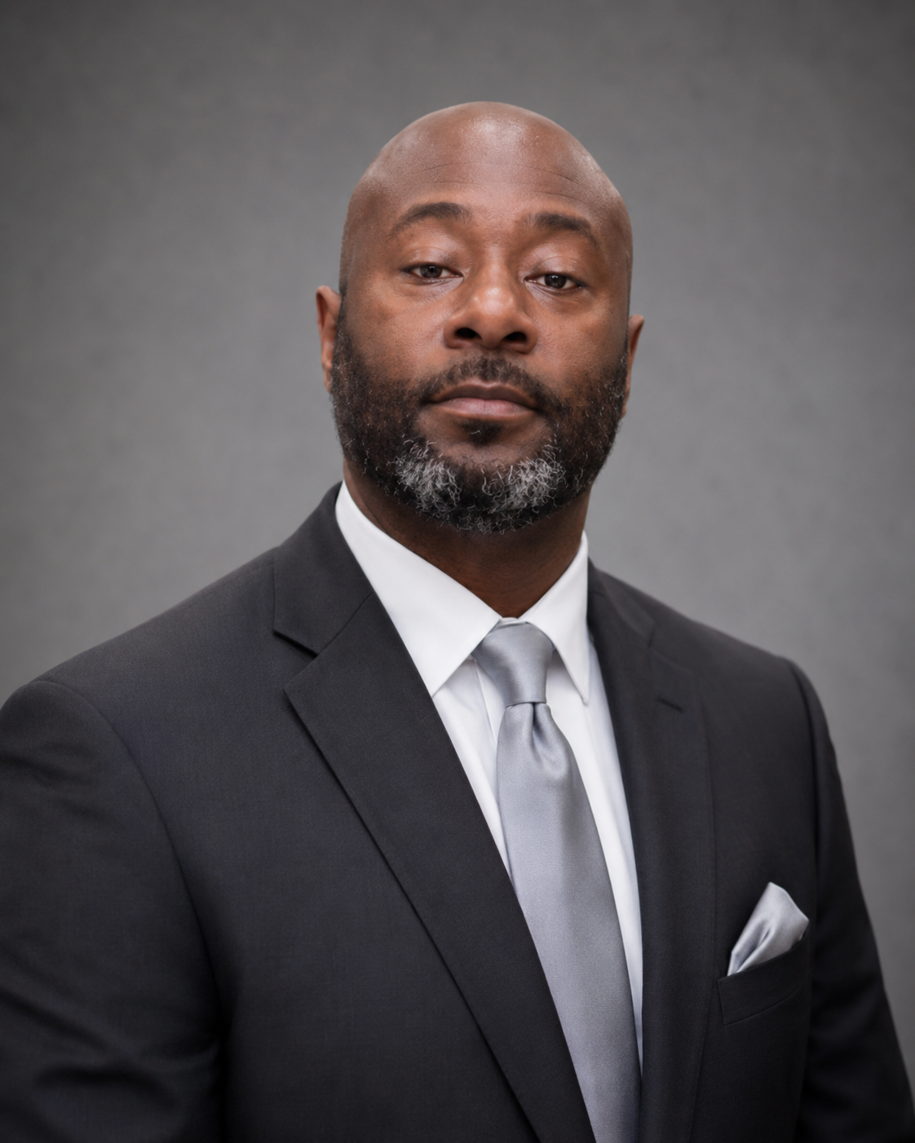
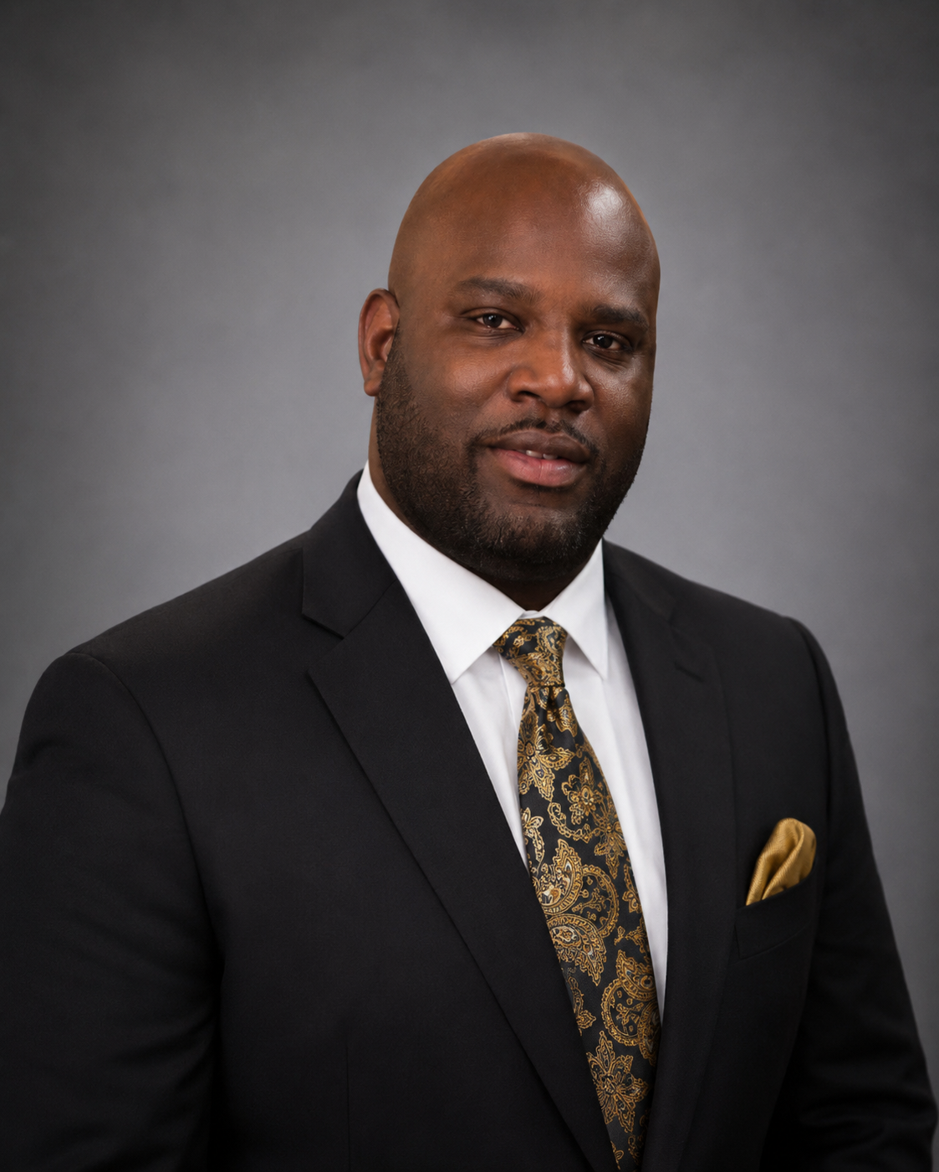
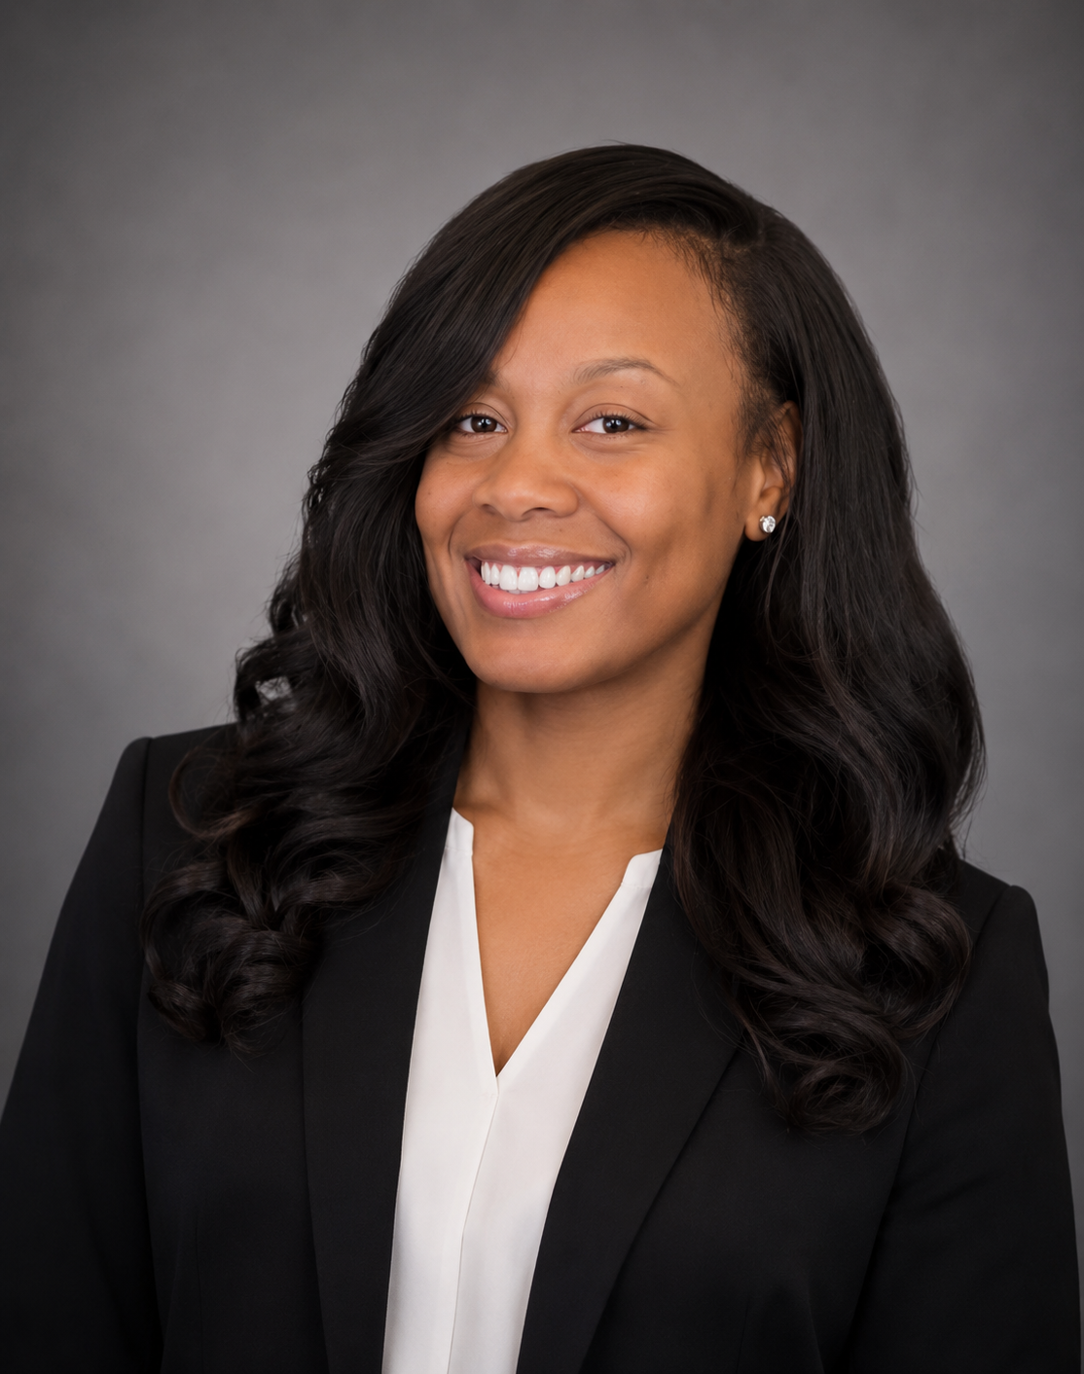
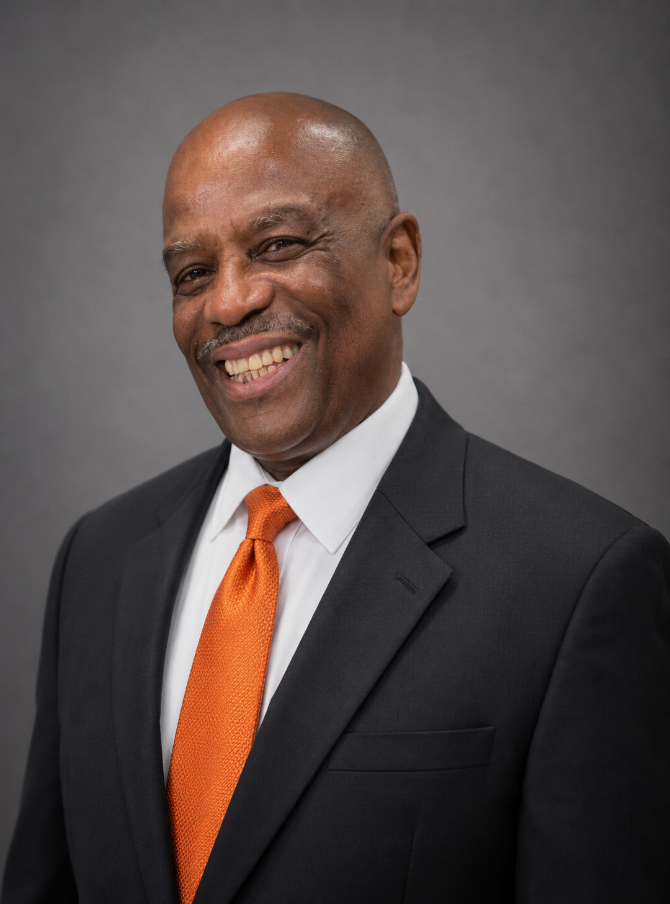
Meet the Team
Title I, instructional, and family support leaders.
Marquita Rice
Dr. Partricka Cole
Rodney Jackson
Antrel Daniel
Instructional Facilitator
Professional School Counselor
Professional School Counselor
Graduation Coach
Our school team works together to support academic progress, student wellness, attendance, behavior, and strong family-school communication.
Tiger Pride
Mitchell High School • Annual Title I Parent Meeting • 2025–2026
Ariel Jones
Reginald Drake
SMS Clerk
Safety Special Project Coordinator
Notes:
[Sources]
- Adapted from the user-provided presentation template: 2024 Title I Parent Meeting UPDATED.pptx
[/Sources]

Slide 19
Funding Snapshot & Family Input
Update the highlighted fields before presenting.
Title I families should have a voice in how parent and family engagement funds are used.
Overall Title I Program Funds
Parent & Family Engagement Set-Aside
How funds were used last year
$43,784.14
2025–2026 school allocation
$2778.85
Examples: parent workshops, family resources, translation/communication support, materials for meetings, take-home learning supports.
How families can help decide how funds are used this year
• attend parent advisory meetings and family engagement events
• complete school or district surveys
• share priorities for workshops, communication, and support resources
• provide feedback during review of the family engagement plan
Mitchell High School • Annual Title I Parent Meeting • 2025–2026
Notes:
[Sources]
- Adapted from the user-provided presentation template: 2024 Title I Parent Meeting UPDATED.pptx
[/Sources]
This slide intentionally includes editable placeholders for current-year funding amounts.

Slide 20
Upcoming Dates, Events, and Workshops
Use these editable spots to add this year’s calendar details.
Parent-Teacher Conferences
Testing Reminders:
September 4, 2025
January 22, 2026
ACT
October 2025 (Seniors)
March 2026 (Juniors)
Pre-ACT-October 2025
April 13 – May 5, 2026 – End of Course TCAP
April – May 2026 - Dual Credit and Advanced Placement
Parent Advisory Council Meetings
Progress Report and Report Card Dates:
September 3rd and October 22nd
November 12th and January 14th
February11th and April 1st
April 22nd and May 27th
3rd Thursdays of the Month-Beginning September 2025
TBD
Parent Workshops/Training Sessions
Mitchell High School • Annual Title I Parent Meeting • 2025–2026
Notes:
[Sources]
- Adapted from the user-provided presentation template: 2024 Title I Parent Meeting UPDATED.pptx
[/Sources]
This slide includes editable placeholders for the school-year event calendar.

Slide 21

Questions & Contact Information
Thank you for partnering with Mitchell High School
to support student success!
Together we can make this an amazing school year for every Mitchell Tiger.
We believe in our students, value our families, and appreciate your continued support of Mitchell High School.
Mailing Address
658 W. Mitchell Road
Memphis, TN 38109
Contact Us
https://schools.scsk12.org/mitchell-hs
School Website
Phone Number
901-416-8174
Mitchell High School • Home of the Mighty Tigers

