Slide 1

Understanding FAST & State Testing (Grades 6–8)
This Photo by Unknown Author is licensed under CC BY-SA
Learn about FAST, EOCs, and how to support your child.

Slide 2

What Tests Will My Child Take?
FAST ELA & Math (3x/year)
8th Grade Science
Civics EOC
Algebra 1 & Geometry EOCs (some students)

Slide 3
FAST Achievement Levels
Level 1: Below
Level 2: Approaching
Level 3: Proficient
Level 4: Above
Level 5: Advanced
https://flfast.org/families.html

Slide 4

Important: FAST is Adaptive
Do NOT skip questions
Answer carefully the first time
Test adjusts based on answers

Slide 5

Brain Dump Strategy
Write formulas and notes at the start to reduce stress

Slide 6

Process of Elimination (POE)
Cross out wrong answers
Narrow choices
Make best guess

Slide 7


Highlight & Annotate
This Photo by Unknown Author is licensed under CC BY
Highlight key words
Take notes on passages

Slide 8

Take Notes
Show work in math
Break down problems
This Photo by Unknown Author is licensed under CC BY-SA-NC

Slide 9
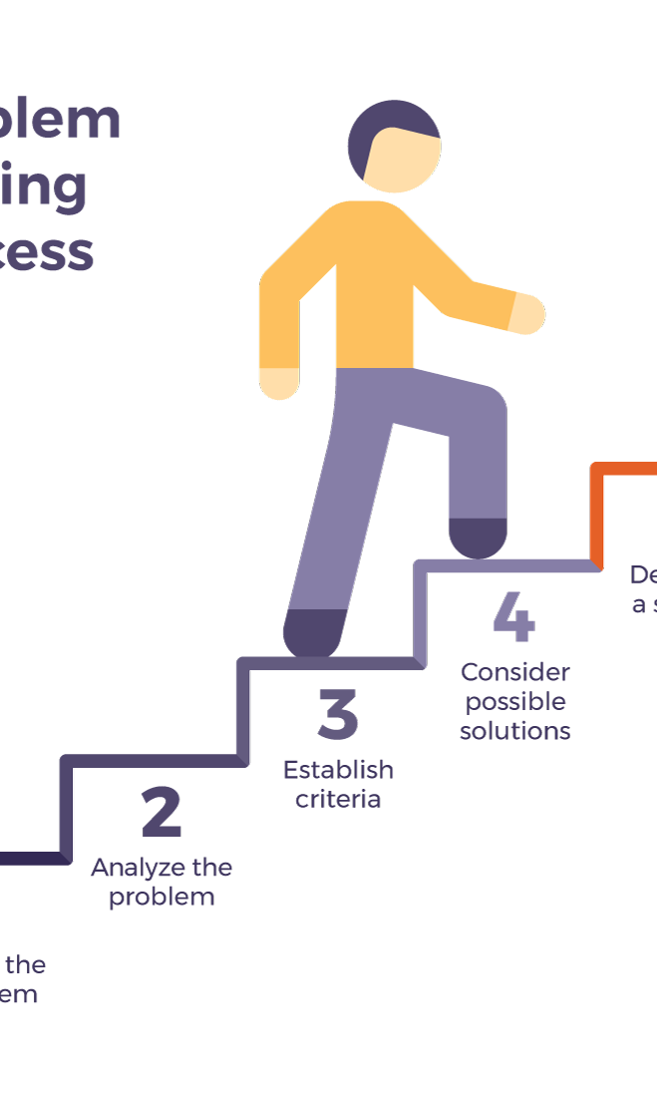
Break Down the Question/steps
Ask: What is this asking?
Answer all parts
This Photo by Unknown Author is licensed under CC BY-SA

Slide 10
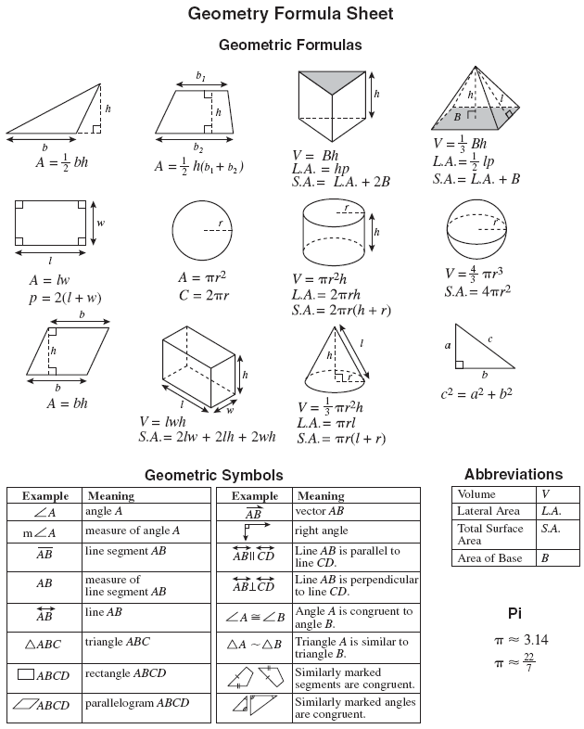
Use Formulas
Write and apply formulas carefully
This Photo by Unknown Author is licensed under CC BY

Slide 11

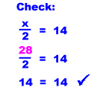
Double Check Work
This Photo by Unknown Author is licensed under CC BY-SA-NC
Reread questions
Check answers
Make sure you answer all the questions and double check your work
This Photo by Unknown Author is licensed under CC BY

Slide 12


Use All Your Time
Don't rush
Review answers
This Photo by Unknown Author is licensed under CC BY-SA-NC
This Photo by Unknown Author is licensed under CC BY-NC-ND

Slide 13

Websites and resources
https://flfast.org/families.html
https://www.fldoe.org/accountability/assessments/k-12-student-assessment/archive/fcat-2-0/sample-questions-answer-key.stml
This Photo by Unknown Author is licensed under CC BY-SA-NC
This Photo by Unknown Author is licensed under CC BY-ND

