Slide 1
Site council meeting
5-12-26

Slide 2


Agenda
Enrollment
Staffing
AASA
4th Quarter Celebrations
PTO Events
End of Year Systems
A Look at Next Year
THANK YOU!

Slide 3
Enrollment Update
Year 1- 525
Year 2- 700
Year 3- 715
Year 4- 740
Year 5- 723
Year 7- 766
Year 6- 732
Year 8- 768
Year 9- 775
Year 10- 776 (408 OE) 52% OE
Year 11- 748 (441 OE) 59% OE (32/94 K in Boundary)

Slide 4

Staff Updates
Retained 92% of certified staff 45/49
Retained 89% of support staff 17/19

Slide 5


AASA
Testing is complete!
Testing took place over 4 weeks.
Official results will be out soon.

Slide 6

Student of the month- 576 students recognized over the last two years
Students receive:
  Certificate
  Medal
  Recognition in Front of Peers
  Extra Recess
  Sticker
  One Student Per Month Selected for Town of Gilbert Recognition

Slide 7
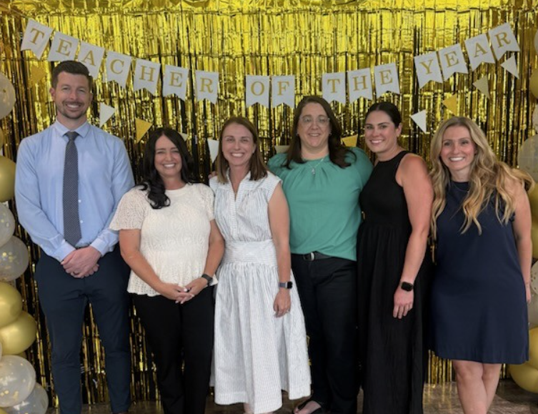
HUSD Teacher of the year- mrs. Brandy Resman
Over 7 years at Bridges and former administrator in Michigan
Received 5 votes from across the campus (multiple grade levels)
Outstanding educator that cares deeply about students
Radiates positivity and support throughout the entire school

Slide 8
Teacher of the Year Video
25-26 Teacher of the Year - Brandy Resman | BRG

Slide 9

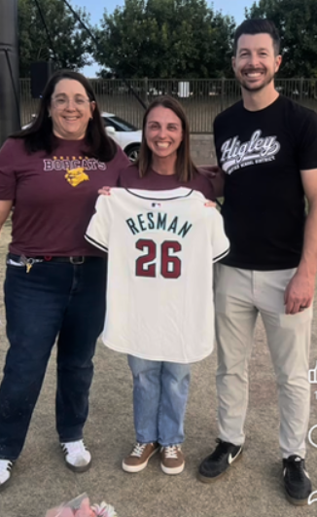
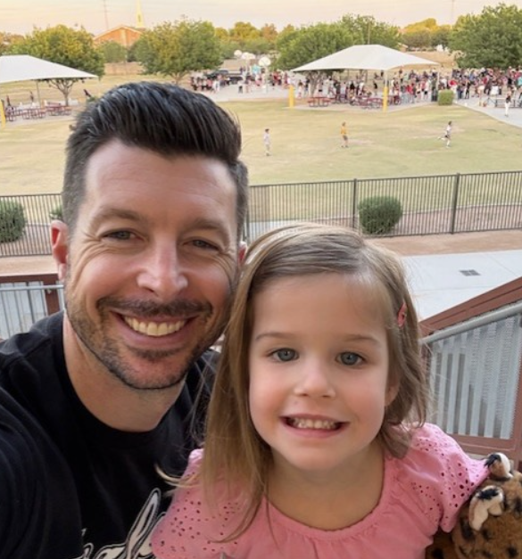
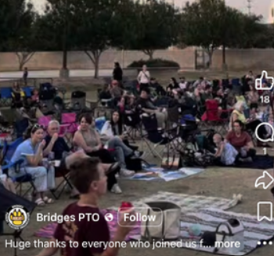
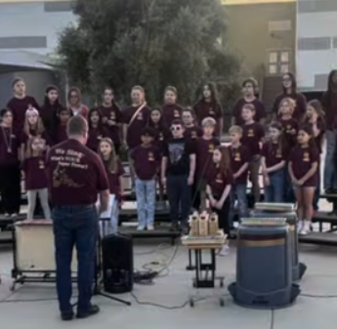
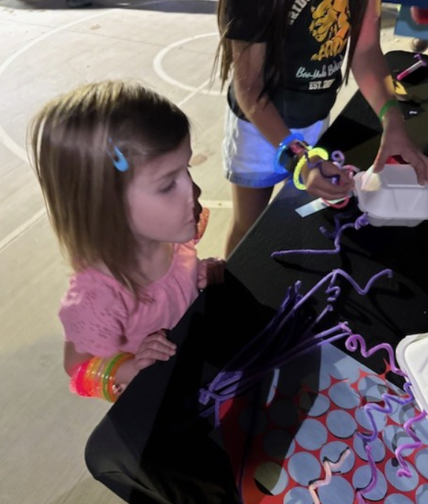
Spring Movie Night

Slide 10

Teacher appreciation week

Slide 11

Bobcat breakfast

Slide 12
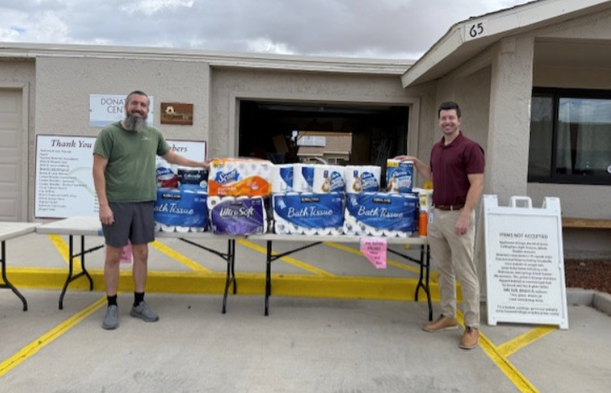
Toilet paper drive- House of refuge

Slide 13

Hydration Drive- Town of Gilbert

Slide 14
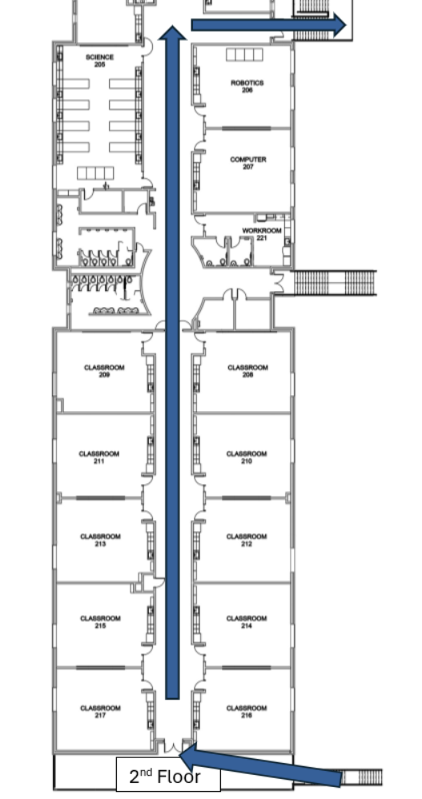
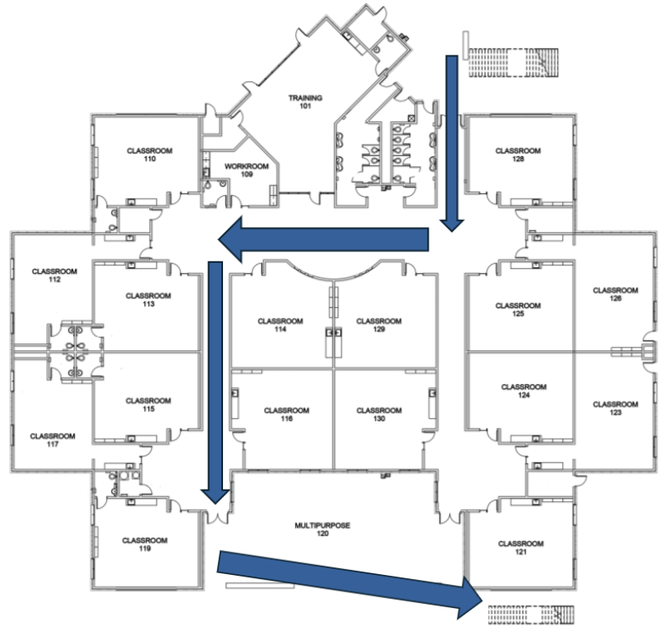
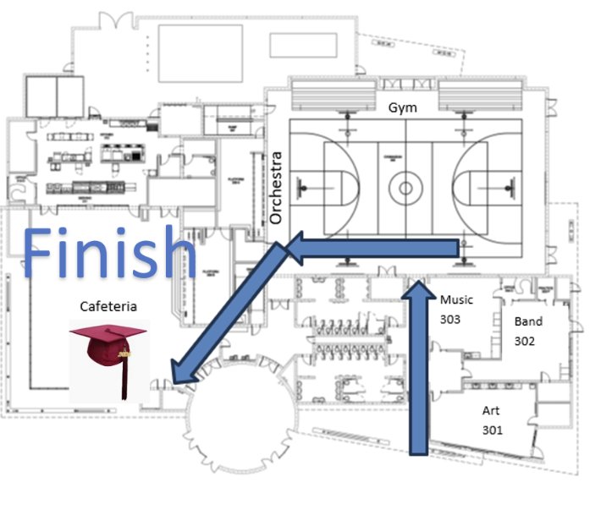
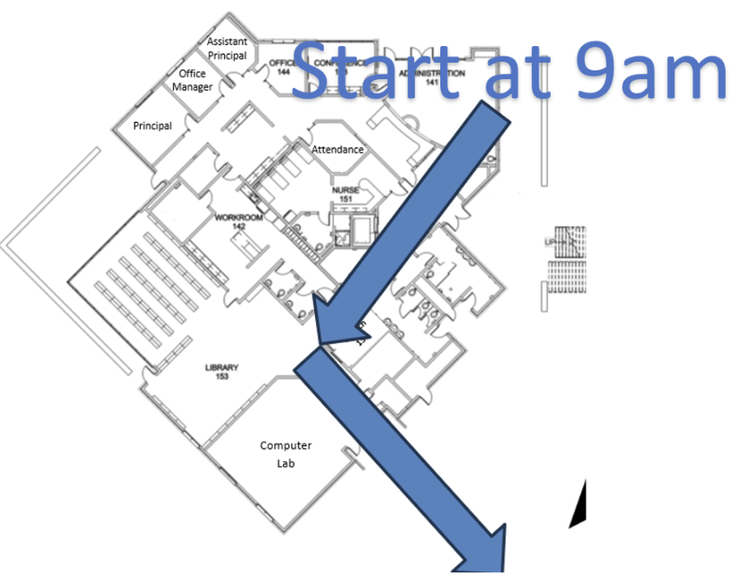
High School Clap Out- May 18th

Slide 15
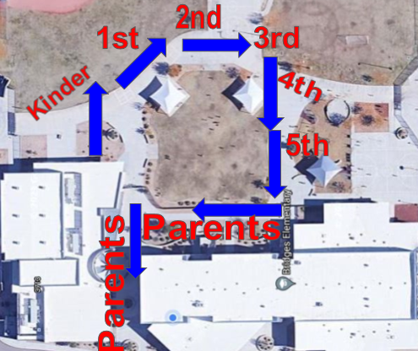
6th Grade Clap-Out
Wednesday, May 20th at 12:45
Everyone is welcome

Slide 16
Winding down
Class lists created by current teachers
Survey given to teachers regarding logistical needs and desired opportunities for growth
Culture and climate survey results dissected
Planning for next school year
Creation of Integrated Action Plans for 2026-2027 based on quantitative and qualitative data from this school year

Slide 17

Student council
30 students applied for student council positions!
Applicants did a tremendous job delivering speeches.

Slide 18
Next School Year - Dates
Teachers return
Meet the Teacher
First day of School
Monday, July 20th
Tuesday, July 21st
Thursday, July 23rd

Slide 19

Questions, Comments, thoughts?

Slide 20

THANK YOU FOR SERVING ON SITE COUNCIL!
We will continue next year with the same council.
We look forward to meeting during the 1st quarter of the 2026-2027 school year!

