Slide 1


FRANKLINVILLE CENTRAL SCHOOL DISTRICT
2026-2027 PROPOSED BUDGET
Annual Budget Hearing – May 12, 2026
Annual Budget Vote (12 pm to 8 pm) – May 19, 2026
Teach, Believe, Aspire ~ Fostering a Culture for Success
Notes:
Welcome to the Annual Budget Hearing for Franklinville Central School – please feel free to ask questions.
Budget Vote Date is Tuesday, May 19 from 12 pm – 8 pm in the Elementary School front foyer

Slide 2

Investing in Our Future
How School Budget Money is Expended
74.5% of Budget – allocated to Student Programming
14.1% of Budget – allocated to Capital Costs (Building Operations & Maintenance, Transportation and Debt Service)
11.4% of Budget – allocated to Administrative Costs (Board of Ed., District offices, BOCES administrative costs, Insurance Costs, External Professional Services (ex: Auditing/Legal), non-student technology and Curriculum office expenses
Your investment in education is an investment in our community’s future. Let’s work together to ensure every student has the resources they need to succeed!
Teach, Believe, Aspire ~ Fostering a Culture for Success
Notes:
The District strives to ensure that all funds, especially taxpayer dollars, are used as efficiently as possible.
The District has been fortunate to have high quality teachers and staff as well as provide additional opportunities for our student such as college courses, field trips, numerous extracurricular activities (75% budget spend on student programs)

Slide 3
2026-2027 Proposed EXPENDITURE Summary
EXPENDITURES | 26-27 Expenses | 25-26 Expenses |  | % Change in Expenditures |  | % of Budget
Program Budget
2000's - Instructional Programming, Pupil Services & Extra-Curricular | $ 12,152,166 | $ 10,974,321
5500's - Pupil Transportation | $ 1,336,548 | $ 1,424,263
9000's - Employee Benefits | $ 4,040,301 | $ 3,931,166
9900's - Interfund Transfers (Cafeteria & Special Aid Fund) | $ 85,000 | $ 78,000
TOTAL Program Budget | $ 17,614,015 | $ 16,407,750 |  | 7.35% |  | 74.5%
Capital Budget
1600's - Operation & Maintenance | $ 1,563,819 | $ 1,402,715
1900's - Refund of Real Property Taxes | $ 2,000 | $ 2,000
5500's - Transportation - Bus Purchases | $ 278,420 | $ 278,420
9000's - Employee Benefits | $ 447,642 | $ 403,644
9900's - Interfund Transfers (Capital & Debt Service) | $ 1,035,850 | $ 2,286,882
TOTAL Capital Budget | $ 3,327,731 | $ 4,373,661 |  | -23.91% |  | 14.1%
Administrative Budget
1000's – District Administrative Costs | $ 1,016,007 | $ 1,007,056
1600's - Technology, Operations & Maintenance | $ 477,760 | $ 437,008
1900's - Insurances & BOCES Administrative/Capital | $ 339,900 | $ 298,405
2000's - Curriculum, Supervision & Special Education | $ 452,239 | $ 435,505
9000's - Employee Benefits | $ 405,788 | $ 388,793
TOTAL Administrative Budget | $ 2,691,694 | $ 2,566,767 |  | 4.87% |  | 11.4%
TOTAL EXPENDITURE BUDGET | $ 23,633,440 | $ 23,348,178 |  | 1.22%
Notes:
School budgets are divided into 3 categories – Program Budget, Capital Budget & Administrative Budget
Program budget – Largest Increase – these are the costs most directly related to students

Slide 4
2026-2027 DEBT SERVICE Summary
2008 Capital Project Bonds - $ 96,050.00
2015 Energy Performance Grant Bonds- $ 145,000.00
2018 Capital Project Bonds - $ 472,000.00
2025 General Obligation Bonds - $ 222,800.00
2026-2027 Capital Outlay Project (HVAC Control System Upgrades) - $100,000.00
TOTAL DEBT SERVICE PORTION OF CAPITAL BUDGET - $1,035,850.00
Teach, Believe, Aspire ~ Fostering a Culture for Success
Notes:
No additional costs related to current capital project (all past projects)
General Obligation Bonds – Legal obligation of the School District

Slide 5
2026-2027 Proposed Revenue summary
 |  |  |  | % Change
REVENUES | 26-27 Revenues | 25-26 Revenues |  | in Revenue |  | % of Budget
Real Property Taxes (Including STAR) | $ 4,755,669 | $ 4,632,771 |  |  |  | 20.12%
State & Federal Aid | $ 16,822,464 | $ 16,382,322 |  |  |  | 71.18%
Local Revenues | $ 424,000 | $ 403,000 |  |  |  | 1.79%
Use of Reserve Funds | $ 63,447 | $ 157,760 |  |  |  | 0.27%
Appropriated Fund Balance * | $ 1,567,860 | $ 1,772,325 |  |  |  | 6.63%
TOTAL REVENUES | $ 23,633,440 | $ 23,348,178 |  | 1.22%
Teach, Believe, Aspire ~ Fostering a Culture for Success
Notes:
NYS State Aid final numbers have not yet been provided to the District – NYS budget was due April 1
Unknown effect of Federal Funding on NYS Budget
District needs to reduce relying on Fund Balance to balance the budget – although the district is reducing its’ reliance on fund balance for next year, we need to continue to do so. Fund balance is like a person’s savings account, and once it’s gone, you have to make decisions on how to reduce expenses

Slide 6
UNDERSTANDING FRANKLINVILLE SCHOOL District Tax RATE History
FRANKLINVILLE SCHOOL TAX RATE HISTORY
 | Proposed Levy (Rate) Change | Franklinville Tax Rate History | Actual Rate Change | Difference
11-12 |  | $ 25.059062
12-13 | 1.74% | $ 24.927700 | -0.52% | -2.26%
13-14 | 1.83% | $ 25.629609 | 2.82% | 0.99%
14-15 | 1.80% | $ 26.115795 | 1.90% | 0.10%
15-16 | 0.00% | $ 25.581717 | -2.05% | -2.05%
16-17 | 0.00% | $ 25.767856 | 0.73% | 0.73%
17-18 | 1.18% | $ 26.348159 | 2.25% | 1.07%
18-19 | 0.00% | $ 26.755280 | 1.55% | 1.55%
19-20 | 0.00% | $ 27.274335 | 1.94% | 1.94%
20-21 | 0.00% | $ 26.142503 | -4.15% | -4.15%
21-22 | 0.00% | $ 25.821233 | -1.23% | -1.23%
22-23 | 0.00% | $ 25.924659 | 0.40% | 0.40%
23-24 | 1.67% | $ 26.336406 | 1.59% | -0.08%
24-25 * | 1.90% | $ 10.289927 | -60.93% | -62.83%
25-26 | 3.99% | $ 10.311876 | 0.21% | -3.78%
26-27 ** | 2.65% | $ 9.955599 | -3.58% | -6.23%
Determining the annual school tax rate
    District Tax Levy (determined by the District)
      The amount needed from taxpayers, after all other aid, to fund the expenditures of the District
    Assessed Property Value (assigned by town assessor)
      An amount that is most often a percentage of your property’s market value
    Equalization Rate (assigned by NYS & town assessor)
      The rate is supposed to level the playing field for all municipalities in a district to “equalize” the taxes uniformly.
    STAR (School Tax Relief Program)
      Determined by NYS and can change from year to year.
  Any change to one of these factors, creates a change in the tax rate . When there is growth in the school taxable values, the tax rate generally decreases.
  Chart Notes:
  24-25 * - Reassessments done in 2024-2025 – Farmersville, Franklinville, Machias
  26-27 ** - Proposed – Tax Cap Levy Limit – using tentative school taxable property values and 2025 NYS equalization rates.
Teach, Believe, Aspire ~ Fostering a Culture for Success
Notes:
The proposed numbers use the tentative school taxable values (from Cattaraugus county, May 1) and 2025 NYS equalization rates from NYS ORPTS website - **THIS COULD CHANGE

Slide 7

Proposed Tax impact to property owners
Assessed Home Value 2026-2027 Projected Tax Change
$50,000 $(17.81)
$75,000 $(26.72)
$100,000 $(35.63)
This information is calculated using the proposed changes to the majority of the taxpayers in the Franklinville School District.
Teach, Believe, Aspire ~ Fostering a Culture for Success
Notes:
Current Projected tax increase for majority – Town/Village of Franklinville & Farmersville

Slide 8
Understanding a Contingent Budget
Non-Contingent Expenses are expenses that are not necessary to; 1) Provide the minimum legal services for operating and maintaining the educational program and school buildings; 2) Preserve the property of the District; and 3) Ensure the health and safety of students and staff. Examples include:
  Student Programming (beyond required educational components):
    Summer Programs
    College Courses
    Field Trips
    Student supplies (any supplies available from sources outside the school district)
  Facility Use by Outside Organizations (anything that would cost the district money):
    Youth Organizations (PAWS Swimming, Youth Wrestling, Youth football/cheer, Youth baseball)
    Maple Festival
    PTO Holiday Shopping Extravaganza
    Various Dance Groups
    Alumni Basketball Tournament, Adult Basketball League
  Equipment Purchases:
    School Buses, School Vehicles
    Buildings & Grounds Equipment (mowers, snow blowers, floor scrubbers, etc.)
    Athletic Equipment
    Technology Equipment for students & staff
  Capital Expenses:
    Transfers to Capital Fund for minor capital costs for buildings – HVAC Controls Upgrades
Teach, Believe, Aspire ~ Fostering a Culture for Success
Notes:
Ordinary Contingent Expenses are determined by the Board of Education – following Commissioner’s regulations for specific areas

Slide 9
Board of Education Candidate(s)
Michael Brisky - Board Member Candidate
5-year term commencing on July 1, 2026
Michael Brisky is a lifelong resident of the Franklinville Central School District, graduating from FCS/TBA in 2002 and subsequently attending SUNY Albany receiving a Bachelor’s Degree. Michael is currently the Cattaraugus County Deputy County Administrator. He and his wife, Elizabeth, the FCS/TBA Elementary Librarian, live in Franklinville with their three children, Renee (7th grade), Michael (5th grade) and Jillian (2nd grade).

Slide 10

2026-2027 Budget & Election Information
All 2026-27 Budget & Election Information is posted to the District Website:
https://www.tbafcs.org/about-us/business-office/2026-2027-budget-information
All information is also available at the District Business Office – please contact Donna Howard at (716) 676-8028 to request a printed copy of the 2026-2027 Budget Information
Teach, Believe, Aspire ~ Fostering a Culture for Success
Notes:
You may go to our website or click the QR code to access the site.

Slide 11
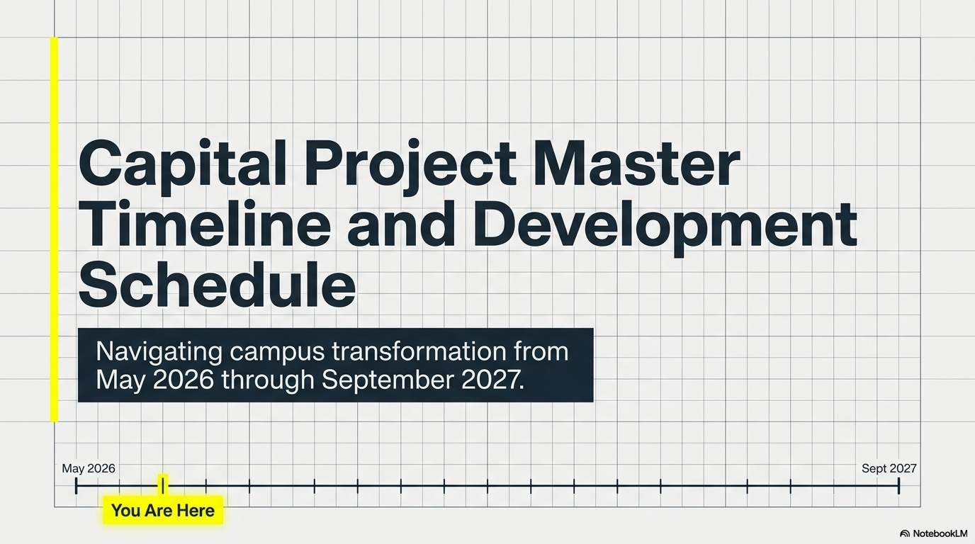

Slide 12
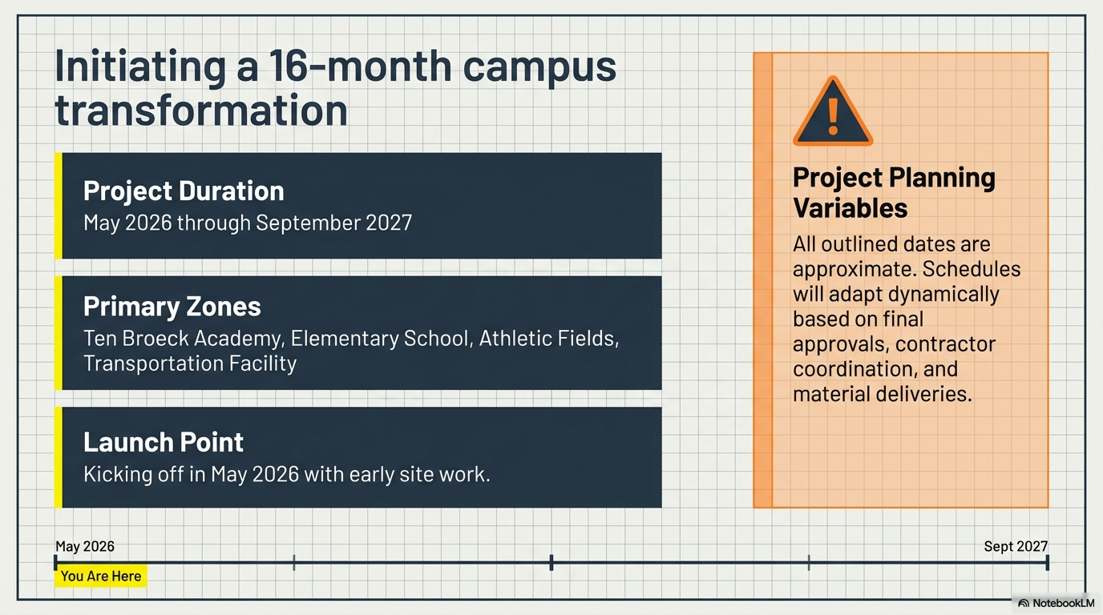

Slide 13
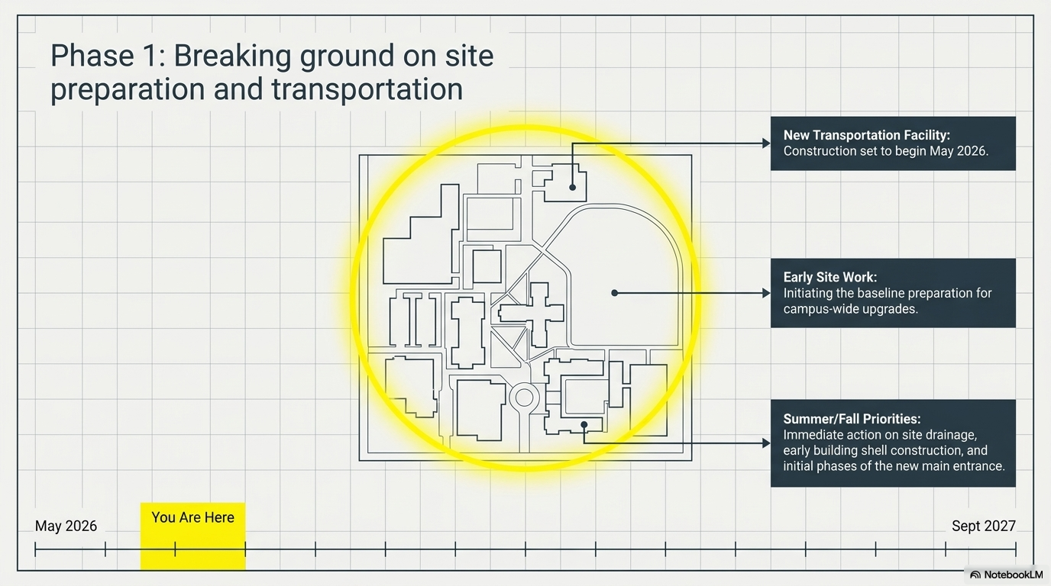

Slide 14
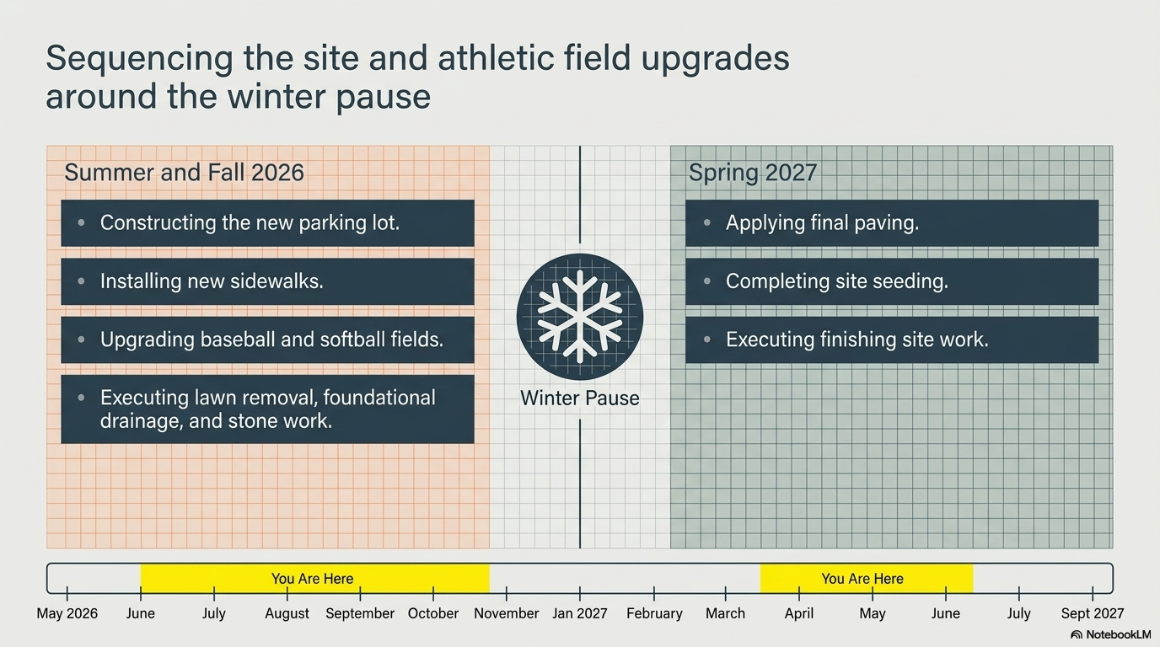

Slide 15
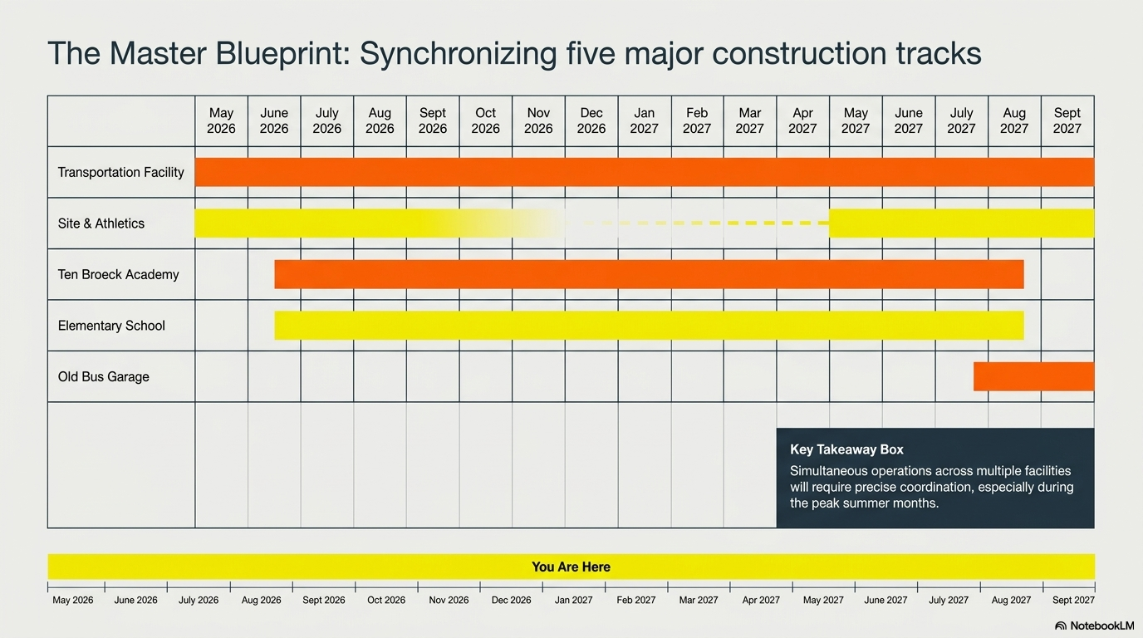

Slide 16

Questions / Discussion
Teach, Believe, Aspire ~ Fostering a Culture for Success

