Slide 1

May 2026
Updates

Slide 2
ELIGIBLE TEACHERS
Teachers of Record for:
  STAAR Tested Content w/Growth Measure
    4th Math – Alg 1 & 4th ELA – ENG II
    Includes Special Education Teachers
2023 – 2024

Slide 3
ELIGIBLE TEACHERS
Teachers of Record for:
  STAAR Tested Content
    3rd ELA & Math, 5th Science, 8th Social Studies & Science, Biology & US History
  Creative Writing
  Mathematics Models with Applications
  Pre-K 4
2024 – 2025

Slide 4
ELIGIBLE TEACHERS
  Kindergarten, 1st & 2nd Math
  2nd Departmentalized Reading
  7th & 10th Band
  7th & 10th Choir
  10th Dance
  AP U.S. History
  English Language Development
  & Acquisition
2025 – 2026

Slide 5
ELIGIBLE TEACHERS
Pending Application Approval from TEA August 2026
  High School
    Literary Genres
    Business English
    Research/Technical Writing
    Algebraic Reasoning
    Specialized Topics in Science
2026 – 2027
Possible Additions

Slide 6
ELIGIBLE TEACHERS
Pending Application Approval from TEA August 2026
  Middle School
    6th Band
  Elementary School
    Early Childhood Special Education
2026 – 2027
Possible Additions

Slide 7
ELIGIBLE TEACHER
Teacher of Record (087)
Must Participate in T-TESS
Bilingual or ESL Certification by October 1st
Minimum of 5 Students (2 for Special Ed)
TO BE AN

Slide 8
PERFORMANCE STANDARDS – STUDENT GROWTH
2023 – 2025 % OF STUDENTS MEET OR EXCEED EXPECTED GROWTH (MAY 2026) |  | RECOGNIZED | EXEMPLARY | MASTER
 |  | 70% | 80% | 90%
2025-2026 % OF STUDENTS MEET OR EXCEED EXPECTED GROWTH (MAY 2027) | ACKNOWLEDGED | RECOGNIZED | EXEMPLARY | MASTER
 | 60% | 70% | 80% | 90%

Slide 9
TEACHER OBSERVATION
T-TESS
TIA will only focus on the “observable” domains of T-TESS
    Domain 2 - Instruction (2.1, 2.2, 2.3, 2.4, 2.5)
    Domain 3 - Learning Environment (3.1, 3.2, 3.3)
Each of the eight dimensions is scored on a scale of 1-5: For a possible total of 40 (then divided by 8 for final score)
PERFORMANCE STANDARDS
Designation Level | Minimum Average Score
Acknowledged | 3.5
Recognized | 3.7
Exemplary | 3.9
Master | 4.5

Slide 10
EXAMPLE 1 – Did Not Meet Minimum
EXAMPLE 1 | 5 | 4 | 3 | 2 | 1
Dimension | Distinguished | Accomplished | Proficient | Developing | Improvement Needed | (Score)
2.1 Achieving Expectations |  |  | ⚫ |  |  | 3
2.2 Content Knowledge |  | ⚫ |  |  |  | 4
2.3 Communication |  | ⚫ |  |  |  | 4
2.4 Differentiation |  |  | ⚫ |  |  | 3
2.5 Monitor and Adjust |  |  | ⚫ |  |  | 3
3.1 Routines, Procedures |  | ⚫ |  |  |  | 4
3.2 Managing Behavior |  |  | ⚫ |  |  | 3
3.3 Classroom Culture |  |  | ⚫ |  |  | 3
 |  |  |  |  |  | 27
 |  |  |  |  | Average Score | 3.375

Slide 11
EXAMPLE 2 – ACKNOWLEDGED
EXAMPLE 1 | 5 | 4 | 3 | 2 | 1
Dimension | Distinguished | Accomplished | Proficient | Developing | Improvement Needed | (Score)
2.1 Achieving Expectations |  |  | ⚫ |  |  | 3
2.2 Content Knowledge |  | ⚫ |  |  |  | 4
2.3 Communication |  | ⚫ |  |  |  | 4
2.4 Differentiation |  |  | ⚫ |  |  | 3
2.5 Monitor and Adjust |  |  | ⚫ |  |  | 3
3.1 Routines, Procedures |  | ⚫ |  |  |  | 4
3.2 Managing Behavior |  | ⚫ |  |  |  | 4
3.3 Classroom Culture |  |  | ⚫ |  |  | 3
 |  |  |  |  |  | 28
 |  |  |  |  | Average Score | 3.5

Slide 12
EXAMPLE 3 – Met Recognized
EXAMPLE 1 | 5 | 4 | 3 | 2 | 1
Dimension | Distinguished | Accomplished | Proficient | Developing | Improvement Needed | (Score)
2.1 Achieving Expectations |  | ⚫ |  |  |  | 4
2.2 Content Knowledge |  | ⚫ |  |  |  | 4
2.3 Communication |  | ⚫ |  |  |  | 4
2.4 Differentiation |  |  | ⚫ |  |  | 3
2.5 Monitor and Adjust |  |  | ⚫ |  |  | 3
3.1 Routines, Procedures |  | ⚫ |  |  |  | 4
3.2 Managing Behavior |  | ⚫ |  |  |  | 4
3.3 Classroom Culture |  | ⚫ |  |  |  | 4
 |  |  |  |  |  | 30
 |  |  |  |  | Average Score | 3.75

Slide 13
EXAMPLE 3 – Met Exemplary
EXAMPLE 2 | 5 | 4 | 3 | 2 | 1
Dimension | Distinguished | Accomplished | Proficient | Developing | Improvement Needed | (Score)
2.1 Achieving Expectations | ⚫ |  |  |  |  | 5
2.2 Content Knowledge |  | ⚫ |  |  |  | 4
2.3 Communication |  | ⚫ |  |  |  | 4
2.4 Differentiation |  |  | ⚫ |  |  | 3
2.5 Monitor and Adjust |  |  | ⚫ |  |  | 3
3.1 Routines, Procedures |  | ⚫ |  |  |  | 4
3.2 Managing Behavior |  | ⚫ |  |  |  | 4
3.3 Classroom Culture | ⚫ |  |  |  |  | 5
 |  |  |  |  |  | 32
 |  |  |  |  | Average Score | 4

Slide 14
EXAMPLE 4 – Met Master
EXAMPLE 3 | 5 | 4 | 3 | 2 | 1
Dimension | Distinguished | Accomplished | Proficient | Developing | Improvement Needed | (Score)
2.1 Achieving Expectations | ⚫ |  |  |  |  | 5
2.2 Content Knowledge | ⚫ |  |  |  |  | 5
2.3 Communication | ⚫ |  |  |  |  | 5
2.4 Differentiation |  | ⚫ |  |  |  | 4
2.5 Monitor and Adjust |  | ⚫ |  |  |  | 4
3.1 Routines, Procedures |  | ⚫ |  |  |  | 4
3.2 Managing Behavior |  | ⚫ |  |  |  | 4
3.3 Classroom Culture | ⚫ |  |  |  |  | 5
 |  |  |  |  |  | 36
 |  |  |  |  | Average Score | 4.5

Slide 15
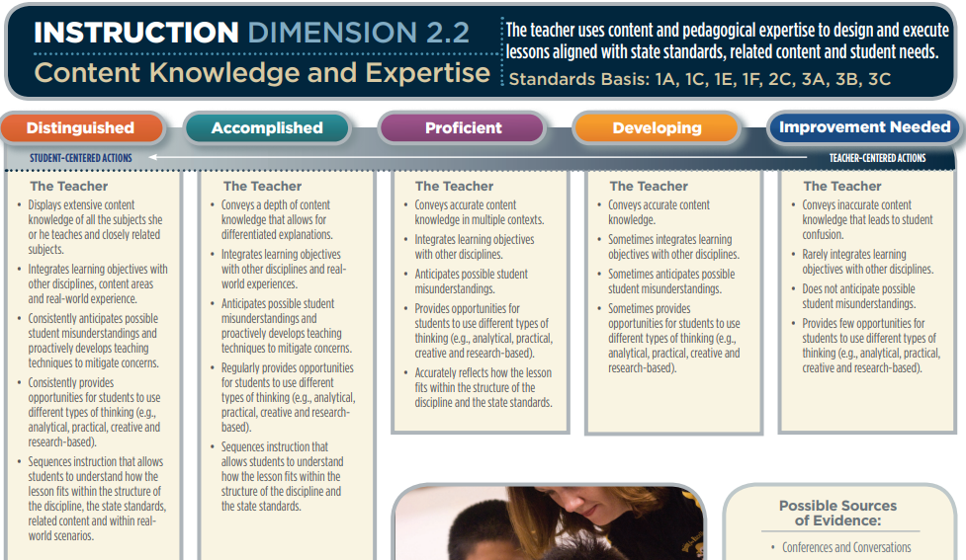
Review What is Expected

Slide 16
TO EARN A DESIGNATION
TEACHERS MUST MEET THE MINIMUM IN BOTH
STUDENT GROWTH (60%) &
T-TESS (3.5)

Slide 17
DATA VALIDATION
TIMELINE
2025-2026 Data Capture
October 2026 – Data Submission to TIA Texas Tech University
April 2027 – Receive from TEA Validated Designations (Remain for 5 Years)
August 2027 – TIA Approved Payouts
Campus Allotments – Please see the TEA TIA FUNDING MAP
  https://tiatexas.org/funding-map/
2025-2026

Slide 18
TIA District Webpage
GPISD TIA Guide Book
GPISD TIA FAQ
QUESTIONS ?

