Slide 1


STUDENT SAFETY TRAINING

Slide 2

What You’ll Learn...
01
Head and Neck Injuries
02
CPR/AED & Chest Trauma
03
Environmental Safety
04
Hydration and Fuel
05
Allergies, Asthma & Diabetes
06
Emergency Action Plans

Slide 3
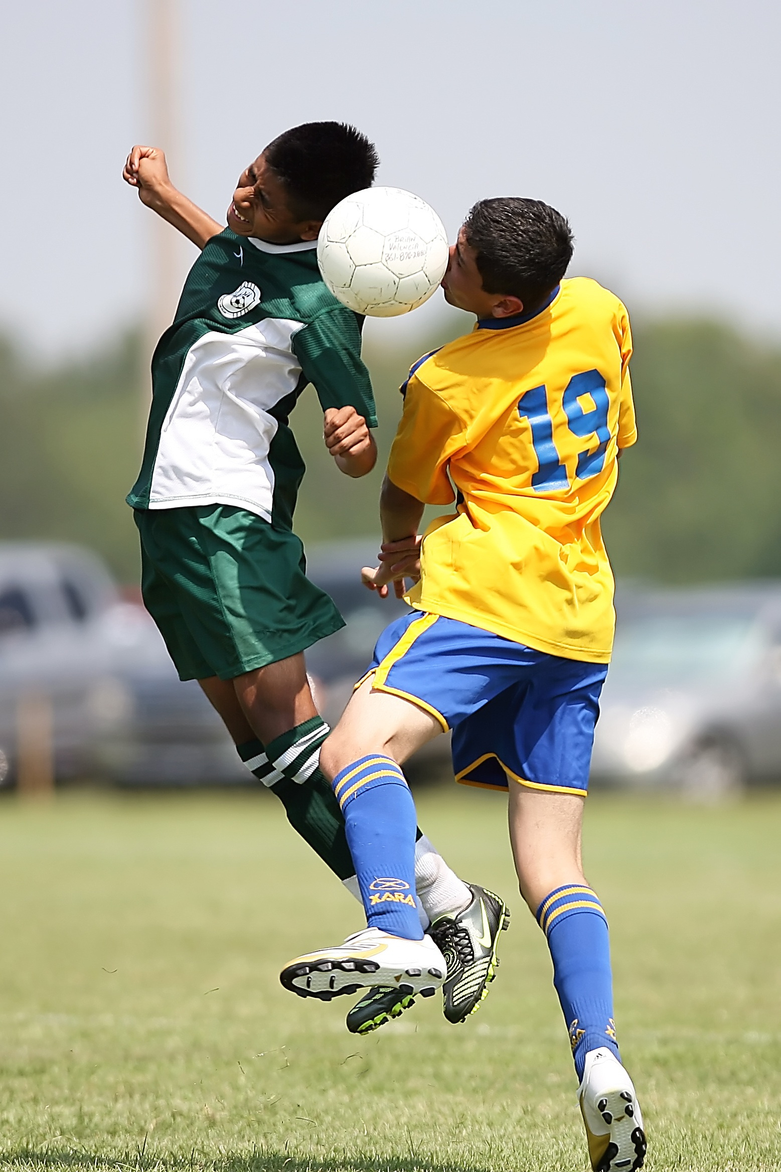
HEAD & NECK INJURIES

Slide 4
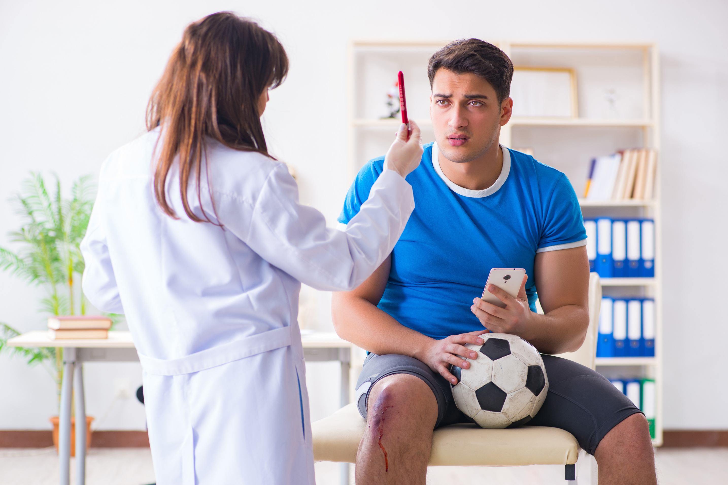
What is a CONCUSSION?
A concussion is a brain injury that impacts how your brain normally works.
  It happens when your brain gets shaken or twisted inside your skull.
  This can be caused by a hit to the head or body—even if it doesn’t seem like a big hit.
  You don’t have to be knocked out to have a concussion.

Slide 5
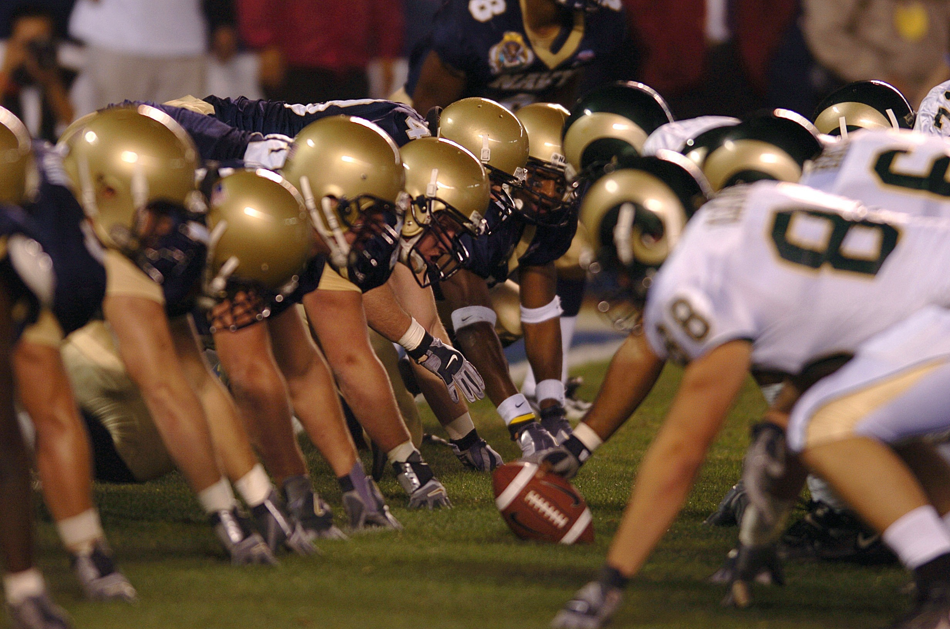
HEAD & NECK INJURIES
  Your head is not a weapon. Don’t hit with your head!
  Respect your helmet. The helmet is an important piece of protective equipment.
  Make sure your equipment fits!

Slide 6





Headache, Nausea
SIGNS OF A CONCUSSION
Balance Problems/Dizziness
If you or one of your friends experience ANY of these symptoms, SAY SOMETHING!
Double or Fuzzy Vision
Sensitivity to Light or Noise
Feeling Sluggish, Foggy, Confused

Slide 7
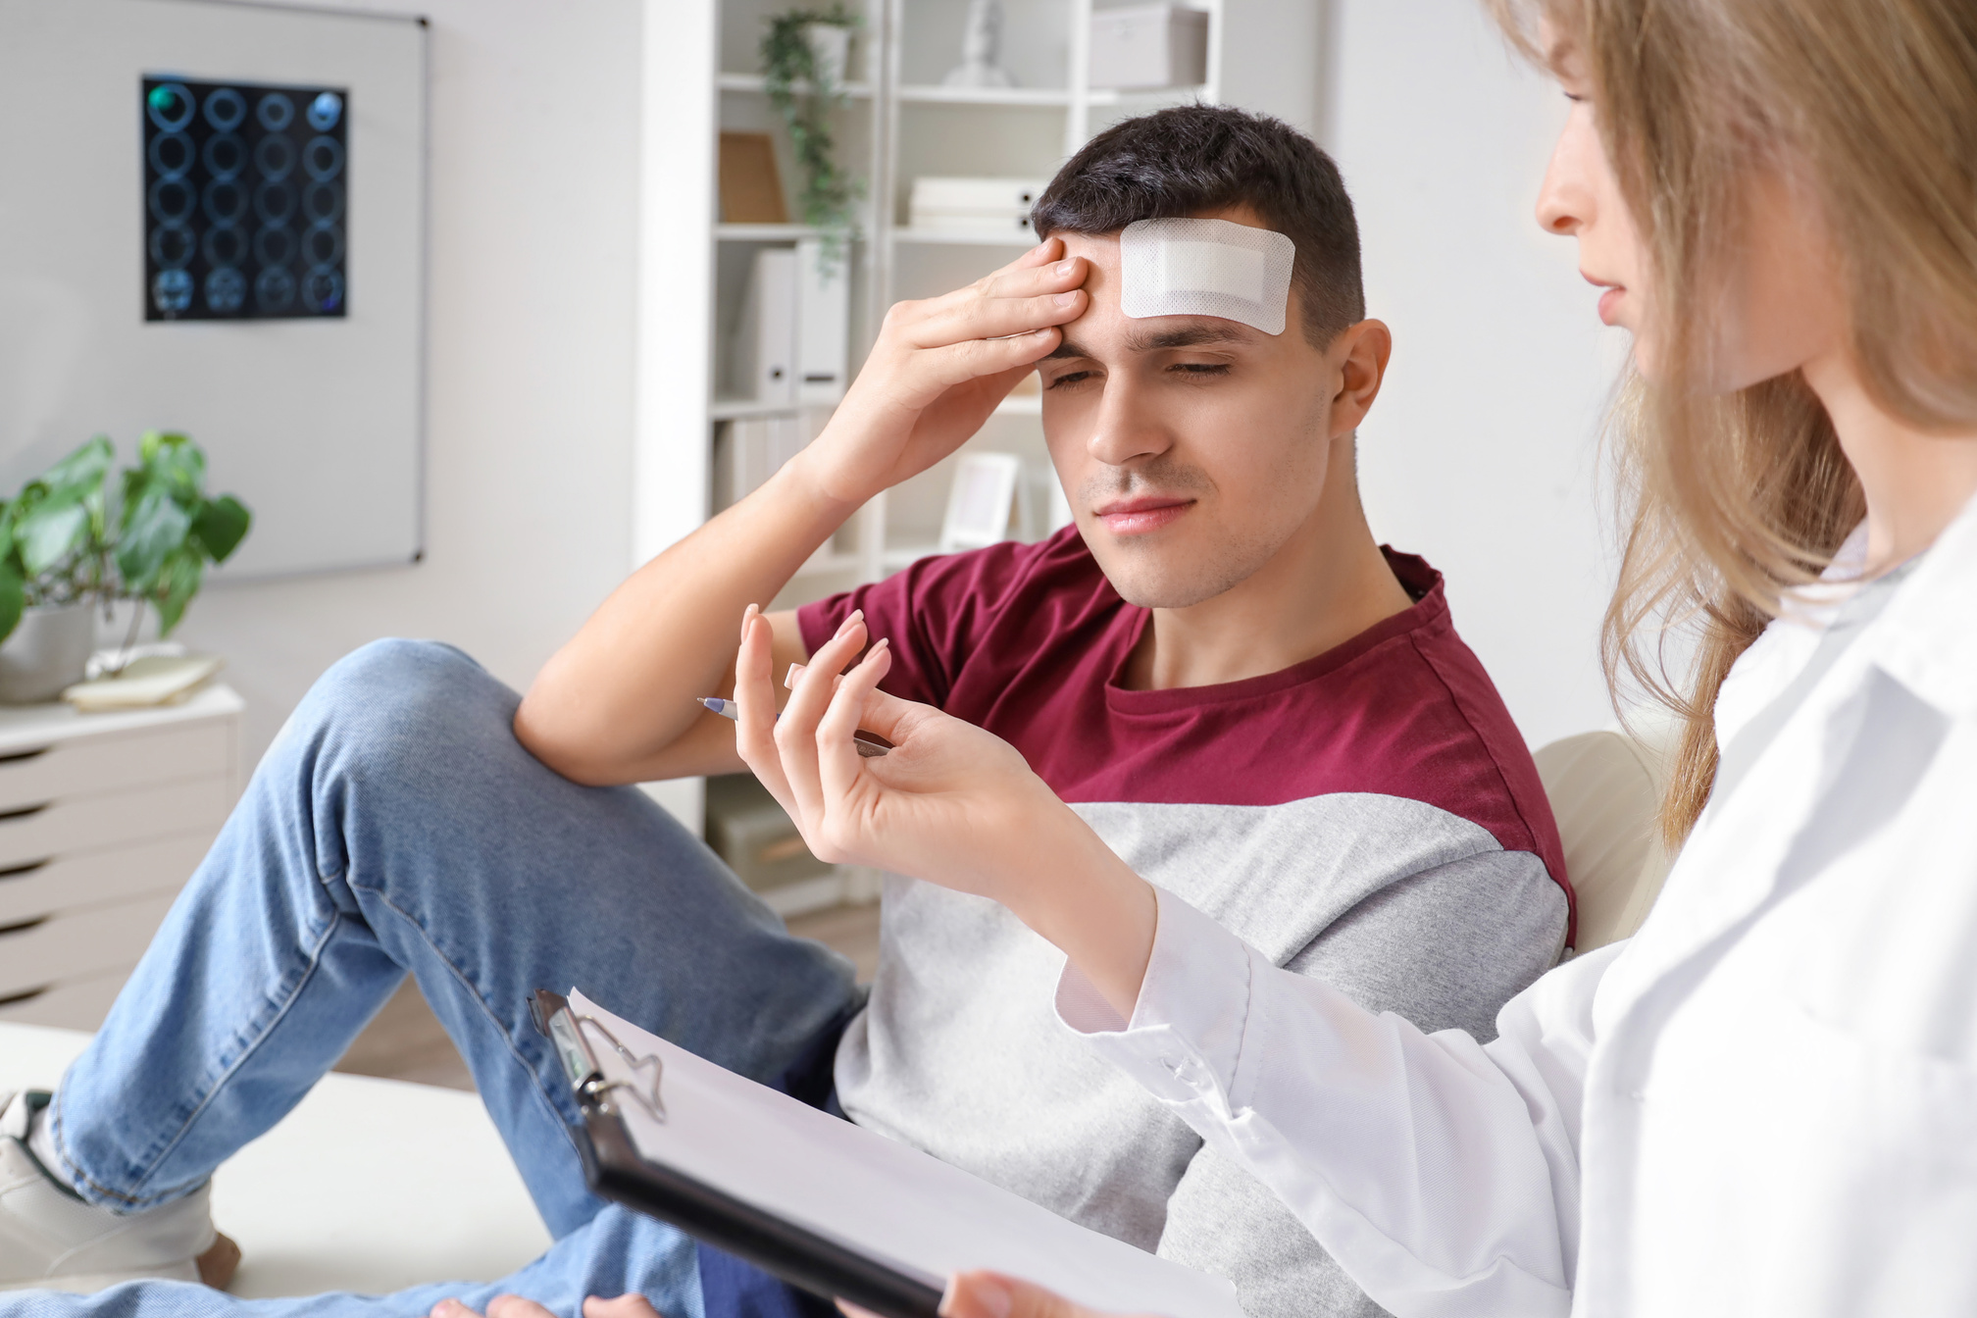
Return to Play Protocol
By State Law, your school district must have rules and regulations in place to follow after a concussion.
District Concussion Oversight Team

Slide 8


HEART: CPR/AED & CHEST TRAUMA

Slide 9


SUDDEN CARDIAC ARREST
(SCA) BASICS
  Happens when the heart's electrical system stops working right
  The heart stops beating normally, and the person has no pulse
  It can happen without warning, even in healthy young athletes
  If not treated immediately, it can be deadly in just a few minutes

Slide 10

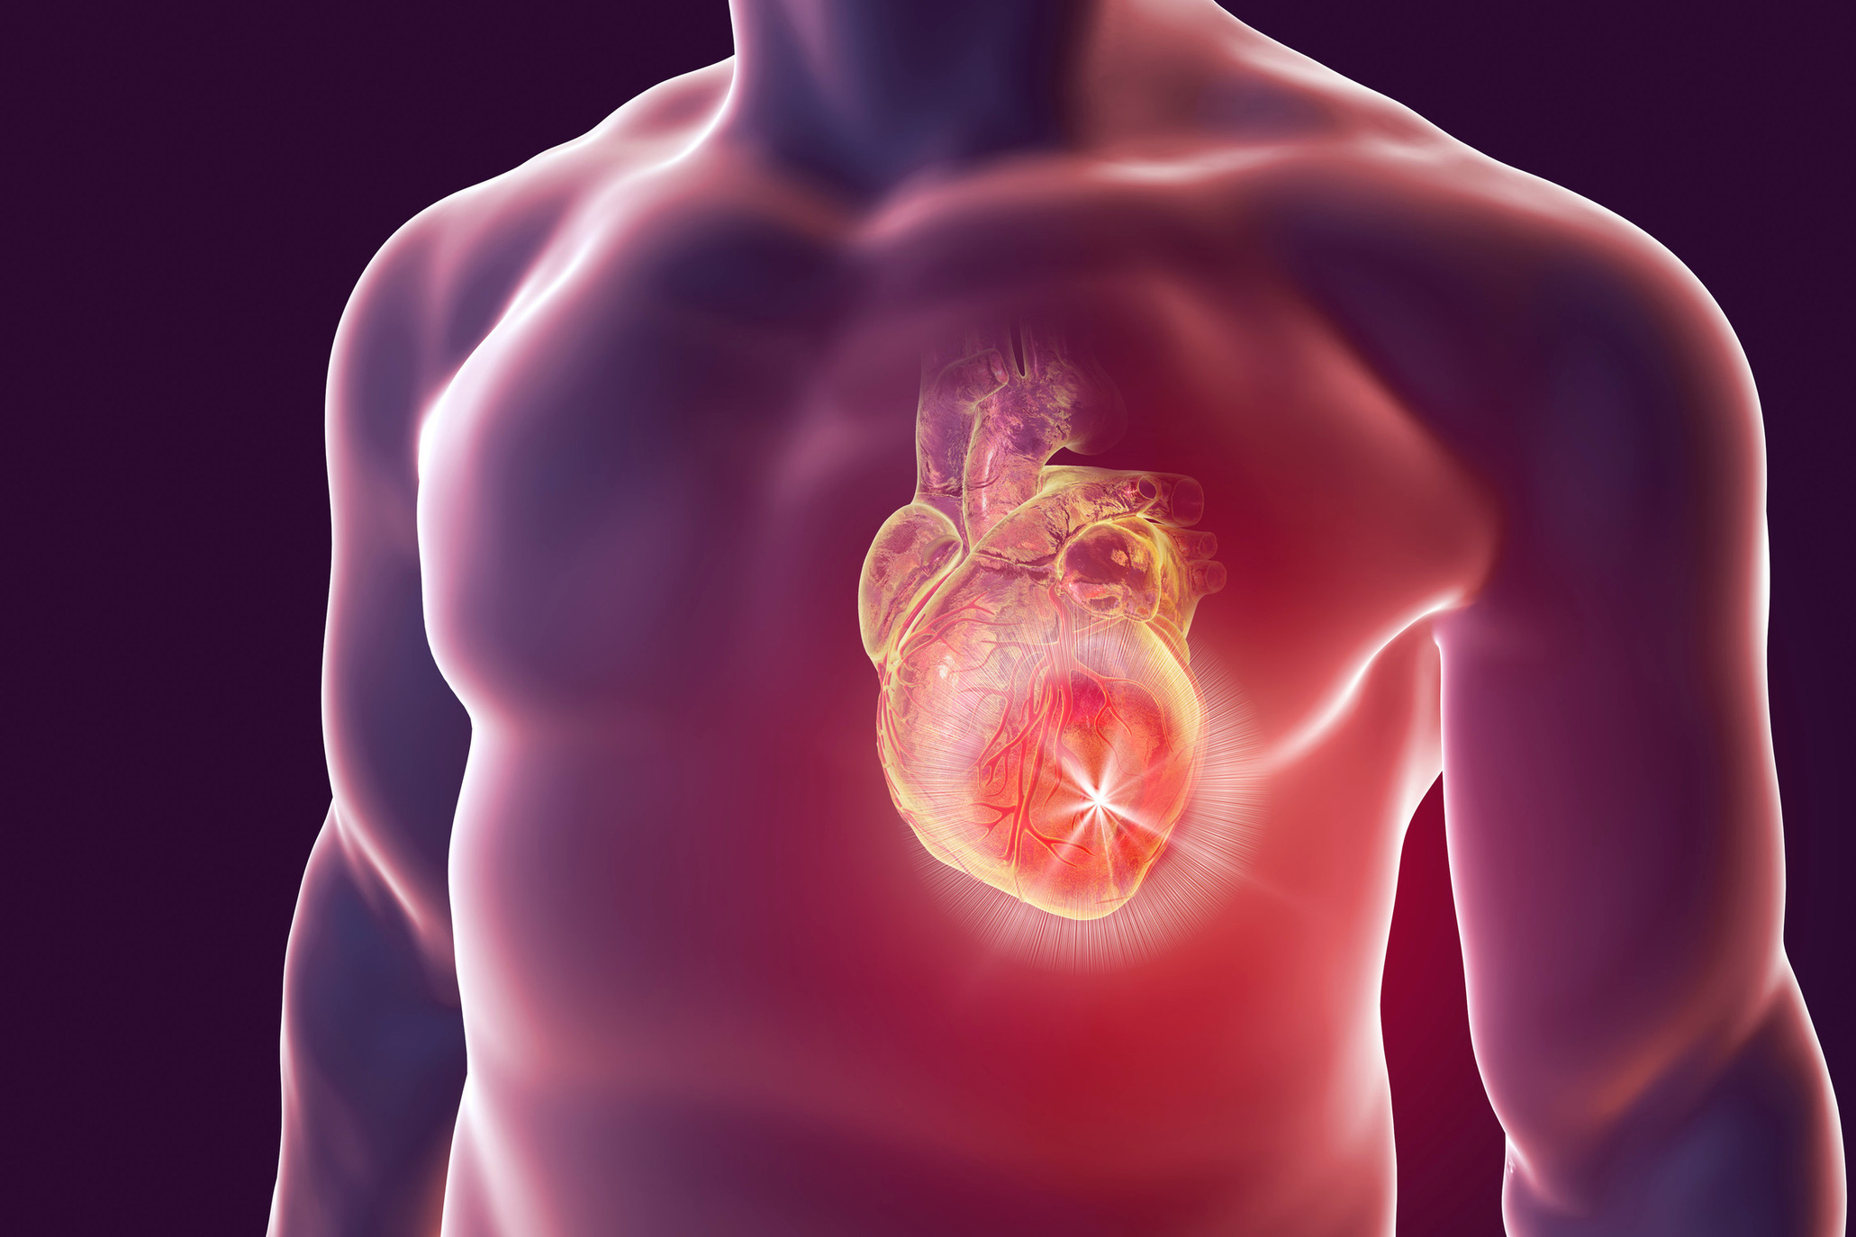
SCA RISK FACTORS
& CAUSES
  Some people are born with heart problems or issues with the heart’s electrical system
  Birth defects in the heart can also be a factor
  Commotio Cordis – when a hit to the chest (like a ball) messes with the heart
  Myocarditis – a heart infection that causes swelling
  Using drugs or steroids to boost performance can raise the risk

Slide 11
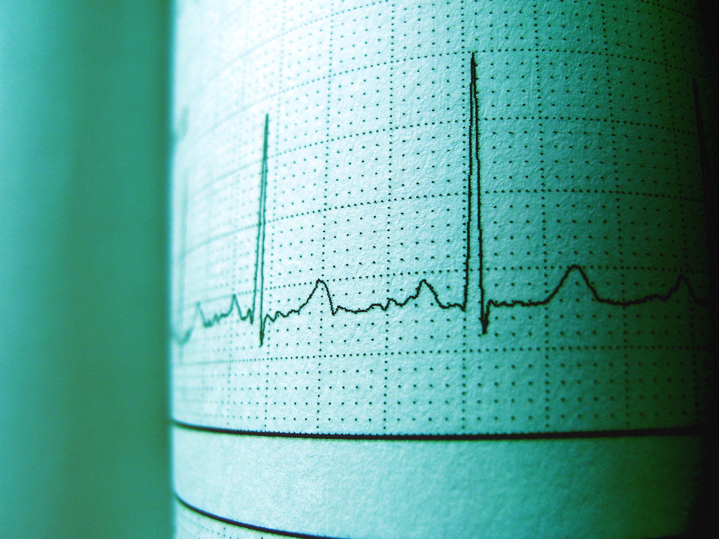
SCA Symptoms
  Fainting/blackouts (especially during a workout)
  Dizziness
  Unusual fatigue/weakness
  Chest pain
  Shortness of breath
  Nausea/vomiting
  Palpitations (heart is beating unusually fast or skipping beats)
  Family history of sudden cardiac arrest at age < 50
If you or one of your friends experience ANY of these symptoms, SAY SOMETHING!
ANY of these symptoms and warning signs that occur while working out may
require evaluation by your physician before returning to
participation in your sport.

Slide 12

SCA
Emergency Response
  CALL 911 immediately
  Begin CPR right away
  Use an AED
  Every second counts! Early defibrillation is critical!

Slide 13
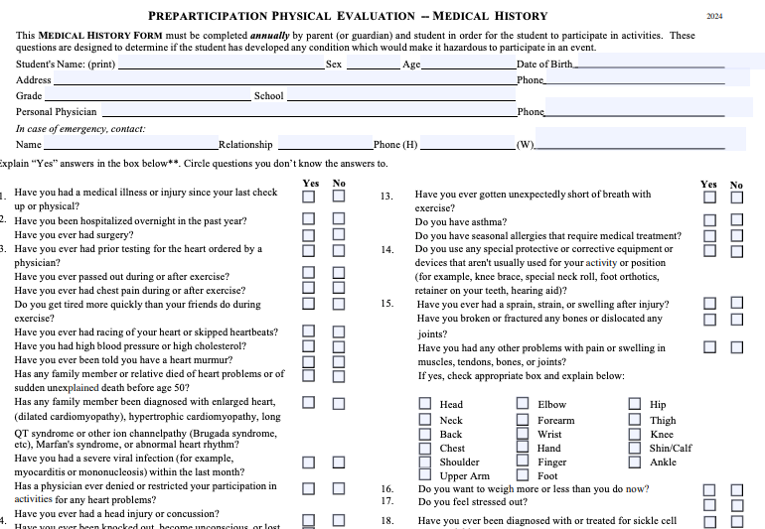
SCA Screening
The UIL Pre-Participation Physical Evaluation & Medical History form includes ALL 14 important cardiac screening elements recommended by the American Heart Association and is mandatory.

Slide 14
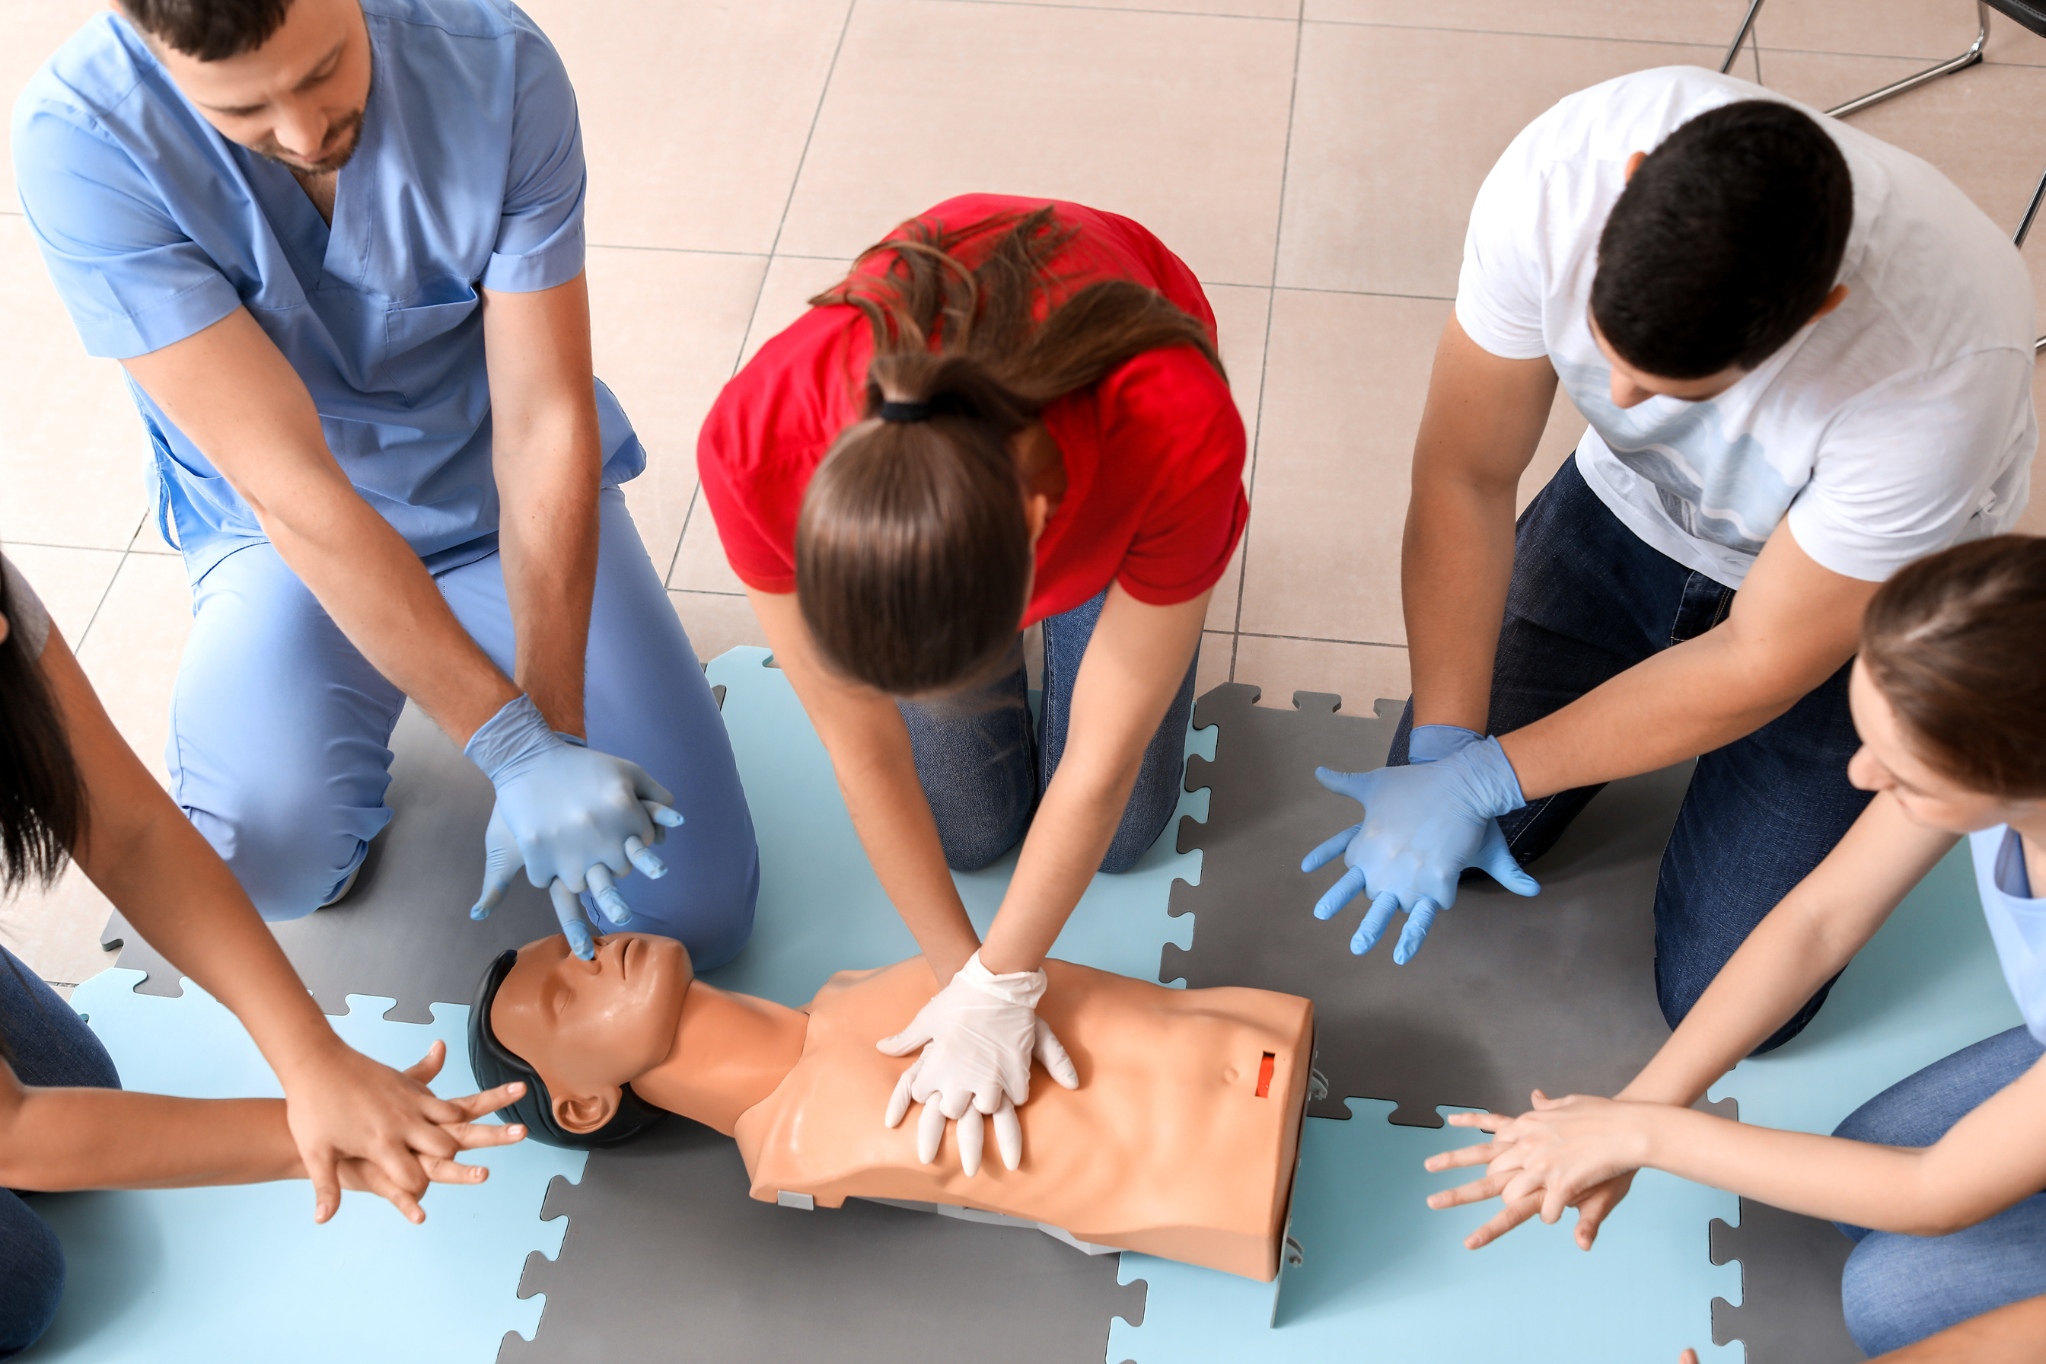
LEARN WHAT TO DO WHEN SOMEONE ELSE’S HEART STOPS
How you can help save a life

Slide 15
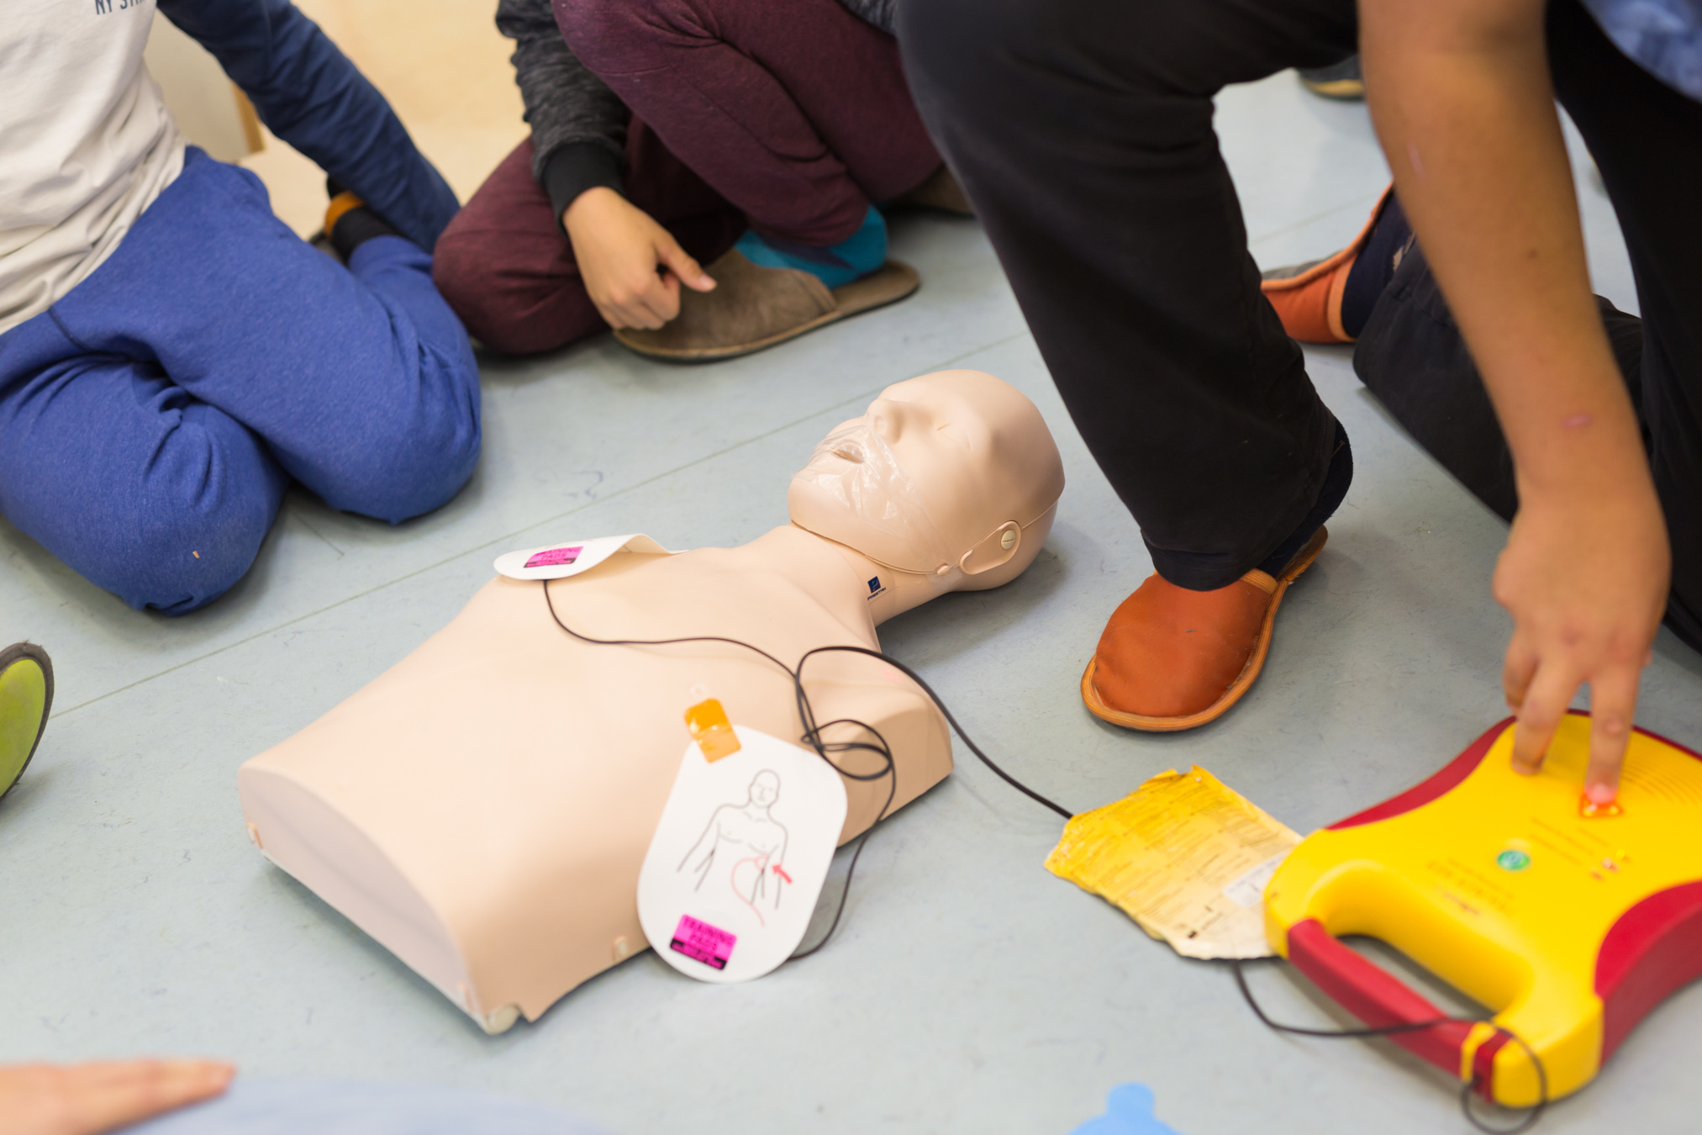
IMPORTANCE OF AN AED
The only effective treatment for ventricular fibrillation is immediate use of an automated external defibrillator (AED).

Slide 16
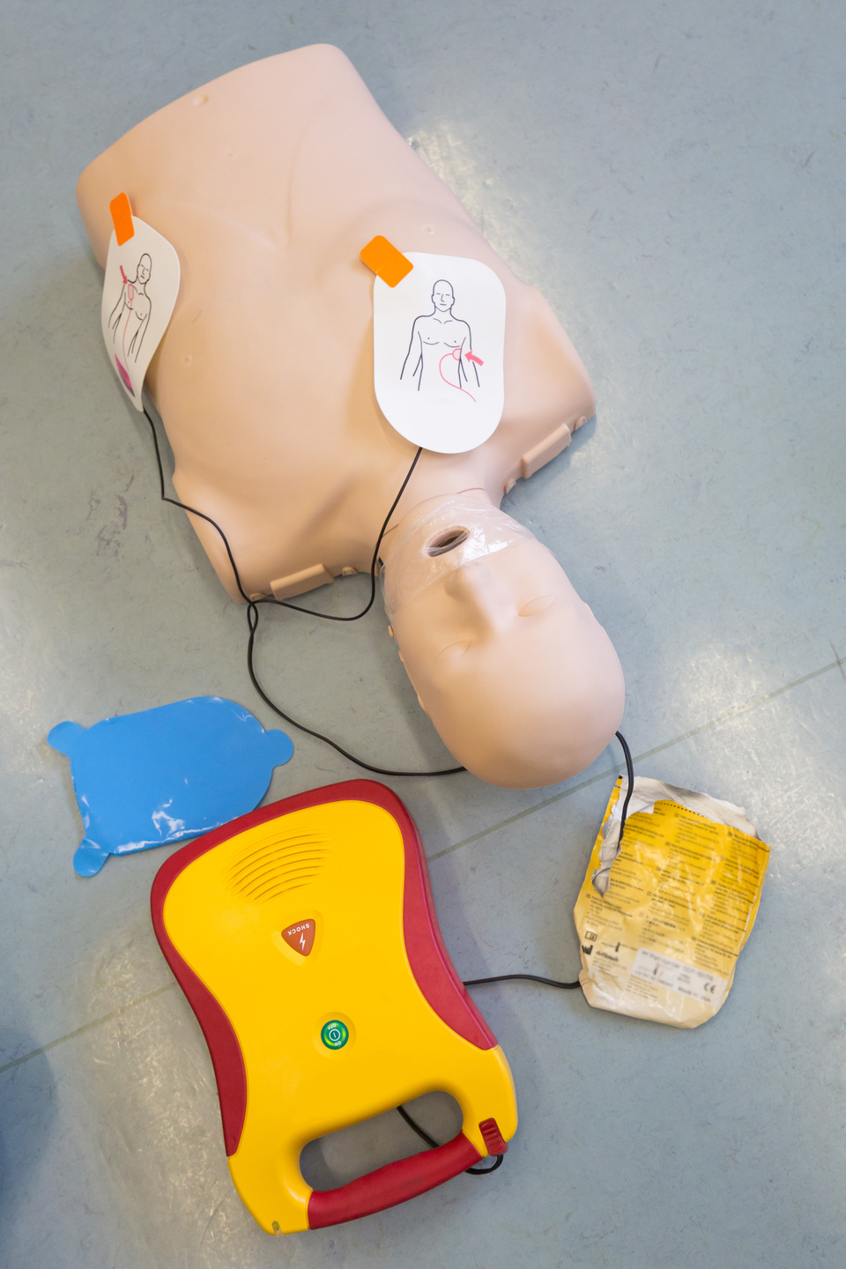

Importance
of an AED
An AED (Automated External Defibrillator) can help restart a heart during sudden cardiac arrest—and it can save a life.
In Texas high schools:
  AEDs must be easy to get to during games and practices
  Coaches, Athletic Trainers, and staff must be trained to use them
  Every school must have a plan for what to do in a heart emergency

Slide 17

Importance of an AED
Experts say AEDs should be in a central spot that’s easy to get to—no more than a 60–90 second walk from anywhere nearby.
While someone grabs the AED, another person should call 911 right away.
Do you know where an AED is located?

Slide 18



ENVIRONMENT

Slide 19

Heat Illness Prevention
  Schools track the heat using a tool called Wet Bulb Globe Temperature (WBGT)
  Practice time & gear should change depending on how hot it is outside
  You should always have unlimited water and required breaks
  Fans, water misters, & cold wet towels may also be utilized.
  This is called a “rapid cooling zone”—and its purpose is to keep you safe

Slide 20


HEAT ACCLIMATIZATION
GETTING USED TO THE HEAT!
If you or someone else shows signs of overheating, say something!
  Start workouts slowly & build up over time
  Drink water often-even if you’re not thirsty
  Take more breaks & wear lighter gear when it’s extra hot or humid
  Coaches will watch you closely for signs of heat illness like dizziness or confusion

Slide 21
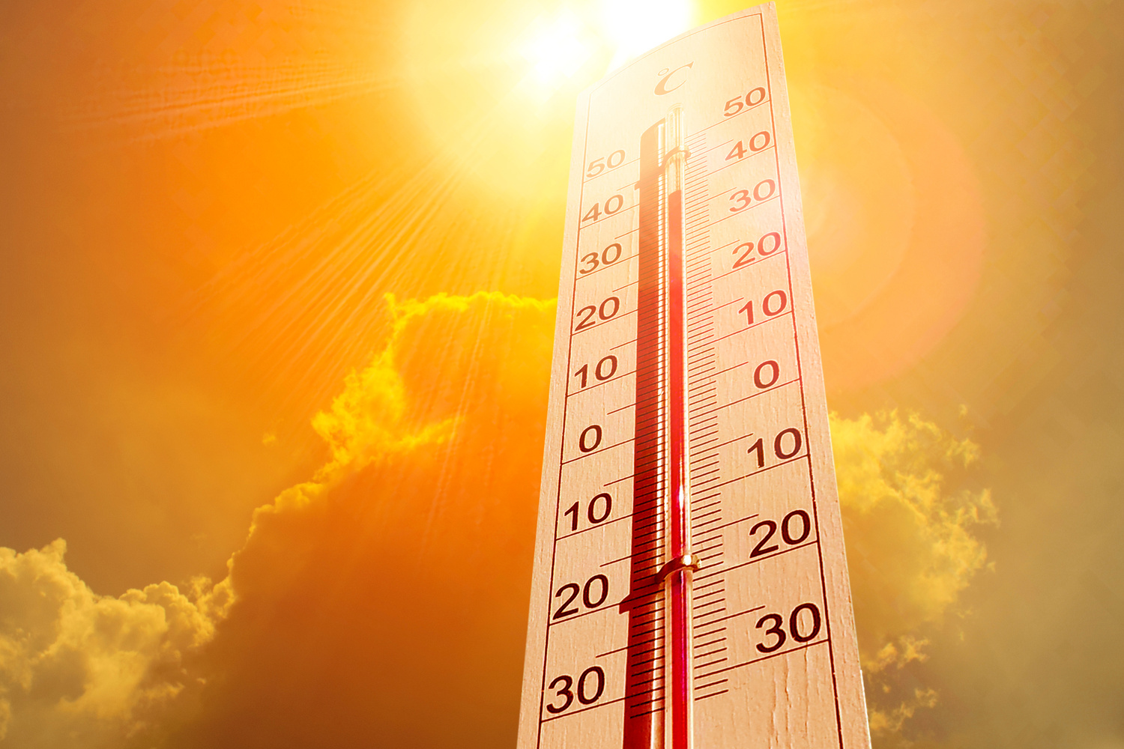
Exertional Heatstroke (EHS)
#1 cause of preventable death in high school sports!
  The body overheats dangerously and can’t cool down fast enough
  Symptoms:
    Confusion
    Dizziness
    Collapse
    Hot flushed skin
    Rapid Heart Beat
    Full Body Cramping
    Nausea & Vomiting
I

Slide 22
COOL FIRST, TRANSPORT SECOND!
UIL HEAT PROTOCOLS
  When experiencing symptoms of heat stroke, UIL policy requires immediate full body immersion in an ice water tub or tarp.
  If experiencing symptoms of a heat stroke, 911 should be called immediately after immersing in the ice water.

Slide 23
COLD WEATHER SAFETY
Frostbite
  Rewarm gradually with warm water or body heat; avoid rubbing
Hypothermia
  Remove wet clothes, warm slowly, give warm fluids if alert
  If someone is passed out, call 911 right away and get help. Don’t try to warm them up on the spot.

Slide 24
Lightning Safety Protocol
Your school should use a weather service that gives lightning warnings specific to your team’s location.
Know the rules on what to do if there’s lightning nearby. Follow your coaches’ directions and go to the location specified.

Slide 25
Lightning Safety Protocol
  Listen to those in charge and who are assigned to watch the weather and share updates.
  Go to safe places nearby as indicated by your coach or trainer—like buildings with walls or cars.
  Outside activities or contests can start again after a minimum of 30 minutes after the last lightning strike. Your coach or Athletic Trainer should monitor the time on their app.

Slide 26
HYDRATION AND FUEL

Slide 27

HYDRATION
Athletes should drink water throughout the day as well as before and after exercise.
Sports drinks can be helpful:
  You’re exercising for more than an hour
  It’s really hot and humid outside
Everest Cantu

Slide 28
What NOT to Drink
  FRUIT JUICES
  CARBONATED SODAS
  ENERGY DRINKS with caffeine and/or ephedrine
    Make you more likely to get heat sickness or heart problems when you exercise
    Cause feelings like anxiety, jitters, nausea, stomach pain, or diarrhea
Everest Cantu

Slide 29
Hydration:
Best Practices Example
  Drink about 16 ounces (a big glass) 2 hours before practice.
  Drink 8-16 ounces 15 minutes before starting.
  Drink 4-8 ounces every 15-20 minutes while you’re practicing.
  After practice, drink 16-20 ounces for every pound you lost (like from sweating).
Check your urine color—clear or light yellow means you’re hydrated!
Everest Cantu

Slide 30
Hyponatremia
  It’s rare but serious and can happen if you drink too much water in a short time.
  This is the opposite of dehydration.
  It happens when you drink way more water than you sweat out.
  Symptoms: feeling confused, headache, very tired, or seizures.
  If someone shows these signs, call 911 right away!
Everest Cantu

Slide 31
Rhabdomyolysis
“Too Much, Too Soon, Too Fast”
  It usually happens when someone trains too hard too fast.
  Very intense exercise can hurt your muscles and release harmful stuff into your body.
  Doing short, super hard, repetitive workouts with the same muscles can cause serious health problems.

Slide 32
Rhabdomyolysis Prevention
  Build up your workouts little by little—don’t jump into super hard stuff all at once.
  You’re more at risk if it’s hot, you’re dehydrated, or not in good shape.
  Watch out for symptoms like:
    Excessively sore muscles
    Swelling
    Dark colored urine
    Trouble moving
  Stay safe by going back to hard workouts slowly, drinking plenty of water, and having someone check on you during practice.

Slide 33
RHABDOMYOLYSIS TREATMENT
  If you have symptoms, let your coach and athletic trainer know immediately. It is advised to seek treatment from a doctor right away.
  Doctors decide how to treat based on your symptoms, health history, and blood tests.

Slide 34
STEROID USE IS ILLEGAL WITHOUT A PRESCRIPTION
  It’s illegal to use anabolic steroids unless a doctor prescribes them.
  Using steroids to improve athletic performance isn’t a valid medical reason.
  Breaking this law can get you in serious trouble, including jail time.

Slide 35
ILLEGAL STEROID USE & ANABOLIC STEROID TESTING
  If you want to play UIL sports, you have to agree not to use anabolic steroids.
  You might be randomly tested for steroids.
  Your parents have to agree and give permission for testing too.
  Tests are done by official labs to make sure they’re accurate.

Slide 36
Health Risks of Steroid Abuse
For Boys and Men:
  Shrinking testicles, lower sperm count
  Baldness, infertility, breast growth
  Stunted growth
For Girls and Women:
  Deeper voice, facial hair
  Smaller breasts, hair loss
  Stunted growth

Slide 37
Health Risks of Steroid Abuse
Males and Females of All Ages
  Liver damage, heart attack, & stroke
  Acne, infections (from needles)
  Mental health issues like aggression, depression, and withdrawal symptoms
Everest Cantu

Slide 38
SUPPLEMENTS CAN BE RISKY
  Supplements aren’t always checked by the FDA.
  Some might have harmful stuff that can make you fail a steroid test.
  UIL does not approve any supplements.
  You are 100% responsible for anything you take.

Slide 39

BEST PRACTICE: FOOD FIRST
Experts say athletes should get their nutrition from healthy, balanced meals—not from supplements.

Slide 40

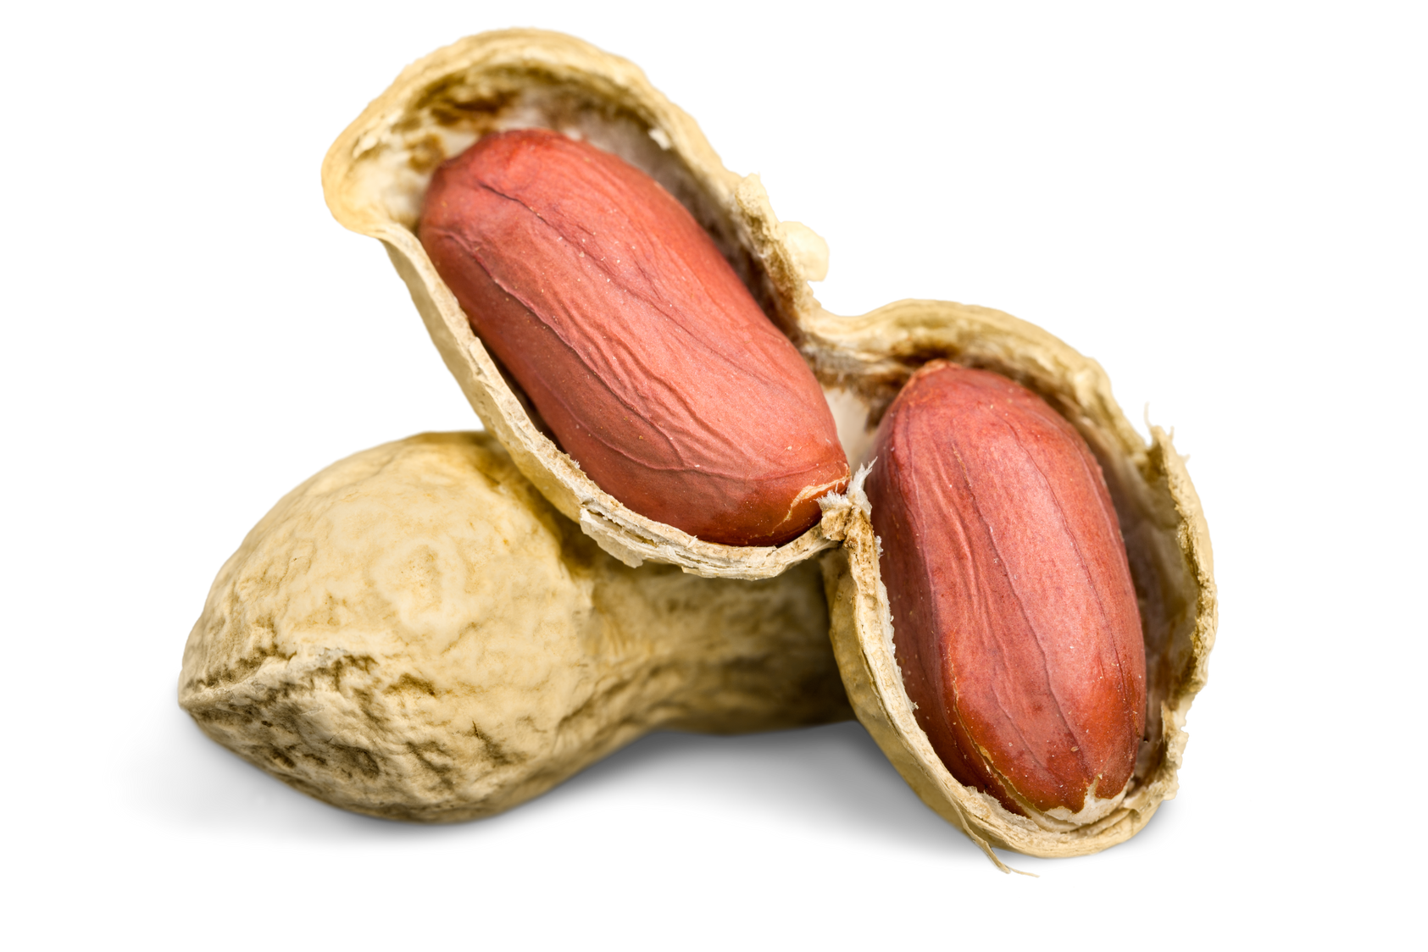
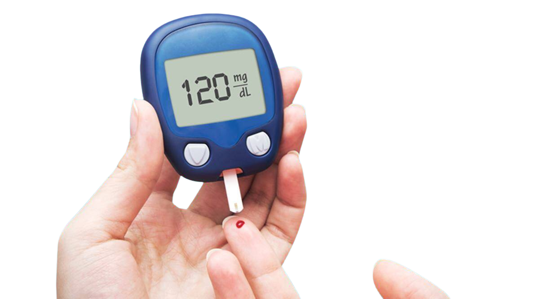
ALLERGIES, ASTHMA & DIABETES

Slide 41
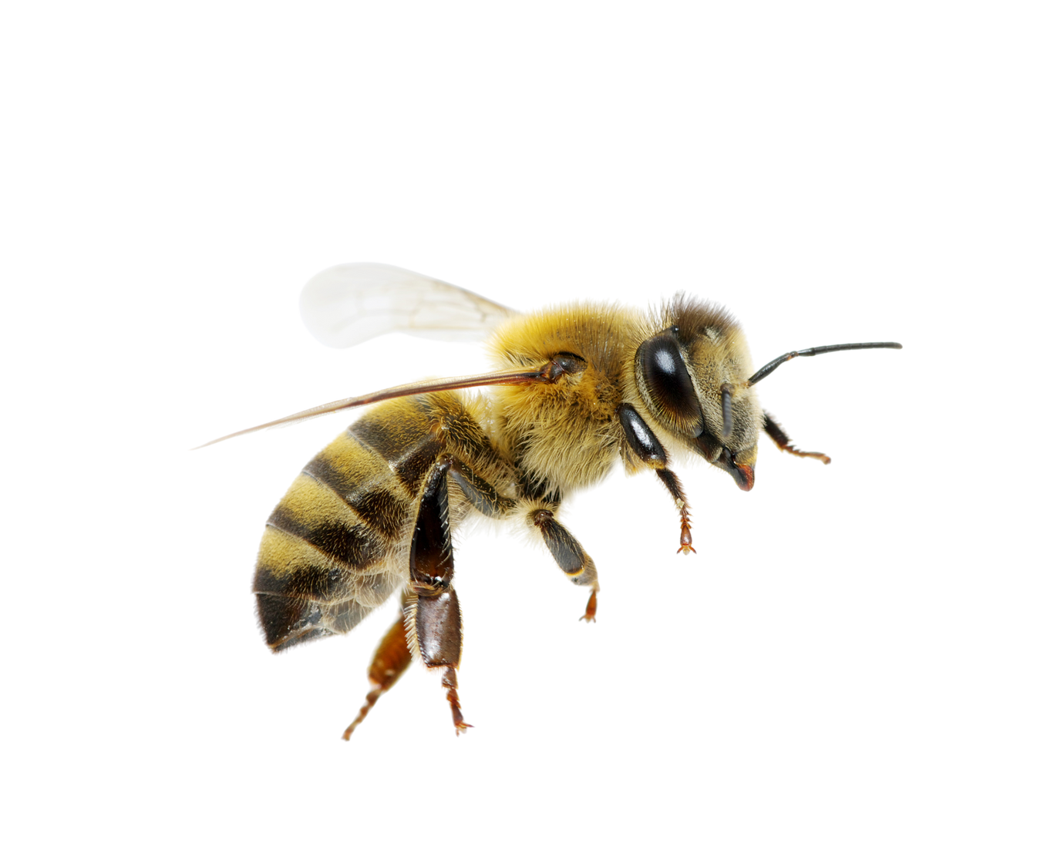
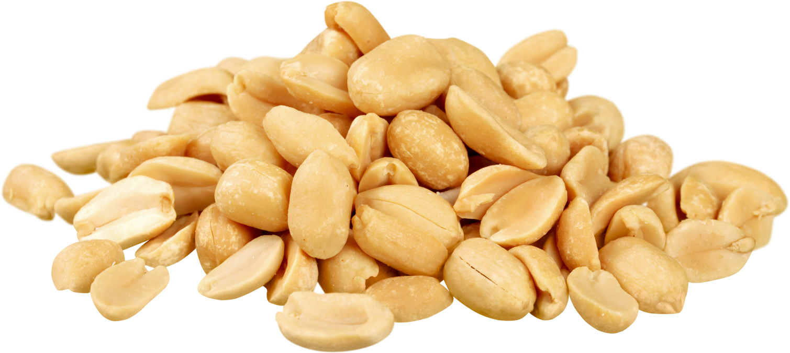
Allergy Awareness & Response
  Make sure your coach knows if you have any allergies and what causes them (like peanuts or bee stings).
  Always carry your emergency medicine (like an EpiPen) with you and check that it’s not expired.
  Make sure your coach knows where your medicine is! Let your coach and teammates know how to help you in case you need your EpiPen.
  Call 911 immediately after administering an epinephrine injection

Slide 42
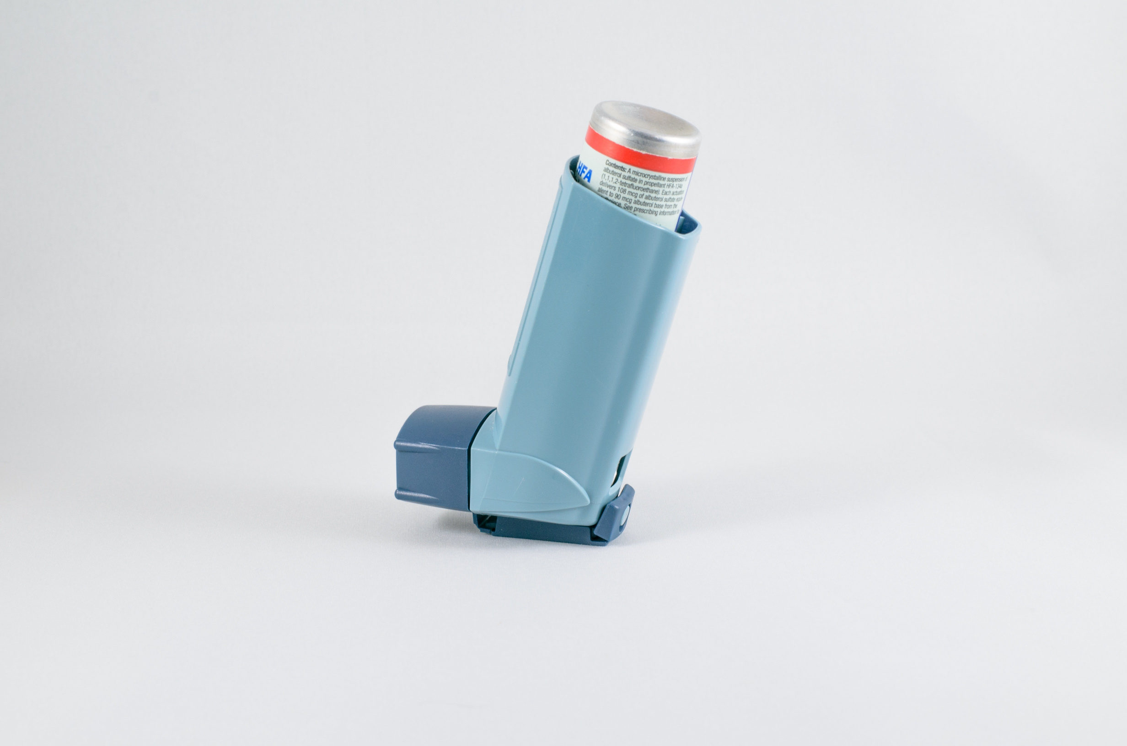
Asthma and
Respiratory Safety
Asthma is common in youth sports!
  Symptoms to Watch for:
    wheezing
    coughing
    rapid breathing
    use of neck/shoulder muscles to aid breathing

Slide 43
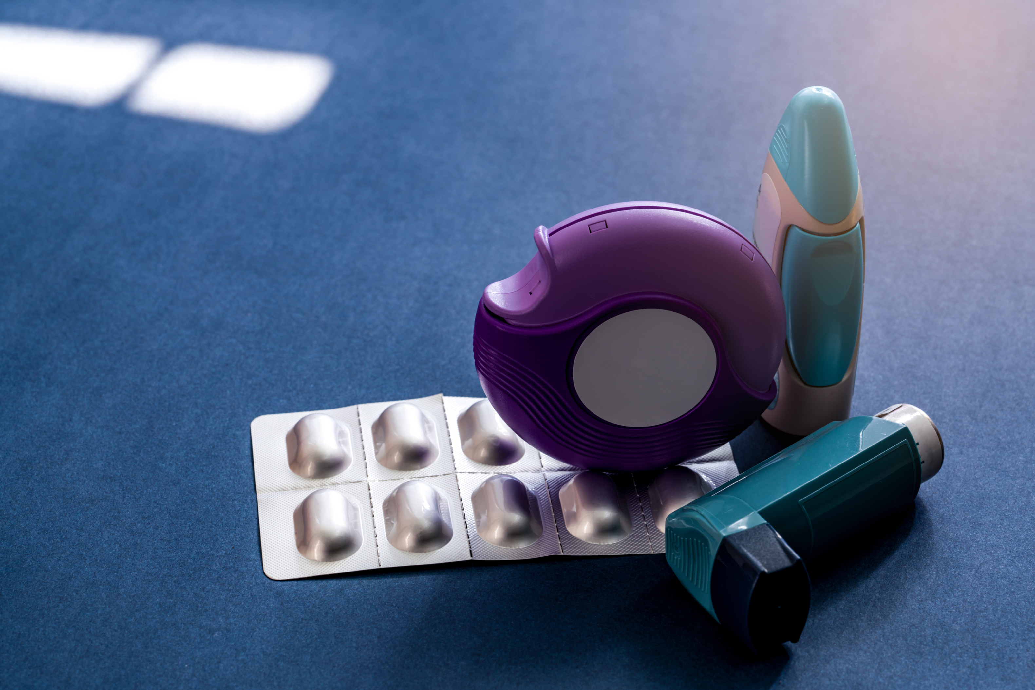
Asthma and
Respiratory Safety
  Make sure your inhaler is always easy to get to.
  It is recommended to have a back up inhaler with your coach/Athletic Trainer
  The team’s Emergency Action Plan should include what to do if you have an asthma attack.
  If you’re having trouble breathing, try leaning forward with your hands on your knees (called the tripod position) to help you breathe better.

Slide 44
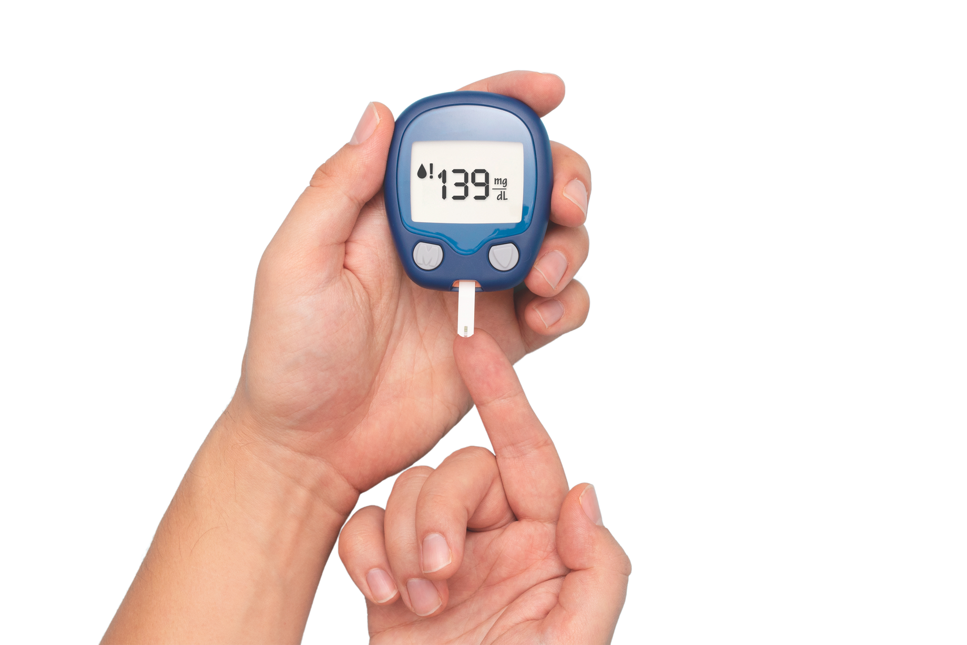
Diabetes Management for Athletes
  Coaches and teammates should know if someone has Type 1 or Type 2 diabetes.
  Learn the signs of low blood sugar: feeling shaky, sweaty, confused, or easily annoyed.
  Make sure testing supplies like glucose meters and strips are ready and working.

Slide 45

Diabetes management
  Keep insulin and other medicines safe but easy to get when needed.
  The team’s Emergency Action Plan should include what to do for diabetes emergencies.
  If someone has a severe low blood sugar episode, call 911 right away.

Slide 46


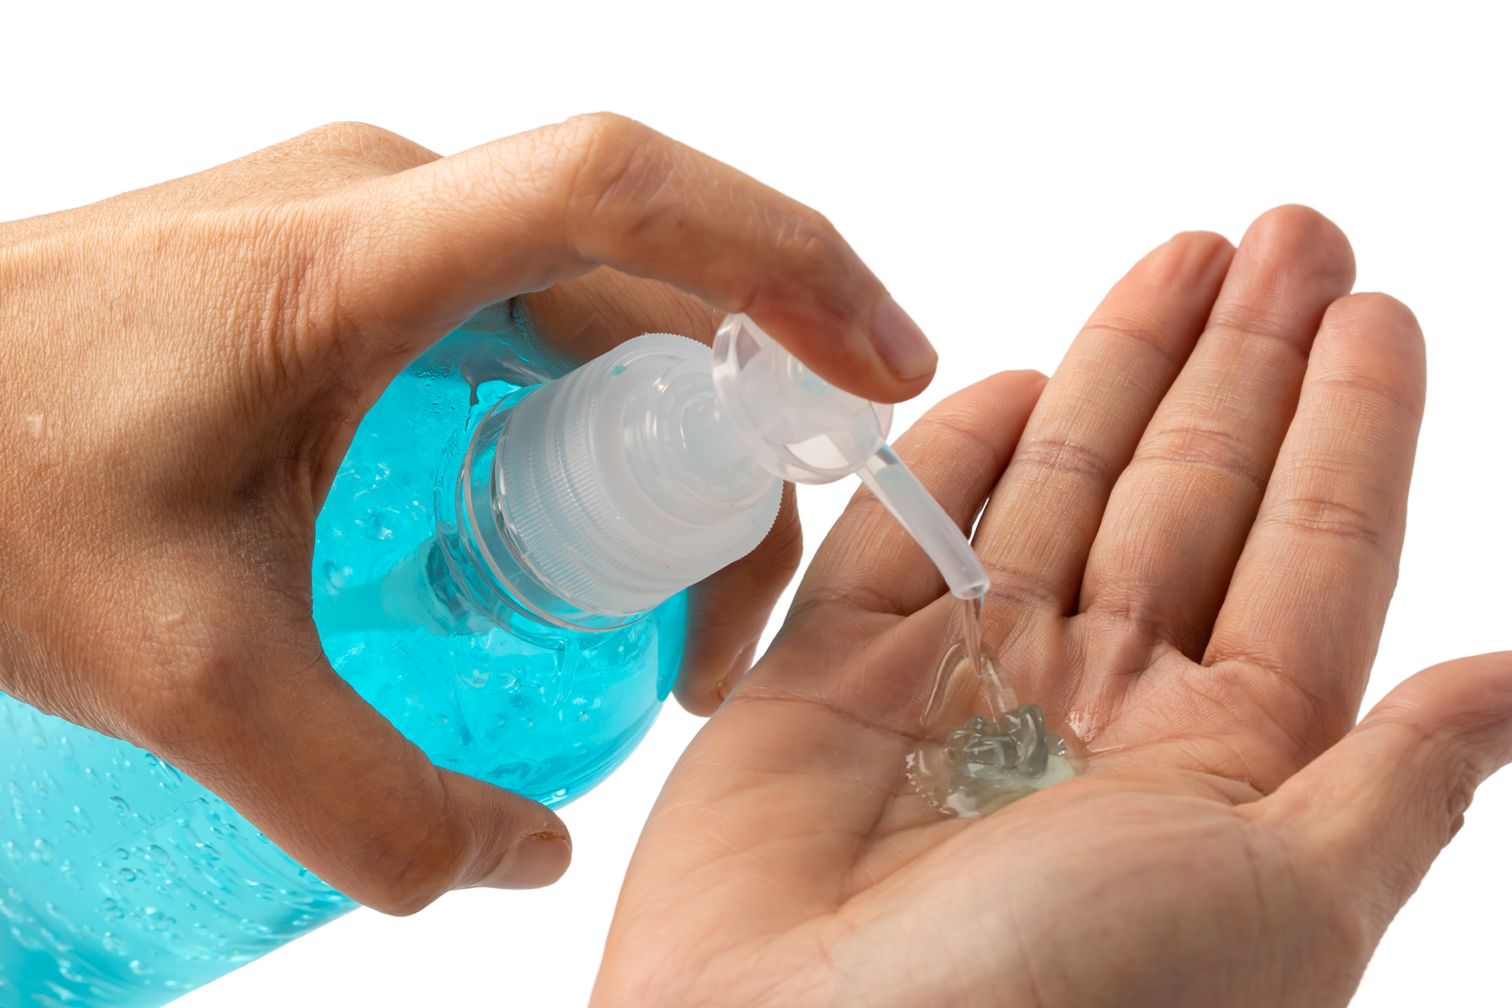
HYGIENE

Slide 47
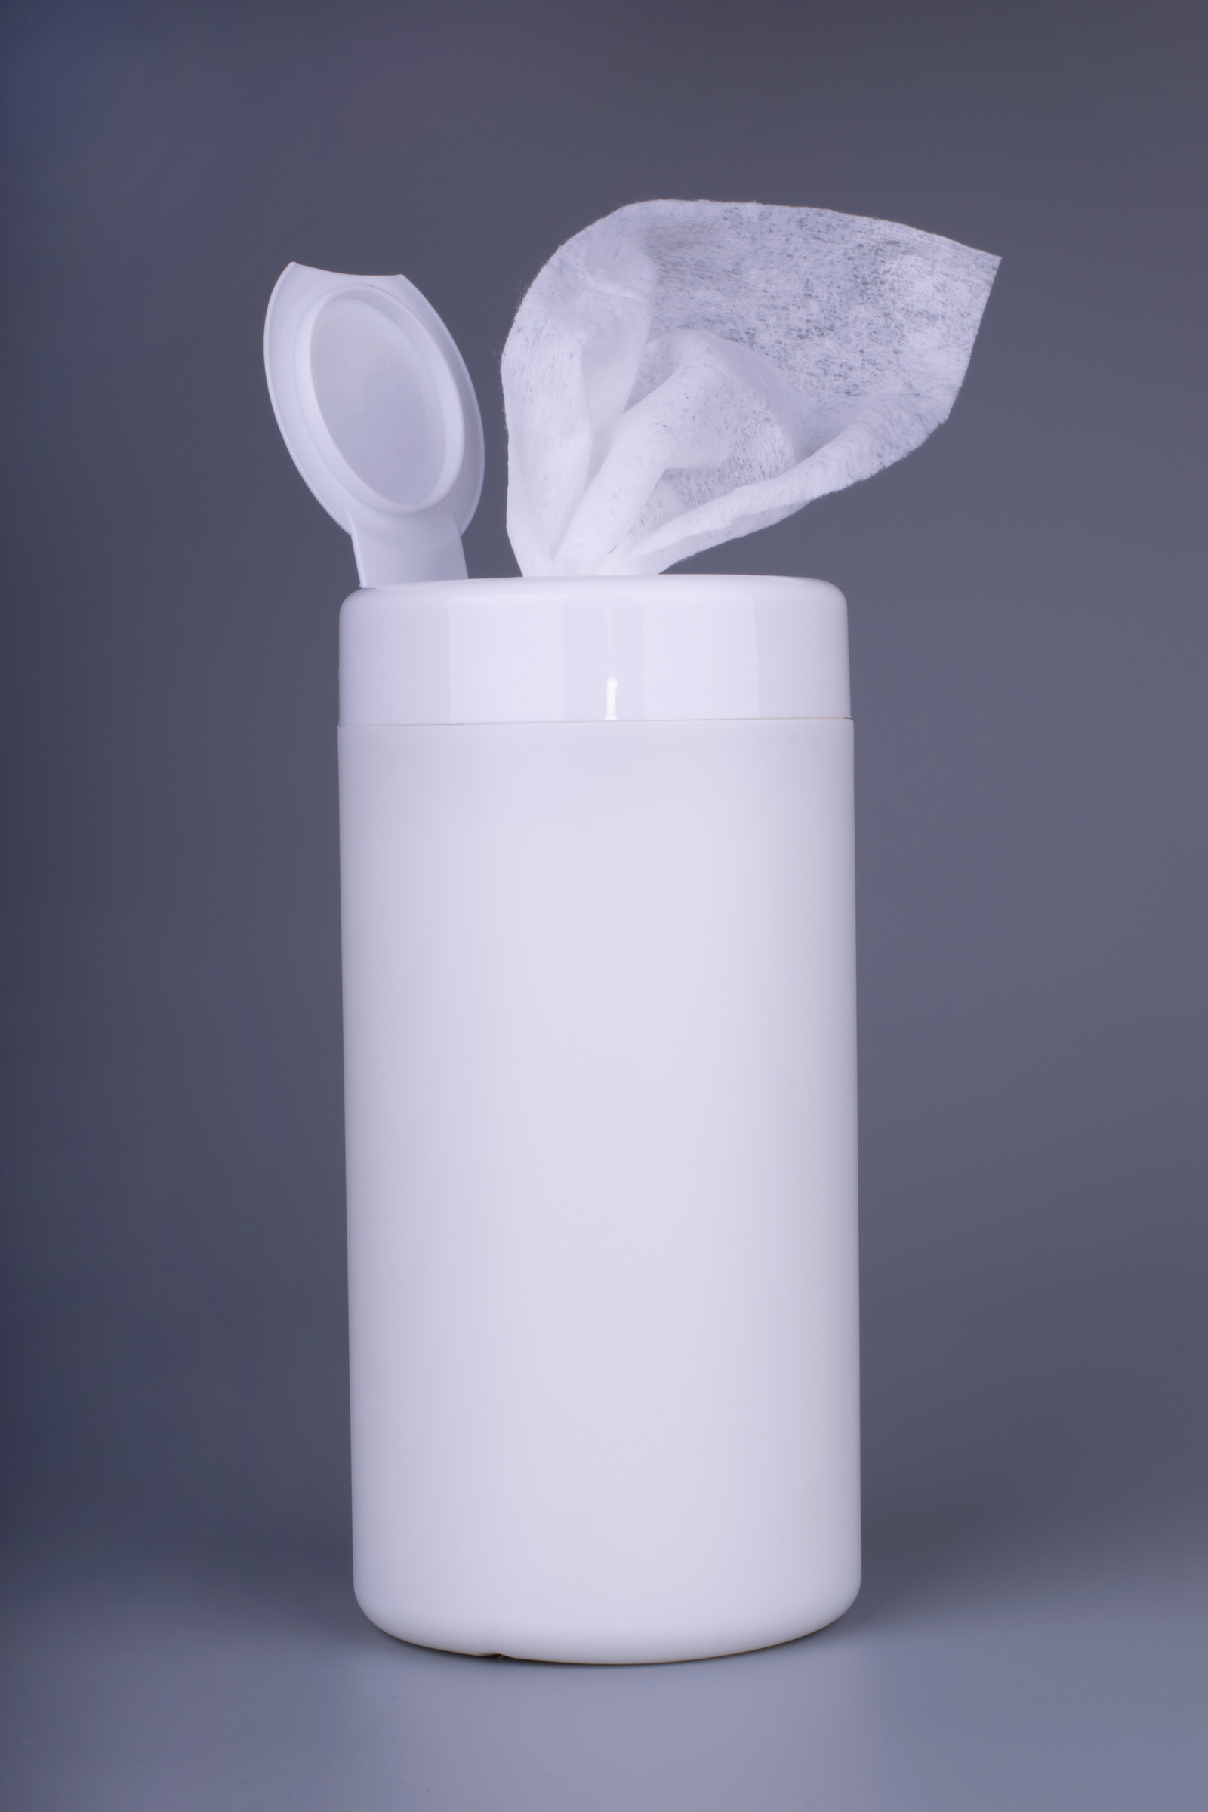
HYGIENE &
INFECTION PREVENTION
  Wash your hands often.
  Keep good personal hygiene habits.
  Don’t share things like water bottles, towels, or personal gear (like pads or workout clothes).
  Make sure shared equipment gets cleaned and disinfected regularly.

Slide 48

HYGIENE &
INFECTION PREVENTION
To prevent spreading of infections:
  Monitor for contagious conditions
    Ringworm, staph, etc.
  Report and treat infections promptly
  Ensure that locker room surfaces are cleaned regularly
  Ensure your clothes are washed on a daily basis

Slide 49

EMERGENCY ACTION PLANS
& SAFETY TRAINING

Slide 50
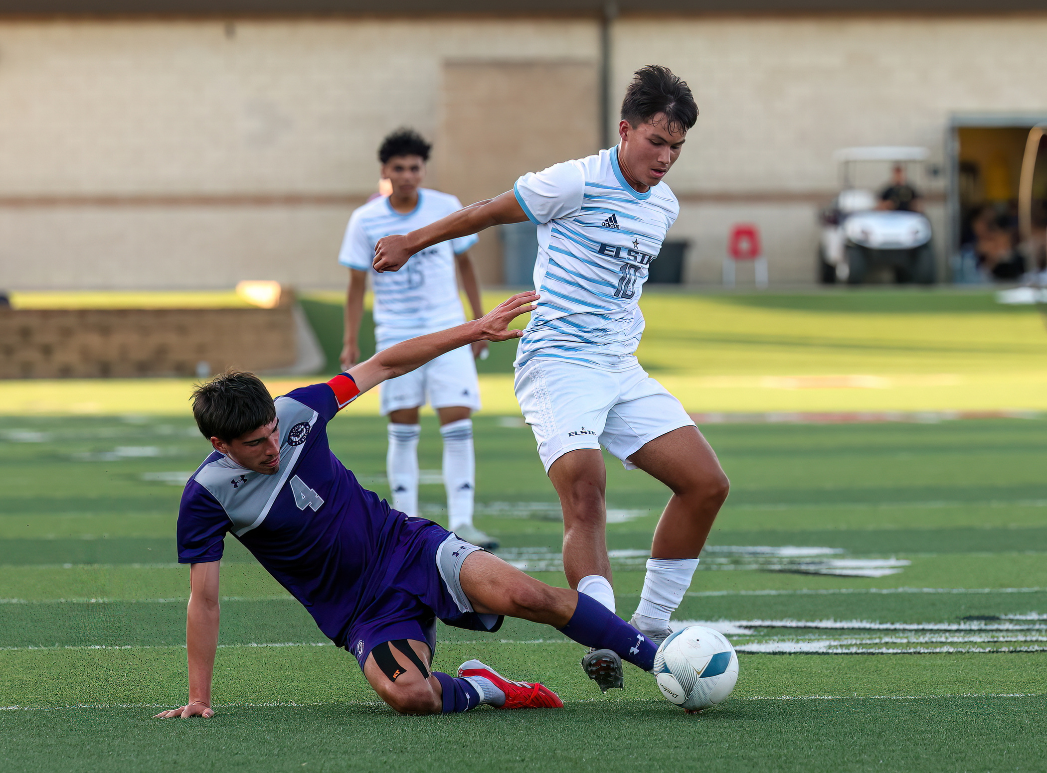
SAFETY IS EVERYONE’S RESPONSIBILITY!
Everyone—staff and athletes—should learn what to do in an emergency.
Practice the emergency plan often so everyone knows their role.

Slide 51
RESOURCES
Document | Link
NFHSLearn Free Courses on Sudden Cardiac Arrest | https://nfhslearn.com/courses/sudden-cardiac-arrest
NFHS Heat Acclimatization and Heat Illness Prevention Position Statement | https://www.nfhs.org/media/5919613/nfhs-heat-acclimatization-april-2022-final.pdf
NFHS Position Statement for Maintaining Hydration | https://www.nfhs.org/media/5919614/nfhs-hydration-position-statement-april-2022-final.pdf
NFHSLearn Free Course on Heat Illness Prevention | https://nfhslearn.com/courses/heat-illness-prevention-2
Hydration Urine Color Chart | http://at.uwa.edu/admin/UM/urinecolorchart.doc
NFHS Guidelines on Handling Practices and Contests During Lightning or Thunder | https://www.nfhs.org/media/7213621/nfhs-smac-guidelines-on-handling-practices-and-contests-during-lightning-or-thunder-disturbances-final-10-30-24.pdf
General Guidelines for Sports Hygiene, Skin Infections and Communicable Diseases | https://www.nfhs.org/media/5546438/2022-nfhs-general-guidelines-for-sports-hygiene-skin-infections-and-communicable-diseases-final-3-8-22.pdf

