Slide 1
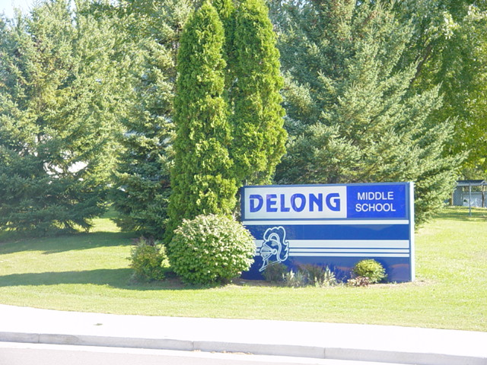

Welcome to
DeLong Middle School!

Slide 2
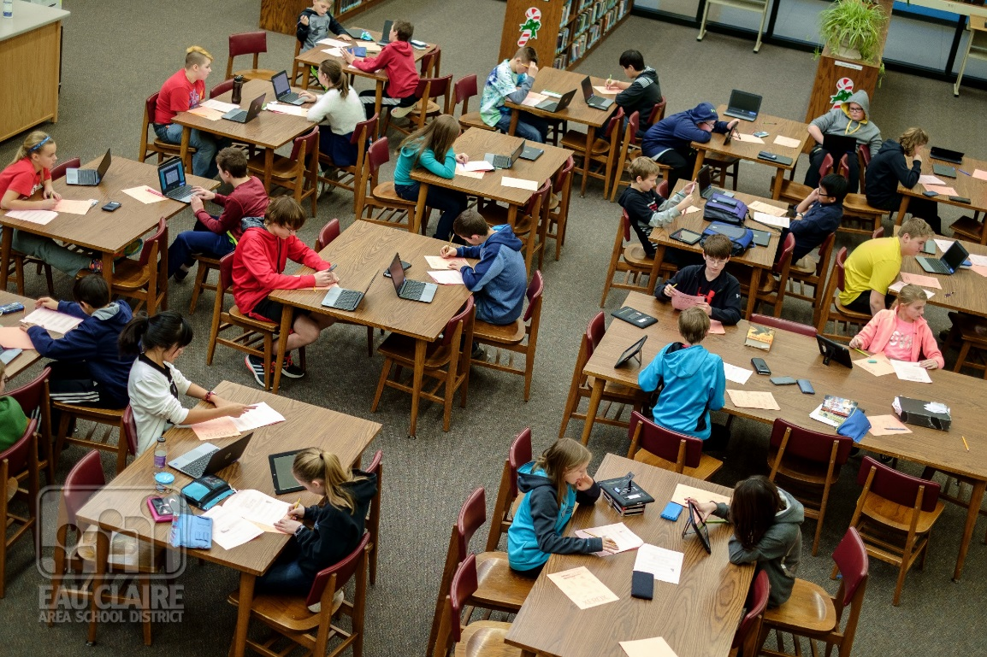
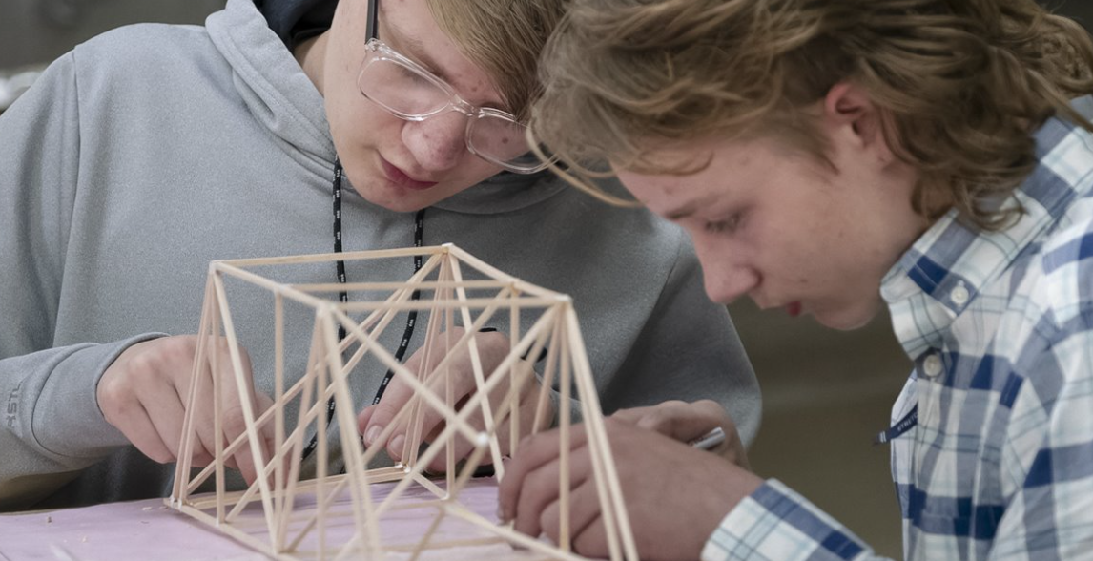

Slide 3
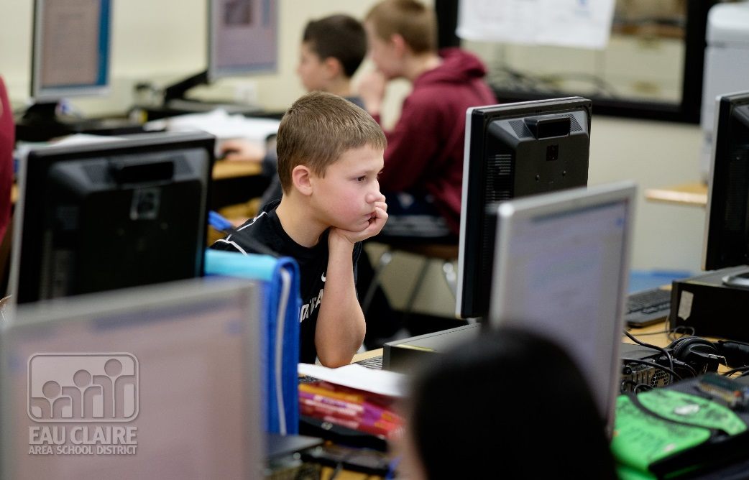
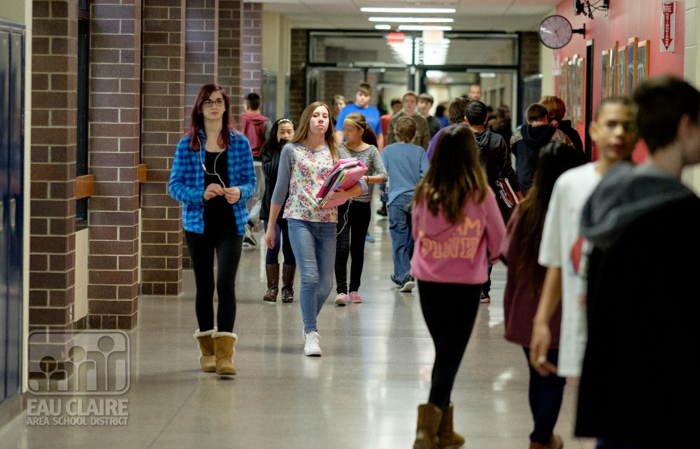

Slide 4
Three 6th Grade Teams
Team G
Team H
Team I

Slide 5
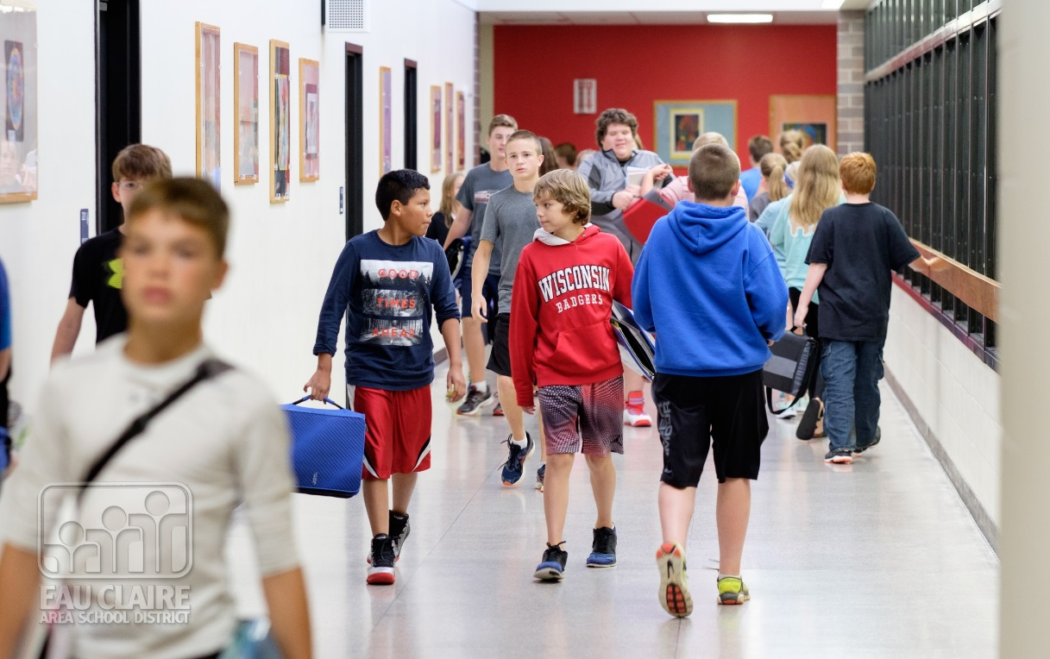

Slide 6
DeLong Bell Schedule
Seven class periods of equal length
Three lunch shifts of equal length
Resource Class

Slide 7
DeLong Middle School Bell Schedule
1st 7:30-8:22 (52 Min)
2nd 8:26-9:15 (49 Min)
3rd 9:19-10:08 (49 Min)
4th 10:12-11:01 (49 Min)
5th 11:05-12:34
A Lunch 11:05-11:32
B Lunch 11:33-12:03
C Lunch 12:04-12:34
6th 12:38-1:26 (48 Min)
7th 1:30-2:18 (48 Min)
KT 2:22-2:51 (29 Min)

Slide 8
Classes
Required
  Reading
  English
  Science
  Social Studies
  Math

Slide 9
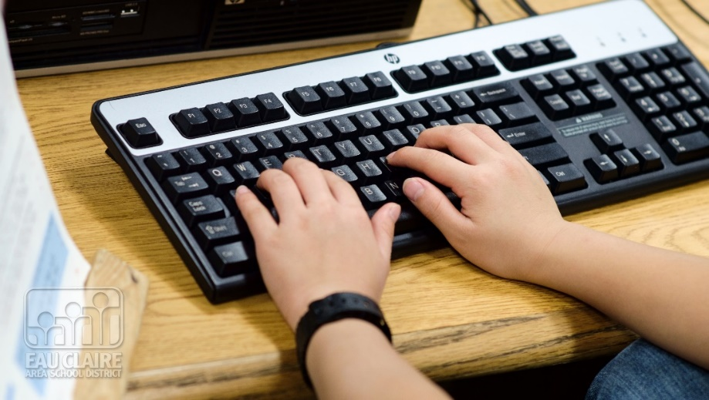
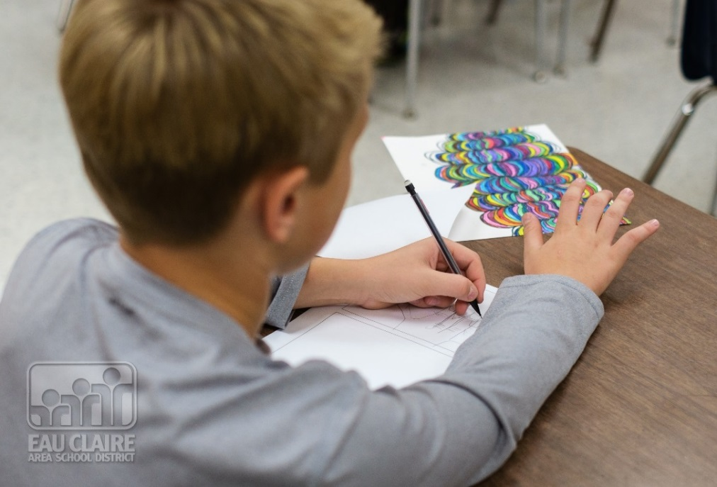
Required Encore Classes
Encore
  Phy Ed
  Music
  Art
  Computer Applications

Slide 10
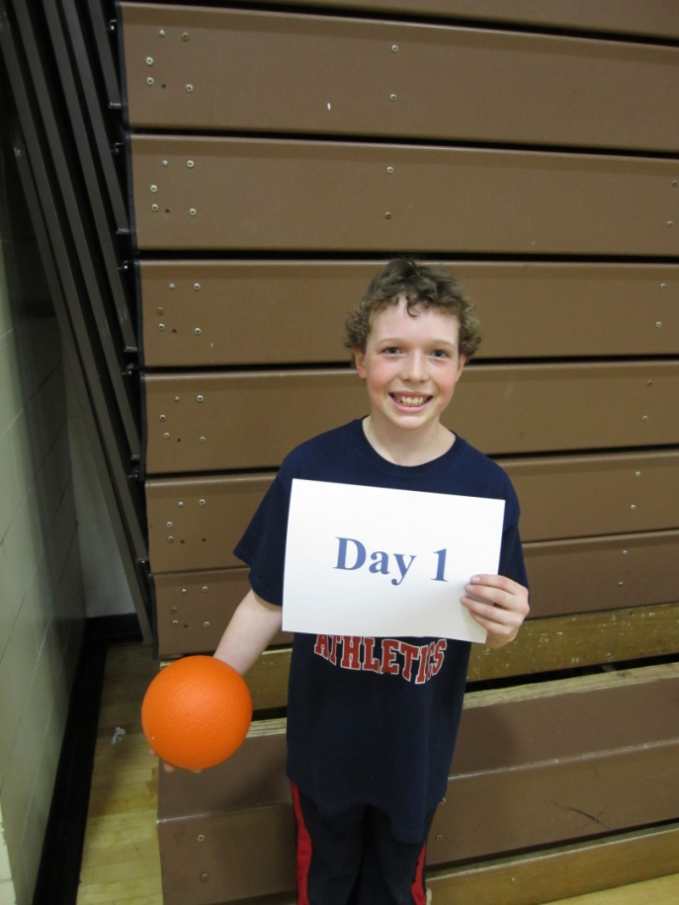
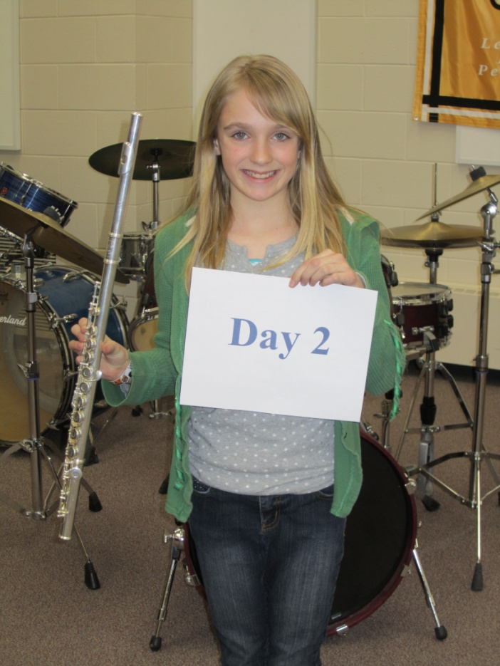
Day 1 and Day 2. What’s That?

Slide 11
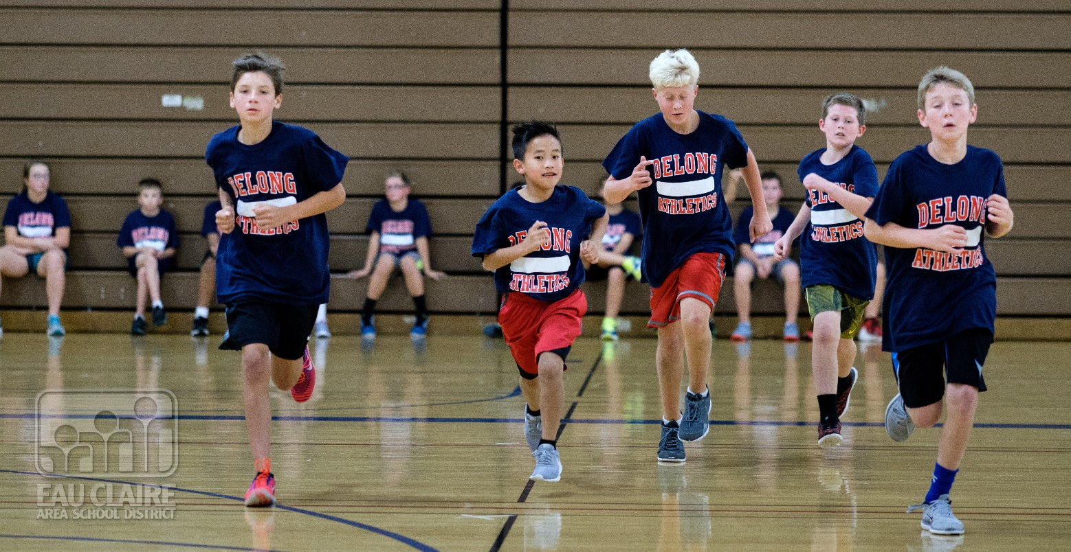
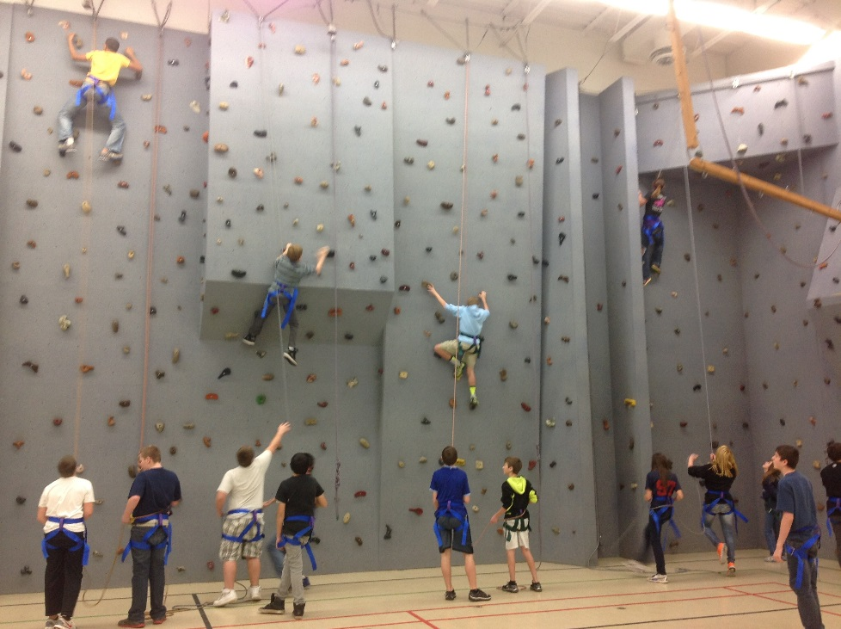

Slide 12
Music Choices
Band
Chorus
Orchestra
Exploring Music

Slide 13
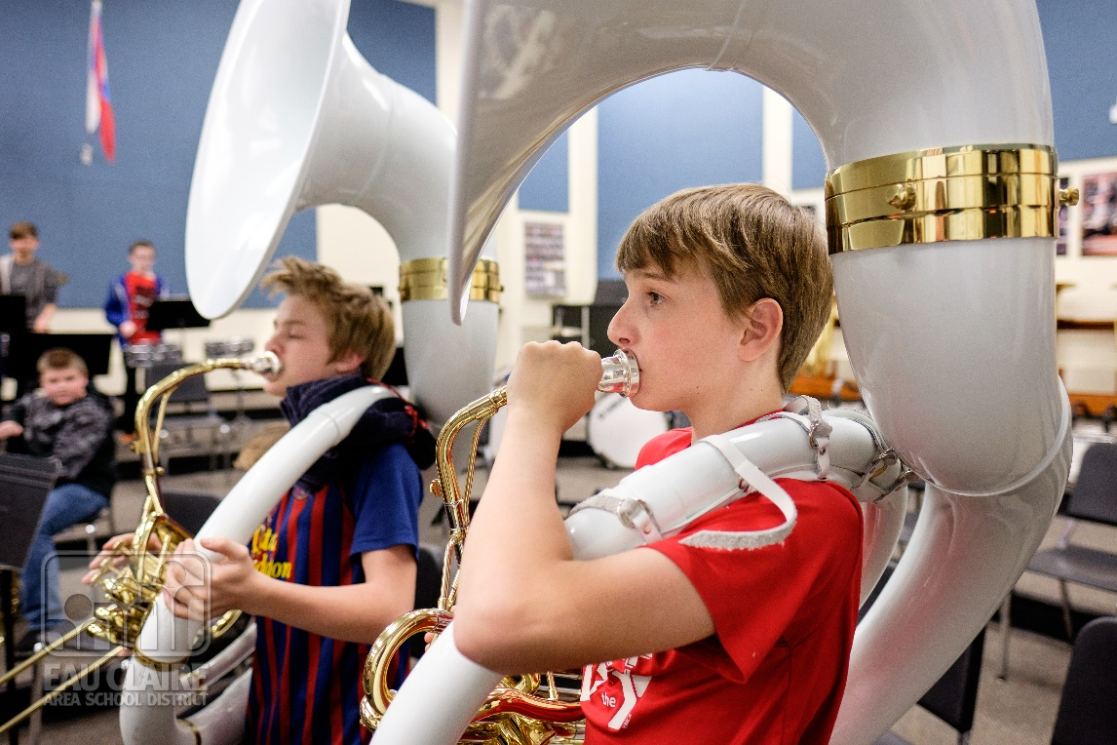
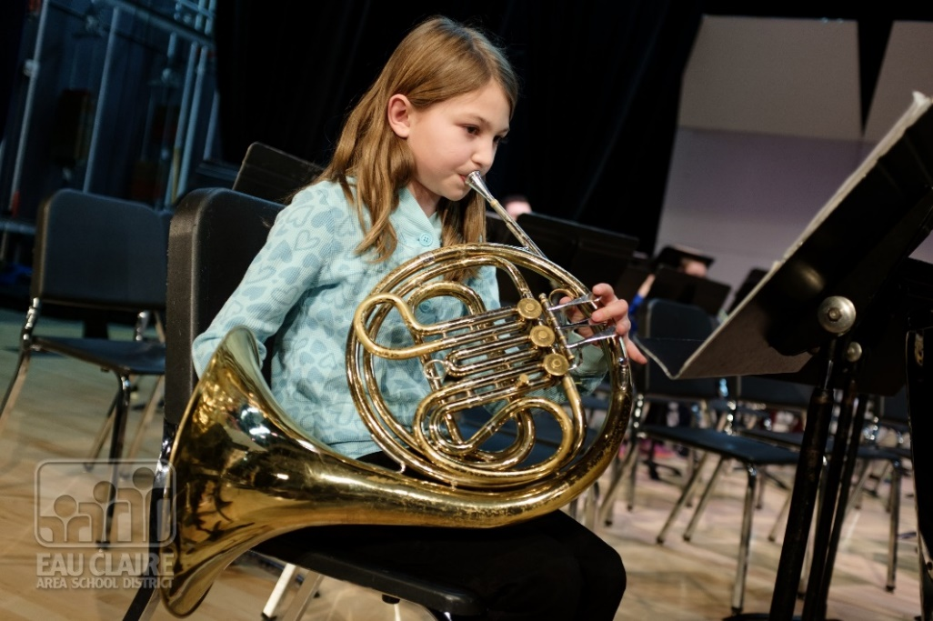
Band

Slide 14
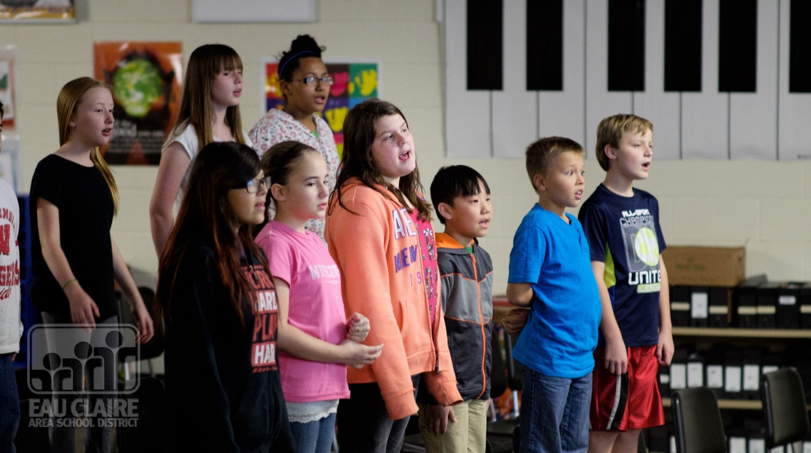
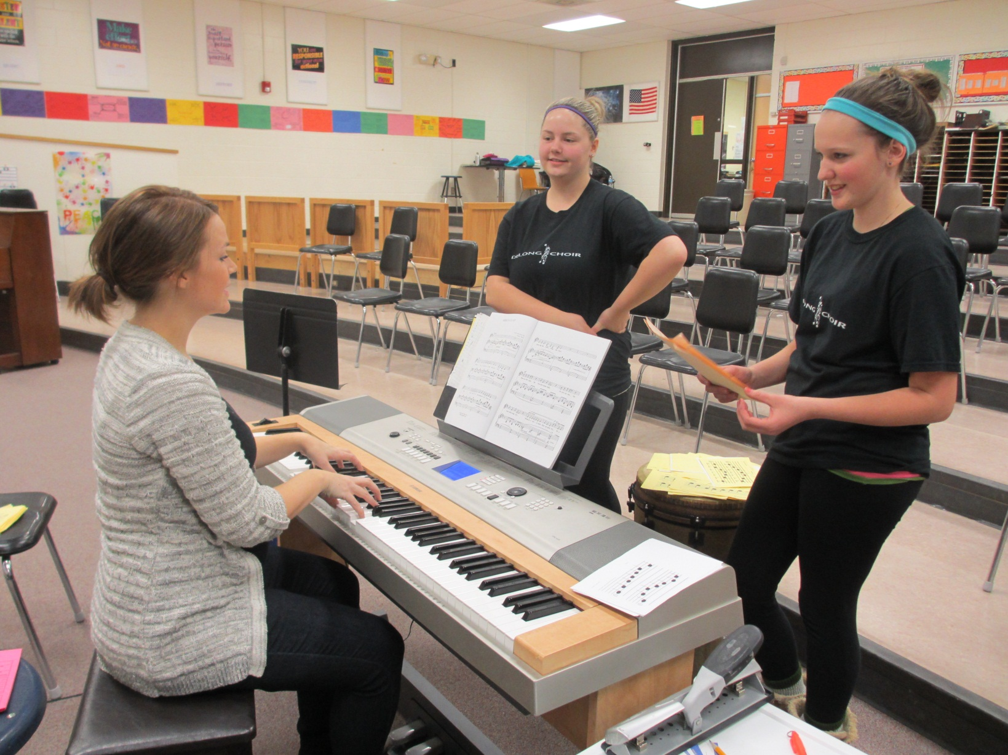
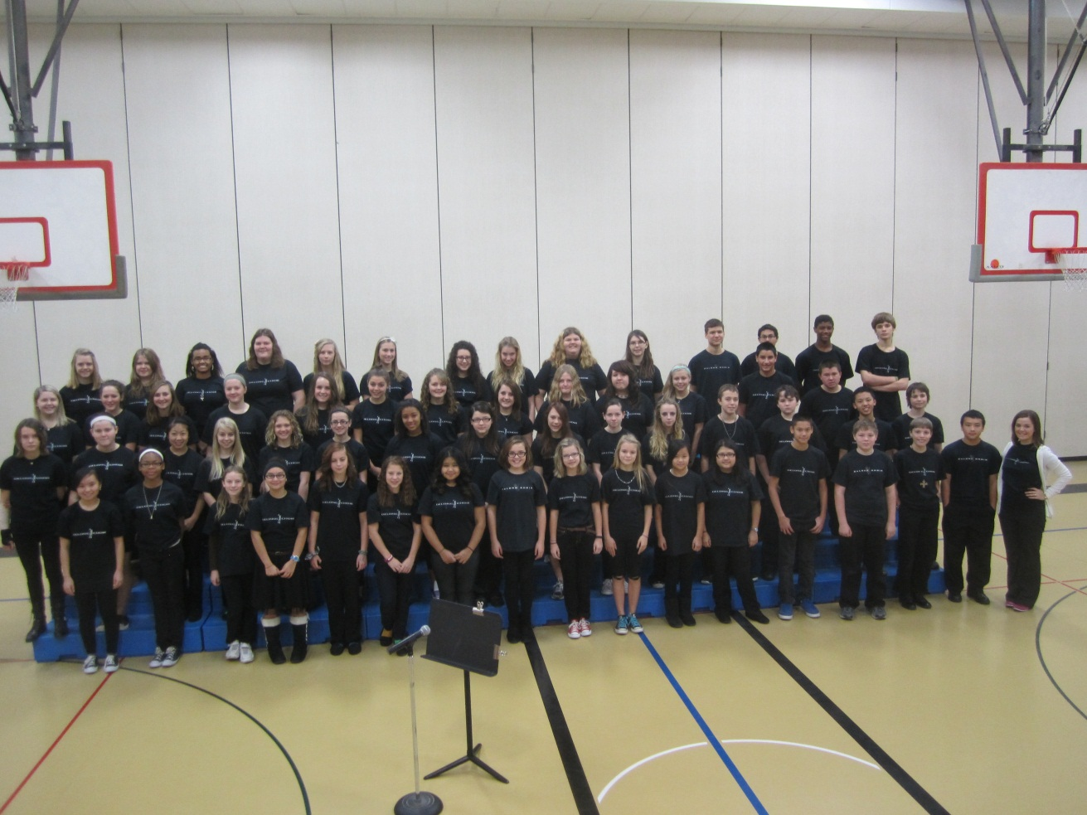

Choir

Slide 15
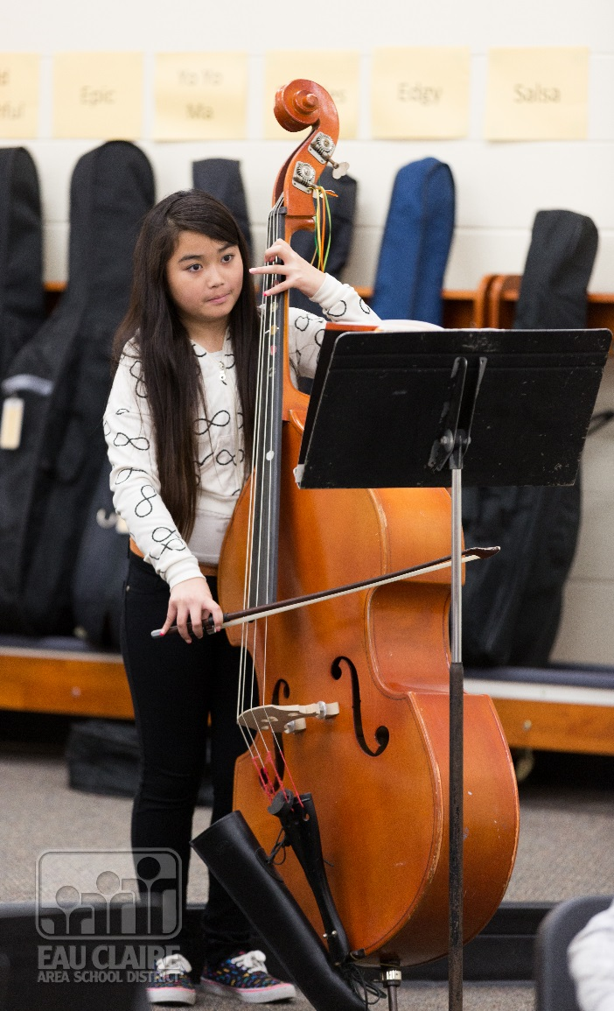
Orchestra

Slide 16
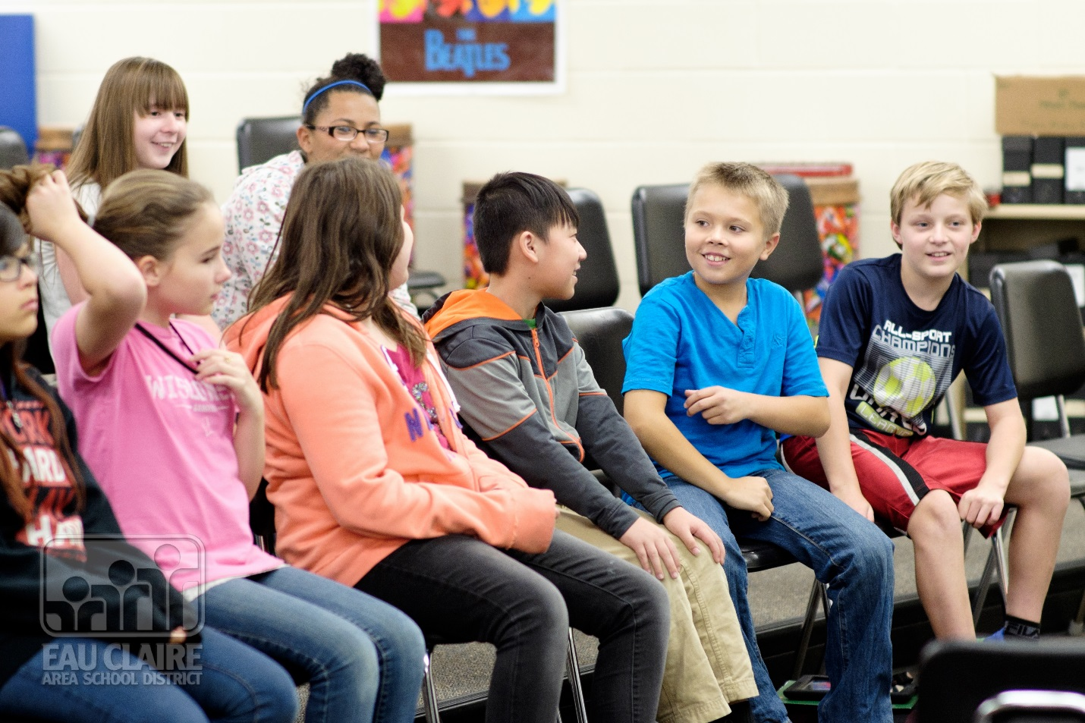
Exploring Music

Slide 17
Registration Process
January
Registration Packet
Sent Home to Families
January
Registration Forms Returned to Elementary School

Slide 18
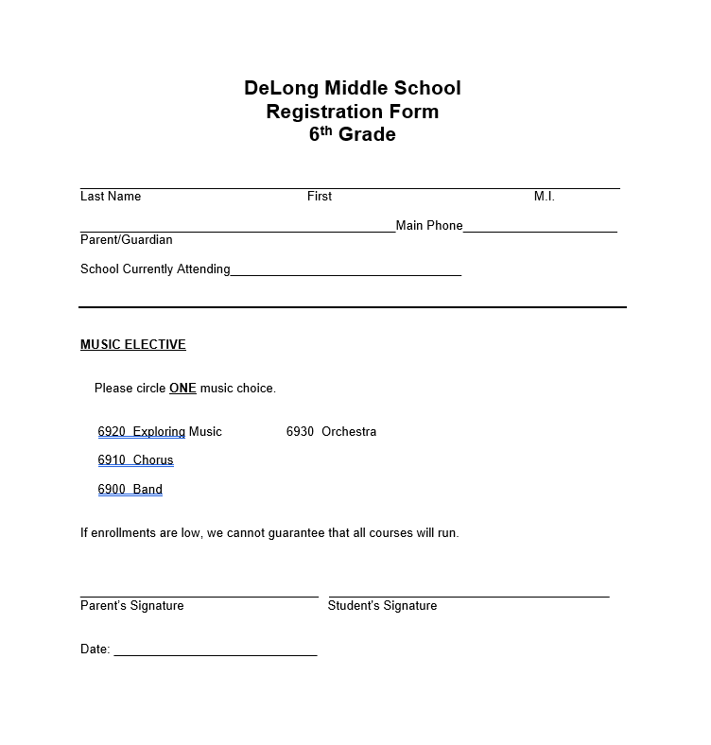

Slide 19
Other Scheduling considerations
Special Education
Intervention
Talented and Gifted

Slide 20
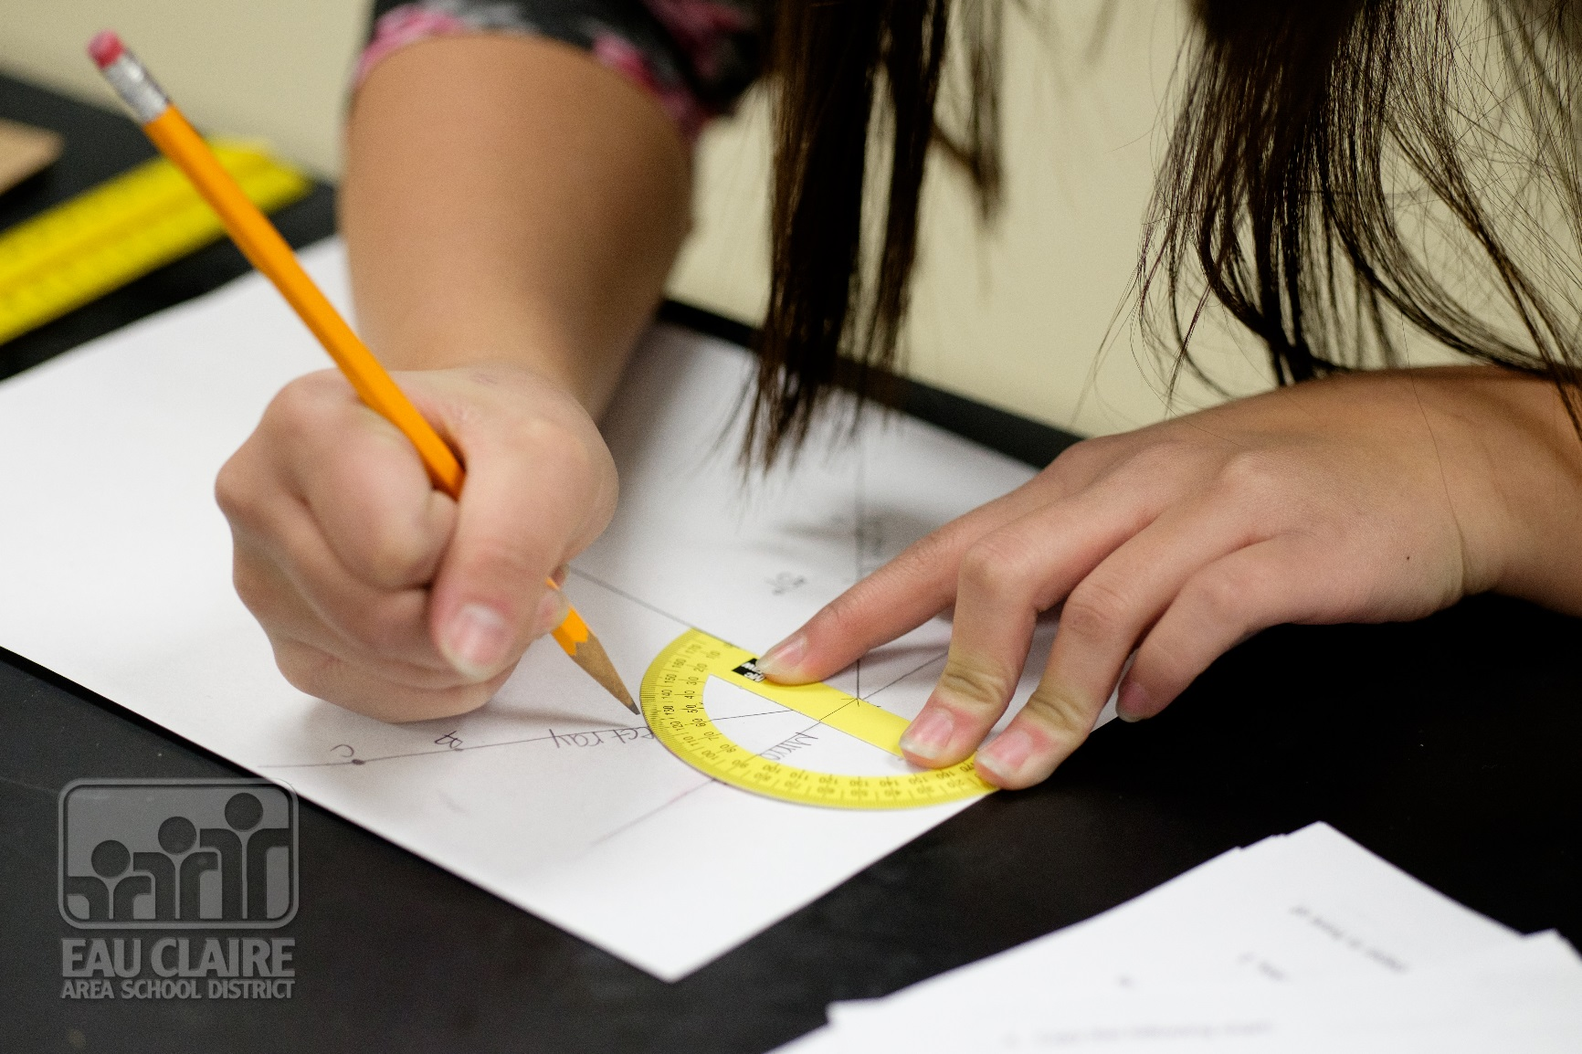
Homework Tips

Slide 21
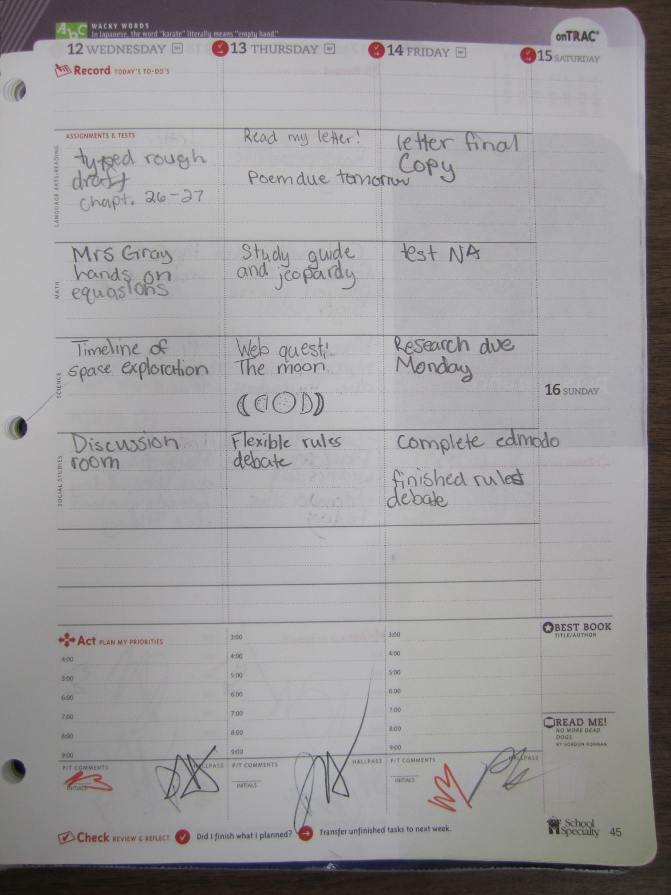

Slide 22
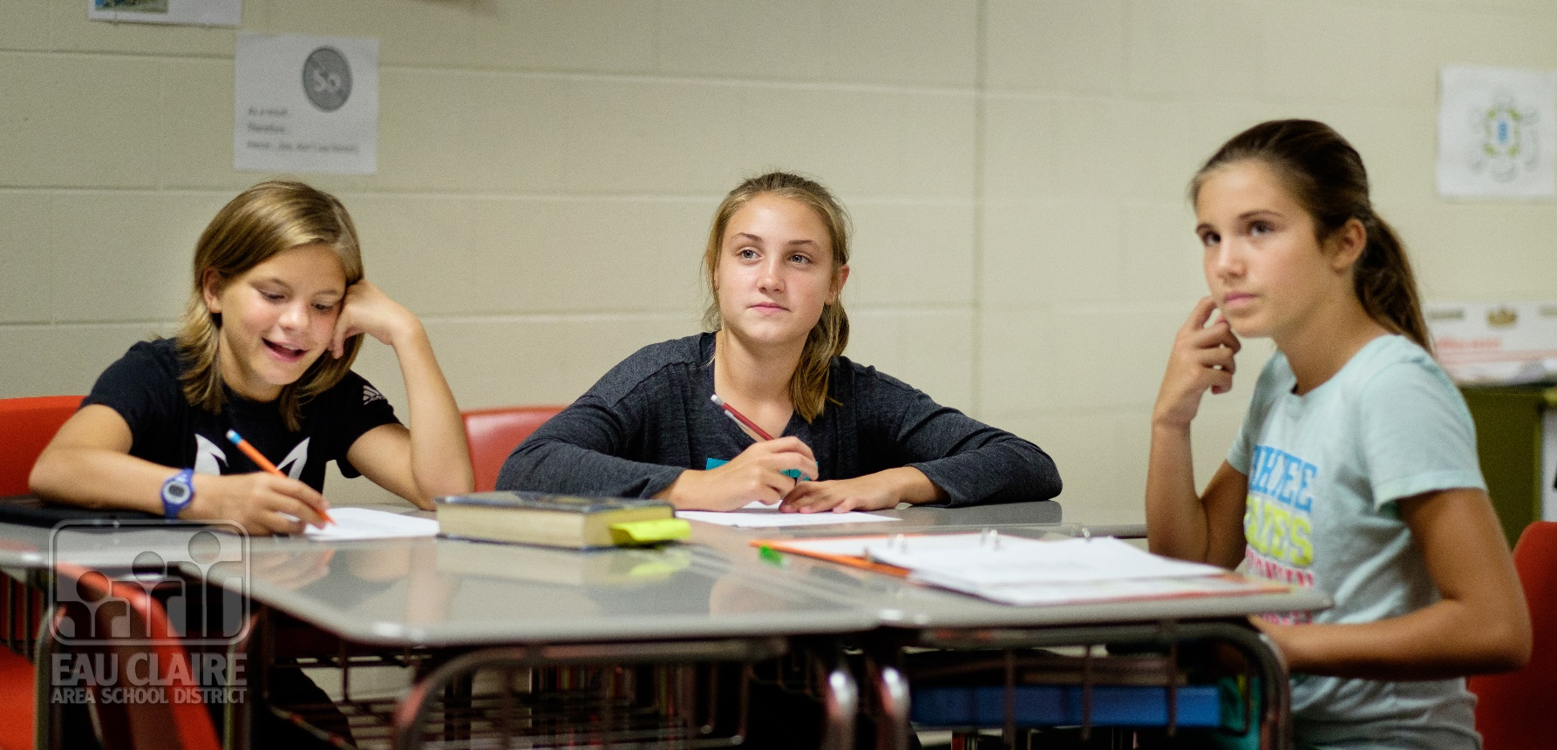

Slide 23
6th Grade Activities
During and after school activities:
Fun Knight
(Once a semester)
Forensics
Student Council
Variety Show
Study Club
Math Counts
School Store
School Play

Slide 24

More Pieces of the Puzzle

Slide 25
More to know!!
  Your PIN number for lunch will transfer from the Elementary School to the Middle School.
  There is an opportunity to have Ala-Carte at lunch!

Slide 26
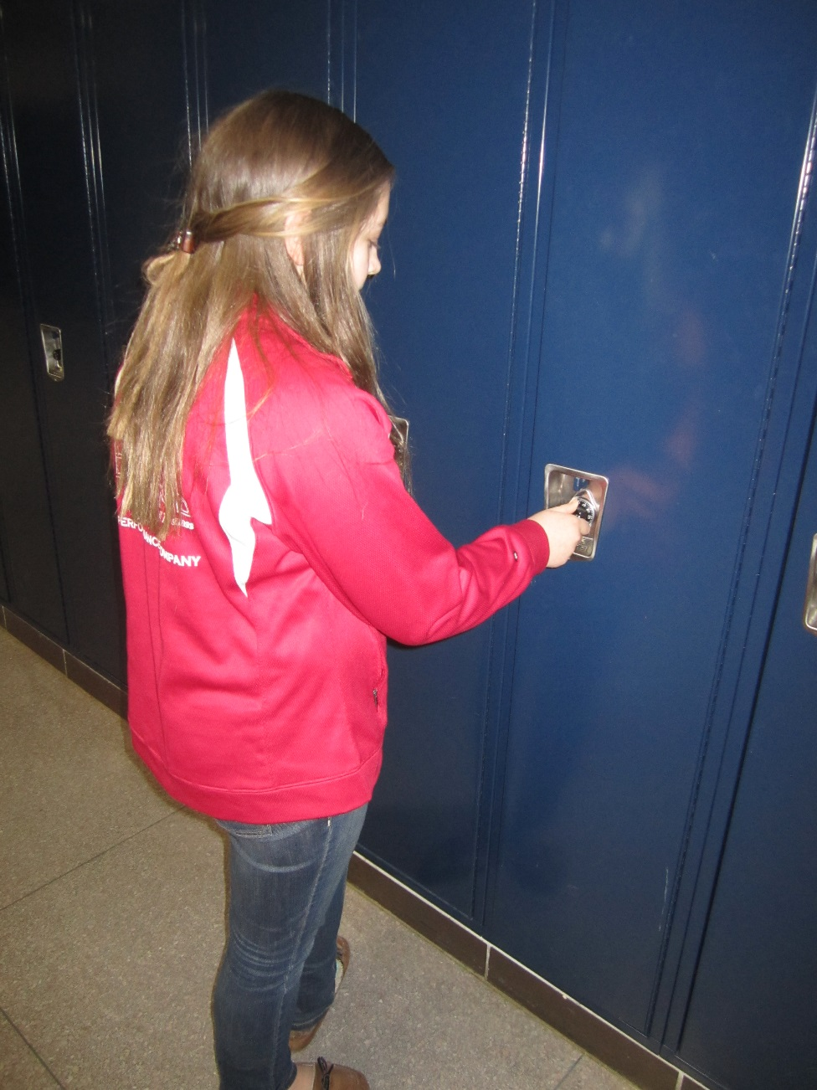
  You get your own hallway locker plus your own locker for Physical Education.
  (Suggestion-purchase a lock over the summer and practice opening)

Slide 27
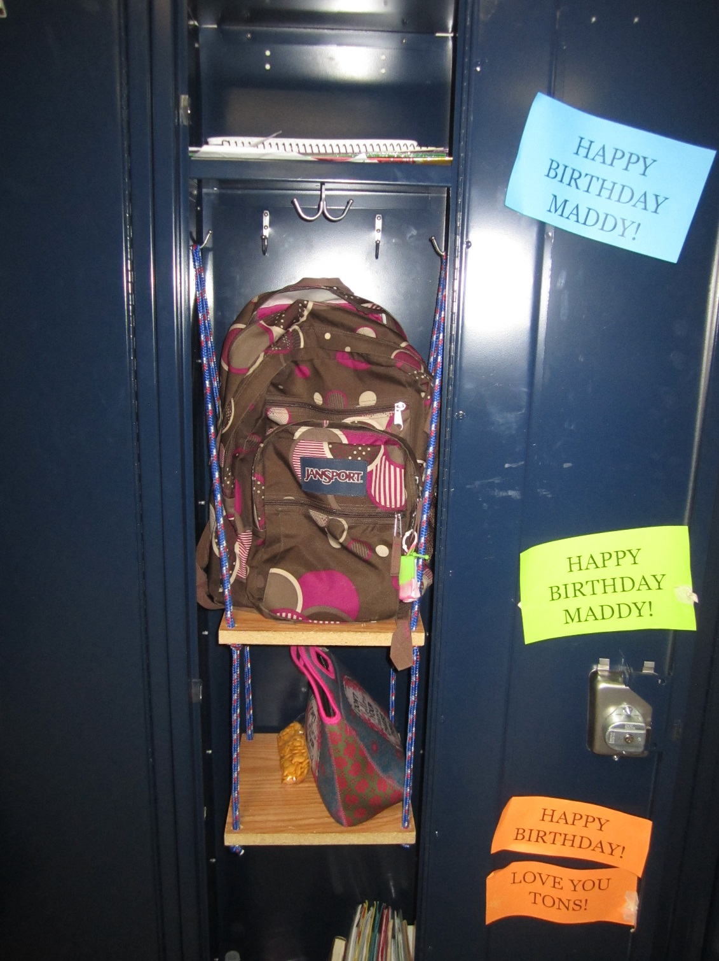

Slide 28
Your 6th grade school counselor is
Mrs. Erickson

Slide 29
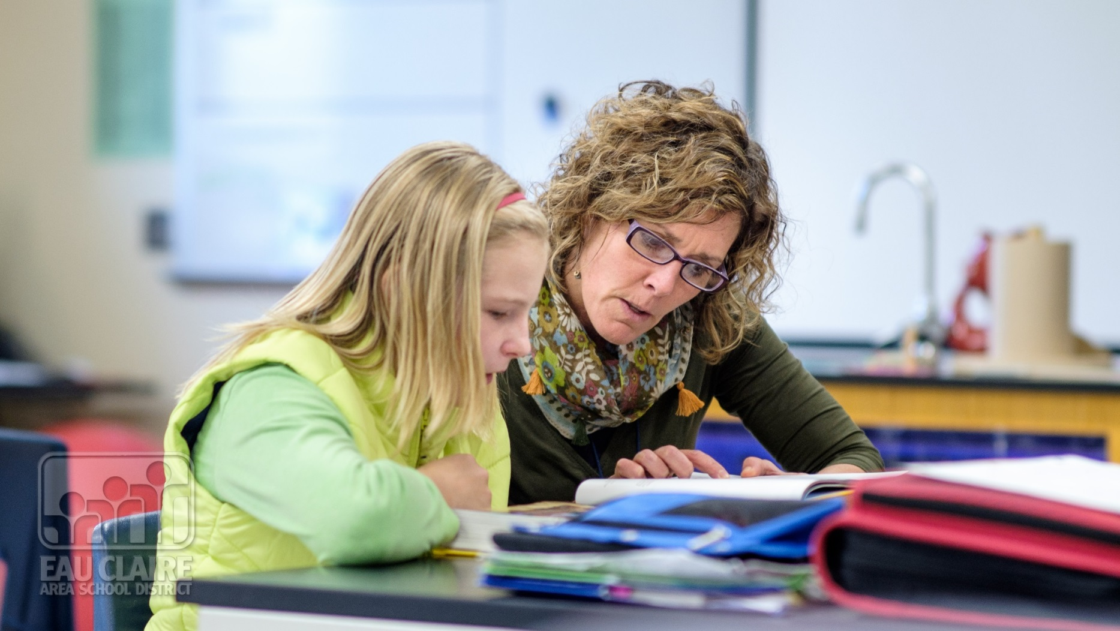

Slide 30
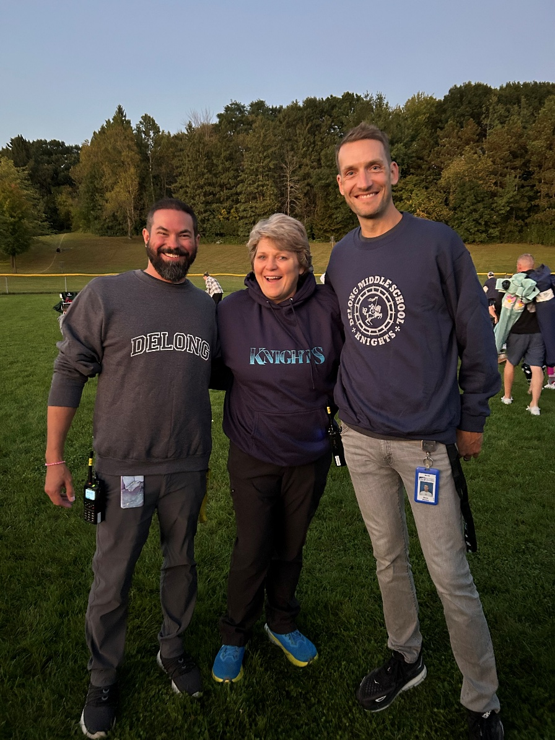
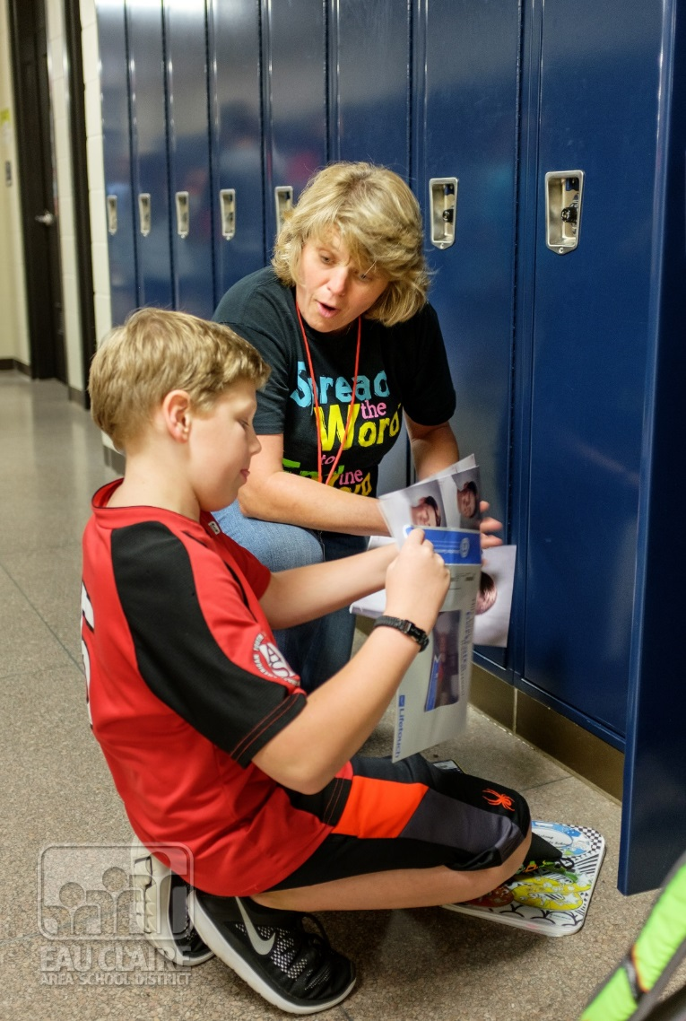

Slide 31
See you in the fall!

