Slide 1

Welcome to
HEB ISD
Kindergarten Kickoff
2026-2027

Slide 2
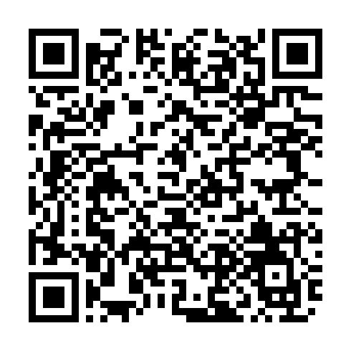
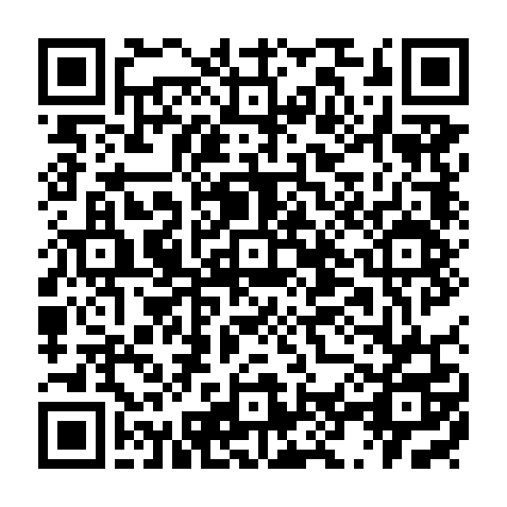
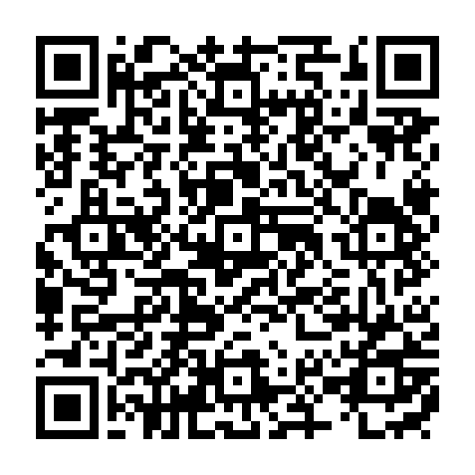
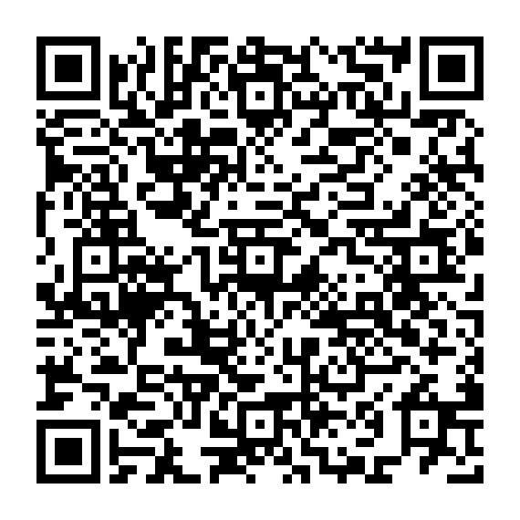

This presentation is also available in translated versions:
English | Spanish | Arabic عربي | French

Slide 3
Kindergarten Registration
Kindergarten student registration forms will be available online beginning mid July 2026.
HEB ISD Registration
You will be asked to upload the following documents:
Valid proof of residency (current gas water or electric bill or signed lease agreement - any form of residency must include the parent/guardian's name and HEB ISD address)
Student birth certificate
Parent/legal guardian government issued photo identification
Student immunization record Required Immunizations
Student Social Security card (if available)
Missing items will delay the registration process for your student.
To complete registration, the campus will contact the guardian to schedule a time for them to present the original/certified birth certificate for the student and provide any of the above documents that were not uploaded.

Slide 4
Meet the Teacher
This night you will have the opportunity to meet your child’s kindergarten teacher and see the classroom and all the fun activities it has to offer. This is also a great time to bring your student’s school supplies and drop them off.
Date: August 10, 2026
Time: 5:30 p.m. - 6:30 p.m.

Slide 5
The 1st Day of School is Wednesday, August 12, 2026
Here’s what you need to know:
School begins at 7:45 a.m. and ends at 3:05 p.m.
The school is open at 7:15 a.m. for early arrival and breakfast.
The first bell rings at 7:35 a.m. and the tardy bell rings at 7:45 a.m.
You are able to walk your student to class the first week of school (Wednesday-Friday). To encourage independence, beginning the second week of school, students will begin walking themselves to class with the assistance of school faculty all along the way.

Slide 6
Breakfast & Lunch Information
Breakfast is served from 7:15 a.m. - 7:45 a.m.
Lunch is provided from the school cafeteria, or you may pack a lunch.
Menus are posted on the HEB ISD Website monthly
Please visit our Child Nutrition Webpage for more information.

Slide 7
Kindergarten Readiness Tips
The following are important skills that will further Kindergarten success!
Student is able to dress him/herself (button, zip, snap).
Student is able to handle all restroom needs.
Student is able to verbalize his/her wants or needs.
Student no longer takes an afternoon nap.
Student is able to eat a meal in 20-25 minutes.
Notes:
1888 students tested in 2025.

Slide 8
Kindergarten Readiness Tips (continued)
Understands how to take turns with his/her classmates or peers.
Can sit and listen to a story for 5 minutes or more.
Can say, recognize and write his/her first name.
Can recognize some letters and numbers.
Student appropriately grips a pencil/crayon and handles scissors and glue independently.

Slide 9
Kindergarten Report Card/Early Literacy and Early Numeracy Information
Students in Kindergarten participate in early literacy and early numeracy assessments. These assessments give teachers and families data to better support our young learners.
Report cards in Kindergarten are skills-based. Students receive a 1, 2, or 3 on learning objectives in content areas, social skills, and work habits. Students who earn 2.5 or better in reading and mathematics are promoted to Grade 1.

Slide 10
Home - School Connection
We strive for a partnership with all families. Your support of your child’s education greatly impacts his/her progress. Reading with your child every night is a great way to grow your young learner.
Families and the school communicate through multiple means, including emails, newsletters, and notes home.
Please visit our Family Engagement website for more ways to connect!
Notes:
Students earn TSI Exempt status based on these threshold scores:
≥ 480 on Reading and Writing
≥ 530 on Math

Slide 11
News to Know from the Nurse
The Nurse is a resource to help with the following:
Provide first response medical assistance.
Routine health checks as mandated by the state.
Administer doctor prescribed medication or procedures with official medical paperwork on file. Documents located on our Health Services Forms website.
Included in online registration is a health inventory. Please fill it out carefully and fully so the campus can support your child’s health needs.
Notes:
Students earn TSI Exempt status based on these threshold scores:
≥ 480 on Reading and Writing
≥ 530 on Math

Slide 12
News to Know from the Counselor
The Counselor is a resource to help with the following:
Classroom Lessons: Teaching Citizenship, Friendship, and Character through monthly HEB ISD Core Essentials lessons.
Small Group Support: Hosting "Lunch Bunches" and "Friendship Circles" to help students practice sharing and social skills.
Academic Partnership: Partnering with parents and teachers to identify learning barriers and create plans for struggling students.
Emotional Safety: Providing a safe, confidential space for students to process "Big Feelings" and learn to self-regulate.
Family Resources: Connecting families to food, clothing, and school supplies through HEB ISD community partners.
Notes:
Students earn TSI Exempt status based on these threshold scores:
≥ 480 on Reading and Writing
≥ 530 on Math

Slide 13

Kindergarten School Supply List
To locate the school supply list, visit the following link:
Elementary Supply Lists (www.hebisd.edu/supplies)
Notes:
133 students tested in 2025.

Slide 14
A Day in the Life of a Kindergarten Student
Some things your child can expect:
Language Arts and Reading
Mathematics
Science
Social Studies
Music, Art, or PE
Intervention Time
Lunch/Recess

Slide 15
Extended Day Academy (EDA)
EDA is on each of the 21 elementary campuses.
EDA provides the children with a safe and fun environment from 3:05 p.m. to 6:00 p.m. on each regular school day.
EDA provides time to work on homework assignments, participate in computer activities, craft activities, science experiments, along with physical activities both in the gymnasium and on the outdoor playground.

Slide 16
Extended Day Academy (continued)
EDA has one site manager, and the number of workers that will maintain a 15 to 1 ratio with the students.
A $25.00 non-refundable registration fee is due at the time of registration.
Monthly tuition is $200.00 a month per child.
First month's tuition is due no later than the first day of student attendance. Tuition for all other months is due on the 1st of each month.
To register go to the HEB ISD Website, under Extended Day Academy.

Slide 17
Important Dates to Remember:
Meet the Teacher - August 10 at 5:30pm
First Day of School - August 12
We can’t wait to see you!

