Slide 1
Summer School Student Registration Procedures
Red Clay Consolidated School District
Training for School Secretaries

Slide 2
Training Goals
  Register students for summer school enrollment
  Assign students to proper summer programs
  Manage transportation records accurately
  Generate summer school student reports
  Avoid registration errors and compliance issues

Slide 3

Critical Compliance Deadline
All summer school registrations must be completed before June 30
Registrations after June 30 will not flow to Ed-Fi for DSC
Late registration may impact reporting and services

Slide 4
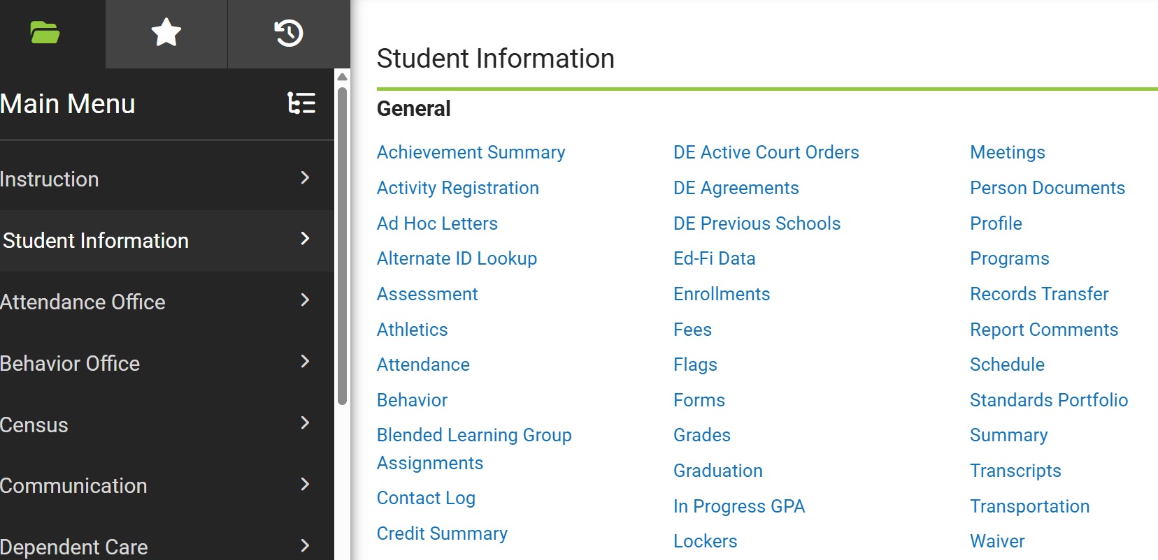
Enrollment Navigation
Student Name Must be in the Search Field
Infinite Campus Path: Student Information > General > Enrollment
Search for student in regular school year calendar
Select Enrollment tab
Click New

Slide 5
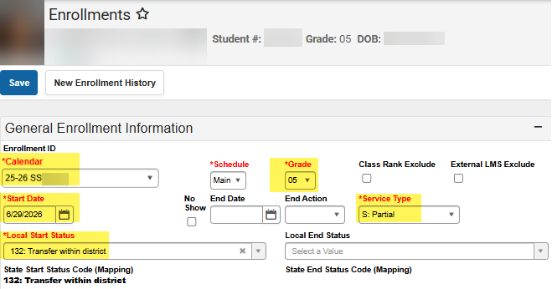
Required Enrollment Fields
Calendar: Select Summer School building
Schedule: Leave unchanged
Grade: Same as current year grade
Start Date: First day of summer program
Local Start Status: 132 Transfer within District
Service Type: Partial
Click Save

Slide 6
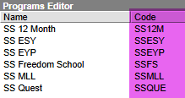
Program Assignment Overview
Infinite Campus Path: Student Information > General > Programs
Required when multiple programs exist in same building
Student must already be enrolled
Use Program Sheet for correct codes and dates

Slide 7
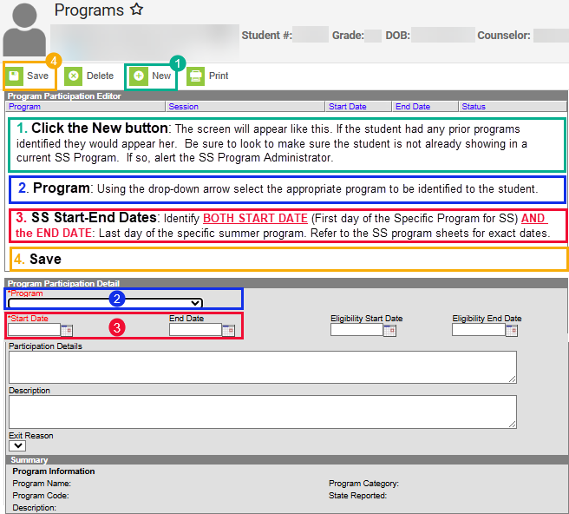
Program Assignment Overview

Slide 8

Transportation Overview
Update if summer address differs from household
Verify accommodations and copied transportation data
Check all transportation details carefully

Slide 9
Summer Route Type Codes
SS-T = Transportation To Only
SS-F = Transportation From Only
SS-TF = Transportation To and From
SS-NT = No Transportation
SS-AU = Autism
SS-SE = Special Education
SS-RG = Regular

Slide 10
Adding Summer School Transportation
Open the students SS Transportation record
Start Date: Identify the start date of the SS Program the student is participating.
Accommodations: These should copy over, but check to make sure if the student has accommodations they are identified accordingly.
Route Type: Note: ALL SS Route Types should start with SS-.
SS-T: Transportation To Only
SS-F: Transportation From Only
SS-TF: Transportation To and From
SS-NT: No Transportation
SS-AU: SS Autism
SS-SE: SS Special Ed
SS-RG: SS Regular
Pick-Up Location and/or Drop-Off Location: If the summer school address identified on the SS Registration is not showing, type the address identified on the Registration form in the appropriate field(s): Pick-up Location and/or Drop-off Location.
Save

Slide 11
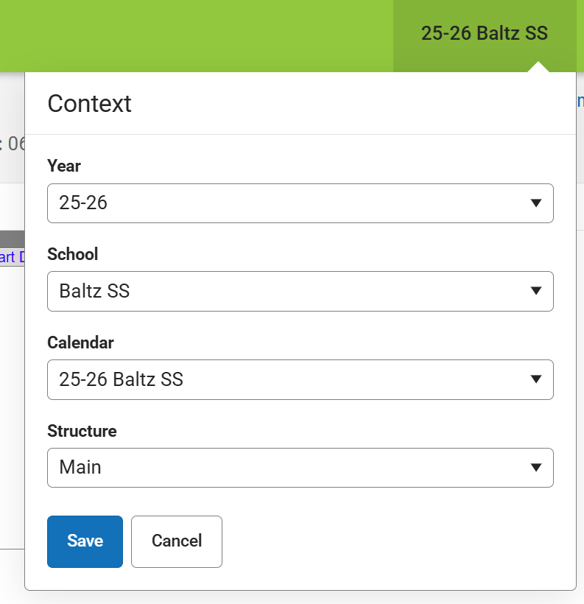
Student Reporting Setup
Set Context Switcher to 25-26 Summer School Building
Use Student Search > Advanced Search > Select Filter
Choose Summer School Schedule Folder
Generate program-specific reports

Slide 12
Common Registration Mistakes
Missing June 30 deadline
Wrong building selection
Incorrect program assignment
Transportation errors
Failure to save records

Slide 13
Secretary Final Checklist
Enrollment entered
Program assigned
Transportation verified
Addresses confirmed
Reports reviewed
All records saved

Slide 14
Support Contact
Contact Data Service Center Helpdesk
(302) 504-7222
helpdesk@dataservice.org
Summer School Registration Manual:
https://docs.google.com/document/d/12MTcRxU5zssczULVyE-tsZlxqvLb3nxe/edit?usp=sharing&ouid=103577118692900726098&rtpof=true&sd=true

