Slide 1

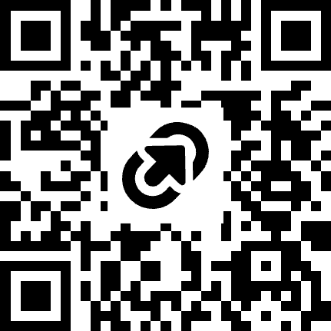
Unpacking the Literacy Content Blocks (TK-5)
https://tinyurl.com/bdp9fcez

Slide 2

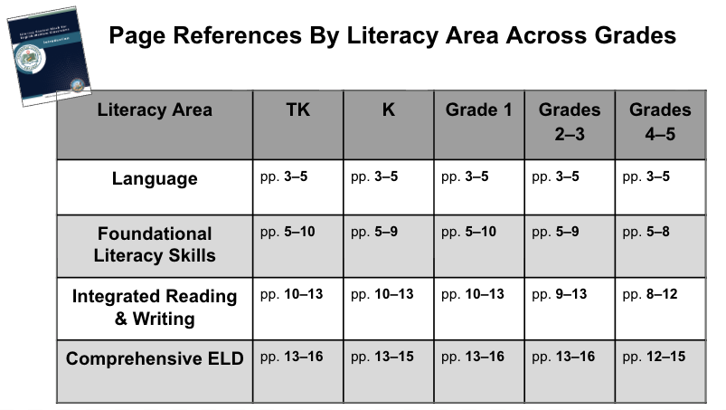

Poster Activity: Literacy Content Block Areas
Step 1: Focus Area (by group)
Each group will focus on one Content Literacy Block:
Language
Foundational Literacy Skills
Integrated Reading & Writing
Comprehensive ELD
Step 2: Roles
1 Scribe- Write group’s understanding
2-3 Readers- Skim your literacy area across TK-5
1 Facilitator- Summarize, rephrase, ask clarifying Q’s
Step 3: Task
Using the reference sheet, skim your area across TK–5 and create a poster:
Key ideas: What stands out?
Student experience: What would this look/sound like in a classroom?
Literacy Area: _________
Key Ideas: What stands out?
Student experience: What would this look/sound like in a classroom?
Notes:
Gallery Walk
Visit each poster, add at least one idea, question, or connection using sticky notes
Whole Group Debrief
What patterns or themes emerged? What feels aligned? What feels new or challenging?

Slide 3
Poster Activity: Literacy Content Block Areas
Step 4: Gallery Walk
Visit each poster, add at least one idea, question, or connection using sticky notes
Step 5: Whole Group Debrief
What patterns or themes emerged?
What feels aligned?
What feels new or challenging?
?
Literacy Area: _________
Key Ideas: What stands out?
Student experience: What would this look/sound like in a classroom?
!
C
Notes:
Gallery Walk
Visit each poster, add at least one idea, question, or connection using sticky notes
Whole Group Debrief
What patterns or themes emerged? What feels aligned? What feels new or challenging?

Slide 4
Page References By Literacy Area Across Grades
Literacy Area | TK | K | Grade 1 | Grades 2–3 | Grades 4–5
Language | pp. 3–5 | pp. 3–5 | pp. 3–5 | pp. 3–5 | pp. 3–5
Foundational Literacy Skills | pp. 5–10 | pp. 5–9 | pp. 5–10 | pp. 5–9 | pp. 5–8
Integrated Reading & Writing | pp. 10–13 | pp. 10–13 | pp. 10–13 | pp. 9–13 | pp. 8–12
Comprehensive ELD | pp. 13–16 | pp. 13–15 | pp. 13–16 | pp. 13–16 | pp. 12–15

Slide 5

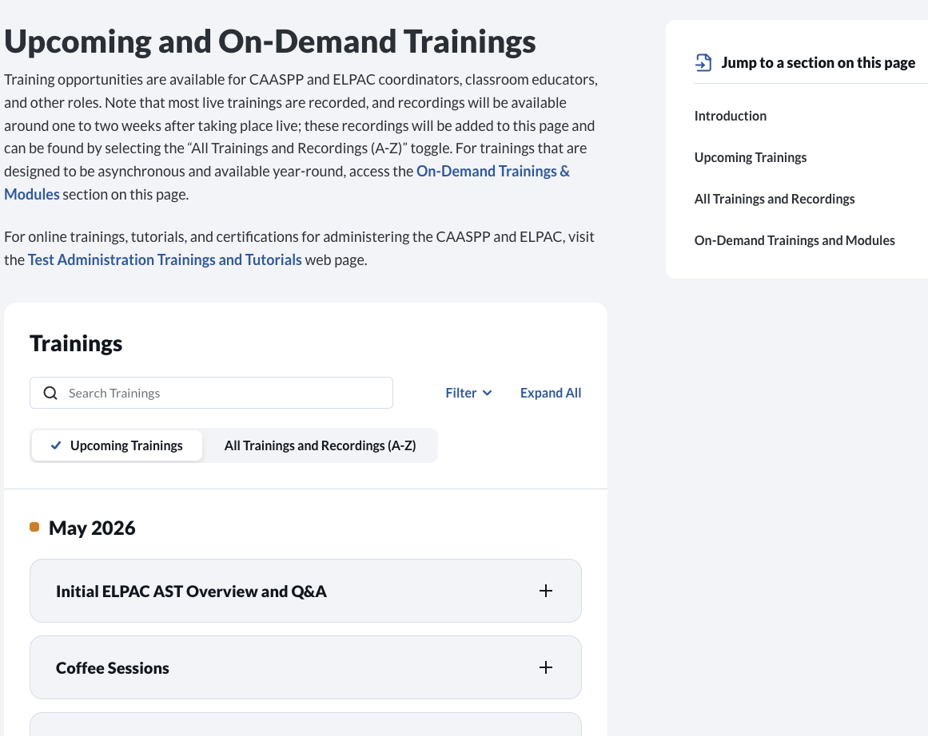
CAASPP-ELPAC Website: Spotlight
Free Summer Learning!

