Slide 1

Guardianship Advocacy Program
Debra A. Bookout, Esq.
Directing Attorney, Guardianship Advocacy Project
dbookout@lacsn.org
702-386-1452

Slide 2
What is guardianship?
The legal authority to make decisions for another person ordered by a court
Serious business – results in loss of some civil rights
Person facing guardianship can lose:
  Right to decide where to live
  Right to vote
  Right to make healthcare decisions
  Right to contract and manage finances

Slide 3
When is guardianship appropriate?
Guardianship is granted by the court only if the protected person is incapacitated AND guardianship is necessary
  Incapacitated= unable to receive and evaluate information or make or communicate decisions to such an extent that the person lacks the ability to meet essential requirements for physical health, safety or self-care without appropriate assistance (NRS 159.019)

Slide 4
Other Options
  Durable Financial POA
  Durable Health Care POA
  Durable Health Care POA for Adults with Intellectual Disabilities
  Durable Health Care POA for Adults with Dementia
  Supported Decision Making Agreement

Slide 5
More Options
  Social Security Administration Representative Payee
  VA fiduciary
  Clark County Public Guardian Representative Payee Program (60+)
  Living Trust

Slide 6
What is Supported Decision Making?
Authorizes an adult to enter into an agreement in which they designate one or more supporters to provide assistance when making decisions or engaging in certain other activities.

Slide 7
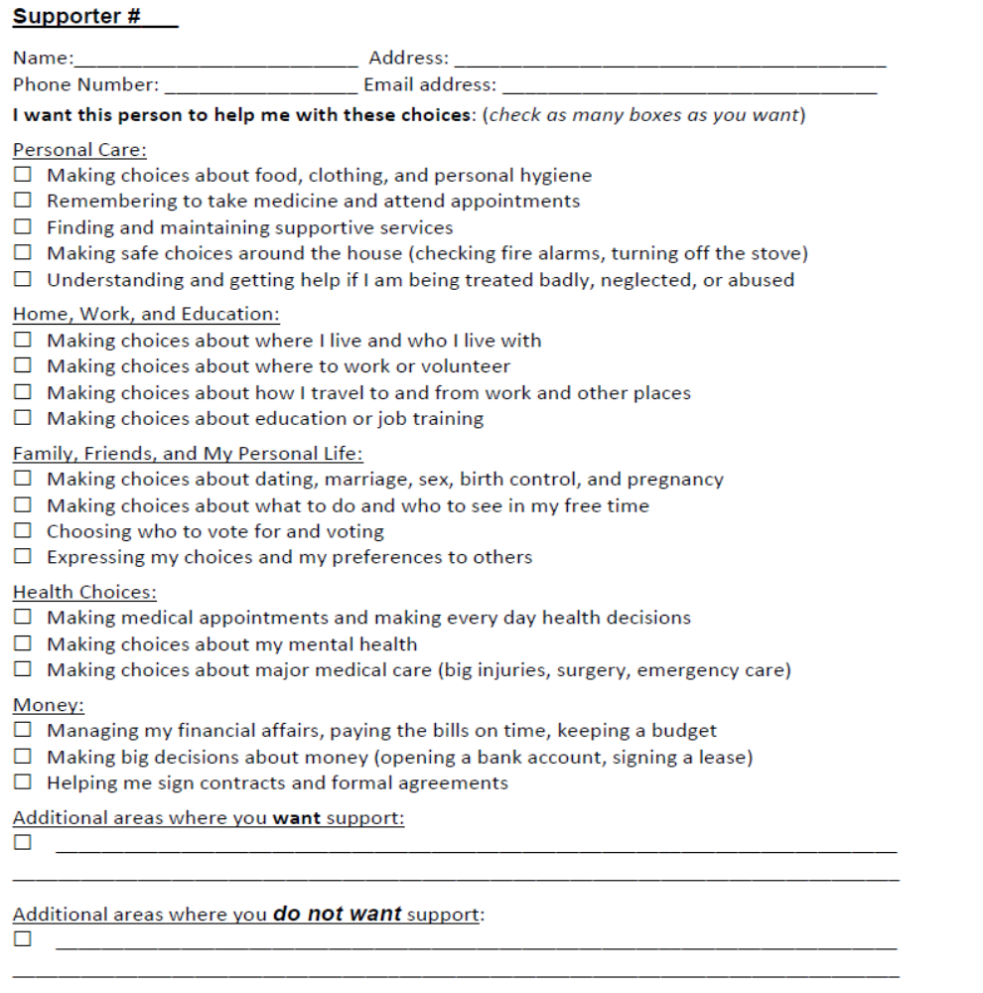
SDM Agreements

Slide 8
SDM Resources
American Civil Liberties Union Disability Rights Program www.aclu.org/supported-decision-making-resource-library
National Resource Center for Supported Decision-Making www.supporteddecisionmaking.org
Family Law Self Help Center https://www.familylawselfhelpcenter.org/images/forms/guardianship/sdma.pdf

Slide 9
Duties of Guardian of Person
Provide food, clothing, and shelter
Provide proper training and education to learn trade or occupation
Authorize and arrange medical care
Provide safe and appropriate housing
  Change of residence or location
  Admission to secured facility
  Visitation

Slide 10
Duties of Guardian of Estate
Protect, preserve, manage, and dispose of estate
Pay for care, maintenance, education, and support of protected person
Take possession of and manage all property (real and personal) and assets
Prepare inventory and appraisal of assets
Annual accounting of all income and expenses with blocked account

Slide 11
Bill of Rights
Have an attorney before a guardianship is imposed
Receive notice and copies of documents filed in guardianship proceedings
Participate in developing a plan of care, managing assets and personal property and determining residence
Have consideration given to current and previously stated desires and preferences

Slide 12
Bill of Rights
Be granted greatest degree of freedom possible consistent with need for guardianship
Engage in any activity not expressly reserved to guardian, including voting, marrying or entering domestic partnership
Visit and communicate with others, without limitation, unless determined to be harmful

Slide 13
Takeaways
Guardianship is only one option of many.
Guardianship is a big responsibility and should be undertaken only if no other option.
Guardianship can only be granted where it’s necessary and the adult lacks capacity.
Guardianship should be tailored to need and capacity.
Even if a guardianship is granted, the adult still retains rights under the Bill of Rights.

Slide 14
RESOURCES
Family Law Self-Help Center
https://www.familylawselfhelpcenter.org/self-help/guardianship
601 N. Pecos
Las Vegas, NV 89155
Legal Aid Center of Southern Nevada, Inc.
https://www.lacsn.org/what-we-do/free-classes
Guardianship classes available (online)
Nevada Legal Services
https://nevadalegalservices.org
  701 Bridger Ave., Suite 400
  Las Vegas, NV 89101
  702-386-0404

