Slide 1
Student End of Year
2025-2026
Collection Overview Training
April/May 2026

Slide 2
Agenda
General Information
  Collection Purpose
  Rates & Data Uses
  SEY Specific Data
  School Exit Type 00
  One-Day Records
  Adequate Documentation of Transfer
  Instances of Mobility
File Layout & Data Sources
  2026 Changes
  What is a Snapshot?
  File Layout
  Data Sources
Timeline & Collection Phases
  Soft Open
  Regular Phase
  Cross LEA Phase
  Post-Cross LEA Phase
  Final Dates & Data Release
Collection Process
  Prepare
  Collection Steps
  File Upload
  Create/Update Snapshot
  Business Rules
  Reporting Exceptions & Post-Cross LEA Data Change Requests
  SASID Merges
  CEDAR/COGNOS Reports
  Status Dashboard
    Uses
    LEA Approver Tasks
Contact & Resources

Slide 3
General Information

Slide 4
Purpose
The purpose of the Student End of Year (SEY) snapshot is to collect enrollment and outcome information for students during a school year. This includes demographic information and student’s entry and exit from public schools within a district.
The SEY collection includes all students in grades PK-12 who were counted in membership in a Local Education Agency (LEA) at any point during the school year.
  This includes at minimum a one-day record indicating the exit (transfer) circumstances for students who completed the 2024-2025school year (School Exit Type 00) and then transferred out of the LEA/district before the start of the 2025-2026 school year.
  Academic Reporting Year: July 1, 2025, through June 30, 2026
    Summer Graduates/Completers may be counted through August 31, 2026

Slide 5
Rates
Graduation/Completion
Dropout
Mobility/Stability
  Cohort Based Calculation
    Reflect students in given Anticipated Year of Graduation (AYG) cohort
  Student Groups
    Cohort based IP/ST Status
      Belong to cohort at some point in grades 9-12
    Gender and Race/Ethnicity based upon current year (or most recent reported year) status
  Graduation/Completion Statistics
  Annual calculation
    Reflect students in grades 7-12
    Accountability Frameworks only include rates for students in grades 9-12
  Student Groups
    Annual IP/ST Status
    Gender and Race/Ethnicity based upon reported school year
  Dropout Statistics
  Annual calculation
    Reflects students in grades K-12
    Calculation based upon membership and movement as of October 1, 2025, through end of year
  Student Groups
    Annual IP/ST Status
    Gender and Race/Ethnicity based upon reported school year
  Mobility/Stability Statistics
Student Data Privacy
All publicly posted data utilizes privacy guidelines.
Individual district CEDAR/COGNOS reports available to users with SEY access in IdM do not utilize privacy guidelines to allow LEAs to review their data in complete detail.
Privacy guideline methodologies posted on the Data Insights, Resources & Archives page for each statistic type
  Graduation/Completion: Data Insights, Resources & Archives
  Dropout: Data Insights, Resources & Archives
  Mobility/Stability: Data Insights, Resources & Archives

Slide 6
Data Uses
Primary Use
Additional Use
Public reporting of graduation, completion, dropout, mobility, and stability rates
State Accountability Frameworks
  Graduation/Completion
  Grades 9-12 Dropout
  Military Enlisted
Federal Reporting (EdFacts)
  Annual graduate and dropout counts
  Federal cohort graduation rates, 4- and 7- cohorts
  Other required student counts such as homeless, migrant, title 1, etc.
Dropout Prevention
Legislative reports
Civil Rights Data Collection (CRDC)
Media

Slide 7
SEY Specific Data
School Entry/Exit Types – Describe circumstances under which student transfers into or out of a school/LEA, including enrollment status changes and mobility instances
Retention Codes – Indicates the expected grade level for the student in the following school year
  Retention Code 1 – grade K-12 student repeating the grade
  Retention Code 2 – grade 12 student returning for a postsecondary program (PTECH 5-6 or TREP)
  Retention Code 3 – grade 12 student returning for SPED 18-21 Transition
Multiple records per student’s enrollment timeframe
Anticipated Year of Graduation Fields
  Set the year a student enters a CO public high school for the first time, typically grade 9
Notes:
A retention code in 2025-2026 SEY indicates the student will be in the same grade level again in 2026-2027

Slide 8
School Exit Type 00
School Exit Type 00 = did not exit
Used for any student who completes the school year, regardless of their anticipated enrollment the next year
  Per the Colorado Code of Regulations (1-CCR-301-1), “students shall be counted as completing (finishing) the school year if they leave school within three weeks of the last day of school…”
Must be paired with school exit date ‘00000000’
Students with school exit type 00 in the prior year (2024-2025) must have a record in the current year (2025-2026)

Slide 9
One-Day Records
Used to reconcile student enrollment records
  Transfer out of the district over the summer
  Summer dropouts
  Grade reassignments
  Reconcile final exit status for a student in the AYG cohort
Must have a valid school code
  Matriculating students who transfer out of the district: Use the school code for the school the student would have attended unless a dropout. Then, use the summer district dropout coding pattern.
Beginning of the Year
Occurs in the summer before the start of a LEA’s school calendar
  Best practice: 07/01 entry and exit date
Grade Level reflects the grade the student would have been in if enrolled in the current year
Language Proficiency reflects the ML proficiency a student would have if enrolled in the current year
End of the Year
Reconcile a student in the AYG cohort who has an updated final exit status from an LEA
Best practice: 06/30 entry and exit date

Slide 10
Adequate Documentation of Transfer
Documentation maintained by districts/schools when students transfer out of their district
  Documentation necessary to avoid incorrectly coding students as dropouts.
  Documentation supports selecting the appropriate exit type for ‘verified transfers out’ of your AYG graduation cohort
Adequate documentation is maintained year-round and should be readily available upon request by SEY collection
All documentation should include the student’s SASID and full name
Type of documentation varies based on school exit type
  Most common: confirmation of enrollment and attendance
See list of required documentation on SEY website or on SSA file layout
Sample forms available on SEY website
Notes:
Reviewed by SEY collection lead on a case-by-case basis
Typically used when addressing SE903 errors in the Post-Cross LEA Phase
Exit 13 – Transfer to a public school in a different CO District
Documentation Required: Confirmation of enrollment and attendance
Provided by receiving district when student has begun attending the receiving school
Must include date of enrollment and date of attendance
Must include student’s SASID and full name
If a SASID merge has taken place or student is found to have two different SASIDs, include both SASIDs on the form
No other documentation is accepted
RITS system is not adequate because a student may have enrolled but never attended
Sending district should request this form if they lack documentation
Districts must respond to records requests within two weeks
Records requests for out of home placements must be responded to within 5 days
Types
Written records request
Confirmation of enrollment and attendance
Provided by receiving district when student has begun attending the receiving school
Must include date of enrollment and date of attendance
Certificate of enrollment
Signed parent/guardian letter
Written confirmation from school administrator

Slide 11
1-CCR-301 Highlights/Reminders
When a student withdraws, districts are authorized to request information from the parent or guardian about the specific type of educational enviornment that a student is transferring to in order to monitor compliance with the School Attendance Law. [section 22-33-104 (1), C.R.S.]
Colorado Public Schools and local education agencies are required to send transcripts or to confirm attendance when requested from another Colorado Public School or local education agency within two weeks of receiving the request with the exception of students in out of-home placements whose records must be transferred within five (5) days pursuant to sections 22-32-138(2)(a)(II) and (3)(a), C.R.S

Slide 12
Instances of Mobility
Required reporting per state board rule
Captures timeframe of extended absence
  10+ consecutive days regardless of reason
  Student did not attend another educational setting during the extended absence
Used to calculate mobility rates
  Mobility rates are based upon movement occurring after October 1st
Requires multiple SSA records (attendance records)
  LEAs should follow local policies and procedures used to track steps taken to attempt to reengage student/pursue truancy/etc. during timeframe where student is not attending the LEA (mobility instance)
Attendance Record | School Code | School Entry Date | School Entry Type | School Exit Date | School Exit Type
Mobility instance initiated | 1234 | 08152025 | 02 | 02012026 | 25
LEA internal record Not state reportable | xxxx | 02022026 | xx | 30312026 | xx
Mobility instance resolved | 1234 | 04012026 | 25 | 00000000 | 00
Notes:
Mobility rates are based upon movement occurring after October 1st
Entry/exit from a school (school instance of mobility)
Entry/exit from a LEA (district instance of mobility)
Oct. 1st date means the one-day records at the beginning of the year to show summer transfers out of a school/LEA do not negatively impact mobility rates
Implications for Attendance collection
Impacts total days possible, attended, excused, and unexcused
Time frame between enrollment records (instance of mobility) not part of attendance data, impacting chronic absenteeism rate
LEA Local Records: This may or may not include records in the LEA’s SIS that do not meet criteria for inclusion in SEY or Attendance collection

Slide 13
File Layout & Data Sources

Slide 14
2025-2026
SEY Changes
Removed ‘Innovative Learning Opportunities Pilot’ data field
  Program sunset, data no longer collected in Student Interchange
New Cross Collection Business Rules
  S-EBT + SEY: FRL Status
  Student Discipline + SEY: Expelled Education Services
Refined Cross Collection Business Rules
  IEP Interchange + SEY
New Business Rules
  Related to new entry/exit codes available on SSA file
CEDAR/COGNOS Report Refinement
  Updates as needed

Slide 15
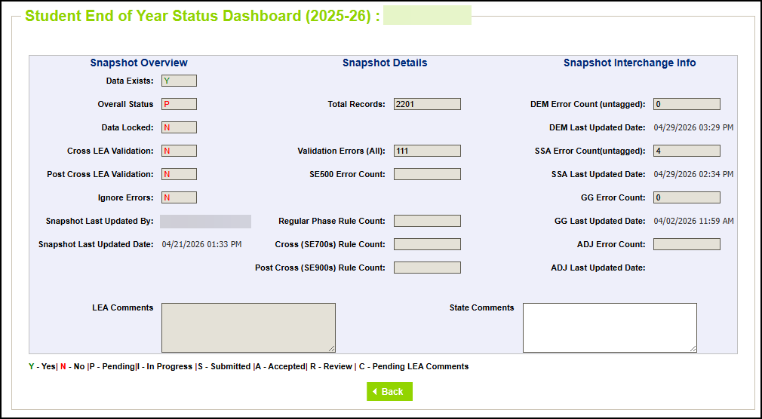
2025-2026 Updated Status Dashboard
Notes:
New Features
Last Updated By
IdM user email address
Validation Errors (All)
Count of all errors
Snapshots cannot be submitted if this value is not 0
SE500 error count
Highlights this specific error code because it has a custom message and requires communication with the collection lead to clear
Regular Phase, Cross LEA, Post Cross Rule Count
Count of all errors and warnings for the phase
Snapshots can still be submitted even if these fields are not 0 because they are reflecting warning counts
Reminder: Error free does not mean there aren’t data issues
Student Interchange File Overview
Error count and last updated date for DEM (untagged), SSA (untagged), GG, and ADJ files
ADJ file is only used in special circumstances, a LEA mean submit their snapshot without needing this file

Slide 16
2025-2026
Coding Scenario Changes
Retained due to PWR (retention code 2)
  ASCENT program sunsets and is not an option for 2026-2027
  P-TECH years 5-6 program continues into 2026-2027
  TREP program continues into 2026-2027, but may have additional checks due to program qualifications
SPED Transition when transfer between LEAs
  *New* Entry Type 98
School Year | LEA | Grade | School Entry Date | School Entry Type | School Exit Date | School Exit Type | Retention Code
2024-2025 | 1234 | 120 | 08152024 | 02 | 05152025 | 90 | 3
2025-2026 | 1234 | 120 | 07012025 | 90 | 07012025 | 13 | 0
2025-2026 | 5678 | 120 | 08012026 | 98 | 05162026 | 27 | 3

Slide 17
What is a Snapshot?

Slide 18
Snapshot (collection): Source Files
A data snapshot begins with uploading the corresponding interchange files. These interchange files become the source of information, or source file for specific data fields on a snapshot.
Source File A
Contains multiple columns of data/information as outlined on the file layout for this source file.
Source File B
Contains multiple columns of data/information as outlined on the file layout for this source file.
File A: Element 1
File A: Element 2
File B: Element 1
File B: Element 3
File B: Element 2
File B: Element 4
File A: Element 3
File A: Element 4
File A: Element 5

Slide 19
Snapshot (collection): Creation
When a snapshot is triggered, it pulls needed information from the source (interchange) files into a new file called the snapshot.
Source File A
Source File B
File A: Element 1
File A: Element 5
File B: Element 1
File B: Element 4
File A: Element 2
File A: Element 3
File A: Element 4
File B: Element 2
File B: Element 3
Snapshot

Slide 20
Snapshot (collection): Internal Flags
Snapshots typically won’t use every data element on a source file.
Snapshots often pull in information called “internal flags.” These are calculated pieces of data from information provided on the interchange files or from other internal data in data pipeline.
Source File A
Source File B
Internal Flags
File A: Element 2
File A: Element 5
File B: Element 3
Internal Flag: 1
Internal Flag: 2
Internal Flag: 3
Snapshot
File A: Element 1
File B: Element 1
File A: Element 3
File A: Element 4
File B: Element 2
File B: Element 4

Slide 21
File Layout

Slide 22
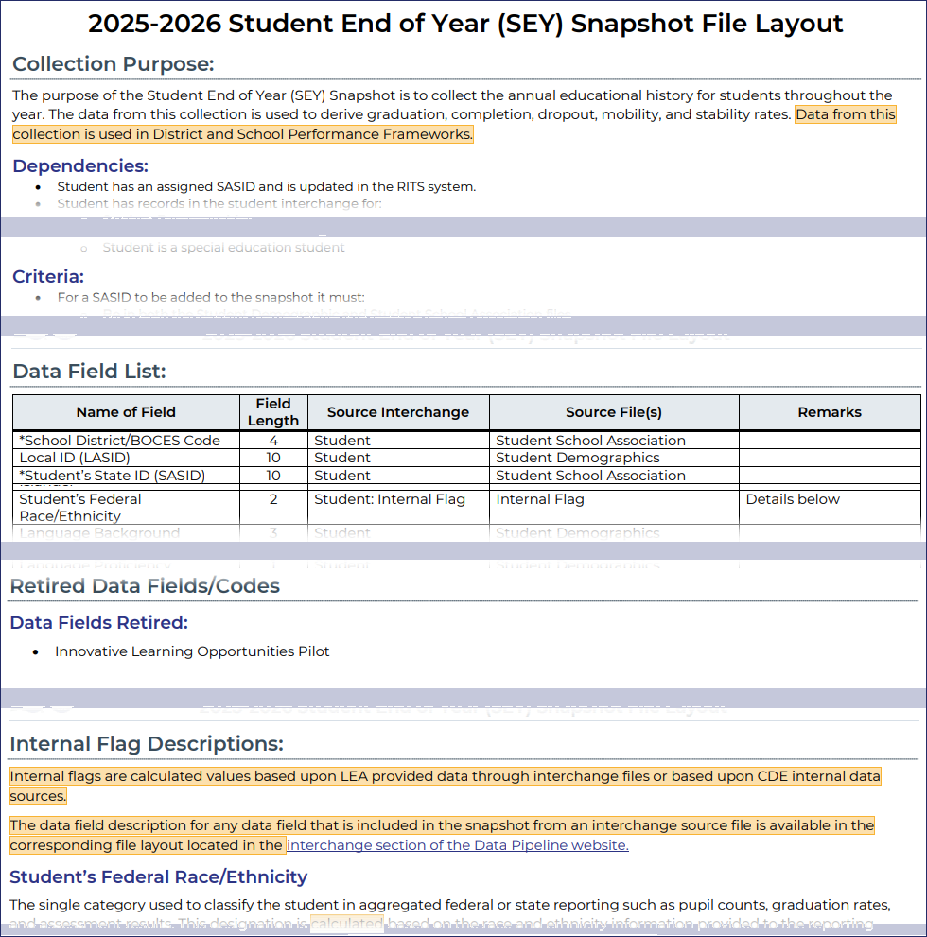
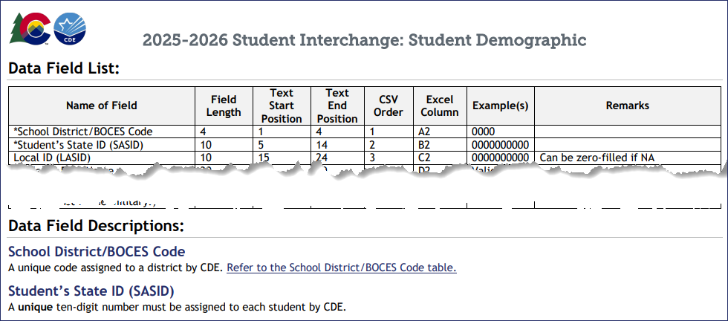
Snapshot vs Interchange File Layout
Snapshot File Layout
Dependencies: List of source interchange files needed for the snapshot
Criteria: Rules regarding the types of records pulled from a source file into a snapshot
Data Fields: Includes a list of specific source files for each data field or indicates the field is an internal flag.
Internal Flag Definitions: Provides detailed descriptions of each internal flag data field and codes.
Interchange File Layout
Provides a list of each data field included on an interchange (source) file with detailed descriptions and codes.

Slide 23
SEY Snapshot Dependencies
Student has been assigned a SASID and updated in the RITS system
Student has a record in the student interchange for:
  Student Demographics
  Student School Association (may have multiple records)
  Graduation Guidelines (only required for graduating students)
  Adjustment File (only required if adjusting prior year data)
Student has a record in the Title 1 interchange if:
Internal Flag
  Student has received Targeted Assisted Services/Funding (as of Oct. 1)
Student has a record in the IEP interchange if:
Internal Flag
  Student is a special education student

Slide 24
SEY Snapshot Criteria
Error free interchange records
Enrollment records on the Student School Association file where…
  Primary School = 1 (Yes)
  School Code is a valid public school
  Pupil Attendance Information is between 01 and 08 (Group A records only)
  Grade Level is not ‘002’ infant
Matched records from other source files
  Student Demographic (SASID, District Code, School Year)
  Graduation Guidelines (SASID)
  Other data sources such as Title I Interchange, SPED Interchange, & internal lists (SASID, School Year)

Slide 25
Records Excluded from the Snapshot due to Criteria
At times, LEAs may have records in their SIS used for other data collections or for internal LEA purposes but are not state reportable student records
Possible examples:
Student enrolled in more than one school in the LEA
  Only one school can be listed as the ‘primary school’, sometimes called ‘school of accountability’
Contractual education scenario: Student is a resident of the LEA, but LEA has contracted with entity to provide educational services for the student
  See the resource Contract Agreement Students: Impacts of Pupil Attendance Information (PDF) on the Student Interchange website for more information
Non-attending student where the LEA has a process in their SIS to track absences for truancy or other LEA purposes
Non-attending student that is accountable to the LEA for the graduation cohort
  LEAs are encouraged to follow-up regarding the student’s educational outcomes in case an adjustment or record is needed in the SEY collection
Special Education reporting situation
Other
COGNOS/CEDAR Report Highlight
Report Name
Student List: Records Excluded from SEY Snapshot Due to Criteria
Report Category
Student End of Year
Report Purpose
Lists student records that are not part of the snapshot due to one of the following reasons
  DEM record only
  Group B PAI Code
  Primary School = 0 (no)
  Grade Level = 002 (infant)
  Errors on DEM and/or SSA file

Slide 26
Data Sources

Slide 27
Student Demographic File (DEM)
Untagged file only
Upload this file first
One record per student
Most data fields found on this file are used in the SEY snapshot
Captures attributes of a student
  Point in Time: Attribute as of extract date
    Examples: Gender, Race/Ethnicity, Military Enlisted, Alternate Assessment Participant
  Cumulative: Once true, the attribute remains true entire school year but may change the following year if student no longer qualifies for the service (Additive, but not subtractive).
    Examples: Homeless Status, FRL Status, English Learner, Military Connected, SPED Transition

Slide 28
Student School Association File (SSA)
Untagged file only
May include multiple records per student
SEY is focused on SSA records that capture the timeframe a student was actively attending a school within the LEA.
  One-day records are the exception.
Only records meeting the snapshot criteria will pull into SEY
  Primary School = 1 (yes)
  Grade is PK-12 (infant excluded)
  PAI code is 01-08 (Group A Records)
Data fields for gifted and talented status and date first enrolled in US should be treated like demographic information, matching across all SSA records
SEY is the only student collection that utilizes the data fields ‘school entry type’ and ‘school exit type’
SEY does not use data fields connected to attendance counts, funding status, or alternative instruction courses.

Slide 29
Graduation Guidelines File (GG)
Secondary students only
Expect multiple records per student
No data field from this file is directly pulled into the SEY snapshot, rather the data from this file is used for the business rule SE301 which checks that graduating students have reported GG measures.
LEA Options/Considerations:
  Minimum Reporting: At least one English and one Math measure meeting the benchmark per graduating student
  Optional: Any attempted GG measure, regardless of planned graduation status during the year
    Allows LEAs to monitor GG with the related COGNOS reports
    GG measures travel with student across CO schools
Note: If a measure was reported in a prior school year but the student did not graduate, it does not need to be reported again in the current year since this data is already stored in pipeline

Slide 30
Adjustment File (ADJ)
As needed for SEY Collection
7th-12th grade students only
Usually not extracted from SIS
  Build file manually using posted template
Adjusts the final exit type for a student in a prior school year who did not attend your district in the current year.
Only used to adjust students with very specific exit scenarios
  Dropout (Exit 40)
  Expulsion (Exit 50)
  HSED transfer (Exit 70)
  Did not Exit (Exit 00)
  Other special circumstance (Exits 18, 19, 21, 26, 30, 31)
Record is loaded in the current year using an adjustment file
Student does not have a record on your DEM or SSA file in the current year

Slide 31
Student Interchange Preparation
Get SASIDs for your new students
  Resource: RITS page
Extract files from your Student Information System (DEM, SSA, GG)
  Recommended format is .xls or .xlsx (excel)
    Data Pipeline also accepts .csv
  All data fields must be zero filled or include an applicable code matching the specified field length and format
  Leading zeros are required for all data fields to maintain the specified field length
    Be careful when opening .csv format in excel to not lose leading zeros
Pro Tip: Use a file naming convention as you will likely extract files multiple times
  Example: 0110_DEM_04052026.xls
    Spaces in the file name are not allowed
Notes:
Resources:
Maintaining leading zeros PDF

Slide 32
Additional Interchanges
Title 1 Interchange (TT1)
SpED IEP Interchange
Only required for LEAs operating Title 1 Targeted Assistance Programs/Schools
Cumulative student status
  Students indicated as receiving TT1 Targeted Assistance in OCT should remain on this list
  Add any students newly receiving TT1 Targeted Assistance after OCT through the end of the year
Schoolwide programs are automatically indicated and do not require this interchange file
Title 1 Student Internal Flag
  0—No
  2—Yes, Schoolwide (SW)
  3—Yes, Targeted Assistance (TA)
Reflects all students with an IEP
Records needed on the following files:
  SpED Child File
  SpED Participation File
Special Education Student Internal Flag
  0—No
  1—Yes
    SASID indicated in SpED interchange as eligible for services during the current school year
    District of Attendance or District of Residence match SEY Reporting District
Note: Partner with the person responsible for these files in your LEA as these files are often overseen by someone other than the SEY data respondent in a LEA.

Slide 33
Internal Flags
CDE Supporting Data Source
Calculated Fields
CDE receives list of students (by SASID) from another state data source which is used to indicate the student’s status
  0—No
  1—Yes
Data Fields:
  Foster
  Migrant
  CTE
  CTE Nontraditional
  Title 1 Schoolwide
Calculated value based upon current or prior year reported data
Data Fields:
  Student’s Federal Race/Ethnicity
  Gifted and Talented (Y/N)
  Multilingual Learner Y/N
  Anticipated Year of Graduation Fields
  IP/ST Cohort Fields
  IP/ST Yearly Flags
  Entry Sequence Flags
  Last Record Flags
  Date First Enrolled in US
    When LEA zero fills field to utilize CDE’s auto calculated date

Slide 34
Timeline & Collection Phases

Slide 35
SEY Collection Cycle
March 30 to April 21
Begin creating snapshot *Optional*
SEY training begins
April 30 to September 3
Primary collection phase
Many interim deadlines throughout the phase
September 21 to October 15
Data validated across state records
October 22 to November 17
Limited changes allowed
Data validated across state records and compared to October 2026-2027 records
November 19 to November 24 Final report review
December 1 Superintendent Verification Due
January 2027
Data Release
Soft Open
Regular Phase
Cross LEA Phase
Post-Cross LEA Phase
Final Dates
Note: The SEY data collection overlaps with many student data collections throughout the cycle. Data respondents who are responsible for multiple collections are encouraged to review the Data Pipeline Collections Calendar.

Slide 36
Soft Open Phase Overview
Focus: Preparation
LEAs are strongly encouraged to upload a graduation guidelines file during this phase if they have not yet done so this year
SEY training opportunities begin
SEY website documentation updated throughout phase
  Business Rules
  SEY Collection Manual
  Additional supporting resources
*Optional* LEAs may create snapshots and begin working on SEY collection during this time

Slide 37
Key Dates—Soft Open Phase
Date | Event | Event Description
3/30/2026 | Open | LEAs may begin creating snapshots
4/1/2026 | Other Date | Student Interchange: Upload DEM, SSA, & GG files to begin preparing for remaining Spring student-level collection
4/3/2026 9:00-11:00am | Training Event | Collection Overview Training 1 of 2 Collection Overview 1 of 2 Registration
4/22/2026 to 4/29/2026 | Closed | Soft open phase ends and snapshots are closed until the next phase.
4/27/2026 10:00am-12:00pm | Training Event | Collaborative Webinar: SEY & SPED EOY Collaborative SEY & SPED EOY Webinar Registration

Slide 38
Regular Phase Overview
Focus: Primary Collection Phase
All LEAs must submit an error-free snapshot during this phase
Ongoing training
Report all PK-12 students who attended at any point in the year
  May include multiple records per student due to mobility instances or enrollment status changes
Reconcile summer transfers between 2024-2025 and 2025-2026 school years
Provide updated exit status for students who did not attend in current year but remain in the AYG cohort for the LEA
Report accurate school exit types for all students
  Finished the year
  Graduated/Completed Education
  Dropped Out
  Transferred out of LEA

Slide 39
Key Dates—Regular Phase
Date | Event | Event Description
4/30/2026 | Open | Collection officially opens. Districts may create snapshots.
4/30/2026 | Other Date | Student Interchange: Adjustment (ADJ) interchange file opens.
5/5/2026 12:30-2:30pm | Training Event | Collection Overview Training 2 of 2: Collection Overview 2 of 2 Registration
5/8/2026 | Interim Deadline | Upload interchange files used in the SEY collection (DEM, SSA, GG) Districts are expected to have an upload date 04/01/2026 or later to meet this interim deadline.
5/8/2026 | Other Date | Title 1 Interchange: LEAs with targeted assistance schools—upload initial Title 1 interchange file that contains all students who received services at some point in the current year.
5/19/2026 1:00-2:00pm | Training Event | Operational Reports Training: Operational Reports Training Registration
5/28/2026 | Interim Deadline | Create at least one SEY snapshot.
5/28/2026 | Other Date | Special Education IEP Interchange: AU Responsibility Error-free IEP Child and Participation files.
6/9/2026 1:00-2:00pm | Training Event | Common Coding Scenarios Part 1 Training: Common Coding Scenarios Pt. 1 Training Registration
6/10/2026 | Interim Deadline | Student Interchange: Error free interchange files (all Spring collections). This includes untagged DEM, untagged SSA, GG, and ADJ files.
6/10/2026 | Other Date | Title 1 Interchange: LEAs with targeted assistance schools—error-free Title 1 interchange file containing all students who received services at some point in the current year.
7/14/2026 1:00-2:00pm | Training Event | Common Coding Scenarios Part 2 Training: Common Coding Scenarios Pt. 2 Training Registration
7/30/2026 | Interim Deadline | Submit necessary reporting exceptions for review.
8/11/2026 1:00-2:00pm | Training Event | Validating Data/Rates with CEDAR Reports Training: Data/Rates Validation Training Registration
8/13/2026 | Interim Deadline | Error free SEY Snapshot
8/13/2026 to 9/2/2026 | Report Review | Validate Student End of Year data using CEDAR/COGNOS reports. Submit snapshot as soon as review is complete.
9/3/2026 | State Deadline | Submit Student End of Year Snapshot
9/4/2026 to 9/20/2026 | Closed | SEY Snapshot closed until the start of the Cross LEA phase.

Slide 40
Cross LEA Phase
Focus: Initial data clean-up phase
All LEAs must create at least one SEY snapshot during this phase and resubmit an error-free snapshot
Cross validate data across all Colorado LEAs
  Cross references student educational history across school districts; focused on transfer students
  SE700 series errors/warnings
Ensures validity of education statistics
  Students may only count as a graduate/completer in one district and one year
  Students who dropout are attributed to their final district of attendance during the school year.
  Students who left a district and were recovered by another district or completed a HSED are reconciled
All data fields may be corrected during this phase
  Final opportunity to update demographic information

Slide 41
Key Dates—Cross LEA Phase
Date | Event | Event Description
9/15/2026 1:00-2:30pm | Training Event | Cross LEA Phase Training: Cross-LEA Phase Training Registration
9/21/2026 | Open | LEAs may begin creating snapshots as soon as they receive a ‘snapshot unlocked’ notification from data pipeline; typically, midday.
10/9/2026 | Interim Deadline | Error free SEY snapshot
10/10/2026 to 10/14/2026 | Report Review | Validate SEY data using CEDAR/COGNOS reports. Submit snapshot as soon as review is complete.
10/15/2026 | Deadline | Resubmit SEY snapshot
10/16/2026 to 10/21/2026 | Closed | SEY snapshot is closed until the start of the Post-Cross LEA phase.

Slide 42
Post-Cross LEA
Focus: Final data clean-up phase
All LEAs must update their SEY snapshot at least once during this phase
Cross validate data across all Colorado LEAs
  Cross references student educational history across school districts
  Compares SEY 2025-2026 to OCT 2026-2027 within the same LEA
  SE900 series errors/warnings
  AYG Reconciliation occurs
Final opportunity for districts to validate their SEY data
Very different mechanics than prior phases
  During this phase, snapshots are not unlocked, only ‘updated’
  Data changes are extremely limited
    School exit types/exit dates for students with SE900 errors
    Retention codes for students with SE900 warnings related to retention status
    SASID merge scenarios
    Approved Post-Cross data change requests

Slide 43
Key Dates—Post-Cross LEA Phase
Date | Event | Event Description
10/20/2026 1:00-2:30pm | Training Event | Post-Cross LEA Phase Training: Post-Cross LEA Phase Training Registration
10/22/2026 | Open | LEAs may begin updating their snapshot to address Post-Cross LEA business rules as soon as they receive a ‘Post-Cross Phase has begun’ email from the SEY collection lead; typically, midday.
11/10/2026 | Interim Deadline | Error free SEY snapshot. Reminder: Per state board rule, LEAs should respond to requests for adequate documentation of transfer within 2 weeks of the request. LEAs must respond within 5 days if the student is in out-of-home placement.
11/11/2026 | Other Date | LEAs may begin submitting Superintendent Verification (sign-off) Forms. Forms will not be accepted prior to this date.
11/11/2026 to 11/16/2026 | Report Review | Validate SEY data using CEDAR/COGNOS reports. Reminder: This phase does not require students to resubmit their snapshot.
11/17/2026 | Deadline | Post-Cross LEA phase ends. LEAs must have an error-free SEY snapshot and have addressed any necessary data changes.
11/18/2026 | Closed | SEY snapshot is closed.

Slide 44
Final Dates & Data Release
Focus: Superintendent Verification Form & Data Release
Superintendent Verification Form: Scan and return signed forms to SEY inbox
  Download from data pipeline ‘status dashboard’ screen
  Signed by Superintendent
    Certifies SEY and Graduation Guidelines data is accurate and complete
    Acknowledgment that this data is used in district/school accountability frameworks
  Dated after the last updated date of your SEY snapshot as shown on the SEY status dashboard
Data Release: All data embargoed until the public data release in January 2027
  LEA data available through COGNOS/CEDAR reports for internal use only
  December through January Release CDE internal processes to prepare data for public release
  LEAs receive a preview of the public data files a few days prior to the public data release
Absolutely no data changes may occur after the final deadline on 12/1

Slide 45
Key Dates—Final Dates
Date | Event | Event Description
11/19/2026 to 11/24/2026 | Report Review | Final review of graduation/completion, dropout, and mobility/stability rates. Reconcile any issues found in CDE’s final review process. SEY Collection lead will notify impacted LEAs directly. Reminder: A new Superintendent Verification (Sign-Off) form may be required if changes occur.
12/1/2026 | Deadline | Superintendent Verification (sign-off) form due. Data remains embargoed until the official release in January.
12/2/2026 | Closed | Collection is closed and finalized. Absolutely no data changes can be made at this point.
January 2027 | Data Release | Official data release and embargo lifts. Graduation/completion, dropout, and mobility rates posted on the CDE website and released to the public.

Slide 46
Collection Process

Slide 47
Prepare

Slide 48
Checklist
Ensure you have access/logins for following systems
  Your LEA’s Student Information System (SIS)
    Must have ability to extract state reporting files and edit student records for related data fields
  Data Pipeline & COGNOS/CEDAR
  RITS (at least viewing permissions)
  Syncplicity Student Folder
    District Code – District Name – Student
Bookmark important CDE websites & review supporting documentation
  Slide #53
Sign up for data pipeline TH emails if you don’t already receive them
  Directions posted on Data Pipeline Training Page → TH tab
Plan to maintain data privacy for Personally Identifiable Information (PII)
  What are your internal processes?
  Utilize Syncplicity when communicating with CDE
Gather/Save Critical Contact Information
  CDE: Reagan Ward, StudentEndOfYear@cde.state.co.us, 720-484-9057
  CDE: Data Pipeline Collection Support Booking Page
  Check your contact information on the COGNOS report SEY Respondent Contact List for accuracy
  Internal:
    Ensure know which colleagues support/oversee which programs such as—Multilingual Learners, Homeless, Foster, SpED including SpED Transition, Title 1, Gifted & Talented, Postsecondary Programs such as ASCENT/TREP/PTECH, Free/Reduced Lunch, Graduation Guidelines, school staff to validate adequate documentation of transfer for school exit types
    Do you have colleagues who will support data validation such as district accountability staff?
    Who needs to be notified of preliminary data?

Slide 49
Identity Management (IdM) Roles
Bookmark: Identity Management Site
District Local Access Manager (LAM) assigns account/privileges
Provides access to the various CDE tools
Data Pipeline permissions are needed to complete data collections
A user can only have one role for each Collection
IdM user roles are used by CDE to create email lists & grant collection specific access
  COGNOS/CEDAR access mirrors pipeline access
  Collection emails – typically only LEA Approvers and LEA Users
  Syncplicity access
    Manually added, monitored by collection leads
Application | Collection | User Role | Access & Notes
Pipeline | Student Interchange | LEA User | Required for SEY data respondents. Upload and edit records for DEM, SSA, & GG files.
Pipeline | Student End of Year | LEA Approver | At least one required per LEA. Create snapshot, submit snapshot, download sign-off form.
Pipeline | Student End of Year | LEA User | Additional support for SEY within the LEA. Create snapshot.
Pipeline | Any | LEA Viewer | View CEDAR/COGNOS reports related to the assigned collection but cannot edit data. Useful role for district support staff who help validate data but do not actively complete the collection.

Slide 50


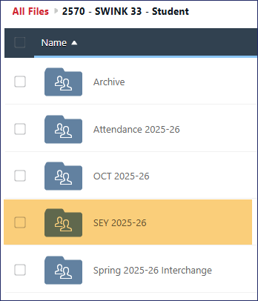
PII and Syncplicity
Personally Identifiable Information (PII)
PII is defined by state and federal laws as information that alone, or in combination, personally identifies an individual
  Includes direct identifiers (SASID, student name)
  Includes information when combined is identifiable
Colorado’s Student Data Transparency and Security Act outlines requirements for how Student PII is collected, used and shared
  See CDE’s data security and privacy site for more information
Communicating PII must be done through secure methods. DO NOT EMAIL PII
  Data Pipeline file upload & COGNOS/CEDAR
  Syncplicity secure file transfer
  Phone call is secure method; 720-484-9057
    Please do not leave PII in voicemail but rather request a return call to discuss PII
Syncplicity
Secure file transfer site
  Syncplicity Login Page
Collection specific folders
  Student End of Year, October, Attendance share a primary folder with subfolders by collection
    Primary Syncplicity Folder:
    District Code – DISTRICT NAME – Student
    Subfolder: SEY 2025-26
Does not notify users of file upload
  Email SEY Inbox if file is ready for review

Slide 51
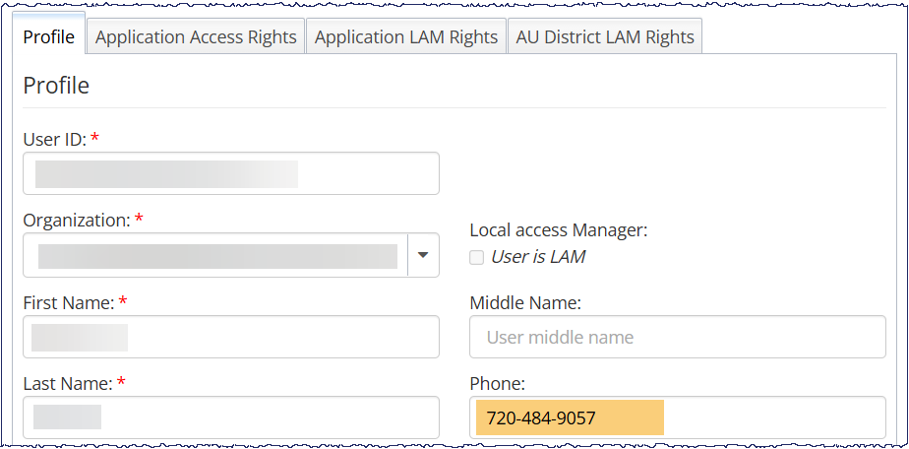
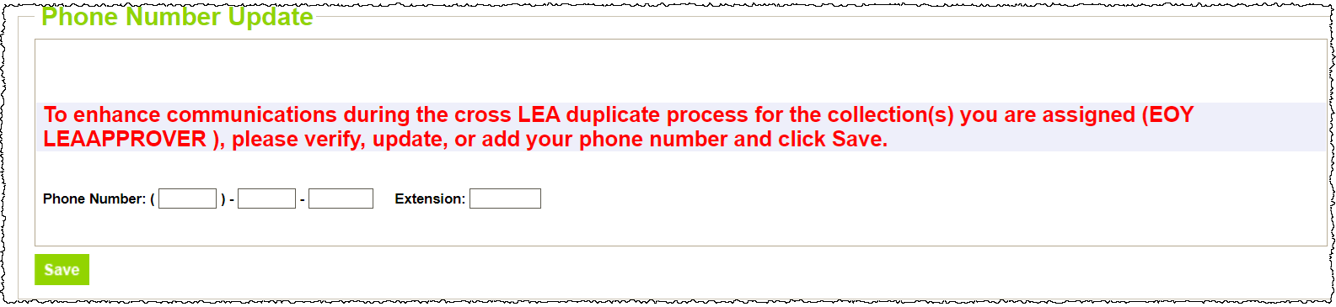
Data Respondent Phone Numbers
Data respondents are asked to maintain current phone numbers in IdM and Data Pipeline
IdM
LAM must update user account to show accurate phone number
Pipeline
On-screen prompt when login to pipeline if no phone number has been entered.
Check existing phone number using CEDAR/COGNOS report EOY Contact List.
Email StudentEndofYear@cde.state.co.us if phone number is incorrect on the COGNOS report SEY Respondent Contact List
but is accurate in IdM and Pipeline

Slide 52
Data Pipeline Weekly Maintenance
Data Pipeline has a weekly maintenance window on Tuesday afternoons, during which time users may not be able to access file uploads and snapshots.
What does this mean for you?
  Avoid taking a SEY Snapshot on Tuesdays between 4pm-8pm.
  If you are attempting to do a file upload and are locked out of pipeline, try again in about an hour.

Slide 53
Bookmark List
Site Name/Link | Information/Uses
Data Pipeline Home Page | Starting point for all pipeline collections, training, and resources
 Student End of Year | Primary site for SEY Collection information Contains file layouts, templates, business rules, training materials, and resources Includes Adequate Documentation of Transfer information
 Student Interchange | Contains file layouts, templates, business rules, training materials, and resources
 SpED IEP Interchange | Contains file layouts, templates, business rules, training materials, and resources
 Title 1 Interchange | Title 1 Targeted Assistance Schools/Programs
 Identity Management (IdM) | This is the landing page with login links to the various CDE data platforms. Data Pipeline, COGNOS/CEDAR Reporting, RITS, etc.
 Frequently Requested Codes and Resources | Includes list of school codes, facility schools, detention centers, etc.
 Data Pipeline Training | Tabs for Town Hall presentations and general respondent training resources
Syncplicity | Secure file transfer site used to communicate personally identifiable information with CDE if you have questions on specific students during reporting or have exception requests.
Education Statistics | Landing page for all Colorado Education Statistics. From here, navigate to graduation/completion, dropout, or mobility/stability statistics.
Graduation Guidelines | Information for program staff regarding the graduation guidelines menu of options.

Slide 54
Collection Steps

Slide 55
 Collection Steps by Phase 
Regular Phase
Cross LEA Phase
Post-Cross LEA Phase
  Upload interchange files
    DEM, SSA, GG
    Title 1 if applicable
    IEP interchange if applicable
    ADJ if needed
  Resolve interchange errors
    Update SIS
    Extract and reupload interchange file
  Create SEY Snapshot
    Deletes all prior snapshot data and recreates snapshot from available data
  Review and resolve errors & warnings
    SE001 through SE500 series rules
    Update SIS & reupload interchange file(s)
    Request exceptions if needed [07/31/2026 interim deadline]
  Validate Data
  Submit error-free snapshot
    SEY~LEA Approver Role required
  Review Cross LEA errors and warnings
    SE700 series
    SE001 through SE500 series
  Update data to resolve errors & warnings
    Update SIS & reupload interchange file(s)
    ADJ file as needed
    Note: Final opportunity to correct demographic data and address SE001 through SE700 warnings
  Create SEY Snapshot
    Deletes all prior snapshot data and recreates snapshot from available data
    All LEAs must complete this step
  Validate data
  Submit error-free snapshot
    SEY~LEA Approver Role required
  Review Post-Cross LEA errors and warnings
    SE900 series errors and warnings
    SE001 through SE700 errors only
  Address errors/warnings
    Update SIS to reflect any necessary changes
    DEM & SSA files → edit directly in pipeline using the edit record screen
    GG, ADJ, and other interchange files → continue to use file upload method
    Request exceptions (as needed)
    Request post-cross data changes (as needed)
  Update SEY Snapshot
    Only updates select data fields to clear SE900 errors, SE900 warnings related to retention codes, and approved post-cross data changes
    Rechecks business rules and internal flag data
    All LEAs must complete this step
  Validate data
  Submit Superintendent Verification (sign-off) form
    SEY~LEA Approver Role required to download form
    Only accepted between Nov. 11 and Dec. 1
Notes:
Interchange files do not need to be error free to create a snapshot. However, errors on interchange files will prevent the record from pulling into the snapshot and may cause follow-up snapshot level errors.
LEAs may update interchange data and create/update SEY snapshot as many times as needed during a phase to be error free.

Slide 56
File Upload

Slide 57
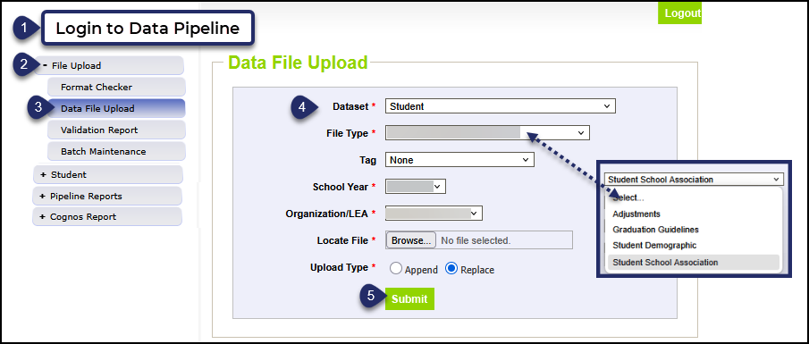
Data File Upload
Update your Interchange files to address errors
  Preferred: Update in SIS → Extract → Upload to Pipeline
  Alternate Method: Edit Record Tool (Data Pipeline)
    Not encouraged during the Regular Phase or Cross LEA Phase
    This method is required for the Post-Cross LEA Phase
Wait for a Confirmation Email from the Pipeline System
  The email will show you the number of errors in your upload
  Use Pipeline or CEDAR reports to review errors and warnings
Resource: Data Pipeline Trainings > Respondent Training tab > Pipeline Reporting Process section

Slide 58
Create/Update Snapshot

Slide 59
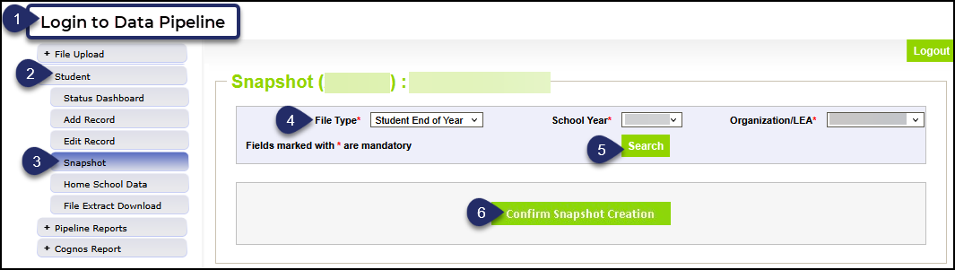
Create Snapshot: Regular Phase & Cross LEA Phase
The message “Snapshot creation triggered and processing. A notification email will be sent upon completion” will appear at the top of the screen after you press the confirm snapshot creation button
Wait for the notification email before reviewing errors/warnings
Creating a new snapshot will replace all the records from your previous snapshot

Slide 60
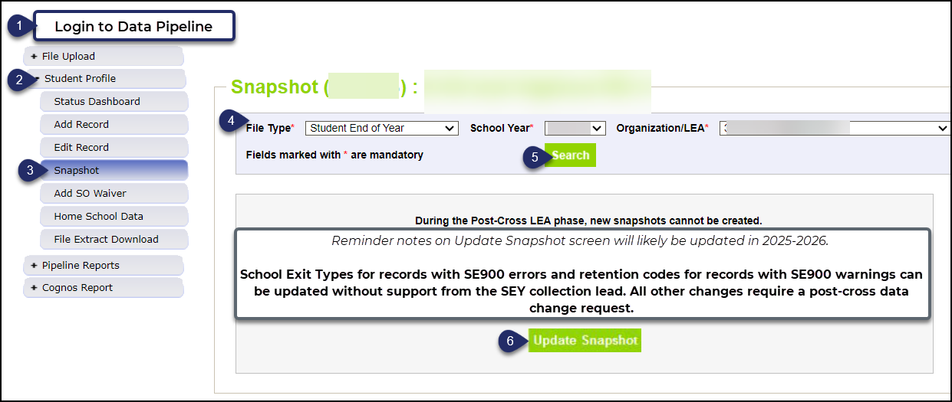
Update Snapshot: Post-Cross LEA Phase
The message “Snapshot creation triggered and processing. A notification email will be sent upon completion” will appear at the top of the screen after you press the confirm snapshot creation button
Data is only updated for records with SE900 series errors or approved data change request
Clears errors for approved exception requests
All districts should ‘update’ their snapshot at least once during the Post-Cross LEA phase even if they do not make any changes to student records

Slide 61
Business Rules

Slide 62
Overview
Business Rules are the list of data validation checks (i.e., errors and warnings) that occur when an interchange file is uploaded or snapshot is created
Available on the SEY Website
  Note: Business Rules will continue to be updated through the official open on April 30th
Kinds of information checked:
  Demographic information (some fields typically do not change from Student October to Student End of Year)
  Valid student entry/exit types, internally and across districts
  Graduating/completing/dropout student coding to ensure accuracy of reporting
    Cohort groups
    Student movement between districts
    Students retained (academic, postsecondary programs, transition programs)
    Identify dropouts from prior years showing up in other districts
    Identify students for whom an HSED certificate has been reported

Slide 63
Interchange vs Snapshot Business Rules
Interchange
Snapshot
Address data inconsistencies that apply to multiple data collections (snapshots)
Errors on the student demographics and student school association interchange files prevent the student from being included on the SEY snapshot
Errors on the graduation guidelines file prevent that measure from being associated with a graduating student’s SASID
Business Rules: Student Interchange Site
Address data inconsistencies that apply to SEY data collection specifically
Focused on the student’s educational history to ensuring accuracy when deriving graduation, dropout, mobility, and stability rates
Business Rules: Student End of Year Site

Slide 64
Errors/Warnings: Overview
Errors
Warnings
Must be addressed
  Update data fields to clear
  Request reporting exception if student data is accurate but does not follow the typical coding pattern as indicated by the error message
Errors on interchange files prevent the record from being used within a snapshot
Snapshot cannot be submitted if there are any errors
Indicate possible data inconsistencies/coding issues
Some SEY warnings indicate issues that will turn into errors in the post collection phases if not addressed
Snapshot can be submitted even if warnings are present
Pro Tip: Review warnings to look for patterns/areas where district data could be documented in a more accurate manner

Slide 65
Business Rules by Phase
Regular Phase
SE001 through SE500 series rules
Focused on checking LEA data against itself for the current year and prior year
  October to SEY
  Assessment to SEY
  S-EBT to SEY
  Student Discipline to SEY
  IEP Interchange to SEY
  Prior SEY to Current SEY
Some warnings indicate potential issues in future phases
  SE137 exit type 13 after May 1
  SE138 exit type 00 multiple LEAs
  SE722 exit type 13 without another LEA claiming student in grade K-12
Cross LEA
SE700 series
Checks data across CO LEAs
  Current year errors: corrected on SSA record
  Prior year errors: corrected with adjustment file or with a one-day record in current year SEY
Some warnings indicate issues that become errors in Post-Cross Phase if not addressed
Post-Cross LEA
SE900 series
Checks data across CO LEAs
  Current and prior SEY,
  Subsequent OCT (2026-2027)
AYG Warnings
  AYG Reconciliation run as part of CDE process to begin phase, re-runs each time snapshot is updated

Slide 66
Addressing Snapshot Errors/Warnings
Data fields must be updated on the corresponding interchange file
  Regular Phase & Cross LEA Phase—Upload corrected interchange file
    Student Interchange: DEM, SSA, GG, ADJ
    Title 1 Interchange
    IEP interchange: Child and/or Participation file
  Post-Cross Phase—file dependent
    Manually edit the interchange file in data pipeline
      DEM & SSA files
    Continue to use file upload process
      GG, ADJ
    Note: Title 1 and IEP interchanges may not be available for update during this phase
Must create a new snapshot to clear snapshot level errors
  Snapshot creation causes pipeline to run the data through the business rules again

Slide 67
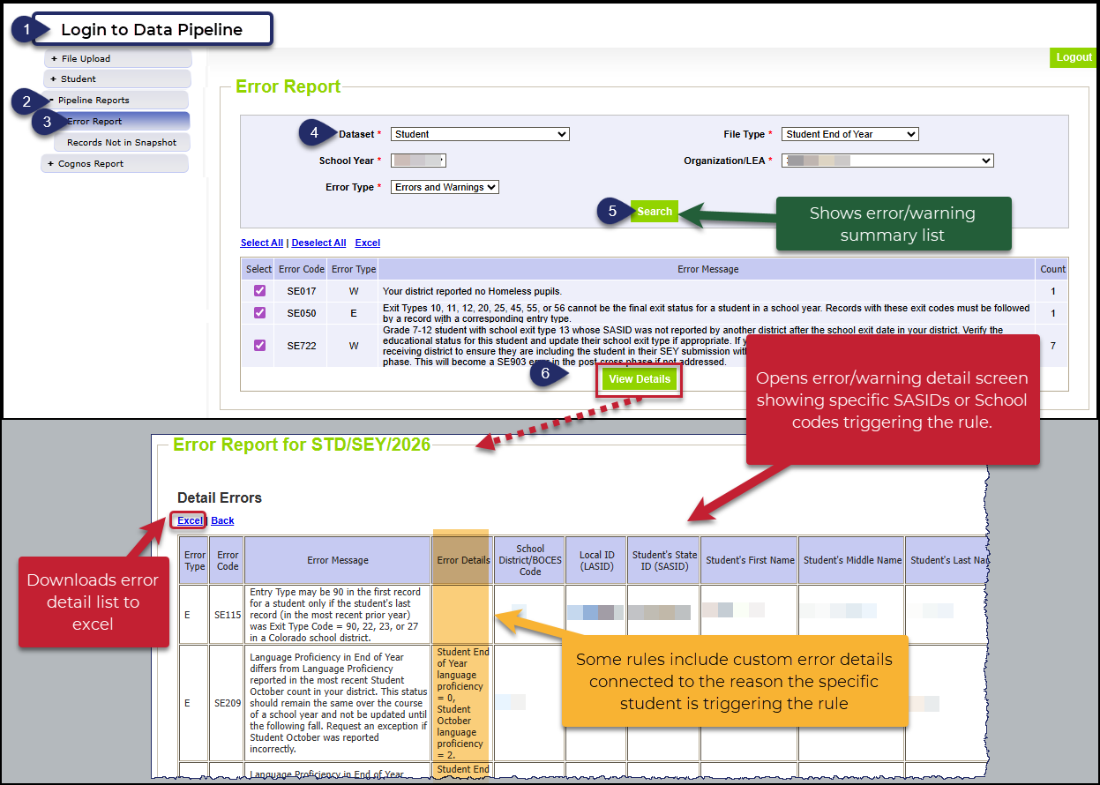
Checking Errors/Warnings: Pipeline Error Report
Preferred method for checking errors/warnings
Some errors and warnings are being updated to use the ‘error log error message’ column that used to be blank on this report
Pro Tip: Use check boxes to select a specific error/warning code before reviewing error details as it may be simpler to focus on one business rule topic at a time

Slide 68
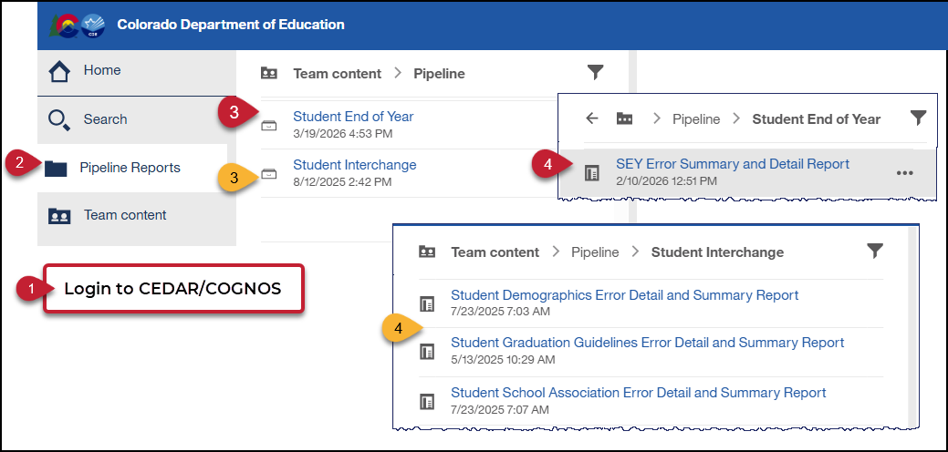
Checking Errors/Warnings: COGNOS/CEDAR
Alternative method for checking errors/warnings
  Login to COGNOS/CEDAR using the link in Data Pipeline or the IdM webpage
Use when reviewing 1,000+ individual error detail records
Some errors and warnings are being updated to use the ‘error log error message’ column that used to be blank on this report
COGNOS/CEDAR is best used to validate data using the various topic specific reports

Slide 69
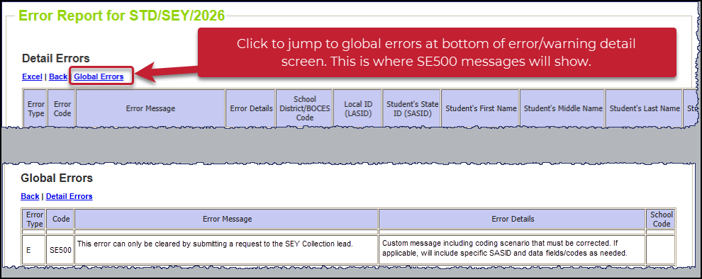
SE500 Custom Business Rule
This rule can only be cleared by submitting a request to the SEY Collection lead
View the ‘error details’ column on the error detail report for a custom message regarding the specific data issue to resolve
  SASID included if needed
Must communicate with SEY Collection lead to resolve
  Exception Request, Post-Cross Data Change Request, Phone Call to discuss situation, etc.
Used when issue found through manual checks
Used in SASID merge situations
Most common in Cross LEA and Post-Cross LEA

Slide 70
Reporting Exceptions &
Post-Cross LEA Data Change Requests

Slide 71
Reporting Exceptions
Reporting exceptions are used to clear the associated errors without changing the data in unique circumstances where a student’s record has accurate information, but their educational history does not follow the anticipated coding patterns outlined in the business rules for an interchange file or snapshot
Data respondents must work with the data collection lead for a given file/snapshot to request an exception be granted
Some reporting exceptions require additional supporting documentation and may be reviewed by other CDE staff
Directions & Templates posted on the SEY Website > Reporting Exceptions section

Slide 72
Reporting Exception Process: All Phases
Complete exception request template
  Available on SEY Website
Upload exception request template to your district’s Syncplicity student folder
  Folder: 1234 – DISTRICT NAME – Student
  Subfolder: SEY 2025-26
Notify the SEY collection lead that you’ve uploaded a document for review
  StudentEndofYear@cde.state.co.us
  Suggestion: Include the date in name of your exception request file as you may upload more than one exception during the collection cycle
Collection lead will review your request and notify you of the outcome
  Approved requests – reupload interchange file and/or create a new SEY snapshot
  Denied requests – collection lead will provide next steps for clearing the error
  Additional information needed – collection lead will request information

Slide 73
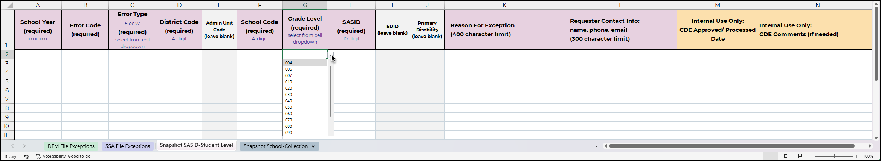
Exception Request Template
Required for all reporting exceptions, even when additional documentation is also being provided
  ML Exceptions use a separate template with additional fields
Uploaded to Syncplicity for Review
  Pro Tip: Include district code, date, and file type in the file name 1234_5.23.25_SEY_exceptions
Some fields (Error Type, Grade Level) have built in cell level dropdown menus to ensure accurate codes and formatting
Do not delete tabs or columns from this form.
  Hidden columns exist on the exception request tab required for accurate processing.
  Select applicable tab for the type of exception.
    Snap SASID-Student Level or Snap School-Collection Level
Submit a new exception request form when additional exceptions are needed
  CDE Collection Lead inputs date request is reviewed to let you know it has been processed. After this point a new form is needed for new requests.

Slide 74
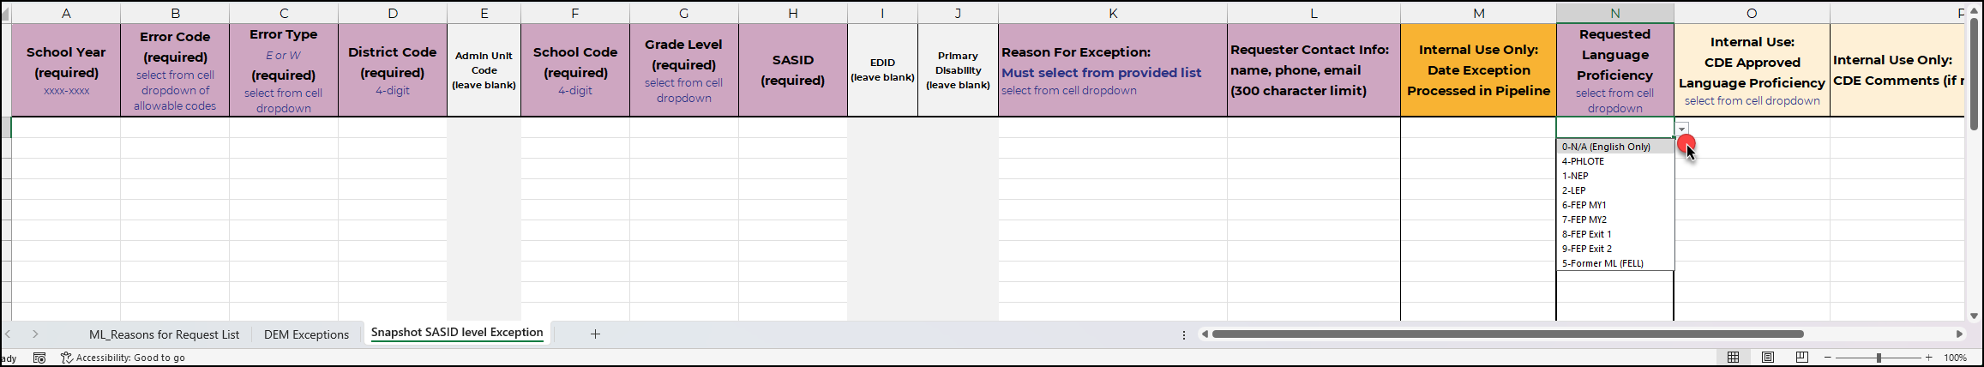
Multilingual Learner Exception Request Template
Used for both DEM level and SEY Snapshot level errors
  DEM: SP570
  SEY: SE170, SE209, SE287, SE309
Uploaded to Syncplicity for Review
  Pro Tip: Include district code, date, and file type in the file name 1234_5.23.25_SEY_exceptions
Reason for Exception
  Overview tab with notes regarding additional documentation requirements
  Cell level drop-down options and reason for exception
Requested language proficiency change
  Dropdown to show desired change, which is currently causing the error
Exceptions for students with 2+ years of ML history must also have a ML Sequence Change Request Form

Slide 75
What types of exceptions might need additional information?
If the reason given for the exception doesn’t make sense with the coding pattern, clarification may be requested
SASID merge situations
  Submit merge request in RITS system or contact RITS inbox
  Once merge is complete, then any follow-up SEY errors are cleared with an exception
Multilingual Learners whose status changed mid-year
  Students with > 2 years of ML history in the same district whose status is changing mid-year (3 OCT, 2 SEY collections)
  ML Sequence Change Request Form
Post-Cross LEA errors (e.g. SE903)
  Proof of adequate documentation required for student to remain coded as Exit 13 (transfer to a public school in another CO district)

Slide 76
Post-Cross Data Change Request
Unique to Post-Cross LEA phase of SEY Collection
Used to request a change to a student’s record under the following circumstances:
  Updating data to clear any regular phase or Cross-LEA business rule (SE001-SE700s)
  Updating exit type/date/retention code to clear a SE900 series warning
  Adding a missing student record to resolve a SE400 error or as directed by SEY collection lead.
  Addressing a SASID merge during the Post-Cross LEA Phase
Directions and template posted on SEY Website > Post Cross Data Change section

Slide 77
Post-Cross Data Change Request Process
Update data in pipeline using the edit record screen
  School Exit Type
  School Exit Date
  Retention Code
  Other data fields in rare circumstances
Complete a data change request form
Submit form to Syncplicity using the same folder as exception requests
Notify StudentEndOfYear@cde.state.co.us that a request has been placed in Syncplicity for review
Collection lead will review the request and notify you of the outcome or any next steps

Slide 78
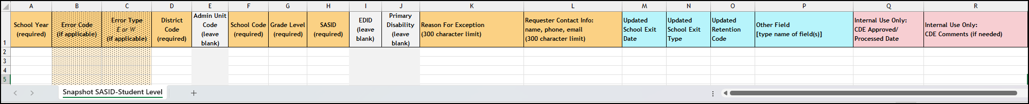
Post-Cross Data Change Request Template
Required for any post-cross data change outside of the SE900 series errors
Must include the new school exit date, school exit type, and retention code
  If other data field changes are requested, include this information in the reason for change request
Do not delete tabs or columns from this form.
  Hidden columns exist on the post-cross changes tab required for accurate processing.
Submit a new change request form when additional changes are needed
  CDE Collection Lead inputs date request is reviewed to let you know it has been processed. After this point a new form is needed for new requests.

Slide 79
Post-Cross Phase:
Exception Requests & Data Change Requests
Post-Cross Error or Data issue
SEY Data Incorrect and must be updated
SEY Data is Accurate as Reported
Submit a Post-Cross LEA Data Change Request
Submit an Exception Request

Slide 80
SASID Merges

Slide 81
SASID Merge Overview
When a single student is found to have multiple assigned SASIDs in the RITS system, a SASID merge is need.
Why does this happen?
  Student transferred between LEAs and the receiving LEA requested a new SASID rather than claiming the existing RITS record
    Most often found during the Cross LEA & Post-Cross LEA phases of the SEY collection
  Typos in student’s name, date of birth, or gender data in RITS leading to a LEA to accidentally request a new SASID rather than claiming the existing RITS record
  Student with hyphenated middle or last names
How is it corrected?
  Submit a merge request in the RITS system
  Additional Support: Email RITS inbox at RITS@cde.state.co.us

Slide 82
SASID Merge resolution
Regular & Cross LEA Phases
Post-Cross LEA Phase
Update all interchange files to reflect the correct SASID, name, date of birth, and gender for the student
  SASID indicated by RITS coordinator
Reupload the interchange files
Create a SEY snapshot
Verify student included in the SEY collection with the correct SASID using the CEDAR/COGNOS report SASID Lookup: SEY and OCT Record (prior, current, subsequent year)
Resource: Handling SASID merges in Regular and Cross LEA Phases (PDF)
Special handling is required during this phase and is handled on a case-by-case basis
Follow posted directions for handling SASID merges in the Post-Cross Phase
After merge is processed: Verify student included in the SEY collection with the correct SASID using the CEDAR/COGNOS report SASID Lookup: SEY and OCT Record (prior, current, subsequent year)

Slide 83
CEDAR/COGNOS Reports

Slide 84

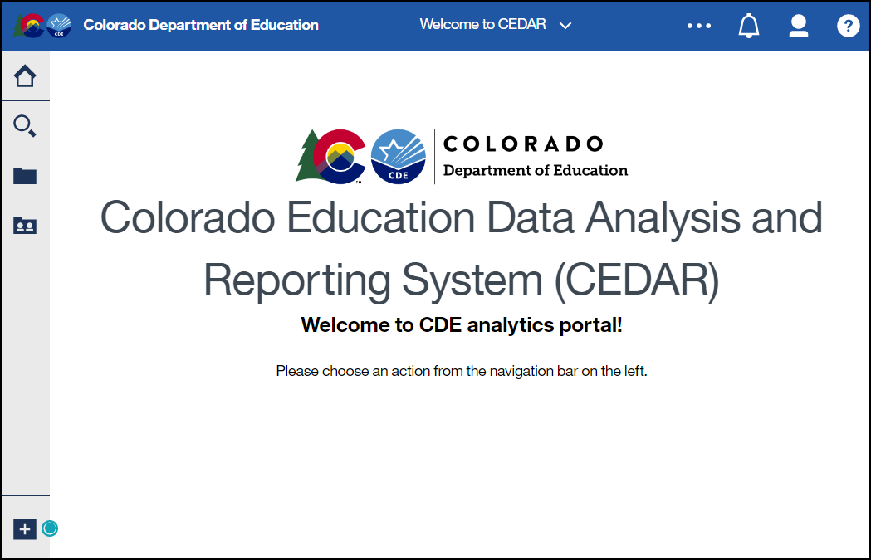
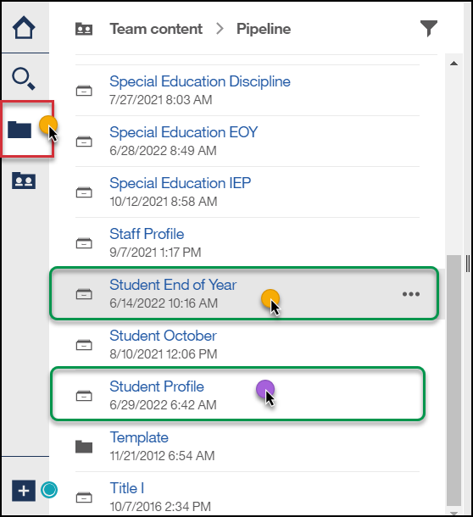
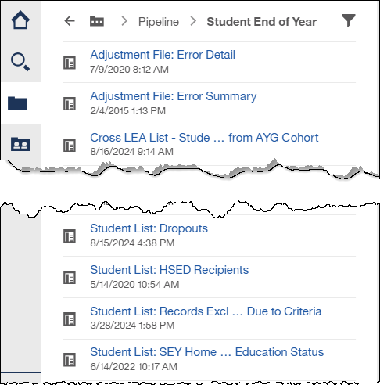
Accessing CEDAR/COGNOS Reports
The Colorado Education Data Analysis and Reporting system (CEDAR) is a private, secure system which provides student level data to authorized users. Access to student-level data is limited to educators who have need for such data.
Accessing CEDAR/COGNOS:
Identity Management Page → CEDAR Section →
Data Pipeline →
Notes:
Often CEDAR is referred to as COGNOS since COGNOS is the software currently powering the Colorado Education Data Analysis and Reporting system (CEDAR).
Reports in CEDAR/COGNOS have multiple purposes. Some are used as operational reports to assist data respondents in looking up specific information on students, file/snapshot errors, and students missing from a snapshot due to profile errors. Other reports are used to validate data when finalizing a data collection. Many reports also provide districts with a preview of data that will be published based upon specific data collections. (i.e., graduation statistics)
SEY CEDAR/COGNOS Reports Guide

Slide 85
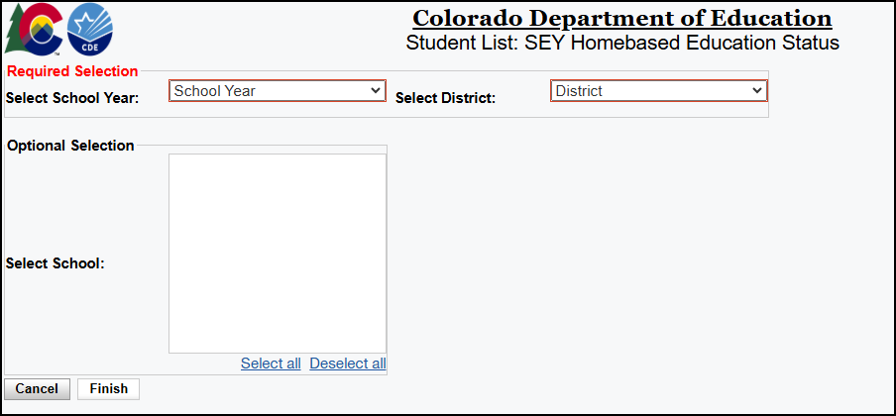
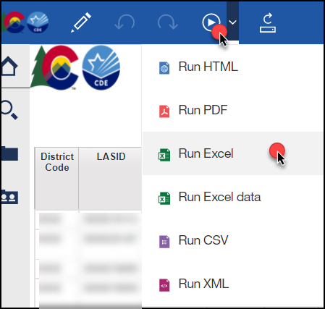
Report Screen & Download
Use dropdown menus to select desired information
Reports can be downloaded as an excel file for easier sorting/filtering of information.

Slide 86
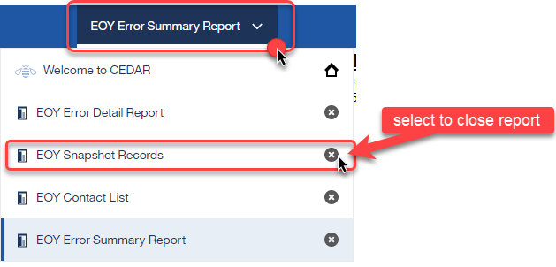
Moving between reports
Toggle between reports using the recent reports dropdown
Close an open report using the recent reports dropdown

Slide 87
Important Report Categories for SEY Collection
Student Interchange
Student End of Year
Individuals with permissions to the Student Interchange in IdM have access to student profile reports
  STD~LEAVIEWER
  STD~LEAUSER
Operational reports to assist LEAs with interchange files
  Include historical SASID level lookups for specific data fields
They are connected to information from the student interchange files:
  Student Demographics
  Student School Association
  Graduation Guidelines
Available to individuals with permissions to Student End of Year in IdM
  SEY~LEAVIEWER
  SEY~LEAUSER
  SEY~LEAAPPROVER
Two main types
  Operational
  Preview/Validate Rates
Resource: SEY CEDAR/COGNOS report guide (PDF)

Slide 88
SEY Report Types
Operational Reports
Adjustment File: Error Detail
Adjustment File: Error Summary
SASID Lookup: Anticipated Year of Graduation
SASID Lookup: Cross LEA
SASID Lookup: SEY and OCT record (prior, current, subsequent year)
SEY Error Summary and Detail Report
SEY Respondent Contact List
SEY Snapshot Records
Student List: HSED Recipients
Student List: Records Excluded from SEY Snapshot due to Criteria
Student List: SEY Homebased Education Status
Validating/Reviewing Rates
Dropout: District and School Rates
Student List: Dropouts
Graduation Rates: District and School by AYG
Graduation: 3-, 4-, 5-, 6-, 7- year rates by school year
Still Enrolled Rates: District and School by AYG
Student List: AYG Cohort
Student List: AYG Cohort Adjustments
Mobility: District and School Rates
Student List: District and School Mobility
School Summary of All Rates
Cross LEA Phase
Cross LEA List – Students Removed from AYG Cohort
Cross LEA List – Students with SE700 errors or warnings
Federal Reporting
Federal Reporting: Graduation Data
  Also includes dropout counts for federal reporting

Slide 89
Status Dashboard

Slide 90
Status Dashboard Uses
Allows you to review the status of a submitted interchange file or snapshot
  Quantity of errors
  Data Exists ‘Y’ means successful snapshot creation
  Data Locked ‘Y’ means snapshot creation is not available
    Post-Cross LEA updates can be completed in this status
  Overall Status
    ‘P’ Pending
    ‘S’ Submitted
  Last Updated Date
    This date/time should be more recent on your SEY snapshot than on the related student interchange files
Used to submit snapshot to CDE
Used to download the superintendent verification (sign-off) form during the final phase of data collection
  Last Updated Date on the status dashboard must be prior to the date on the sign-off form for the form to be accepted

Slide 91
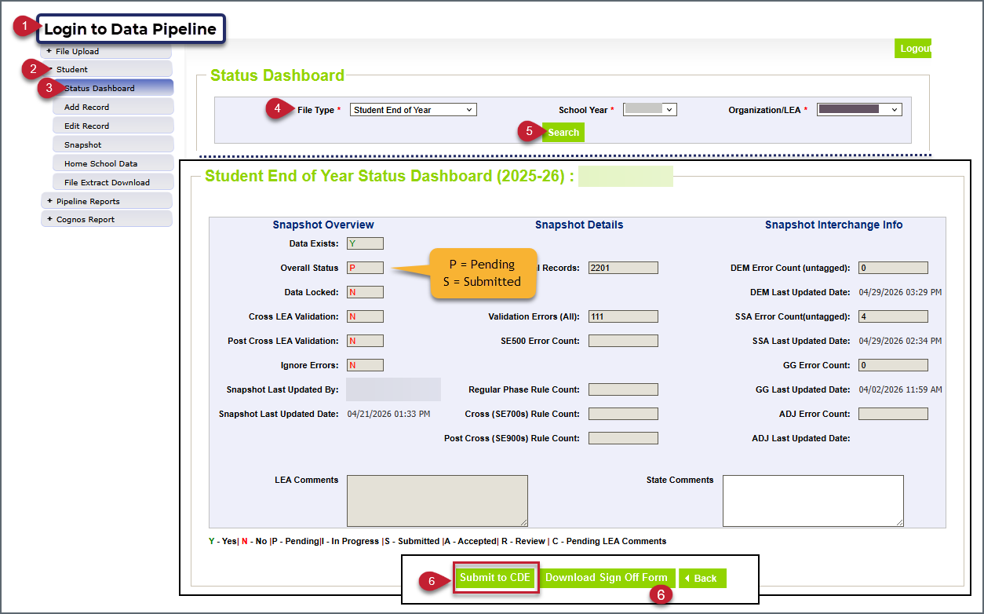
Status Dashboard Steps and LEA Approver Tasks
Features
Snapshot Overview
  Overall Status (N, P, S)
  Last Updated By…IdM user email address
  Last Updated Date
Snapshot Details
  Total Records
    At least one per attending student, possibly more
  Validation Errors (All)
    Count of all errors
    Snapshots cannot be submitted if this value is not 0
  SE500 error count
  Regular Phase, Cross LEA, Post Cross Rule Count
    Count of all errors and warnings for the phase
    Snapshots can still be submitted even if these fields are not 0 because they are reflecting warning counts
    Reminder: Error free does not mean there aren’t data issues
Student Interchange Info
  Error count and last updated date for DEM (untagged), SSA (untagged), GG, and ADJ files
  Note: ADJ file is only used in special circumstances, a LEA mean submit their snapshot without needing this file
LEA Approver Tasks:
  Regular Phase & Cross LEA Phase = Submit to CDE
  Post-Cross LEA Phase = Download Sign Off Form

Slide 92
Contact & Resources

Slide 93
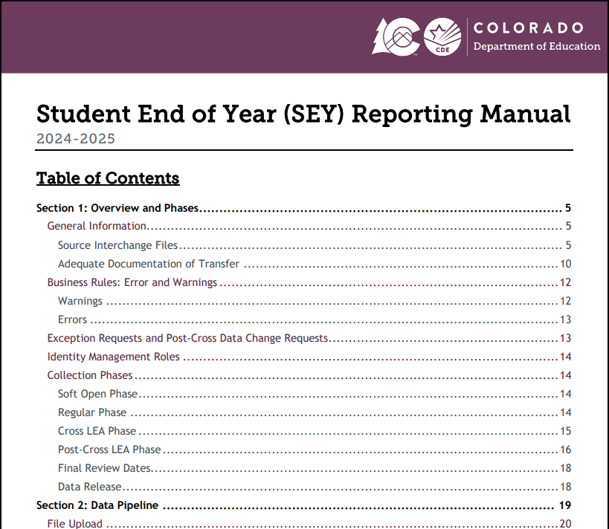
Resource: SEY Collection Manual
Available on Student End of Year Page
Update in progress for 2025-2026, expected May 2026
Topics include:
  Collection Phases and Requirements
    Steps
    Unique Features
  SEY Data Use
    Graduation/Completion
    Dropout
    Mobility/Stability
    Other Uses
  SEY Data Privacy Guidelines
  Frequently Asked Questions
    AYG Cohort scenarios & data implications
Common Coding scenarios are migrating to the SSA Record Guide

Slide 94
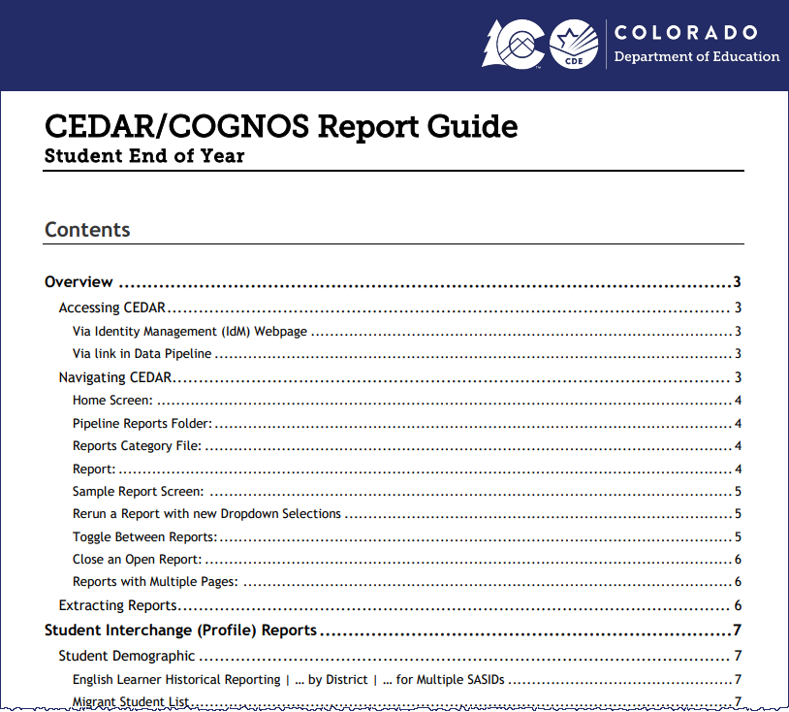
Resource: SEY CEDAR Report Guide
Available on Student End of Year Page
Update in progress for 2025-2026, expected May 2026
Topics Include:
  Access & Navigating CEDAR/COGNOS
  List of all SEY reports with overview and purpose
    Operational
    Graduation/Completion
    Dropout
    Mobility/Stability
Expect “Student Interchange” reports topic to be removed once the Student Interchange CEDAR/Report Guide is updated Summer 2026

Slide 95
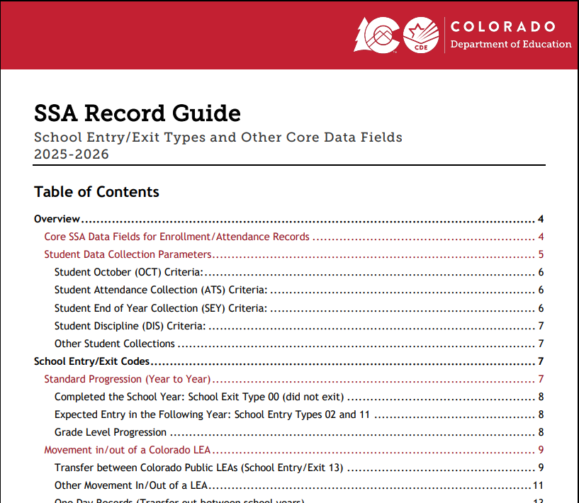
Resource: SSA Record Guide
Available on Student Interchange Page
Update for 2026-2027 expected in June 2026
  Plan: Include more coding scenarios related to SSA fields, which may shift scenarios from the SEY Collection Manual to SSA Record Guide
Topics include
  Overview
    Critical SSA fields used to determine if a record is pulled into specific snapshot collections
  School Entry/Exit Codes
    Different types of student movement and the related school entry/exit types needed to capture the movement
    Anticipated Year of Graduation Cohort connection to exit types
  Data Implications
    Data implications based upon SSA records, especially accurate school entry and exit dates
  Common Coding Scenarios
    Enrollment Status Changes
    Instances of Mobility
    Much more!

Slide 96
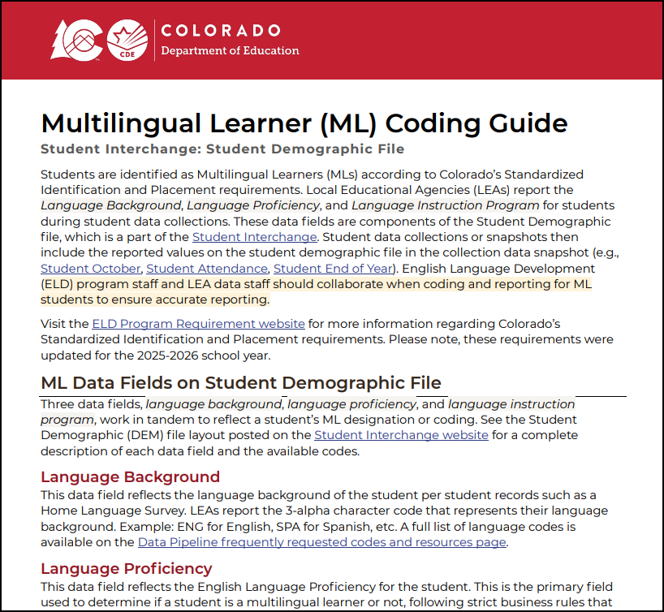
ML Coding Guide
Available on Student Interchange Page
Last updated July 2025 to reflect implications from updated program guidance
Topics Include:
  DEM file ML data fields
  CO standardized ML Progression
  Annual Data Cycle
  Coding guidance
  CEDAR/COGNOS reports
  Business Rules and Reporting Exceptions
  Data Best Practices
  Frequently Asked Questions

Slide 97
SEY Collection Lead: Reagan Ward
Here to answer questions and assist where possible
  Student End of Year collection
  Student Interchange questions
Don’t get frustrated, reach out!
To best assist you, please help me with the following
  Include your 4-digit district code in emails and voicemails
  Leave voicemails or send follow-up emails if I miss your call
  Ensure your phone number is accurate in IdM (ask your LAM to help if it needs to be updated) – Bonus if your email contains your direct phone number when possible
Email: StudentEndofYear@cde.state.co.us
Phone (direct line): 720-484-9057
Book a Meeting: Data Pipeline Collection Support > Student End of Year or Student Interchange support category

