Slide 1


Slide 2
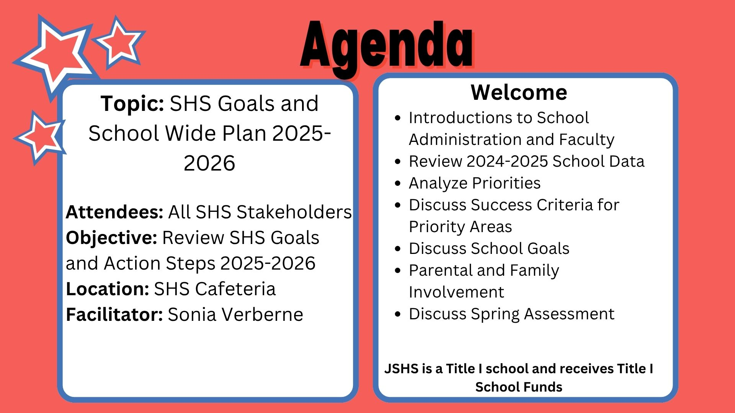

Slide 3
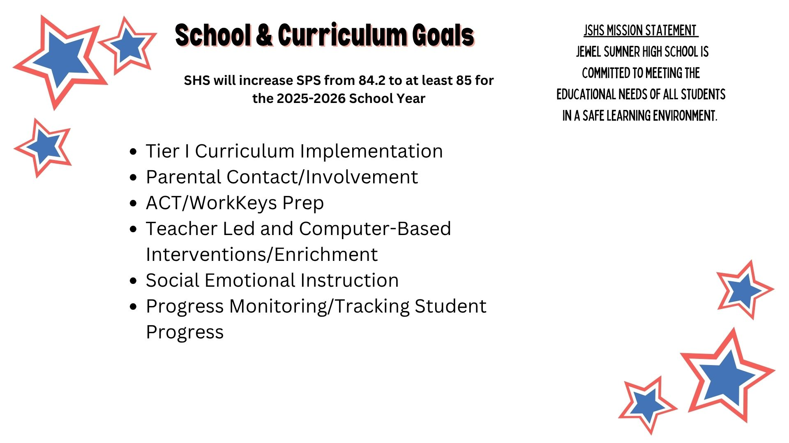

Slide 4
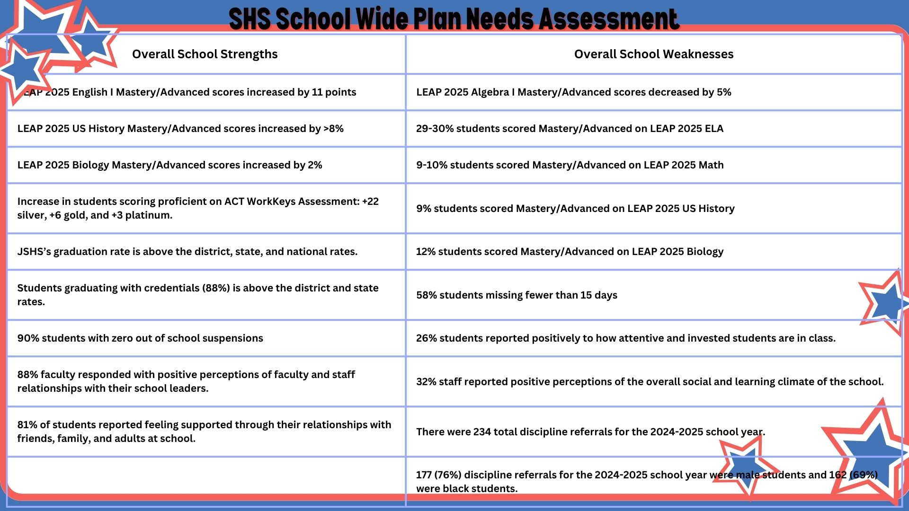

Slide 5
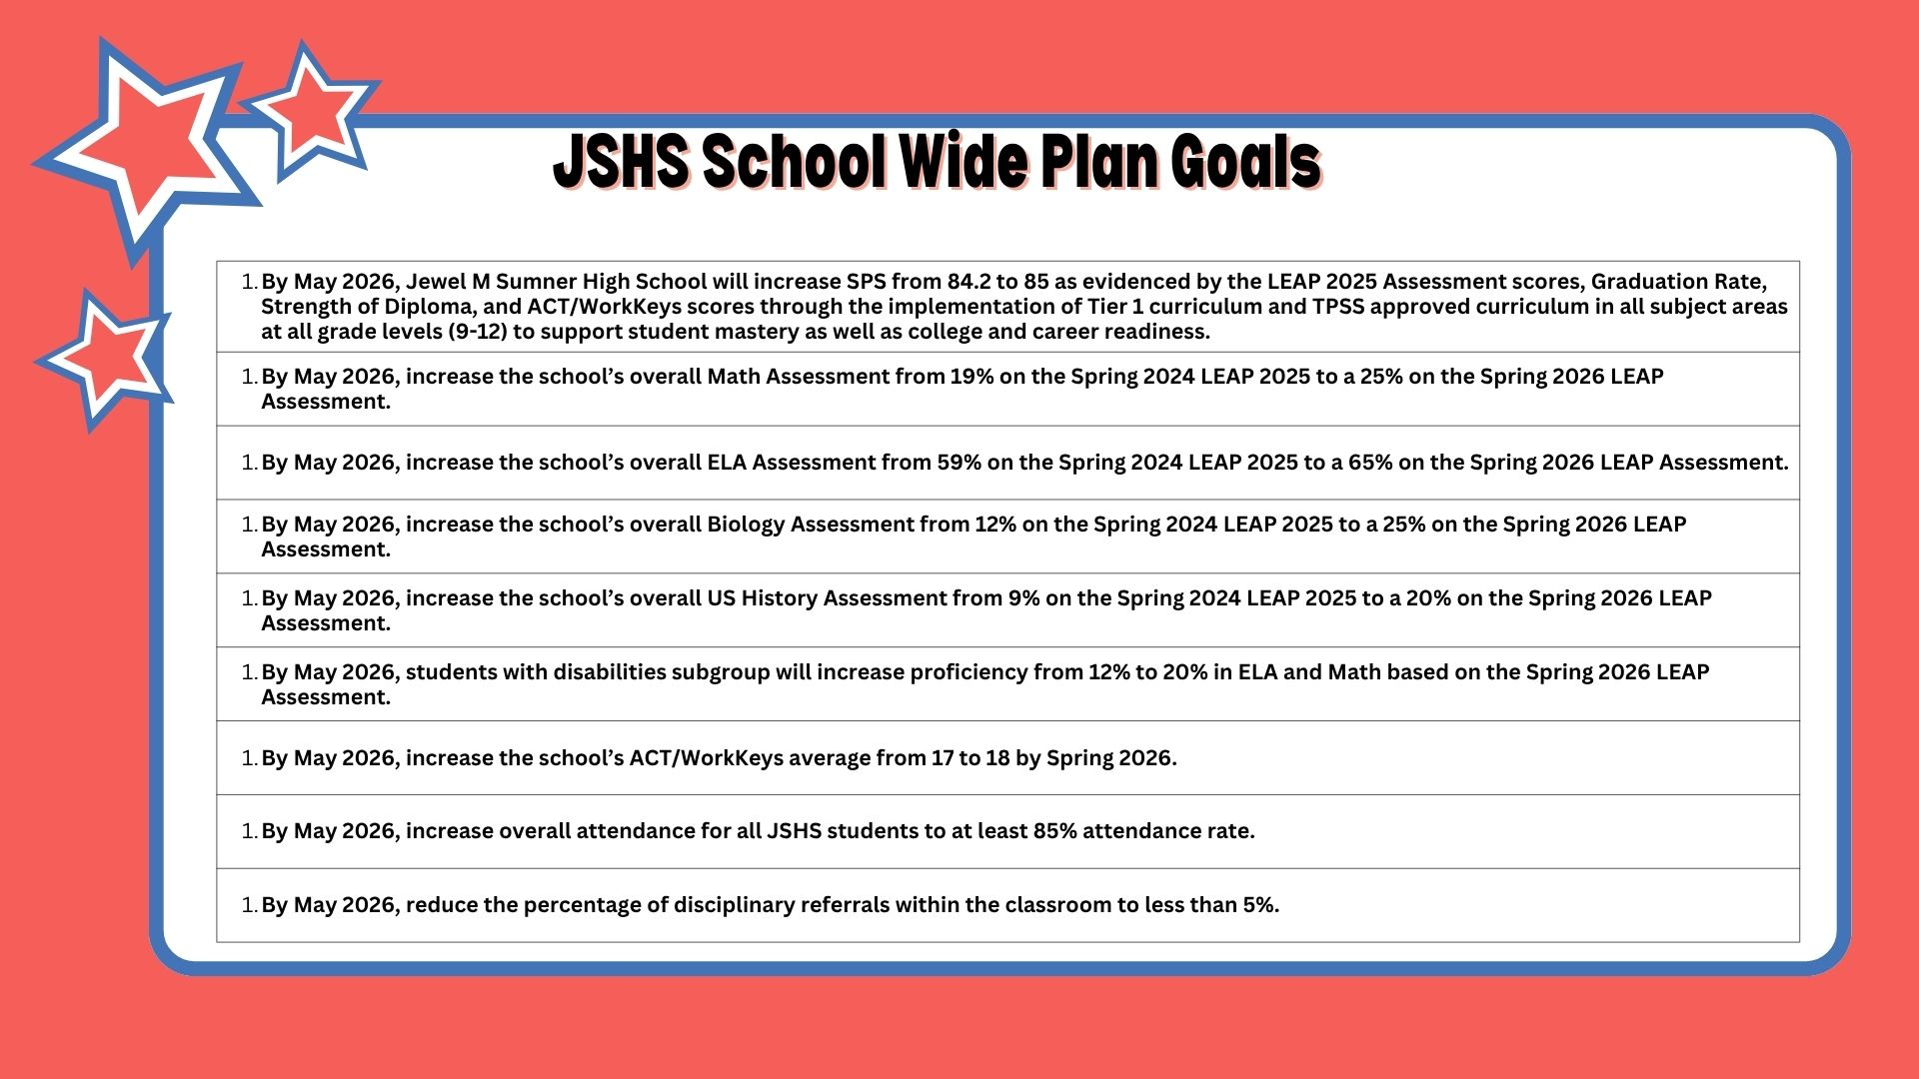

Slide 6
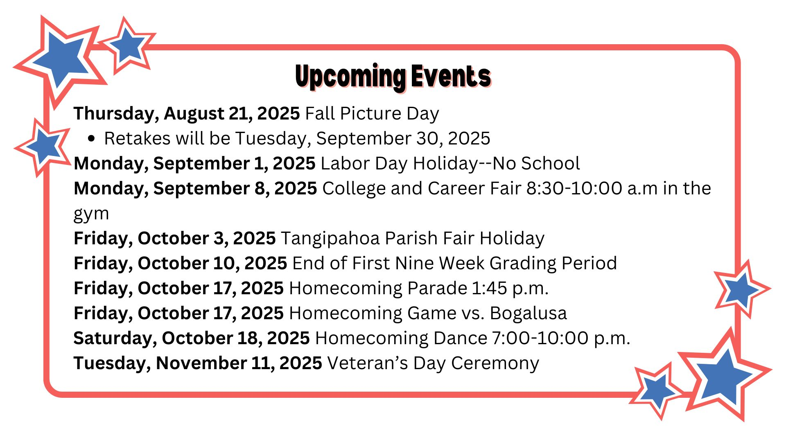

Slide 7
Parent and Family Events
Monday, September 8th College and Career Fair
Wednesday, September 17th Senior Meeting
Friday, November 7th Veterans Day Program
Tuesday, December 17th Band Concert
Thursday, January 22nd Career Expo
Monday, March 9th 10 Grade Parent Meeting for Pathway and Scheduling
Thursday, March 19th Personality Awards

Slide 8


