Slide 1
Supplementary & Additional Authorizations
Webinar
Thursday, April 16, 2026
Monica Robinson, Credential Analyst

Slide 2
Types of
Added Authorizations
1
2
Supplementary Authorization
3
Subject Matter Authorization
Adding a FULL Authorization

Slide 3
Adding a Full Teaching or Content Area
(Full Authorization)
Applicable for General Education Credential Holders ONLY

Slide 4
Adding a FULL Authorization
Allows a teacher to obtain an additional General Education teaching credential without completing the full professional preparation program for that credential.
Must hold a valid basic General Education teaching credential.

Slide 5
Adding a FULL Authorization
A Multiple Subject holder can obtain a Single Subject by completing the following:
Subject Matter Competence (SMC) via passage of appropriate CSET exam
OR
Degree major in one of statutory subjects available
OR
- Completion of a Commission-approved subject-matter program. Must obtain verification of completion from the authorized person in the education department of a California college or university with an approved program
Notes:
https://www.ctc.ca.gov/aspiring-educators/req-credentials/subject-matter-competence/

Slide 6
Adding a FULL Authorization
OR
Successful completion through a combination of coursework and examination options that meet or exceed the domains of the subject matter requirements adopted by the Commission in the content area of the Single Credential.
  Such mixing of options may only be done by candidates enrolled in a Commission-approved preparation program.
Notes:
This option is not available as a DIRECT application or as a courtesy online application via employer.

Slide 7
Adding a FULL Authorization
Completion of a three-semester-unit or four-quarter-unit course in methodology directly related to teaching in a departmentalized setting in the specific content area sought (example: adding English/needs methodology/pedagogy course in English content area)
Possession of an English Learner authorization issued by the Commission authorizing service in English Language Development (ELD) and Specially Designed Academic Instruction delivered in English (SDAIE)

Slide 8
Adding a FULL Authorization
A Single Subject holder can obtain a Multiple Subject by completing the following:
Subject Matter Competence (SMC) via passage of appropriate CSET exam
OR
Degree major in liberal studies or interdisciplinary studies
OR
- Completion of a Commission-approved subject-matter program. Must obtain verification of completion from the authorized person in the education department of a California college or university with an approved program.
Notes:
For a Multiple Subject Teaching Credential, the degree must be in liberal studies or an interdisciplinary major that includes coursework in the content areas

Slide 9
Adding a FULL Authorization
OR
Completion Successful completion through a combination of coursework and examination options that meet or exceed the domains of the subject matter requirements adopted by the Commission in the content area of the Multiple Subject Credential.
  Such mixing of options may only be done by candidates enrolled in a Commission-approved preparation program.

Slide 10
Adding a FULL Authorization
Completion of a three-semester-unit or four-quarter-unit course in methodology directly related to teaching in a self contained setting
Course in Developing English Language Skills for Beginning Readers
Meet the literacy requirement by passage of Foundations of Reading Exam or the prior exam- the Reading Instruction Competence Assessment (RICA) prior to 10-31-25
Possession of an English Learner authorization issued by the Commission authorizing service in English Language Development (ELD) and Specially Designed Academic Instruction delivered in English (SDAIE)

Slide 11
Adding a FULL Authorization
A Single Subject holder can add an additional Single Subject by completing the following:
Subject Matter Competence (SMC) via passage of appropriate CSET exam
Completion of a three-semester-unit or four-quarter-unit course in methodology directly related to teaching in a departmentalized setting in the specific content area sought (example: adding English/needs methodology/pedagogy course in English content area)
Notes:
Exception – Science and Math. If they already have a Science or Math authorization and are seeking additional authorization in same area, they are not required to take a methodology course.

Slide 12
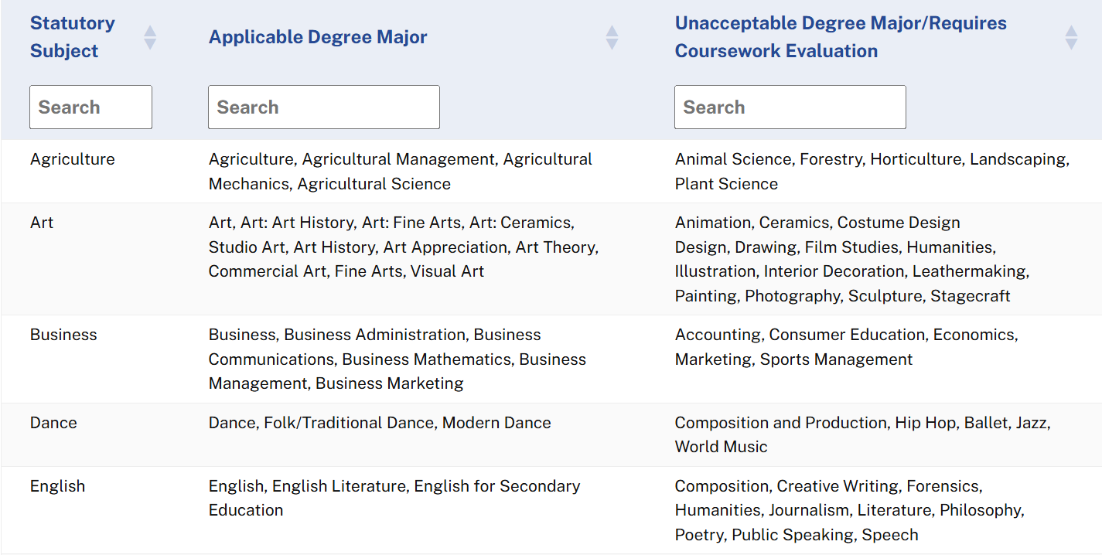
Table – Applicable Degree Major

Slide 13
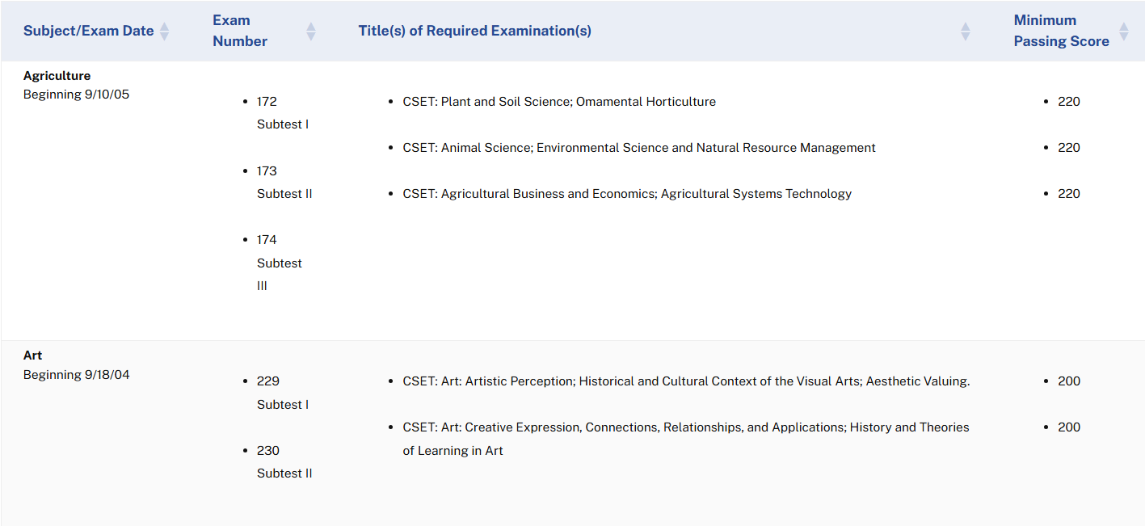
Table – CSET Examinations
Notes:
Gives you the exam numbers, title of required exam(s) and the minimum passing scores. They have the languages separated in a different table.

Slide 14
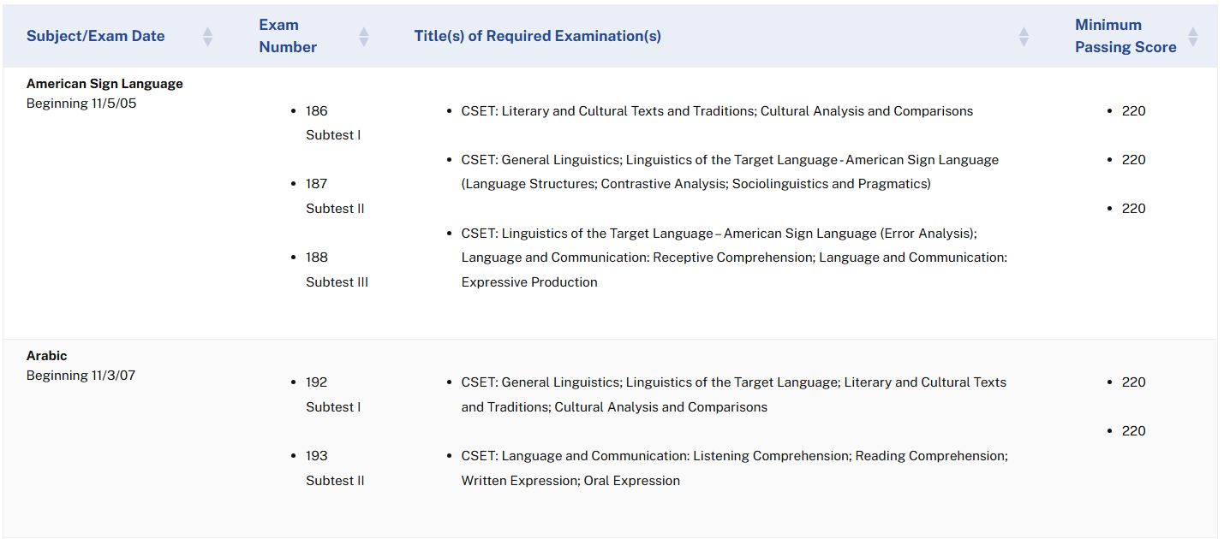
Table – CSET Exam – World Languages
Notes:
World Languages are separated in a different table.

Slide 15
How to obtain a Supplementary Authorization
Authorizes grade 9 and below

Slide 16
Supplementary and Subject Matter Authorizations
Based on coursework
Two types of supplementary authorizations available:
  Introductory Subjects
  Specific Subjects
Subject Matter Authorizations available:
  Introductory Subject Matter Authorizations
  Specific Subject Matter Authorizations

Slide 17
Adding a Supplementary Authorization
May be added to Multiple or Single Subject Teaching Credentials and authorize the holder to teach subject in grades 9 and below.
Requirements:
20 Semester Units (10 upper division) or more in content areas – grade C or higher
OR
Degree Major in subject area requested

Slide 18
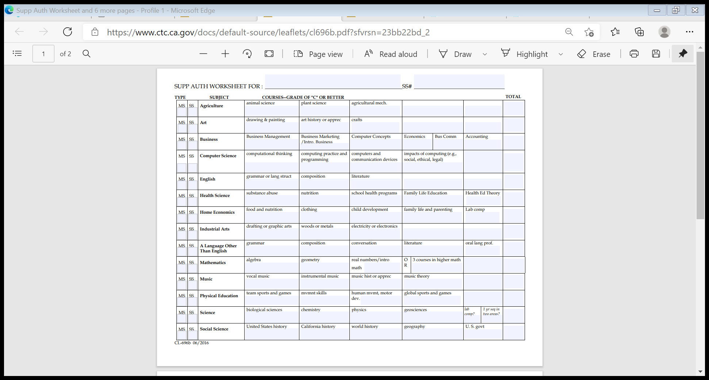
Adding a Supplementary Authorization
Notes:
Within the 20 semester units, you must have completed a course in each of the areas. Example: Social Science – you can have over 20 semester units but if you do not have all the areas than you do not qualify. Most people do not have the CA History course completed.

Slide 19
Adding a Supplementary Authorization
Expanded Options to meet requirements:
CSET exams in subject area
Combo of CSET subtests and coursework equivalent to a subtest verified via program evaluation
Comparable authorization on Out of State License/Credential
Notes:
AB 2373. Appendix B will give you all the options on the leaflet online. Great tool.

Slide 20
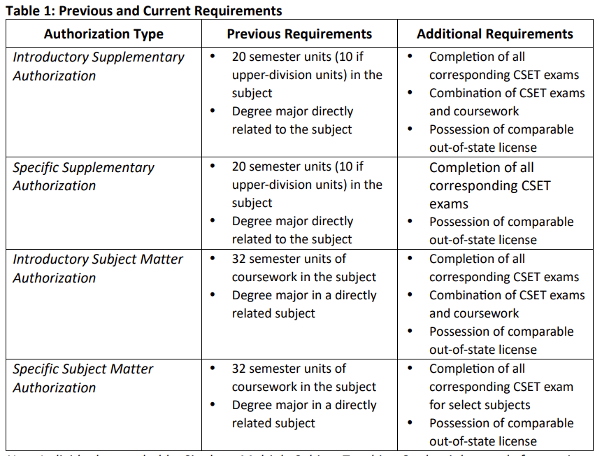
Adding a
Supplementary Authorization –
Previous
&
Current
Table 1
Coded Correspondence 25-03
Notes:
Gives you the exam numbers, title of required exam(s) and the minimum passing scores. They have the languages separated in a different table.

Slide 21
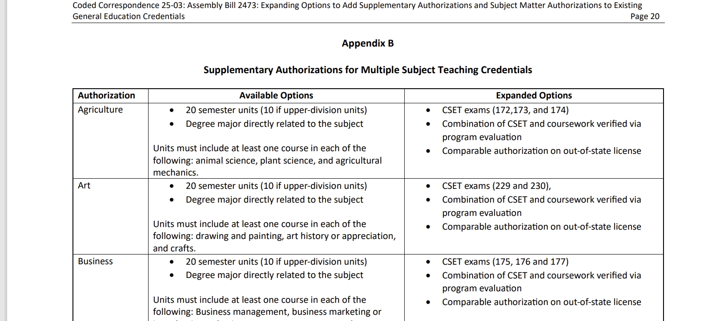
Adding a Supplementary Authorization – Appendix with available Options
Coded Correspondence 25-03
Notes:
Gives you the exam numbers, title of required exam(s) and the minimum passing scores. They have the languages separated in a different table.

Slide 22
Expanded Options example:
An educator holds an out-of-state license in Elementary Education (Self-Contained General Education) and also holds a Middle Grades Mathematics authorization through grade 8.
The mathematics authorization in middle grades authorizes departmentalized instruction; therefore, it can be used to meet subject matter competence to add an Introductory Supplementary Authorization in Mathematics to the Multiple Subject Credential.
Notes:
Example of various out-of-state teaching licenses align with and transfer to California teaching credentials.

Slide 23
Expanded Options example:
An educator holds an out-of-state license in Secondary Education General Science grades 9-12 and also holds a Middle Grades Mathematics authorization through grade 8.
The educator would be eligible to add an Introductory Supplementary Authorization in Mathematics to a Single Subject Credential in Foundational-Level General.
Notes:
Example of various out-of-state teaching licenses align with and transfer to California teaching credentials.

Slide 24
Adding a Specific
Supplementary Authorization
May be added to Single Subject Teaching Credentials and authorize the holder to teach specific subject in grades preschool, K -12 and adults.
Requirements:
20 Semester Units (10 upper) or more in specific content areas – grade C or higher
OR
Degree Major in subject area requested
Notes:
Not limited to 9th grade level.

Slide 25
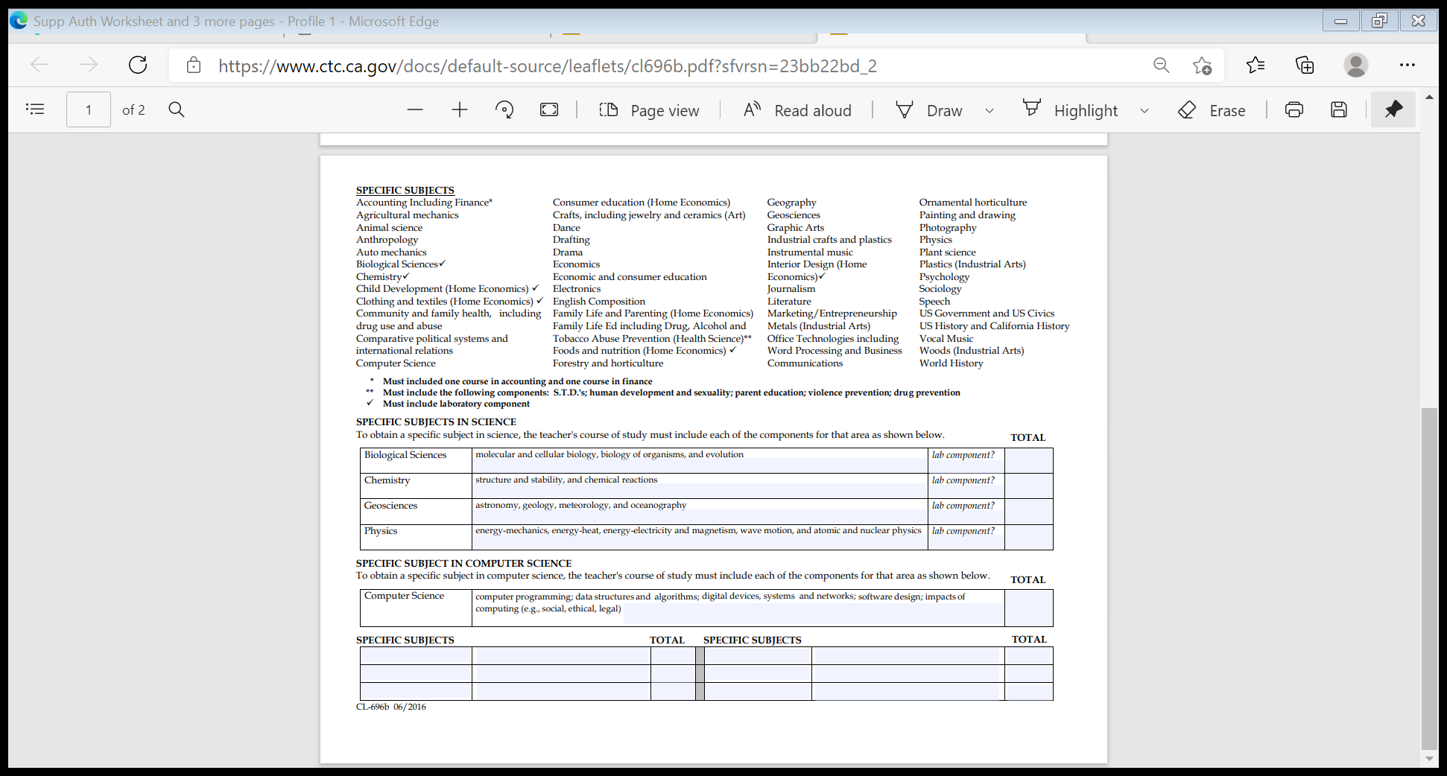
Adding a Specific Supplementary
Notes:
May only be added to Single Subject credentials/not multiple subjects

Slide 26
How to obtain a Subject Matter Authorization

Slide 27
Subject Matter Authorizations
Introductory and Specific Subject Matter Authorizations may be added to:
Single Subject Credentials
Multiple Subject Credentials
Standard Elementary and Secondary Credentials
University Intern Credentials (Multiple and Single)
Special Secondary Credentials (academic subjects only)

Slide 28
Subject Matter Authorizations
Subject Matter Authorizations:
Authorize the holder to teach subject matter curriculum typically included for grades 9 and below (students can be preschool, K-12, and adults)
Specific Subject Matter Authorizations:
Authorize the holder to teach the specific subject at any grade level (preschool, K-12, and adults)

Slide 29
Subject Matter Authorization Coursework Requirements
One of the following in the area of the supplementary authorization requested:
Degree major
32 semester units
  Minimum of three semester or four quarter units of coursework in each content area*
  Balance of the units may be in any courses within the subject category
  *Intro Science requires six semester or eight quarter units in each of the four science content areas

Slide 30
Acceptable Coursework
From a regionally-accredited college/university
Grade of “C” or better
Must be “Credit”, “Passing”, or “Satisfactory”
Applicable to a Bachelor’s or higher degree

Slide 31
Intro Subject Matter
Authorization Subjects
Available in the following subject areas:
Art
English
Languages Other Than English
Mathematics
Music
Science
Social Science
Notes:
Authorize the holder to teach subject matter curriculum typically included for grades 9 and below (students can be preschool, K-12, and adults)

Slide 32
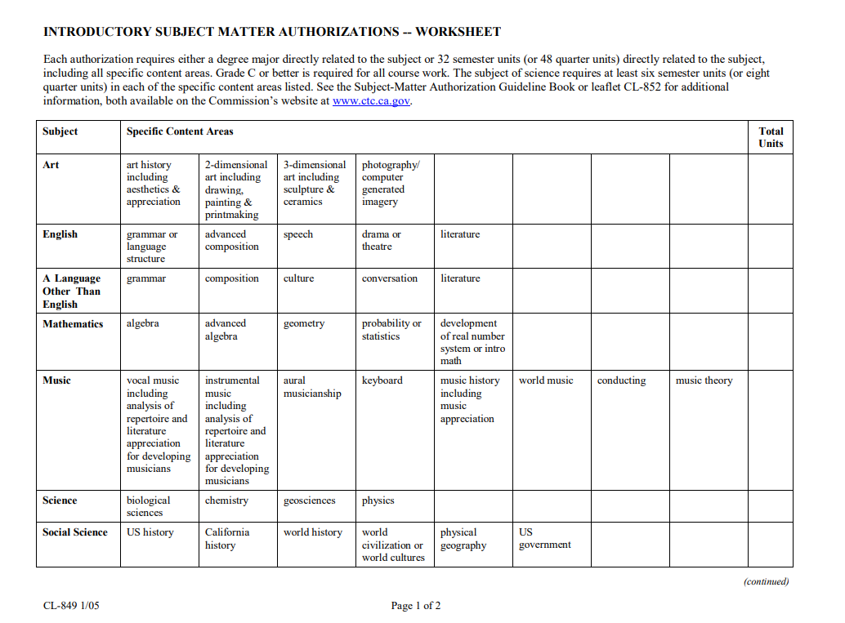
Adding a Subject Matter Authorization
Notes:
Within the 20 semester units, you must have completed a course in each of the areas. Example: Social Science – you can have over 20 semester units but if you do not have all the areas than you do not qualify. Most people do not have the CA History course completed.

Slide 33
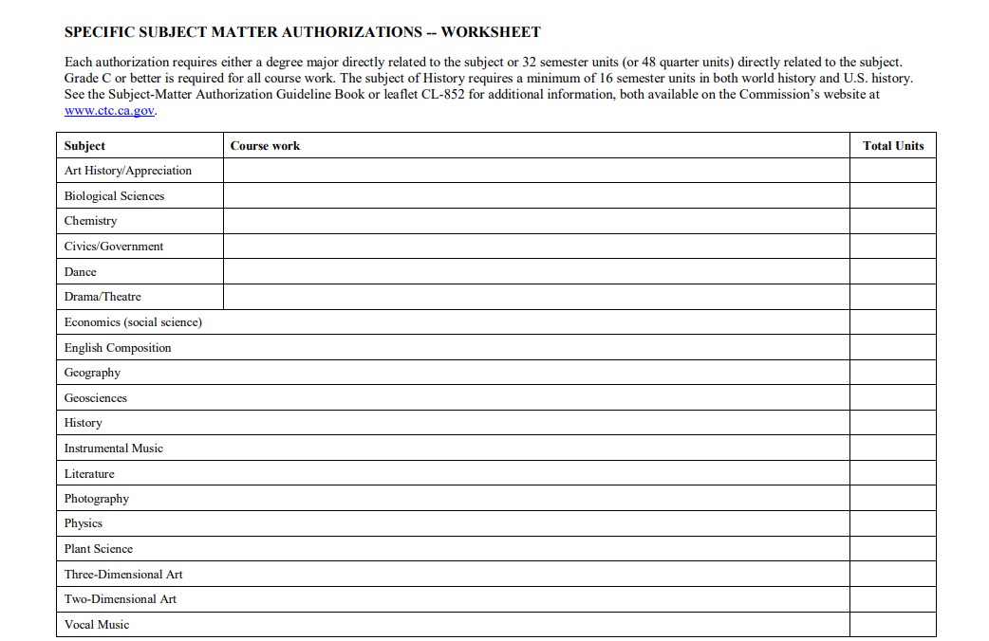
Adding a Specific Subject Matter Authorization
Notes:
Within the 20 semester units, you must have completed a course in each of the areas. Example: Social Science – you can have over 20 semester units but if you do not have all the areas than you do not qualify. Most people do not have the CA History course completed.

Slide 34
Acceptable Coursework
Must be from the department (or a subsumed department) of the subject being requested
Drama, Journalism, Speech, and Theater are subsumed under the broad subject area of English
Anthropology, Economics, Government, History, Psychology, and Sociology are subsumed under the broad subject are of Social Science

Slide 35
Unacceptable Coursework
Remedial
Professional development and Continuing Education (CEU) Units
In-service training workshops
Education and Education methodology courses (some exceptions)

Slide 36
Coursework Exceptions
Coursework from other departments may be accepted with a supplemental letter from the department chair of the subject area being requested
Letter must state that the course is equivalent to one offered by the department

Slide 37
Subsumed Subjects
A subject area that is subsumed under the statutory single subject listed on the prerequisite teaching credential cannot be added as a Supplementary or Subject Matter Authorization
Examples of unacceptable supplementary/subject matter authorization requests:
Drama, Journalism, Speech, or Literature to a Single Subject Credential in English
Photography to a Single Subject Credential in Art

Slide 38
How to apply for an
Added Authorization,
Supplementary Authorization,
OR
Subject Matter Authorization

Slide 39
Application Checklist
$100 money order/cashier's check payable to CTC
A completed 41-4 Application form
Official Transcripts
(if applicable)
CSET Exam Score Report (if applicable)
Evidence of holding EL authorization
(if applicable)

Slide 40
Resources
San Diego County Office of Education
Commission on Teacher Credentialing
Credential Leaflets
CL-621A - Adding A Teaching OR Content Area to Multiple and Single Subject Credentials
CL-629 – Supplementary Authorizations for Multiple Subject
CL-603 – Supplementary Authorizations for Single Subject
CL-696B - Supplementary Authorization Worksheet
Supplementary Authorization Guideline Handbook
For more details on Adding Subjects to an existing credential or clarification on requirements, please refer to the California Commission on Teacher Credentialing (CTC). These slides are only for general information only and do not cover all scenarios.

Slide 41
Resources
CL-852 - Subject Matter Authorization Leaflet
CL-849 – Subject Matter Authorization Worksheet
Subject Matter Authorization Guideline Handbook
Coded Correspondence 25-03 (tables and appendix for easy reference)
For more details on Adding Subjects to an existing credential or clarification on requirements, please refer to the California Commission on Teacher Credentialing (CTC). These slides are only for general information only and do not cover all scenarios.

Slide 42
Questions
?

Slide 43
Thank you for attending!

