Slide 1
MITCHELL HIGH SCHOOL
SENIOR CLASS MEETING
2026

Slide 2
SENIOR EVENTS TIMELINE
May 1st- Senior Sunset (6pm-8:30pm)
May 4th- Field Day (1:15pm-3:15pm)
May 6th-8th Senior Finals
May 4th - May 8th Senior Checkout
May 8th -Final Senior Checkout (1:30pm)
May 14th -Senior Breakfast (8:00am)
May 18th -Graduation Rehearsal (9:00 am)
May 18th - Senior Awards Night (5:30 pm)
May 19th -Graduation Day! (3:00pm)

Slide 3

SENIOR FIELD DAY AND SUNSET ON THE BASEBALL FIELD
May 1st- Senior Sunset 6:00 pm-8:30 pm
Senior Sunset is a new tradition for graduating students to gather, celebrate their final days at Mitchell, reflect on their high school journeys, and create lasting memories.
May 4th- Field Day 1:15 pm-3:15 pm

Slide 4
SENIOR SUNSET​
DATE: MAY 1, 2026​
TIME: 6:00 PM – 8:30 PM​
LOCATION: BASEBALL FIELD​
YARD GAMES, MUSIC, MEMORIES!​
MUST HAVE YOUR ID TO ENTER​
PARKING: STUDENT LOT​
STAY WITHIN THE DESIGNATED AREA OF THE EVENT UNTIL YOU LEAVE (ONCE YOU LEAVE, YOU MAY NOT RE-ENTER)​
RESTROOM IS THE PORTA-POTTY

Slide 5
SENIOR FIELD DAY​
DATE: MAY 4, 2026​
TIME: 1:15 PM – 3:15 PM (5TH-8TH BLOCKS)​
LOCATION: BASEBALL FIELD​
YARD GAMES, MUSIC, FUN!​
WRISTBANDS DISTRIBUTED BY STUCO TO FUTURE READY TEACHERS AND HANDED OUT TO STUDENTS AND BE CHECKED UPON ENTRY.​
STAY WITHIN THE DESIGNATED AREA OF THE EVENT UNTIL SCHOOLWIDE DISMISSAL AT 3:10PM​
RESTROOM IS THE PORTA-POTTY

Slide 6
SENIOR FINAL CHECKLIST
  Complete all coursework and pass all classes
  Finish Senior Finals (May 6th - 8th )
  Complete Senior Checkout on May 8th
  Return all school property
  Pay all fees and fines
  Pick up and bring cap and gown
  Attend rehearsal on May 18th
  Celebrate responsibly and enjoy the moment

Slide 7
SENIOR FINALS
FINISH STRONG- THIS IS THE FINAL ACADEMIC PUSH!
MAY 6TH BLOCK 8 FINAL
MAY 7TH BLOCK 1-4 FINALS
MAY 8TH BLOCKS 5-7 FINALS
MAY 8TH BLOCK 8 FINAL CHECKOUT

Slide 8
SENIOR CHECKOUT
May 4th Checkout Forms Distributed in Future Ready
May 4th - 8th Get Checkout Form “stamped”
May 8th During 8th block
  Location: Courtyard
  Return textbooks, laptops, and materials
  All fines and fees must be paid
  Completed checkout form required to receive your cap and gown
  Seniors will receive their yearbooks if they paid for one

Slide 9
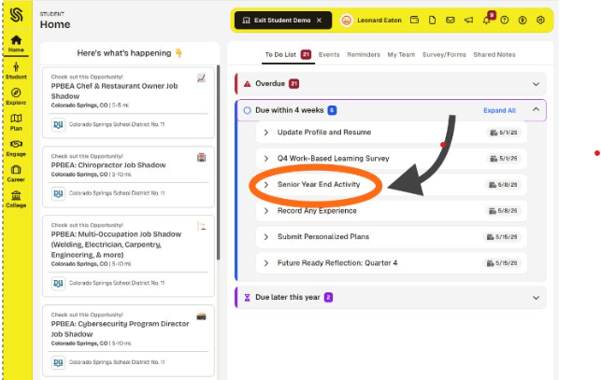
SENIOR YEAR END ACTIVITY IN SCHOOLINKS

Slide 10
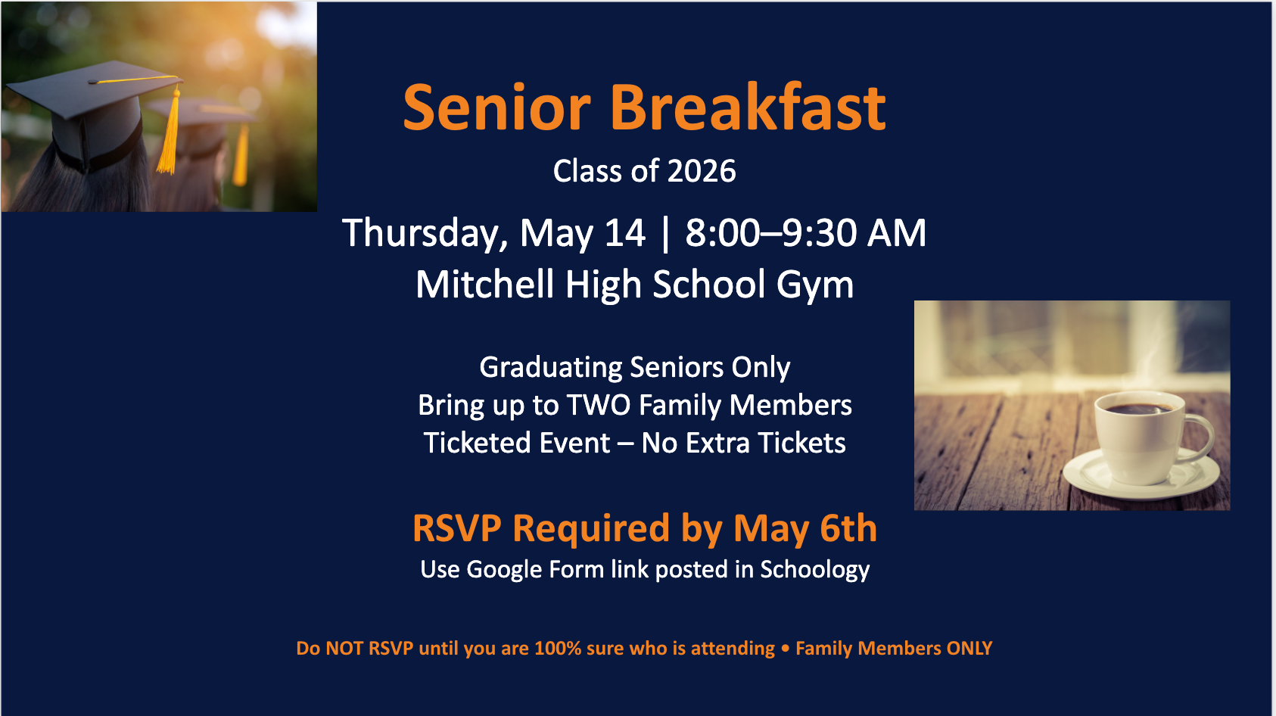

Slide 11
Graduation Rehearsal
May 18th
  You must be at Ed Robson Arena by 9:00am
  No transportation provided. Make plans to get yourselves there. Consider carpooling. Parking is limited.
  Mandatory for all graduating seniors
  Learn seating, walking order, and expectations

Slide 12

SENIOR AWARDS NIGHT
May 18th
  5:30pm
  Mitchell High School Auditorium
  Students receiving awards will get an invitation
  Students wear cap and gowns

Slide 13


Slide 14
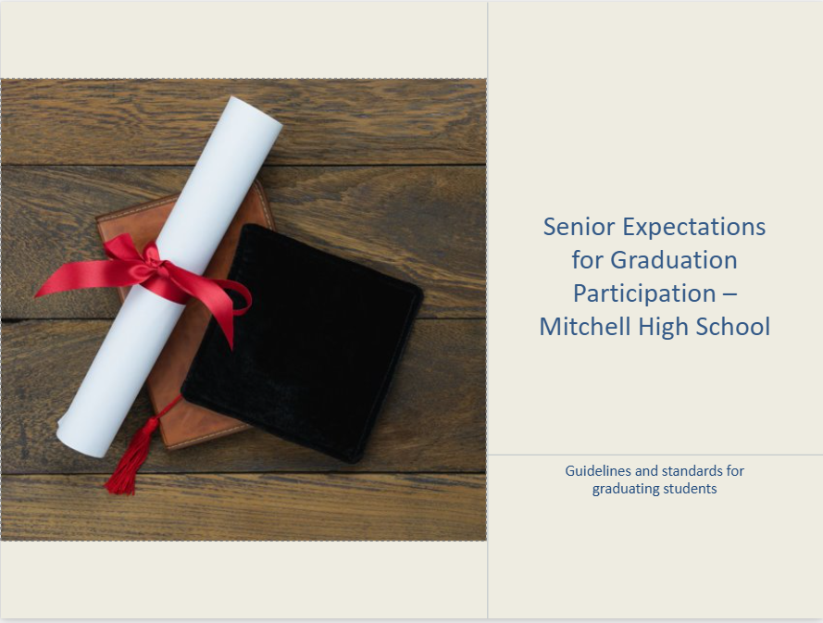

Slide 15
Senior Behavior Expectations
ACCEPT CORE VALUES
You are representing Mitchell High School, your families, and yourselves!
Disrespectful behavior and not following directions will not be tolerated.
You must follow all of school rules or you will face disciplinary action, including suspension, according to the Code of Conduct. You will not be able to participate in the graduation ceremony.

Slide 16
GRADUATION DAY
May 19th
  Caps and gowns required
  Transportation provided from Mitchell High School
  Graduates will load and depart from MHS by 1:30pm
  Students self-transporting must be at Ed Robson Arena at 2:00pm
  No transportation provided after graduation.
Celebrate your achievement with family and friends!

Slide 17
Who to Contact
  Senior Field Day and Sunset → STUCO
  Grades, credits, graduation status → School Counselor
  Senior checkout, fees, fines, textbooks → Business Office
  Senior Breakfast → Mrs. Torres
  Graduation → Mr. Short
  Awards Night → Mrs. Montez
Still unsure? Start with the Counseling Office

Slide 18

WHAT TIME DO YOU NEED TO BE AT GRADUATION REHEARSAL?

Slide 19
9:00 AM
MONDAY, MAY 18TH AT ED ROBSON ARENA
NO BUS FROM MHS

Slide 20
WHAT TIME DO YOU NEED TO BE AT GRADUATION?

Slide 21
1:30 PM
TUESDAY, MAY 19TH
IF YOU ARE RIDING THE BUS FROM MHS
2:00 AT ED ROBSON ARENA

Slide 22
YOU DID IT!
Be proud of everything you have accomplished!
Stay informed - Check email and annoucements
Finish strong and celebrate safely!
Congratulations, Class of 2026!

Slide 23
Let’s Vote!
Senior Breakfast Speaker Write‑In Ballot
We want to hear from staff members who have made a difference to you!
Please write in your top three Mitchell High School staff members you’d most like to hear from during Senior Breakfast.
(Staff may include teachers, counselors, coaches, or other school staff.)
Congratulations, Class of 2026!

