Slide 1

Murray Elementary Health Safety Training

Slide 2

Health Emergency Response
What to do in the case of a health emergency:
Stay calm
Call for help *Health Emergency + location
Asses the environment for safety
Administer first aid per training
Provide privacy to the affected student
Shelter bystander students from a stressful situation
If needed, call 911

Slide 3

Seizure Training
Who is required to take the training:
Any staff who has direct regular contact with a student with epilepsy, this includes:
Teachers
TAs
Any staff taking the student on a field trip
The 1-hour online training can be found here.
Once you have completed the training you will be awarded a certificate. Please submit this certificate to the school nurse

Slide 4


Slide 5
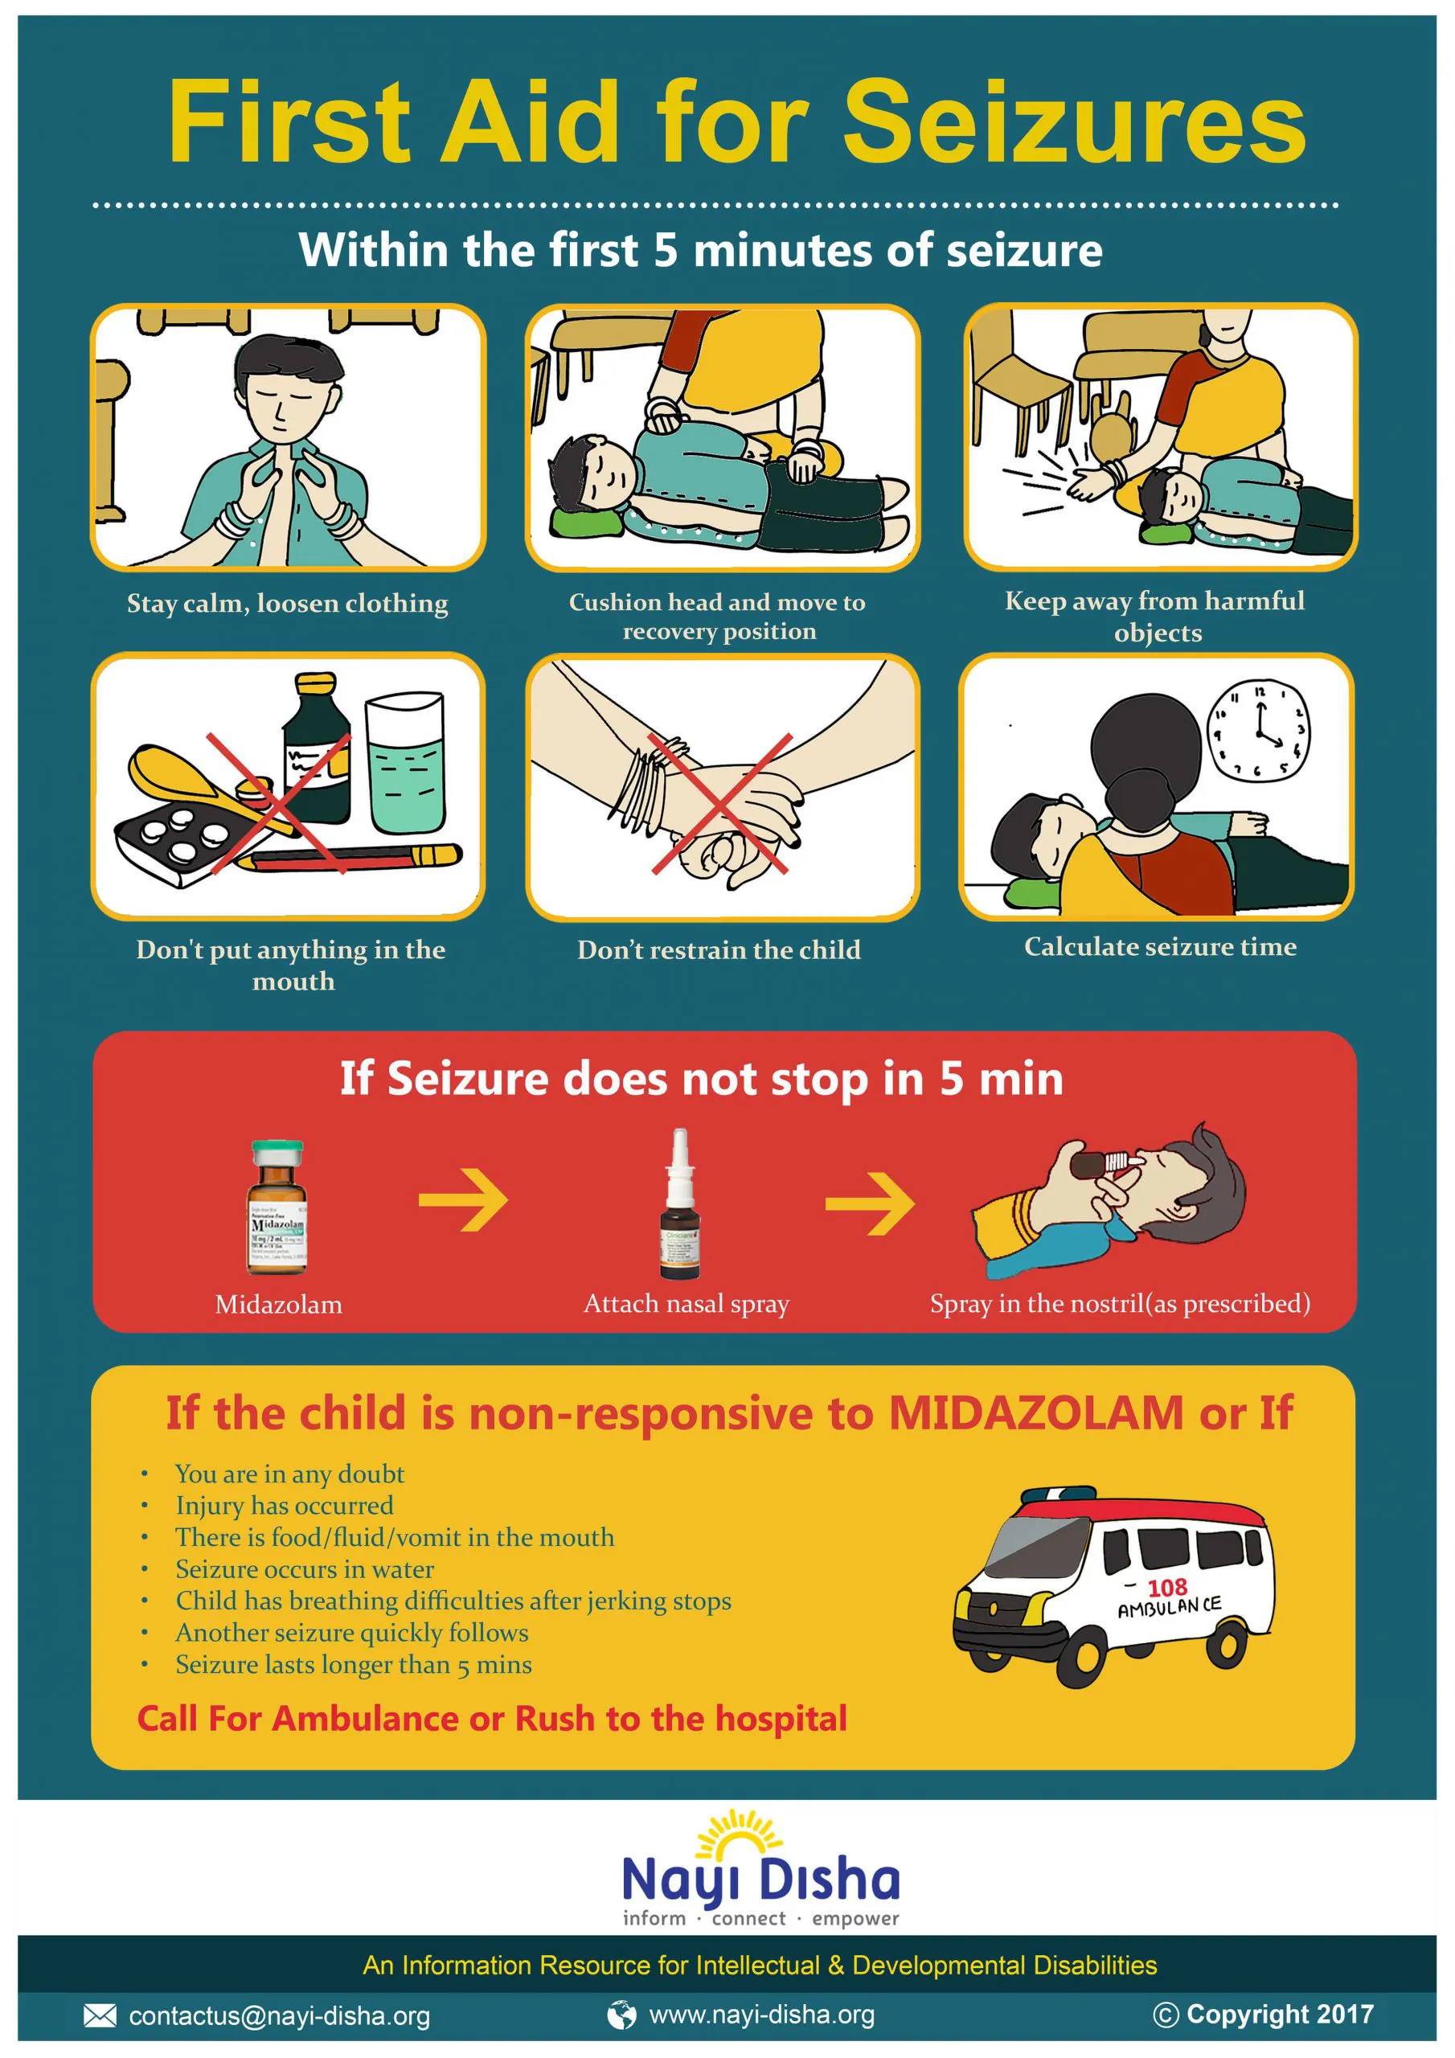
What to do:
Stay calm
Call for help
Cushion head and place on the side
Keep student away from harmful objects
Do not put anything in the mouth
Do not restrain
Time the S seizure
Follow action plan for medication administration. Usually if Seizure last longer than 3 – 5 minutes
Call 911per action plan

Slide 6
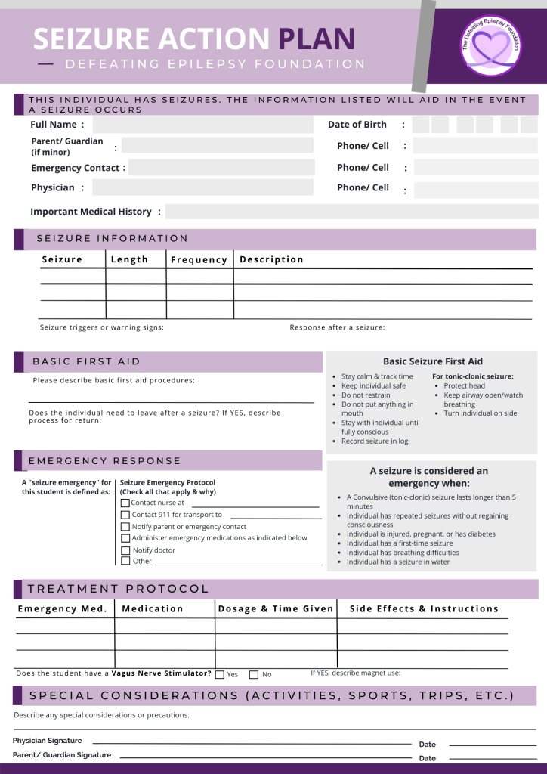
Epilepsy Action Plan
What is an action plan?
Doctor orders on how to respond to a seizure for a specific student
What is included in an action plan?
Student information
Diagnosis and what symptoms to expect with a seizure
How to respond to a seizure
Prescribed medication details

Slide 7
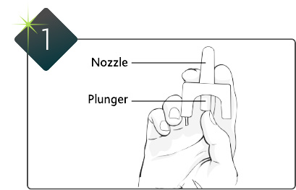
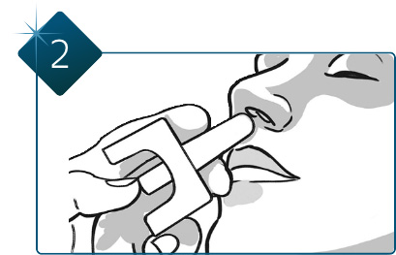
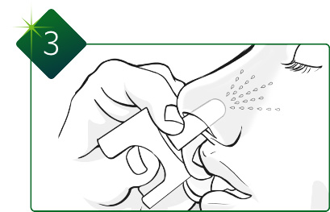
How to Administer
Epilepsy Rescue Medication
Hold VALTOCO with your thumb on the bottom of the plunger and your first and middle fingers on either side of the nozzle.
DO NOT test or prime; each device sprays only one time.
Insert the tip of the nozzle into one nostril until your fingers, on either side of the nozzle, are against the bottom of the person’s nose. For nasal use only.
Press the bottom of the plunger firmly with your thumb to give VALTOCO. Throw away nasal spray device(s) after use.

Slide 8
Asthma Training
Who should take this training:
Any staff who has direct contact with a student with Asthma (this training is not required but highly encouraged), this includes:
Teachers
TAs
Any staff taking the student on a field trip
This online training can be found here.
Click to register. Once you log in for the first time select self enroll.
Once you have completed the training you will be awarded a certificate. Please submit this certificate to the school nurse

Slide 9
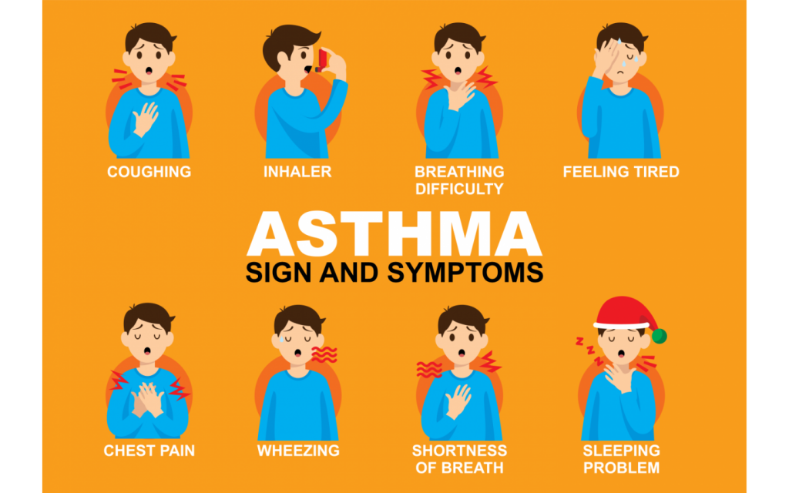

Slide 10
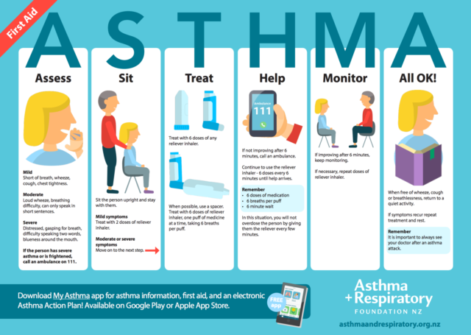
What to do:
Stay calm
Call for help
Have the student sit down
Review action plan
Treat according to action plan instructions
Monitor
If symptoms worsen Call 911

Slide 11
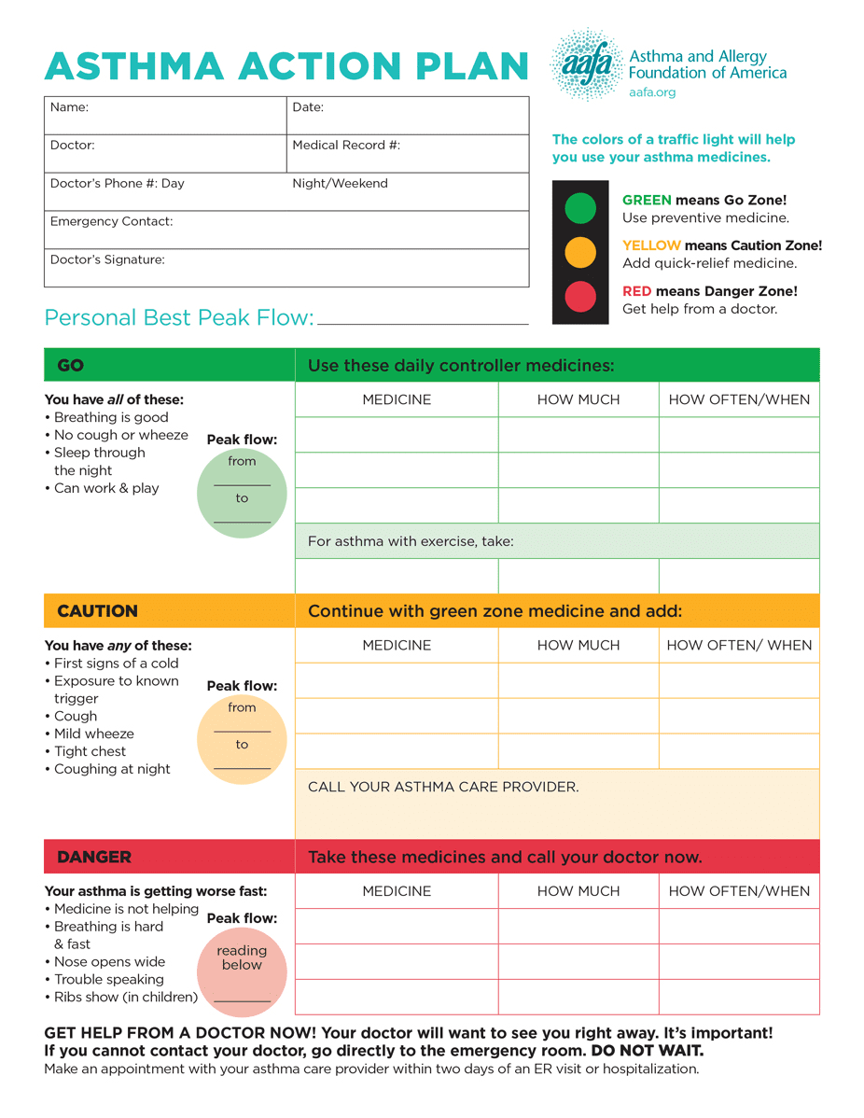
Asthma Action Plan
What is an action plan?
Doctor’s orders on how to respond to an Asthma attack for a specific student
What is included in an action plan?
Student information
How to respond to an Asthma attack depending on the severity of symptoms
Prescribed medication details

Slide 12
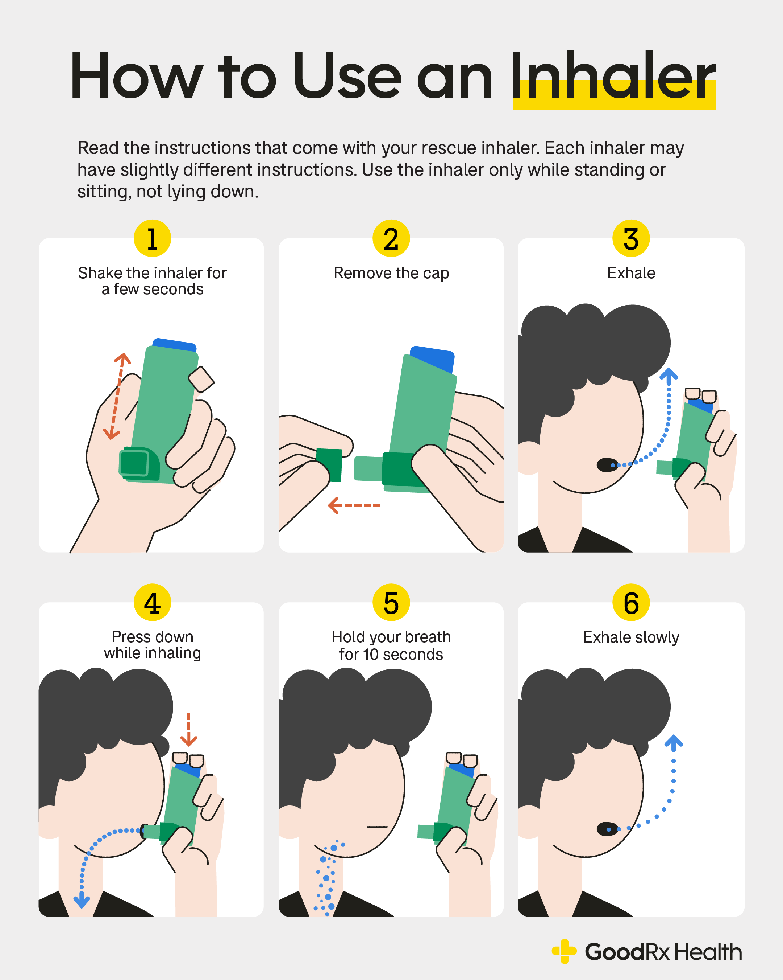
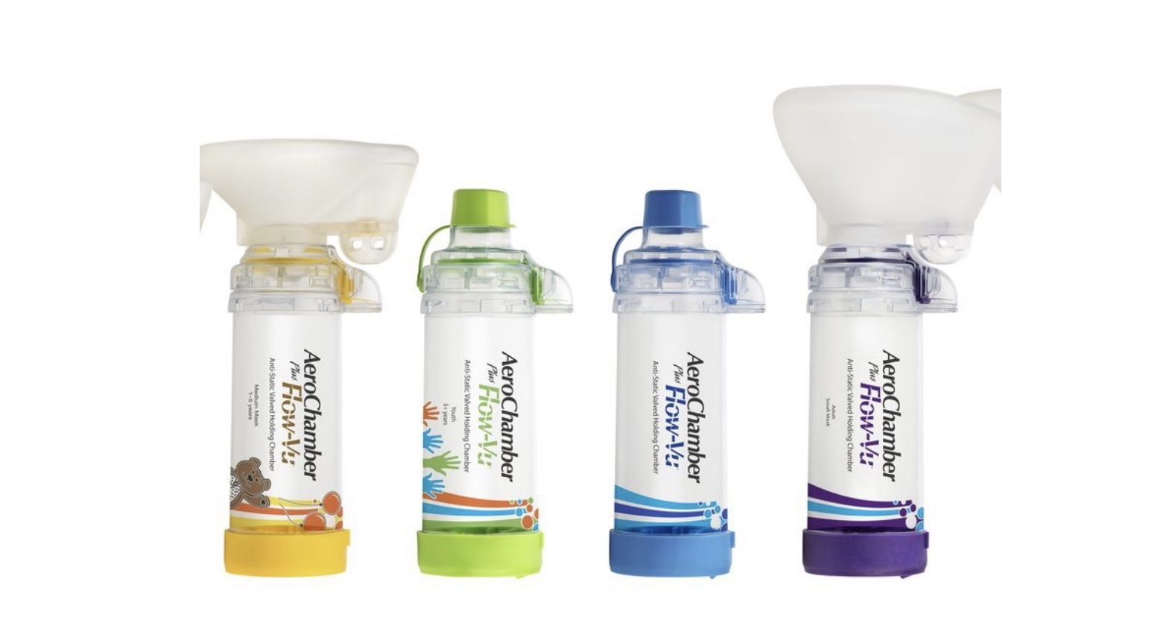
How to use an Inhaler and Spacer

Slide 13
Allergy Training
Who should take this training:
Any staff who has direct contact with a student with allergies (this training is not required but highly encouraged), this includes:
Teachers
TAs
Any staff taking the student on a field trip
This online training can be found here.
Register for a free account to access the course
Once you have completed the training you will be awarded a certificate. Please submit this certificate to the school nurse

Slide 14
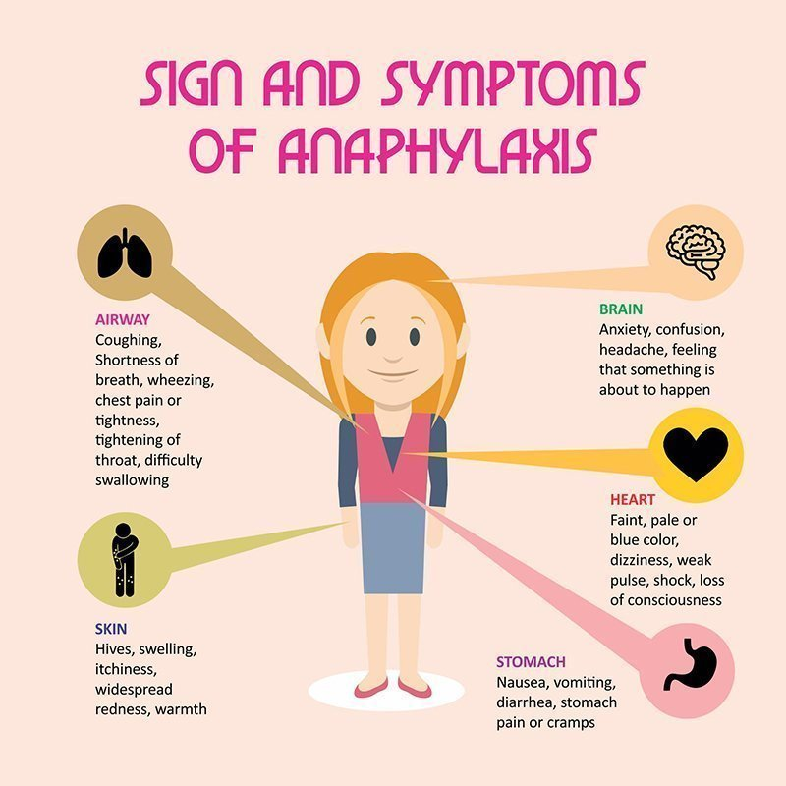

Slide 15
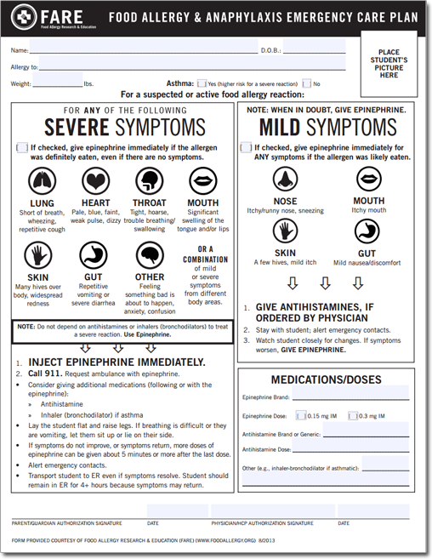
FARE Action Plan
What is an action plan?
Doctor’s orders on how to respond to an allergic reaction for a specific student
What is included in an action plan?
Student information
How to respond to an allergic reaction depending on the severity of symptoms
Prescribed medication details

Slide 16
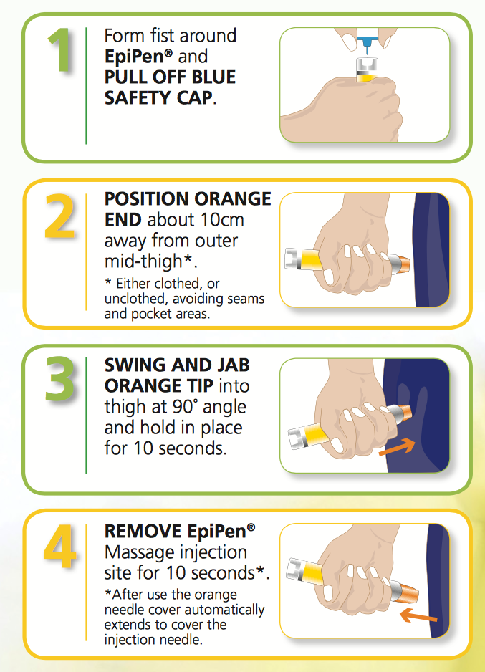

How to use an EpiPen

Slide 17


Slide 18
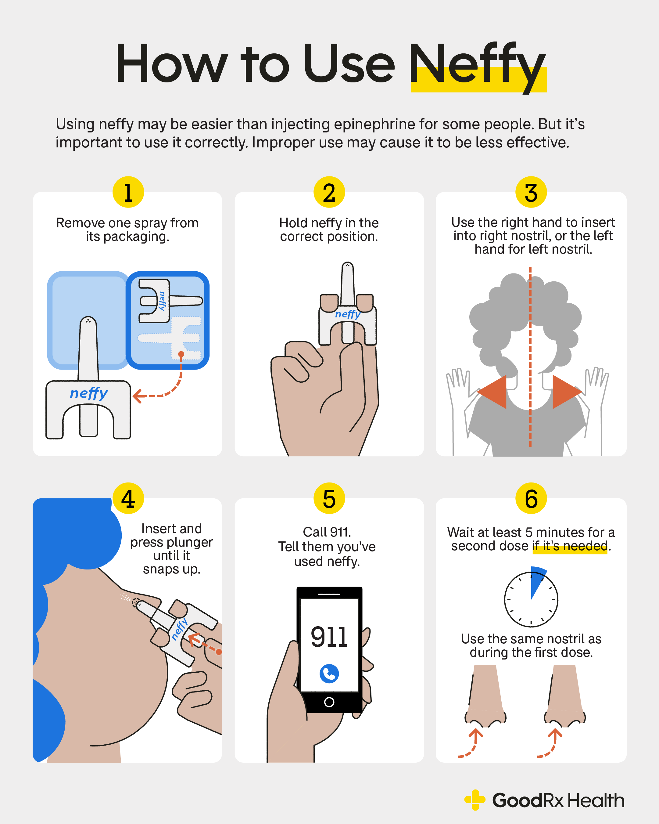

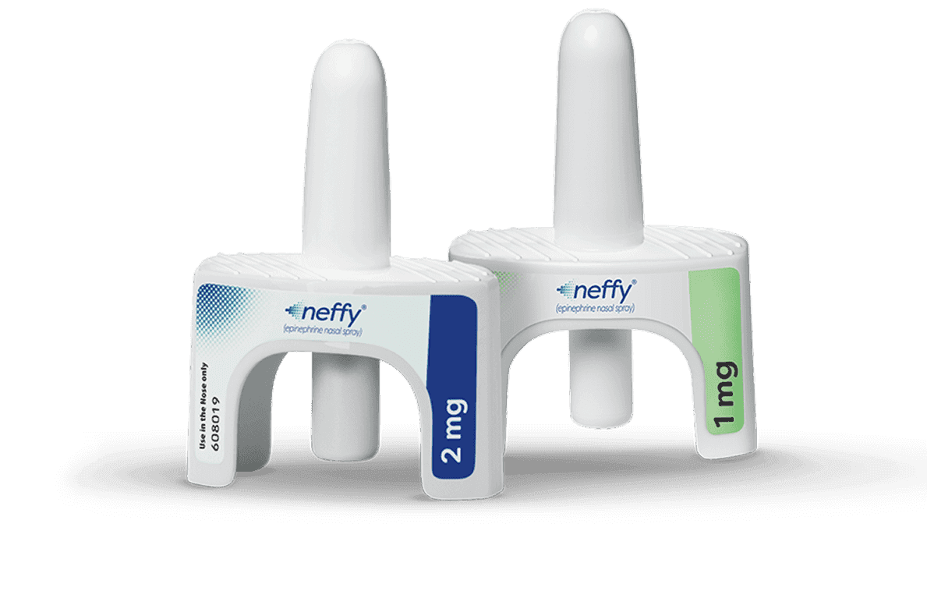

Slide 19
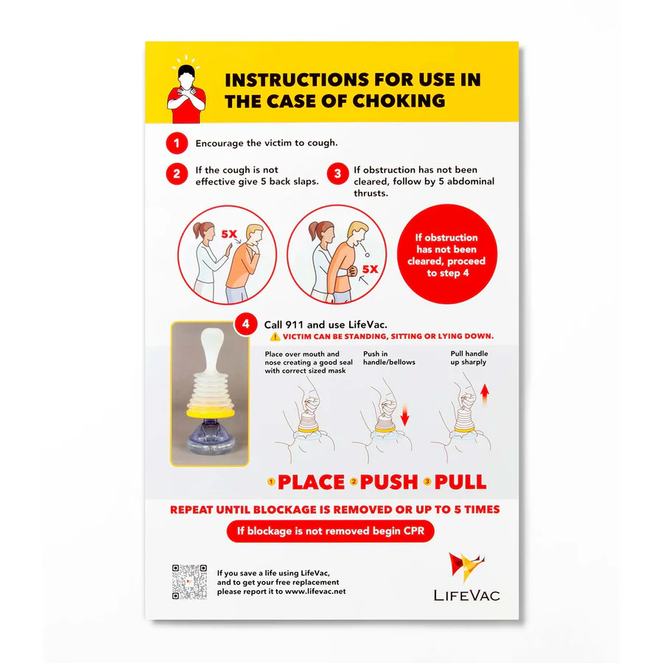
If a Student is Choking
Call for help
Encourage coughing
If cough is not effective:
Give 5 back slaps
If obstruction has not cleared:
Give 5 abdominal thrusts
If obstruction has not cleared:
Call 911
Use LifeVac up to 5 times
If student is unconscious begin CPR.

Slide 20

CPR Training
Available through the county
Please send me your CPR/BLS card to keep on file. Training through ACPS is not a certification and I don’t think they issue cards.

Slide 21

Health Emergency Response
What to do in the case of a health emergency:
Stay calm
Asses the environment for safety
Call for help *Health Emergency + location
Administer first aid per training
Provide privacy to the affected student
Shelter bystander students from a stressful situation and protect affected student’s privacy to the extent possible.

Slide 22


