Slide 1

Grafton Rising Senior Night
Grafton's Procedures for
College Applications

Slide 2

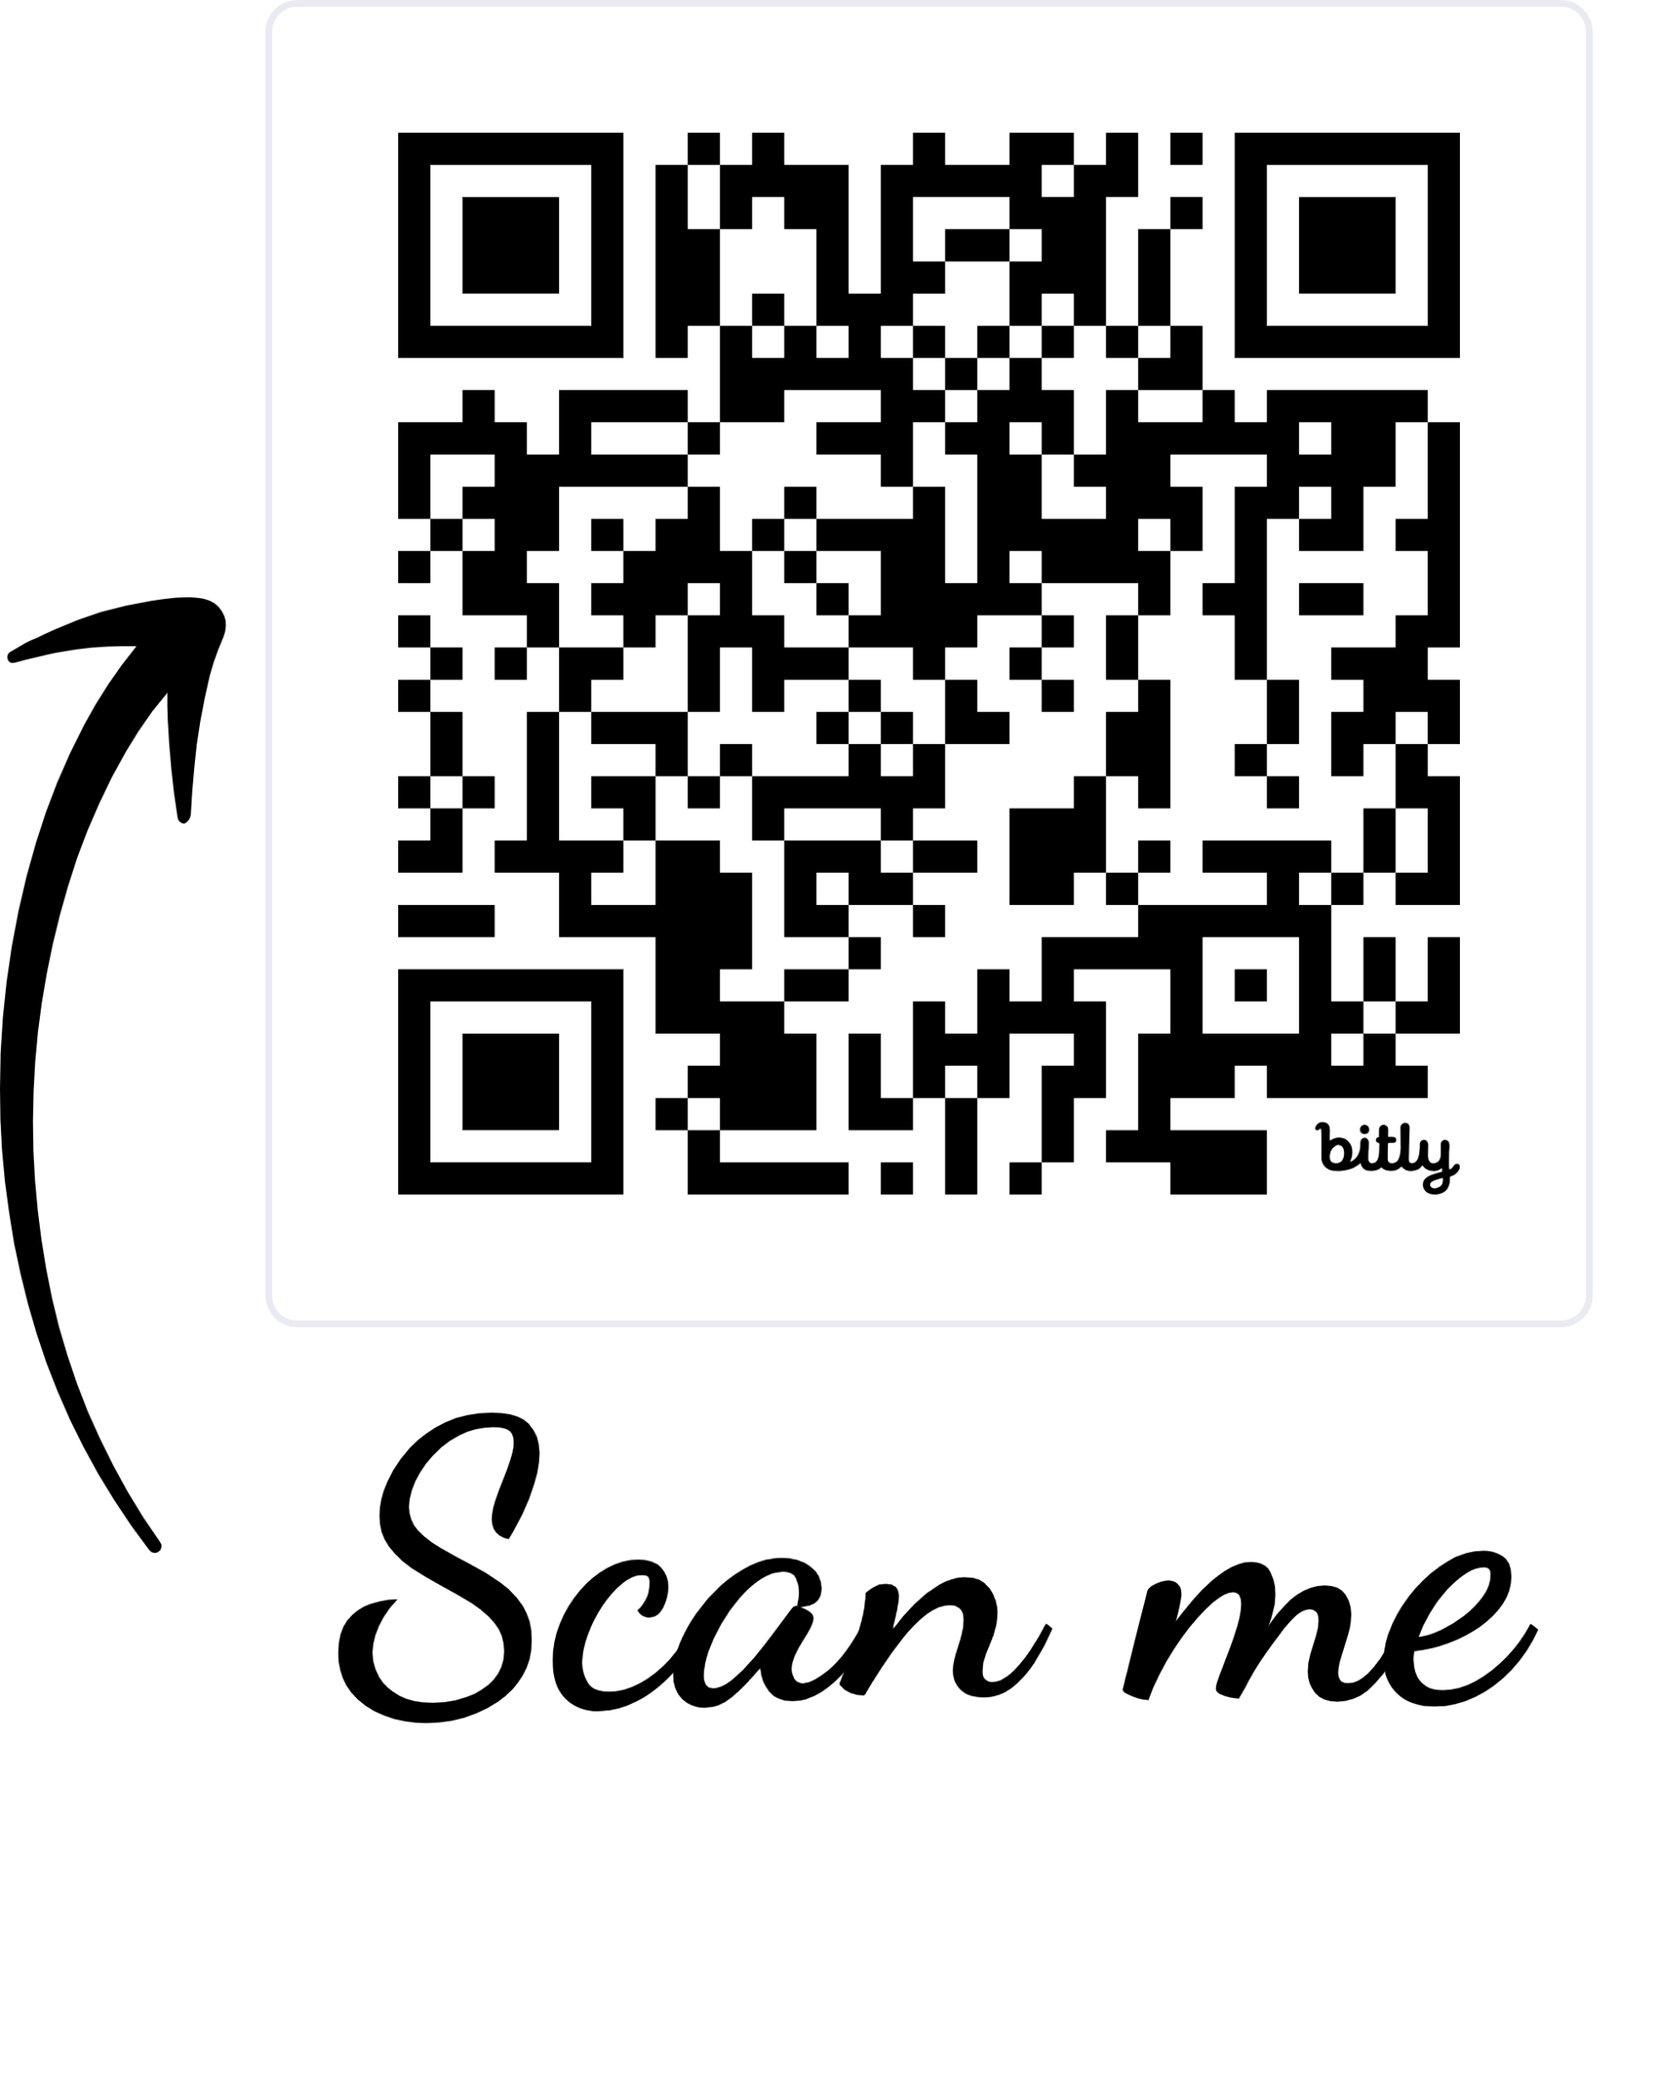
GHS Counseling Team
A-Ca Mrs. Andrea Ross, Counseling Director aross@ycsd.york.va.us - (757) 898-0551
Ch-H Ms. Taryn Grasty, School Counselor tgrasty@ycsd.york.va.us - (757) 898-0552
I-Po Mrs. Amy Farmer, School Counselor afarmer@ycsd.york.va.us - (757) 898-0553
Pr-Z Mrs. Kara Hogge, School Counselor khogge3@ycsd.york.va.us - (757) 898-0554
School Counseling Secretary
Mrs. Debi Johnson, djohnson3@ycsd.york.va.us
GHS Counseling Website
Visit the GHS Counseling webpage regularly to stay informed and make the most of the shared resources!

Slide 3
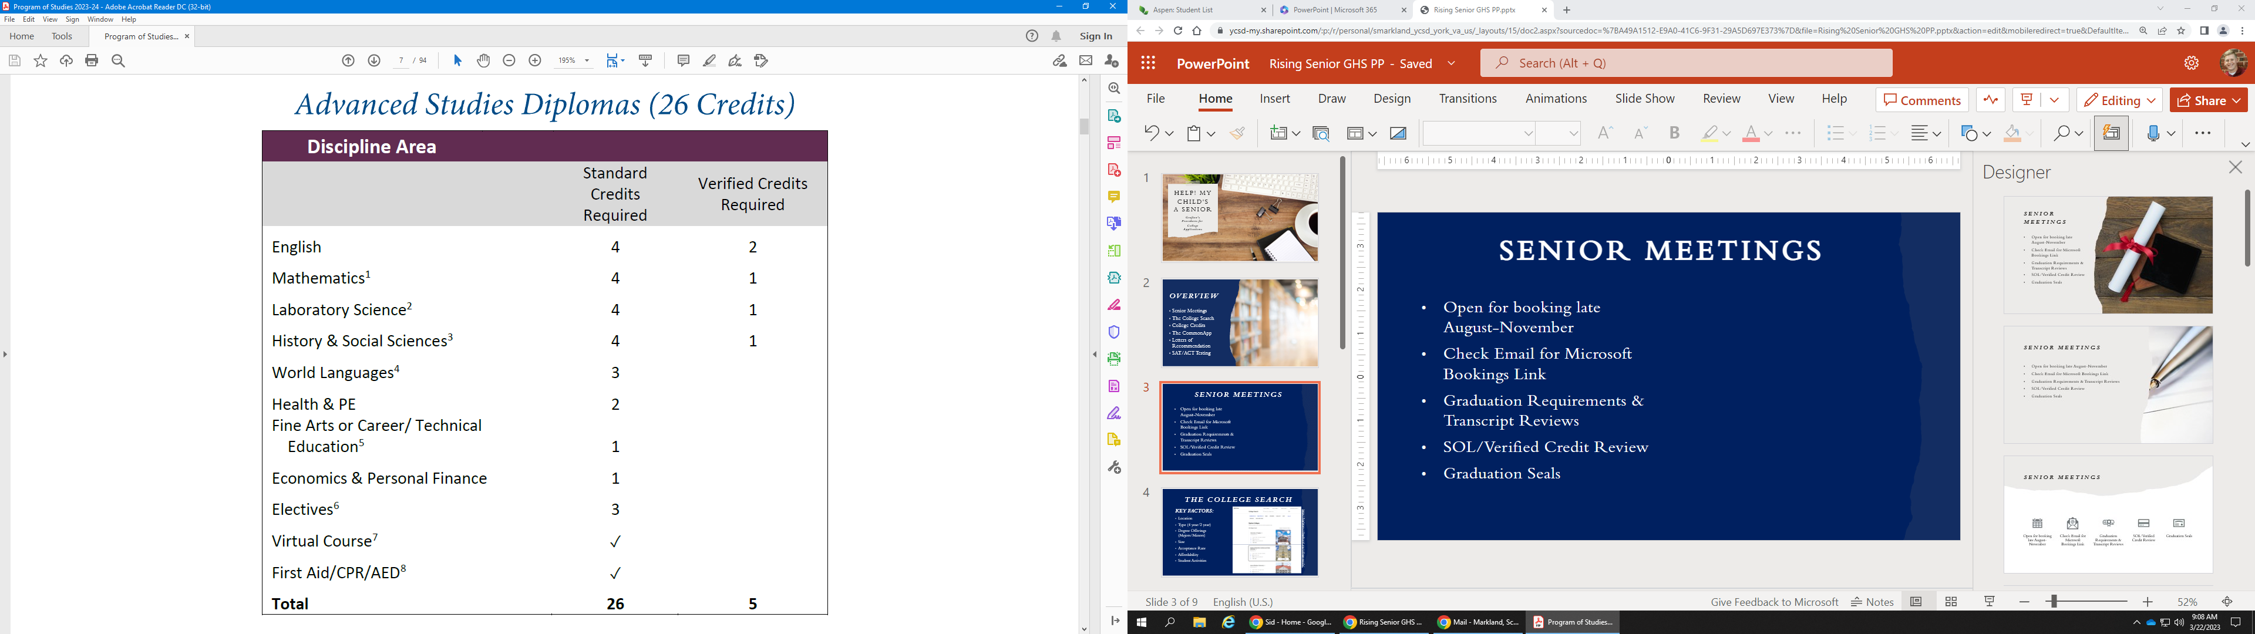
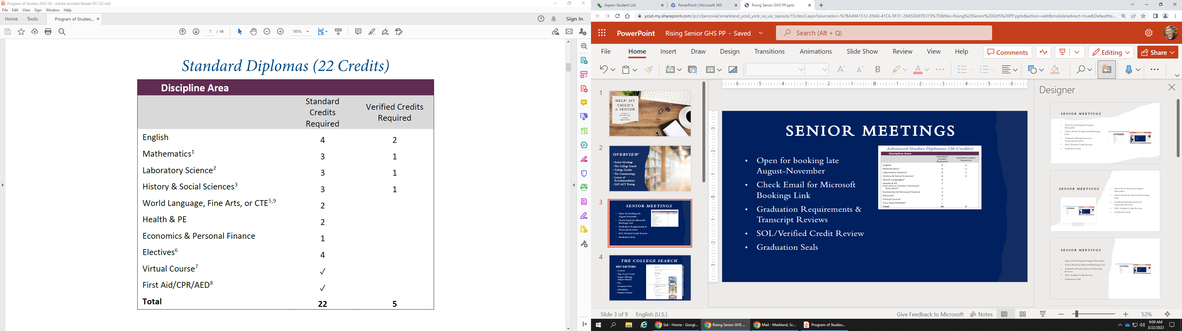
Senior Meetings
We would love families to be a part of their student’s senior meeting in the fall
Check your email for senior meeting information and invitations (late August)
Senior Meetings will Include:
    Graduation Requirements & Transcript Reviews
    Diploma Track Confirmation
    SOL/Verified Credit Review
    Graduation Seal Information
    Post High School Plans

Slide 4
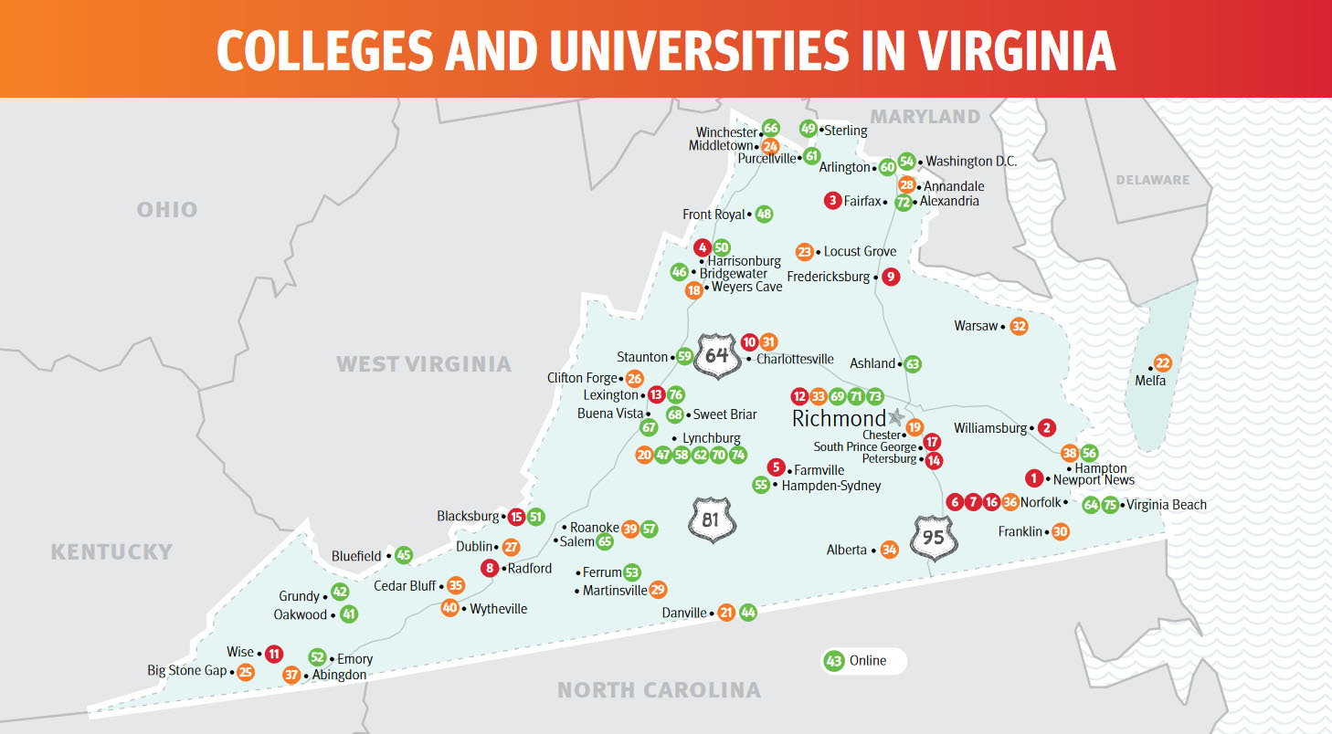
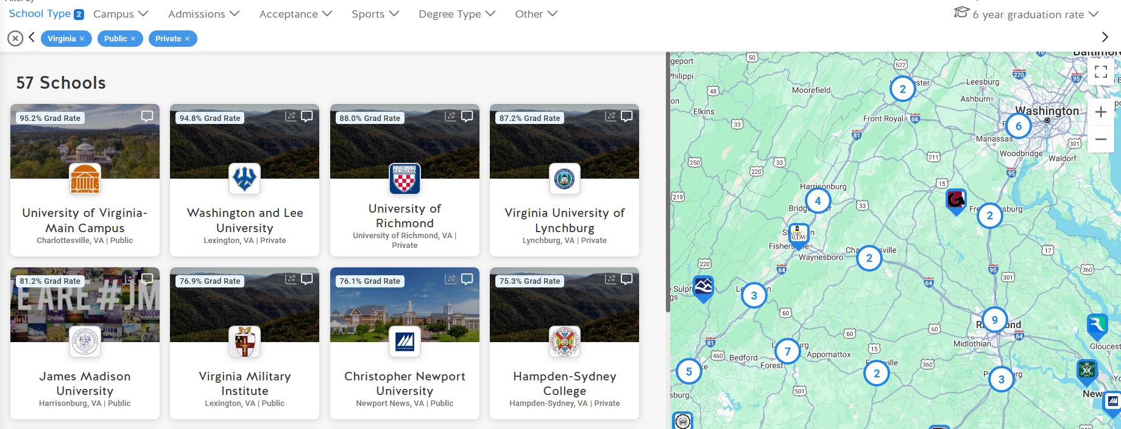
THe COllege Search
KEY FACTORS:
Location
Type (4 year/2 year)
Degree Offerings (Majors/Minors)
Size (Campus & Average Class)
4 Year Graduation Rate
Acceptance Rate
Affordability
Student Activities
SchooLinks College Search
https://app.schoolinks.com/schools/search

Slide 5
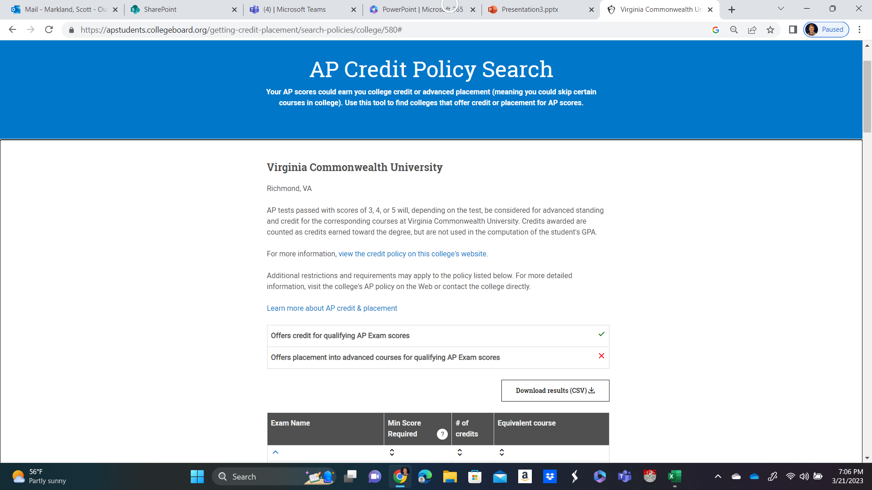
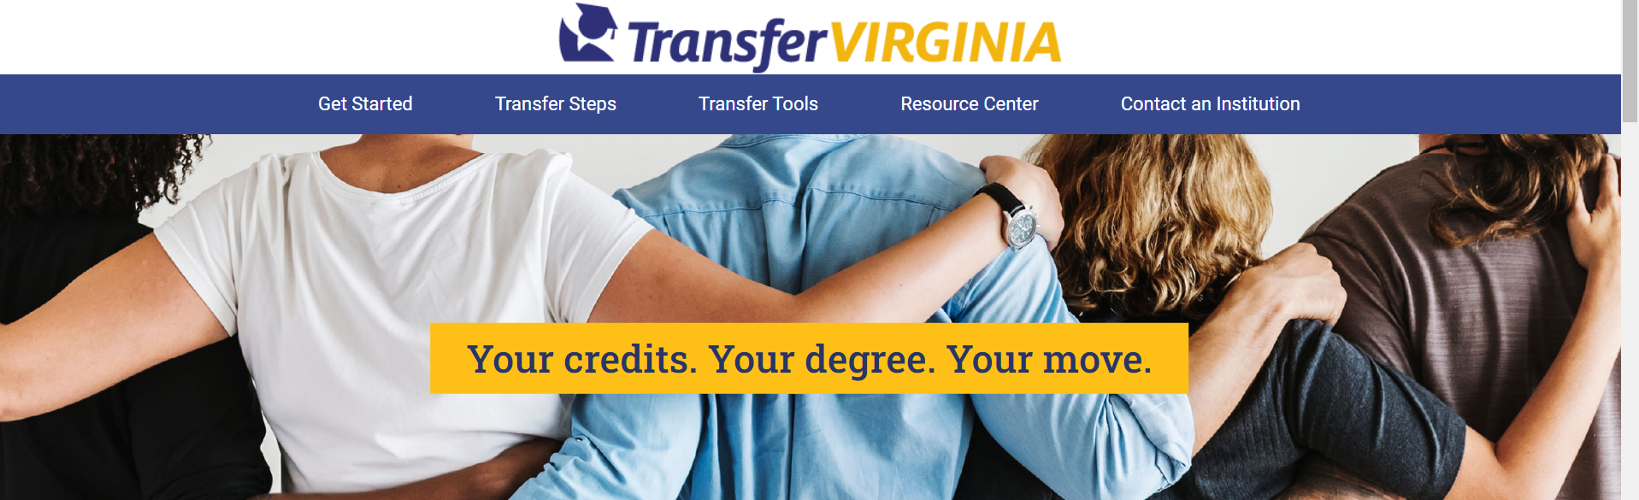
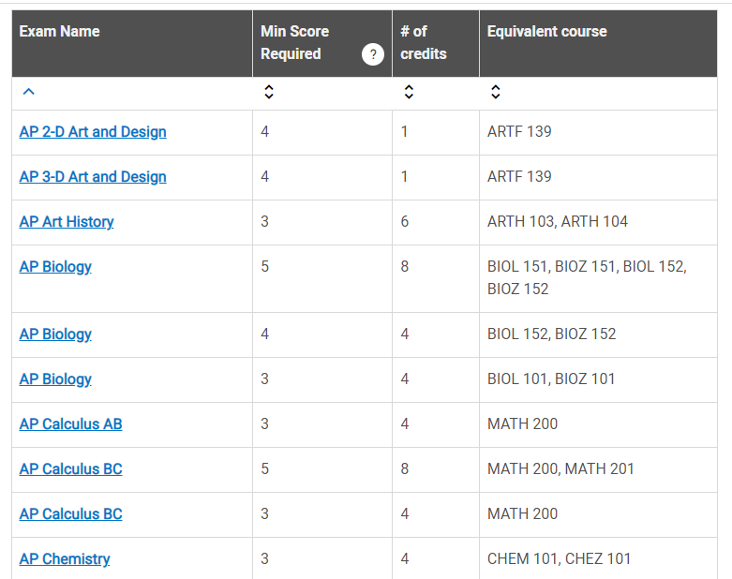
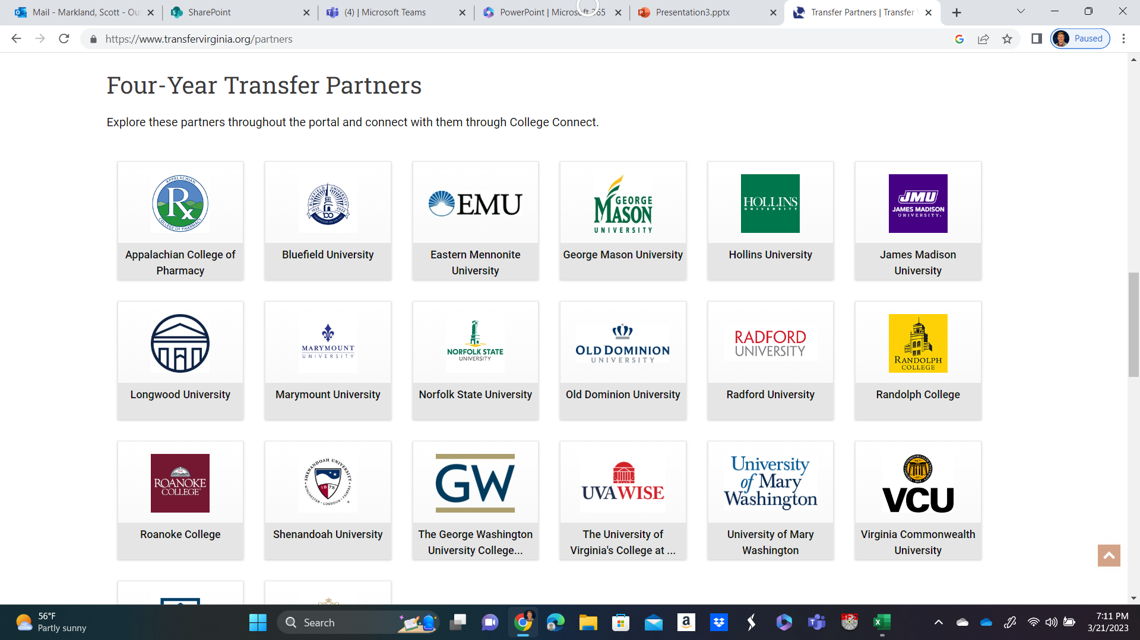
College Credits
https://apstudents.collegeboard.org/getting-credit-placement/search-policies
https://www.transfervirginia.org/

Slide 6


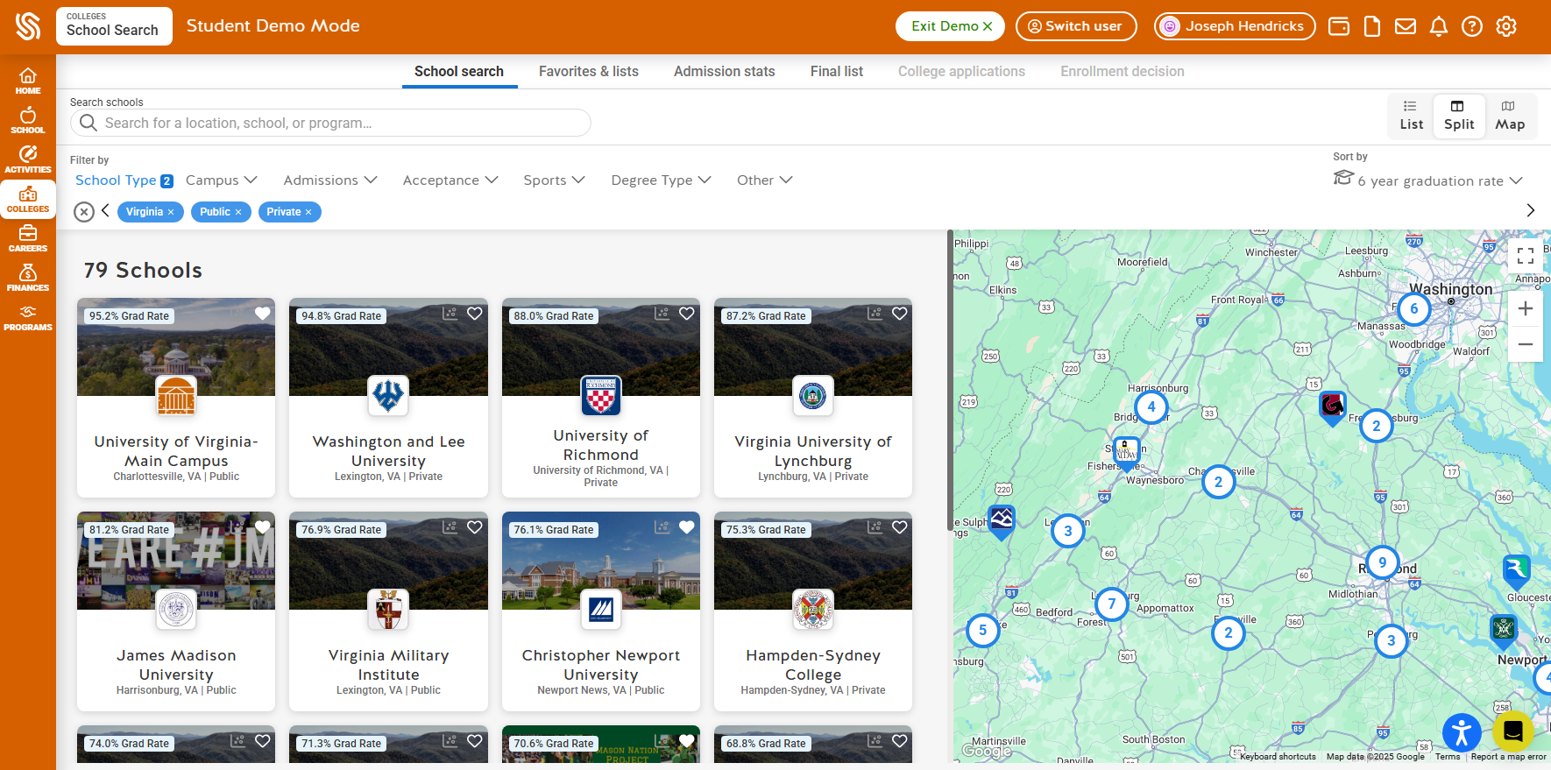
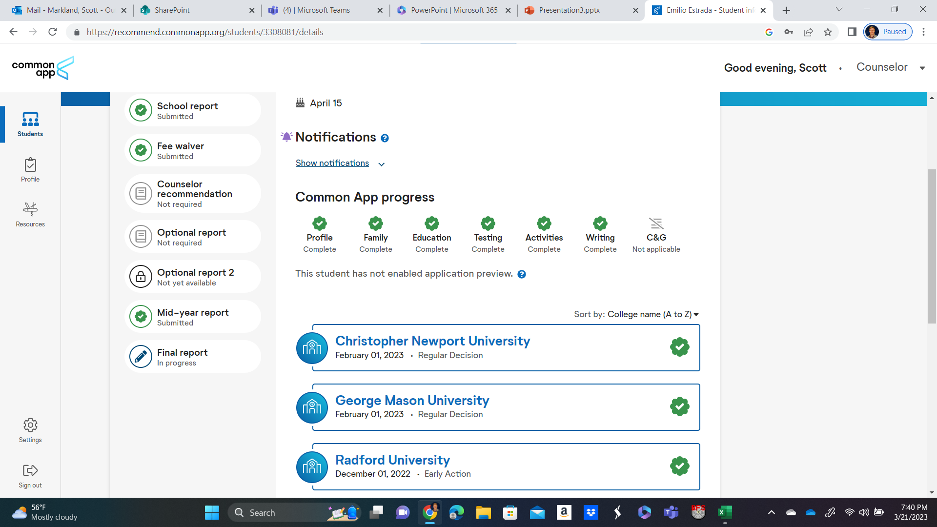
The Common APP & SCHOOLINKS
Common App:
1 Application for over 1000 College/Universities
Deadlines, requirements, & status updates:
        Early Decision Rolling Admissions
        Early Action Deferment
        Regular Decision Denial
SchooLinks:
College School Search
College Application Manager
Letters of recommendation requests
Scholarships, Career Exploration, and More!

Slide 7

Common Application
FAQs
When should I create my Common App?
Common App opens August 1st every year
You can create an account and save answers to Common App tab questions at any time
Responses to questions in your My Colleges tab do not remain year over year and should only be started if you intend to apply this school year
Once you make your Common App, connect it to Schoolinks during senior year when you add your colleges to My Colleges!
Can schools see to which other colleges I've applied?
Your application data is private and will not be shared with other colleges
If I make a mistake, can I delete or start a new Common App account?
You may delete your account, but deleting your account is permanent and will delete all application data
Before deleting your account, contact Common App for help to common problems
Which email address should I use?
Use a personal email address that you check regularly and will have access to after you graduate

Slide 8

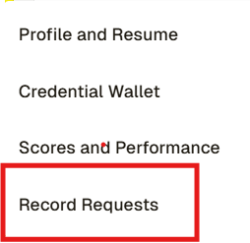

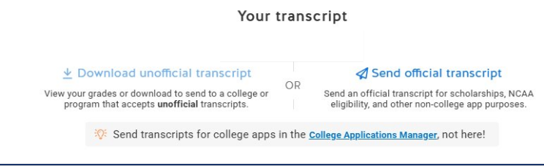
Requesting Transcripts
For College Applications
Requesting Official Transcript for NCAA and Colleges not in Common app or Schoolinks
Link Common App with SchooLinks
Add schools to Common App/SchooLinks
Counselors will upload Fall, Mid-Year, and Final Transcripts for the students
Fall ‘26 Transcripts will have GPA & Rank through end of 11th Grade and Senior Classes around Mid-September of 2026
You can request your transcript through the YCSD Student Records Request System
All students have access to their transcript on SchooLinks and can download an unofficial copy

Slide 9
Letters of Rec & Essays
Recommendation Letters
Essays
Not always required – check with your colleges for specific letter of recommendation information
1-2 teachers, 1 school counselor, 1 personal (suggested)
Utilize Senior Info Sheet (GHS Counseling Website)
    Quality over Quantity
Request at least 2 weeks in advance
Not always required
If optional, recommendation is to write it
Be specific, but be honest
Have English teacher or classmate proof drafts
Save essays for scholarships

Slide 10

Scholarships
Students should research scholarships and grants from the schools they are interested in by utilizing the specific institution's financial aid department and website
Please check SchooLinks regularly for scholarships –
  Complete the Scholarship Matching tool on SchooLinks
  SchooLinks has a large database of scholarships, and we, as a school and a division, are also able to post smaller, local scholarships – please don’t miss opportunities to apply for scholarships that are only available to YCSD and GHS students
Check the GHS School Counseling website for scholarship information

Slide 11

CoLlege Entrance Exam Testing
Know the Requirements: Some colleges remain test optional, but policies vary depending on the college/university. Always check the college’s website for specific testing requirements. Note: Some schools only allow test-optional applications for students with a GPA above a certain threshold.
Upcoming SAT Test Dates: Upcoming ACT Test Dates:
  SAT Test Dates: Registration Deadline: ACT Test Dates: Registration Deadline:
  June 6, 2026 May 22, 2026 June 13, 2026 May 8, 2026
                July 11, 2026 June 5, 2026
Fall 2026 SAT Dates
  August 22, 2026
September 12, 2026
October 3, 2026 Visit the ACT website for more ACT testing November 7, 2026 information
December 5, 2026
Visit the College Board website for more SAT
testing information

Slide 12








Other Important Info
College Athletics with NCAA Eligibility Center
Service Academies & ROTC Scholarship Deadlines
ASVAB Test Dates (at GHS)
FAFSA Application (Opens October 1st)
VPCC Application & Transfer Options
Vocational Certifications & Apprenticeship Opportunities

Slide 13
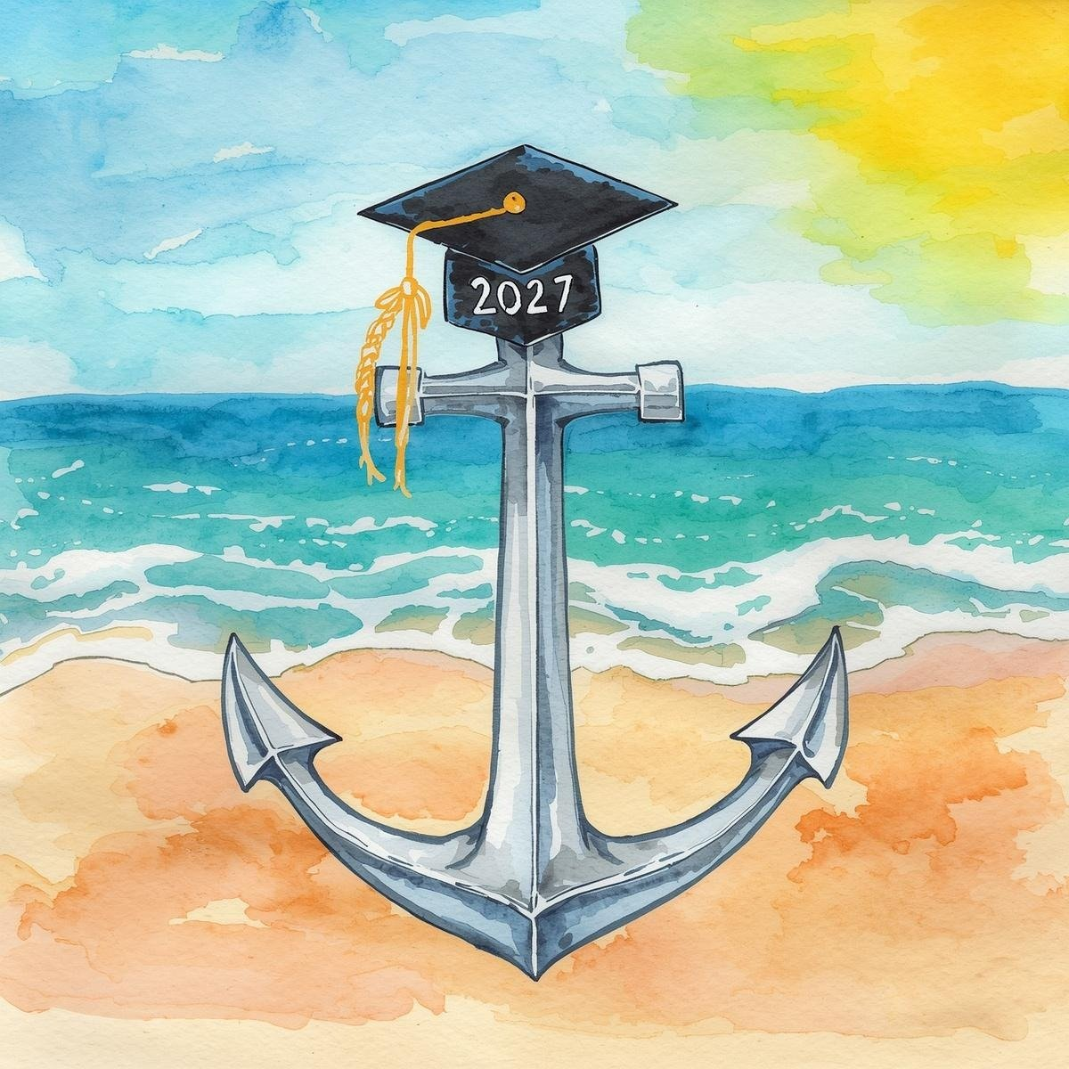
Senior Year Checklist
Meet with your School Counselor to discuss credits needed to graduate and post-secondary plans.
Create a well-rounded college list. Remember to check application requirements and deadlines.
Complete the Senior Information Sheet. Please return this to your School Counselor. Take time to update your resume.
If using the Common App, create an account and begin working on the application. Link Common App and SchooLinks.
Request letters of recommendation at least 2 weeks in advance. Follow up as your deadline approaches. Emails and in-person check-ins go a long way in ensuring follow-through.
Take the SAT/ACT. If applying to colleges with your test scores, send your SAT and/or ACT scores to your schools via www.collegeboard.org and/or www.actstudent.org.
Maintain successful academic grades, yet also take time to relax and enjoy your senior year. Self-care is vital during this time to combat senioritis and burnout!

