Slide 1







Top 5 Boarding School | North America

Slide 2
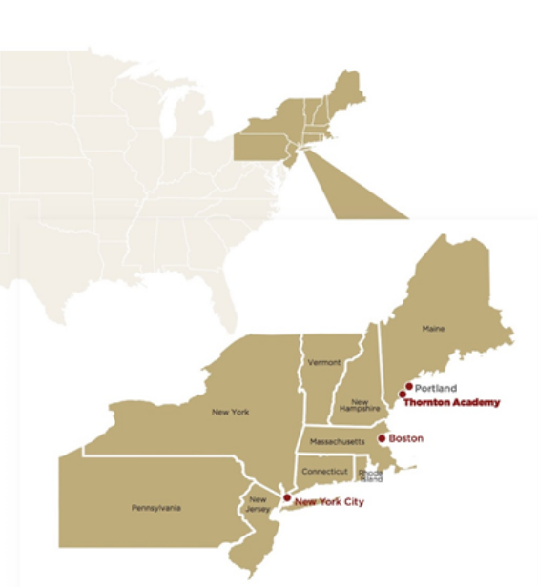
Location
Saco, Maine, USA
  90 minutes from Boston by car
  15 minutes to airport & Portland
  1 hour flight to NYC from Portland
  5 minutes to train station (2 hours to Boston)
THORNTON ACADEMY

Slide 3



Location
Saco, Maine, USA
  #1 safest state
  Walkable to town (Starbucks!)
  5 minutes to the beach
  1.5 hour to largest ski resort in the region
  Experience city life & beautiful natural beaches, forests, and mountains
THORNTON ACADEMY

Slide 4
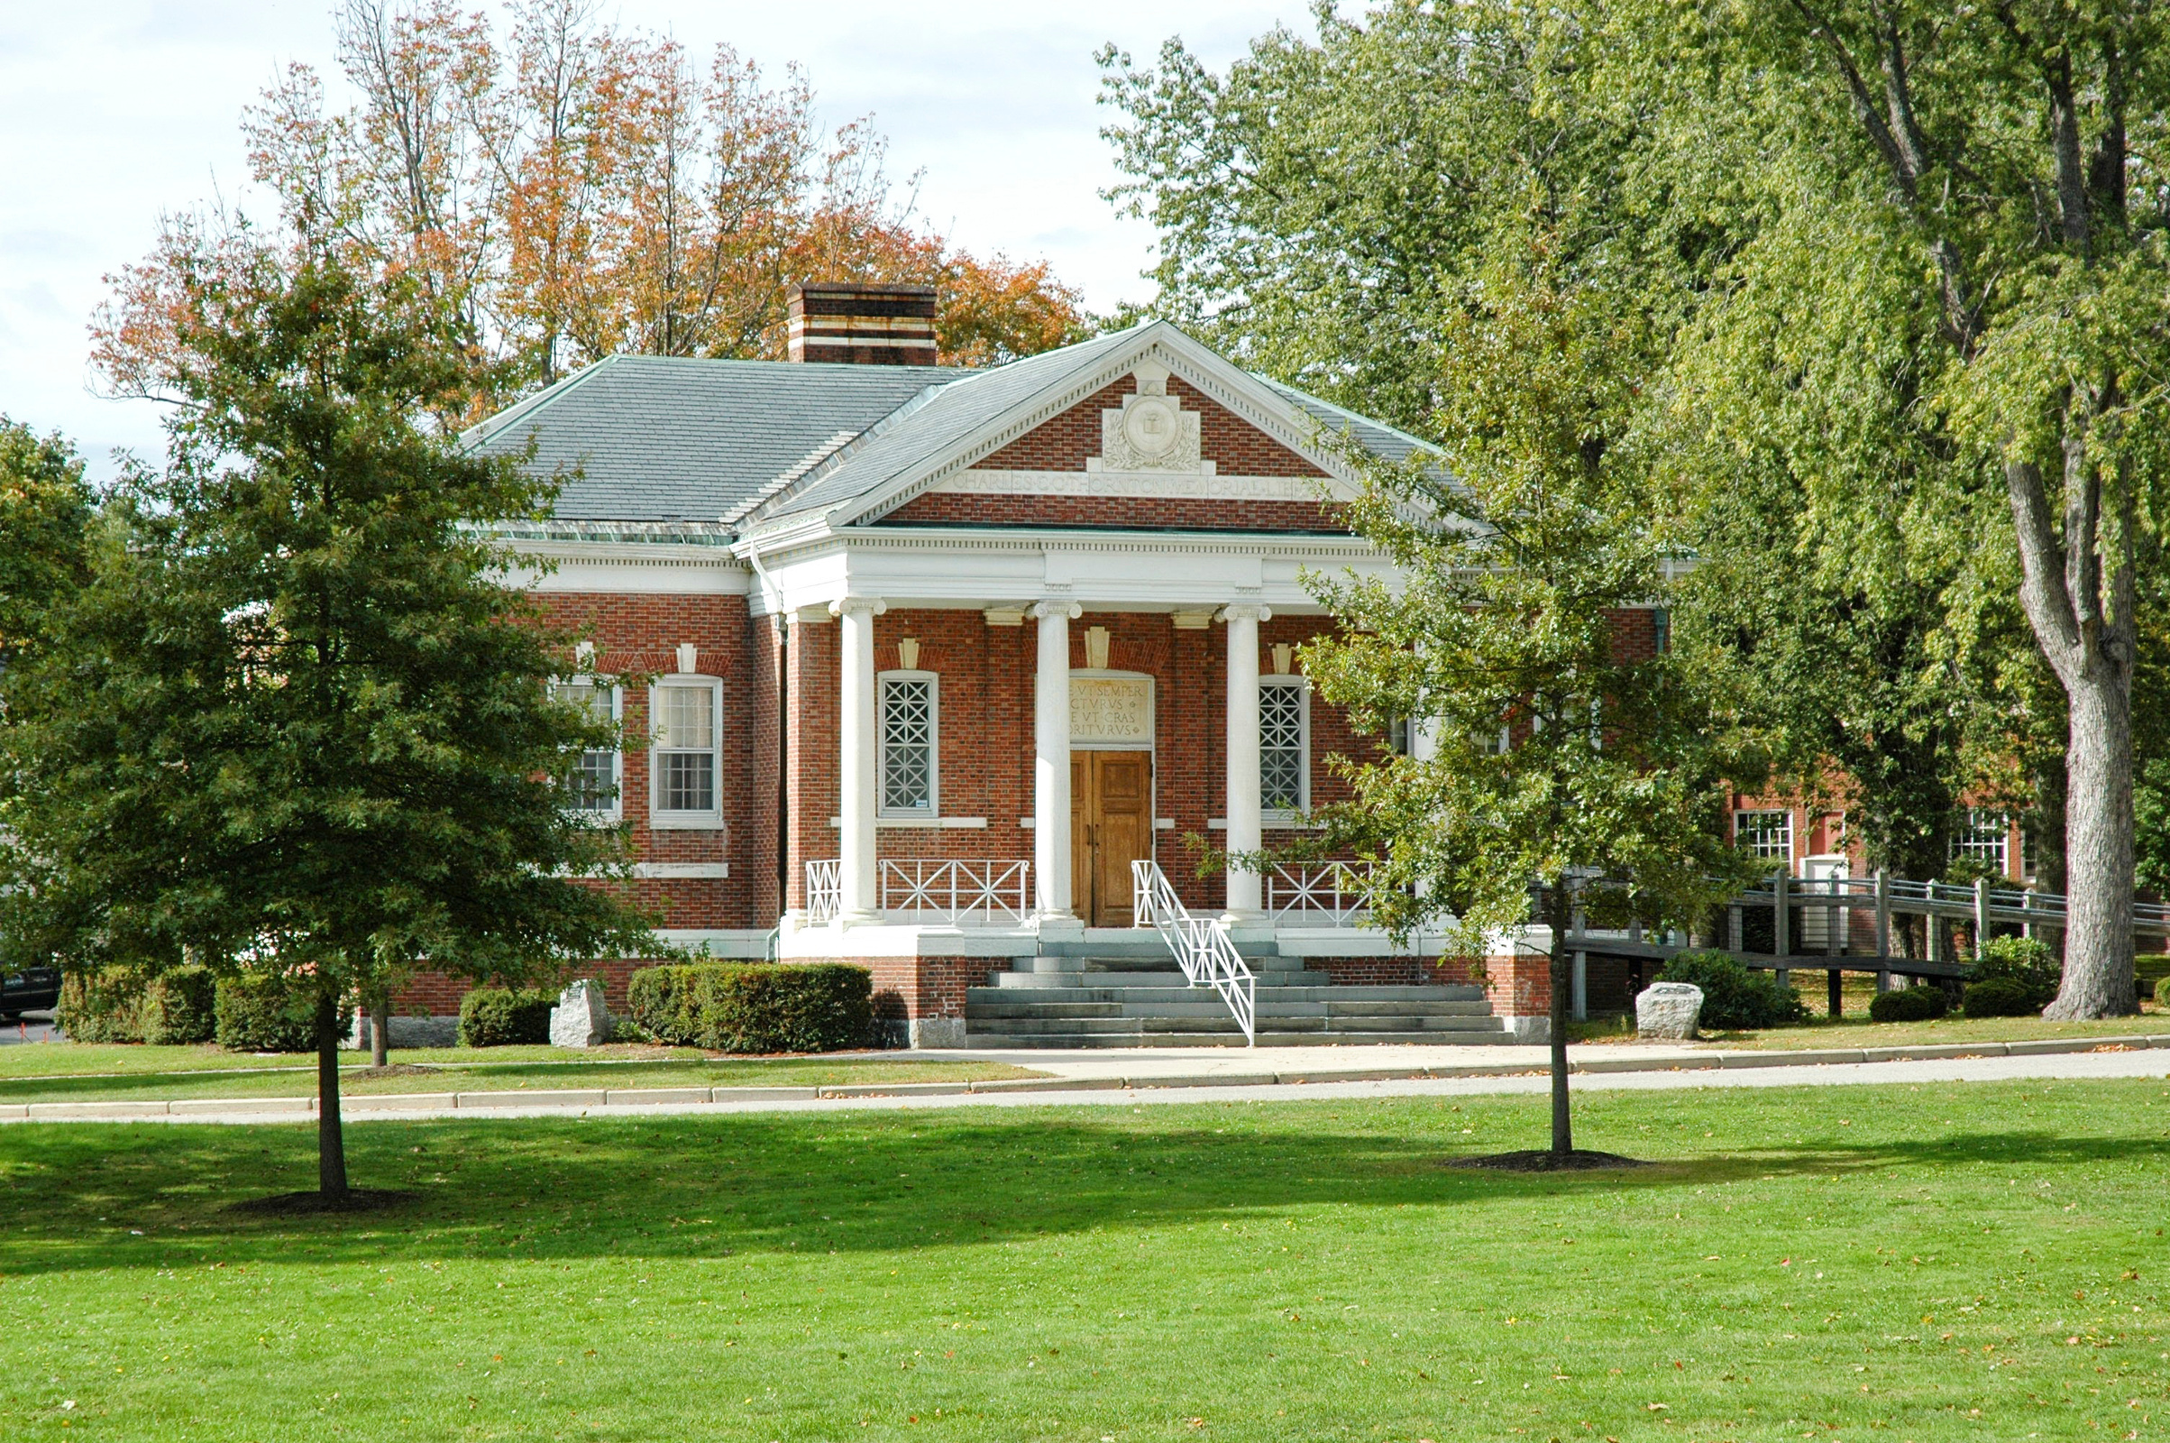

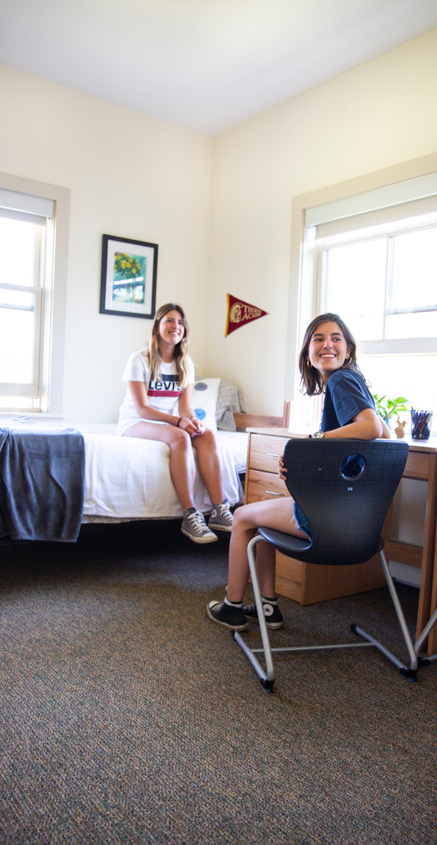
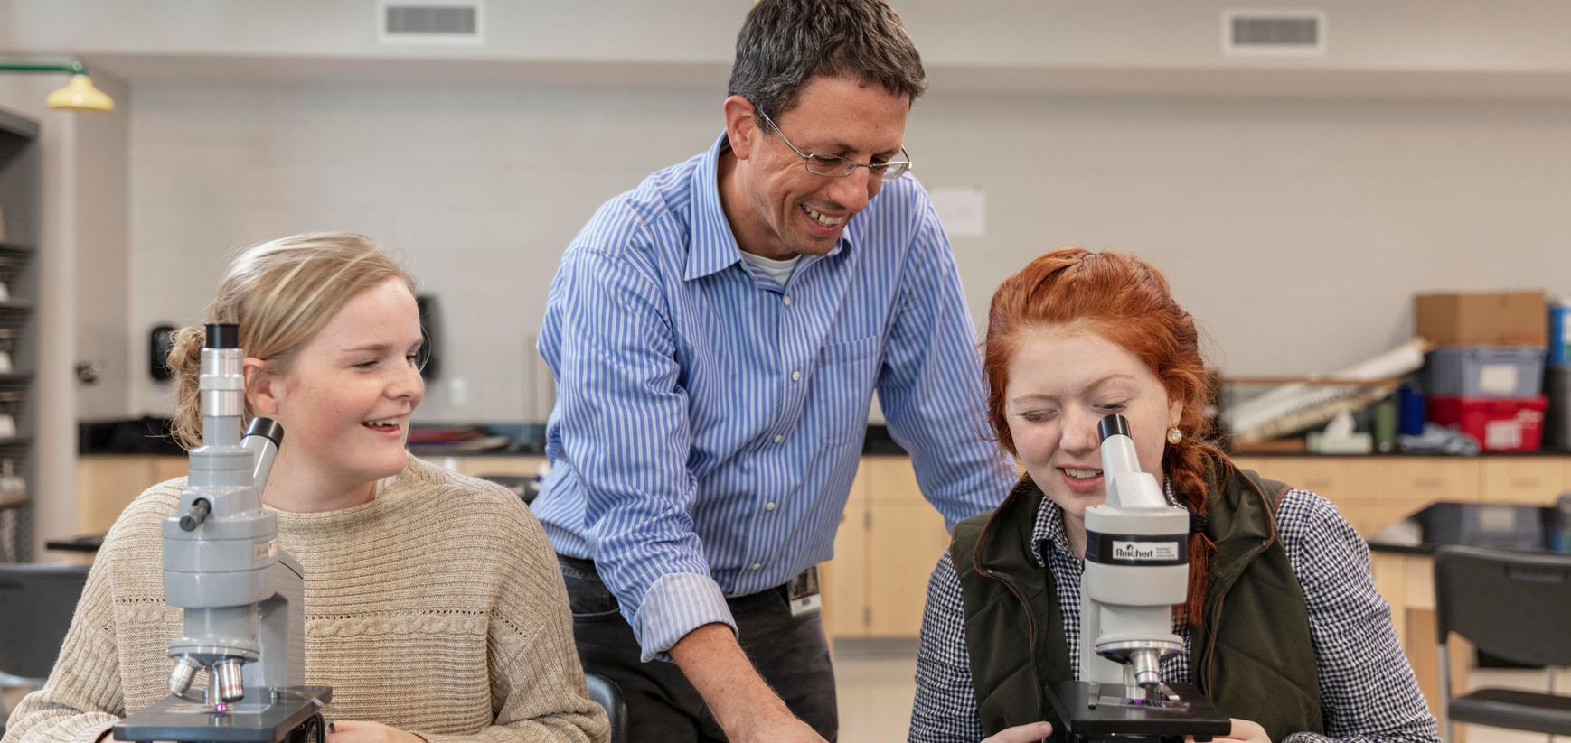
By the numbers
  Co-ed, grades 6-12
    1,300 day students
      (200 middle school, 1,100 upper school)
    180 international boarding students
  26 AP courses, 50 honors courses
  200+ courses
  57 sports teams
  40+ clubs
  12:1 student to teacher ratio
  1 of only 1000 Apple Distinguished Schools worldwide
  One semester, one year or multiple years
  Eligible for a diploma in grade 12
THORNTON ACADEMY

Slide 5
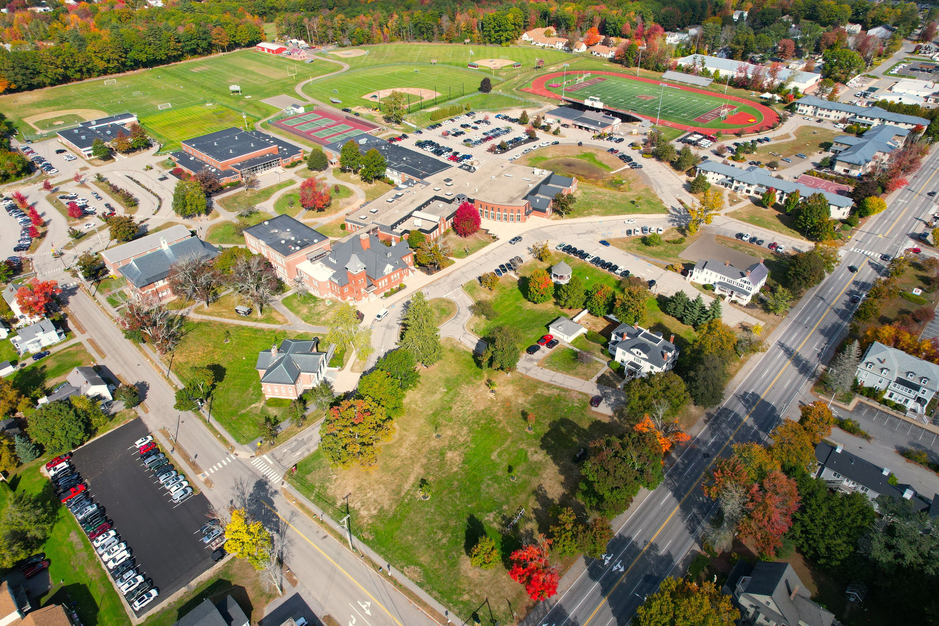
Campus
2025

Slide 6



Why?
Location
The Best of Both
Community
  #1 safest state
  90 minutes from Boston
  Walkable to town
  15 minutes to airport
  Train to Boston
  Beaches + mountains
The opportunities of a large day school
+
The care and attention of a small boarding program
“It feels like the movies!”
Academics are 1/3 of the experience. Our residential life team is here to make sure you are happy, healthy, safe and exploring.
THORNTON ACADEMY

Slide 7
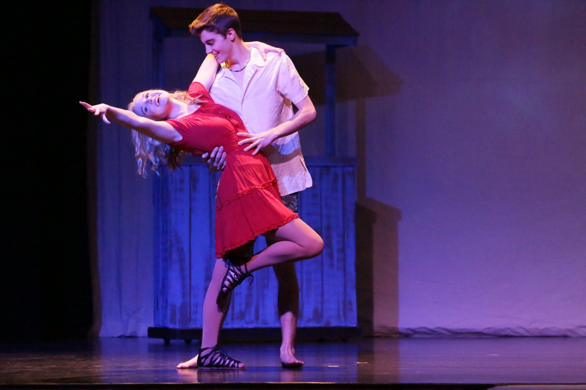


Who?
Artists
Athletes
Academics
With 34 art courses in visual and performing arts, we have a place for you.
Brand new to the sport? Hoping to play at a US university? We have 57 sports teams.
TA is ranked in the top 2% of schools in the US for athletics.
Looking to move beyond the curriculum? Great, so are we!
We also offer 4 levels of ESL.
THORNTON ACADEMY

Slide 8
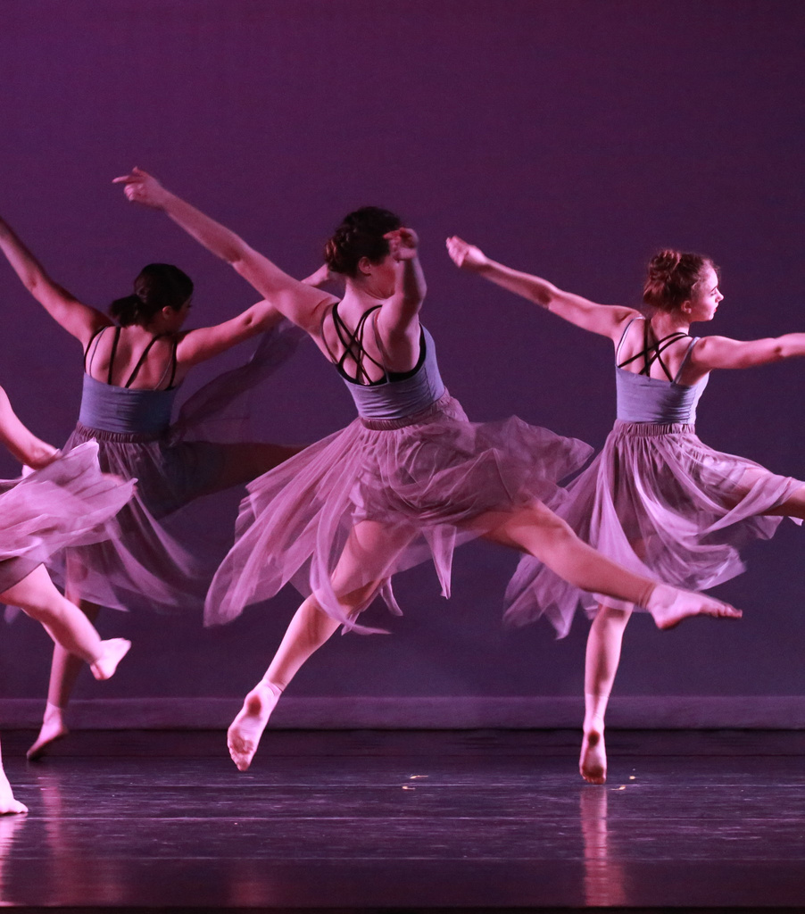
Arts
Performing Arts
4-year dance program
Fall Play & Spring Musical, One Act Plays
5 bands & 3 singing groups
Classes in music theory, songwriting, and more!
Visual Arts
AP Art and Design
University portfolio support
Unique digital media program
38 Arts
Courses
What do our graduates do?
Theater in New York City
Animation for Disney
Minor in art
Portland Symphony Orchestra
SCAD, NYU, RISD
THORNTON ACADEMY

Slide 9
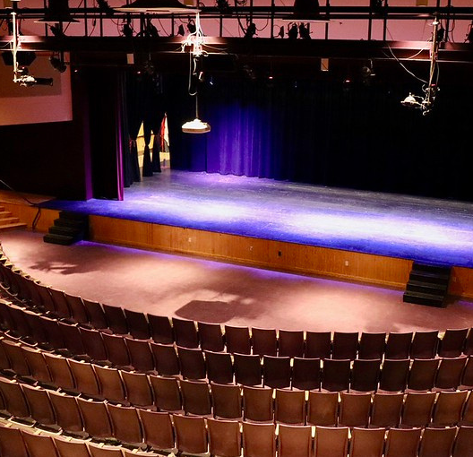
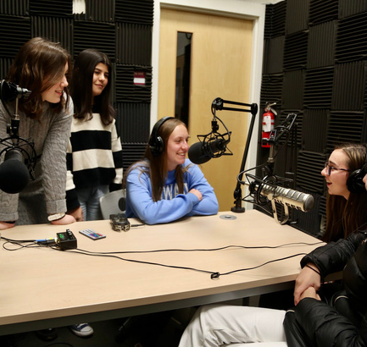

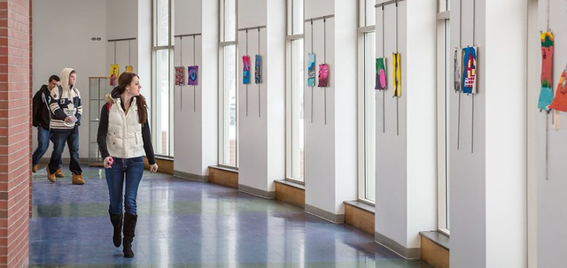
Art
Facilities
38 art courses, 8 studios
  Digital Art Room
  TV/Video production studio & sound stage
  Dark room
  Recording studio
  Ceramics studio
  Music practice rooms
  Pianos
  500-seat auditorium
THORNTON ACADEMY

Slide 10

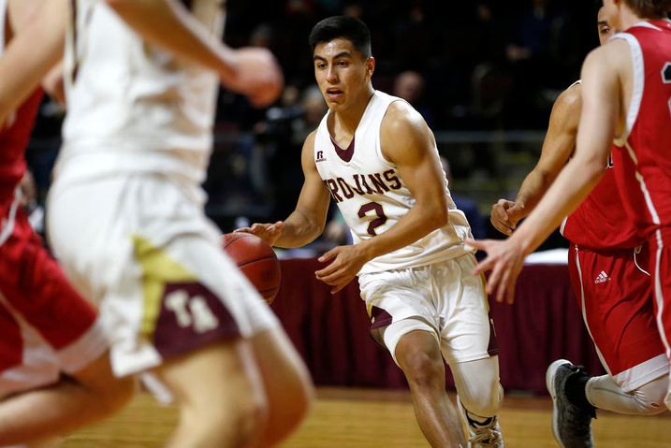

Sports
30+ state champion wins in 5 years
Fall
Winter
Spring
  Football*
  Soccer
  Golf*
  Cheering
  Cross Country
  Field Hockey
  Volleyball
  Basketball*
  Swimming*
  Ice Hockey*
  Cheering
  Indoor Track and Field*
  Baseball*
  Softball
  Lacrosse*
  Tennis
  Track and Field*
THORNTON ACADEMY

Slide 11
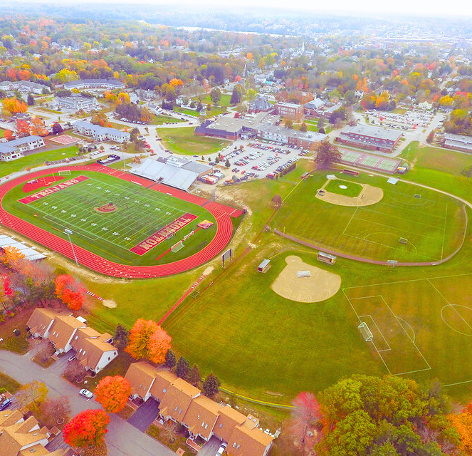
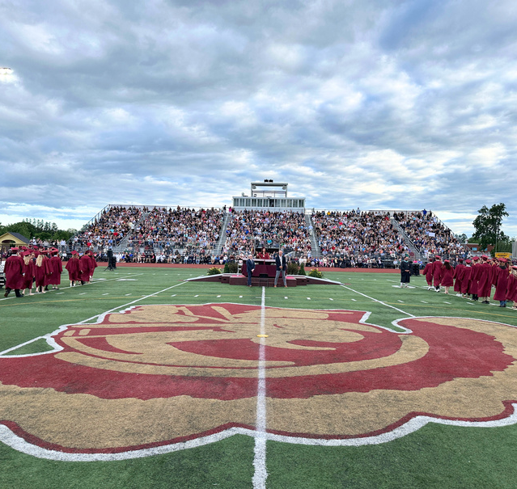
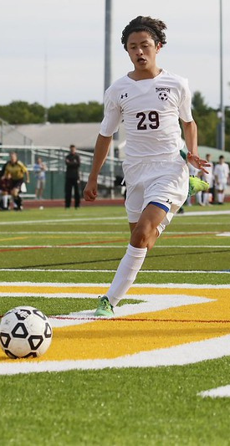
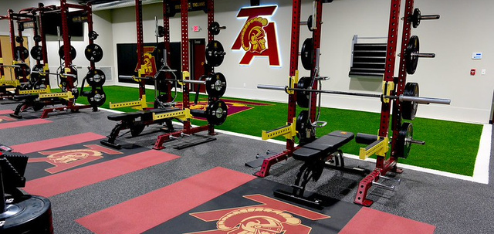
Sports
Facilities
  State of the art turf field
  New indoor sports complex
  New on-campus fitness center
  4 outdoor tennis courts
  3 baseball & softball diamonds
  5 practice fields
  1000-seat gymnasium
  Swimming pool, ice hockey rink, and full 18-hole golf course within a 10 minute drive
THORNTON ACADEMY

Slide 12


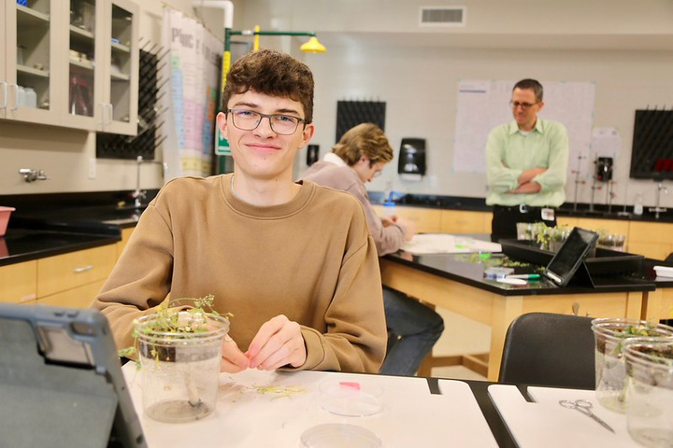
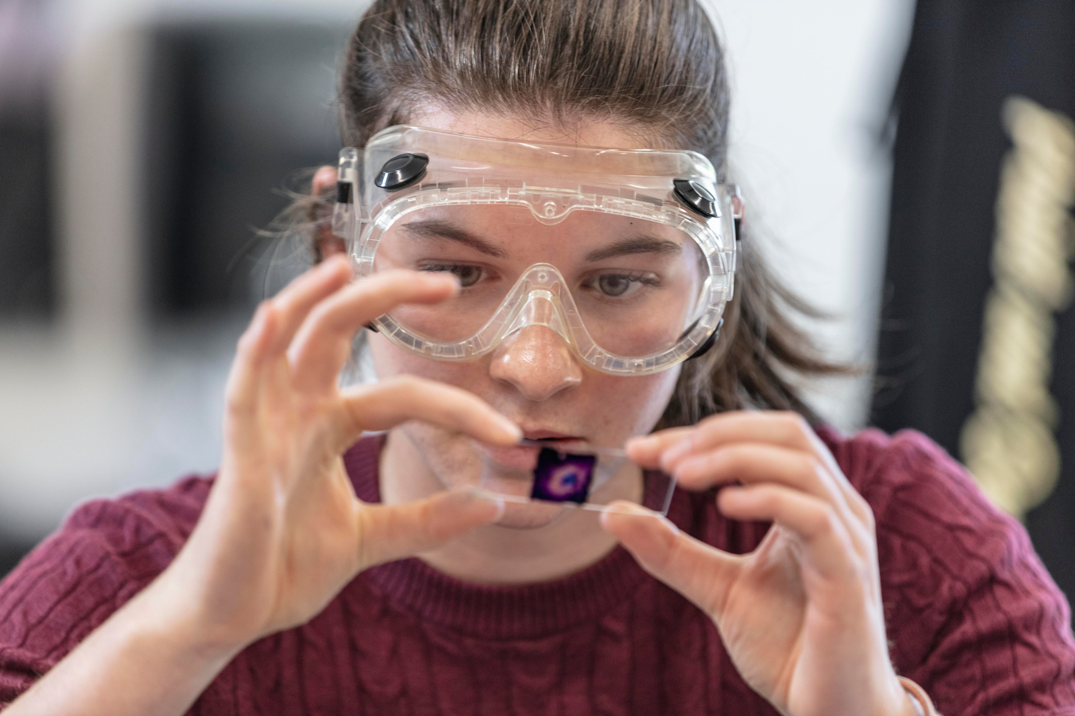
Academics
ELL
26 AP, 50 Honors
6-8 courses/year
  Included in tuition
  4 levels, based on placement test
  Part of the school day/curriculum
  Takes the place of “mainstream English”
  443 AP exams
  37 National Merit Scholars
  Honors courses in 12 disciplines
  Most courses are full year
  Some are single semester
  Some AP courses are 2 credits
  No class? Study hall
  School Counselor will help
THORNTON ACADEMY

Slide 13
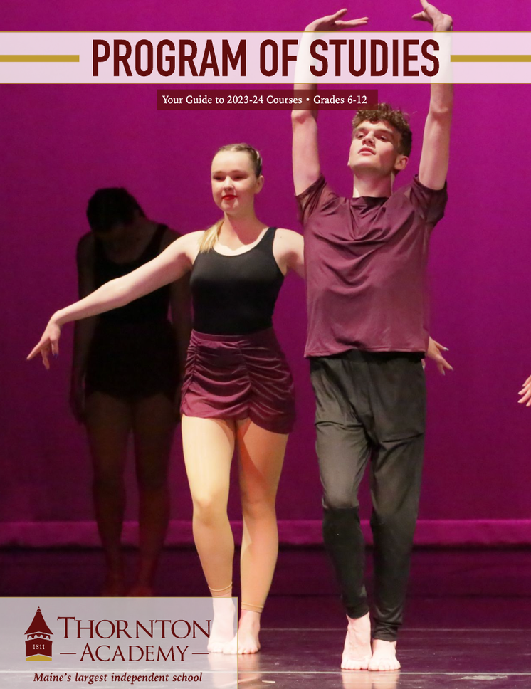
Academics
Before you arrive...
English Placement Test
Math Placement Test
We use the Duolingo as the placement test, but the Duolingo is NOT required for admission.
The TA math department has created a custom placement test that you will take online.
Step 1: Enroll at TA
Step 2: Register your new TA email address
Step 3: Take the placement tests
Step 4: Complete the course request form
Your school counselor will create your course schedule. Changes can be made before classes start and up to 10 days after they start.
THORNTON ACADEMY

Slide 14
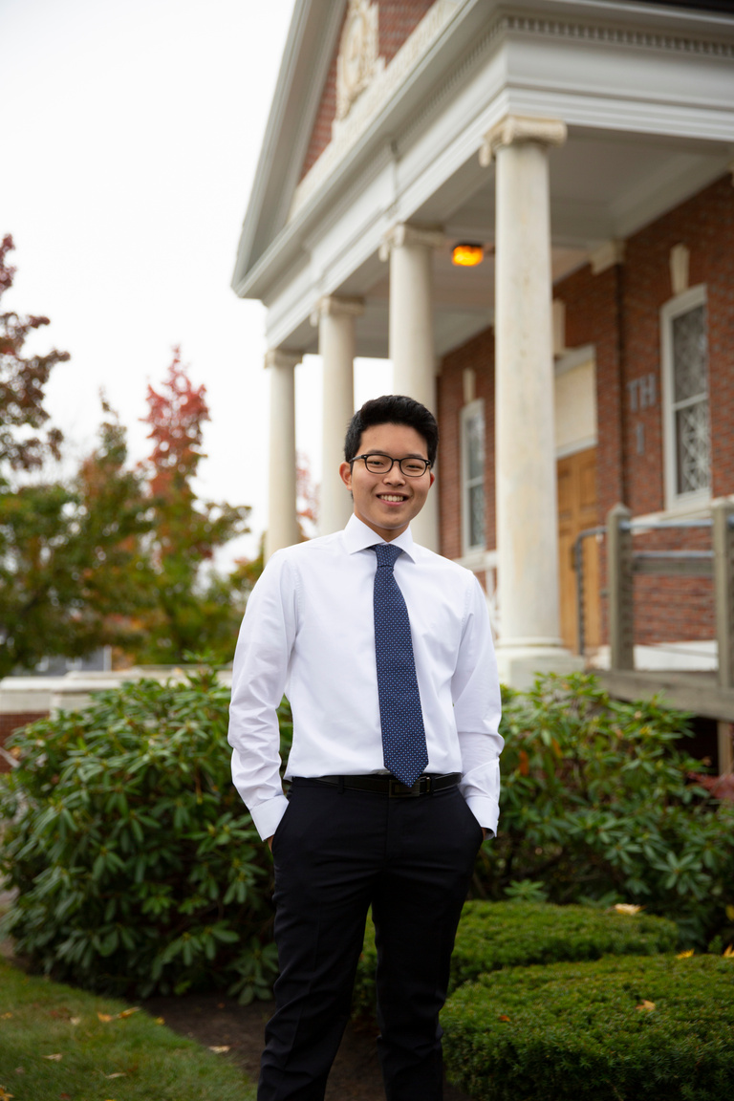
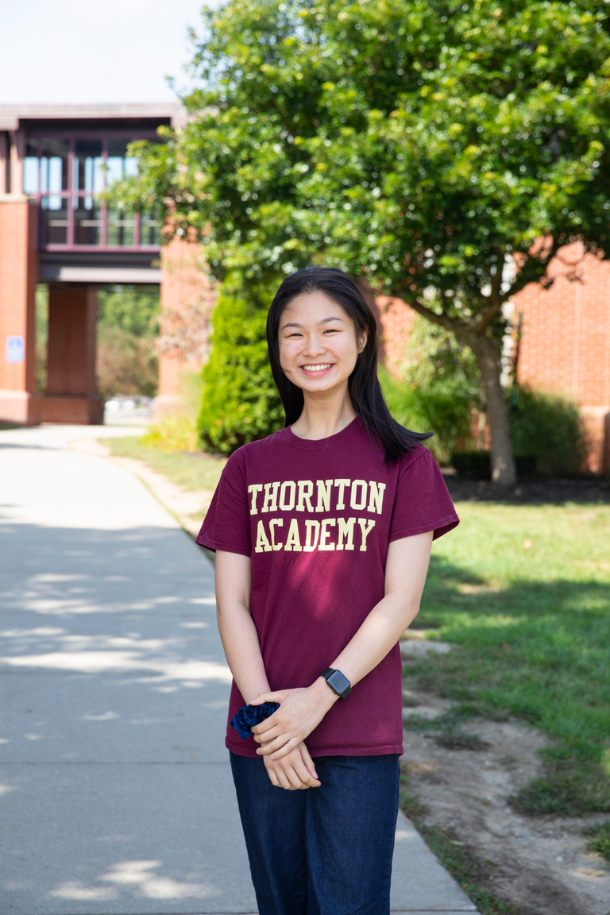

Student Profiles: the story
Student 1
Student 2
What’s Important
GPA: 4.0
Weighted GPA: 4.17
# AP courses: 6
Acceptances: Michigan, Northeastern, Wisconsin, UC-San Diego, Illinios-Urbana
Final decision: University of Rochester
  AP courses
  Clubs
  Sports
  SAT + TOEFL
  GPA
+
How are you unique?
GPA: 4.0
Weighted GPA: 4.08
# AP courses: 5
Acceptances: Yale, Williams, Colby, Wesleyan, Bowdoin
Final decision: Harvard
THORNTON ACADEMY

Slide 15

University Acceptances
Bates College • Berklee College of Music • Boston College • Boston University • Bowdoin College • Colby College • Columbia University • Cornell University • Dartmouth College • Duke University •Emory University • George Washington University • Georgetown University • Harvard University • Johns Hopkins University • Maine College of Art • MIT • New York University • Parsons School of Design • Providence College • The New School • Tulane University • Union College • UC Los Angeles (UCLA) • UC Berkeley • UC Irvine • University of Michigan • University of Southern California (USC) • University of Texas • University of Vermont • Wellesley College
THORNTON ACADEMY

Slide 16
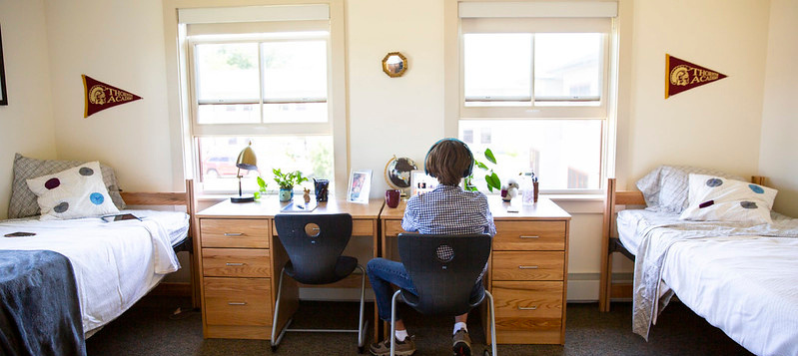
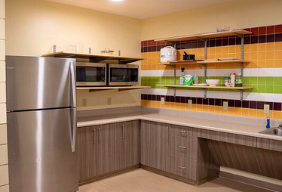
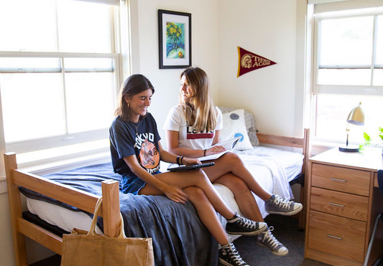
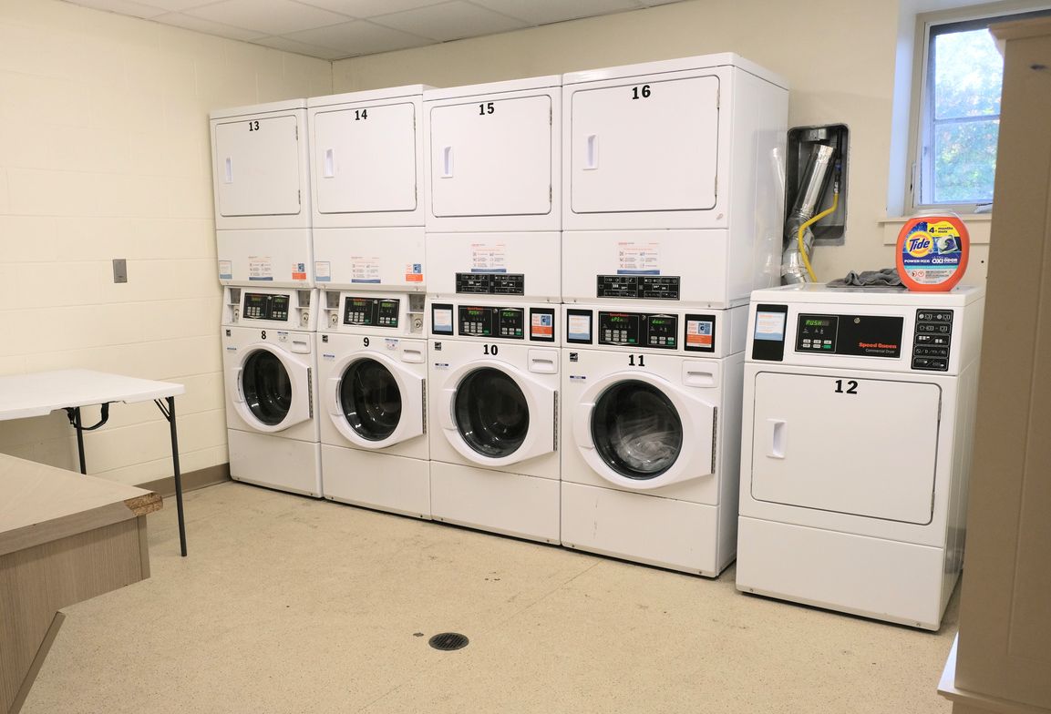
Dormitories
  modern, new, and large dorms
  on-campus, steps away from dining hall and classes
  4 dorms
  double rooms, some triples, 9 singles for girls
  shared bathrooms
  kitchens, study lounges, and laundry rooms
THORNTON ACADEMY

Slide 17
International Student Support
Res Life Advisor
After School Study Center
Achievement Center
01
02
03
THORNTON ACADEMY

Slide 18
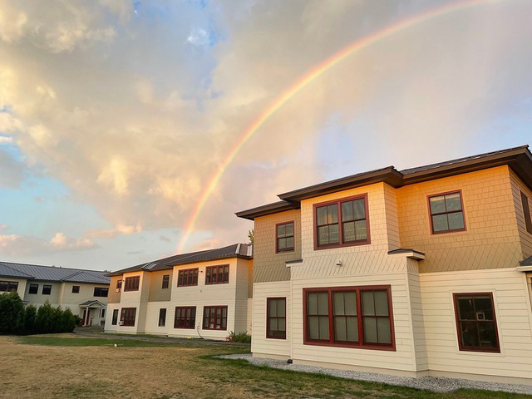
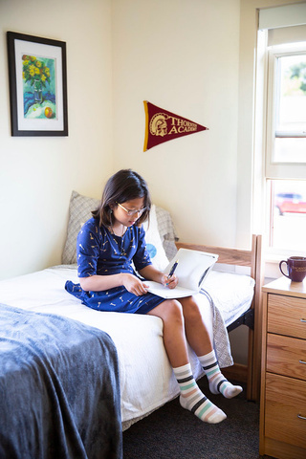

Residential Life
Breaks
Support + Safety
Homestay
Thanksgiving: OPEN
Christmas: CLOSED
February: OPEN
April: OPEN
$80/day includes activities and meals
  Nurse
  Study hours
  Advisor
  14 families live in the dorms
  Keycard access
  15 homestay spaces
  Our homestay coordinator does the placements and supports students
  Same tuition as boarding
THORNTON ACADEMY

Slide 19

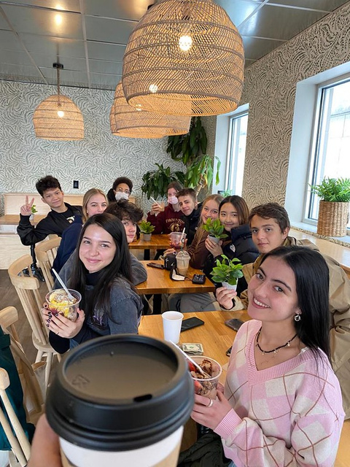

Weekends @ TA
Explore, play, and try new things with 10-15 different trip & activity options each weekend.
Every Friday, we publish the weekend activity schedule. Students can sign up for whatever they wish!
The most popular activities:
Skiing and going to Boston via train
THORNTON ACADEMY

Slide 20

Weekends @ TA
THORNTON ACADEMY

Slide 21
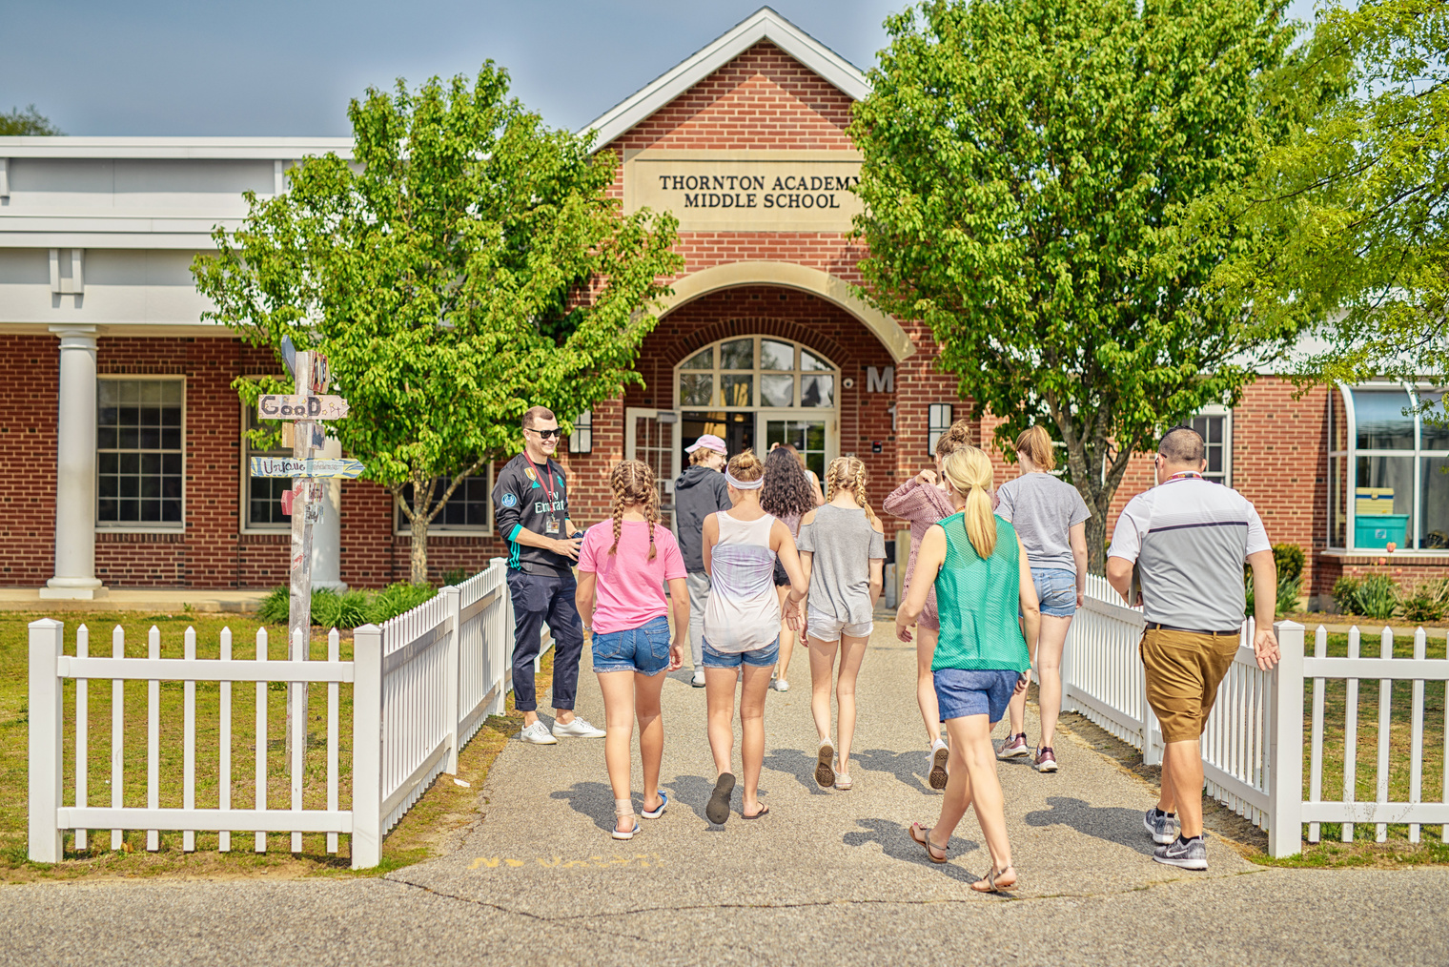

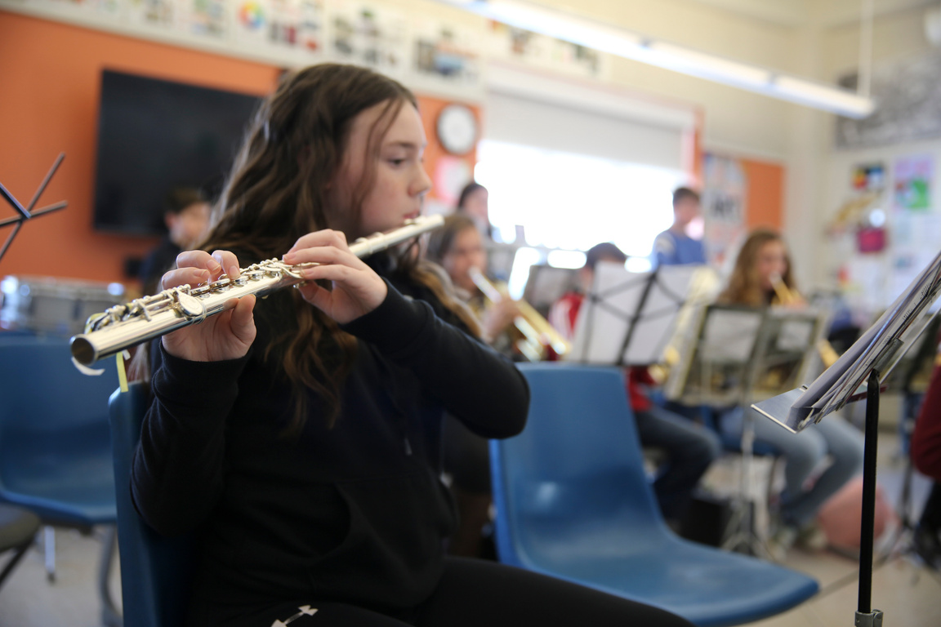
Junior Boarding
Thornton Academy Middle School (TAMS)
Support
Program Details
  After School Study Center
  1:1 peer tutoring
  Quarterly reports
  Middle School Principal and Assistant Principal live in the dorms
  Must play a fall sport (soccer, tennis or cross country)
  Must participate in a club
  Technology management
  Take courses at the Upper School
  180 students
  8% international
  Grades 6-8
  Shared campus
  Shared dorms
THORNTON ACADEMY

Slide 22
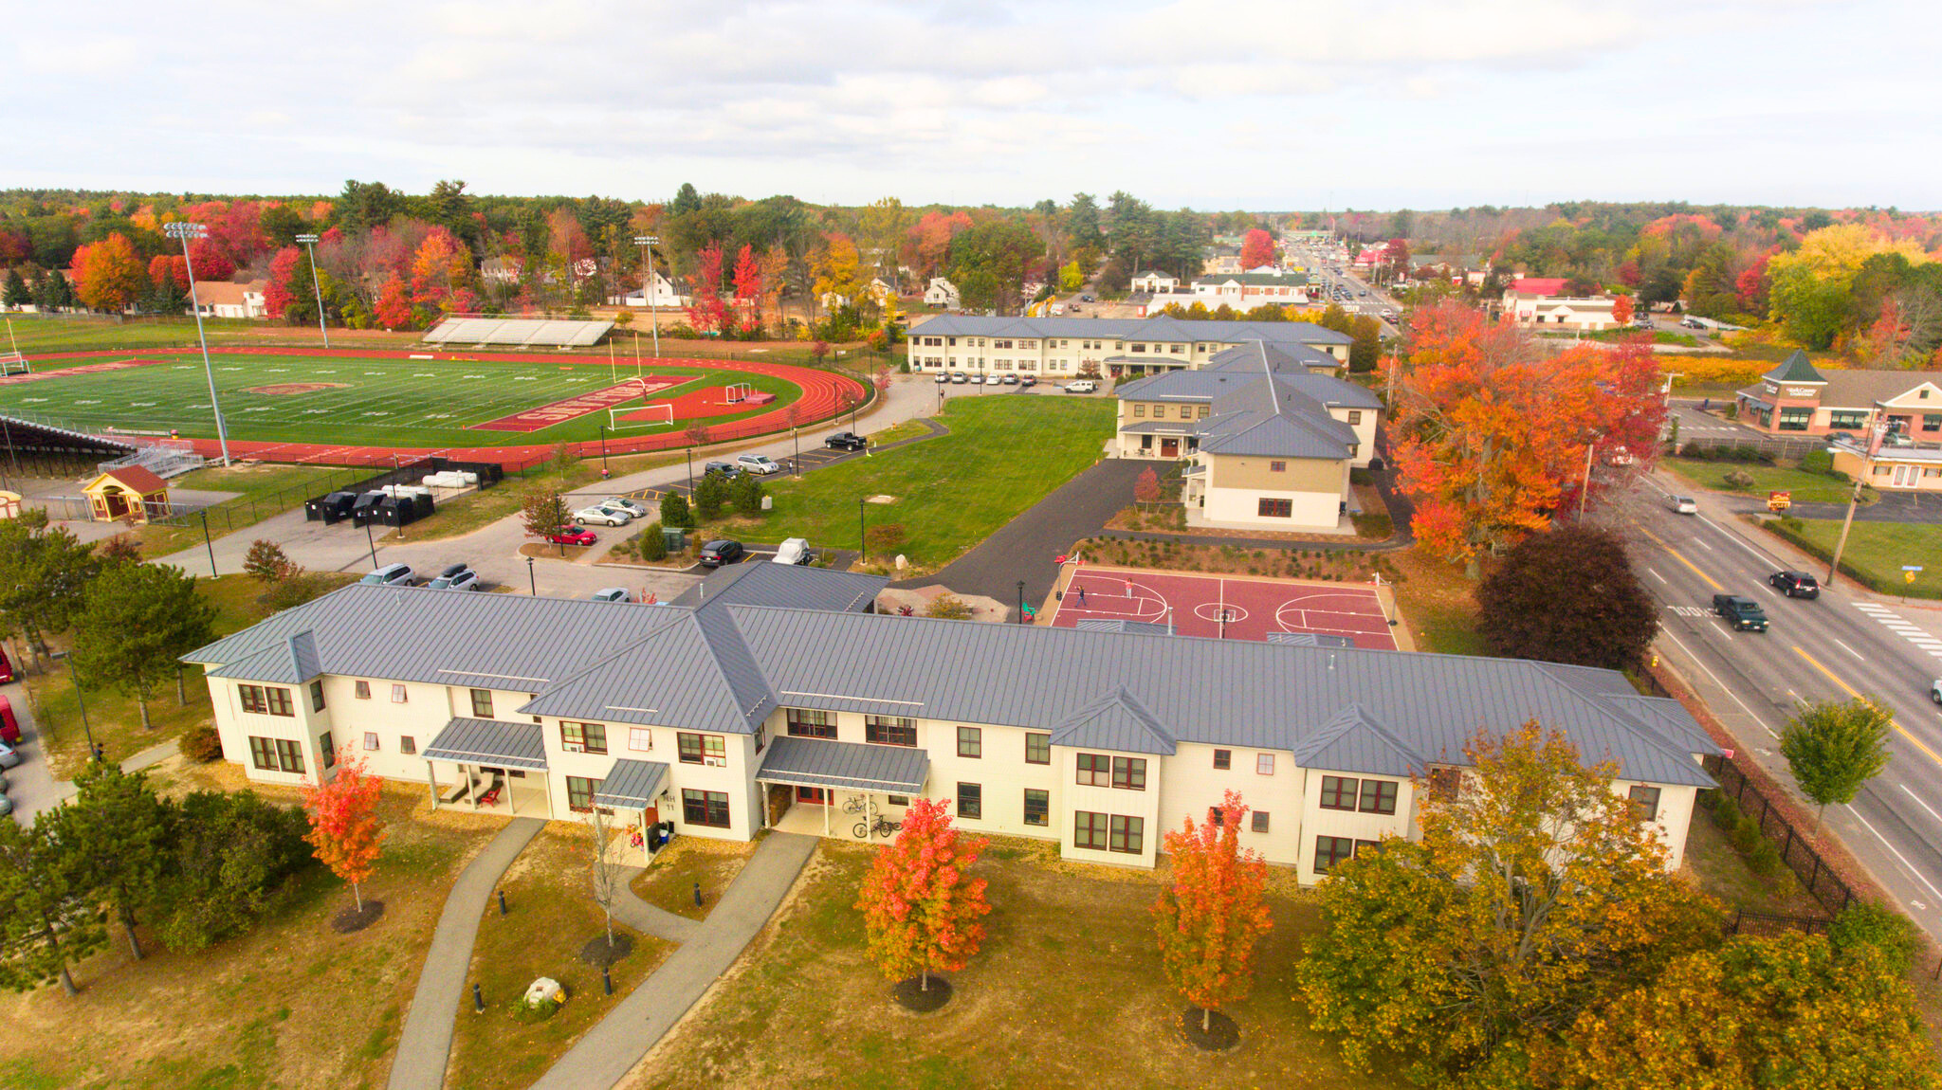
Apply
*Rolling Admission*
  Online Application (or SAO)
  3 recommendation letters
    2 teachers (any teachers)
    1 other adult (not a parent)
  Transcripts from the past 2 years + the current year
  Passport
  Zoom interview
Thornton Academy is test optional...ask us why!
THORNTON ACADEMY

Slide 23
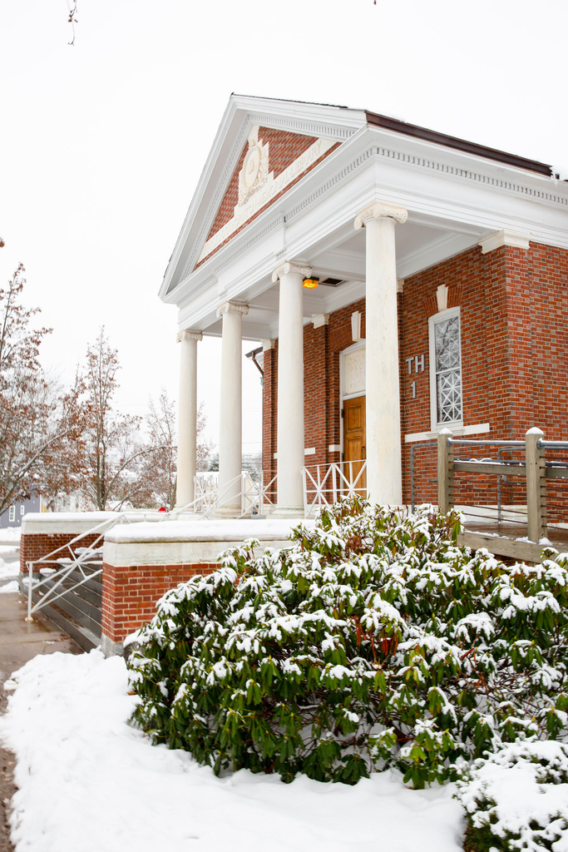
Tuition
Full Year 26-27
  $55,400 tuition, Room and Board
  $2,600 Health Insurance (mandatory)
  $3,000 Student Life Fee (iPad, I-20, books, etc)
Total:$61,000
+ $500 security deposit + $1,000 Incidental Account Refundable fees
collected at enrollment and refunded if not used
Single Semester 26-27
  $29,200 tuition, Room and Board
  $1,400 Health Insurance (mandatory)
  $1,500 Student Life Fee (iPad, I-20, books, etc)
Total: $31,100
+ $500 security deposit + $1,000 Incidental Account Refundable fees
collected at enrollment and refunded if not used
THORNTON ACADEMY

Slide 24
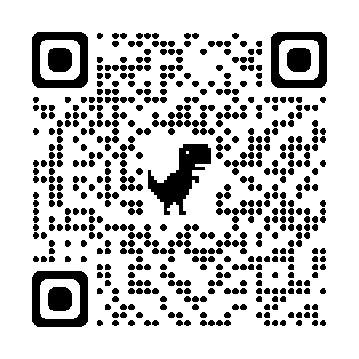

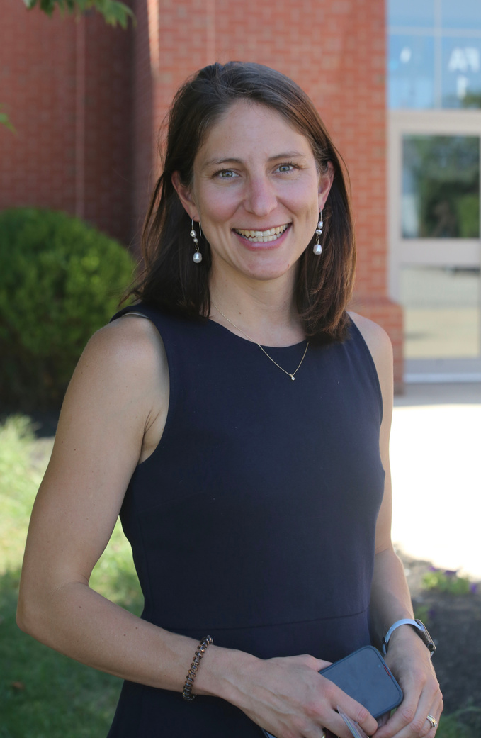

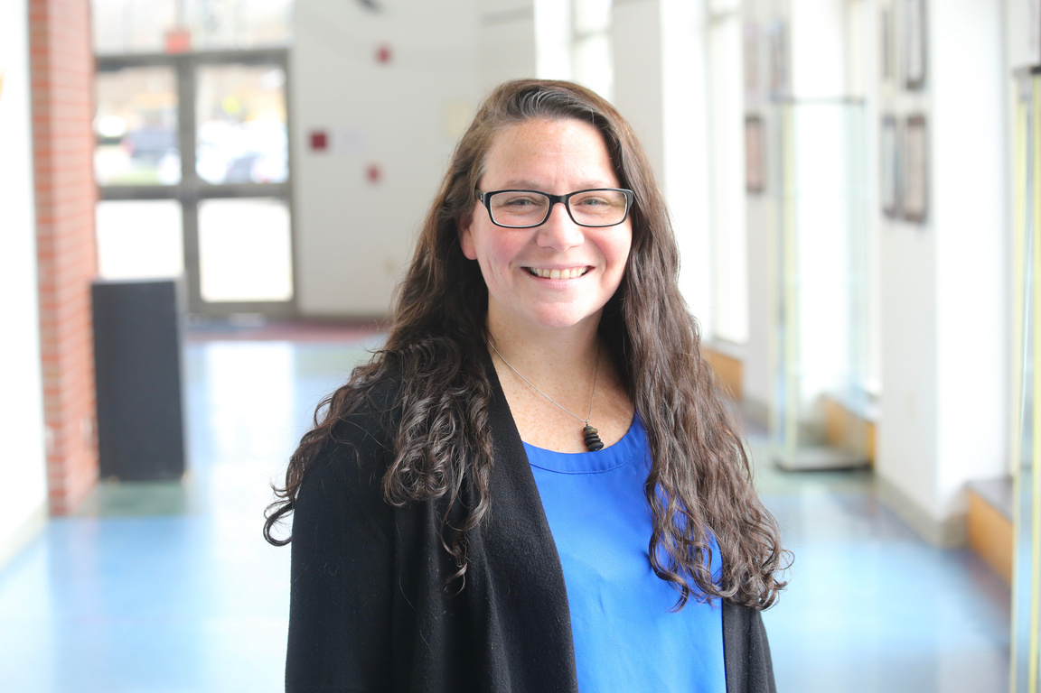
Admissions Team
Clint
Mackenzie
Megan
Jamie
Director of Enrollment
Loves the outdoors, skiing and golf
Senior Associate Director of Enrollment
Loves bike rides and interior design
Associate Director of Enrollment & Outreach
Loves cooking and birdwatching
Associate Director of Day Enrollment
Loves walking the beach and funny movies
ADMISSIONS@THORNTONACADEMY.ORG

Slide 25
Clint Williams
WeChat: Seedoubleuu
WhatsApp: 1-207-416-8607
Mackenzie Hanson
WeChat:MackenzieHanson212
WhatsApp: +1-207-745-0448
Megan Cornwall
WeChat:Megan0123
WhatsApp: +1-207-776-9312
thorntonacademy.org/agents

Slide 26

Additional Programs
Summer Program
Dual Diploma
Partnerships
THORNTON ACADEMY

Slide 27

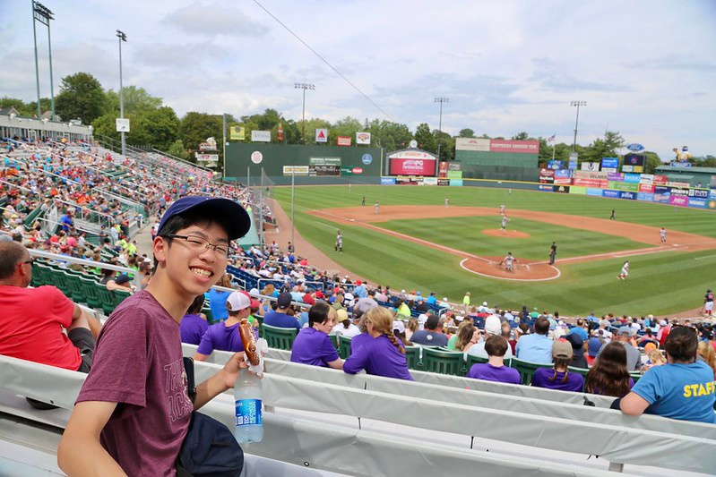
Summer Program 2026
3-week program:
July 11 - August 1
$6,000
Dynamic classes & fun experiences
2-week program:
July 11 - July 25
$4,000
THORNTON ACADEMY

Slide 28
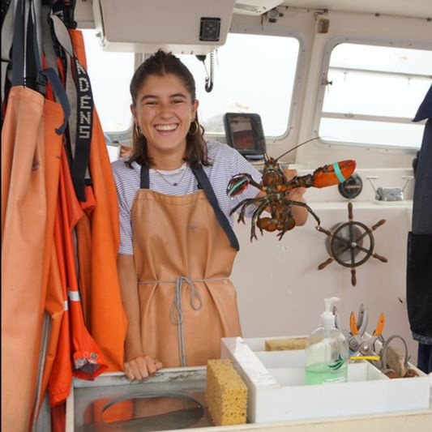
Summer Program
Details
  Ages 12-17
  Do not have to be enrolled at Thornton Academy
  2 Classes in the morning, activities in the afternoon, trips on the weekend
  Courses include: ELL, Photography, Robotics, Acting, Marine Ecology + more
  Tourist visa
  Accommodations in our on-campus dormitory
  Health insurance and airport transfer included (BOS and PWM)
  Example activities: Boston, lobster boat cruise, shopping, amusement park
THORNTON ACADEMY

Slide 29
Dual Diploma
  Standard Program: take 6 courses, earn a Thornton Academy Diploma with a Thornton Academy Transcript.
  Hybrid Dual Diploma: For J-1 students. 2 credits are awarded for their J-1 year. Take 4 additional courses. Can begin before, during or after the J-1 year.
  About:
    Average time: 3 years
    Certified teachers
    self-paced
    Elective and core courses
    24/7 synchronous tutoring
    optional lectures
    ACT/SAT/IELTS prep
THORNTON ACADEMY

Slide 30
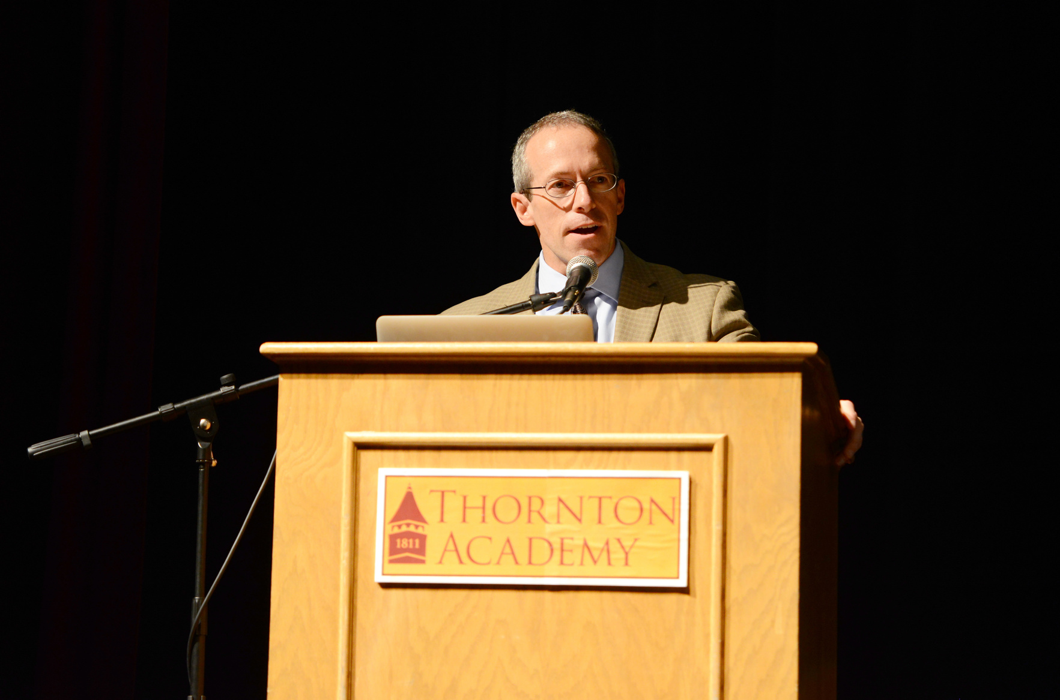
Partnerships
We’re interested!
  University admission agreements
    Existing: UMaine, University of New England, FIT, SUNY Albany
  High school partnerships:
    Dual diploma
    Online programs
  Custom Summer Programs
THORNTON ACADEMY

