Slide 1
Transition from School to Adult Life:
Using the IEP to Create Success
Notes:
1st talk general overview then more specific IEP process

Slide 2
Overview
Laws addressing transition requirements for youth with disabilities
  Individuals with Disabilities Education Act (IDEA)
    Special education services while in school
  Chapter 688 (State Law)
    Services AFTER special education
Notes:
What you will take away during this training
There are two laws that address transition requirements…
These different requirements can be
confusing as they both are called transition
and involve many of the same players such
as parents, school districts, human service
agency representatives and the student.

Slide 3
IDEA Transition
These requirements include school services
which will help ensure that young adults will
live, work, and/or attend post-secondary
school as independently as possible when
they leave public school.

Slide 4
IDEA Transition
Who is eligible for Transition Services?
  All students with disabilities age 14-22
Notes:
So who is eligible? All students 14-22 y/o are eligible for transition services in MA

Slide 5
IDEA Transition
The Goal of Transition: Ensure students receive transition special education services preparing them for:
employment
independent living
further education
Notes:
1. The goal of transition is for students to be prepared for Employment, independent living or future education
2. What that would look like would be different for each individual student
College
Community college
Trade school
Apprenticeships
MAICEI
3. This sounds great but it takes a lot of work to make this happen and it is not easy

Slide 6
IDEA Transition
What are transition services?
Instruction
  Provided in Small group or one to one
Related services
  Provided in the community
  Social skills that may be needed
  Mental Health
  Functional skills
Community experiences
  Focus on health and safety
Notes:
What are transition services?
They are services and supports that help student in these areas (read slide)
Example work related
Sm group instruction on interview practice (14 y/o)
One to one training on filling out job applications (online/in person) 14 y/o
One to one job coach- training in community (16 and up)
INDEPENDENT LIVING
Cooking instruction, 1 to 1, small group (14 and up)
Safety- direct instruction in the community
Transportation small group, 1 to 1 and include Uber training especially now with COVID
Banking skills
Sex education
Hygiene
COLLEGE
Transportation with fading supports
Social skills goal- how to act college friends/job/community

Slide 7
IDEA Transition
What are transition services?
Development of employment and other post-school adult living objectives
  Focus on relationship skills/building
Acquisition of daily living skills
  getting dressed and ready on time
  Travel training
  Daily schedule posted
Notes:
Read slide
Read list below
MAKE GROCERY LIST/READING NUTRITION LABELS
STAYING HEALTHY- EXERCISING – YOU TUBE VIDEOS FOR EXERCISING – ZOOM CLASSES
TRAVEL TRAINING
USE GOOGLE MAPS IN THE COMMUNITY
WALKING TO THE “T”
LEARN COMMUNITY SAFETY SIGNS

Slide 8
IDEA Transition
Guidelines for Transition Services
Transition services must be based on the youth’s needs, taking into account strengths, preferences, and interests
Notes:
Transition services must be based on individual needs and take into account the students Strengths, preferences and interests
Different for each student
Goal should be meaningful for the life of that student
Example:
Michelle has autism and she takes great photo’s but the school has her working in a factory.. She’s late, never want to work and avoids it as much as possible… what can be done differently ?
CVS developing photos
Store that sells camera’s
Art museums
Other options include
Greeter at Walmart
Working in the library
Animal shelter as paid staff, or volunteer

Slide 9
IDEA Transition
The law requires IEP teams to address the
academic, developmental, and functional
needs of the student in developing the IEP.
Notes:
Read slide
It is the functional piece that is getting the students out of the classroom and into the community
It’s independence vs interdependence
What does transition mean for YOUR youth
and must include measurable goals for each area as needed for the
student.

Slide 10
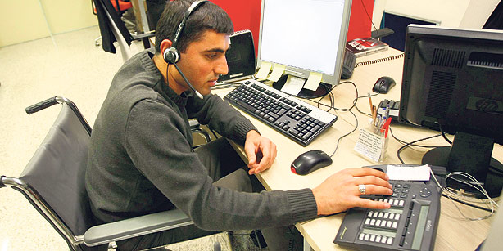
Transition Services-Employment Skills
Paid job opportunities (support options)
How to fill out applications
Job interview skills and strategies
  Including online interview strategies
Time management
How to dress appropriately
Social skills in each specific job area
Workplace relationships
Notes:
Next slides are examples of what transition services can be…but know it will look different from student to student and age to age.
Services that facilitate your child’s transition from school
to post school activities, such as:
-post-secondary education
-vocational education
-integrated employment (including supported employment)
-continuing and adult education
-adult services
-independent living
-community participation

Slide 11
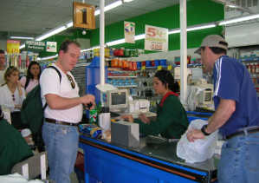
Transition Services-Community
& Independent living Skills
How to use public transportation/Driver education
  Other options taught such as Uber/Lyft
Safety
Banking and purchasing skills
Self-management of medical needs
  Telehealth
Appropriate behaviors in restaurants and stores
Interactions with neighbors, local officials such as police
Accessing recreation, sports opportunities
Use of PCAs
Notes:
How to use public transportation new ideas since COVID using cell phone for google maps,
learning uber now instead of the “T”
Vision: live with roommates in residential home near family with access to volunteer opportunities, recreation and community options
What should goals be for this in the IEP?
Social interaction
Life skills
With help from PCA going on trains, going to concerts, town events etc.

Slide 12

Transition Services-College
Identifying and applying
Getting campus supports and services
  How to self-identify
  Study skills, tutors
Time management and study skills
Social skills
  Dorm living skills
Self-advocacy skills
Assistive technology needs
Notes:
Chris story here meteorologist
Guidance counselor
Electrician
Social stories may be needed

Slide 13
IDEA Transition
Massachusetts Inclusive Concurrent Enrollment Initiative (MAICEI)
https://www.massadvocates.org/maicei
Notes:
MAICEI was Pilot in 2007
Created partnerships with colleges and schools so that students 18-22 have the opportunity to attend college with coaches to help navigate the campus and help to focus on social skills. 18-20 have not passed MCAS/20-22 have passed
Name may be changing soon to Massachusetts Inclusive Postsecondary Education (MAIPSE)
Law just passed in 2022 making it mandatory for all colleges to offer MAICEI programs and expands opportunity for those over 22 as well
Allows students to audit college courses without having a diploma
Threshold program at Leslie example of another type of program, other colleges have programs like this as well but they are not inclusive that is the difference with MAICEI

Slide 14
Process to Ensure School Transition Services

Slide 15
Transition assessment
Age 14 - Request an age-appropriate transition
assessment(in writing) which must address:
Training
Education
Employment
Independent living, as appropriate
Notes:
1. The foundation of good transition is an age-appropriate transition assessments that will help find the students strengths, preferences and interests – Dianne’s example here… (tools for transition/plumber
EXAMPLES:
WHAT EDUCATION DOES YOUR STUDENT NEED
WHAT EMPLOYMENT INFORMATION DOES YOUR STUDENT NEED AND WHAT DO THEY NEED TO LEARN TO WORK IN THE COMMUNITY
WHAT INDEPNDENT LIVING SKILLS DO THEY NEED

Slide 16
Youth participation
Student must be invited to the IEP Team meeting starting at age 14.
Help to determine the best way for student to participate.
Notes:
Its important to figure out ways for students to participate in the IEP process, they need to be involved in making things happen in their own lives as much as possible
Videos letting Team know what they want
PowerPoint presentation
Social stories to help them know what a Team meeting is
Social stories on the process
Why
Gain self determination skills
Gain self advocacy skills
Ensure transition services based on youth’s preferences and skills
Increase post school success
MY KIDS STORY not having them come to meetings
Did not think important to come at first
But really helps prepare youth how to advocate for themselves in college, work and community

Slide 17
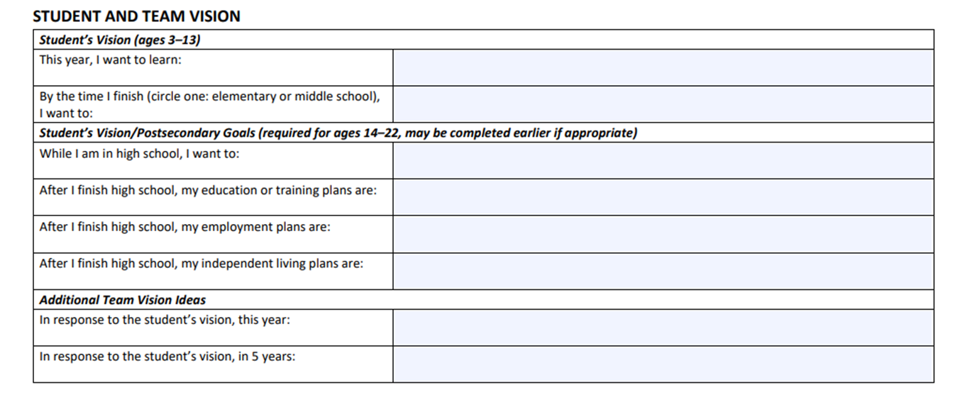

IEP Transition Sections: Student and Team Vision
Notes:
Used to have a transition planning form, now everything is in the IEP
Starting with student’s Vision/Postsecondary Goals on the first page of the IEP

Slide 18
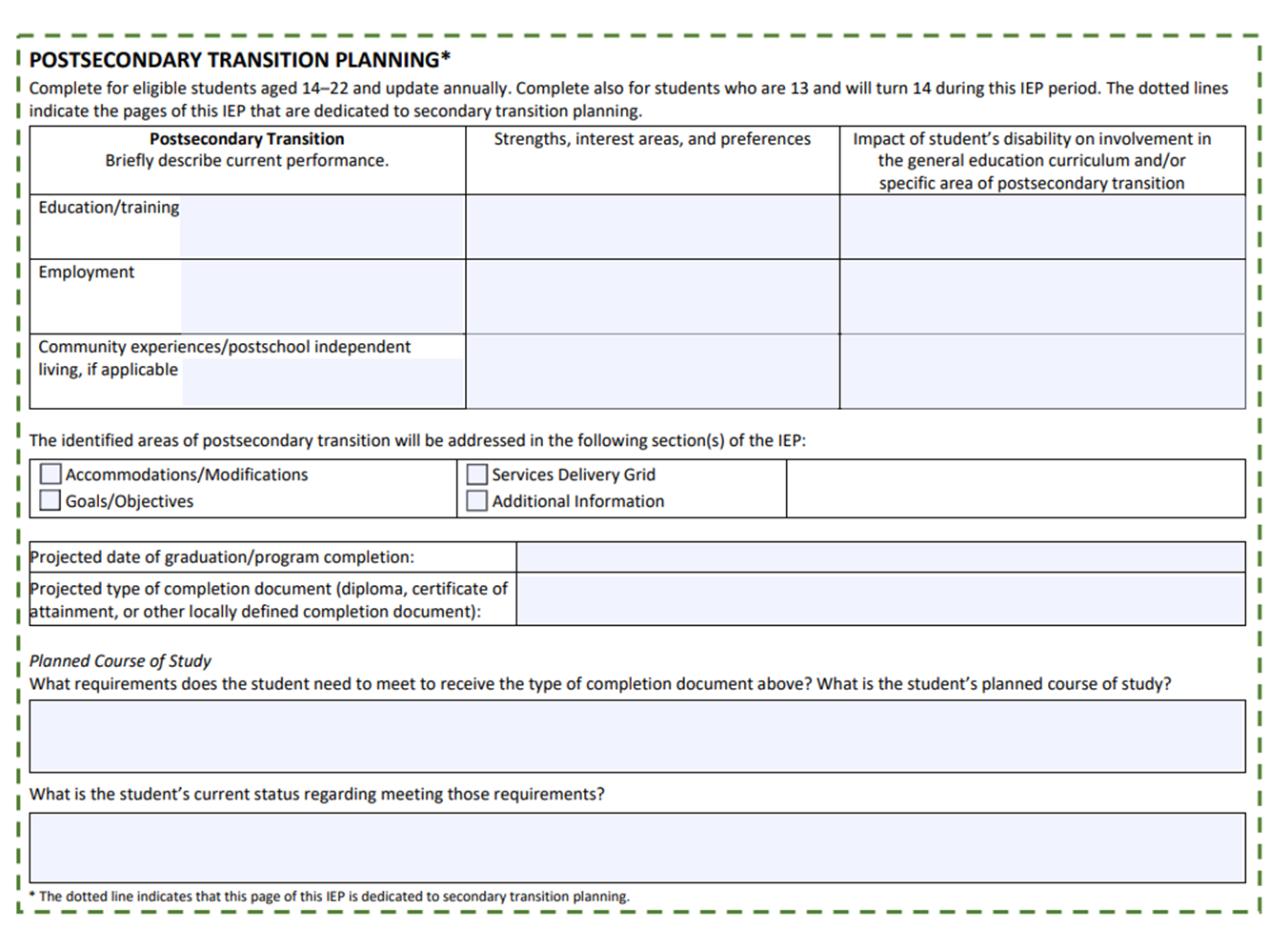
IEP Transition Sections: Postsecondary Transition Planning
Notes:
Just want to point out that the projected date of graduation/program completion is listed here. This date is important especially if you are thinking you youth will be staying until they are 22 so be sure it is the date that you expect.

Slide 19
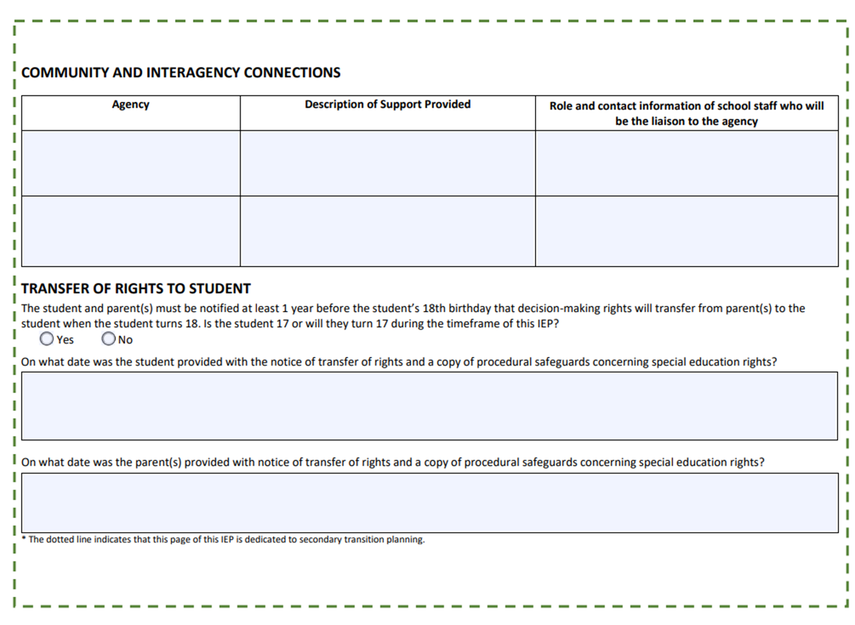
IEP Transition Sections: Connections and Transfer of Rights
Notes:
Community and interagency connections
Pre-Ets here
Next Gen
JVS
Job coach connection

Slide 20
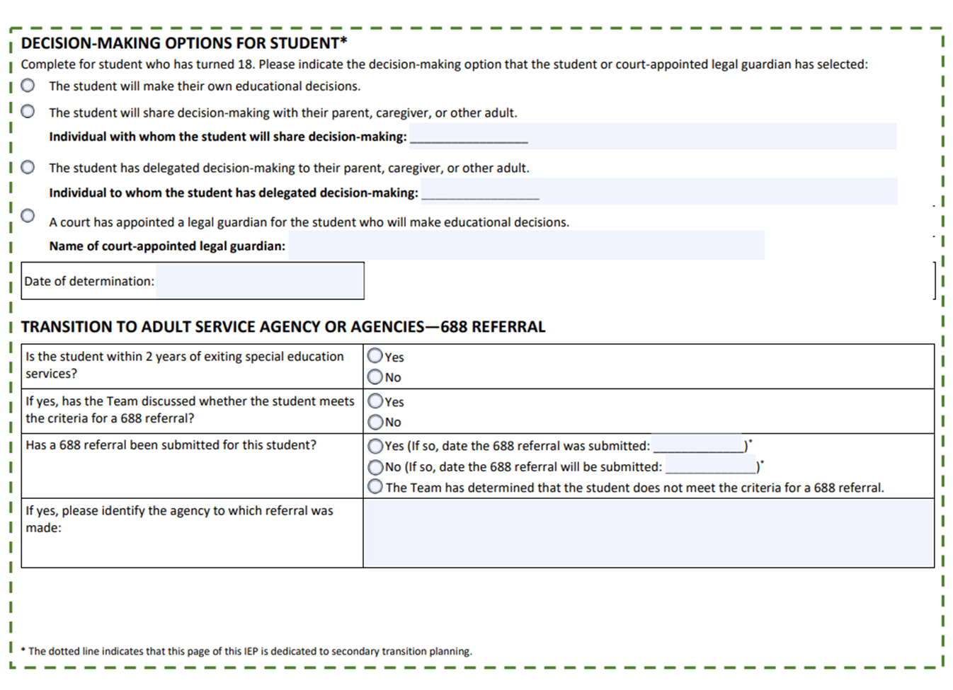
IEP Transition Sections: Decision Making and 688 Referral

Slide 21
Goals
Make sure that the IEP includes measurable postsecondary AND annual IEP transition goals related to
  Training
  Education
  Employment
  Independent living, as appropriate
Notes:
Read slide
Lots of students including “regular” Ed students don’t always know what they want to do
But once interests are determined
Talking 1 to 1
Person centered planning
Interest inventories
You can determine goals and objectives related to their interests
One young lady non verbal but sang beautifully, school had her washing tables at McDonalds… rewrite goals and objectives and have her work somewhere else that would have meaning such as recording studio, places that sell music

Slide 22
Determine transition services
List specific transition services in the IEP that will help the student meet their transition goals
Notes:
Specific transition servicies can be listed in the IEP related to
Employment
College
Self advocacy
Independent living
Transportation
Community participation
May need a range of experiences
One school has student work at 3 job sites 1st ½ of year and then they choose where to work the 2nd ½ and work on more specific skills for that job
PreEts (job exploration, workplace readiness, work base learning experiences, counseling and self advocacy/peer mentoring) and Next Gen (STEM) services from MRC

Slide 23
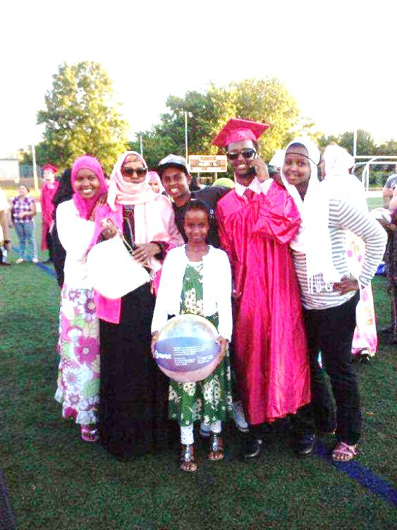
Graduation
Graduation—what it means
Notes:
If you feel your student has not received a free and appropriate public education (FAPE) you can reject the graduation date and stay put comes into play…
WHAT IS YOUR CHILD MISS WHILE SCHOOLS are short staffed- COMPENSATORY SERVICES EVEN IF STUDENT IS 22 MAY BE STILL AVAILABLE FOR YOUR STUDENT- federation Dennis
BSEA case: dracut

Slide 24
688 Transition
Chapter 688
  Services after exiting special education
Notes:
WAS 688 REFERAL MADE…. BE SURE IT WAS
Referrals are down 75% - this is concerning because one reason for the referral is that the adult agency will have time to plan and budget for your child
not an entitlement

Slide 25
688 Transition
Chapter 688- two-year planning process for students with severe disabilities, eligibility requirements
Chapter 688- NOT an entitlement or guarantee of services
Chapter 688- NOT a continuation of special education services
Notes:
The law provides a two year planning process and focusses on which adult agency MIGHT provide services for the student when they leave school, but adult services are not an entitlement
IF the student is diagnosed with autism and mental health you should apply to BOTH DDS and DMH- you can receive services from BOTH agencies

Slide 26
688 Transition
Who is eligible?
Automatically eligible for chapter 688 include:
  Anyone receiving SSI/or SSDI based on his/her own disability
OR
  Anyone listed in the registry of Massachusetts Commission for the Blind
Notes:
Read

Slide 27
688 Transition
All students referred to chapter 688 must be:
  Receiving special education services in Massachusetts paid by the school district
  And
  In need of continuing services because of the severity of their disability
  And
  Unable to work 20 or more hours a week in competitive employment

Slide 28
688 Transition
What are the benefits?
Provides timelines and planning time for state agencies
Identifies a state agency that will work with eligible student
Individual Transition Plan (ITP) -developed by the state agency to understand the student’s needs, planning to help provide necessary services
Notes:
1. So if not guarantee of services why bother???? READ SLIDE
The student can be approved for services but if there are no funds they may not receive the services

Slide 29
688 Transition
The ITP:
Outlines day, vocational, residential, and support services needed
Lists the agency responsible for providing services once found eligible
Should be complete before the young adult finishes their education or turns 22
Notes:
Self directed funds

Slide 30
Mass Advocates for Children
Free Multilingual Helpline
(617)357-8431
Massadvocates.org/helpline

Slide 31
RESOURCES
Massachusetts Advocates for Children 617-357-8431
www.massadvocates.org
-- MAC Helpline
-- MAC Sample letters
-- MAC Special Education Rights Videos
-- For the latest MAC news: Facebook | Twitter | Instagram | YouTube
-------------------------------
File a PRS complaint or BSEA mediation
Office of Civil Rights (OCR) 617-289-0111
-------------------------------
National Secondary Transition Technical Assistance Center NSTTAC
http://www.nsttac.org/
The Federal IDEA Regulations (34 CFR 300): http://www.ed.gov/legislation/FedRegister/finrule/2006-3/081406a.pdf
Massachusetts Special Education Regulations (603 CMR 28): http://www.doe.mass.edu/lawsregs/603cmr28.html

Slide 32
THANKS FOR ATTENDING!
Visit us at:
www.massadvocates.org
Donate:
www.massadvocates.org/donate

Slide 33
Mass Rehabilitation Commission (MRC)
PRE-Employment Transition Services
(Pre-Ets)
Provided to students with disabilities:
14-22 years of age and still in enrolled in school
Pre-ETS DO NOT take the place of school special education transition services necessary to receive FAPE
688 referrals to MRC services are not needed for Pre-ETS
Notes:
Read slides
These services are for potentially eligible students
They do not have to apply to VR
Do not need social security numbers
Do not need income
Don not need birth certificate
Do not need disability documentation such as evaluations or IEPs to get these services
DELETE THIS AND THE NEXT SLIDE: Combine Pre-Ets, Next Gen and JVS on one slide as options???? AT END

Slide 34
MRC PRE-ETS
Services offered in groups and focus on individual’s skill development
Job Exploration Counseling
Seminars or workshops on careers and required skills, career ladders and interest inventory
Workplace Readiness Training
Development of transferable work skills which may include resume writing, interview skills and professionalism
Work-based Learning Experiences
Counseling in Post-secondary or Training Programs
Self-advocacy and Peer Mentoring
Opportunities to job shadow, complete informational interviews, volunteer opportunities, and internships
Counseling and guidance about options upon exiting high school which may include academic or vocational programs
Peer mentoring, development of individual advocacy skills, and rights and responsibilities
Notes:
Lots happening online

