Slide 1









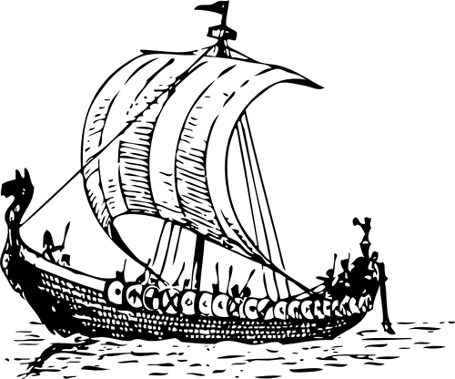


Course Description
WELCOME TO
6th Grade Social Studies
1st Quarter
World Geography, Rise of Civilizations, Mesopotamia
2nd Quarter
Egypt and Kush, Ancient India, Ancient China
3rd Quarter
Classical Greece, Rome
4th Quarter
Medieval Europe, Feudal Japan, African Kingdoms, Early Americas
You will be placing this brochure syllabus into your Social Studies notebook to reference throughout the year as needed.
Social Studies Notebook:
You are responsible for maintaining your notebook this year. Your Social Studies notebook will be organized by unit and will contain notes/information, assignments, and vocabulary. Take care of it!
Mrs. Rorie
How to contact Mrs. Rorie:
crorie@davidson.k12.nc.us
Remind
336-475-8845 (BMS)
Google Classroom
Student Take-home/Work Folder

Slide 2

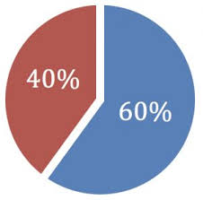


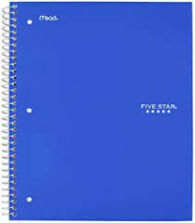

Expectations
Grades
Technology
A 100-90 B 89-80
C 79-70
D 69-60
F <59
Google Classroom will be utilized throughout the year. Unit resources and assignments are periodically posted via Google Classroom. No code needed; you have already been
added!
I use Remind, a texting reminder service. To receive messages, text @roriess6 to 81010.
Beginning of class → Come in prepared! Take your seat, get out your Starter Sheet, attempt the posted question, and wait for further instructions.
During class → Be an active participant in your learning. Listen, collaborate, and ask questions.
End of class → Stay in your seat until dismissal. Leave prepared!
Always respect your peers, your teacher, property, and YOURSELF.
BE KIND, STAY ENGAGED, WORK HARD!
60% Major Works
40% Minor Works
YOUR LEARNING:
You will learn in a variety of ways including: working in groups, teacher and student guided lessons, working independently, and multimedia presentations
TYPES OF ASSIGNMENTS:
You will be responsible for studying key vocabulary for each unit. Expect to be quizzed on these terms. Homework is assigned throughout the year. Homework is often assigned if an assignment was not completed in class.
LATE WORK:
Late assignments will be accepted, but there will be a deduction of points each day the assignment is late.
MAKE-UP WORK:
Please check the ‘While you were out’ folder bulletin board when you return to school.
IT IS YOUR RESPONSIBILITY TO MAKE UP MISSED ASSIGNMENTS!
TURNING IN ASSIGNMENTS:
All assignments must include your first and last name, date, and class.
*Get updates on tests, homework, quizzes, activities, etc.*
Academic Dishonesty
Academic dishonesty will not be tolerated under any circumstances. Cheating, copying, or plagiarism of any form will result in the following consequences:
Required Materials
One 100 sheet spiral bound notebook
Pencils
Colored pencils
Glue sticks/clear tape
failure of the assignment
disciplinary referral
parent contact
Earbuds/headphones are highly recommended for class.
Value what YOU are capable of.

