Slide 1

Fiscal Year 2027 Budget Report
FY2027 Budget Report
Millage Rate Hearings
April 2 and 16, 2026

Slide 2


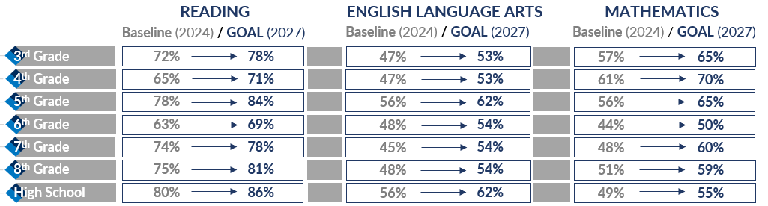
SUPPORTIVE ACCOUNTABILITY GOVERNANCE MODEL
Core Beliefs
Core Policies
All students are highly engaged in their education and capable of reaching their full learning potential.
Employees are trusted and supported as professionals and provided with resources to elevate student outcomes.
Families and our community are involved partners in student success and can expect all students to receive the best education possible.
Schools are positive and welcoming environments with clear expectations and accountability in all academic and operational areas.
Policy BAB: School Board Governance
Balanced Autonomy with Supportive Accountability
Cohesive System of Teaching & Learning
Standards, Instructional Resources, Monitoring Learning
Accountability & Support
Superintendent Evaluation, Aligned School Goals, Intentional Support
Policy IFAD: Literacy in CCSD
Reading, Writing, & Communicating
Phonics, Phonemic Awareness, Decoding, Fluency, Comprehension
Spelling, Vocabulary, Print, Cursive, Keyboarding, Conventions, Grammar
Extended Reading & Writing, Evaluate, Synthesize, Communicate
Student Achievement Goals
Key Priorities
Elevate the Excellence!
Elevate the Excellence in academics and achievement for all students
Elevate the Excellence in effective School Board-Superintendent Governance
Elevate the Excellence in the district’s coordination of goals, systems, and processes
Elevate the Excellence by embracing a pervasive high-quality school environment defined by high standards, effective supports, and consistent practices

Slide 3
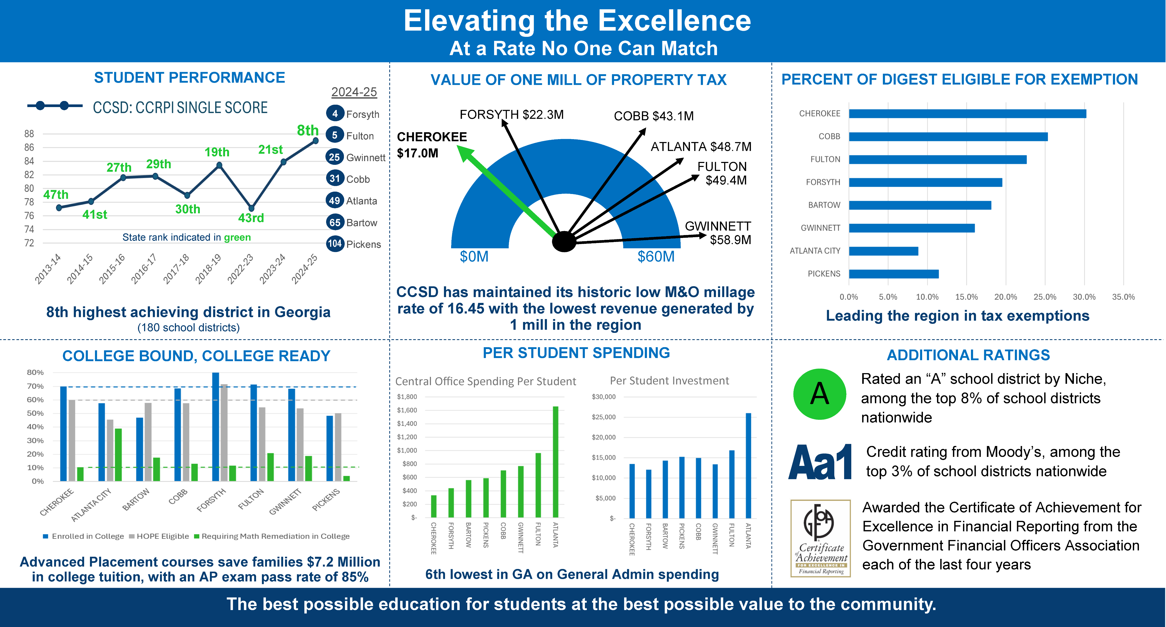
Notes:
Feb 27 version

Slide 4
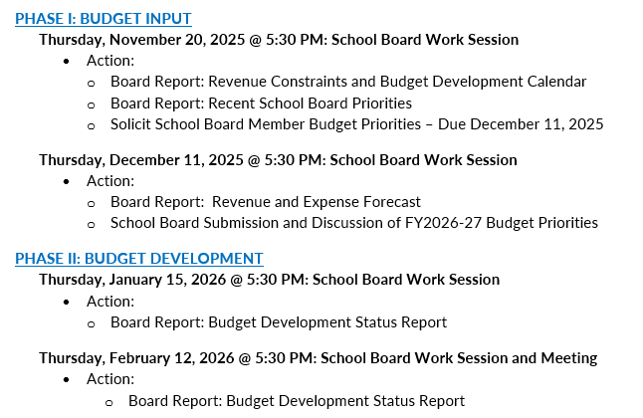

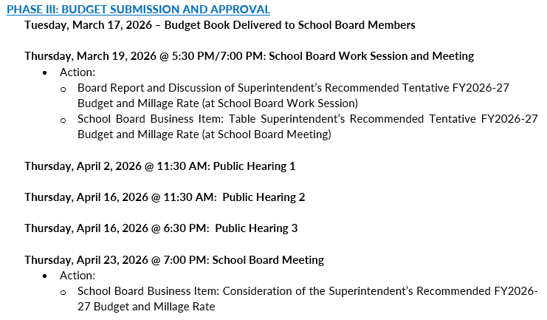

Budget Development Calendar of Events

Slide 5
Investment Highlights
Invest in teachers & staff providing direct support & services to students
  Increase teacher and all eligible employee salaries by 3% in addition to the longevity step increase (+$14.4M local investment)
  Increase the hourly rate by $1/hr for all Bus Drivers ($344K local investment)
  Increase the hourly rate by $1/hr for all Paraprofessionals serving in Self-Contained classrooms (+$700K local investment)
  Increase the daily rate by $20/day and hourly rate by $2.67/hr for Paraprofessional substitutes (+$150K local investment)
  Align Pre K Teacher salaries to K-12 scales
  Increase school-based allotments (+2 Speech Language Pathologists, +3 teachers on special assignment (Knox ES, Liberty ES, Woodstock MS), +1 occupational therapist, +4 custodians, +1 teacher of the deaf and hard of hearing (+$1.2M local investment)
  Continuing administering the Third-Party personnel survey (+$138K local investment)
Invest in resources as close to students as possible
  Implement 1:1 student learning devices, improve technology infrastructure, and add 2 technology positions to support Middle School student learning (+$4.4M local investment)
  Invest in a customized learning tool for reading and math intervention and enrichment (K-12)
  Continue school-based budgets to support consumable instructional materials, classroom supplies, and instructional expenses (+$1.4M)

Slide 6
Investment Highlights
Invest in resources to advance school safety & security and operational effectiveness
  Increase in Campus Crossing Guards (+5) (+$135K local investment)
  Institute Cybersecurity improvements (+$1M local investment)
  Continue to shed redundant, duplicative and/or non-aligned programs and materials (-$5M cumulative total over 2 years)
  Leverage current operations and systems to make the best and most efficient use of existing resources
  Improve operational efficiency by adding restroom capacity at Twin Forks (+$500K local investment)
Legislative Requirements
  Internal Auditor designation based on House bill 845 (+$718K local expense)
  Fully fund the employer portion of the increase in State Health Benefit Plan premiums and TRS for all employees (+$3.8M local expense)
Other
  Due to continued inflationary factors, meal prices will increase slightly for the first time in five years (Breakfast $0.15, Lunch $0.80)

Slide 7
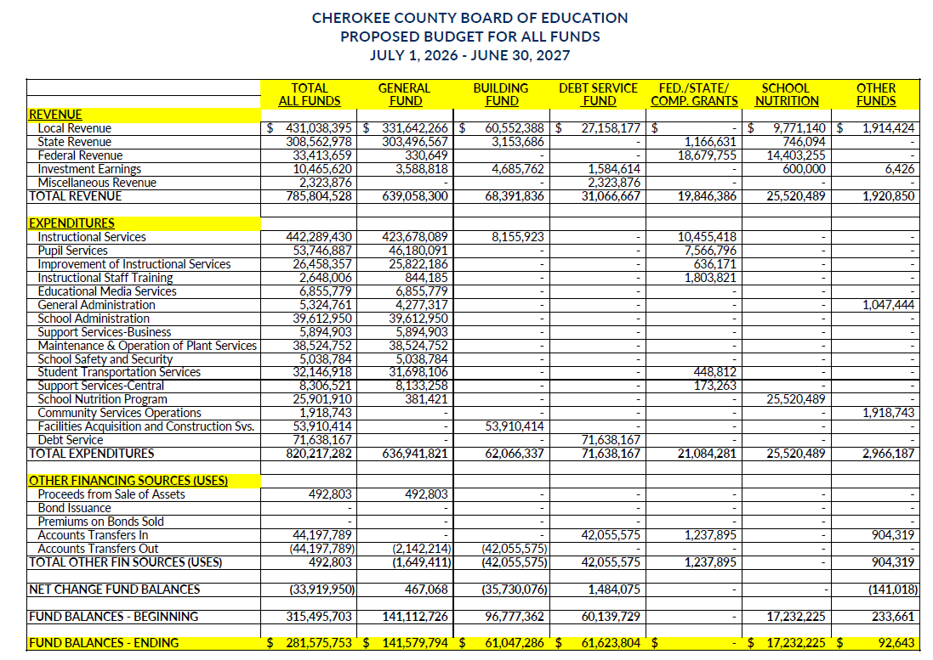
Proposed Budget For All Funds

Slide 8
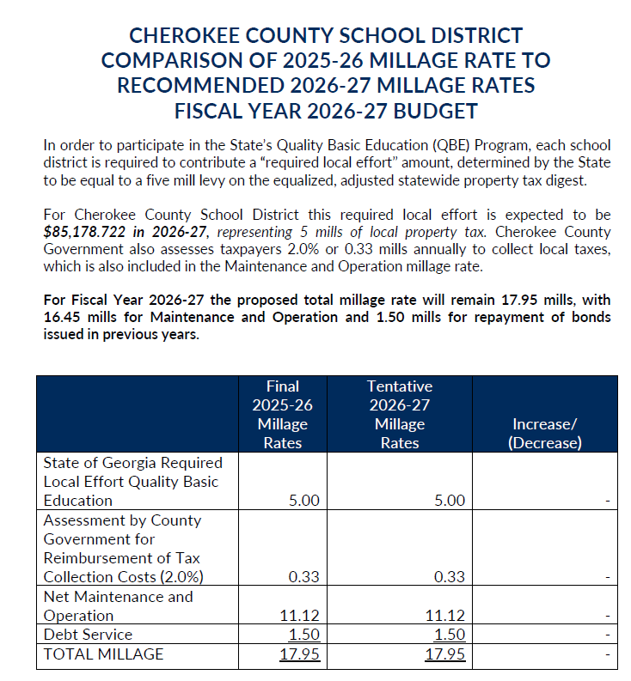
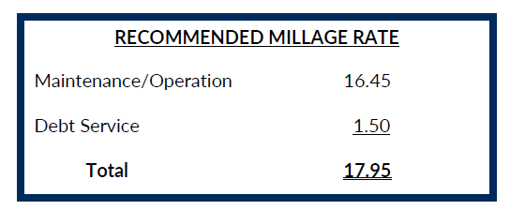
Millage Rate Comparisons

Slide 9
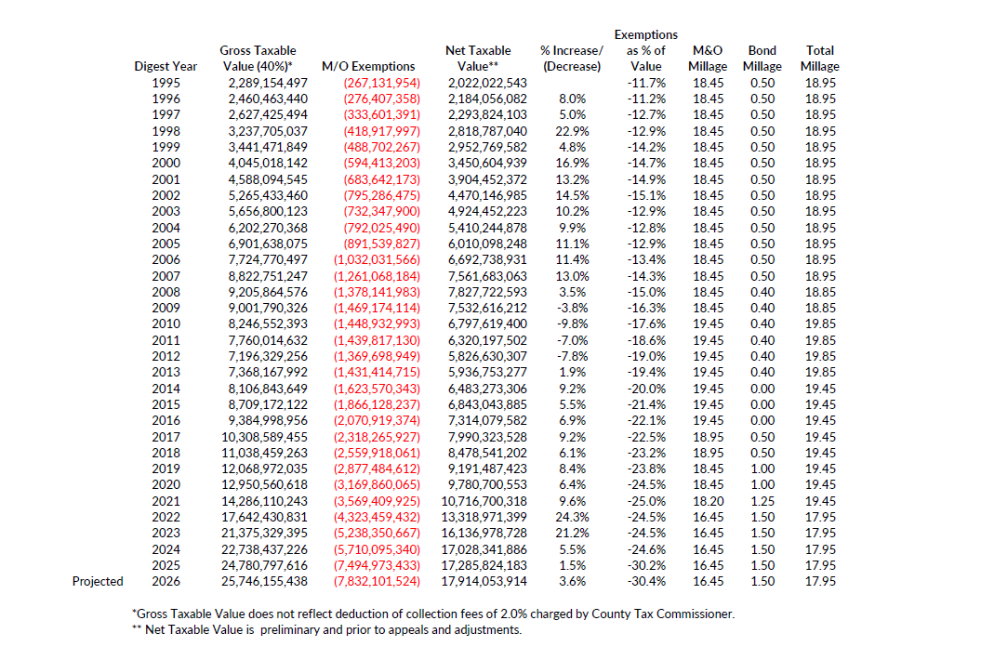
Cherokee County School District
Comparison of Cherokee County Gross Taxable Value
Fiscal Year 1995-2026

Slide 10
Cherokee County School District
Comparison of Cherokee County Gross Taxable Value
Fiscal Year 1995-2026

Slide 11
Cherokee County School District
Comparison of Cherokee County Gross Taxable Value
Fiscal Year 1995-2026

Slide 12
Cherokee County School District
Comparison of Cherokee County Gross Taxable Value
Fiscal Year 1995-2026

Slide 13
Cherokee County School District
Comparison of Cherokee County Gross Taxable Value
Fiscal Year 1995-2026

Slide 14
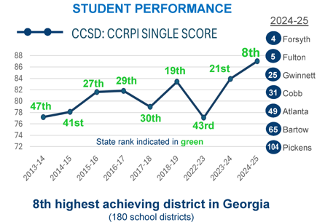
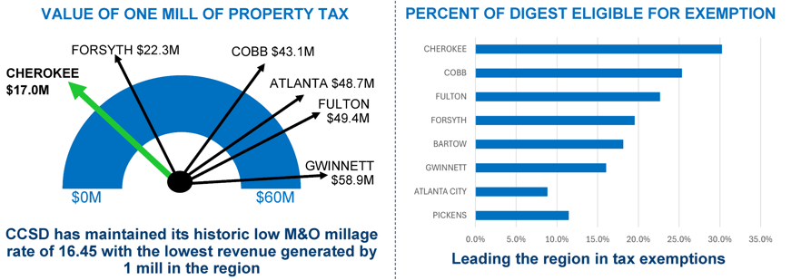
Elevating the Excellence: Return On Investment
District | M&O Millage Rate | Debt Services Millage Rate
Cherokee County | 16.45 | 1.5
Cobb County | 18.7 | 0
Fulton County | 17.08 | 0
Forsyth County | 15.208 | 1.418
Bartow County | 17.18 | 0
Gwinnett County | 18.7 | 1.45
Atlanta City Schools | 20.5 | 0
Cherokee County Schools achieved the highest CCRPI score while generating the lowest revenue per mill of tax and the highest percentage of property exempt from school tax.

Slide 15
How Does Cherokee County School District Use Local Property Tax Revenue?
Local funds are derived primarily from property taxes and fill the gap between the Quality Basic Education (QBE) formula funds provided by the State and the actual cost of providing services above and beyond the basics to the students of Cherokee County. The table below shows a few of those gaps between what is considered basic by the State and the cost in local funds to provide excellence to our students and community in FY25.
FY25 FUNDING RATIOS
CATEGORY | STATE FUNDS | LOCAL FUNDS | TOTAL
Student Transportation | $10,996,881 | $21,533,880 | $32,530,761
School Nurses | $997,440 | $2,556,980 | $3,554,420
Safety and Security | $2,398,861 | $3,811,989 | $6,210,850
Teacher Compensation | $142,503,230 | $77,761,626 | $220,264,856
Teacher Benefits | $65,651,930 | $51,035,162 | $116,687,092
Special Education | $53,053,923 | $29,811,963 | $82,865,886
Technology/Hardware/Software | $2,746,557 | $20,273,639 | $23,020,196
Pre-K | $2,765,597 | $3,847,965 | $6,613,562
TOTALS | $281,114,419 | $210,633,204 | $491,747,623
Teacher Compensation
Safety and Security
Technology
Transportation
STATE $
LOCAL $

Slide 16
Budget Development Calendar of Events

