Slide 1
Fresno Unified Blended
Instructional Models

Slide 2
FUSD MODELS

Slide 3
ELEMENTARY ELA K-1

Slide 4


Rotation Model with Targeted Pull-Out for Designated ELD
Targeted Small Group
Independent or Pairs
Whole Group Opening
Students pulled as needed; Consider strategies to ensure all students have instructional time with teacher.
Check Understanding
?
Independent
3
station rotation
Collaboration/Creation
Introduce or review new concepts followed by a quick check for understanding.
Student Reflection or Check for Understanding
If you have... | Whole Group Opening | Station Rotation | Closing: Check for Understanding
85-90 mins | 5-20 mins | 20 minute Rotations x 3 = 60 minutes (5-10 mins to rotate) | 5-15 mins
120 mins | 10-20 mins | 30 minute Rotations x 3 = 90 minutes (5-10 mins to rotate) | 5-15 mins
This instructional model can be implemented in any subject area.
This instructional model can be implemented in any subject area.
Notes:
ELD Students are pulled out homogeneously based on EL levels and ELD standards
Students need to receive designed ELD daily and minimally for 30 minutes
This is one grouping option for designated ELD, in kinder designated ELD can also be whole group

Slide 5
4 Rotation Model: Kinder. ELA w/ Instructional Assistant
Targeted Small Group
Whole Group Opening
Check Understanding
?
Independent
Collaboration
4
station rotation
Introduce or review new concepts followed by a quick check for understanding.
Student Reflection or Check for Understanding
Targeted Small Group
If you have... | Whole Group Opening | Station Rotation | Closing: Check for Understanding
85-90 mins | 5-20 mins | 20 minute Rotations x 4 = 80 minutes (5-10 mins to rotate) | 5-15 mins
120 mins | 10-20 mins | 30 minute Rotations x 4 = 120 minutes (5-10 mins to rotate) | 5-15 mins
This instructional model can be implemented in any subject area.
Notes:
4 station rotation includes a targeted small group led by the instructional assistant.
Digital Tools can be used at independent station (Wonders/GoMath assignments), digital games
Collaboration-peer projects, peer editing/revising, HFW, sight words
Using Wonders foundations kits, leveled readers, extension activities, listening center, RWW
Formative assessments, Practice Books

Slide 6
3 Rotation Model: First Grade (Example 1)
Targeted Small Group
Whole Group Opening
Check Understanding
?
3
station rotation
Independent/Digital Content
Collaboration
Introduce or review new concepts followed by a quick check for understanding.
Student Reflection or Check for Understanding
If you have... | Whole Group Opening | Station Rotation | Closing: Check for Understanding
85-90 mins | 5-20 mins | 20 minute Rotations x 3 = 60 minutes (5-10 mins to rotate) | 5-15 mins
120 mins | 10-20 mins | 30 minute Rotations x 3 = 90 minutes (5-10 mins to rotate) | 5-15 mins
This instructional model can be implemented in any subject area.
Notes:
Digital Tools can be used at independent station (Wonders/GoMath assignments), digital games
Using Wonders foundations kits, leveled readers, extension activities, listening center, RWW
Collaboration-peer projects, peer editing/revising, HFW, sight words
Formative assessments, Practice Books

Slide 7
4 Rotation Model: First Grade (Example 2)
Targeted Small Group
Whole Group Opening
Check Understanding
?
Independent
Collaboration
4
station rotation
Introduce or review new concepts followed by a quick check for understanding.
Student Reflection or Check for Understanding
Digital Content
If you have... | Whole Group Opening | Station Rotation | Closing: Check for Understanding
85-90 mins | 5-20 mins | 20 minute Rotations x 4 = 80 minutes (5-10 mins to rotate) | 5-15 mins
120 mins | 10-20 mins | 30 minute Rotations x 4 = 120 minutes (5-10 mins to rotate) | 5-15 mins
This instructional model can be implemented in any subject area.
Notes:
Digital Tools at independent(digital content) station (Wonders/GoMath assignments), digital games
Independent Center listening center, foundational skills activities, Practice Books
Using Wonders foundations kits, leveled readers, extension activities, RWW
Collaboration-peer projects, peer editing/revising, HFW, sight words
Formative assessments, Practice Books

Slide 8
3 Rotation Model with Targeted Pull-Out
Targeted Small Group
Independent or Pairs
Whole Group Opening
Students pulled as needed; Consider strategies to ensure all students have instructional time with teacher.
Check Understanding
?
Independent
Collaboration/Creation
Introduce or review new concepts followed by a quick check for understanding.
3
station rotation
Student Reflection or Check for Understanding
If you have... | Whole Group Opening | Station Rotation | Closing: Check for Understanding
85-90 mins | 5-20 mins | 20 minute Rotations x 3 = 60 minutes (5-10 mins to rotate) | 5-15 mins
120 mins | 10-20 mins | 30 minute Rotations x 3 = 90 minutes (5-10 mins to rotate) | 5-15 mins
This instructional model can be implemented in any subject area.
This instructional model can be implemented in any subject area.

Slide 9
ELEMENTARY ELA 2-6

Slide 10
3 Rotation Model
Targeted Small Group
Whole Group Opening
Check Understanding
?
3
station rotation
Independent
Collaboration
Introduce or review new concepts followed by a quick check for understanding.
Student Reflection or Check for Understanding
Student Choice
Time frames below are flexible and will depend on your content and students.
If you have... | Whole Group Opening | Station Rotation | Closing: Check for Understanding
85-90 mins | 5-20 mins | 20 minute Rotations x 3 = 60 minutes (5-10 mins to rotate) | 5-15 mins
120 mins | 10-20 mins | 30 minute Rotations x 3 = 90 minutes (5-10 mins to rotate) | 5-15 mins
This instructional model can be implemented in any subject area.

Slide 11





3 Rotation Model over a Series of Days
Timeframe of ~86 minutes
Whole Group Opening
Check for Understanding
Independent
Student Share
Reflection
?
Day 1
 | 20-25 mins | 5-10 mins | 1 station x 25-30 mins *Based on individual needs from the check for understanding - highest need first. | 10-15 mins | 5-10 mins
Warm-Up
Focus Lesson
Targeted Small Group
Collaboration and/or Creation
Independent
Reflection
Day 2
 | 5 mins | 15 mins | 2 stations x 25 mins *Two rotations for this series that students did not complete yesterday | 5-10 mins
Day 3
Warm-Up
Targeted Small Group
Collaboration and/or Creation
Independent
Reflection
 | 5 mins | 3 stations x 25 mins | 5-10 mins
Time frames are flexible and will depend on your content and students.
This instructional model can be implemented in any subject area.
Notes:
Possible model for Days 3-5 after two days of modeling and guided practice with the Reading-Writing Workshop text/lessons.

Slide 12
3 Rotation Model with Targeted Pull-Out (Designated ELD)
Targeted Small Group
Independent or Pairs
Whole Group Opening
Students pulled as needed; Consider strategies to ensure all students have instructional time with teacher.
Check Understanding
?
Independent
3
station rotation
Collaboration/Creation
Introduce or review new concepts followed by a quick check for understanding.
Student Reflection or Check for Understanding
Time frames below are flexible and will depend on your content and students.
If you have... | Whole Group Opening | Station Rotation | Closing: Check for Understanding
85-90 mins | 5-20 mins | 20 minute Rotations x 3 = 60 minutes (5-10 mins to rotate) | 5-15 mins
120 mins | 10-20 mins | 30 minute Rotations x 3 = 90 minutes (5-10 mins to rotate) | 5-15 mins
This instructional model can be implemented in any subject area.
This instructional model can be implemented in any subject area.

Slide 13
SECONDARY ELA

Slide 14
3 Rotation Model
Targeted Small Group
Whole Group Opening
Check Understanding
?
3
station rotation
Independent
Collaboration
Engage/Introduce/Review
Expectations: Learning Target
Student Reflection/
Feedback/CFU
If you have... | Whole Group Opening | Station Rotation | Closing: Check for Understanding
45-55 mins | 5 mins | 10 minute Rotations x 3 = 30 minutes (5 mins to rotate) | 5-10 mins
120 mins | 10-15 mins | 30 minute Rotations x 3 = 90 minutes (5 mins to rotate) | 5-10 mins
This instructional model can be implemented in any subject area.
Notes:
Note: Teacher may need to plan for two targeted days of instruction, if schedule/instructional minutes do not allow for full rotation.
Use feedback from Revision Assistant (be sure to login to access link) and the Embedded Assessment to create a blended learning environment.
Teacher is focused on providing “targeted” small group instruction, based on trends identified in the data.
Whole Group Opening: Teacher builds student clarity by: Engaging/Introducing/Reviewing Expectations (LT and Station Norms)
Independent Rotation: Students work on improving and revising their essay online (attention given to concerns highlighted in revision assistant)
Targeted Small Group: Teacher discretion, based on trends in data.
Collaboration: Teacher provides questions that engage students in collaboration/feedback/sharing that is specific to the LT and writing process.
Opportunity to take advantage of Zinc Articles/Close Reading Labs during digital independent times
CFU: Opportunity for students to reflect on their growth/offer feedback to teacher, etc.

Slide 15
1-2 Day Three Rotation model, Two Targeted Pull-Outs
Targeted Small Group
Targeted Small Group
Independent or Pairs
Students pulled as additional topics needed including designated ELD; Consider strategies to ensure all students
have instructional
time with teacher.
Whole Group Opening
Students pulled depending on topics of need
Check Understanding
?
Independent
Collaboration/Creation
Introduce or review new concepts followed by a quick check for understanding, including integrated ELD.
3
station rotation
Student Reflection or Check for Understanding
If you have... | Whole Group Opening | Station Rotation | Closing: Check for Understanding
(Two day) 45-55 mins | 10 mins | 20 minute Rotations x 2 = 60 minutes (5-10 mins to rotate) Day 1:Whole group+Independent+targeted+C4U Day 2: Independent+Collaborative Creation+C4U | 5 mins
(One day)120 mins block schedule | 10-20 mins | 30 minute Rotations x 3 = 90 minutes (5-10 mins to rotate) As illustrated | 5-15 mins
This instructional model can be implemented in any subject area.
Notes:
Considerations:
Schools not on block schedules would break this down over two days
Whole group opening should leverage the language resources available in selected texts and tasks for integrated ELD as defined by the CA ELD Standards in Parts 1 and 3
Teachers use the content, literacy, and ELD Standards to plan for instruction, Part 1 ELD Standards to define the purposes and content of collaboration (academic discourse) and Part 2 to define the language challenges of their disciplinary text in support of literacy and content standards
The first targeted Small Group should address language features, content challenges, literary discipline features.
Second Small Group should address language (designated ELD) and/or disciplinary concepts not grasped during Whole Group or first Small Group, based on just in time data collection and checks for understanding
Teachers group students according to language proficiency, content proficiency.
Opportunity to take advantage of Zinc Articles/Close Reading Labs during digital independent times.
Independent learning can include programs that provide primary language support such as Google translate or Khan Academy in home languages or Khan en espanol, or through BIA.
Collaboration/Creation should be structured to support academic discourse where students build on each others’ responses and build knowledge together, with appropriate scaffolds to produce rigorous work.

Slide 16

Type of card: Whole Group Opening (Start with this set)
During “Engage” and “Explore” of the Lesson
Critical component of each lesson
Teacher provides opportunity for students to engage in mathematical investigation (Unlock the Problem/Think Smarter)
Students provide the strategies and thinking
Teacher circulates and addresses misconceptions through questioning across groups as needed
Teacher makes mathematics of lesson explicit by sharing a variety of students’ representations and/or solution methods
Notes:
Please include the following components
Grade level/subject areas (when applicable)
Time-Allotments - Ranges of time allotments for different components of model
Model Summary - paragraph description of model
BE SURE TO USE THE FUSD LOGOS WHERE APPLICABLE
Digital Content and Tools - identify any suggested tools or providers you plan to incorporate
Key Instructional Strategies - Any common instructional strategies you plan to incorporate and where they fit within the model
Opening/Closing - Including any Checks for Understanding or formative assessment strategies

Slide 17
Type of card: Skill-based Small Group
Skill-Based Targeted Small Group
During “Explain” of Lesson
Teacher uses data to determine a specific skill in need for a small group (homogeneous grouping)
Students targeted based on skill-based need
Teacher and students connect concepts to procedures
Common errors are corrected
Tools and modeling support student understanding
Notes:
Please include the following components
Grade level/subject areas (when applicable)
Time-Allotments - Ranges of time allotments for different components of model
Model Summary - paragraph description of model
BE SURE TO USE THE FUSD LOGOS WHERE APPLICABLE
Digital Content and Tools - identify any suggested tools or providers you plan to incorporate
Key Instructional Strategies - Any common instructional strategies you plan to incorporate and where they fit within the model
Opening/Closing - Including any Checks for Understanding or formative assessment strategies

Slide 18
Type of card: Concept-based Small Group
Concept-Based Targeted Small Group
During “Explain” of Lesson (semi-heterogeneous grouping)
Students interact with each other
Teacher surfaces student strategies and elicits common errors
Teacher elicits and corrects common errors
Teacher facilitates concept application to additional problems/tasks as needed
Notes:
Please include the following components
Grade level/subject areas (when applicable)
Time-Allotments - Ranges of time allotments for different components of model
Model Summary - paragraph description of model
BE SURE TO USE THE FUSD LOGOS WHERE APPLICABLE
Digital Content and Tools - identify any suggested tools or providers you plan to incorporate
Key Instructional Strategies - Any common instructional strategies you plan to incorporate and where they fit within the model
Opening/Closing - Including any Checks for Understanding or formative assessment strategies

Slide 19

Type of model: Independent Practice
During “Explain” or “Evaluate” Phase of Lesson
When students are using a computer, they should use tools to support their processing, ie. Whiteboards, manipulatives, digital tools
Quality tech options
  GoMath-PMT or ISE
  Digital One Note or PPT
3 ways for Independent Practice (can be tech or not)
  Work assigned differentiated to student need
  Same assignment assigned for all students
  Student menu of choice of at grade level or above tasks
Notes:
Please include the following components
Grade level/subject areas (when applicable)
Time-Allotments - Ranges of time allotments for different components of model
Model Summary - paragraph description of model
BE SURE TO USE THE FUSD LOGOS WHERE APPLICABLE
Digital Content and Tools - identify any suggested tools or providers you plan to incorporate
Key Instructional Strategies - Any common instructional strategies you plan to incorporate and where they fit within the model
Opening/Closing - Including any Checks for Understanding or formative assessment strategies

Slide 20
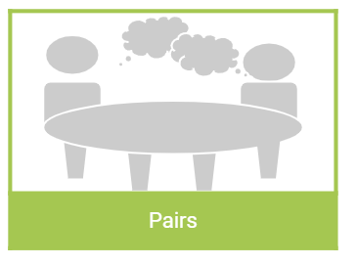
Type of card: Pairs
During the “Explore” or “Explain” Phase
Students solve mathematical tasks in pairs
Structure opportunities so that both students are able to model and explain their reasoning
Academic math language is less a requirement and more a “means” to an end
  Students speak about each other’s thinking to clarify, self-assess and improve their understanding
  Language is used through building, argumentation, and questioning
Tech Connection:
Ways to utilize tech tools with pairs
One device with two students (driver/passenger model)
Both on device with one student processing, the second recording
Notes:
Please include the following components
Grade level/subject areas (when applicable)
Time-Allotments - Ranges of time allotments for different components of model
Model Summary - paragraph description of model
BE SURE TO USE THE FUSD LOGOS WHERE APPLICABLE
Digital Content and Tools - identify any suggested tools or providers you plan to incorporate
Key Instructional Strategies - Any common instructional strategies you plan to incorporate and where they fit within the model
Opening/Closing - Including any Checks for Understanding or formative assessment strategies

Slide 21

Type of card: Group Collaborative Task
During “Explain”, “Elaborate” or “Evaluate”
Students engage in a collaborative task that must be accomplished together
Opportunity to have defined student roles or for students to clarify their roles
Group comes to consensus when completing
Needed criteria for success understood by students
Task is rich and deepens application of standards knowledge
Students reflect on both their content applied and the process their group used to experience success or failure
Possible Tools/Resources
GoMath
  Enrichment
  Performance Task
  Unit Project
Digital tools
  One computer/group to support research/digital support through TC or Khan
Notes:
Please include the following components
Grade level/subject areas (when applicable)
Time-Allotments - Ranges of time allotments for different components of model
Model Summary - paragraph description of model
BE SURE TO USE THE FUSD LOGOS WHERE APPLICABLE
Digital Content and Tools - identify any suggested tools or providers you plan to incorporate
Key Instructional Strategies - Any common instructional strategies you plan to incorporate and where they fit within the model
Opening/Closing - Including any Checks for Understanding or formative assessment strategies

Slide 22
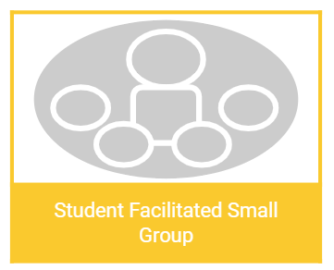
Type of card: Student Facilitated Small Group
During “Explain” or “Elaborate”
Based on data, create an opportunity for students who are mastering a concept/skill to facilitate learning for small groups of students who are not (similar to AVID tutorial)
Student facilitator uses a word problem or set of problems to engage fellow students in analyzing the math
Student facilitator guides discussion through questions and does not do the math for the students
Students reflect on the experience in two ways:
  Student facilitators stand in front of the room and share how their classmates’ (by name) understanding improved
  Student learners share the growth they experienced
Tools Needed:
Giant sticky/chart paper with problems written
Math resources/manipulatives to support learning
Notes:
Please include the following components
Grade level/subject areas (when applicable)
Time-Allotments - Ranges of time allotments for different components of model
Model Summary - paragraph description of model
BE SURE TO USE THE FUSD LOGOS WHERE APPLICABLE
Digital Content and Tools - identify any suggested tools or providers you plan to incorporate
Key Instructional Strategies - Any common instructional strategies you plan to incorporate and where they fit within the model
Opening/Closing - Including any Checks for Understanding or formative assessment strategies

Slide 23
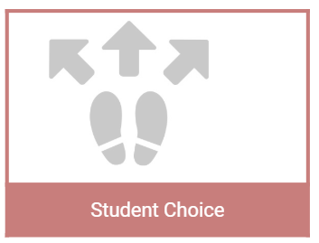
Type of card: Extension Student Choice
During “Explain” or “Elaborate” or Outside of Core
Students choose between a menu of options at or above grade level to reflect their learning
Options could include students choosing from the card options provided, ie. Independent, Small Group Support with the teacher, collaborative task, pairs, etc.
Digital content could be used to support different options, such as ISE for students who think they need a higher level of support, PMT for students who believe they need less support
Ability to set “Must do” and “May do”, such as Must do PMT, May do Khan Academy to extend
Notes:
Please include the following components
Grade level/subject areas (when applicable)
Time-Allotments - Ranges of time allotments for different components of model
Model Summary - paragraph description of model
BE SURE TO USE THE FUSD LOGOS WHERE APPLICABLE
Digital Content and Tools - identify any suggested tools or providers you plan to incorporate
Key Instructional Strategies - Any common instructional strategies you plan to incorporate and where they fit within the model
Opening/Closing - Including any Checks for Understanding or formative assessment strategies

Slide 24

Type of card: Genius Hour Inquiry Model
Outside of Core Extension Opportunity to Cross Contents
Students determine an important research question/problem to solve, ie. school, science, community, health, sports related topics
  Students determine what digital resources they will use to collect, analyze, and present information
  Students research the topic
  Students determine what data they need to gather (interviews, multiple choice questions they can ask their schoolmates)
  Students determine how they will collect the data (digital surveys, research, etc.)
  Students reflect on what math they will need to be successful as they work to solve a problem
  Students collect and analyze data
  Students share research to class, school, community, potentially in digital spaces
Notes:
Please include the following components:
Grade level/subject areas (when applicable)
Time-Allotments - Ranges of time allotments for different components of model
Model Summary - paragraph description of model
BE SURE TO USE THE FUSD LOGOS WHERE APPLICABLE
Digital Content and Tools - identify any suggested tools or providers you plan to incorporate
Key Instructional Strategies - Any common instructional strategies you plan to incorporate and where they fit within the model
Opening/Closing - Including any Checks for Understanding or formative assessment strategies

Slide 25
SECONDARY MATH

Slide 26
Secondary Mathematics 3 Rotation Model
Engage | Explore | Explain | Elaborate | Evaluate
Targeted Small Group
Mini Lesson
Check Understanding
?
Teacher guided through flexible grouping to allow more one on one guided practice. Could be based on extension, intervention, and/or misconception
Differentiated Lessons from Big Ideas Curriculum
Engagement: Make connections between past and present learning experiences. Focus students’ thinking on the learning outcomes of the day and engage student in concept, process, or skill to be learned.
Evaluate- Encourages learners to assess their understanding and abilities and lets teachers evaluate students’ understanding of key concepts and skill development.
Student Owned Practice
Collaborative Tasks
3
station rotation
Explain and elaborate using technology, your turn, online student edition, with tutorial video, desmos, dynamic classroom, online quiz, khan academy, etc
Exploration, elaborate with higher order thinking problem task, keep kids in heterogeneous grouping
If you have... | Mini Lesson | Station Rotation | Closing: Check for Understanding
45-60 (MS) | 10-15 mins | 20-30 mins (3 rotations) | 5-10 mins
85-90 mins (HS) | 5-20 mins | 20 minute Rotations x 3 = 60 minutes (5-10 mins to rotate) | 5-15 mins
This instructional model can be implemented in any subject area.
Notes:
Considerations:
Set up classroom expectations and routines for group work
Practice and talk about what the station looks like while implementing the current learning within the lessons
Model each station group separately while students work within small groups while all are doing the same rotation
Teacher could have a teacher led group, small group instruction, and/or one on one instruction while all students rotate within independent groups
Teacher can have a teacher led group,

Slide 27
Mathematics Class Shift with Effective Use of Technology
Engage | Explore | Explain | Elaborate | Evaluate
Mini Lesson
Targeted Small Group
Student Owned Practice
Check Understanding
?
Engagement: Make connections between past and present learning experiences. Focus students’ thinking on the learning outcomes of the day and engage student in concept, process, or skill to be learned.
Teacher guided through flexible grouping to allow more one on one guided practice. Could be based on extension, intervention, and/or misconception
Differentiated Lessons from Big Ideas Curriculum
Explain and elaborate using technology, your turn, online student edition, with tutorial video, desmos, dynamic classroom, online quiz, khan academy, etc
Evaluate- Encourages learners to assess their understanding and abilities and lets teachers evaluate students’ understanding of key concepts and skill development.
If you have... | Mini Lesson | Station Rotation | Closing: Check for Understanding
45-60 (MS) | 10-15 mins | 15 - 20 mins (2 rotations) | 5 mins
85-90 mins (HS) | 5-20 mins | 20 minute Rotations x 3 = 60 minutes (5-10 mins to rotate) | 5-15 mins
This instructional model can be implemented in any subject area.
ese
Notes:
Ways to innovate within the station teaching to help students and teachers begin using the processes in a targeted way

Slide 28
Mathematics Class Shift with Collaborative Practice
Engage | Explore | Explain | Elaborate | Evaluate
Mini Lesson
Student Owned Practice
Collaborative Tasks
Check Understanding
?
Engagement: Make connections between past and present learning experiences. Focus students’ thinking on the learning outcomes of the day and engage student in concept, process, or skill to be learned.
Explain and elaborate using technology, your turn, online student edition, with tutorial video, desmos, dynamic classroom, online quiz, khan academy, etc
Exploration, elaborate with higher order thinking problem task, keep kids in heterogeneous grouping
Evaluate- Encourages learners to assess their understanding and abilities and lets teachers evaluate students’ understanding of key concepts and skill development.
If you have... | Mini Lesson | Station Rotation | Closing: Check for Understanding
45-60 (MS) | 10-15 mins | 15 - 20 mins (2 rotations) | 5 mins
85-90 mins (HS) | 5-20 mins | 20 minute Rotations x 3 = 60 minutes (5-10 mins to rotate) | 5-15 mins
This instructional model can be implemented in any subject area.
Notes:
Ways to innovate within the station teaching to help students and teachers begin using the processes in a targeted way

Slide 29
PHYSICAL EDUCATION

Slide 30
Rotation Model with Targeted Pull-Out for Physical Education
Targeted Small Group
Independent or Pairs
Whole Group Opening
Students pulled as needed; Consider strategies to ensure all students have instructional time with teacher.
Check Understanding
?
Independent
Collaboration/Creation
Introduce or review new concepts followed by a quick check for understanding.
3
station rotation
Student Reflection or Check for Understanding
If you have... | Whole Group Opening | Station Rotation | Closing: Check for Understanding
85-90 mins | 5-20 mins | 20 minute Rotations x 3 = 60 minutes (5-10 mins to rotate) | 5-15 mins
120 mins | 10-20 mins | 30 minute Rotations x 3 = 90 minutes (5-10 mins to rotate) | 5-15 mins
This instructional model can be implemented in any subject area.
This instructional model can be implemented in any subject area.
Notes:
Instructor opens with new concept/skill regarding Physical Education Activity Topic
Station Rotations: Each station builds and practices upon a specific skill/strategy to work on
Target Small Group: Students receive instructional time with teacher to receive feedback, reflect and re-teach or build upon current level of skills if necessary
Check For Understanding: Instructor assesses if students were have met all target goals and are ready to move on

Slide 31



Physical Education Flexible Playlist
Independent
Targeted Small Group
E
E
Whole Group Opening
Check Understanding
E
E
Independent or Pairs
Creation
?
Check for Understanding
E
E
Engagement: teacher uses a video clip, book, demonstration or lab model
Note: Depending on readiness, interest, and/or choice determines the playlist experience.
Evaluate: STEM or Performance Assessment
Genius Hour
Student Choice
E
E
If you have... | Opening and Check | Student Playlist with order based on need, choice, interest | Closing: Check for Understanding
40-45 mins | 5-10 mins | 25-30 minutes on Flexible Playlist | 5-10 mins
60 mins | 5-15 mins | 30-40 minutes on Flexible Playlist | 5-15 mins
This instructional model can be implemented in any subject area.
Notes:
Whole Group- Instructor introduces several different activities that will enhance fitness
Instructor does a quick check for understanding to ensure students understand task and expectations
Students choose activities from a flexible playlist based upon fitness area of need, choice, and interest
Instructor provides a check for understanding by using a rubric to identify performance assessment

Slide 32
BASE BL MODELS

Slide 33
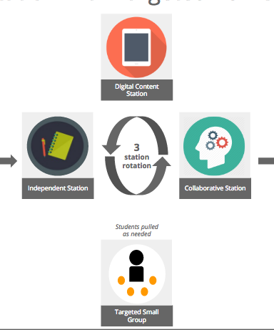
Base Model: Rotation
Description: Students to visit various stations or centers during the allotted time for a specific subject. Stations may be assigned by teacher, or self-selected by students. Digital content plays a role in delivery of content, aligned with offline curriculum.
Benefits:
Stations can address different levels of depth with students
Teachers can work with smaller groups of students to provide targeted instruction
Students have opportunities for collaborative and self-led learning
Students have multiple opportunities to reflect their learning in different ways
Considerations:
What digital content and tools are available to support offline instruction?
How do you ensure content is differentiated across stations for individual students?
How are students being grouped?
What routines and procedures do you have in place to support a blended station rotation?

Slide 34
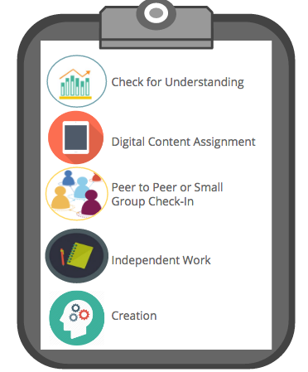
Base Model: Flexible Playlist
Description: Students work through customized and flexible playlists of learning objectives and activities within a lesson, unit, or full course. The teacher provides face-to-face support on a flexible and adaptive basis.
Benefits:
Students are able to choose how they learn and when they learn.
Students are able to receive more one-on-one support from the teacher.
Students are able to supplement their learning with material online and offline.
Students are able to experience targeted instruction, group projects, and individual instruction.
Considerations:
What routines and procedures do you have in place to support a flex model?
How do students take control of their learning?
What decisions does the teacher have to make to differentiate the learning for individual students?
What digital content and tools are available to support instruction during a flex model?

Slide 35





Base Model: Flipped Instruction
Description: Students receive first exposure instruction individually (i.e. through a screencast, video, reading, etc.) and use time in class to apply concepts and go deeper with teacher guidance and support.
Benefits:
Students can engage with direct instruction at their own pace
Class time can be used to engage in deeper learning opportunities, collaboratively or independently, and also with teacher guidance.
Classroom materials are accessible for students and parents anytime and anywhere.
Whole Group Hook
Considerations:
What platform will be used to host resources?
What structures will be in place for students that do not complete work outside of class?
How will teacher find time to curate and create resources ahead of lessons?
How can teacher ensure that all students have access to resources (wifi, devices) outside of class?
Whole Group Hook
Small Group
Collaboration
Digital Content

Slide 36
INSTRUCTIONAL MODEL RESOURCES

Slide 37
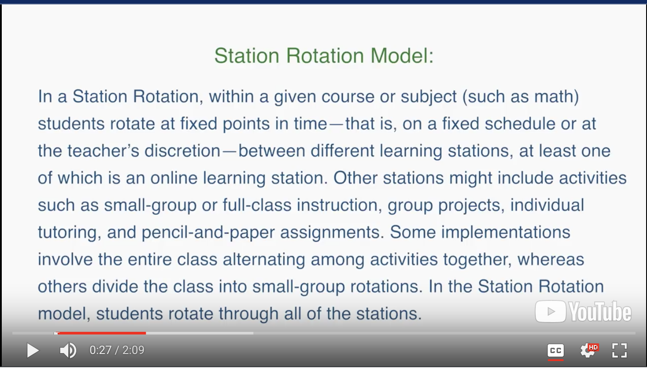
Rotation Model
Watch video here

Slide 38
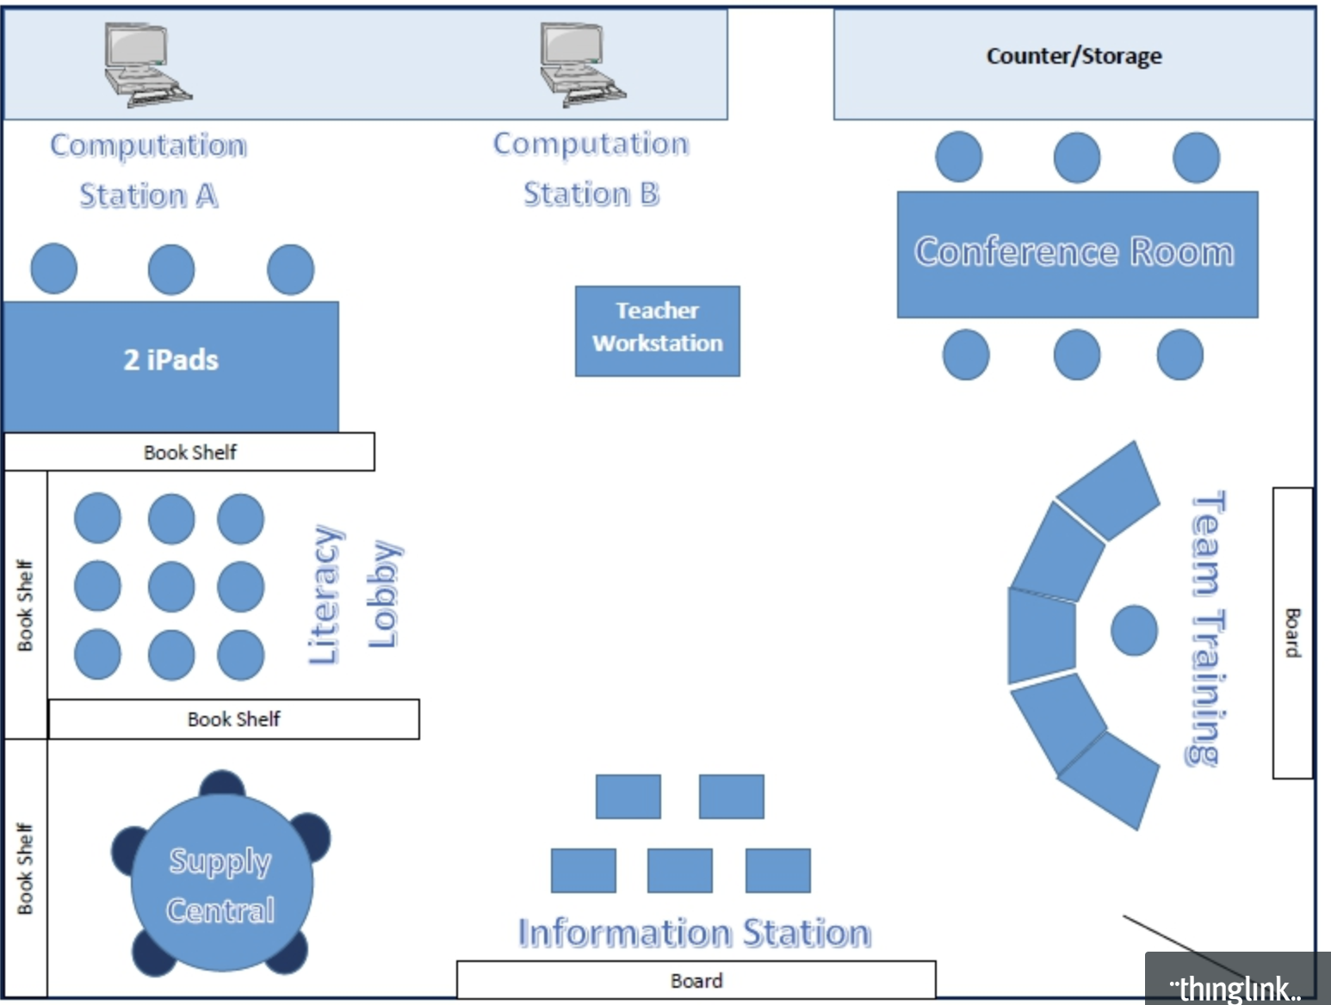
Rotation Model
Click here for interactive description of each station

Slide 39
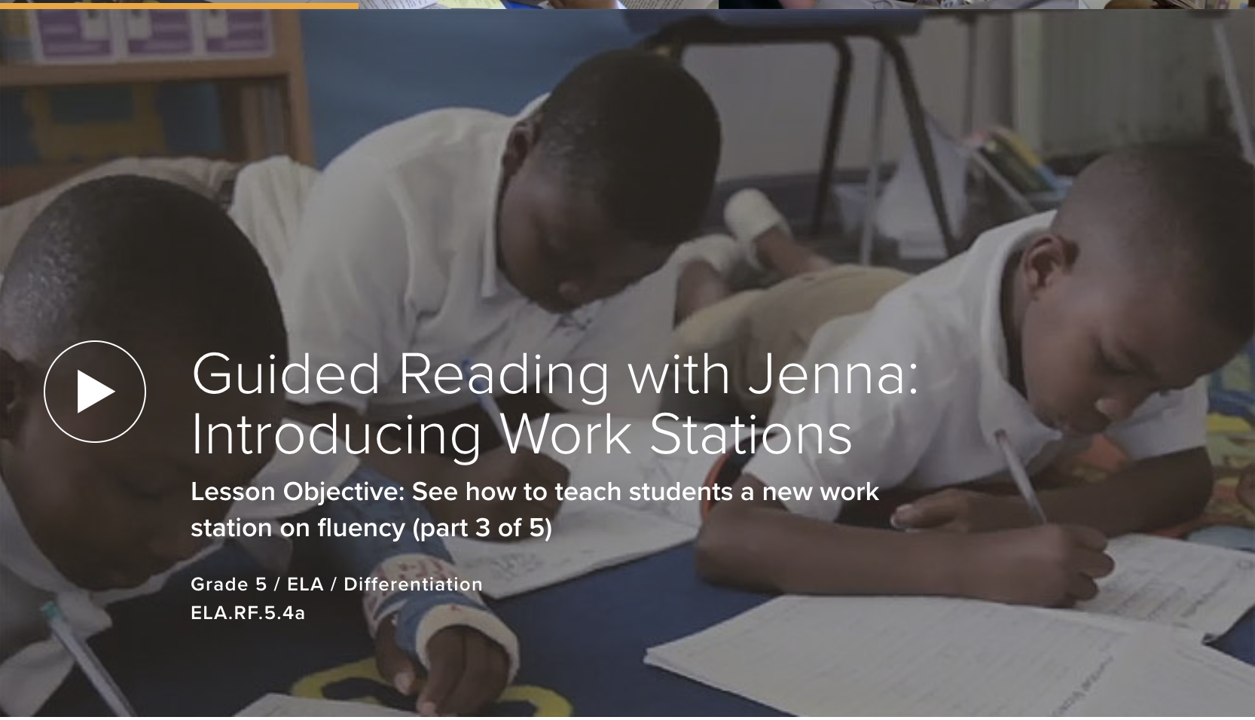
Rotation Samples
Click here to see how a new station is introduced

Slide 40
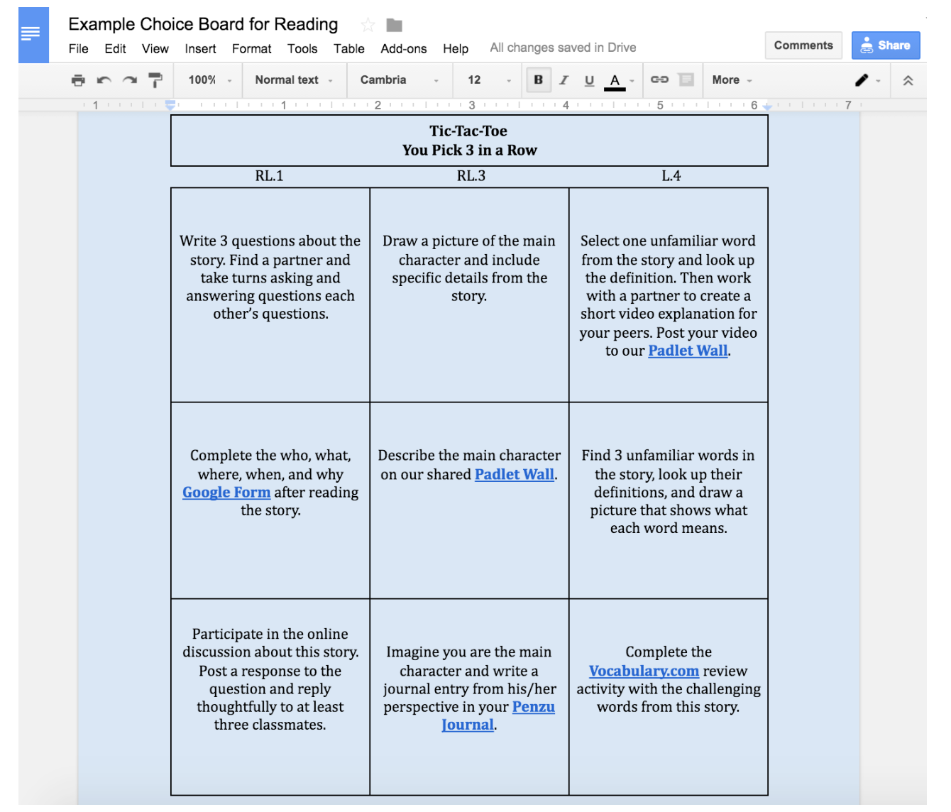
Flex Playlist
Click here to read about choice boards that include differentiation, student choice and demonstrate understanding.

Slide 41
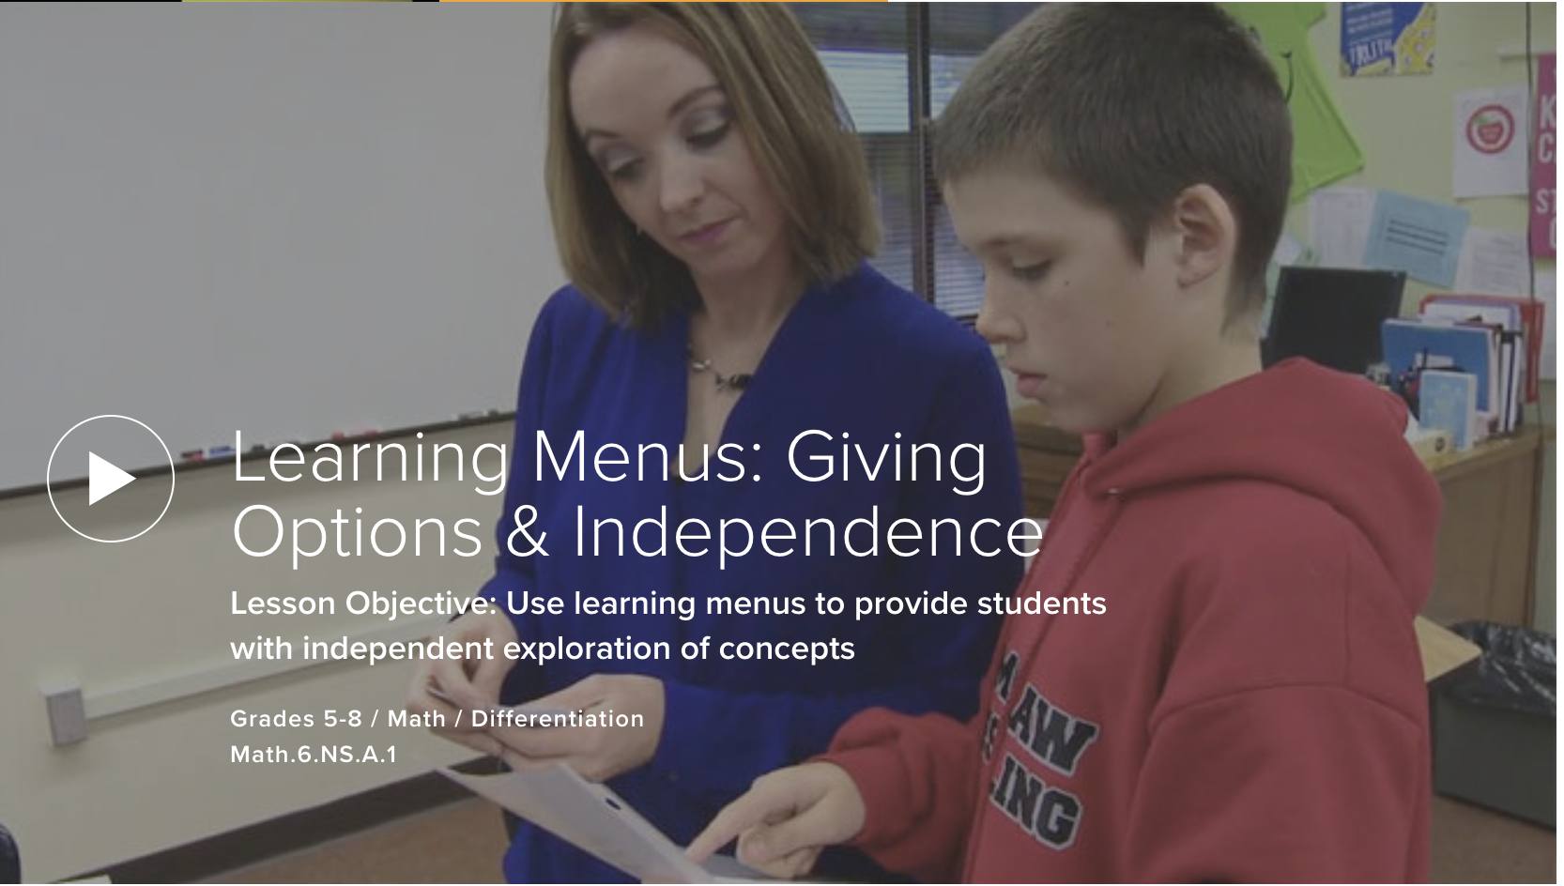
Flex Playlist
Watch video here about how a PL teacher creates learning menus to provide students with independent exploration of concepts: appetizer, main course and a dessert.

Slide 42
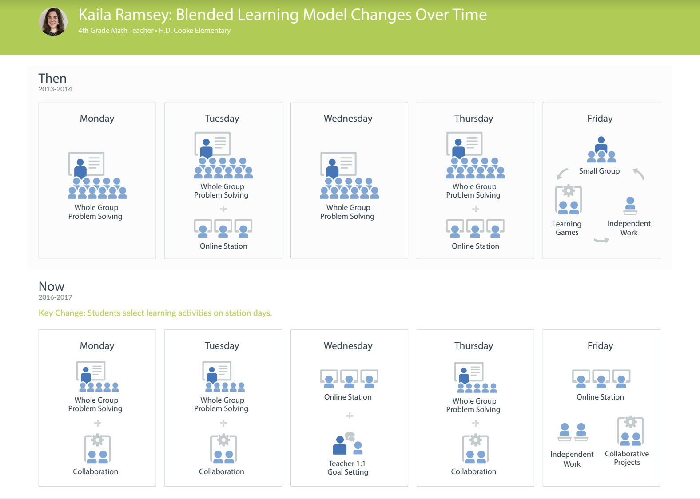
Rotation & Flex Playlist
Read about how a 4th grade math teacher has adapted her weekly station rotation model to incorporate playlists.

Slide 43

Flipped
Examples of flipped lesson plans across K-12 and subject areas [Resource Collection]

Slide 44
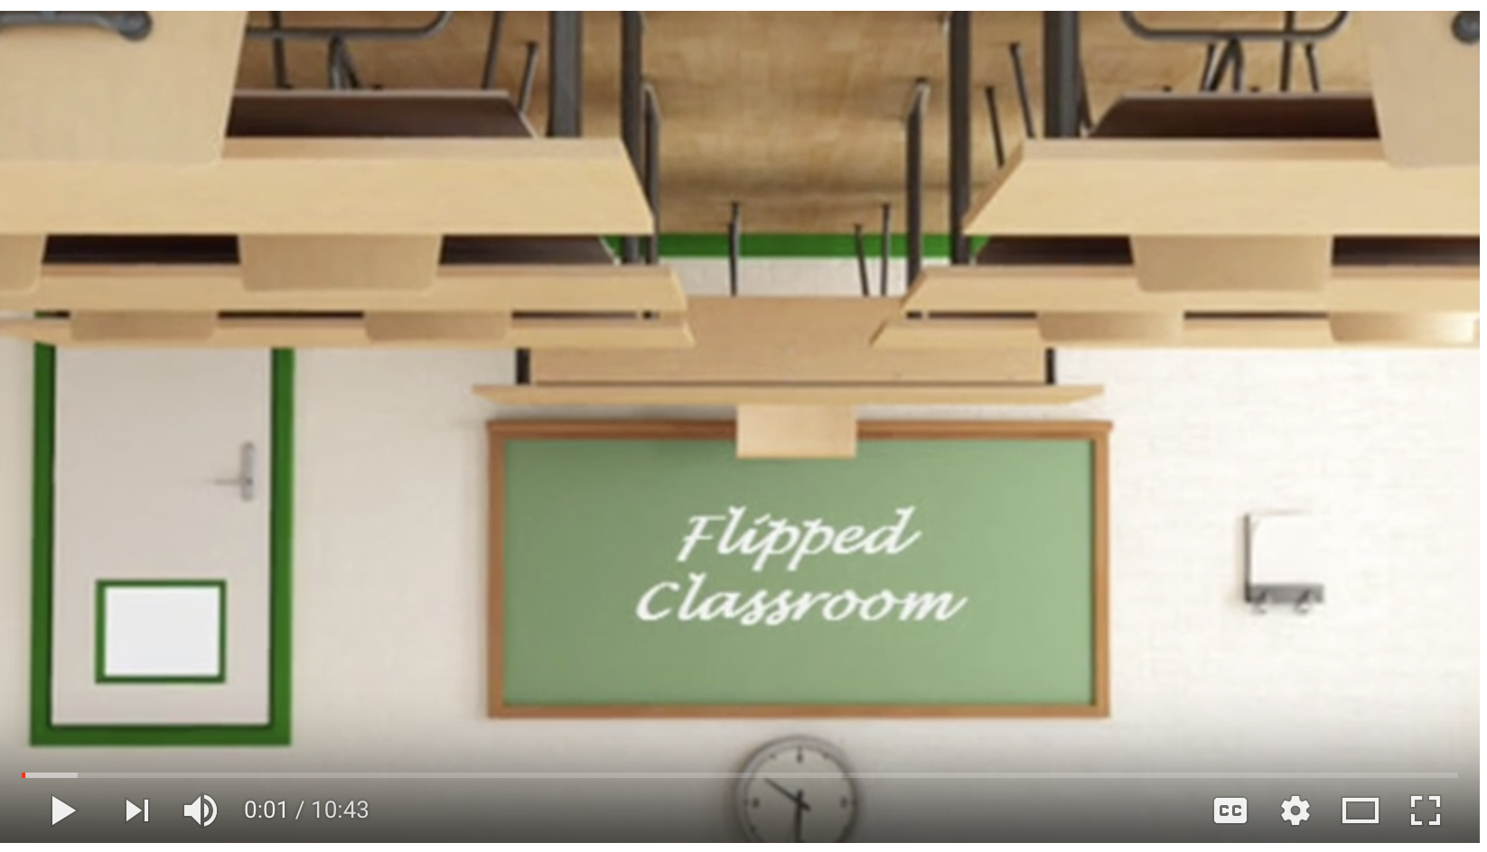
Flipped
Click here to watch Co-teachers discuss their approach to flipped using a sample lesson

Slide 45
SAMPLE CUSTOMIZED MODELS

Slide 46
3 Rotation Model
Targeted Small Group
Whole Group Opening
Check Understanding
?
3
station rotation
Independent
Collaboration
Introduce or review new concepts followed by a quick check for understanding.
Student Reflection or Check for Understanding
If you have... | Whole Group Opening | Station Rotation | Closing: Check for Understanding
85-90 mins | 5-20 mins | 20 minute Rotations x 3 = 60 minutes (5-10 mins to rotate) | 5-15 mins
120 mins | 10-20 mins | 30 minute Rotations x 3 = 90 minutes (5-10 mins to rotate) | 5-15 mins
This instructional model can be implemented in any subject area.

Slide 47
3 Rotation Model with Targeted Pull-Out
Targeted Small Group
Independent or Pairs
Whole Group Opening
Students pulled as needed; Consider strategies to ensure all students have instructional time with teacher.
Check Understanding
?
3
station rotation
Independent
Collaboration/Creation
Introduce or review new concepts followed by a quick check for understanding.
Student Reflection or Check for Understanding
If you have... | Whole Group Opening | Station Rotation | Closing: Check for Understanding
85-90 mins | 5-20 mins | 20 minute Rotations x 3 = 60 minutes (5-10 mins to rotate) | 5-15 mins
120 mins | 10-20 mins | 30 minute Rotations x 3 = 90 minutes (5-10 mins to rotate) | 5-15 mins
This instructional model can be implemented in any subject area.
This instructional model can be implemented in any subject area.

Slide 48
3 Rotation Model over a Series of Days
Whole Group Opening
Check for Understanding
Independent
Student Share
Reflection
?
Day 1
 | 20-25 mins | 5-10 mins | 1 station x 25-30 mins *Based on individual needs from the check for understanding - highest need first. | 10-15 mins | 5-10 mins
Warm-Up
Focus Lesson
Targeted Small Group
Collaboration and/or Creation
Independent
Reflection
Day 2
 | 5 mins | 15 mins | 2 stations x 25 mins *Two rotations for this series that students did not complete yesterday | 5-10 mins
Day 3
Warm-Up
Targeted Small Group
Collaboration and/or Creation
Independent
Reflection
 | 5 mins | 3 stations x 25 mins | 5-10 mins
Timeframe of ~86 minutes
This instructional model can be implemented in any subject area.

Slide 49
3 Rotation Model with Co-Teacher, Two Targeted Pull-Outs
Targeted Small Group
Targeted Small Group
Independent or Pairs
Whole Group Opening
Students pulled depending on topics of need
Students pulled as additional topics needed; Consider strategies to ensure all students
have instructional
time with teacher.
Check Understanding
?
3
station rotation
Independent
Collaboration/Creation
Introduce or review new concepts followed by a quick check for understanding.
Student Reflection or Check for Understanding
If you have... | Whole Group Opening | Station Rotation | Closing: Check for Understanding
85-90 mins | 5-20 mins | 20 minute Rotations x 3 = 60 minutes (5-10 mins to rotate) | 5-15 mins
120 mins | 10-20 mins | 30 minute Rotations x 3 = 90 minutes (5-10 mins to rotate) | 5-15 mins
This instructional model can be implemented in any subject area.
Notes:
Considerations:
Co-teachers (including SPED and EL Ts) can have mixed small groups while also servicing their students.
If co-teacher is not available for entire block, schedule supplemental instruction during targeted pull out
Consider possibility of 3 co-teachers (Content, EL, SPED) with possibility of 3 targeted groups at once

Slide 50
Writing 3 Rotation Model
Targeted Small Group
Mini Lesson
Check Understanding
Targeted Small Group could include conferring and additional mini lessons
?
3
station rotation
Connection
Teaching Point
Active Engagement
Link
Independent
Independent Writing
Student Reflection or Check for Understanding
Additional Options: Partners or Research
If you have... | Mini Lesson | Station Rotation | Closing: Check for Understanding
45-60 (ES) | 10-15 mins | 15 - 20 mins (2 rotations) | 5 mins
85-90 mins (MS) | 5-20 mins | 20 minute Rotations x 3 = 60 minutes (5-10 mins to rotate) | 5-15 mins
This instructional model can be implemented in any subject area.
Notes:
Considerations:
Texts can include hard copy or use of a device/digital content
Small group: guided writing groups, conferring, strategy groups
Writing Workshop is a component of balanced literacy. At the elementary level in LCPS, balanced literacy is called Pathways.

Slide 51
Writing 3 Rotation Model
Targeted Small Group
Mini Lesson
Check Understanding
Targeted Small Group could include conferring and additional mini lessons
?
3
station rotation
Connection
Teaching Point
Active Engagement
Link
Independent
Independent Writing
Student Reflection or Check for Understanding
Additional Options: Partners or Research
If you have... | Mini Lesson | Station Rotation | Closing: Check for Understanding
45-60 (ES) | 10-15 mins | 15 - 20 mins (2 rotations) | 5 mins
85-90 mins (MS) | 5-20 mins | 20 minute Rotations x 3 = 60 minutes (5-10 mins to rotate) | 5-15 mins
This instructional model can be implemented in any subject area.
Notes:
Considerations:
Texts can include hard copy or use of a device/digital content
Small group: guided writing groups, conferring, strategy groups
Writing Workshop is a component of balanced literacy. At the elementary level in LCPS, balanced literacy is called Pathways.

Slide 52

Math Workshop Model (60 or 90 Minutes)
1
Task
Classroom Routine
Collaborative Math Task
Student Share
Reflection
 | 5 or 15 mins | Collaborative Math Task 30 or 45 mins | 15 mins | 5-15 mins
Whole
Small
Whole
Focus Lesson
Small Group Guided Math
Independent
Collaborative
Classroom Routine
2+2
Reflection
 | 5 or 15 mins | 15 or 20 mins | Small Group Guided Math and Stations 30 or 45 mins | 5-15 mins
Small
Group with Stations or Tasks
Classroom Routine
Small Group Guided Math
Independent
Collaborative
Reflection
 | 5 or 15 mins | Small Group Guided Math and Stations 45 or 65 mins | Reflection 5-15 mins
Minimum of 60 or 90 minutes suggested for each Workshop Model

Slide 53
Science Flexible Playlist
Independent
Targeted Small Group
E
E
Whole Group Opening
Check Understanding
E
E
Independent or Pairs
Creation
?
Check for Understanding
E
E
Engagement: teacher uses a video clip, book, demonstration or lab model
Note: Depending on readiness, interest, and/or choice determines the playlist experience.
Evaluate: STEM or Performance Assessment
Genius Hour
Student Choice
E
E
If you have... | Opening and Check | Student Playlist with order based on need, choice, interest | Closing: Check for Understanding
40-45 mins | 5-10 mins | 25-30 minutes on Flexible Playlist | 5-10 mins
60 mins | 5-15 mins | 30-40 minutes on Flexible Playlist | 5-15 mins
This instructional model can be implemented in any subject area.

Slide 54
Flipped Instruction with Station Rotation
Flipped Exposure
Targeted Small Group
Whole Group Opening
Check Understanding
?
3
station rotation
Independent
Collaboration/Creation
Introduce or review new concepts followed by a quick check for understanding.
Student Reflection or Check for Understanding
If you have... | Whole Group Opening | Station Rotation | Closing: Check for Understanding
85-90 mins | 5-20 mins | 20 minute Rotations x 3 = 60 minutes (5-10 mins to rotate) | 5-15 mins
120 mins | 10-20 mins | 30 minute Rotations x 3 = 90 minutes (5-10 mins to rotate) | 5-15 mins
This instructional model can be implemented in any subject area.
This instructional model can be implemented in any subject area.

Slide 55
MODEL ICONS

Slide 56


Whole Group Opening
Targeted Small Group
Independent
Collaboration
Check Understanding
?
Warm-Up
Targeted Small Group
Lab
Genius Hour
Purposeful Share
Specialized Reading
Independent Reading
Independent Writing
Student Choice
Mid-Workshop

