Slide 1
Investment Report
Quarter Ended February 28, 2026
Ann Westbrooks, CPA, RTSBA
Chief Financial Officer

Slide 2
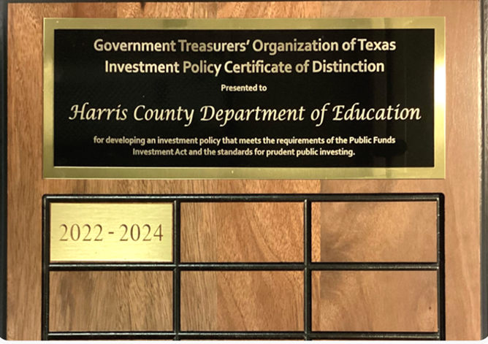
QUARTERLY INVESTMENT REPORT (unaudited)
PURPOSE OF REPORT
As of March 31, 2026
State compliance with state law, HCDE policy and investment strategy.
Texas Government Code, Section 2256, Public Funds Investment Act; and
HCDE CDA (LEGAL) and CDA (LOCAL), Other Revenues: Investments
Describe investment position at report date.
HCDE Portfolio by Investment Type / PFC Portfolio by Investment Type
State account or fund for each investment asset.
HCDE Investment Earnings Reports / PFC Investment Earnings Reports
State book and market value for each investment asset at beginning and end of the period.
HCDE Inventory Report / PFC Inventory Report
Present a summary statement for each pooled fund group, including beginning market value; additions and changes to market value during the period; and ending market value.
HCDE Inventory Report / PFC Inventory Report

Slide 3
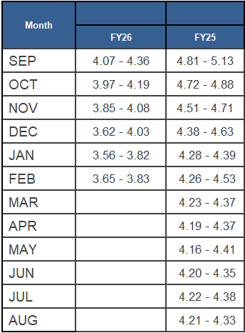
QUARTERLY INVESTMENT REPORT (unaudited)
INVESTMENT INTEREST RATES AND EARNED YIELD
Quarter Ended February 28, 2026
Interest rates are trending lower in 2026 when compared to 2025 due to interest rate cuts in late 2025
Investment approach – safety→ liquidity→ yield

Slide 4
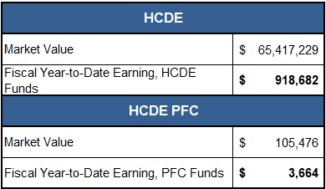
QUARTERLY INVESTMENT REPORT (unaudited)
HCDE & PFC PORTFOLIO MARKET AND BOOK VALUE
Quarter Ended February 28, 2026
Book Value = Market Value
Book value refers to the financial institution statement which is reconciled to the department's general ledger

Slide 5
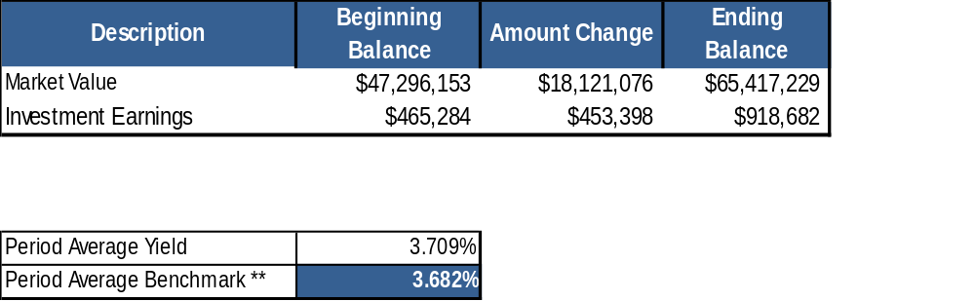
QUARTERLY INVESTMENT REPORT (unaudited)
BEGINNING AND ENDING VALUES
Quarter Ended February 28, 2026

Slide 6
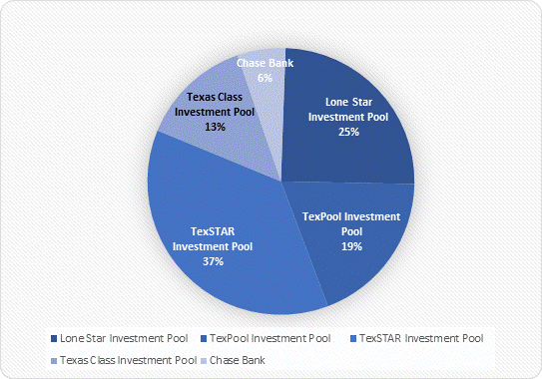
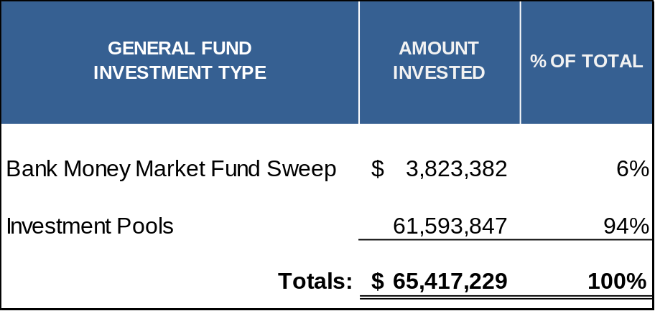
QUARTERLY INVESTMENT REPORT (unaudited)
HCDE PORTFOLIO BY INVESTMENT TYPE
Quarter Ended February 28, 2026

Slide 7
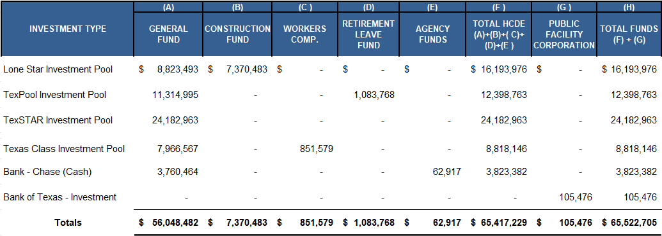
QUARTERLY INVESTMENT REPORT (unaudited)
INVESTMENT BY FUND BY TYPE
Quarter Ended February 28, 2026

Slide 8
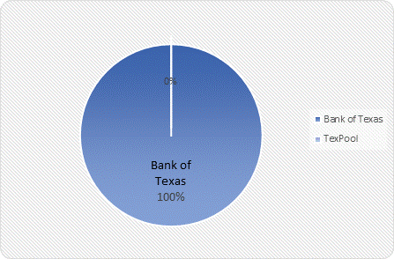
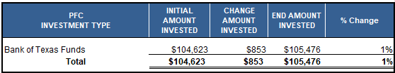
QUARTERLY INVESTMENT REPORT (unaudited)
PFC PORTFOLIO BY INVESTMENT TYPE
Quarter Ended February 28, 2026

Slide 9





Q&A
I certify that the following information is true and accurate to the best of my knowledge.
/s/ Ann Westbrooks, CPA, RTSBA
Chief Financial Officer
/s/ Marcia Leiva, Senior Director

