Slide 1
GO Team Meeting
M. Agnes Jones ES
April 23, 2026

Slide 2
Agenda
Call to Order
Roll Call; Establish Quorum
Action Items
Approval of Agenda
  Approval of Previous Minutes:
Discussion Items
  2026 Spring MAP results
  Pulse Check: Planning for 2026-2027
Information Items
  Principal’s Report
    2025-2026 Family Engagement and/or Partnership Highlights
  Cluster Advisory Team Report – 3/4/2026 and 4/21/2026
  GO Team Elections
Announcements
Adjournment

Slide 3
2026 Spring
MAP Results
Data Points to Consider
Spring Results
Fall to Spring Comparison
  Literacy
  Numeracy

Slide 4
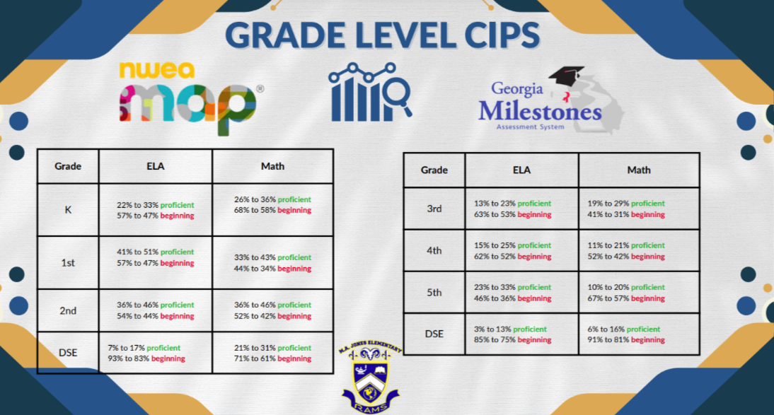

Slide 5
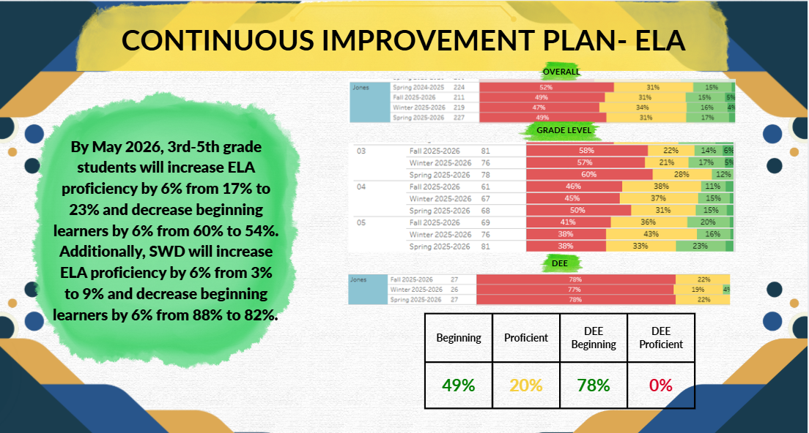

Slide 6
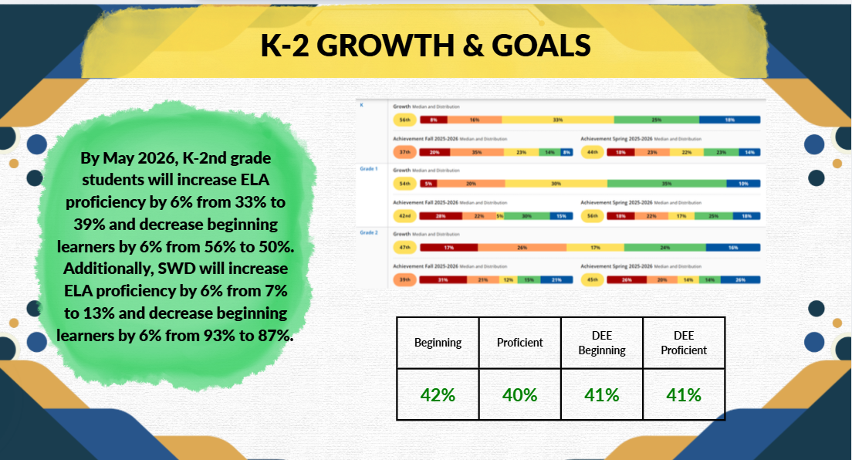

Slide 7
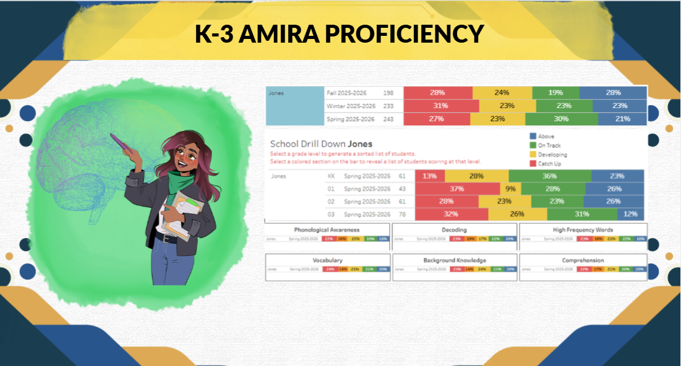

Slide 8
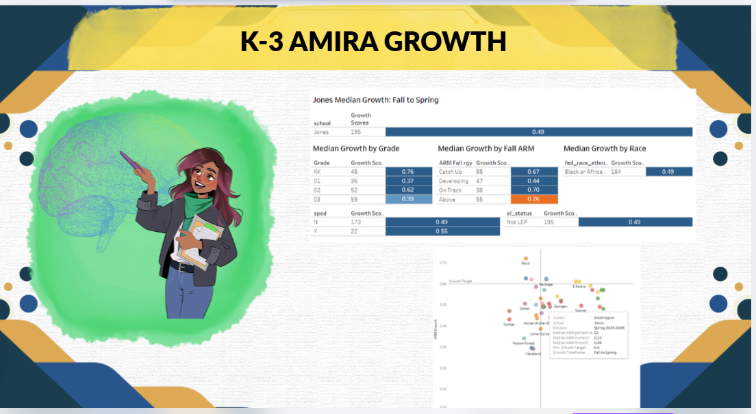

Slide 9
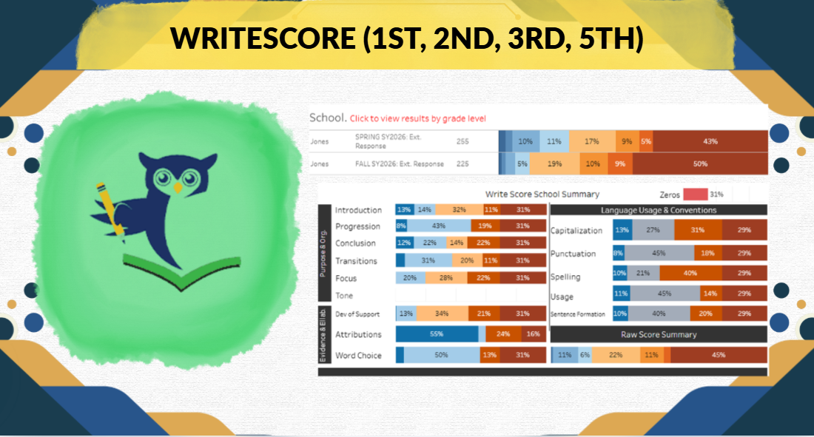

Slide 10
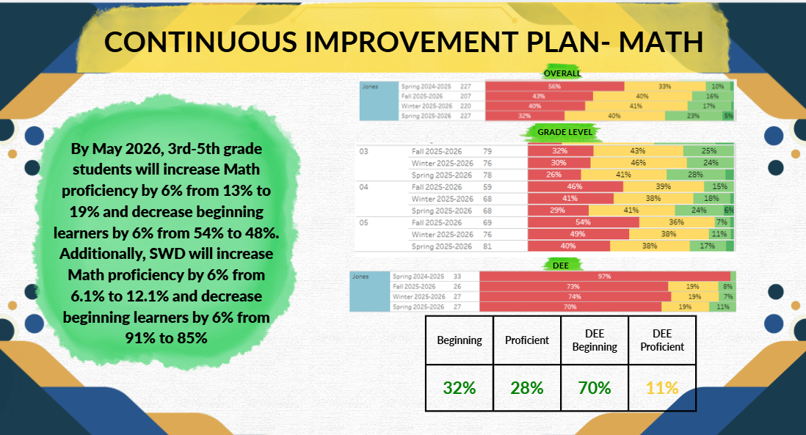

Slide 11
Pulse Check: Planning for 2026-2027
ACTIVITY:
During this discussion, we will look at data from the Spring MAP administration and identify 2-3 potential needs for the 2026-2027 school year.
This activity will help school leadership as they prepare for the 2026-2027 school year.

Slide 12
Pulse Check: Planning for 2026-2027
Guiding Questions
What does this data tell us?
What good news is there to celebrate?
Where are growth opportunities?
What trends do we see in the data?

Slide 13
ACTIVITY: Strengths & Opportunities
Based on your discussion about the school data, determine points of strength and opportunities for improvement and summarize them below.
Strengths | Opportunities
K-2 met ELA goals (Woohoo) | More help for families to receive resources for student support (504, EIP, IEP, Gifted)
Majority of goals were met ¾ goals were met for general ed. students. (ELA Beginning Decrease, Math Proficiency Increase, Math Beginning Decrease) | More tailored practice for students (differentiated homework packets so parents can help)
Attribution/word choice based on Write Score data/ Publishing parties & writing prompts | Early intervention for reading phonics and phonemic awareness → quicker decision tree for support outside of general ed. Classroom Building fluency/orthographic mapping
15% increase in 3-5th grade math on MAP | Virtual field trips with partners (Building background knowledge)
 | More reading for leisure and journaling (topic of the day– free writes)

Slide 14
Planning for 2026-2027:
Based on your responses for strengths and opportunities, what must be true for M. Agnes Jones ES to Achieve Excellence:
 | Need
1 | Building students background knowledge through virtual field trips and ensuring parents have access to assessment like questions.
2 | Tactile learning/real world connections
3 | Building foundational skills (decoding and ensuring students who are strong decoders work on fluency and comprehension), vocabulary acquisition, keyboarding, and DOK questions (test prep earlier in the year) Accessing resources (OG)

Slide 15
Next Steps
Principals will spend the summer preparing for SY2026-27
Schools will begin meeting after July 1 to organize their GO Teams for the year
During the first business meeting in Fall 2026, principal and GO Teams will review strategic priorities and metrics for the year

Slide 16
Information Items

Slide 17
Principal’s Report

Slide 18
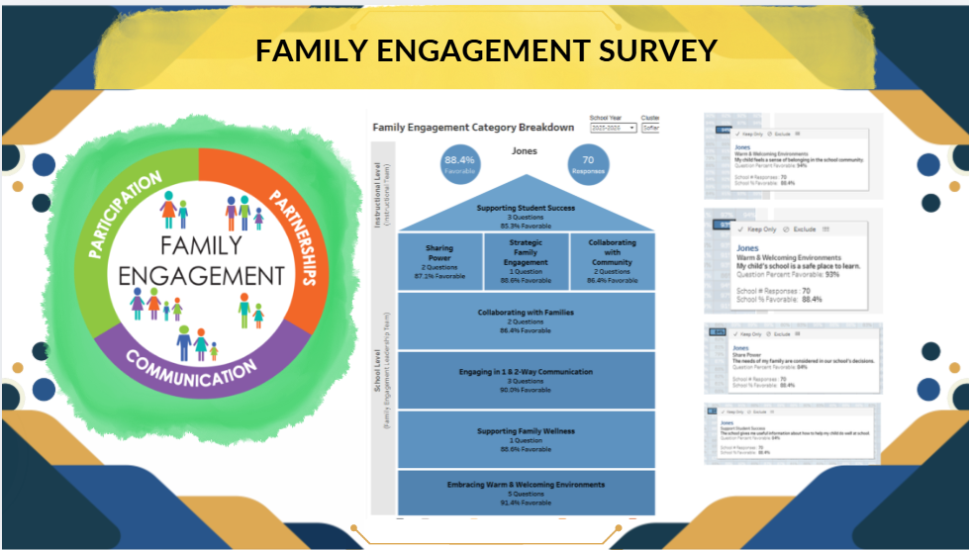
Principal Report

Slide 19


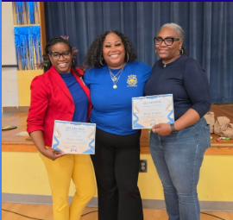
Principal Report

Slide 20
Additional Information Items
Cluster Advisory Team Report
GO Team Elections
  Voting open April 15-24
  Find candidates, information, and request your voting link at apsstrongschools.com

Slide 21
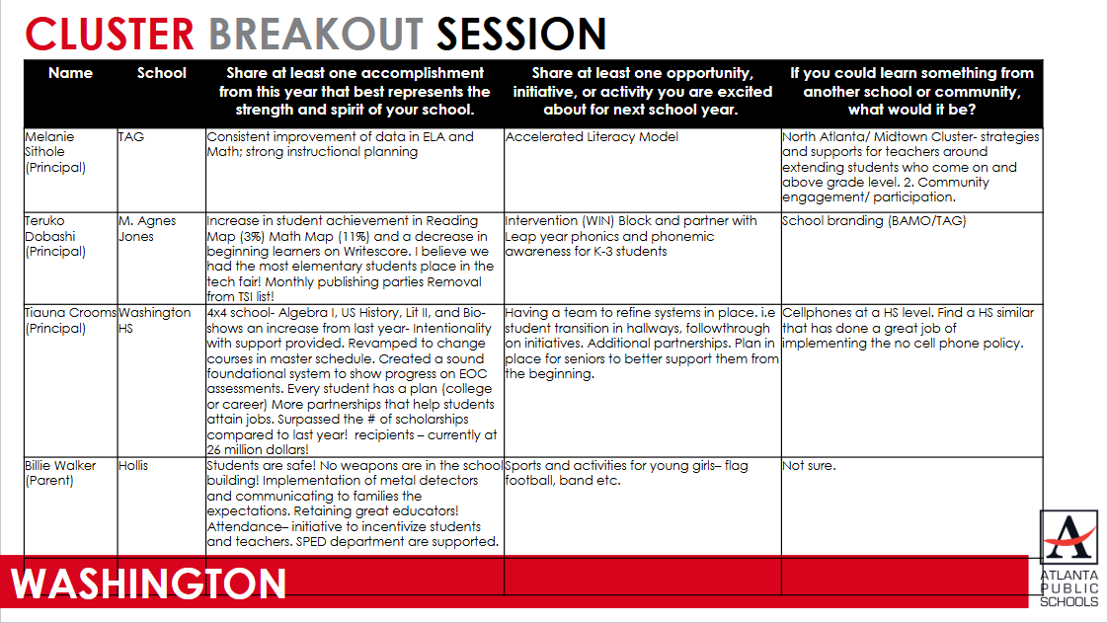
Cluster Advisory Team Report

Slide 22
Announcements
GO Team Members
  Complete your end of year surveys (AVAILABLE NOW! Check your email for the link)
    Principal Feedback Survey
  Complete your required trainings ASAP
    Contact the GO Team Office with any questions
    2026-2027 Business Meeting 1:
    Thursday, July 16, 2026 or Thursday, July 23, 2026

Slide 23

Thank you!

