Slide 1
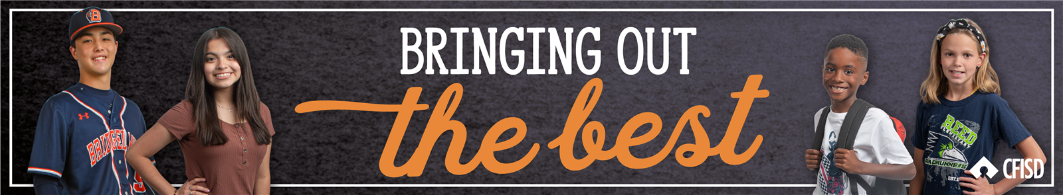
Respect
PK-2
May 2026

Slide 2
Respect
Define
Identify
Apply
We will define respect.
We will identify ways to show respect.
We will determine how to show respect to people, places, and things.

Slide 3
Respect
Treating people appropriately

Slide 4


Slide 5

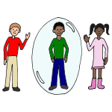
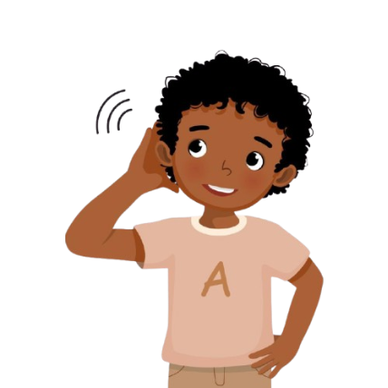

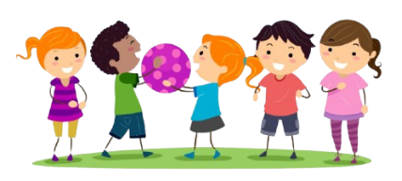
Ways to show respect:
Follow all directions the 1st time
Be aware of personal space
Take care of property
Be polite and use your manners
Listen carefully
Share and play fairly
FAD1

Slide 6
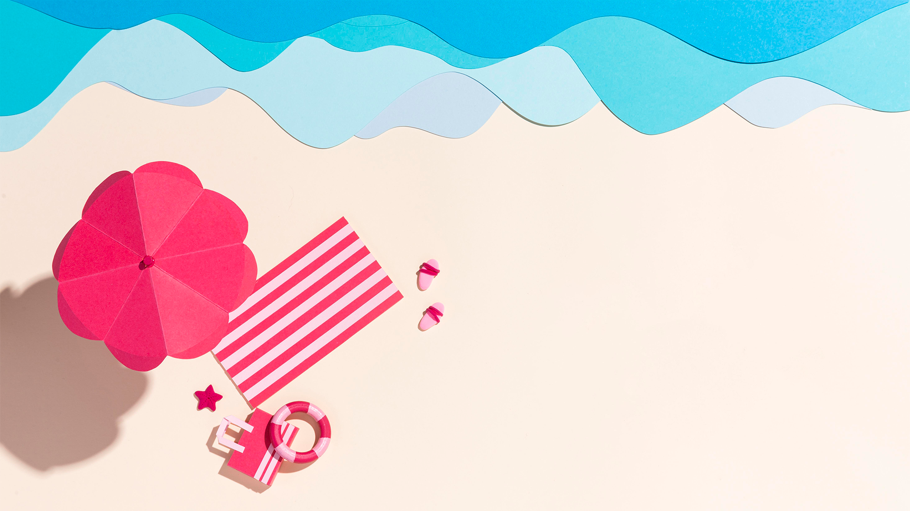
Show what you know!

Slide 7
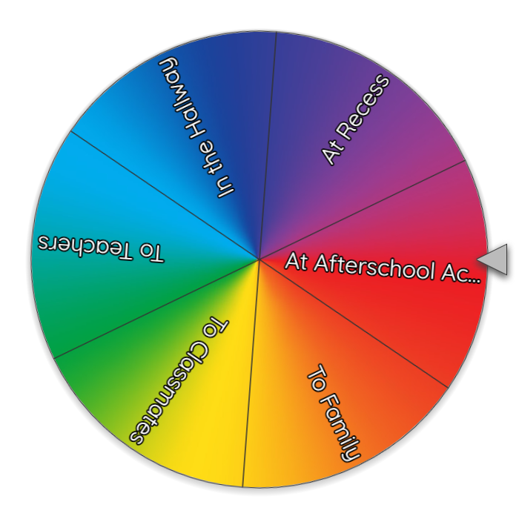

Spin the wheel and discuss how to show respect.

Slide 8
Share about a time when you have shown respect or someone has shown respect to you.

Slide 9
Home Connections:
Respect BINGO
See how many of these ”respect”-ful behaviors you can complete.
Take care of toys/supplies | Recycle | Pick up trash | Invite others to join in | Listen to your parents
Brush your teeth | Take a bath | Looking at the person talking to you | Do a kind act | Share with someone
Lend a helping hand | Give someone their space | FREE SPACE | Be friendly | Think positively
Get plenty of rest | Give someone a compliment | Be on time | Be prepared for class | Greet someone appropriately
Eat a healthy meal | Think about how someone feels | Tell the truth | Listen to others ideas | Console someone who needs it

