Slide 1
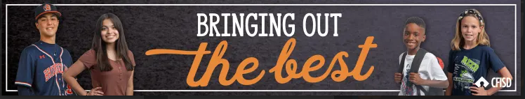
Respect
May 2026
Grades: 3rd-5th

Slide 2
The learner will…
Define what respect means.
Identify why it’s important to show respect.
Apply showing respect at school and at home.

Slide 3
Respect
Treating people appropriately

Slide 4
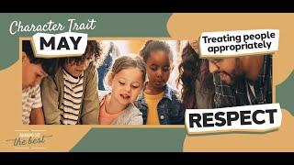

Slide 5
Why should we show respect to others?
It creates a healthy environment for ourselves and those we are respecting.
We want to receive respect from others, because it expresses how much they care.
Showing respect allows us to develop a sense of trust and confidence.

Slide 6
Respect Share Session
Turn and talk with a partner about how we show respect to the following people…
Staff Members
Classmates
Someone who is different from you
Someone you do not know
Those who are serving or has served in the military
Family

Slide 7
Closure
Respect is….
Treating someone how you and they want to be treated.
Caring about the thoughts, feelings, beliefs, and rights of others.

Slide 8
Home Connection
Discuss at home with your parent or guardian what does respect looks like, sounds like, and feels like to you at home and in your community.
May Home Connection Activity

