Slide 1




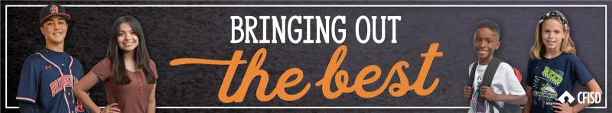




May Character Trait
RESPECT

Slide 2


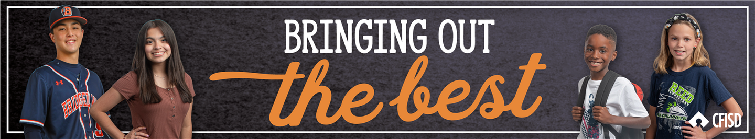
Teachers…
In the presentation, students will learn what
it means to have RESPECT in different situations. Each slide will contain interactive activities and guided questions for
“Bringing Out The Best” RESPECT
Character Trait for grades 6-8.
RESPECT

Slide 3

Campus Matrix
RESPECT

Slide 4
Learning Objectives
The learner will…
Define what it means to show respect
Explore how to show respect
Identify the importance of respect
RESPECT

Slide 5
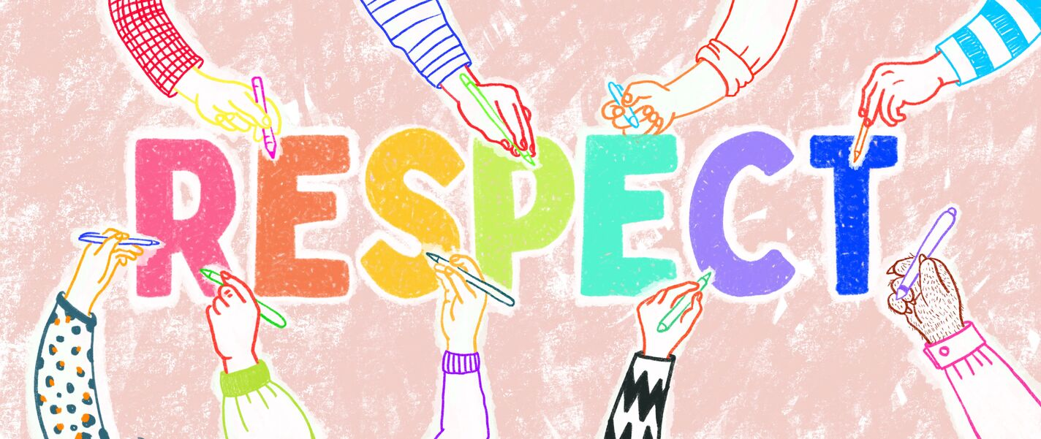
Definition
Treating others appropriately.
RESPECT

Slide 6
What do you think?
Teachers, label the corners of your room with:
Agree
Strongly Agree
Disagree
Strongly Disagree
Students, your teacher will label the corners of the room and then read some statements on the next slide. You will go to the corner that best represents your response to the statement. This is just to observe where we land in each statement. We will discuss these statements later in lesson.
RESPECT

Slide 7
Is respect...
Is respect...
Using a sarcastic or angry tone of voice when your teacher ask you to do something?
Looking at someone when they’re talking to you and paying attention to what they’re saying?
RESPECT

Slide 8
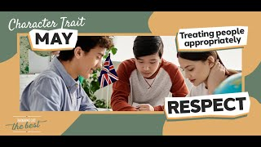
RESPECT

Slide 9
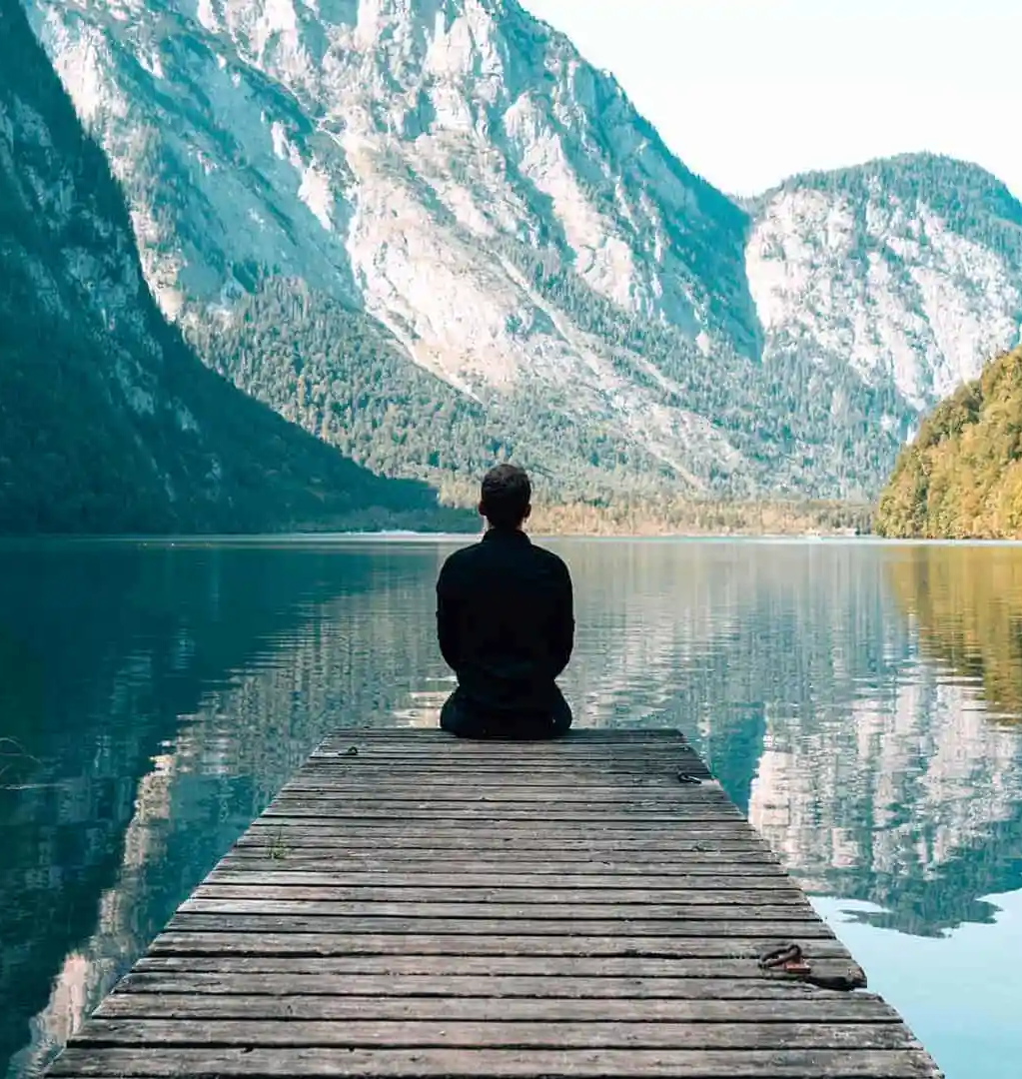
Video Reflections
Share any reflections you may
have after watching this video.
Discuss a time when you showed RESPECT at school and/or at home.
RESPECT

Slide 10
Activity
Teachers, like we did before the video, remind your students what corner is: Agree, Strongly Agree, Disagree, Strongly Disagree
Students you will be asked the same statements as before and some additional ones. Think about what you have learned about respect when answering the statements on the next slide.
RESPECT

Slide 11
Is respect...
Is respect...
Laughing when someone in your class shares something difficult that happened to them?
Helping someone who is stuck on something in class instead of laughing?
Is respect...
Is respect...
Using a sarcastic or angry tone of voice when your teacher ask you to do something?
Looking at someone when they’re talking to you and paying attention to what they’re saying?
RESPECT

Slide 12
PBIS Rewards
Teachers: Please pass out PBIS awards to students who are showing RESPECT.
Example 1: Holding the door open for other people, helping the teacher or their classmates and/or giving a person a sincere compliment.
Example 2: Being well-behaved and exceeding expectations when a sub/guest is covering a class.
Example 3: Greeting the teacher as the students walk in the classroom.
RESPECT

Slide 13

Home Activity
Families!
Like the game charades and/or Pictionary, each family member can either choose to act out or draw something either respectful or rude.
Other family members can guess if the action or picture is rude or respectful and why.
Parents, here is a great digital bingo card on RESPECT too.
Digital Respect Bingo
RESPECT

