Slide 1
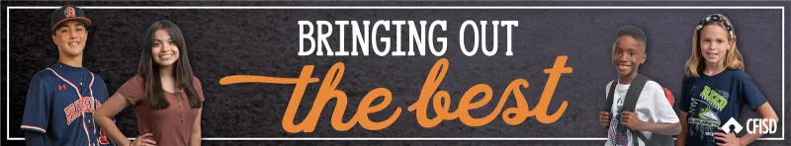
RESPECT
May, 2026

Slide 2
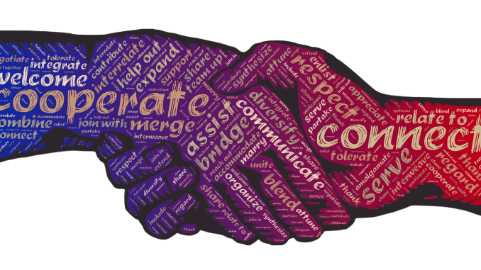
3 Types of RESPECT
Self-
Respect
Respect for Others
Respect
for Differences

Slide 3
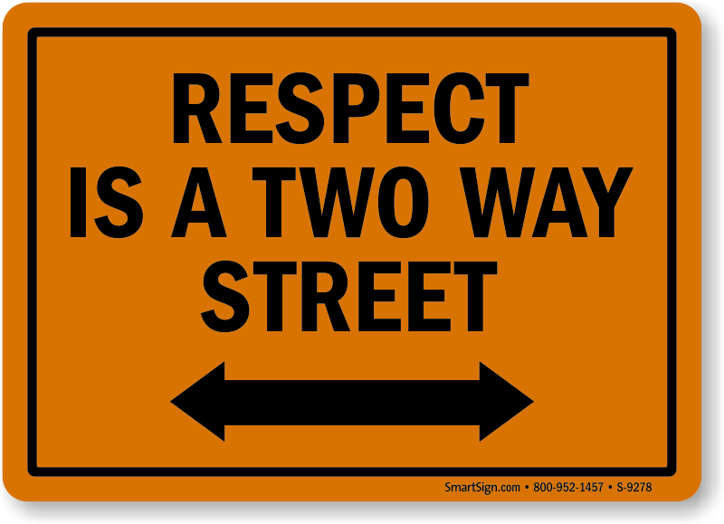
Definition:
Treating People Appropriately

Slide 4


Slide 5
Builds positive relationships with: classmates, teachers, & school staff
Prevents conflict and bullying
Creates a safe, inclusive learning space
Helps prepare for adulthood and professional life
Why is
RESPECT
Important?

Slide 6


What does RESPECT sound like and look like
“I will not judge you.”
“I respect your opinion.”
“I will not gossip about you.”
“I apologize for my mistake.”
“I appreciate your hard work.”
“I will not interrupt you.”
“I will not bully you.”
Being punctual
Keeping promises
Apologizing when wrong
Not interrupting
Active listening
Being mindful of personal space
Not always having to be right
Notes:
Each line will slide in separately.

Slide 7
Ways to Teach RESPECT
Classroom Scenarios
A classmate gives a wrong answer, and another student laughs out loud.
A student respectfully asks a question when they don’t understand something.
A student talks over others during a class discussion.
Friendship & Social Scenarios
Your friend shares a secret with you. Later, you’re tempted to tell others.
A peer from a different social group asks to sit with you at lunch..
Your friends start teasing someone about their appearance.
A student apologizes for something they said in anger.
Respect for Differences
A new student speaks with an accent, and others imitate it to be funny.
A classmate with a disability is left out of group activities.
You disagree with a classmate's opinion in a respectful debate.

Slide 8
Ways to Teach RESPECT
Online & Social Media Scenarios
Someone shares a screenshot of a private conversation without permission.
You see someone being bullied online — do you ignore it, join in, or speak up?
A student spreads a rumor through a group chat.
Self-Respect Scenarios
You’re pressured into going to a party you don’t want to attend.
You fail a quiz and think badly about yourself for days.
You say “no” to something and a friend tries to make you feel guilty.
You stand up for yourself when someone makes a hurtful comment.

Slide 9
Stand Up, Sit Down: RESPECT Check
Instructions: Read Statements Out Loud
Stand up if you’ve apologized after realizing you were disrespectful.
Stand Up if you've ever sent a message you later regretted.
Stand Up if you’ve ever judged someone before getting to know them.
Stand Up if you’ve ever felt disrespected by someone.
Sit Down if you’ve listened to someone with a totally different opinion and stayed respectful.
Sit Down if you think you handled a disagreement respectfully this week
Sit Down if you’ve ever interrupted someone without realizing it.
Stay Standing if you've stayed silent in a situation where you now wish you had spoken up.
Notes:
Optional Discussion Prompts
Use one or two after every few statements:
· “What made you want to stand (or sit) on that one?”
· “What would treating someone appropriately look like in that situation?”

Slide 10
What Does Respect Look Like?
Situation
Respectful
Disrespectful
Disagreeing with Someone
Listening Calmly
Yelling or Mocking
Contributing Fairly
Ignoring the Group
Being in a Group Project
Positive Comments
Gossip or bullying
Online Behavior
Notes:
On this slide, the situation will appear and then the respectful answer will show, and then the disrespectful answer will show. Teachers can allow the students to discuss what the answers may look like before they show up.

Slide 11
Key Takeaways
Respect is treating people appropriate in every setting.
You can be respectful even when you disagree.
Respect is earned- but it starts by giving it.

Slide 12
How would our school change if everyone treated each other with respect?

