Slide 1
Facility Alignment
Task Force
April 14, 2026
Notes:
Jim updated notes version

Slide 2
Facility Alignment Task Force
Meeting #1
Agenda:
    Welcome
    Introductions
    Purpose and norms
    Timeline review
    Student Enrollment presentation
    School Finance 101 presentation
    OPS Boundary overview
    Wrap up

Slide 3
Welcome and Introductions
We have over 120 members of our Facility Alignment Task Force...
At your table, please share your:
  Name
  School representation
  Role (staff, parent, administrator, etc.)
  Favorite ride at Disneyland or Disneyworld
Show of hands activity

Slide 4
Purpose and Norms
Purpose
Review OPS student enrollment data past, present, and future
Gain an understanding of our budget and how we are funded
Provide feedback on recommendations to align the number of instructional buildings to our current and future enrollment
Norms
Ask questions
Be engaged
Be respectful
Seek to understand
Try to put on your big picture hat
Look for a long-term solution that is best for the district
Have a little fun

Slide 5
Timeline

Slide 6
STUDENT ENROLLMENT & FACILITY ALIGNMENT
PHASE ONE
FEBRUARY – MAY 2026
PHASE TWO
JUNE – OCTOBER 2026
PHASE THREE
OCTOBER – JANUARY 2027
The Olathe Public Schools will conduct a three-phase study to analyze student enrollment and facility alignment as the district works to reduce the footprint of our schools to align with current and future enrollment projections.
The three-phase study will be a collaborative process with involvement from parents, staff, and administration. The goal of the task force and steering committee will be to provide a recommendation to the Board of Education regarding the number of schools to consider reducing. District staff will also work with a school consolidation consultant throughout the process.

Slide 7
PHASE ONE
STUDENT ENROLLMENT & FACILITY ALIGNMENT TASK FORCE
February
  Present the process and timeline to the BOE
March
  Establish the Student Enrollment and Facility Alignment Task Force
  The Task Force will be made up of 1 parent and 1 staff member from each school in the district, in addition to building administration, district leadership, and community leaders
  The Task Force will have three meetings from April to May

Slide 8
PHASE ONE (continued)
STUDENT ENROLLMENT & FACILITY ALIGNMENT TASK FORCE
April
  Session 1 – Goals and norms, outcomes, Enrollment review, school finance 101, and a school boundary overview
  Session 2 – Quadrant/data breakdown of elementary and middle schools and a presentation from our third-party demographer
May
  Session 3 – Data analysis, small group work, discussion over alignment numbers, survey and recommendations
  Establish the Facility Alignment Steering Committee (group of 15)

Slide 9
PHASE TWO
FACILITY ALIGNMENT STEERING COMMITTEE
June
  Board of Education update
  Meeting #1 with the Facility Alignment Steering Committee
July
  Meeting #2 with the Facility Alignment Steering Committee
August
  Board of Education update
  Meeting #3 with the Facility Alignment Steering Committee

Slide 10
PHASE TWO (continued)
FACILITY ALIGNMENT STEERING COMMITTEE
September
  Presentation to the Board of Education with a recommendation for building consolidation and timeline as a future action item
October
  Board of Education asked to take action on school consolidation

Slide 11
PHASE THREE
BOUNDARY ADJUSTMENT TIMELINE
October
  District leadership will hold parent information nights at the impacted buildings to review potential boundary adjustments at the buildings impacted for the 2027-2028 school year
December
  Boundary options will be presented to the Board of Education as a future action item
January
  The Board of Education will be asked to take action on new boundaries in the impacted communities

Slide 12
ADDITIONAL WORK
Human Resources will work with classified and certified staff at the impacted buildings to determine employment placement for 2027-2028.
Transportation review with communication for new attendance areas, safety variances, etc.
Operations/Service Center will work with staff to move classroom items and belongings to their new school.
Food Production study of new enrollment as a result of boundary changes, analyzing any staff and equipment needs.

Slide 13
Student Enrollment
2025-2026

Slide 14
Olathe Public Schools Enrollment
 | 2025-26
District Enrollment | 28,140
Early Childhood | 951
Grades K-5 | 11,669
Middle School | 6,320
High School | 8,938
Alternative | 262
Notes:
2023-24 number is audited total from state

Slide 15
Olathe Public Schools Enrollment (Continued)
 | 2024-25 | 2025-26 | Difference
District Enrollment | 28,454 | 28,140 | -314
Early Childhood | 872 | 951 | +79
Grades K-5 | 11,903 | 11,669 | -234
Middle School | 6,273 | 6,320 | +47
High School | 9,149 | 8,938 | -211
Alternative | 257 | 262 | +5

Slide 16
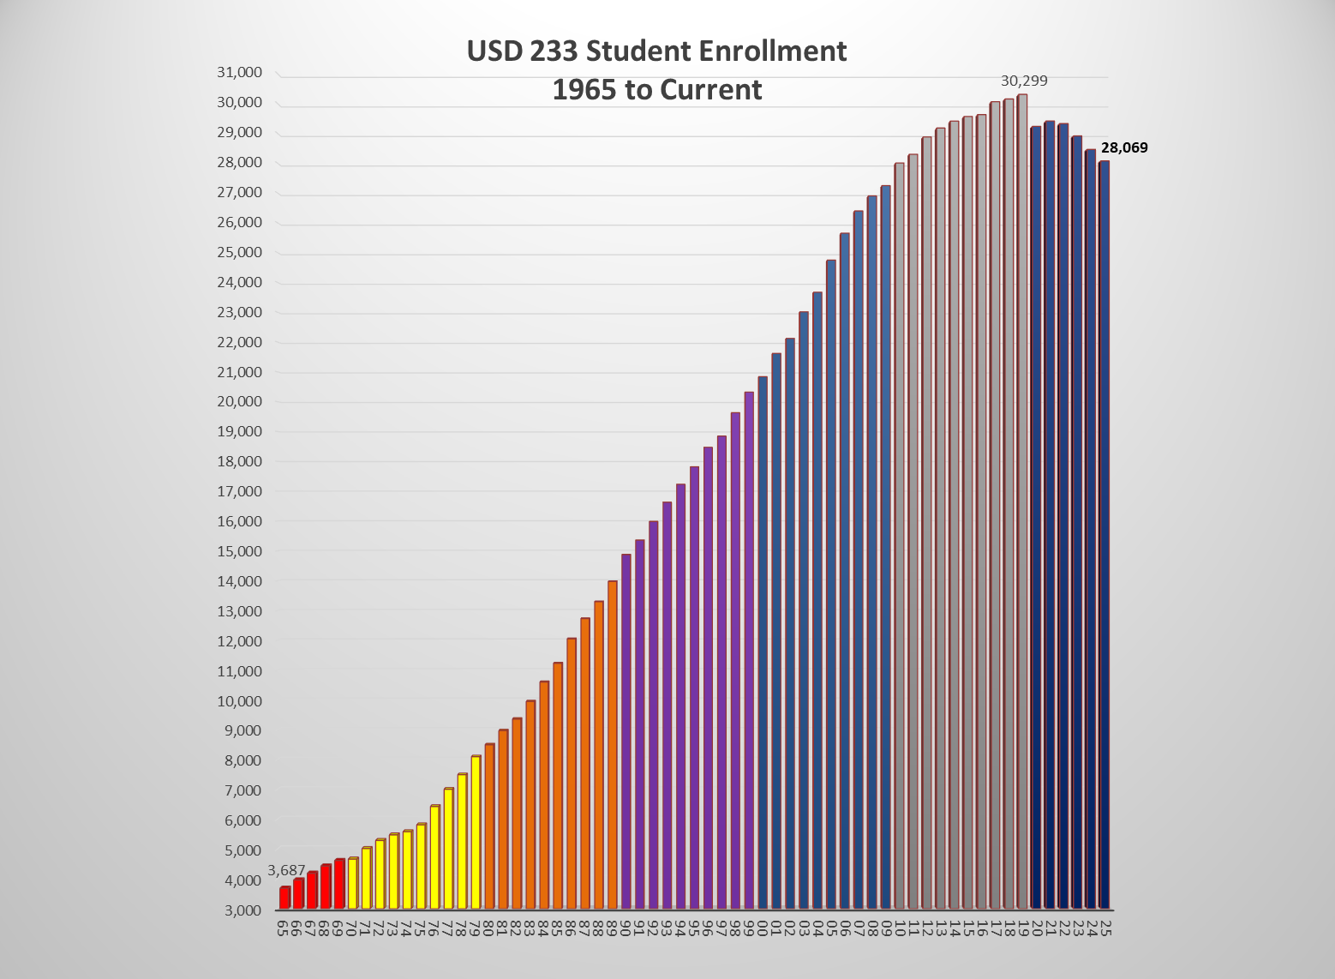
USD 233 Student Enrollment from 1965-2025
Decade | Enrollment Change | Bldgs. Const.
2020s | -1,803 | 1
2010s | +3,014 | 7
2000s | +6,802 | 17
1990s | +6,426 | 12
1980s | +5,876 | 15
1970s | +3,479 | 7
1960s | +1,996 | 4
1950s | +1,474 | 5
‘70s
‘80s
‘90s
‘00s
‘10s
‘20s
Notes:
54 years of consecutive growth (1965 to 2019).
During that time grew by 26,529 students (491 students a year).
Since 2019 district has lost 1,762 students (293 students a year).

Slide 17
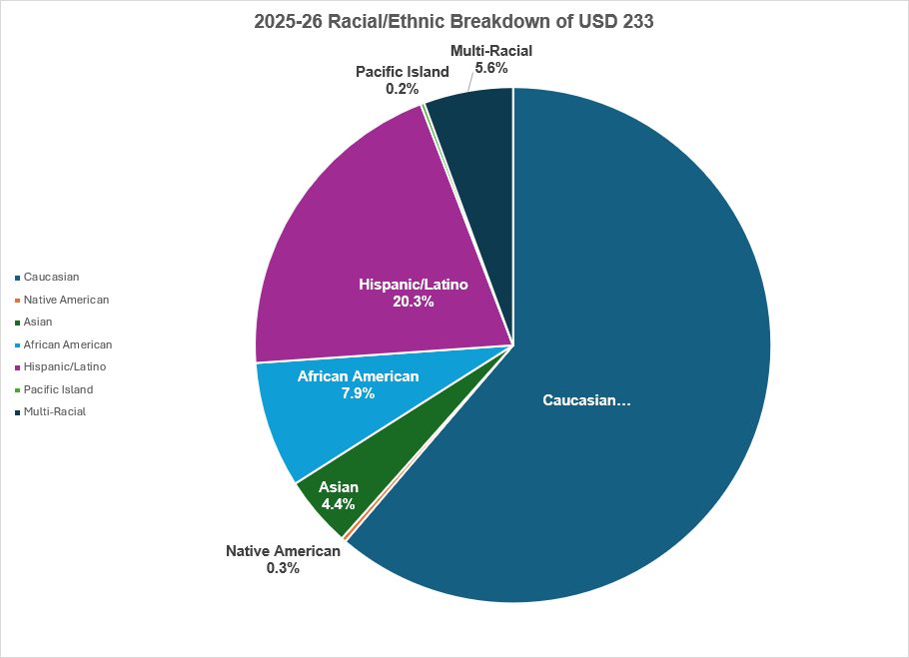
2025-26
Racial/Ethnic
Breakdown

Slide 18
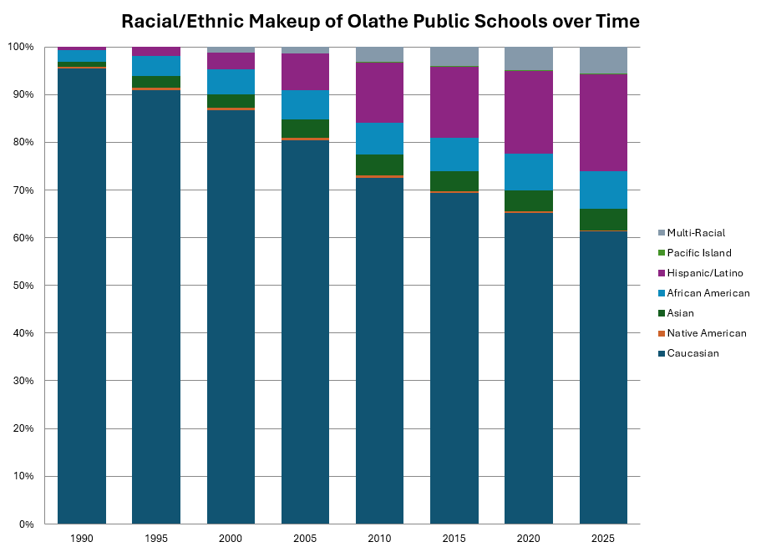
Racial/Ethnic Makeup of OPS Over Time
Notes:
In 1990 our district was 95% caucasion.
Based on current trends Olathe will be a minority majority (no single racial group being the majority) by 2037.

Slide 19
Racial/Ethnic Makeup of OPS Over Time (Continued)
 | 1990 | 1990 Percent | 2025 Numbers | 2025 Percent | Number Change | Percent Change
District Enrollment | 14,870 | 100% | 28,140 | 100% | 13,270 | 189%
Caucasian | 14,262 | 95.6% | 17,238 | 61.3% | 2,976 | 124%
Native American | 32 | 0.2% | 81 | 0.3% | 49 | 253%
Asian | 173 | 1.2% | 1,252 | 4.6% | 1,079 | 724%
African American | 347 | 2.3% | 2,226 | 7.9% | 1,879 | 641%
Hispanic/Latino | 112 | 0.8% | 5,703 | 20.3% | 5,591 | 5,091%
Pac Islander | NA | 0 | 65 | 0.2% | 65
Multi-racial | NA | 0 | 1,575 | 5.6% | 1,575
Notes:
From 1990-2024 district grew by 13,584 students. Only 3,400of those students Caucasian, 10,200 minority. Hispanic population has increased by 5,000%

Slide 20
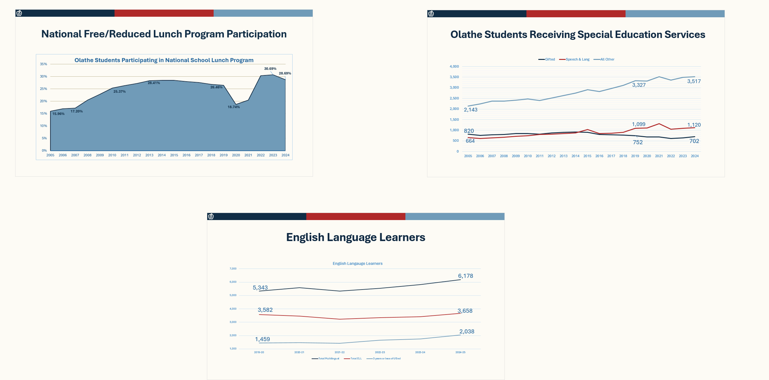
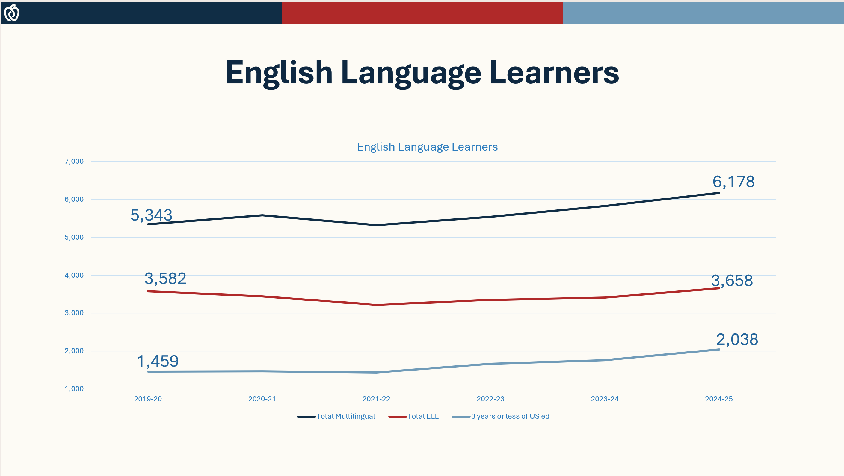
Fewer students doesn’t mean fewer challenges — we’re seeing more complex needs across our schools.

Slide 21
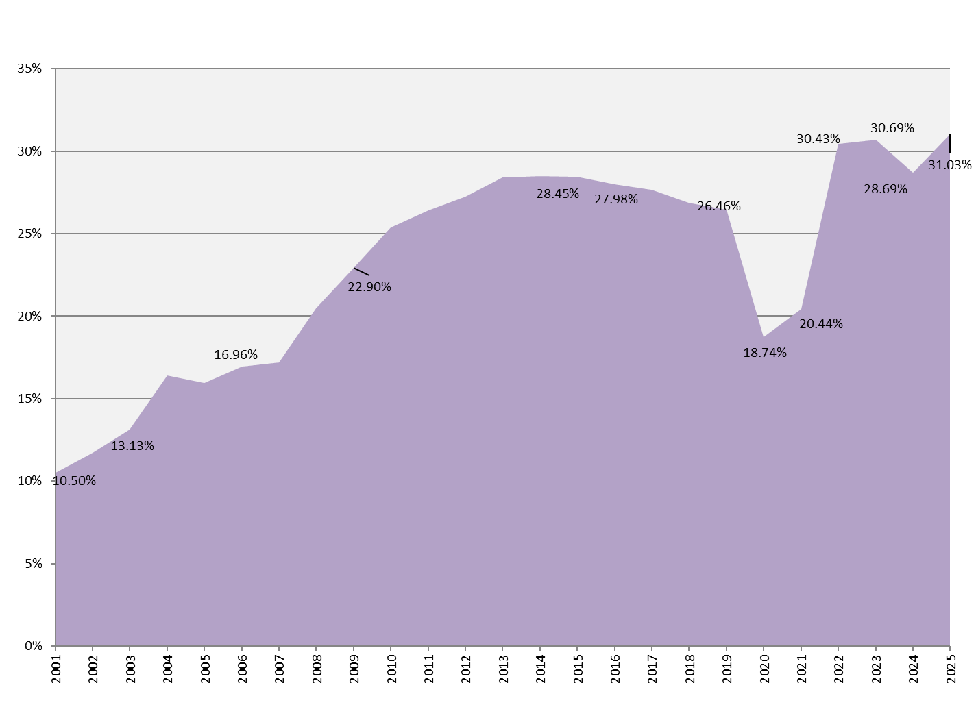
National Free/Reduced Lunch Program Participation
Notes:
Dip in 2020 and 2021 was because families did not have to fill out paperwork to receive free meals these two years, free meals were provided to all students.

Slide 22
Olathe Students Receiving Special Education Services
Notes:
Peak enrollment was 2019, but number of student receiving SPED services continues to increase +190 Other Sped (Resource, Behavior Disorder, Autism, Etc.) and +21 in speech and language

Slide 23
English Language Learners
Notes:
This graph starts at our peak enrollment year of 2019.
Red line is total students receiving ELL Services and it has increased slightly 76 students (2%).
Light blue line show immigrants that have been in United States less than three years. That number of students has increased by 40% since 2019.

Slide 24
Largest and Smallest Elementary Schools
Enrollment Rank | School | 2025 Enrollment
1 | Manchester Park | 601
2 | Clearwater Creek | 521
3 | Mahaffie | 463
34 | Green Springs | 217
35 | Northview | 199
36 | Westview | 144
 | 2025 Elem Total | 12,620
2015 Enrollment
615
589
403
266
262
254
14,079

Slide 25
Largest and Smallest Elementary Schools (continued)
Enrollment Rank | School | 2025 Enrollment
1 | Manchester Park | 601
2 | Clearwater Creek | 521
3 | Mahaffie | 463
34 | Green Springs | 217
35 | Northview | 199
36 | Westview | 144
 | 2025 Elem Total | 12,620
2015 Enrollment
615
589
403
266
262
254
14,079
550 homes built + Creation of Spanish Immersion Program
43% decline in 11 years
Notes:
MP data includes homes built in what is now the canyon creek attendance area, which used to feed Manchester Park

Slide 26
Three Largest and Smallest Middle Schools
Enrollment Rank | School | 2025 Enrollment
1 | Prairie Trail | 735
2 | Frontier Trail | 699
3 | Mission Trail | 667
8 | Chisholm Trail | 580
9 | Indian Trail | 578
10 | Summit Trail | 576
 | 2025 Total MS Enroll | 6,320
 | School | 2015 Enrollment
1 | Prairie Trail | 850
2 | Mission Trail | 813
3 | Chisholm Trail | 769
7 | California Trail | 729
8 | Pioneer Trail | 695
9 | Oregon Trail | 550
 | 2015 Total MS Enrollment | 6,670
2015’s 8th largest school would rank 2nd in 2024
CST enrollment down 25% in 10 years

Slide 27
Three Largest and Smallest Middle Schools (continued)
Enrollment Rank | School | 2025 Enrollment
1 | Prairie Trail | 735
2 | Frontier Trail | 699
3 | Mission Trail | 667
8 | Chisholm Trail | 580
9 | Indian Trail | 578
10 | Summit Trail | 576
 | 2025 Total MS Enroll | 6,320
 | School | 2015 Enrollment
1 | Prairie Trail | 850
2 | Mission Trail | 813
3 | Chisholm Trail | 769
7 | California Trail | 729
8 | Pioneer Trail | 695
9 | Oregon Trail | 550
 | 2015 Total MS Enrollment | 6,670
2015’s 8th largest school would rank 3rd in 2025
CST enrollment down 25% in 11 years
Notes:
CST had 932 students during the 2009-2010 school year

Slide 28
High School Enrollments
School | 2025
Olathe East | 1,805
Olathe North | 1,929
Olathe Northwest | 1,938
Olathe South | 1,740
Olathe West | 1,526
Total | 8,938
2015 | +/-
1,995 | -152
2,237 | -228
2,180 | -221
2,110 | -327
0 | +1,555
8,522 | +627

Slide 29
High School Enrollments (continued)
School | 2024
Olathe East | 1,805
Olathe North | 1,929
Olathe Northwest | 1,938
Olathe South | 1,740
Olathe West | 1,526
Total | 9,139
2015 | +/-
1,995 | -190
2,237 | -308
2,180 | -242
2,110 | -370
0 | +1,526
8,522 | +617
Notes:
Overall we have gained 627 HS students since 2015

Slide 30
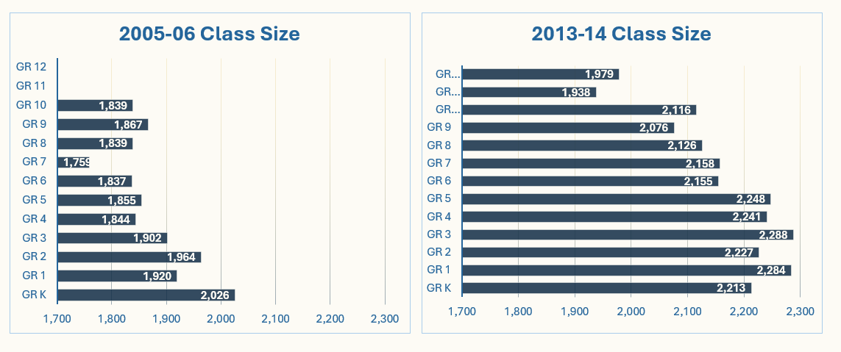
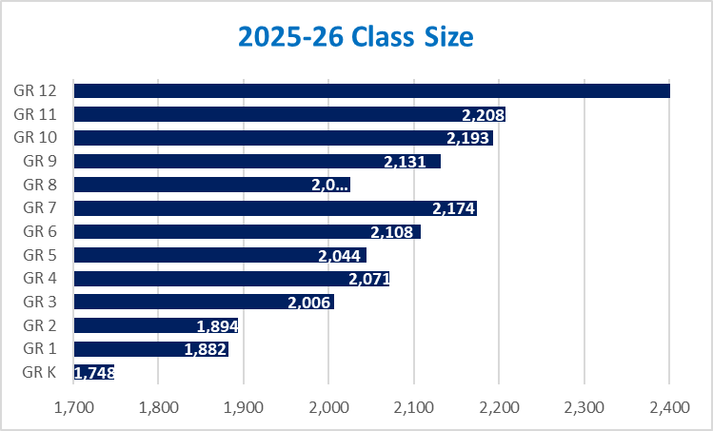

Class Size Comparison
1,698
1,694
Notes:
When looking at this data comparing class sizes, this illustrates trends that started in 05/06 with K being the largest and 11/12 the smallest.
13/14 shows fairly even classes across the board.
24/25 reverses the trend with 11/12 the largest and K the smallest.

Slide 31
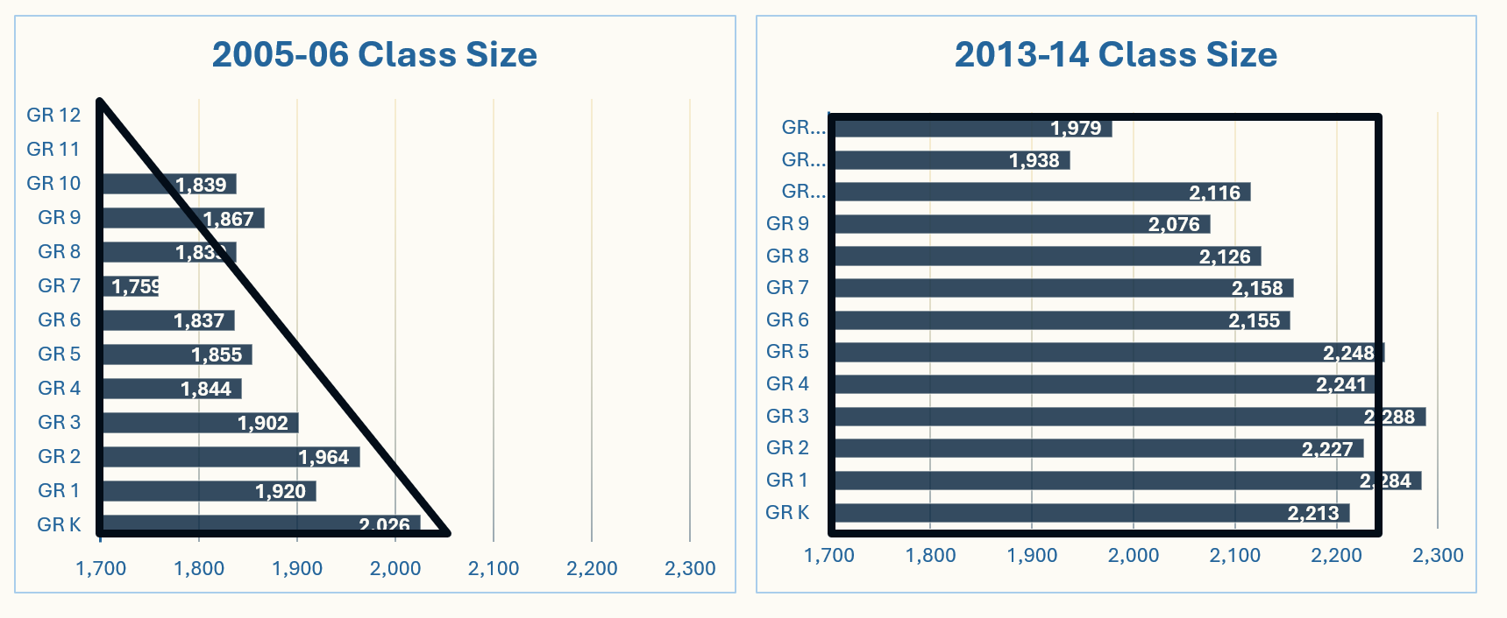
Class Size Comparison (continued)
1,698
1,694
Notes:
Enrollment is a triangle shape with the biggest grades on the bottom and the smallest grades at top, is a hallmark of a rapidly growing district.
Demographics in square with the upper grades and the lower grades equal, is a hallmark of a district with steady enrollment.
An inverted triangle with the biggest grades at the top and the smallest grades at the bottom is a hallmark of a declining district.

Slide 32
Declining Enrollment Factors
Smaller kindergarten class than the graduating senior class
Lower birth rate
Empty nesters/aging population
Home prices
Fewer new construction permits
More multi-family unit construction

Slide 33
2026 Senior Class – Change Over Past 13 yrs
 | 2026 Class Size | Class Change
Gr K | 2,213
Gr 1 | 2,202 | -11
Gr 2 | 2,195 | -7
Gr 3 | 2,207 | +12
Gr 4 | 2,248 | +41
Gr 5 | 2,257 | +9
Gr 6 | 2,295 | +38
Gr 7 | 2,281 | -14
Gr 8 | 2,310 | +39
Gr 9 | 2,340 | +30
Gr 10 | 2,343 | +3
Gr 11 | 2,332 | -11
Gr 12 | 2,401 | +69
 |  | +188
The class of 2026 gained 188 students.
Their 7th grade year was 2020, which saw an unusual drop likely due to COVID.
Overall, the class of 2025 grew by 8.5% over the 13 years.
For comparison, classes in the 2000s grew an average of 24.1% over 13 years.

Slide 34
2011 Senior Class – Change Over Past 15 yrs
 | 2026 Class Size | Class Change
Gr K | 2,213
Gr 1 | 2,202 | -11
Gr 2 | 2,195 | -7
Gr 3 | 2,207 | +12
Gr 4 | 2,248 | +41
Gr 5 | 2,257 | +9
Gr 6 | 2,295 | +38
Gr 7 | 2,281 | -14
Gr 8 | 2,310 | +39
Gr 9 | 2,340 | +30
Gr 10 | 2,343 | +3
Gr 11 | 2,332 | -11
Gr 12 | 2,401 | +69
 |  | +188
2011 Class Size | Class Change
1,364
1,534 | +170
1,555 | +21
1,602 | +47
1,648 | +46
1,683 | +35
1,735 | +52
1,759 | +24
1,797 | +38
1,838 | +41
1,866 | +28
1,843 | -23
1,837 | -6
 | +473
The class of 2025 gained 142 students by 9th grade, but enrollment has declined over the past 3 years.
Their 8th grade year was 2020, which saw an unusual drop likely due to COVID.
Overall, the class of 2025 grew by 4.4% over the 13 years.
For comparison, classes in the 2000s grew an average of 24.1% over 13 years.

Slide 35
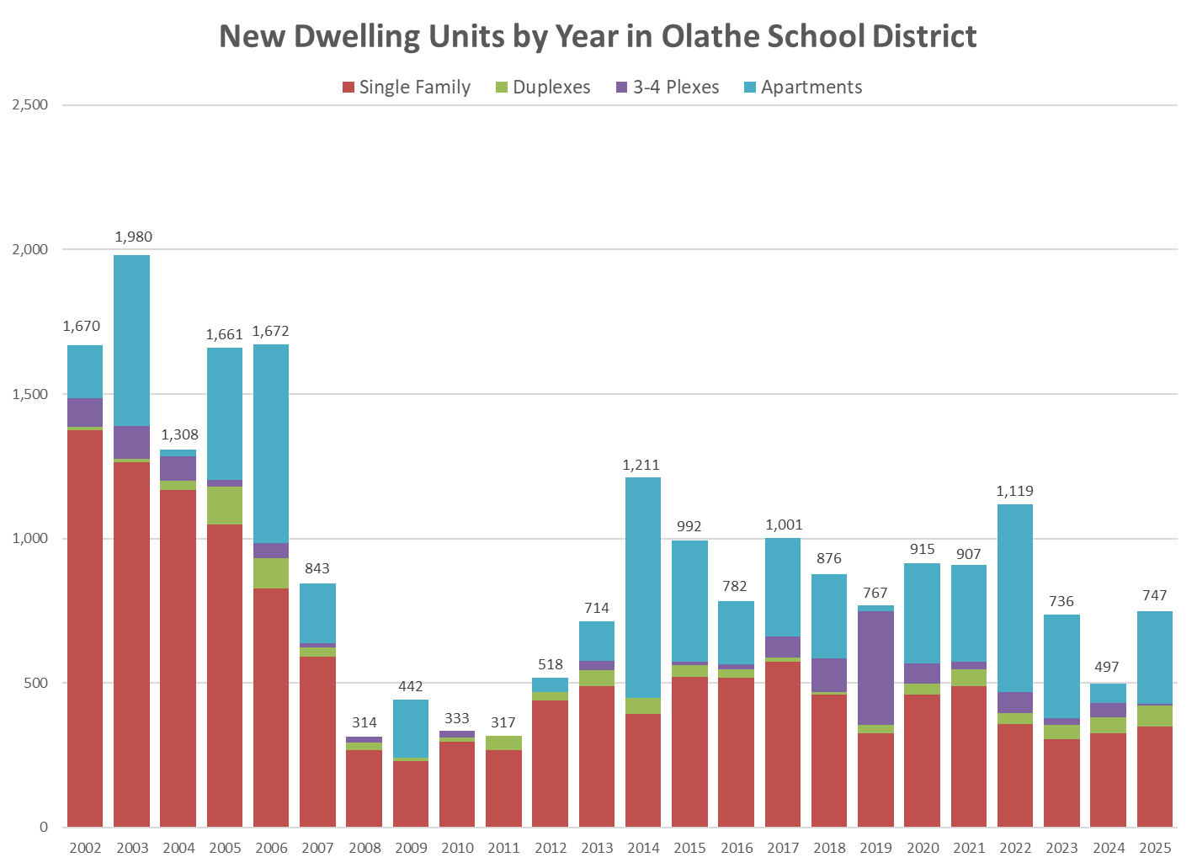
New Dwelling Units by Year
Single Family Homes
Notes:
Number of newly constructed single-family homes has not equaled the level of 2007.
Which was right before the 2008 Recession, with the housing market collapse and the global financial crisis.
Single family homes have remained below 2007 building numbers since then.
House = 45 students per 100 homes
Apartments = 10 students per 100 homes

Slide 36
Average Sales Prices of Single-family Homes
Notes:
Home prices in Olathe School District have increased by 75% in the past 8 years.

Slide 37
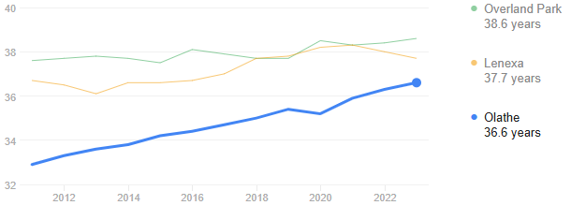
Aging Population
Notes:
Average age is increased over 3% over the last 10 years in this data set

Slide 38
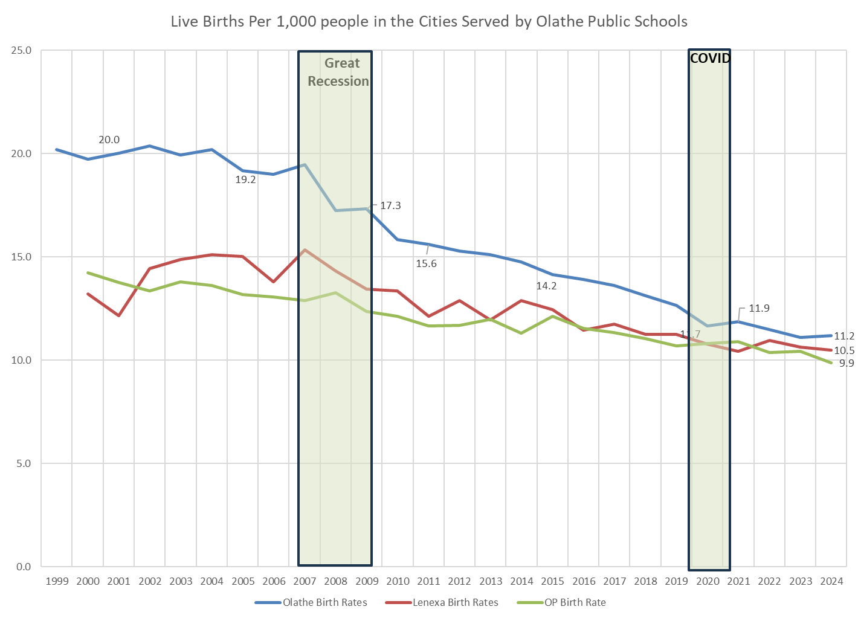
Birth Rates
Difference between 19.5 and a 11.1 birth rate is 1,200 kids annually
Notes:
Almost a 50% reduction in births in Olathe since 2002
Difference between 19.5 and 11.1 birth rate is 1,200 kids annually

Slide 39

Enrollment Projections for the next five years

Slide 40
Overall District Enrollment Estimate
Notes:
Overall 5 year projection shows a decline of about 800 students over the next five years.

Slide 41
Elementary School 5-Year Enrollment Estimate
Notes:
Current data suggests a drop of 435 students over the next five years at ES

Slide 42
Middle School 5-Year Enrollment Estimate
Notes:
Losing 147 students at MS over the next 5 years.

Slide 43
High School 5-Year Enrollment Estimate
Notes:
HS drops 237 over the next five years (avg. of 47 per school, or about 10 students a year)

Slide 44
Johnson County Districts Enrollments
Four of the six Johnson County school districts experienced their peak enrollment in 2019. Since then:
District | Change in Students | Percentage Change
State of Kansas | -15,269 students | (-3.1%)
Blue Valley | -637 students | (-2.8%)
De Soto | -145 students | (-2.0%)
Gardner Edgerton | -274 students | (-4.5%)
Olathe | -1,856 students | (-6.2%)
Shawnee Mission | -1,545 students | (-5.7%)
Spring Hill | +1,391 students | (31.4%)
Source: Kansas Department of Education
Notes:
Shawnee Mission’s is one of the 2 district's who's peak was not 2019, the peak was in1969. SMSD has declined since 2019 too
(Almost half of Spring Hill’s growth is due to growth within their Virtual Schools (from 1,147 to 1,752 students.)

Slide 45
Olathe Peer Districts Enrollment Since 2019
District | Students +/- | %
Naperville CUSD 203 (IL) | -617 | -3.7%
Millard Public Schools (NE) | -785 | -3.2%
Bentonville Schools (AR) | -1,727 | -8.8%
Edmond Public Schols (OK) | +262 | +1.0%
Frisco ISD (TX) | +2,584 | +4.0%
Source: Various State Department of Education
Notes:
Frisco ISD, a suburban school district north of Dallas, between 2011-12 and 2019-20 grew by an average of 2,800 students a year.

Slide 46
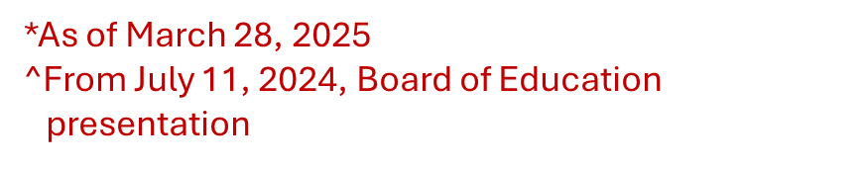
Open Enrollment
Board of Education will be asked to approve Open Enrollment Available Capacity of 2,970 students for the 2025-26 School Year
Deadline for this year is June 15, 2025
 | 2025-26* | 2024-25^
Elementary | 23 | 28
Middle School | 15 | 20
High School | 28 | 29
Total | 66 | 77
Notes:
Current open enrollment data

Slide 47

Conclusions and Future Considerations
We are entering a new phase in Olathe where our growth is declining.
Continued monitoring of school enrollment numbers and projections.
Future evaluation of the need for our current number of schools considering the declining enrollment in certain areas of the district.
Open communication with our staff and stakeholders regarding future enrollment projections.

Slide 48
Questions?

Slide 49
School Finance 101

Slide 50

Public Perception
Public Perception
Notes:
Public perception of our funding- one big bucket.

Slide 51
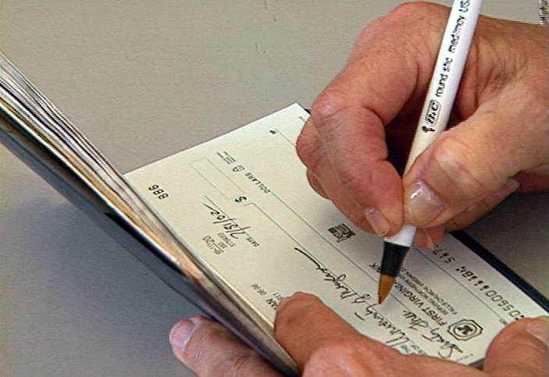
Understanding Multiple Accounts
Notes:
To understand how school districts account for their money think of your personal finances made up of individual checkbooks and special accounts …
Maybe you have set up accounts for specific purposes like house payments, vacations, entertainment or a rainy day.

Slide 52
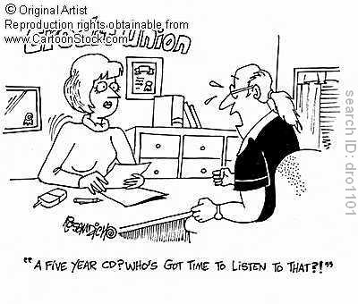
Accessing the Money
Credit Union
Notes:
And don’t forget that escrow account you have at your mortgage holder- that’s yours too. So is your pension fund and that 5-year CD you bought last year you can’t touch until it matures or be penalized. It’s all your money, even if some of it is harder to use than others.

Slide 53
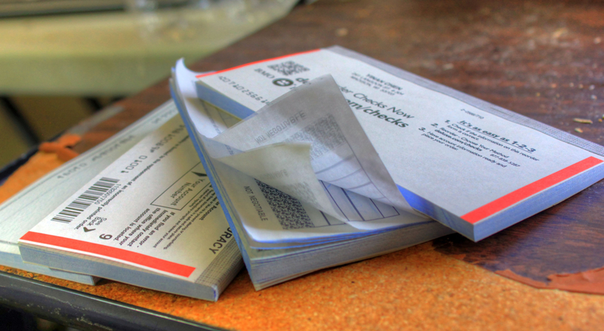
27/31
27 Funds
31 Funding Sources
Notes:
Well school districts have the same kinds of checkbooks or accounts that are called funds.
We have 27 different funds or checkbooks and 31 different funding sources.

Slide 54

27
12 Restricted
12 Semi-Restricted
3 Unrestricted

Slide 55

3-Legged Stool of the Annual Budget
BUDGET
LEGAL MAX
BOND AND INTEREST
CAPITAL OUTLAY
Notes:
But even with all of those different funds, we are really supported by the three- legged stool of Legax Max, Capital Outlay and Bond and Interest.

Slide 56
Three Parts of the Budget
BOND & INTEREST
OPERATING
CAPITAL OUTLAY
Notes:
The simplest analogy I can think of to explain how our budget works is to talk about these three buckets.

Slide 57
Tax Bill
Fund | FY2026 Mill Rate
233 Unified | 20.000
233 Sch Gen | 19.539
233 Sch Capital Outlay | 8.000
233 Bond | 14.371
TOTAL | 61.910
Tax Bill

Slide 58
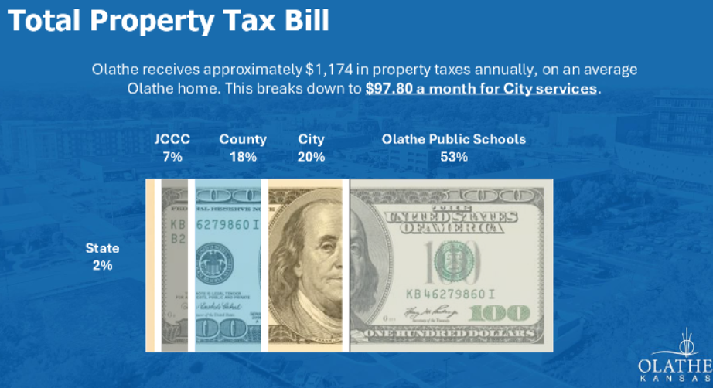
Total Property Tax Bill

Slide 59


Apples to Oranges
Apples to Oranges
 | Property Tax Rate | Equivalent Rate | Other Sources
Olathe Public Schools | 61.948 | 64.529 | Federal Funding (4.0%)
City of Olathe | 23.334 | 66.668 | Sales Tax (50.0%) , Fees and Other Sources (15.0%)

Slide 60
Use of Authority
Fund | FY2026 Mill Rate | Authority Utilized
General | 20.000 | Maximum Authority Utilized
Local Option Budget (LOB) | 15.590 | Maximum Authority Utilized
Extraordinary Growth Facility (BOTA) | 0.222 | Maximum Authority Utilized
Special Liability Expense | 0.311 | Equals Budgeted Need
Cost of Living | 3.170 | Maximum Authority Utilized
Special Assessment | 0.267 | Equals Budgeted Need
Capital Outlay | 8.000 | Maximum Authority Utilized
Bond and Interest | 14.388 | Equals Budgeted Need
Total | 61.948
Notes:
Unlike a business, our Board cannot increase prices.
They can only maximize the use of their authority.
Everything else has to be adjusted on the expense side of the equation.

Slide 61
Sch Gen
Fund | FY2026 Mill Rate | Authority Utilized
General | 20.000 | Maximum Authority Utilized
Local Option Budget (LOB) | 15.590 | Maximum Authority Utilized
Extraordinary Growth Facility (BOTA) | 0.222 | Maximum Authority Utilized
Special Liability Expense | 0.311 | Equals Budgeted Need
Cost of Living | 3.170 | Maximum Authority Utilized
Special Assessment | 0.267 | Equals Budgeted Need
Capital Outlay | 8.000 | Maximum Authority Utilized
Bond and Interest | 14.388 | Equals Budgeted Need
Total | 61.948

Slide 62
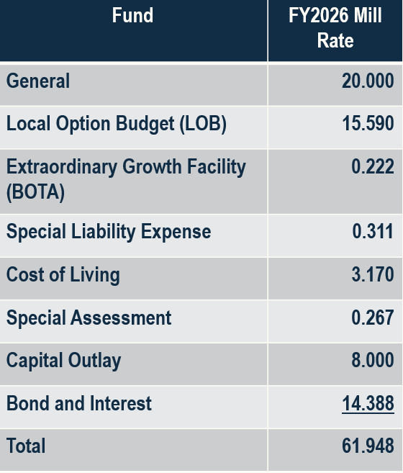
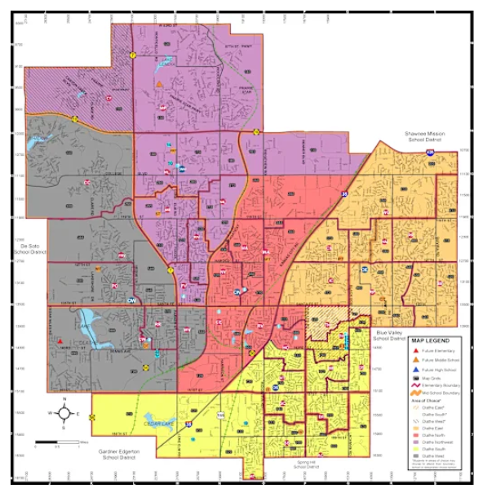
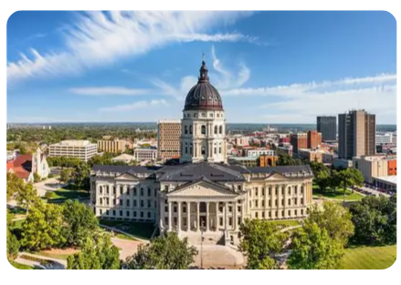
Where Funding Goes
Olathe Public Schools
Topeka

Slide 63

Variables of Funding

Slide 64

Variables of Funding - Enrollment

Slide 65

Variables of Funding - Base

Slide 66
BASE (Base Aid for Student Excellence)
Estimated

Slide 67
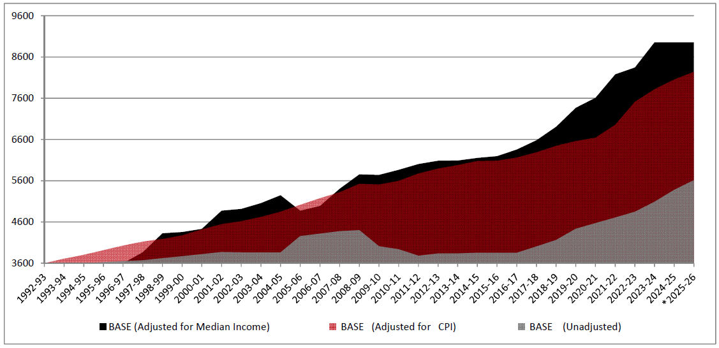
Has Funding Kept Pace?
Notes:
You have seen this chart before in the budget book but I thought it important to walk through it again.

Slide 68
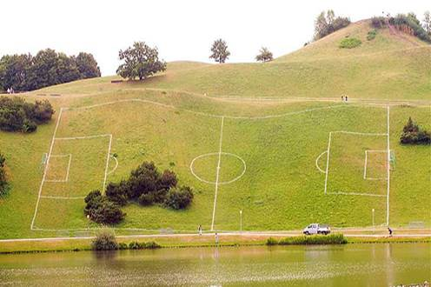
WEIGHTINGS- A CLOSE COUSIN TO BASE FUNDING
Notes:
You could begin by explain that even with equalization, districts would be operating on an uneven playing field if the difference in students was not recognized.
Weightings are a recognition that not all students and communities are the same.

Slide 69

Typical Student
Notes:
Take Anna for instance.
Anna just move here from another country.
Joseph does not speak English and qualifies for free lunch.

Slide 70






Why Weighting is Needed
Notes:
If we provide the same funding to Joseph that we receive for any child, our BASE, Joseph is at a disadvantage.
Weightings are what can balance the scales of academic success.
Assume the silver dollar represents 1FTE of funding.
Now lets add another 45 cents or .45 FTE of funding for Joseph being at-risk as measured by his qualifying for free lunch.

Slide 71

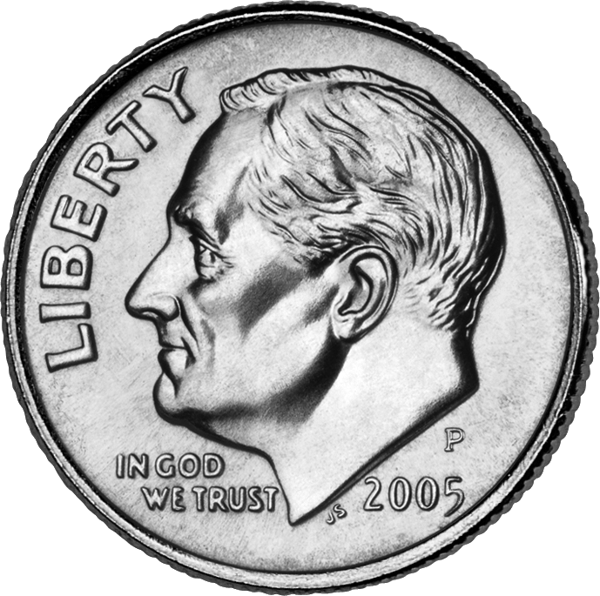
At-Risk Weighting
Notes:
The at-risk weighting helps tip the scales in Joseph’s favor but he still is not on a level playing field.
Now lets add another 40 cents or .40 FTE of funding for Joseph needing ELL services.

Slide 72

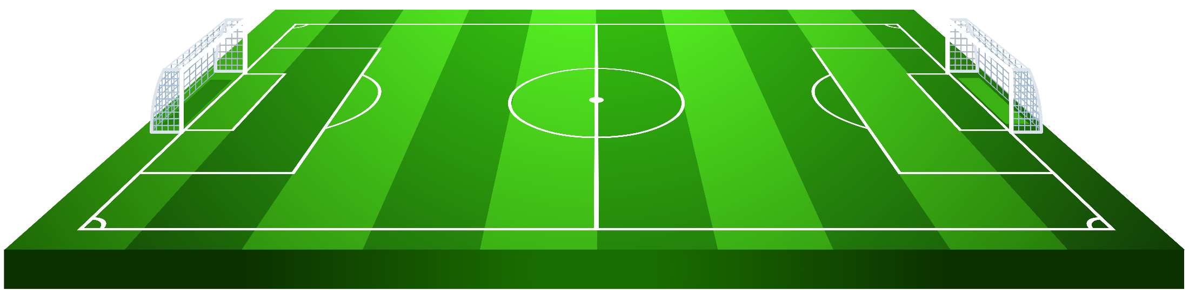
An Even Playing Field
Notes:
Now Joseph is on a level playing field- his needs are balanced with the proper funding at 1.85 FTE.
That’s what weightings do. They level the playing field by allocating additional funding toward the different challenges of our students.
See- pictures worth a thousand words.

Slide 73

Variables of Funding – Assessed Valuation

Slide 74
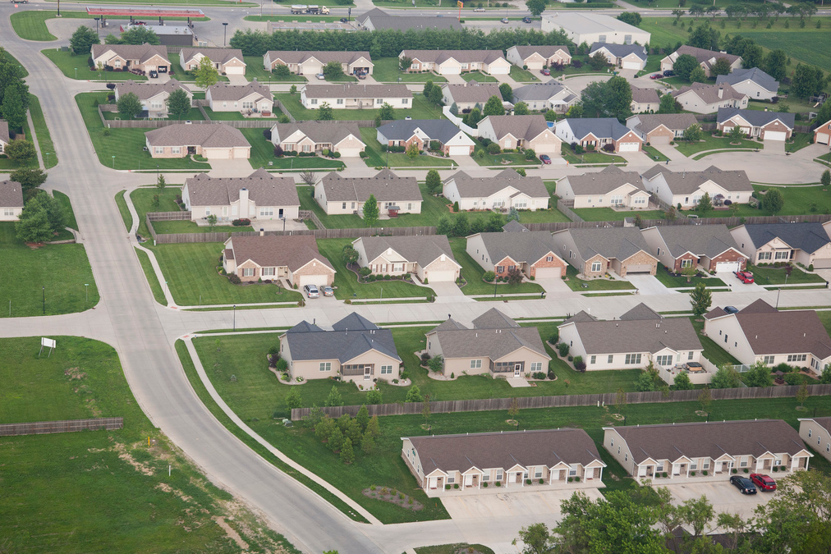
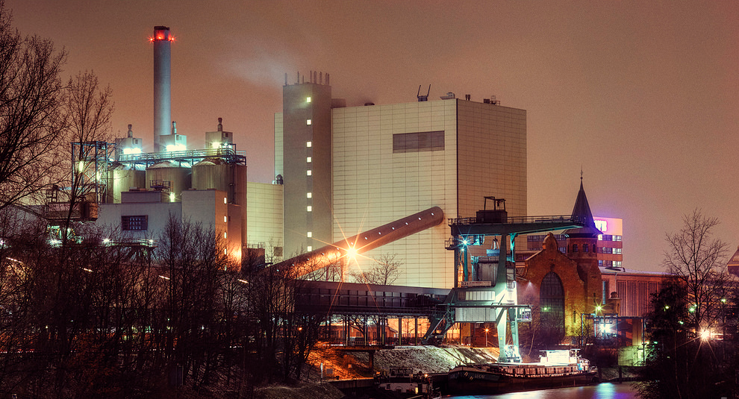
Difference between Residential and Commercial
RESIDENTIAL
COMMERCIAL

Slide 75
Taxing Rates
RESIDENTIAL Market Value X 11.5%
COMMERCIAL Market Value X 25.0%
(… and no kids!)

Slide 76
Capital Funds Reality
Olathe Public Schools (2024)
Assessed Valuation
$3.2 Billion
Capital Outlay Revenue
$39 Million
Funded FTE
27,708
Neighboring District (2024)
Assessed Valuation
$5.6 Billion
Capital Outlay Revenue
$47 Million
Funded FTE
25,905
Notes:
(Shawnee Mission is the neighboring district)
Because of this additional capital outlay, our neighbor is able to fund their education initiatives often without the use of bond funds- a luxury we do not have and therefore need bond funds for repairs to buildings and infrastructure and other items our neighbors purchase out of the capital outlay bucket.
So how does all this help retain and attract quality staff?

Slide 77

Variables of Funding – Mill Rate

Slide 78
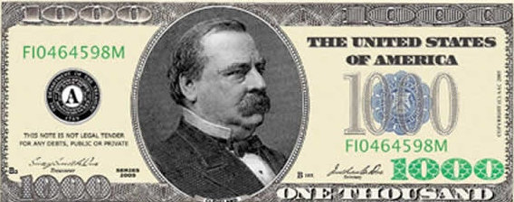
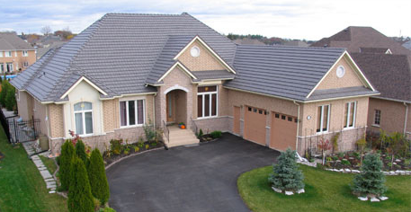


Converting Mills to Tax Dollars
1 mill raises $1 of taxes per $1,000 of AV
51.75 Clevelands
$450,000 Market Value
X
61.948 Mills
=
$51,750 Assessed Valuation (11.5%)
$3,205.81 Tax Bill

Slide 79
Mill Rate- Board of Tax Appeals (BOTA)
$26,600,000
$25,273,917
$19,176,366

Slide 80
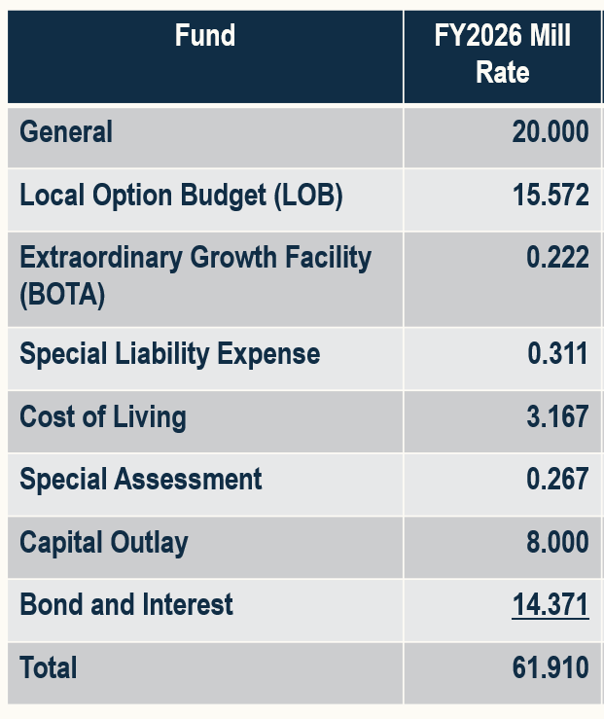
Where Funding Goes - Review
Olathe Public Schools
Topeka
Notes:
So again, although we are all taxed in Olathe, not all of the funding goes directly to Olathe.
As I mentioned earlier, the 20 mills goes to Topeka and then back to us through a funding formula called the Legal Maximum Budget.

Slide 81
Filling the Bucket- Legal Maximum Budget
Enrollment x BASE
+ Student Weightings (High enrollment, Bilingual, CTE, At- risk, High-density at-risk)
+ Other Funding Weightings (Transportation, BOTA, Special Education, COLA)
General Fund Legal Max Budget
x 33%
Local Option Budget Legal Max
OPERATING
NO MORE!

Slide 82
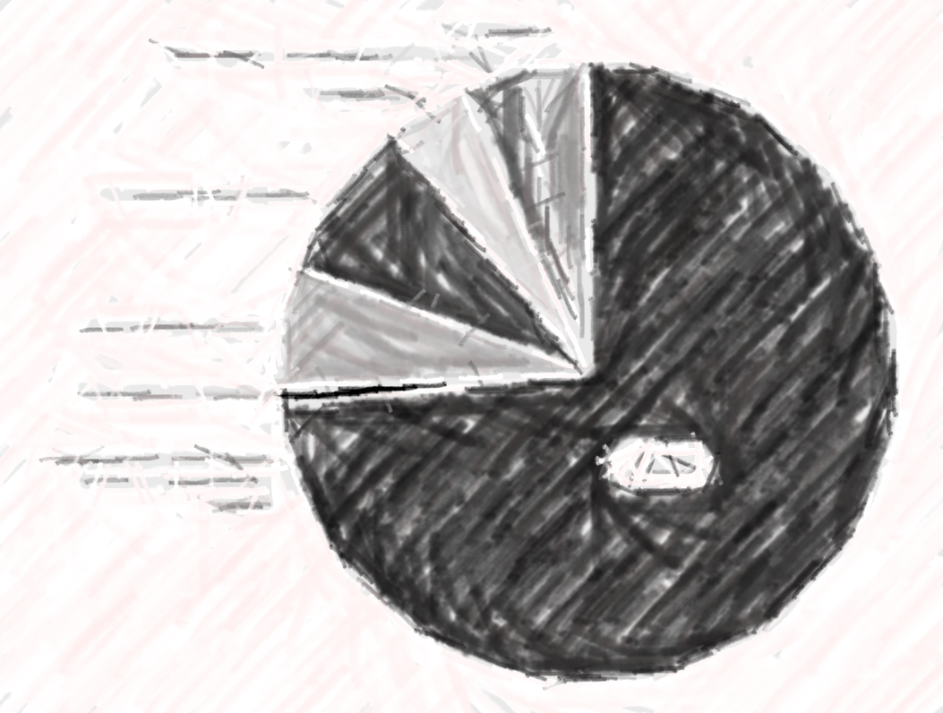

Emptying the Bucket(s)
Notes:
So once we fill our Operating Bucket, how do we empty it?
What does all of that money go towards?

Slide 83
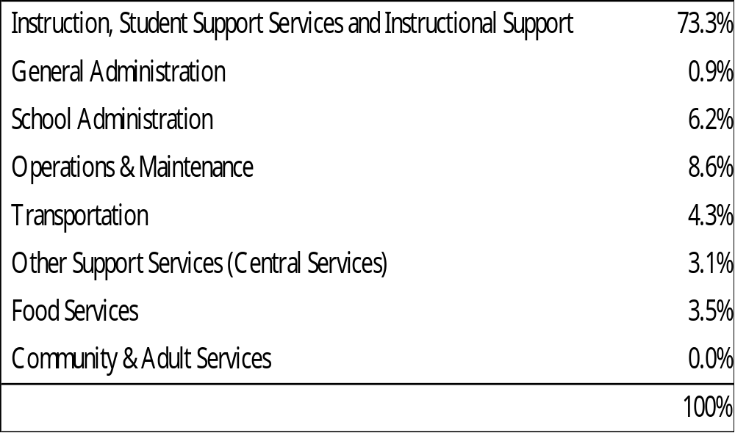
Emptying the Bucket(s) - Percentages
OPERATING
Notes:
Last year, this is how we emptied the bucket.
Notice that if we include school administration with instruction and student supports, 80% of our operating funds went directly in support of students.
I don’t know about you but I think we are emptying the bucket wisely.

Slide 84
The Impact
TOTAL FUNDS INCREASE OVER 10 YEARS
+$51.4 M
$5.15M Per Year Average
The Impact of the State Legislature’s Choice Not to Fully Fund Special Education
+$35.9M
General Budget
+$15.5M
SPED
TOTAL EXPENDITURE INCREASE OVER 10 YEARS
+$14.0
General Budget
+$37.4M
SPED COST INCREASE
+$14.0M
$1.4M Per Year Average
TOTAL ADDITIONAL (NON-SPED)
BUDGET FUNDS INCREASE OVER 10 YEARS
Notes:
(Highlight only $14 million for all other non-special education operating costs)
Special education services are required, and they help students who need extra support.
Over the last ten years, the cost of providing those services increased by $37.4 million.
State support increased too — by $15.5 million — but that’s less than the total increase in costs.
That means the district had to cover the remaining $21.9 million with local dollars.
At the same time, the overall general education budget did increase — but inflation rose faster.
So even though the budget number is higher, it doesn’t buy as much as it used to.
Bottom line: special education costs have grown faster than state funding, and the gap has required more local dollars — which puts pressure on the rest of the budget.

Slide 85
Expenses Outpace Funding
+$14.0 M
over 10 years is not a lot of funding.
Compensation increases for this year alone = $15.1 million.
Health insurance costs paid by the district over the past 7 years = $14.1 million.
Notes:
We desperately need help from our legislature to address this.
Unfortunately, Bond 2026 cannot fix this but does help us with operating fund relief in the short-term.

Slide 86
Expenditure Variables
1.0% CPI = additional $500,000 in non-compensation costs
CPI (3-year avg. = 3.710, 10-year avg. = 2.027)
One step on salary schedule equals approx. $2.6 million
$100 increase in teacher starting salary equals approx. $400,000
1.0% in non-teacher salaries equals approx. $850,000
Annual growth in special ed. expenditures = approx. $2.0 million

Slide 87
The Cost of Misalignment
We are operating a model with too many schools. It’s a model set up for over $22 million more in state aid that we are not receiving and is not sustainable.

Slide 88
Questions?

Slide 89
Olathe Public Schools
Boundary Review

Slide 90
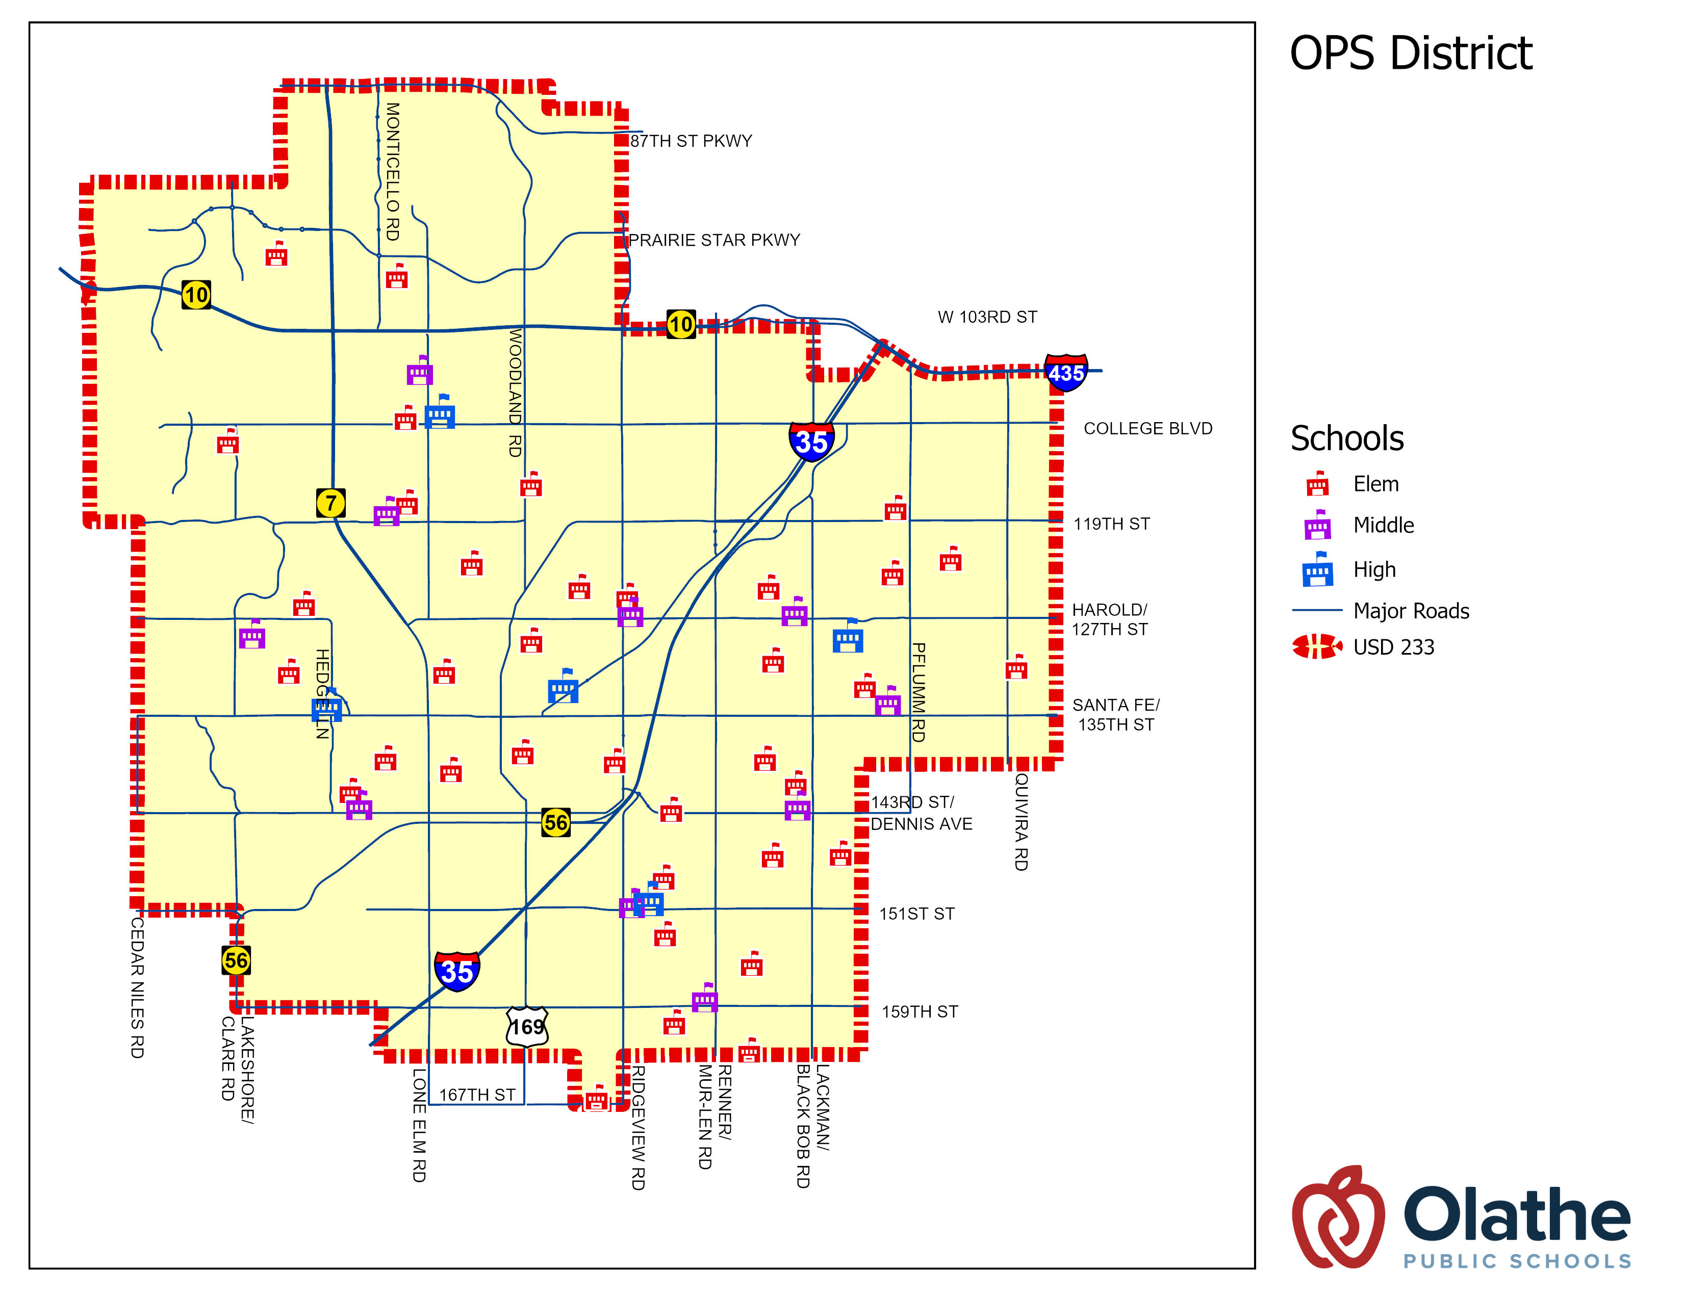
District Facts
District Facts
  Boundaries established by State of Kansas in 1965
  Covers 74.62 square miles
  168,386 Patrons (ACS 2024 Estimate)
  28,387 students (as of April 2026)

Slide 91
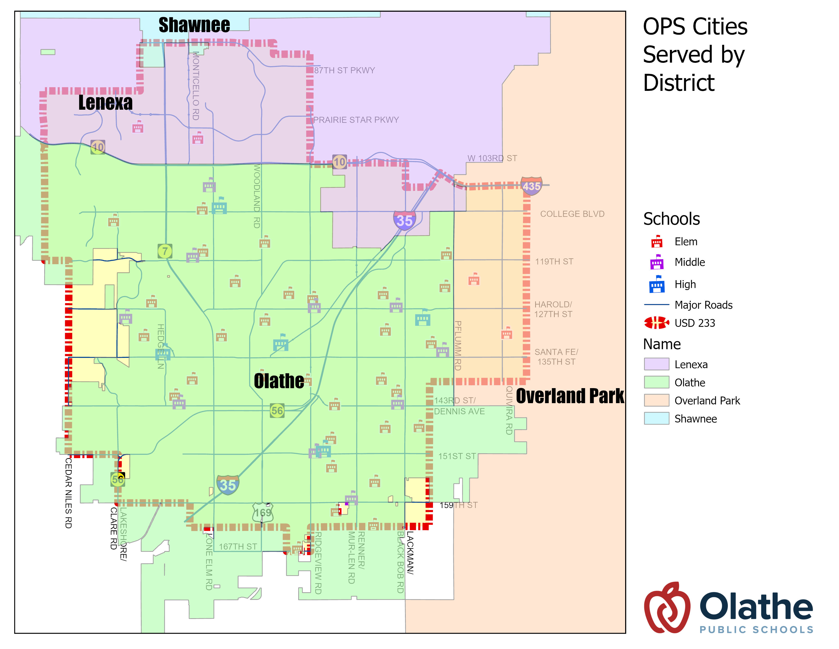
Cities We Serve

Slide 92
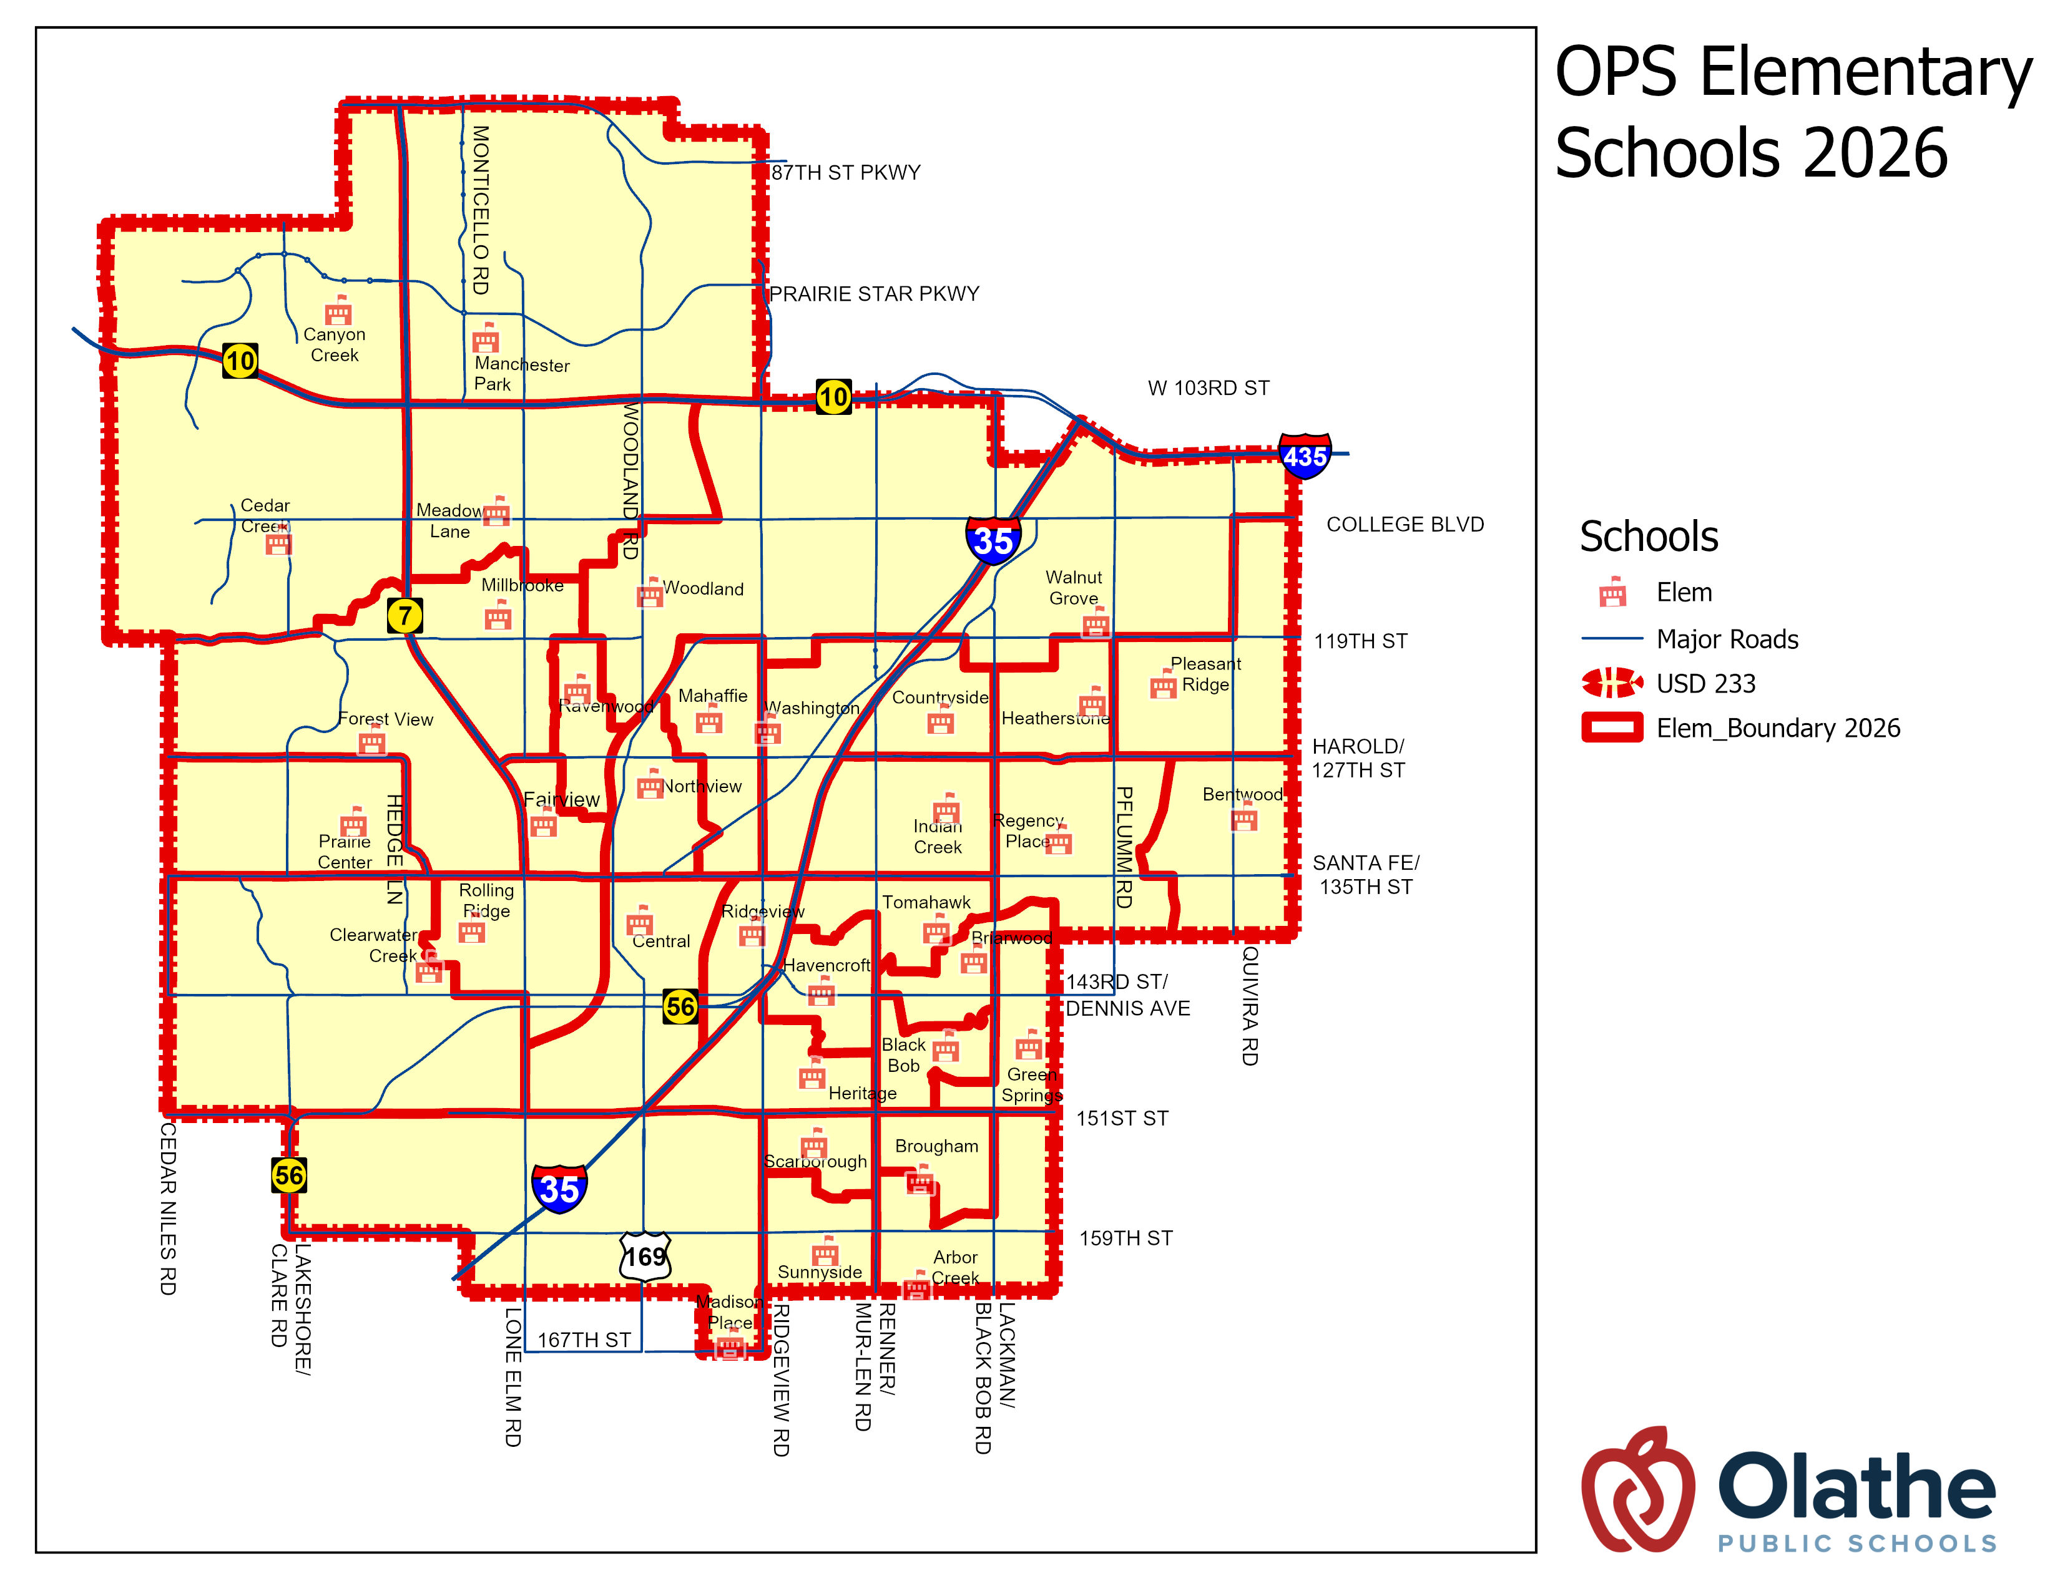
OPS Elementary Schools 2026

Slide 93
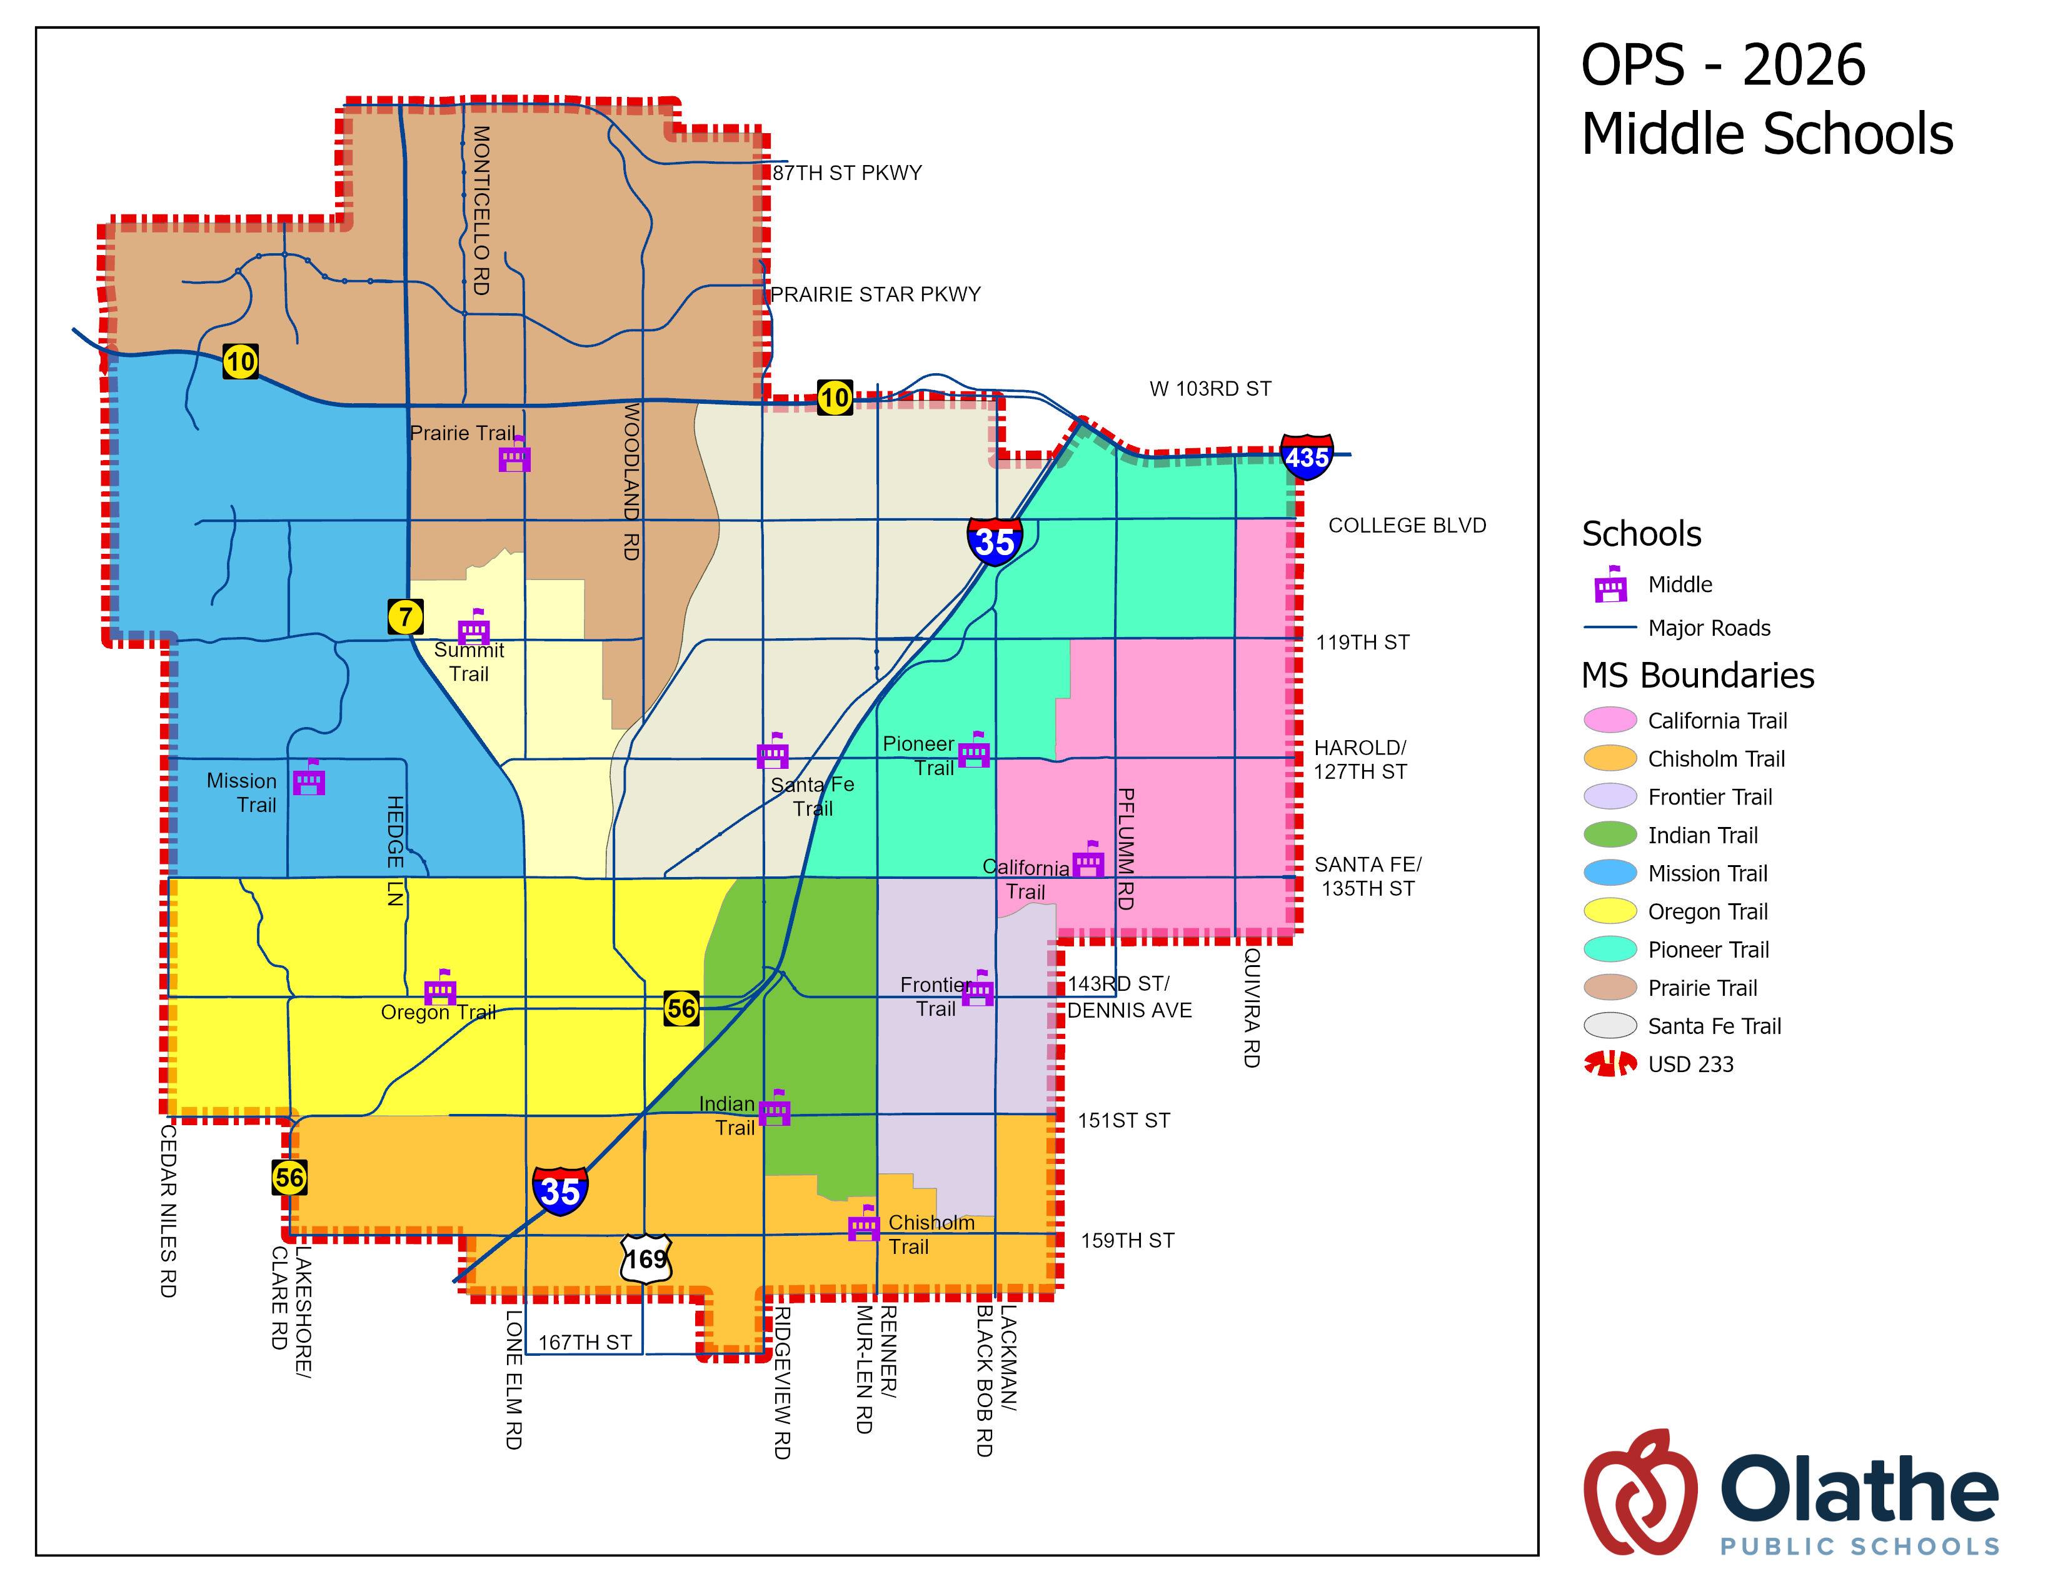
OPS 2026 Middle Schools

Slide 94
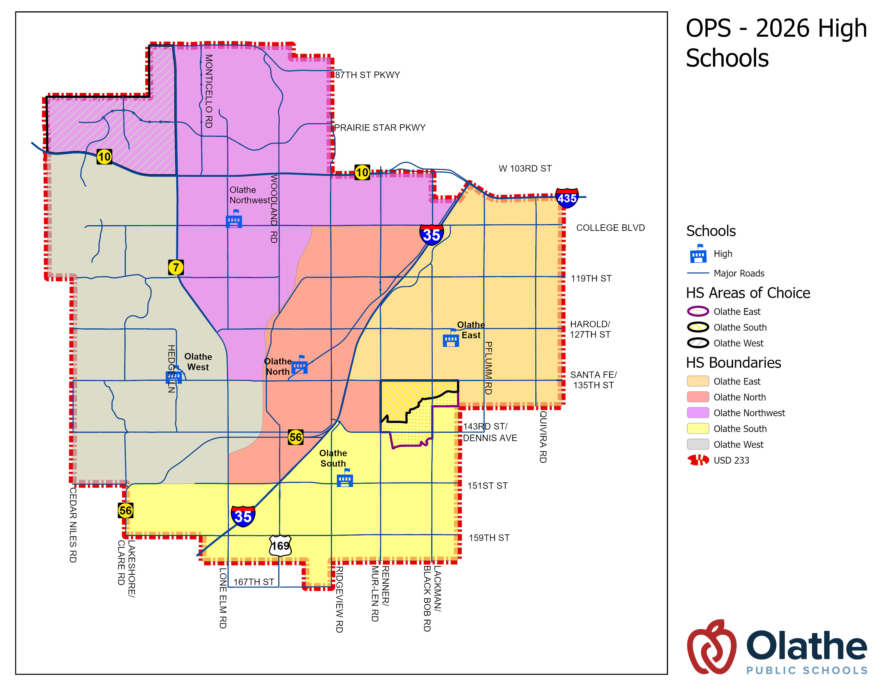
OPS 2026 High Schools

Slide 95
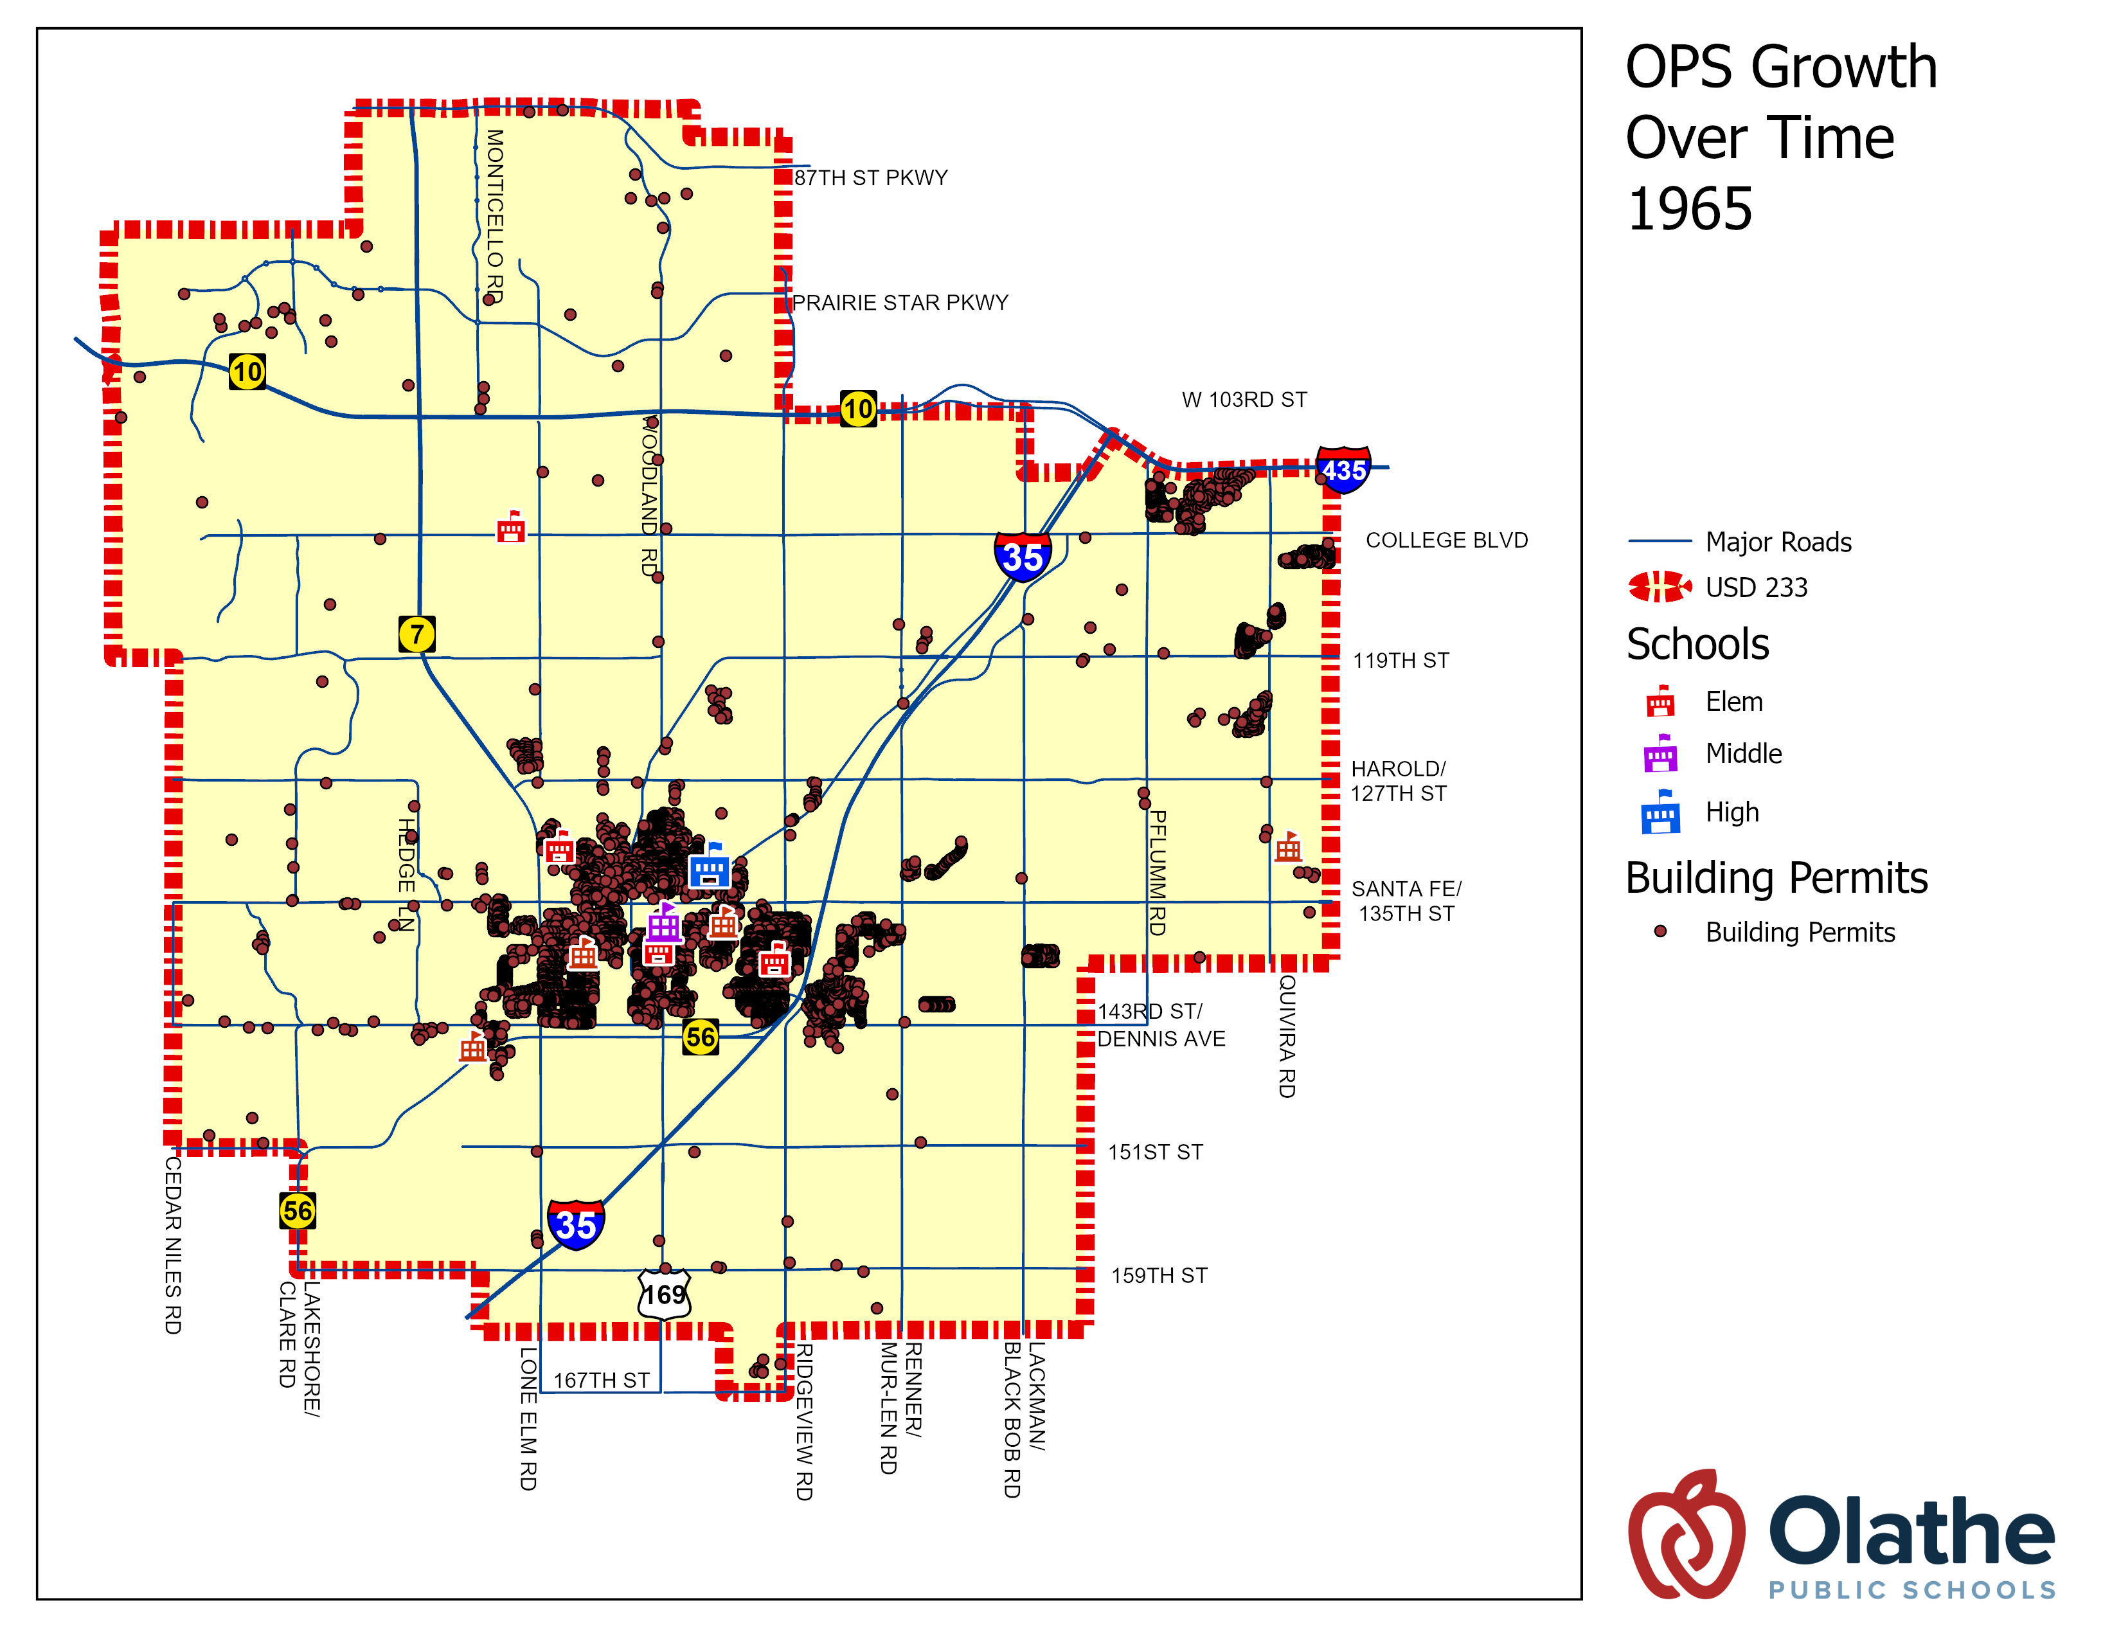
Pre-1965
Pre 1965
Open Schools
  Central Elem
  Old Countryside Elem
  Fairview Elem
  Meadow Lane Elem
  Ridgeview Elem
  Stuck Elem
  Old Washington Elem
  Westview Elem
  Olathe Junior High
  Olathe North High
Closed Schools
  Lincoln Elem
  Pleasant View Elem
  Mount Zion Elem

Slide 96
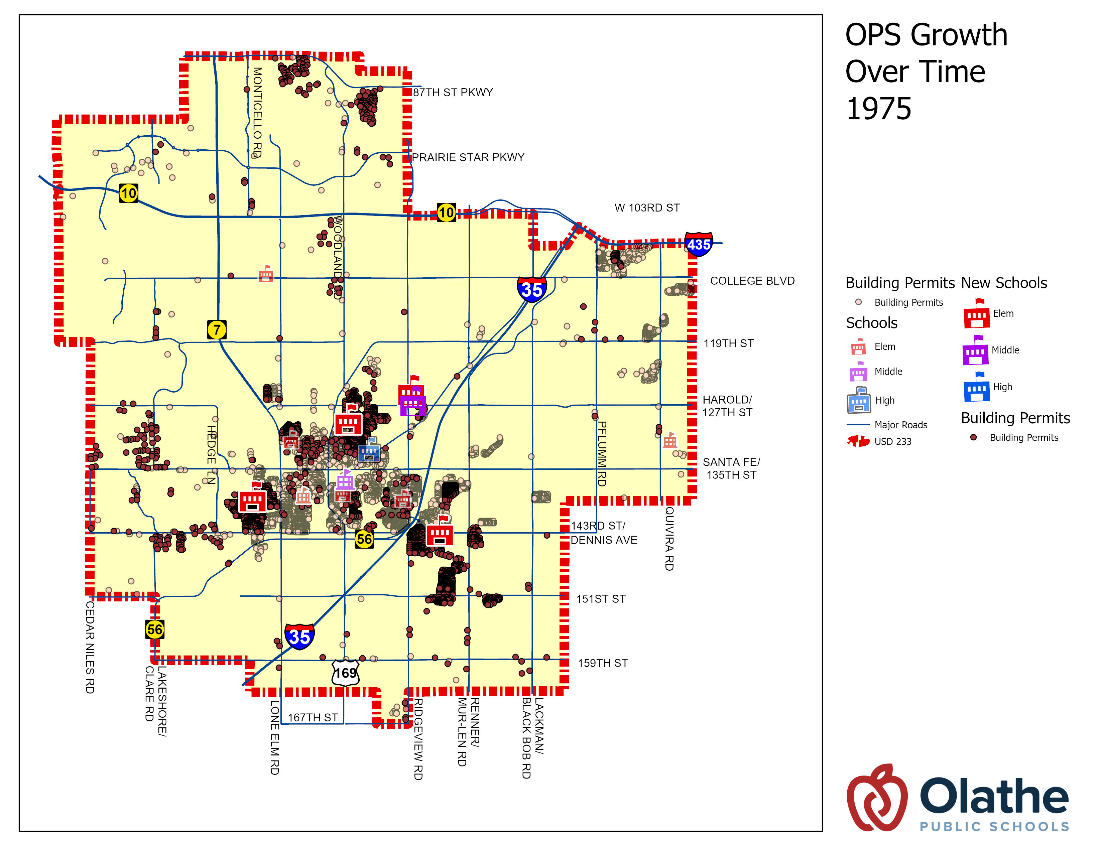
1965-1975
1965-1975
Opened Schools
  Havencroft Elem
  Northview Elem
  Rolling Ridge Elem
  Washington Elem
  Santa Fe MS
Closed Schools
  Stuck Elem

Slide 97
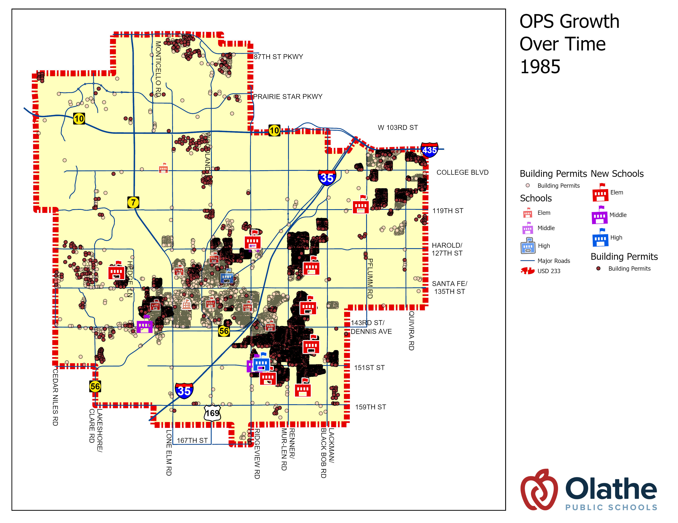
1975-1985
1975-1985
Opened Schools
  Black Bob
  Brougham
  Indian Creek
  Prairie Center
  Scarborough
  Tomahawk
  Walnut Grove
  Indian Trail MS
  Oregon Trail MS
  Olathe South HS
Closed Schools
  Old Countryside
  Millbrooke Junior High

Slide 98
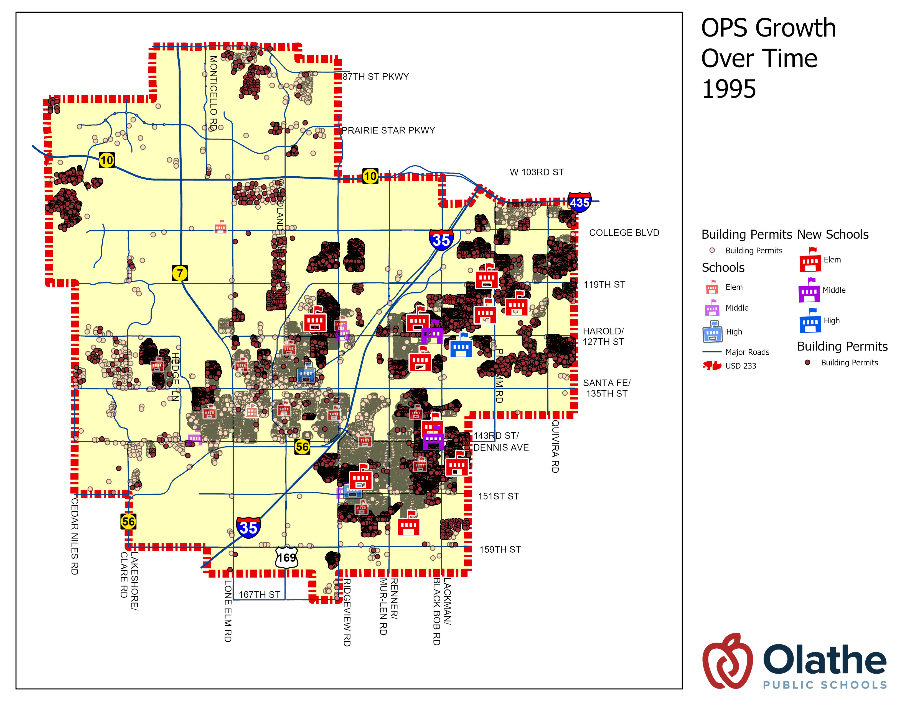
1985-1995
1985-1995
Opened Schools
  Briarwood Elem
  Countryside Elem
  Green Springs Elem
  Heatherstone Elem
  Heritage Elem
  Mahaffie Elem
  Frontier Trail MS
  Pioneer Trail MS
  Olathe East HS
Closed Schools
  None

Slide 99
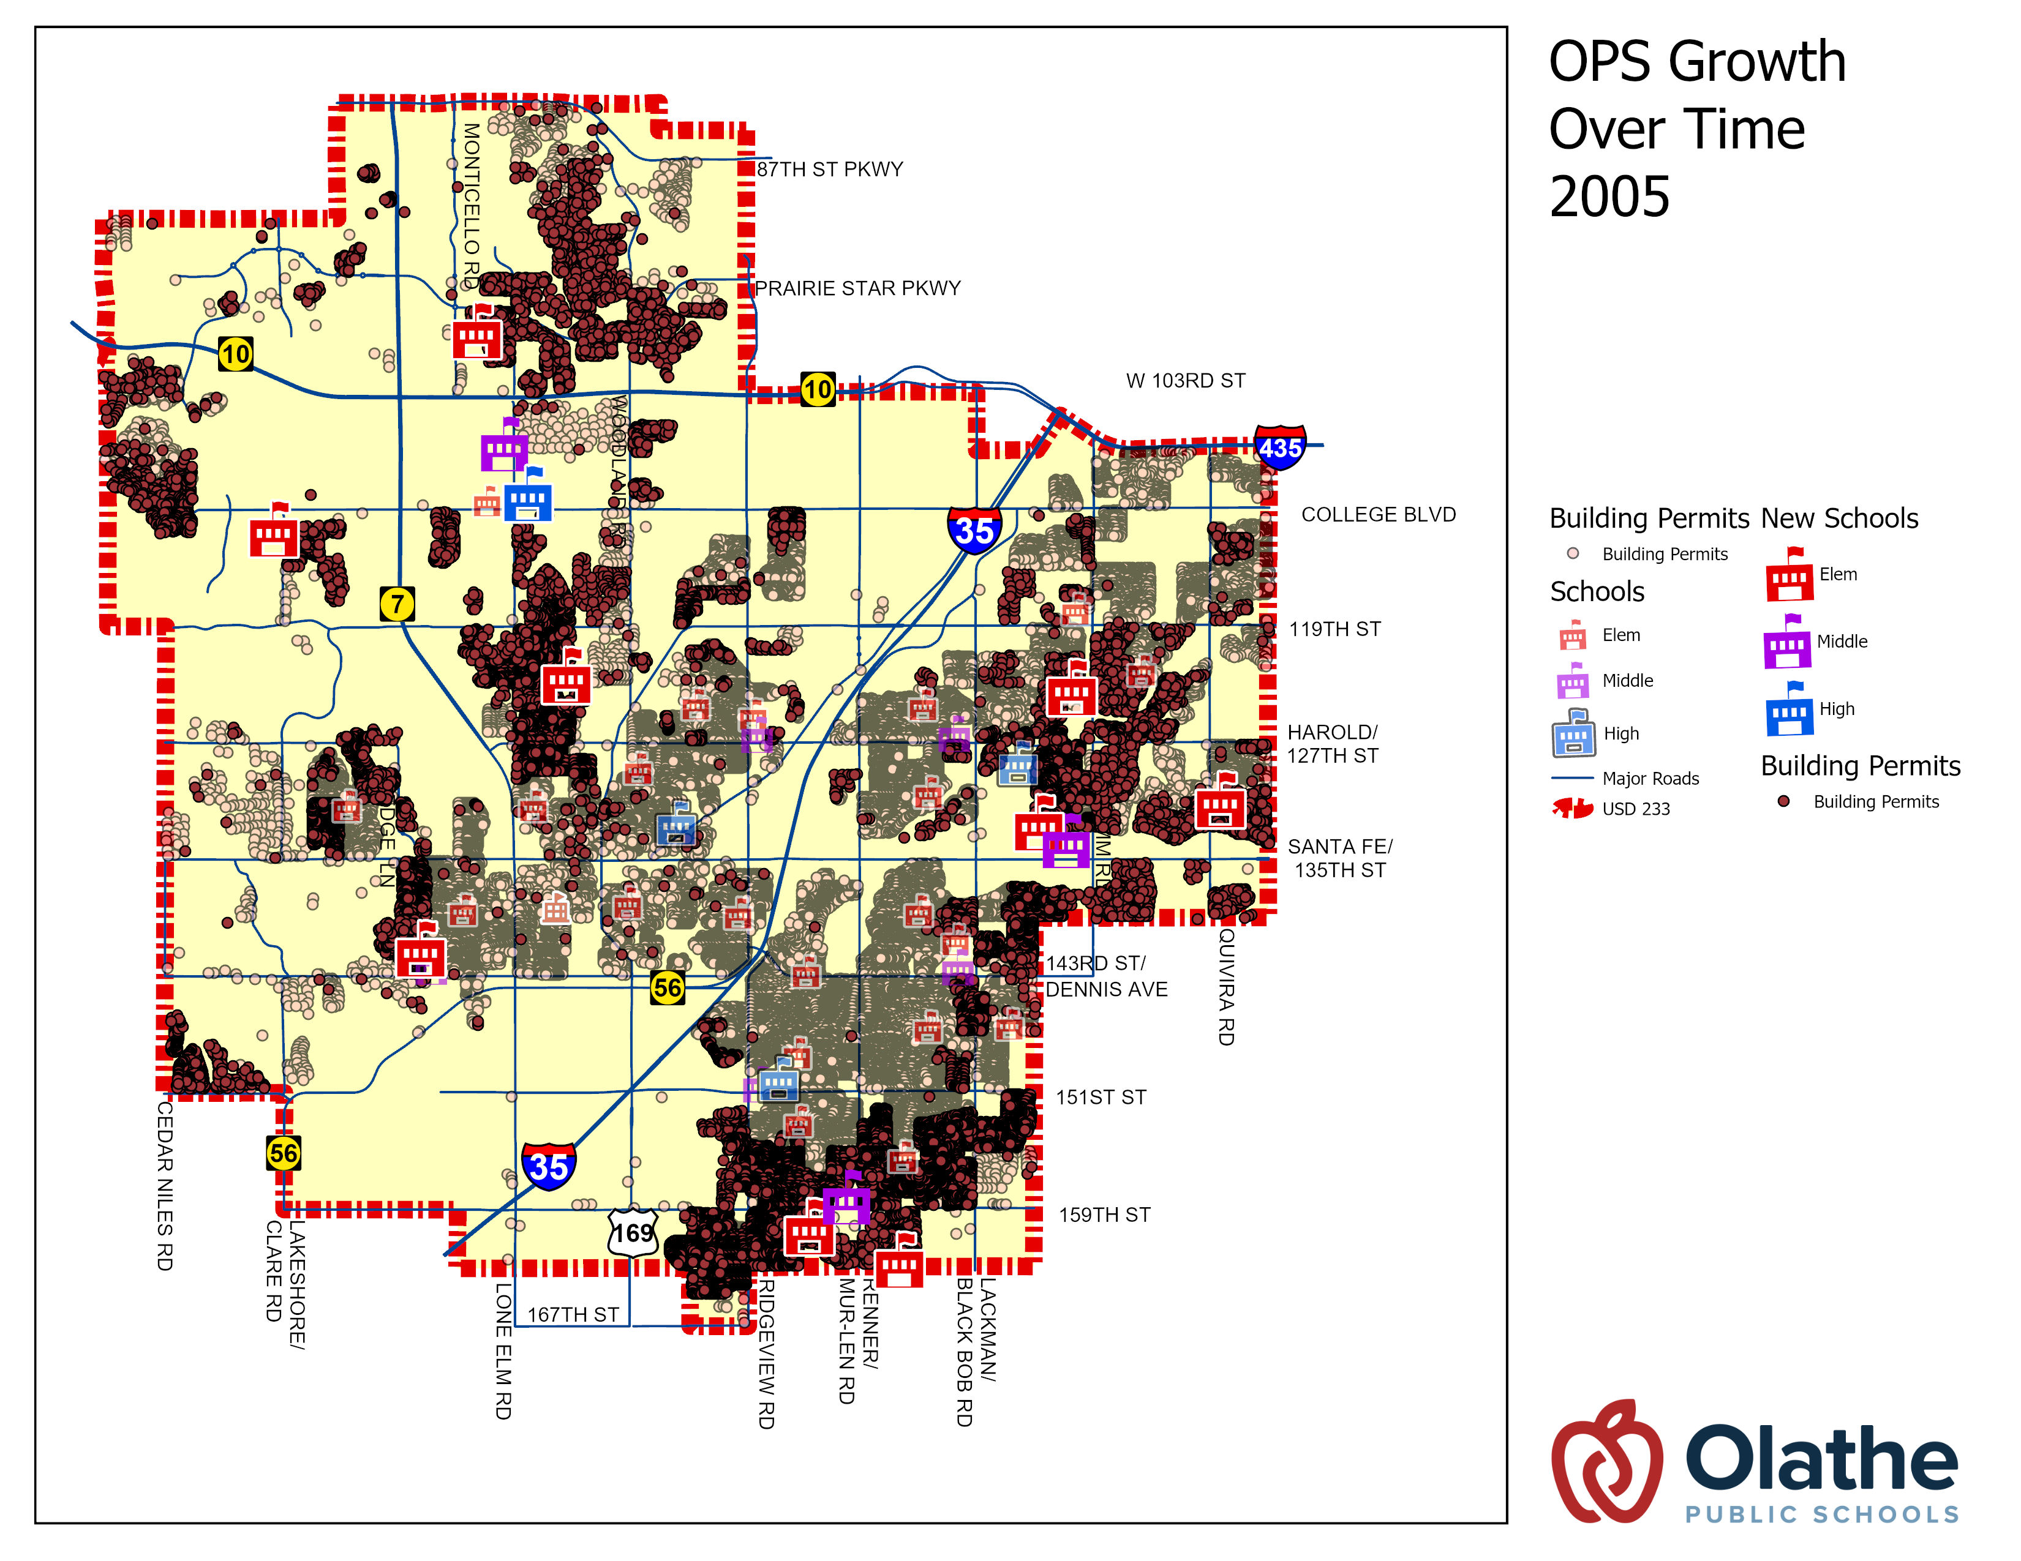
1995-2005
1995-2005
Opened Schools
  Arbor Creek Elem
  Bentwood Elem
  Cedar Creek Elem
  Clearwater Creek Elem
  Manchester Park Elem
  Ravenwood Elem
  Regency Place Elem
  Sunnyside Elem
  California Trail MS
  Chisholm Trail MS
  Prairie Trail MS
  Olathe Northwest HS
Closed Schools
  None

Slide 100
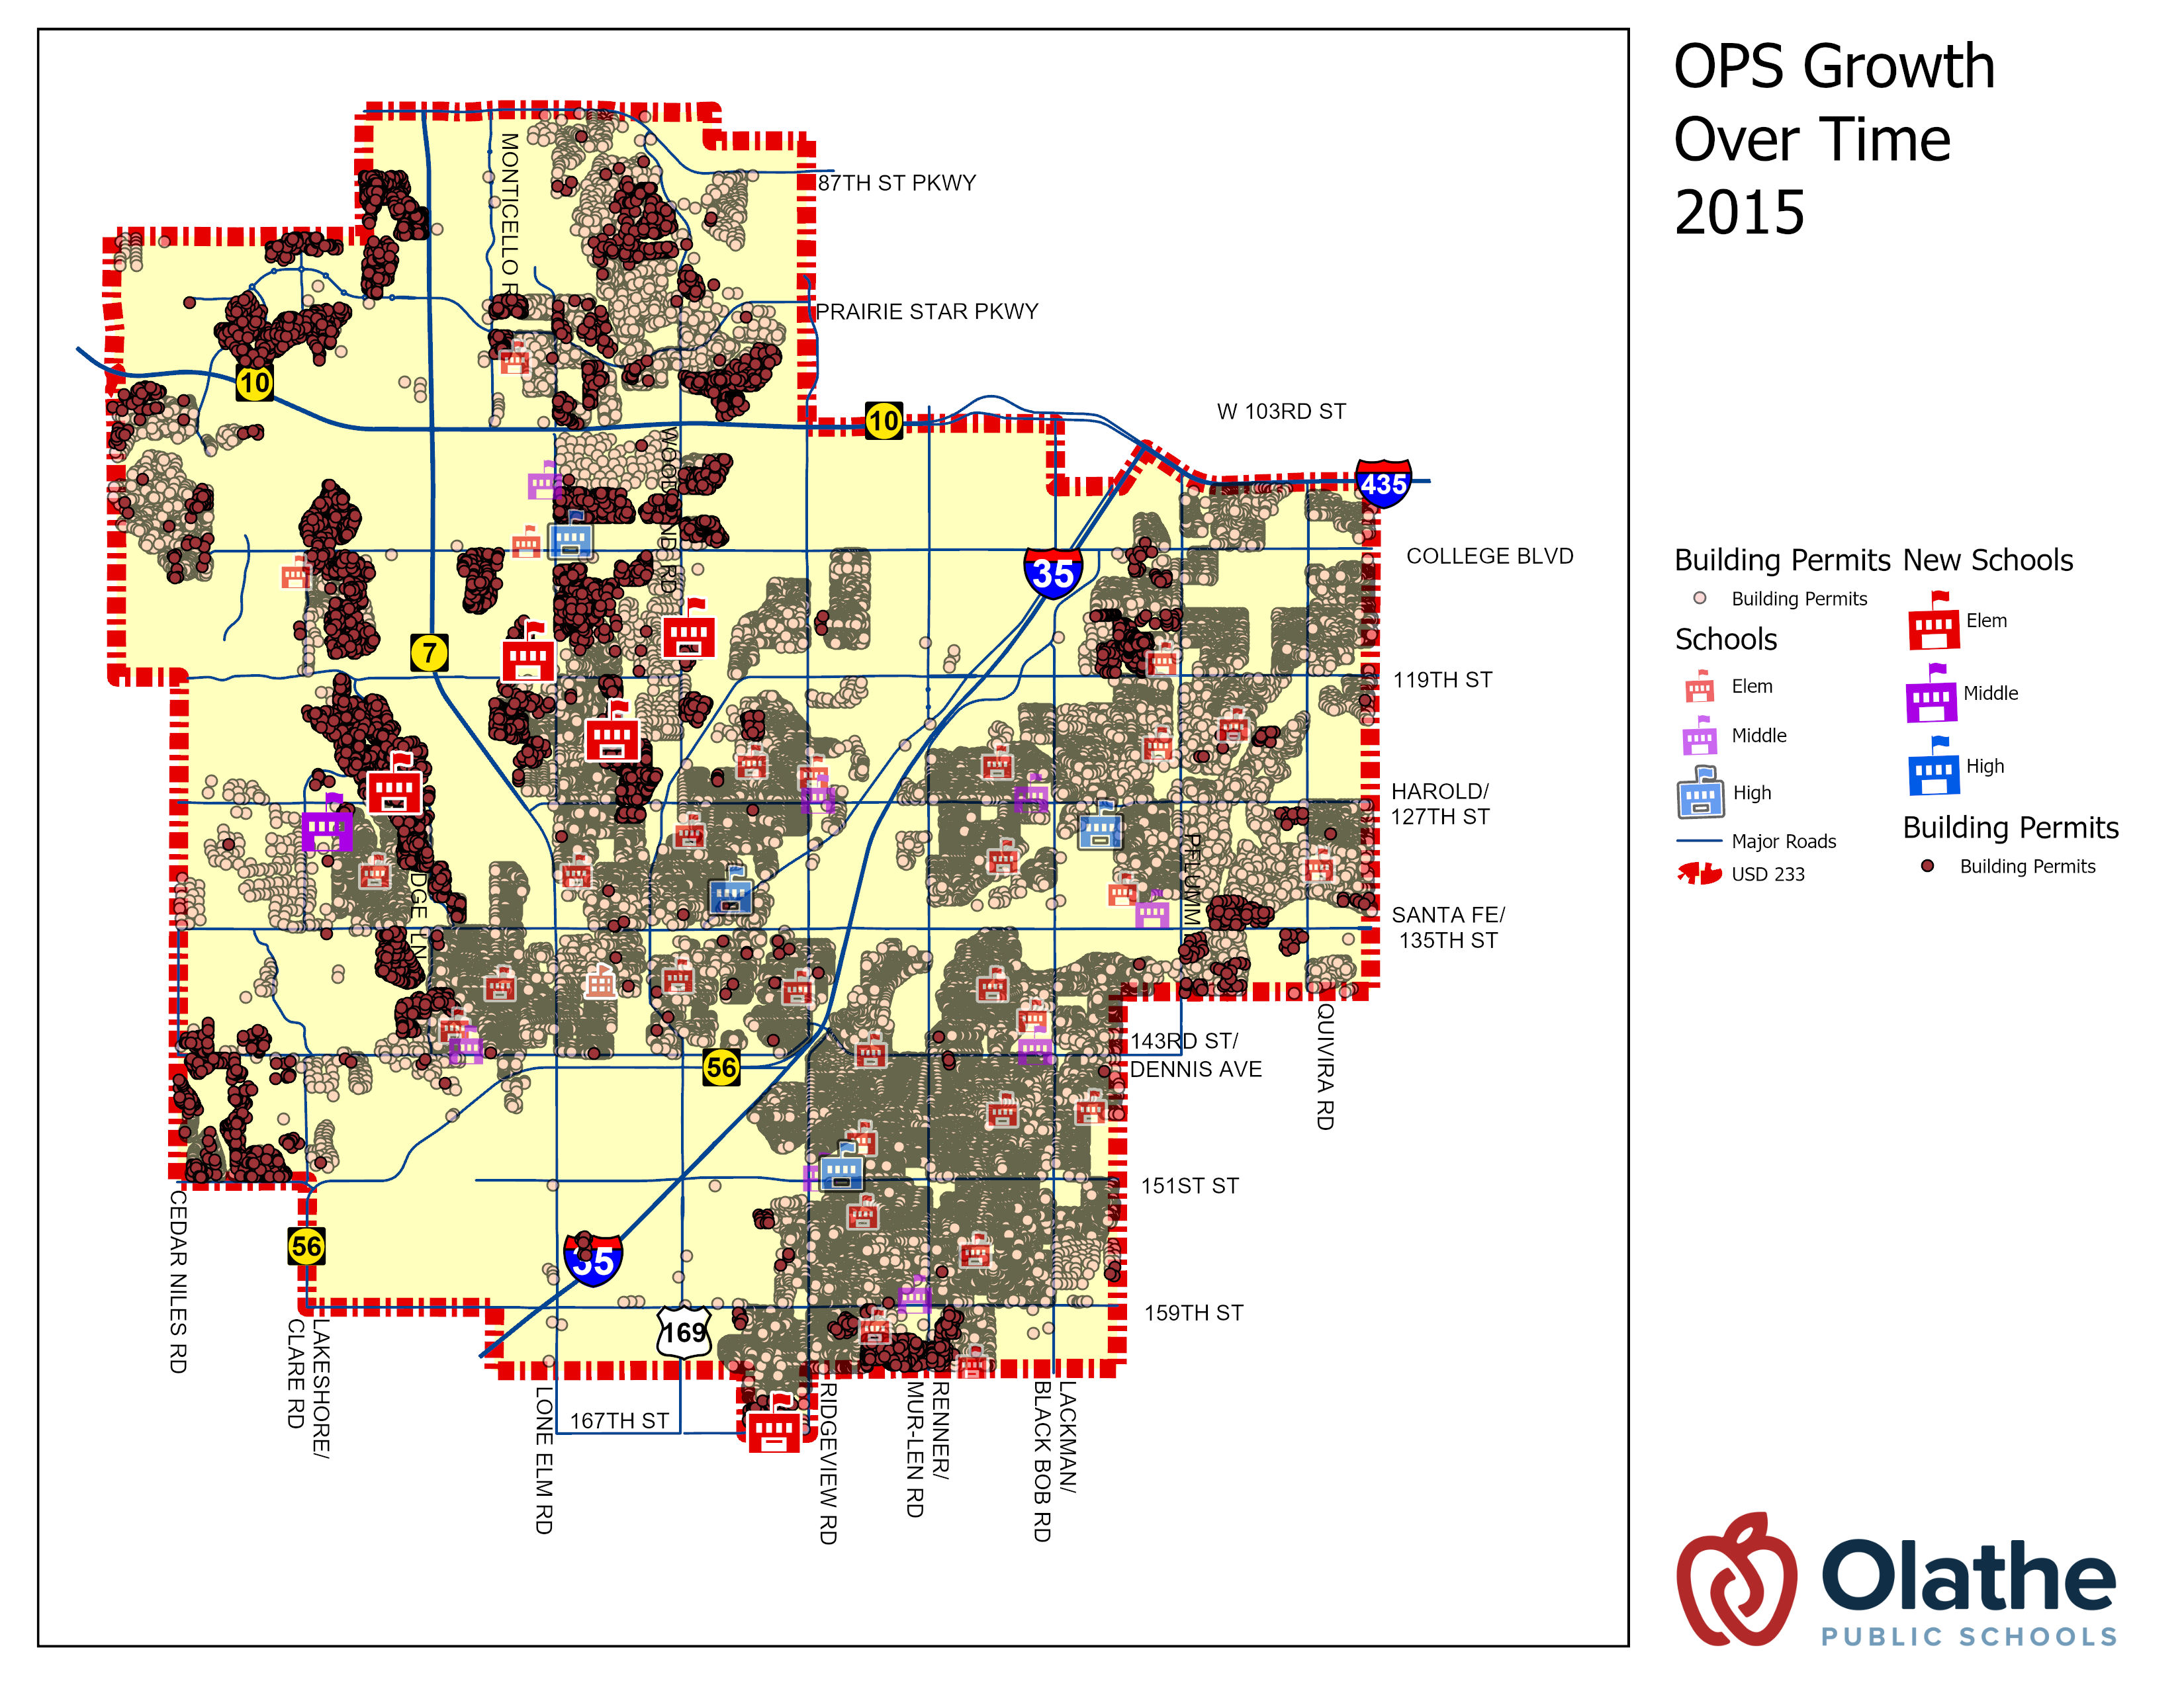
2005-2015
2005-2015
Opened Schools
  Forest View Elem
  Madison Place Elem
  Millbrooke Elem
  Woodland Elem
  Mission Trail MS
Closed Schools
  None

Slide 101
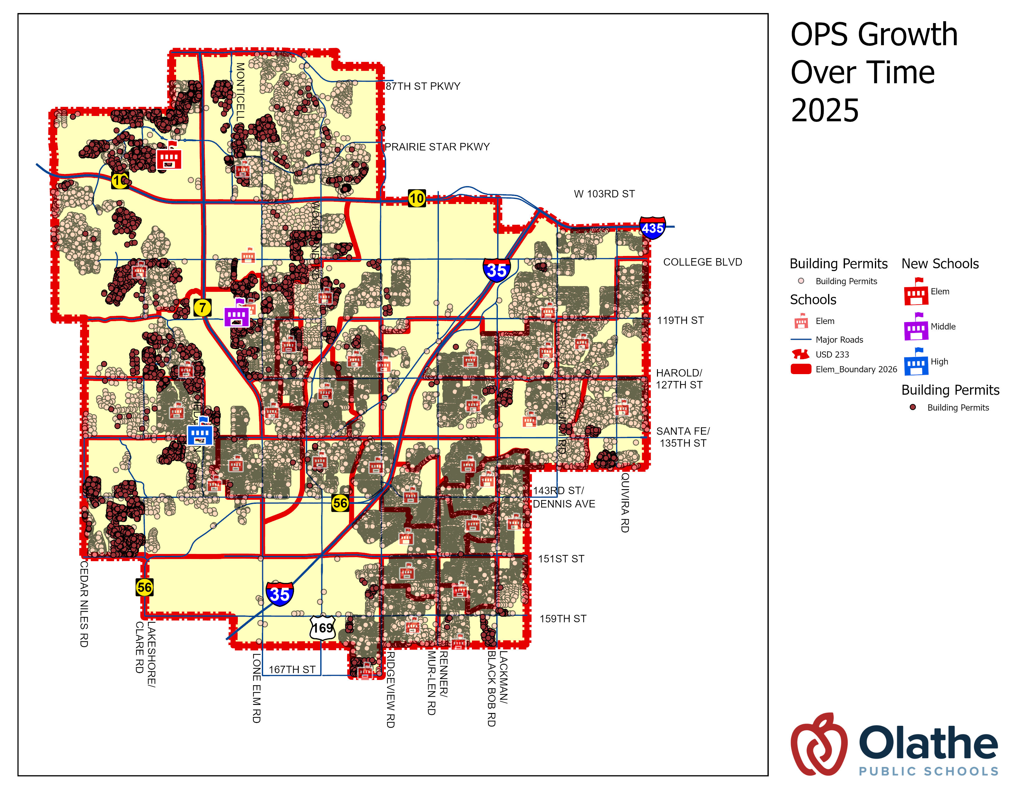
2015-2025
2015-2025
Opened Schools
  Canyon Creek Elem
  Summit Trail MS
  Olathe West HS
Closed Schools
  Westview Elem

Slide 102
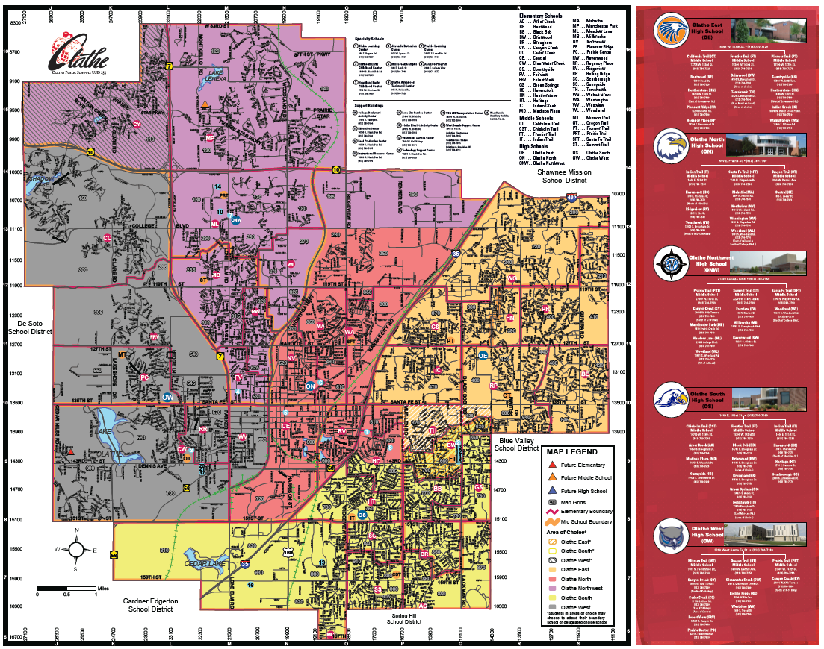
District Map

Slide 103
Questions?

Slide 104
Next meeting(s)
April 28th
  Presentation from our consultant
  Review how we calculate school capacity, size, additional programming, etc.
  Quadrant breakdown of elementary and middle schools
  Neighborhood school model – fact or fiction?
May 12th
  ^{Data analysis}
  ^{Small group work/discussions}
  ^{Recommendations}
  ^{Surveys}

Slide 105
Thank you for attending tonight!

