Slide 1

STUDENT FINANCIAL SERVICES
Next Steps for Financial Aid and Billing
2026-2027
Academic Year

Slide 2

Steps for Financing your Education
File 2026-2027 Free Application for Federal Student Aid (FAFSA) at studentaid.gov
  May 1, 2026 Deadline for Pennsylvania residents
Review Financial Aid Offer Letter
Complete Financial Aid Verification requirements, if selected
Send Deposit
Complete Outstanding Items for Federal/State Financial Aid
Review Payment Options

Slide 3

Financial Aid Offer Letter
Upon receipt of a completed FAFSA, MU will provide admitted students with a financial aid offer with financial aid eligibility
Listing of Financial Aid (Federal, State, and Institutional Grants, Scholarships, Loans, Federal Work Study)
Housing and Dependency Status
Financial Aid Handout/Guide to Financing your MU Education will help you & your family to:
  Understand your offer letter
  See the Full Year Cost of Attendance
  View Payments Options/Filling the Gaps

Slide 4
Pennsylvania Residents Only
PHEAA Instructions for 2026-27
Complete FAFSA at studentaid.gov
Wait for an email from PHEAA with a link to activate your GrantUs account. The email will be sent to the email address you used on the FAFSA.
In your GrantUs activation email, use the link and your email address to activate your GrantUs account. To activate your account, you will need to set a password and enable multifactor authentication.
First-Time Applicants: Complete the PA State Grant Form and High School Form.
    If PHEAA needs additional information, they will email you and direct you back to your GrantUs account for next steps.
Website with updates: https://www.pheaa.org/grants/state-grant-program

Slide 5

Guide to Financing your MU Education
Explains the Financial Aid offer letter in detail
  The types of aid offered and available
  Terms of aid received
Provides direct and indirect costs
Provides options for payments
  Loans, payment plans, direct payment
In depth detail on Federal Loans
  Terms, repayment, student responsibility

Slide 6
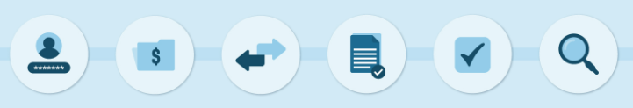
Federal Verification (if selected)
The Department of Education selects a percentage of students for a process called Verification
Schools are required to verify the information entered on the student’s FAFSA and make necessary corrections in order to apply aid to a student’s bill
Verification Letter/Worksheet mailed to Students/Parents
Both student and parent information must be completed

Slide 7

Federal Direct Loans are included in your aid offer if you completed a FAFSA
Direct loans are issued in the student’s name and must be repaid by the student
Lenders will be assigned by the Dept of Education
Direct Subsidized Loan: Need based federal loans available to undergraduate students. The interest will not accrue (accumulate) on this loan while the student is enrolled at least half time.
Direct Unsubsidized Loan: The interest will accrue (accumulate) on this loan while the student is in school.
After you graduate, leave school, or drop below half-time enrollment, you have a six-month grace period before you must begin making payments on these loans.
Current Interest rate is 6.39%. Current Origination fee is 1.057%.
Dept of Education sets new rates each July.
Federal Direct Student Loans
(Unsubsidized and Subsidized Loans)

Slide 8
Accepting/Declining Federal Loans
To accept the federal loans offered, the student must complete the following
Master Promissory Note (MPN)
* Legal document in which you promise to repay your loan(s) and any accrued interest and fees to the U.S. Department of Education
* Explains the terms and conditions of your loan(s)
Loan Entrance Counseling
*Counseling to ensure that you understand the responsibilities and obligations you are assuming.
*Types of Federal Student Loans, Loan Limits, Loan Basics
Declining Loans Students are not required to accept the loans(s) offered to them. To decline all or part of their federal direct student loans, students can send an email from their MU account to their financial aid counselor or finaid@misericordia.edu with the subject "Decline Student Loans." Students need to send an email each academic year that they would like to decline their loan(s)

Slide 9

Tuition Payment Worksheet
Online link sent with second financial aid offer- sent to Deposited students in spring
Fillable form to assist in determining all direct costs for the entire Academic Year
  Tuition, fees, housing, food, program/course fees
Helps students plan for the academic year
This is not your bill
  Bills are made available one semester at a time

Slide 10
ESTIMATED FIRST YEAR COSTS
 | Fall | Spring | Full Year
Tuition (12-17 credits each semester) | $21,325 | $21,325 | $42,650
General Fee | $ 1,050 | $ 1,050 | $2,100
First Year Housing & Food* | $8,200 | $8,200 | $16,400
Estimated 1st year costs before financial aid** | $30,575 | $30,575 | $61,150
  Net costs: Often lower than those of other regional, private institutions!
  *Cost determined using 265 Meal plan & $75 Dining Dollars per semester
  ** This is estimated and subject to change. It does not include orientation, program, course, or major fees. These fees will be reflected on the semester billing statement

Slide 11

Billing & Student Accounts
Bills are mailed once to the home address to enrolled students
Bills are due one week before the semester begins
At all times, Students can view Billing Statements on the MyMU portal under Students > Accounts & Financial Aid
Fall Semester Begins August
Spring Semester Begins January
Bills are mailed in November
Summer (if enrolled) begins in May
Bills are mailed in April
Bills are mailed in July
Notes:
Fall Semester Begins August- Bills are mailed in July
Spring Semester Begins January- Bills are mailed in December
Summer (if enrolled) begins in May- Bills are mailed in April

Slide 12

Payment Options
Self pay
Check/Cash
TAP/529/Savings Accounts
Card payments- online or in person (2.5% fee)
Pay in person- check/cash (1st Floor Mercy Hall)
Monthly payment plan- Administered through Transact
  Maximum of 5 months per semester
  Payment due on the 5thof every month
    Fall Only Plan (July 5th - November 5th)
    Spring Only Plan (December 5th - April 5th)
  Enrollment fees apply
Loans
Lenders send approved certifications directly to MU

Slide 13

Loan Options
Direct Parent Plus Loan:
  Parent is the borrower
  Apply at studentaid.gov
  4.228% origination fee taken before loan is disbursed to school
  Ex. If Parent apply for a $10,000 Plus Loan for the year, $9,577 will be applied to the Student account (Fee is $423)- $4,789 applied to fall and $4,788 applied to spring
  If denied, student is eligible for additional unsubsidized loan money
  New Federal Regulation Beginning July 1, 2026: Parents can borrow up to $20,000 per year for each child enrolled in college. There is a lifetime limit of $65,000 per child.
Alternative or Private Loan:
  Student is the borrower with creditworthy co-signer
  Parent options available
  List of preferred lenders on Misericordia Financial Aid website under “Loans”
  Most lenders will send funds directly to MU

Slide 14

Important Financial Aid Dates 2026-2027
May 1, 2026
  FAFSA Deadline for PA State Grant Eligibility
Beginning May 1, 2026
  Students complete Entrance Counseling and MPN for federal loans
  Parents can apply for a Direct Plus Loan, if needed
  Students/Families can apply for an alternative loan, if needed
July 5, 2026
  Fall 2026 Payment Plan First Payment
    Can begin to sign up May 15th
August 24, 2026
  Fall Tuition Bills Due
December 5, 2026
  Spring 2027 Payment Plan First Payment
    Can begin to sign up November 15th
January 12, 2027
  Spring Tuition Bills Due

Slide 15
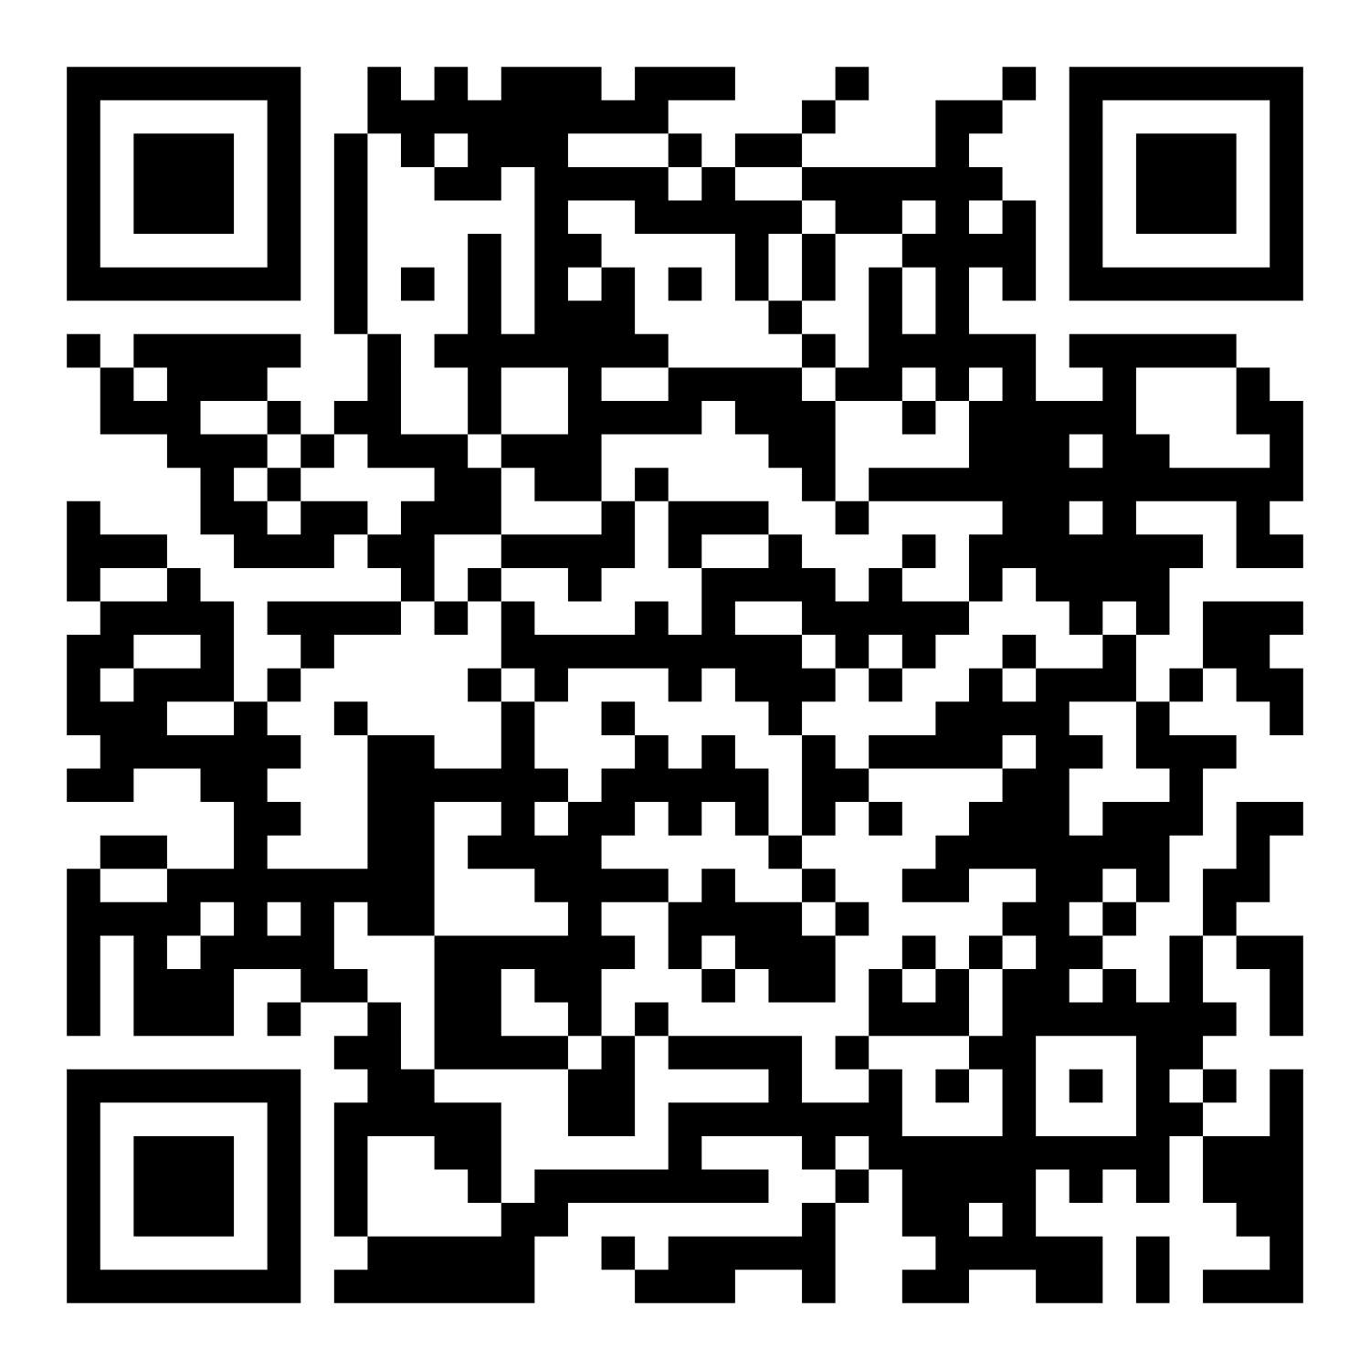
Helpful Links
www.Misericordia.edu/financialaid
  Guide to Financing your Misericordia Education
  Scholarships and Grants
  Loan Options
  Payment Options
  Financial Literacy
  Studentaid.gov
    To complete the FAFSA
    To complete Federal Loan Entrance Counseling
    To complete Federal Loan Master Promissory Note
  Grantus.pheaa.org (PA Residents)
    Will need to create account to view information, finish application, or complete validation.

Slide 16

Students and Families
Review Payment Options/Plans to Meet the Full Year Balance
Look for outside scholarships to help you pay for college expenses:
    Your high school
    Clubs or organizations where you are a member
    Your employer or that of your parent(s)
    Other local opportunities in your area
    FREE Scholarship Search Websites
Make your Deposit with Admissions
Keep MU up to date with changes to your mailing address and personal email
  Once enrolled, the Student Financial Services Office will correspond with students via MU email (updates, reminders, bill availability, change in aid)
Contact Student Financial Services- 1st Floor Mercy Hall, finaid@misericordia.edu

Slide 17


QUESTIONS?

