Slide 1







ACTIVITIES DEPARTMENT
The Holden R-III School District activities programs are a significant part of the total educational experience available to students. These programs enhance learning in the school and contribute to a positive school climate. Participation in extracurricular activities is strongly encouraged because students learn teamwork, develop physically and emotionally, develop a sense of belonging and enhance their self-image.
Participation in activities is a privilege and differs from a student’s right to a general high school education. Rules and regulations
governing each of the various athletic programs have been established to ensure fairness to all students and to guarantee that the school image resulting from the students who represent their school is a positive one.
The ultimate purpose of extra-curricular activities is to provide a maximum number of students an opportunity to grow as young
adults within the structure and framework of organized and disciplined programs. Extra-curricular activities offer a positive and meaningful experience that will enhance the growth and development of all young men and women who participate. The Holden R-III School District is committed to the belief that participation in interscholastic activities is a PRIVILEGE, not a right.
It is our philosophy to take the best student participants and represent Holden Schools to the highest degree. Successful programs
are a by-product of commitment, fundamental skills, preparation, training and strength of character. We will strive for success and to win by developing these traits.

Slide 2
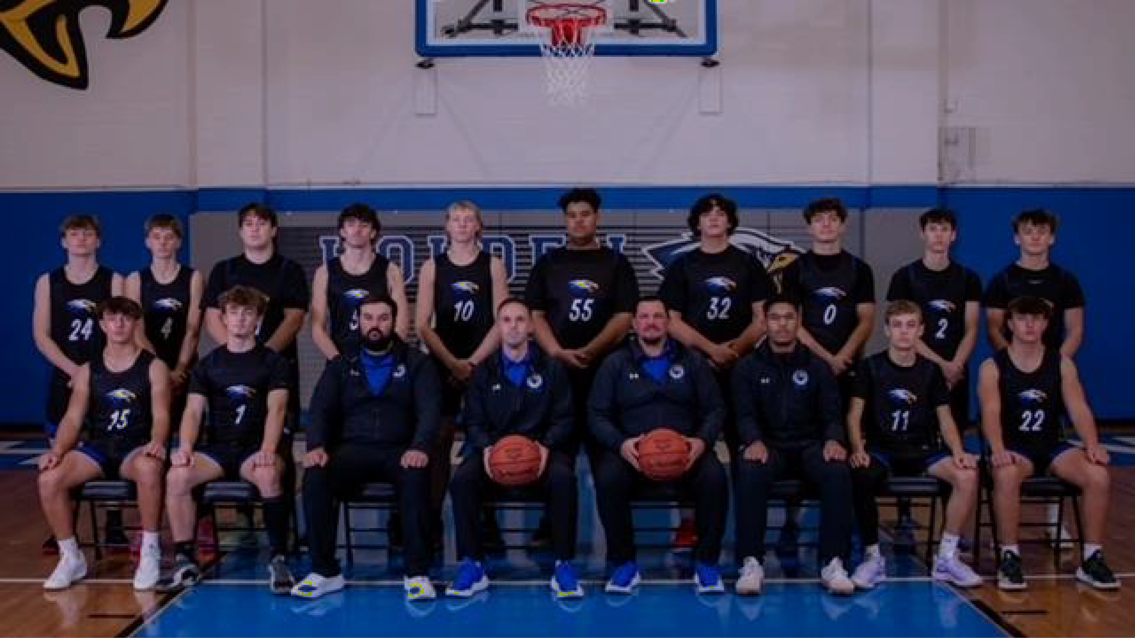
Boys Basketball
Head Coach – Nathan Martin
Assistant Coaches – Trent Pritchard, Aaron Andes, Tylor Coulson, Preston Cole
Number of Participants: HS – 38 MS – 22
Overall Record HS: 5-21 JV: 5-9 C Team: 1-6 MS: 6-7
MRVC Record HS 0-10

Slide 3
Boys Basketball
Individual Honors
Academic All – Conference
Kolby Hill, Brayden Taylor, Owen Doogs, Evan Killion Brody Bockover, Truman Wamsley, Cole Thomas
All – Conference
1st Team: Kolby Hill
All – District
1st Team: Kolby Hill

Slide 4
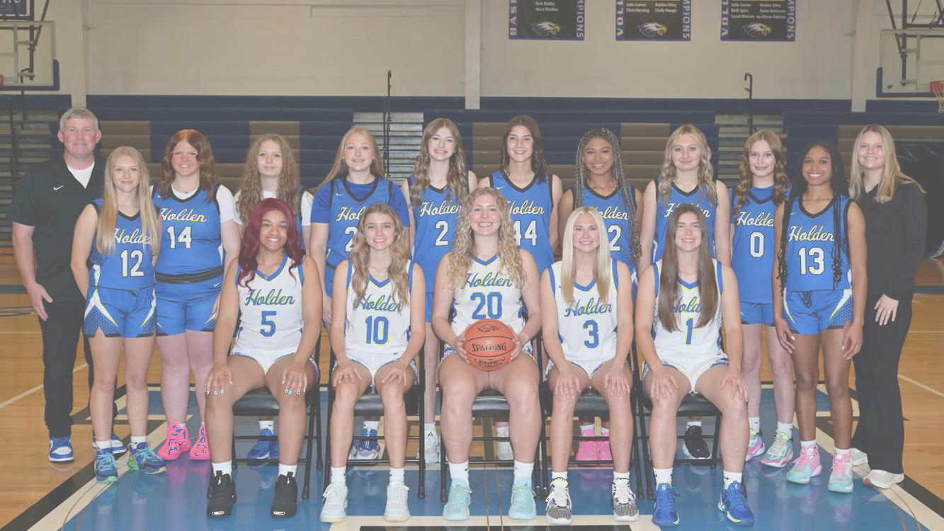
Girls Basketball
Head Coach: Todd Shanks
Assistant Coaches: Rebekah Riffle, Scott Teufel, Reagan Berlin
Number of Participants: HS – 16 MS – 18
Overall Record: HS: 9-19 MS : 7-7
MRVC Record HS 3-7
Class 3 District 13 Champions

Slide 5
Girls Basketball
Individual Honors
Academic All – Conference
Adalyn Campbell, Lilly Carver, Brooke Gimmaro, Brionna Johnson, Arionna Johnson Karleigh Tevis, Bella Haggard, Audrey Enneking
All – Conference
1st Team Honors: Adalyn Campbell Honorable Mention: Lilly Carver, Karleigh Tevis
All – District
Adalyn Campbell, Lilly Carver, Karleigh Tevis
District Player of the Year
Adalyn Campbell
KMZU Dream Team
Adalyn Campbell, Karleigh Tevis

Slide 6
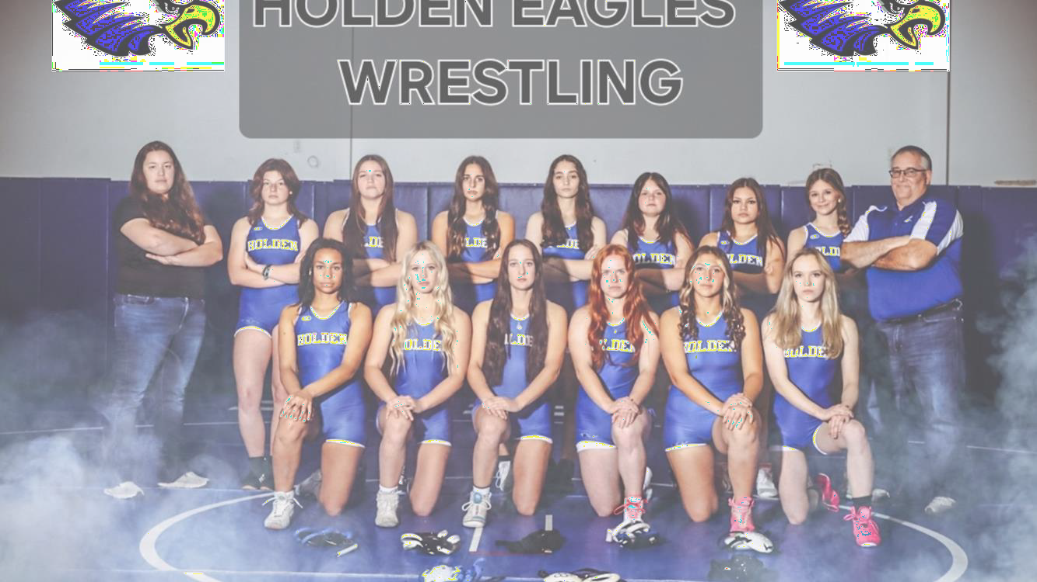
Girls Wrestling
Head Coach – Ron Franklin
Assistant Coaches – Ashley Purnell
Number of Participants: HS – 13 MS – 10
Dual Record: 7-4
MRVC Dual Record: 2-3
District – 9th Place Team
3 State Qualifiers
1 State Medalist

Slide 7
Girls Wrestling
Individual Honors
Academic All – Conference
McKenna Hartsell, Hayden Wright, Haley Brooks, Macey Greene, Adasyn Yoder Neveah Dick, Penny Caldwell, Bobbie Diibon, Taylor Hubbard, Ashtyn Treece
State Qualifiers
Haley Brooks, Macey Greene, Adasyn Yoder
State Placer
Haley Brooks – 5th
Haley was also a 4-time State Medalist
Career Win Milestones
100 – Bobbie Diibon
150 Wins – Adasyn Yoder, Macey Greene 200 Wins – Haley Brooks

Slide 8
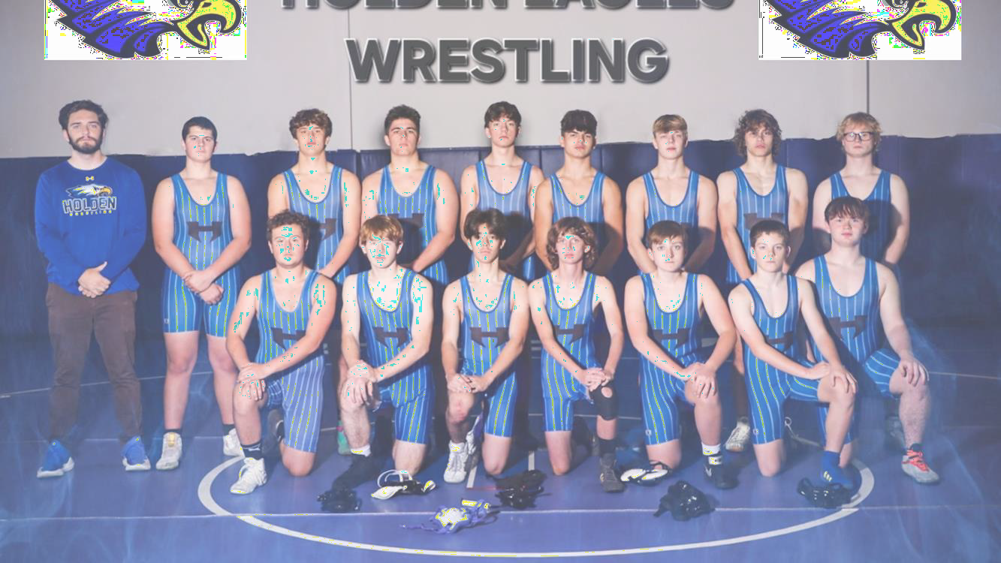
Boys Wrestling
Head Coach – Zachary Kroah
Assistant Coaches – David Diener, Tyler Jolly, Matt Hertzog
Number of Participants: HS – 14 MS – 16
Dual Record: 1-9
MRVC Dual Record: 0-5

Slide 9
Boys Wrestling
Individual Honors
Academic All – Conference
Kaleb Catron, Bobby Bowlin
All – Conference
1st Team – Hudson Gregg 2nd Team – Kaleb Catron
State Qualifiers
Hudson Gregg, Kaleb Catron

Slide 10

HS & MS Marching Band
HS & MS Choir
HS Flag Corps
HS & MS Sideline Cheerleading
HS & MS Science Olympiad
HS & MS Scholar Bowl
HS & MS Student Council
HS & MS National Honor Society
HS FBLA
HS Trap Shooting
HS FCCLA
HS Foreign Language Club
HS & MS Math Relays
HS & MS Art Club
HS Student Ambassadors
HS & MS Drama Club
HS & MS Yearbook
HS FFA
HS & MS Football
HS & MS Volleyball
HS Softball
HS & MS Cross Country

