Slide 1
Student Restraint and Seclusion Collection Overview
2025-2026

Slide 2

Agenda
Collection Purpose & Data Use
Collection Timeline
Data Pipeline Process
  Setting up for Success
  Collection Steps
  No Events
  File Upload
  Business Rules
  Status Dashboard & Submitting SRS Data
Reviewing/Validating Data (CEDAR/COGNOS Reports)
Contact & Resources

Slide 3
Collection Purpose & Data Use

Slide 4
Purpose and Data Use
The Student Restraint and Seclusion (SRS) collection collects the number of students restrained along with the type and duration of the restraint. This includes demographic information.
Primary Data Use
Public reporting of restraints, duration, student counts, demographic breakdowns. (Profile Reports)
Protection of Persons Reporting Act (PPRA)
  Annual Restraint Review Report
Data Privacy Guidelines
All publicly posted data utilizes privacy guidelines.
Education Statistics Site privacy methods include blurring of cohort/membership base sizes with small populations (all students & subgroups), and limited suppression.
Individual district CEDAR/COGNOS reports available to users with SRS access in IdM do not utilize privacy guidelines to allow LEAs to review their data in complete detail.

Slide 5
Data Release Process
Collection closes July 7, 2026
  Data locked; no changes to data are made after this point
  Superintendent verification form due
July through August - CDE internal processes to prepare data for public release
Education statistics based upon the 2025-2026 SRS data are embargoed until the public data release in September 2026
  District data available through COGNOS/CEDAR reports
Districts receive a preview of the public data files a few days prior to the public data release
  Sent to SRS Data Respondents from the SRS Collection Lead
  SRS Data Respondents should share with applicable administrative staff within their district
CDE sends out notifications through their communication department when this data is publicly released
  SRS Data Collection lead will send an email to data respondents when the embargo has lifted, and data has been publicly released

Slide 6
Collection Timeline

Slide 7
Timeline
Date | Event | Event Description
04/30/2026 | Open | Student Restraint and Seclusion (SRS)
05/07/2026 | Interim Deadline | Upload the initial Student Restraint and Seclusion File
05/14/2026 | Other Date | Suggestion: Begin PPRA Narrative Response
05/28/2026 | Interim Deadline | Error free interchange file: Student Demographic (DEM) This file is expected to have an upload date 05/01/2026 or later to meet this interim deadline.
06/04/2026 | Other Date | Exception request deadline
06/11/2026 | Interim Deadline | Error free Student Restraint and Seclusion File
06/18/2026 to 06/25/2026 | Report Review | LEAs validate Student Restraint and Seclusion data using CEDAR/COGNOS reports.
06/25/2026 | State Deadline | Submit Student Restraint and Seclusion Data to CDE
06/30/2026 | State Deadline | Complete the PPRA Narrative Response and send to StudentRestraintSeclusion@cde.state.co.us Note: CDE must receive each LEA’s PPRA Narrative by this deadline to complete the submission to CDE process.
07/07/2026 | State Deadline | Superintendent Verification (Sign-Off) form due.
07/15/2026 | Closed | Collection is no longer available for LEA.
09/2026 | Data Release | Education statistics based upon this collection are publicly released and the embargo is lifted for this dataset.

Slide 8
Data Sources

Slide 9
Interchange Preparation
Get SASIDs for your new students
  Through RITS or Data Pipeline
  Visit the RITS Website for resources and instructions regarding SASIDs
Extract files from your Student Information System (DEM)
  Recommended format is .xls or .xlsx (excel)
    Data Pipeline also accepts .csv
  All data fields must be zero filled or include an applicable code matching the specified field length
  Leading zeros are required for all data fields to maintain the specified field length
    Be careful when opening .csv format in excel to not lose leading zeros
      The newest version of excel has a pop-up asking if you want to keep leading zeros
  Spaces in the file name are not allowed
  Pro Tip: Use a file naming convention as you will likely extract files multiple times. Example: 0110_SRS_04052025.xls

Slide 10
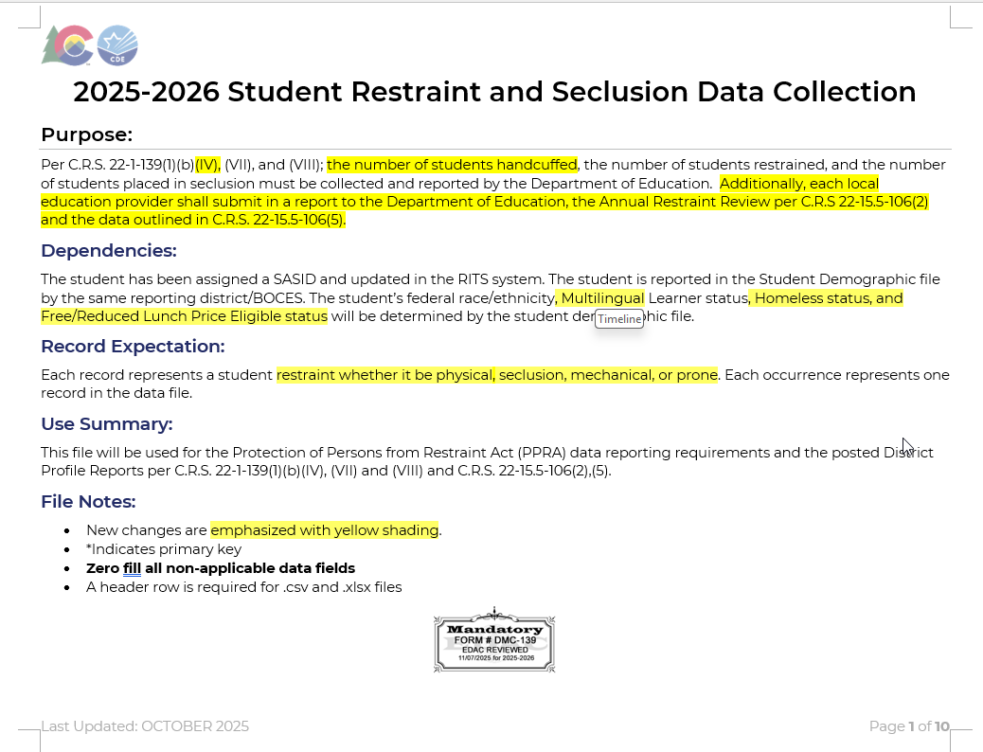
Student Restraint and Seclusion File (SRS)
All data fields in this file are used in the SRS collection.

Slide 11
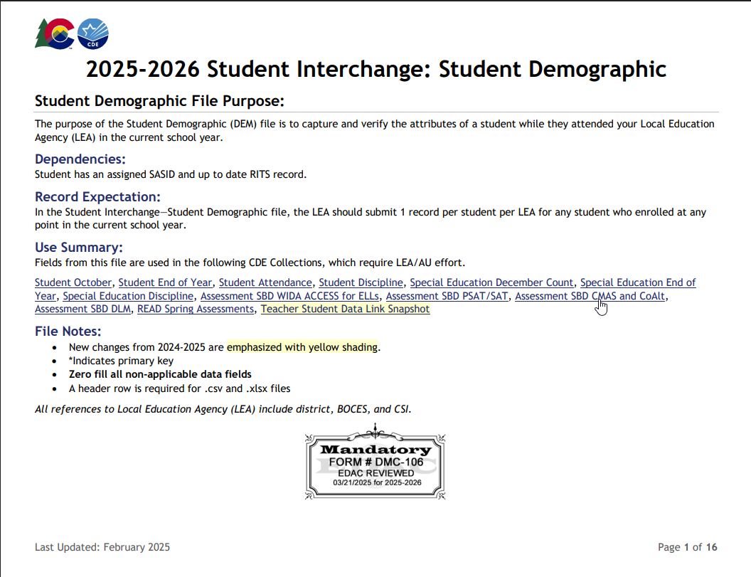
Student Demographic File (DEM)
Several data fields in this file are used in the SRS collection
One record per student
Captures attributes of a student
  Point in Time: Attribute as of extract date
    Race/Ethnicity
  Cumulative: Once true, the attribute remains true entire school year but may change the following year if student no longer qualifies for the service (Additive, but not subtractive).
    Homeless Status
    FRL Status
    Multilingual Learner

Slide 12
Data Pipeline Process

Slide 13
Setting up for Success

Slide 14
Checklist
Ensure you have access/logins for following systems
  Your LEA’s Student Information System (SIS)
    Must have ability to extract state reporting files and edit student records for related data fields
  Data Pipeline & COGNOS/CEDAR
  RITS (at least viewing permissions)
  Syncplicity Student Folder
    District Code _ SRS
Bookmark important CDE websites & review supporting documentation – Bookmark List
Sign up for data pipeline TH emails if you don’t already receive them
Plan to maintain data privacy for Personally Identifiable Information (PII)
  What are your internal processes?
  Utilize Syncplicity when communicating with CDE
Gather/Save Critical Contact Information
  CDE: Carrie Martin, StudentRestraintSeclusion@cde.state.co.us, 720-665-4456
  Internal:
    Know which colleagues support/oversee which programs such as—Multilingual Learners, Homeless, SPED, Free/Reduced Lunch
    Do you have colleagues who will support data validation?
    Who needs to be notified of preliminary data?

Slide 15
SRS Identity Management (IdM) Roles
Bookmark: Identity Management Site
District Local Access Manager (LAM) assigns account/privileges
Provides access to the various CDE tools
Data Pipeline permissions are needed to complete data collections
A user can only have one role for each Collection
IdM user roles are used by CDE to create email lists & grant collection specific access
  COGNOS/CEDAR access mirrors pipeline access
  Collection emails – typically only LEA Approvers and LEA Users
  Data Pipeline Town
    Manually added, can subscribe via email
  Syncplicity access
    Manually added, monitored by collection leads
Application | Collection | User Role | Access & Notes
Pipeline | Student Restraint and Seclusion | LEA User | Required for SRS data respondents. Upload and edit SRS records.
Pipeline | Student Restraint and Seclusion | LEA Approver | At least one required per LEA. Submit SRS data, download sign-off form.
Pipeline | Student Interchange | LEA User | Required for data respondents. Upload and edit records for DEM file.
Pipeline | Any | LEA Viewer | View CEDAR/COGNOS reports related to the assigned collection but cannot edit data. Useful role for district support staff who help validate data but do not actively complete the collection.

Slide 16
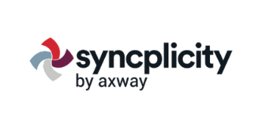
PII and Syncplicity
Personally Identifiable Information (PII)
PII is defined by state and federal laws as information that alone, or in combination, personally identifies an individual
  Includes direct identifiers (SASID, student name)
  Includes information when combined is identifiable
Colorado’s Student Data Transparency and Security Act outlines requirements for how Student PII is collected, used and shared
  See CDE’s data security and privacy site for more information
Communicating PII must be done through secure methods. DO NOT EMAIL PII
  Data Pipeline file upload & COGNOS/CEDAR
  Syncplicity secure file transfer
  Phone call is secure method; 720-665-4456
    Please do not leave PII in voicemail but rather request a return call to discuss PII
Syncplicity
Secure file transfer site
  Syncplicity Login Page
Collection specific folders
  Primary Syncplicity Folder:
  District _ SRS
Does not notify users of file upload
  Email SRS Inbox if file is ready for review

Slide 17
Data Pipeline Weekly Maintenance
Data Pipeline has a weekly maintenance window on Tuesday afternoons, during which time users may not be able to access file uploads.
What does this mean for you?
  Avoid taking uploading a file on Tuesdays between 4pm-8pm.
  If you are attempting to do a file upload and are locked out of pipeline, try again in about an hour.

Slide 18
Collection Steps

Slide 19

Steps
Upload Student Demographic interchange file
Resolve DEM file errors
  Update student information system
  Extract and upload new interchange file
Upload SRS File
Resolve SRS Errors
  Update student information system
  Extract and upload new SRS file
  Request exceptions if needed (repeat steps 1 to 4 as needed)
Validate data
Submit error-free data
  SRS~LEAApprover role in IdM required
Submit Superintendent Sign-Off form to CDE
  SRS~LEAApprover role in IdM required to download form
  Email completed forms to StudentRestraintSeclusion@cde.state.co.us by July 7, 2026

Slide 20
No Restraint Events

Slide 21
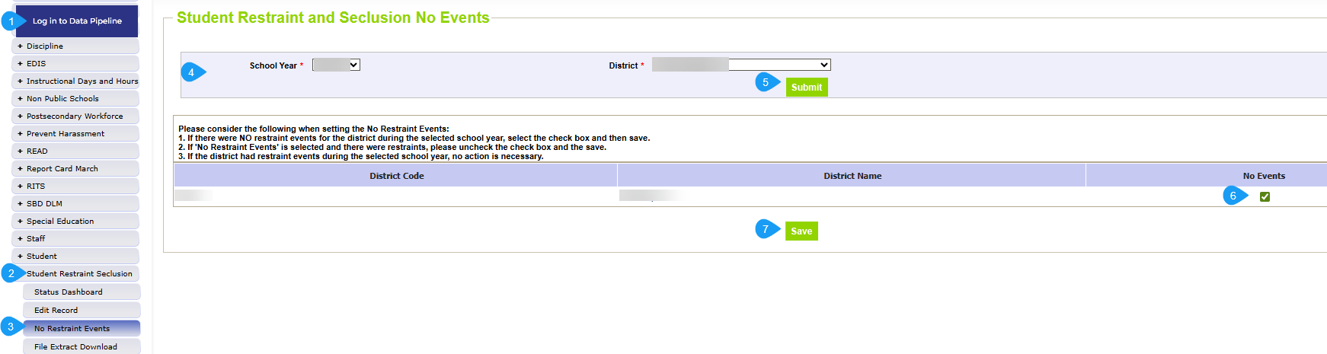
No Restraint Events Steps
THIS IS ONLY NEEDED IF YOUR DISTRICT HAS NO RESTRAINT DATA TO REPORT

Slide 22
File Upload

Slide 23
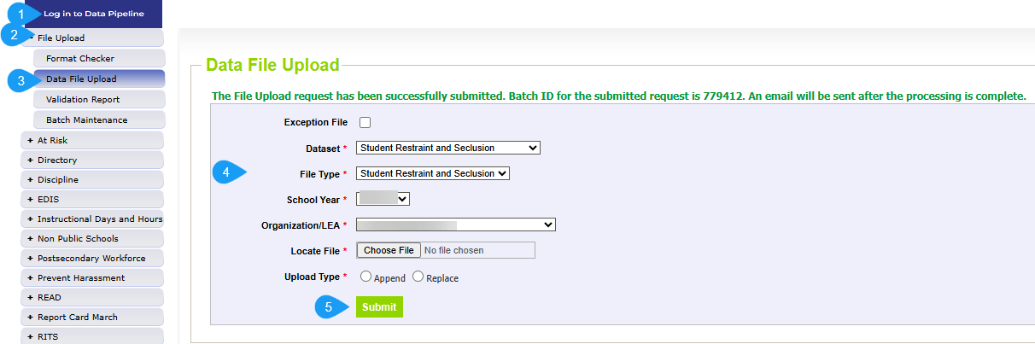
Data File Upload
Update files to address errors
  Preferred: Update in SIS → Extract → Upload to Pipeline
  Alternate Method: Edit Record Tool (Data Pipeline)
    Not encouraged
Wait for a Confirmation Email from the Pipeline System
  The email will show the number of errors in the file upload
  Use Pipeline or CEDAR reports to review errors and warnings

Slide 24
Business Rules

Slide 25
SRS Business Rules
Business Rules are the list of errors and warnings that are checked when a file is uploaded.
Available on the Student Restraint and Seclusion Website
Types of information checked:
  File Layout expectations
  Demographic information
Errors: Must be addressed
  Update data fields to clear
  Request reporting exception if data is accurate but does not follow the typical coding pattern as indicated by the error message
  Data cannot be submitted if there are any errors
Warnings: Indicate possible data inconsistencies/coding issues
Pro Tip: Review warnings to look for patterns/areas where district data could be documented in a more accurate manner

Slide 26
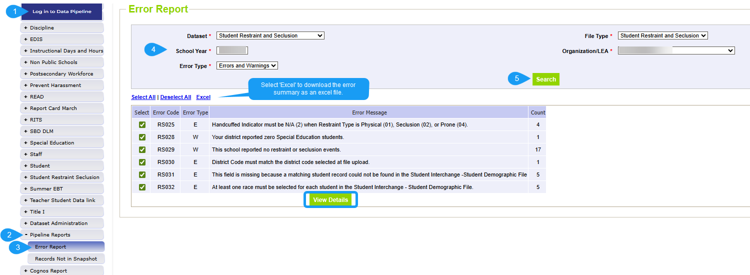
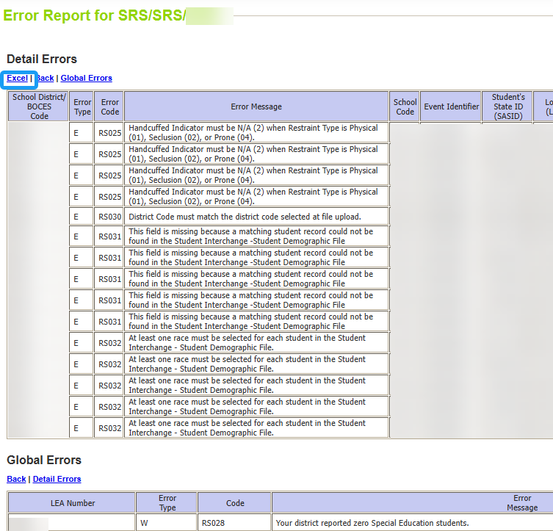
Checking Errors/Warnings: Pipeline Error Report
To view specific student records that are triggering an error/warning,
select View Details at the bottom of the screen.
Preferred method for checking errors/warnings
Some errors and warnings are being updated to use the ‘error log error message’ column that used to be blank on this report
Pro Tip: Use check boxes to select a specific error/warning code before reviewing error details as it may be simpler to focus on one business rule topic at a time

Slide 27
Status Dashboard & Submitting SRS Data

Slide 28
Status Dashboard Information
Allows you to review the status of an uploaded file
  Total Records
  Quantity of errors
  Data Locked ‘Y’ means file upload is not available
  Overall Status
    ‘P’ Pending
    ‘S’ Submitted
  Updated Date- This date/time the file was uploaded
  Updated By-email of the user
Used to submit data to CDE
Used to download the superintendent verification (sign-off) form

Slide 29
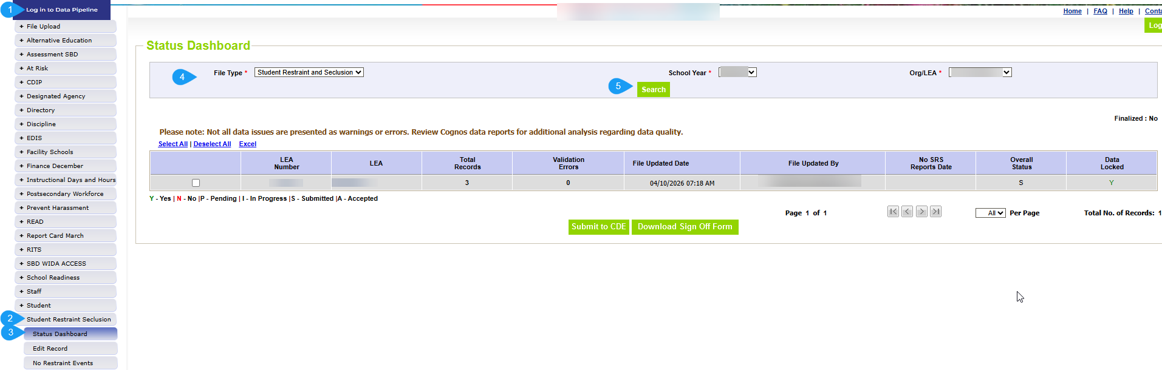
Status Dashboard Screen

Slide 30
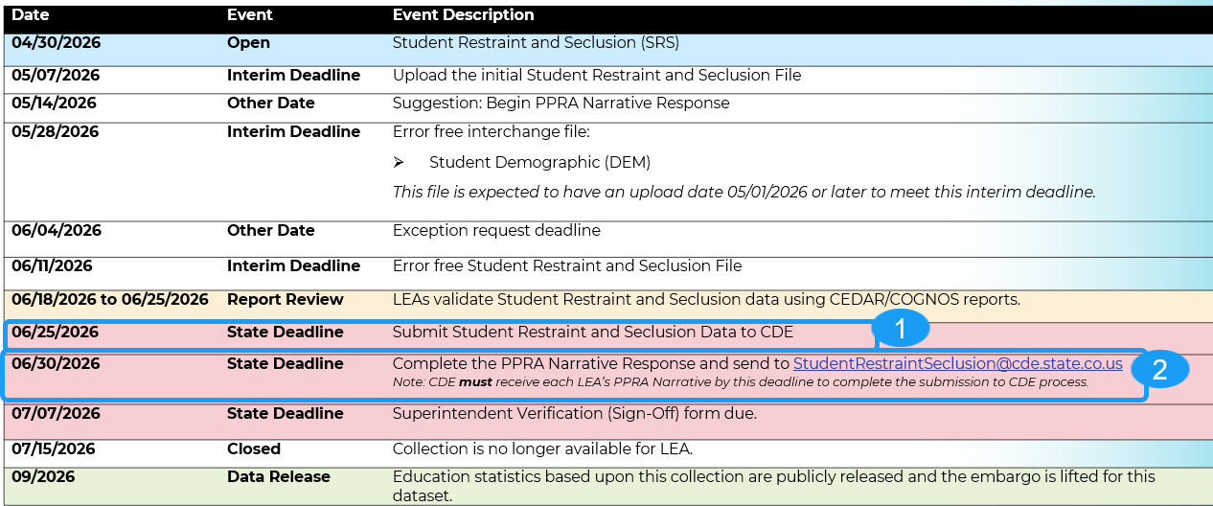


Completing the Collection
Once the SRS data is error free and been validated using the CEDAR/COGNOS reports then
by June 25th
and
and
send the completed PPRA report to StudentRestraintSeclusion@cde.state.co.us
by June 30th
and
return the signed superintendent form to StudentRestraintSeclusion@cde.state.co.us
by July 7th
Notes:
Required for all LEAs even if you have no restraints to report
Data cannot be submitted prior to the last day of school
Data must be submitted prior to completion of the PPRA report
Data will be accepted once the PPRA report is received

Slide 31
Reviewing/Validating Data
(COGNOS/CEDAR Reports)

Slide 32
CEDAR/COGNOS Reports Overview
The Colorado Education Data Analysis and Reporting system (CEDAR) is a private, secure system which provides student level data to authorized users. Access to student-level data is limited to educators who have need for such data.
Reports in CEDAR/COGNOS have multiple purposes. Some are used as operational reports to assist data respondents in looking up specific information on students or file errors. Other reports are used to validate data when finalizing a data collection. Many reports also provide districts with a preview of data that will be published based upon specific data collections.
Notes:
Often CEDAR is referred to as COGNOS since COGNOS is the software currently powering the Colorado Education Data Analysis and Reporting system (CEDAR).

Slide 33
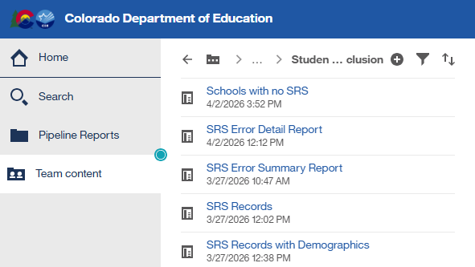
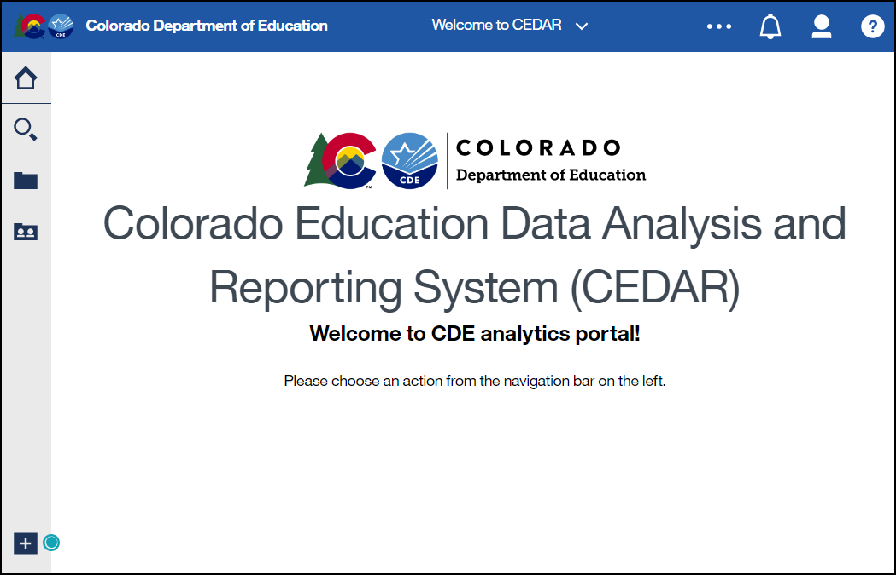
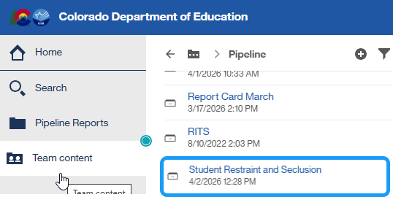
Accessing Reports
Identity Management Landing Page → CEDAR Link
Data Pipeline →

Slide 34
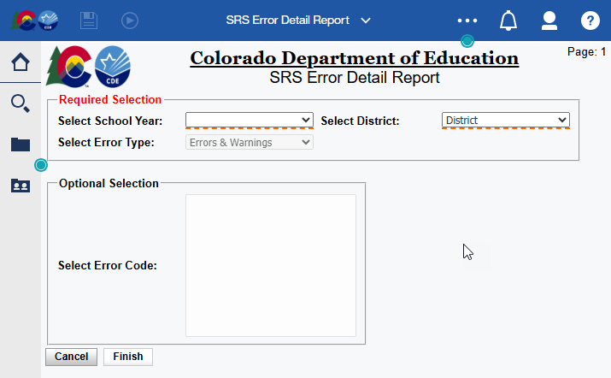
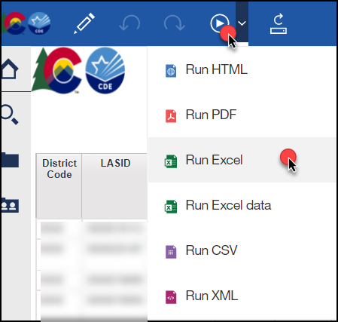
Report Screen & Download
Use dropdown menus to select desired information
Reports can be downloaded as an excel file for easier sorting/filtering of information.

Slide 35
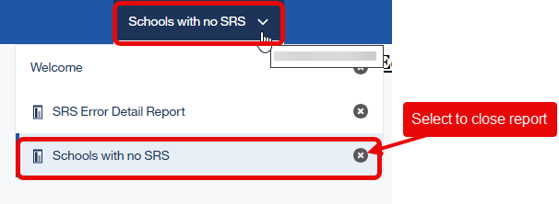
Moving between reports
Toggle between reports using the recent reports dropdown
Close an open report using the recent reports dropdown

Slide 36
Contact & Resources

Slide 37
Bookmark List
Site Name/Link | Information/Uses
Data Pipeline Home Page | Starting point for all pipeline collections, training, and resources
 Student Restraint and Seclusion | Contains file layouts, templates, business rules, training materials, and resources
 Identity Management (IdM) | This is the landing page with login links to the various CDE data platforms.
 Frequently Requested Codes and Resources | Includes list of school codes, facility schools, detention centers, etc.
 Trainings | Town Hall presentations and general respondent training resources.
Syncplicity | Secure file transfer site used to communicate personally identifiable information with CDE if you have questions on specific students during reporting or have exception requests.
Education Statistics | Landing page for all Colorado Education Statistics.

Slide 38

SRS Collection Lead
Don’t get frustrated, reach out!
  Book a time to meet with me that works with your schedule
To best assist you, please :
  Include your 4-digit district code in emails and voicemails
  Ensure your phone number is accurate in IdM
  (ask your LAM to help if it needs to be updated)
Email:
StudentRestraintSeclusion@cde.state.co.us
Phone: 720-665-4456

