Slide 1
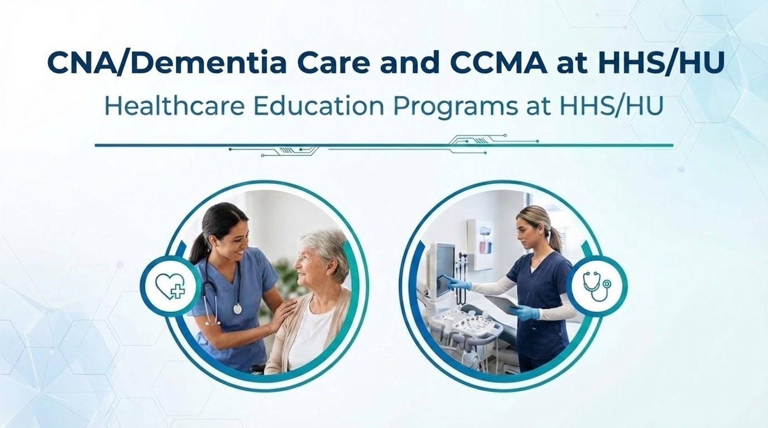

Slide 2
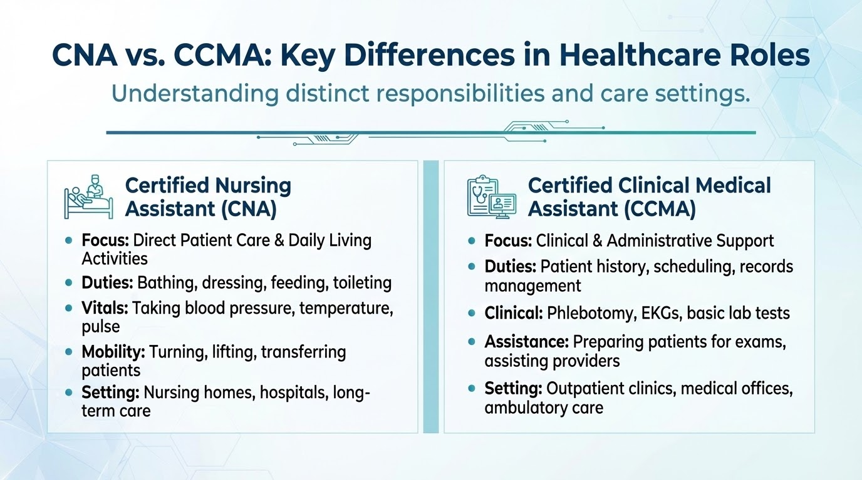
*You must possess a high school diploma for license eligibility- Candidates who do not currently meet this requirement, but will be able to do so within twelve months, may be eligible for a Provisional Certification.

Slide 3
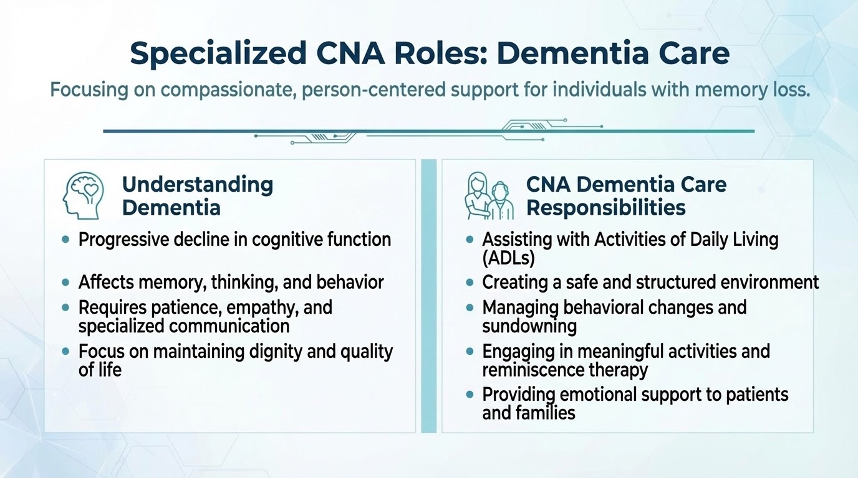

Slide 4
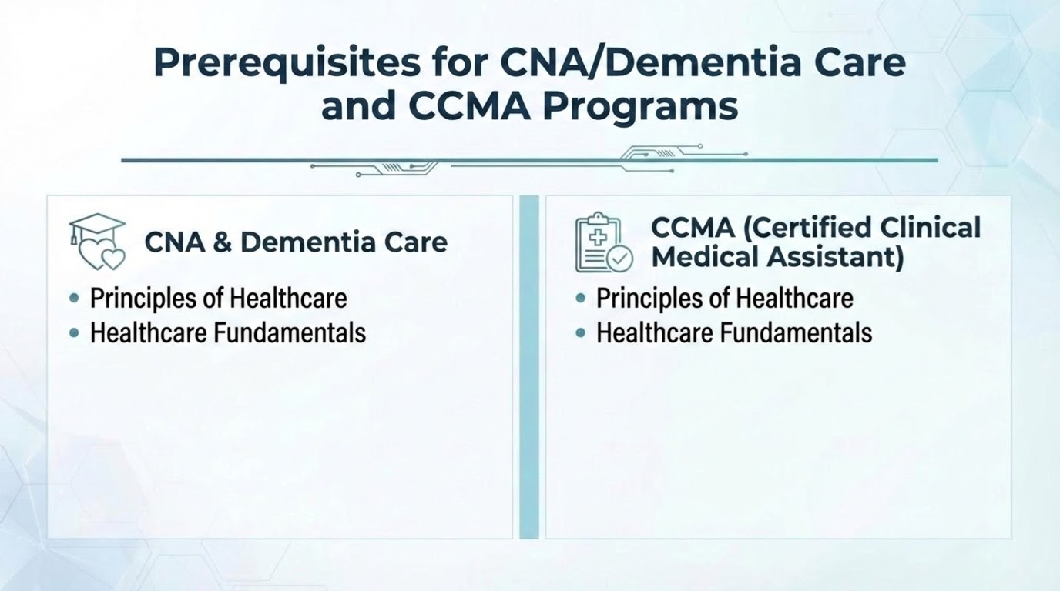

Slide 5
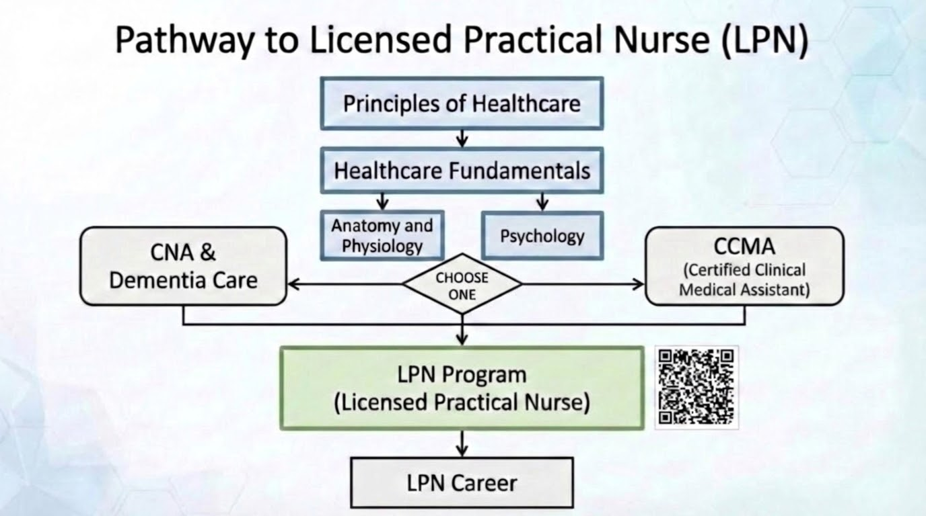

Slide 6
