Slide 1

Date: October 2nd 2023
Bond Referendum Planning
October 2, 2023
Presented By:
Robert J. Fisicaro, Ed. D.
Superintendent
Haddon Township School District

Slide 2

Years in Review
2021
District Demographic Study
Community Surveys
2022
Shared Vision
Focus Groups
2023
School Board/District Level Planning
Architect Engagement

Slide 3
Areas Identified
Bottom Line Up Front
$30 Million Referendum
(26% Reimbursed by NJDOE)
Cost: Approximately $220 Annually
Simplified: $20 per month
Vote: March 2024
Full Day Kindergarten
Facilities &Safety
Future Ready Programs
Vocational Education
Wellness/Extra Curricular

Slide 4
Next Steps
October
Scope of Work Review
November-January
Survey Development /Public Presentations
6 months to 60 Days Campaign
Adjustments/Decisions

Slide 5
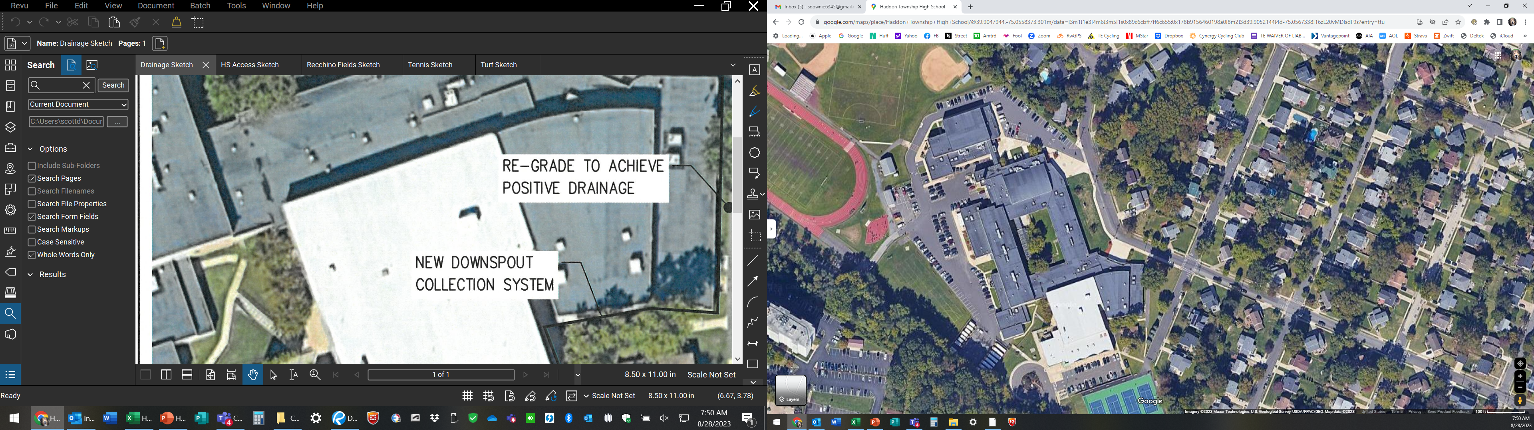
Reconfigure sharp turn at entry. Impact: 2 spaces but no impact on utility pole
Widen entry width, reduce plaza slightly to create larger width for entry
Replace stair with accessible ramp from walk to plaza
Safety & Access
High/Middle School – Entry drive EXISTING

Slide 6
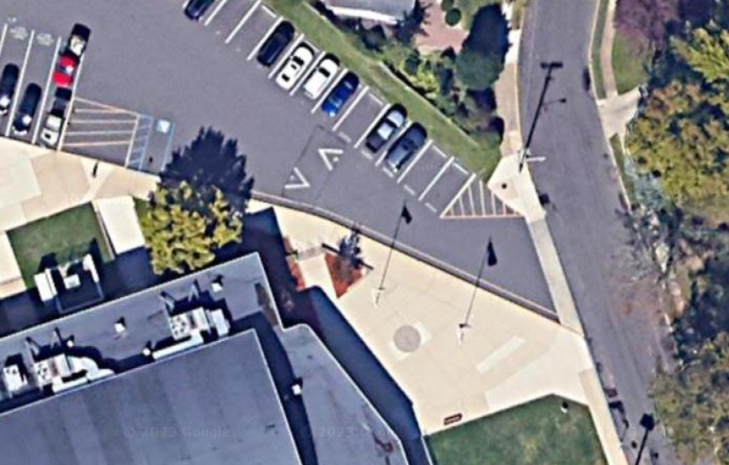
New paved and eased corner condition (- 2 spaces)
Widened entry with in/out lane markings and crosswalk
Widened drive with 2-way flow traffic
New accessible ramp from walk to main entry plaza
Safety & Access
High/Middle School – Entry drive NEW (Safety/ADA Improvements)

Slide 7
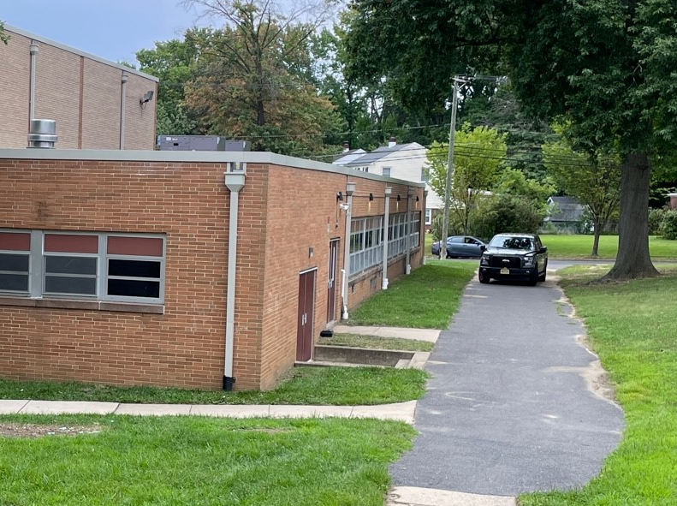
New drainage line to MS driver inlet
Re-grade and repave @ IMR/VMR and around stage
New inlet collection system
Inset photo location
Re-grade and repave
Tie into existing inlet at MS entry and drive area
Safety
High/Middle School – VMR/IMR/Auditorium Stage Site Drainage

Slide 8
Stage roof replacement
Middle School roof replacement
Safety
Middle School – Roof Replacement

Slide 9
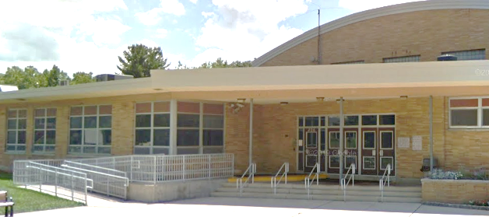
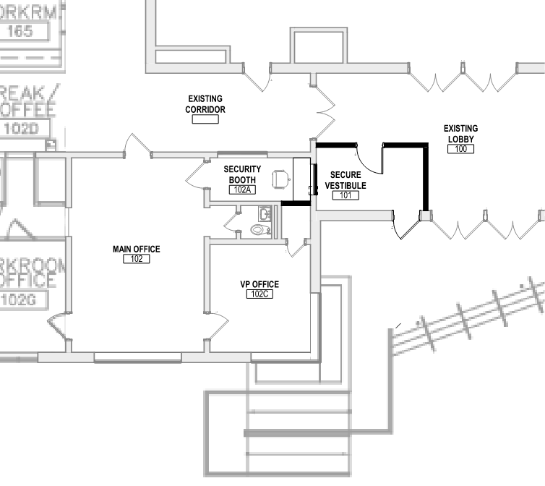
Modify door for controlled entry
Renovated office area wall & window
Separate Secure Vestibule & Window
Safety
High School – Security Vestibule

Slide 10
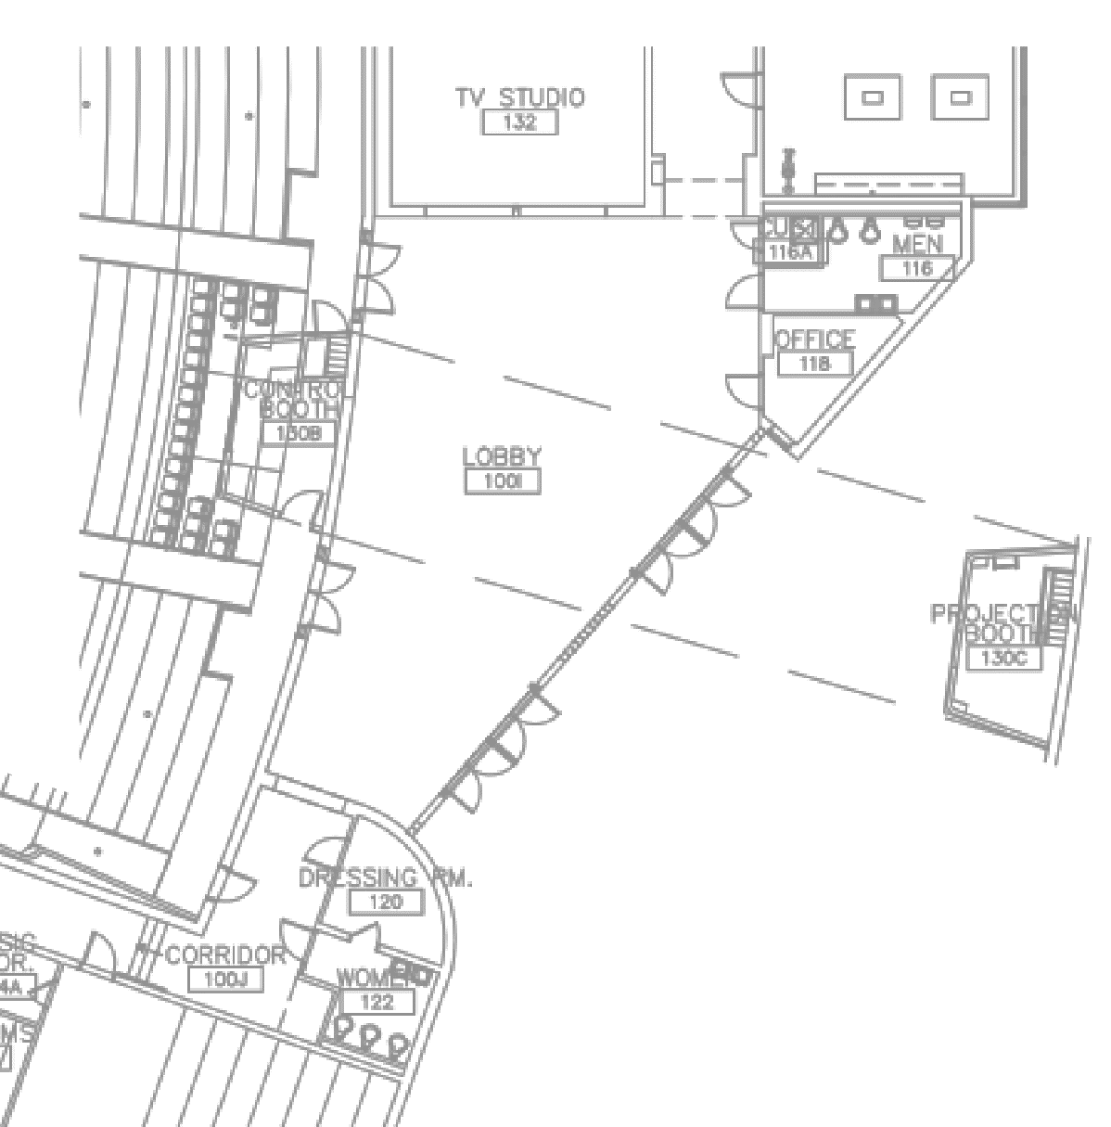
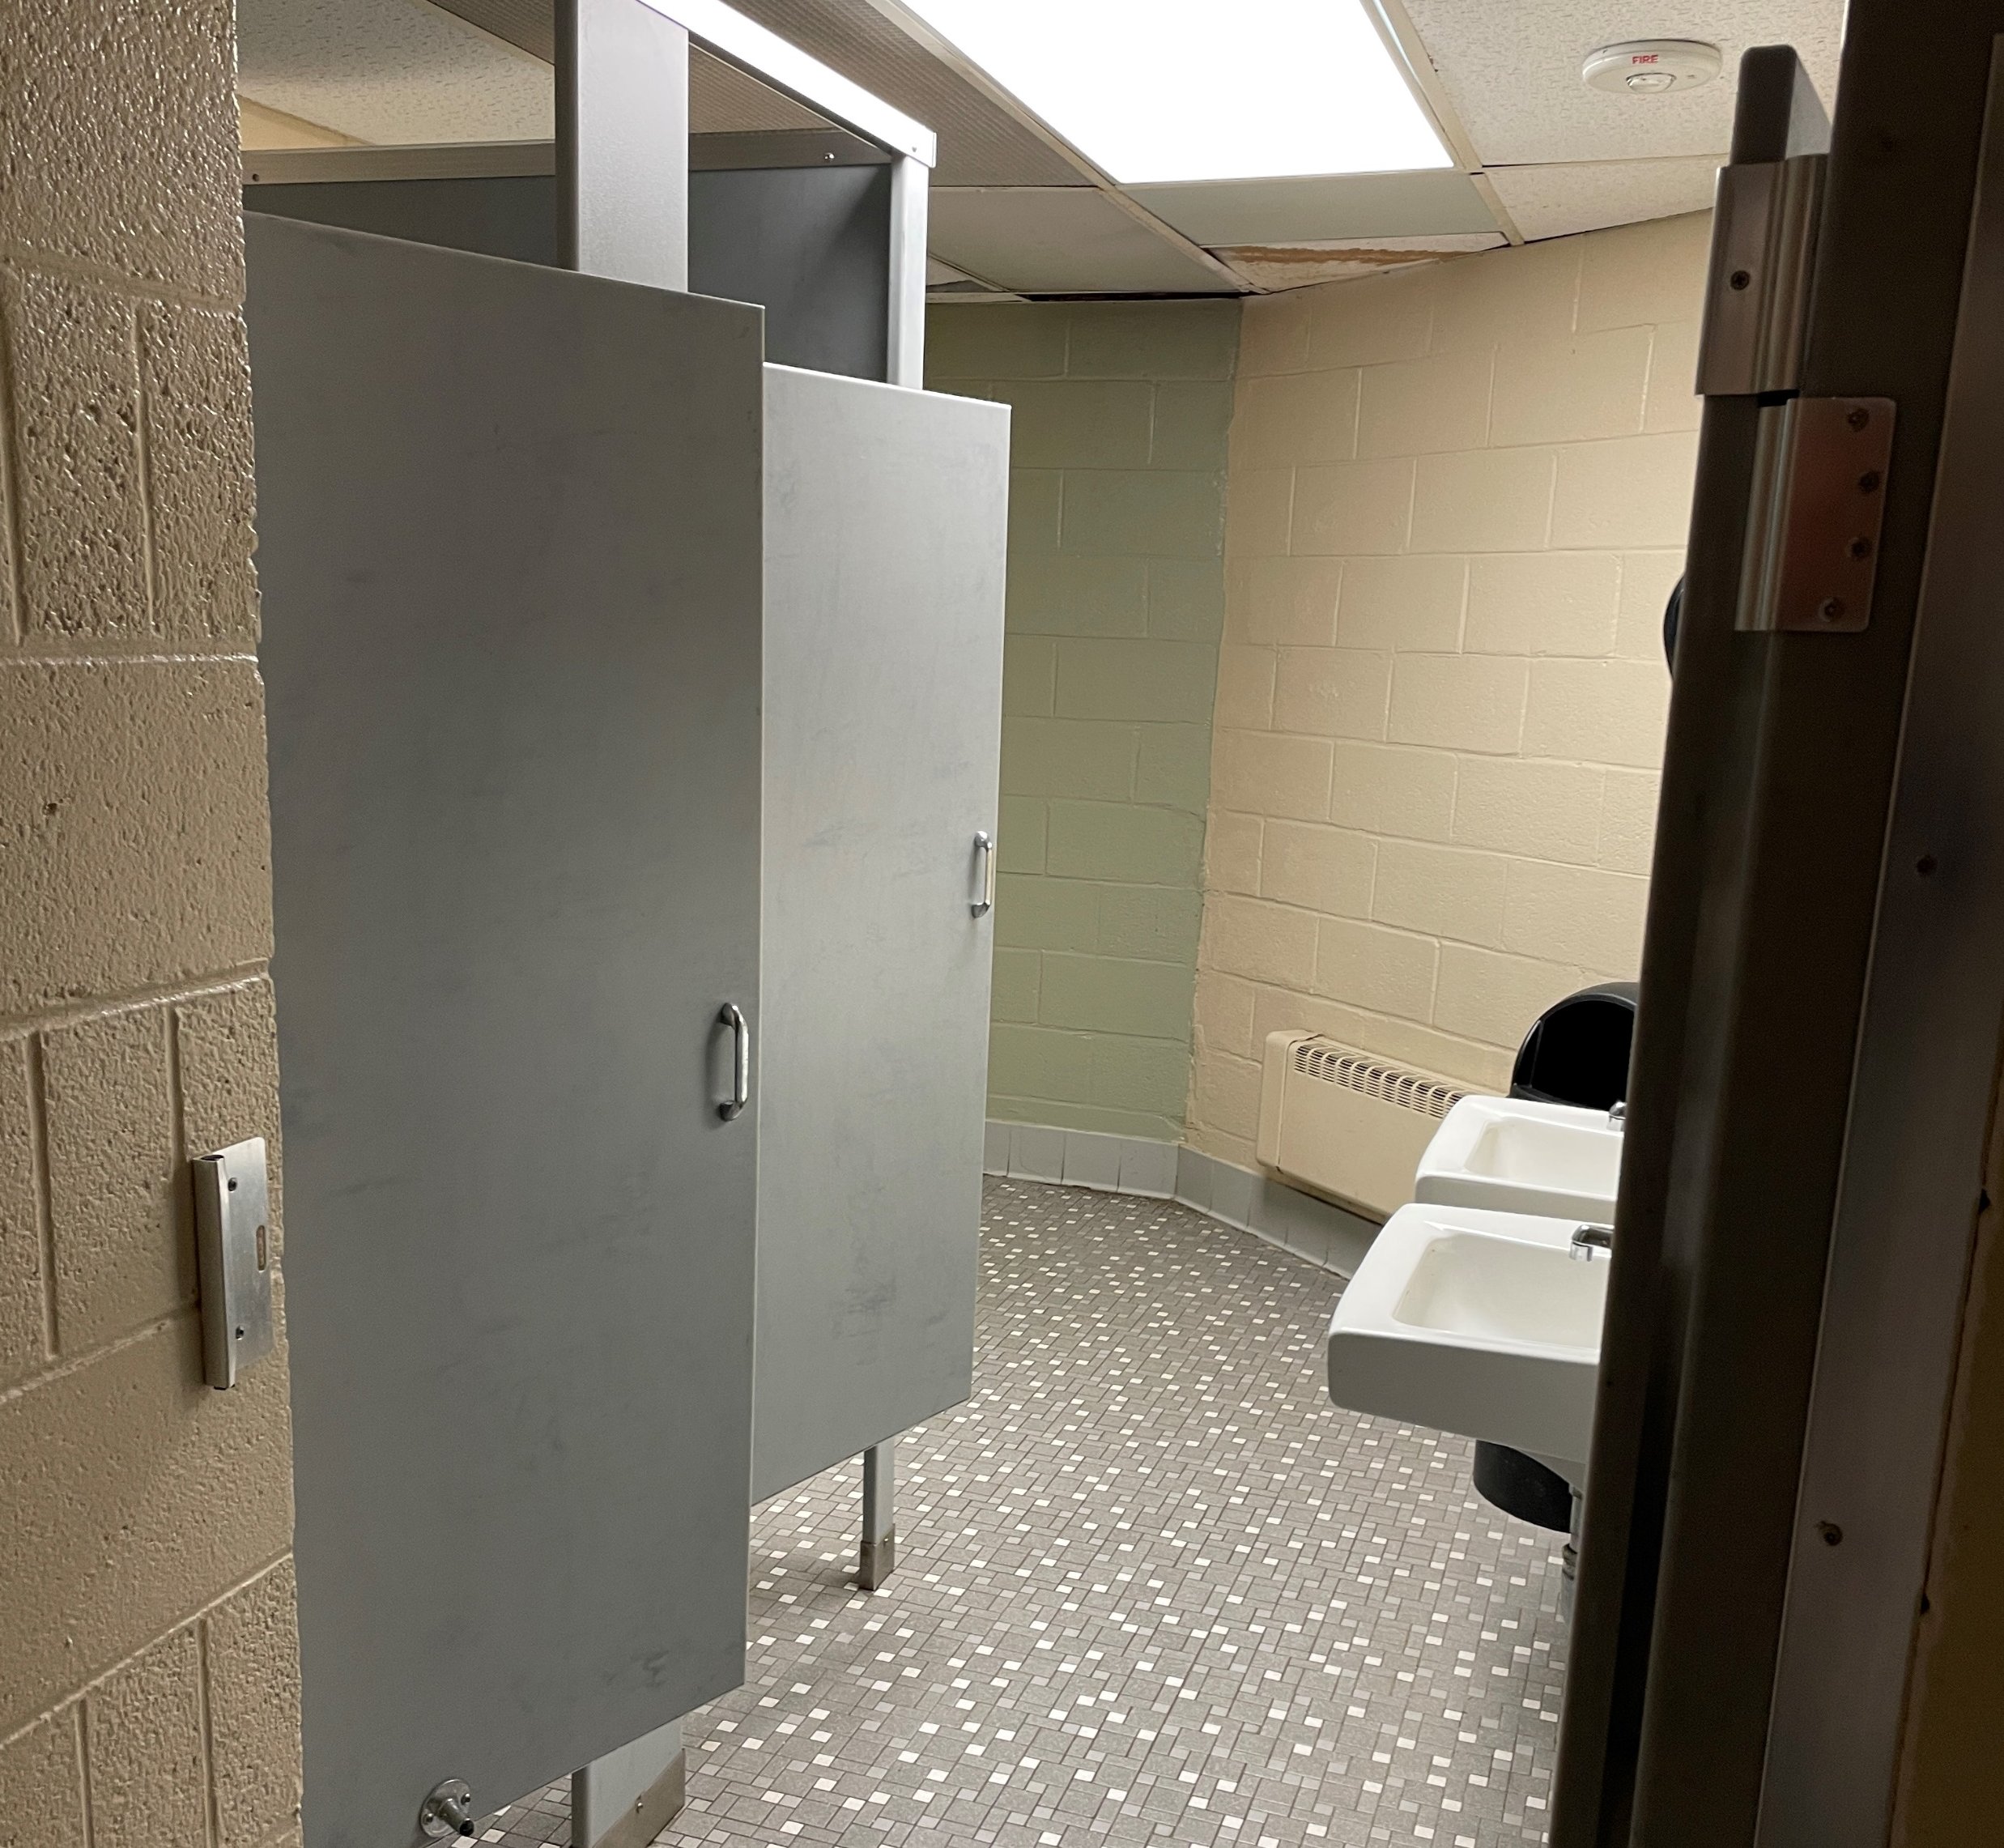
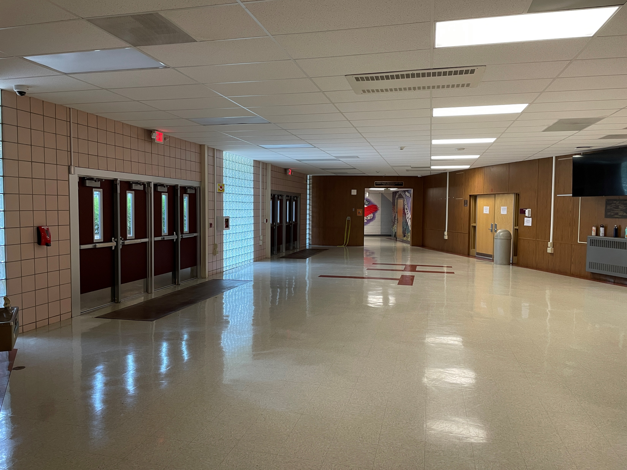
Existing custodial room
Existing Men’s room
Existing office area
Existing Men’s room
Proposed layout
Existing Lobby
Existing dressing area
Existing women’s bathroom
Existing
Access & Arts
High School – HS Auditorium Lobby Bathrooms - EXISTING

Slide 11
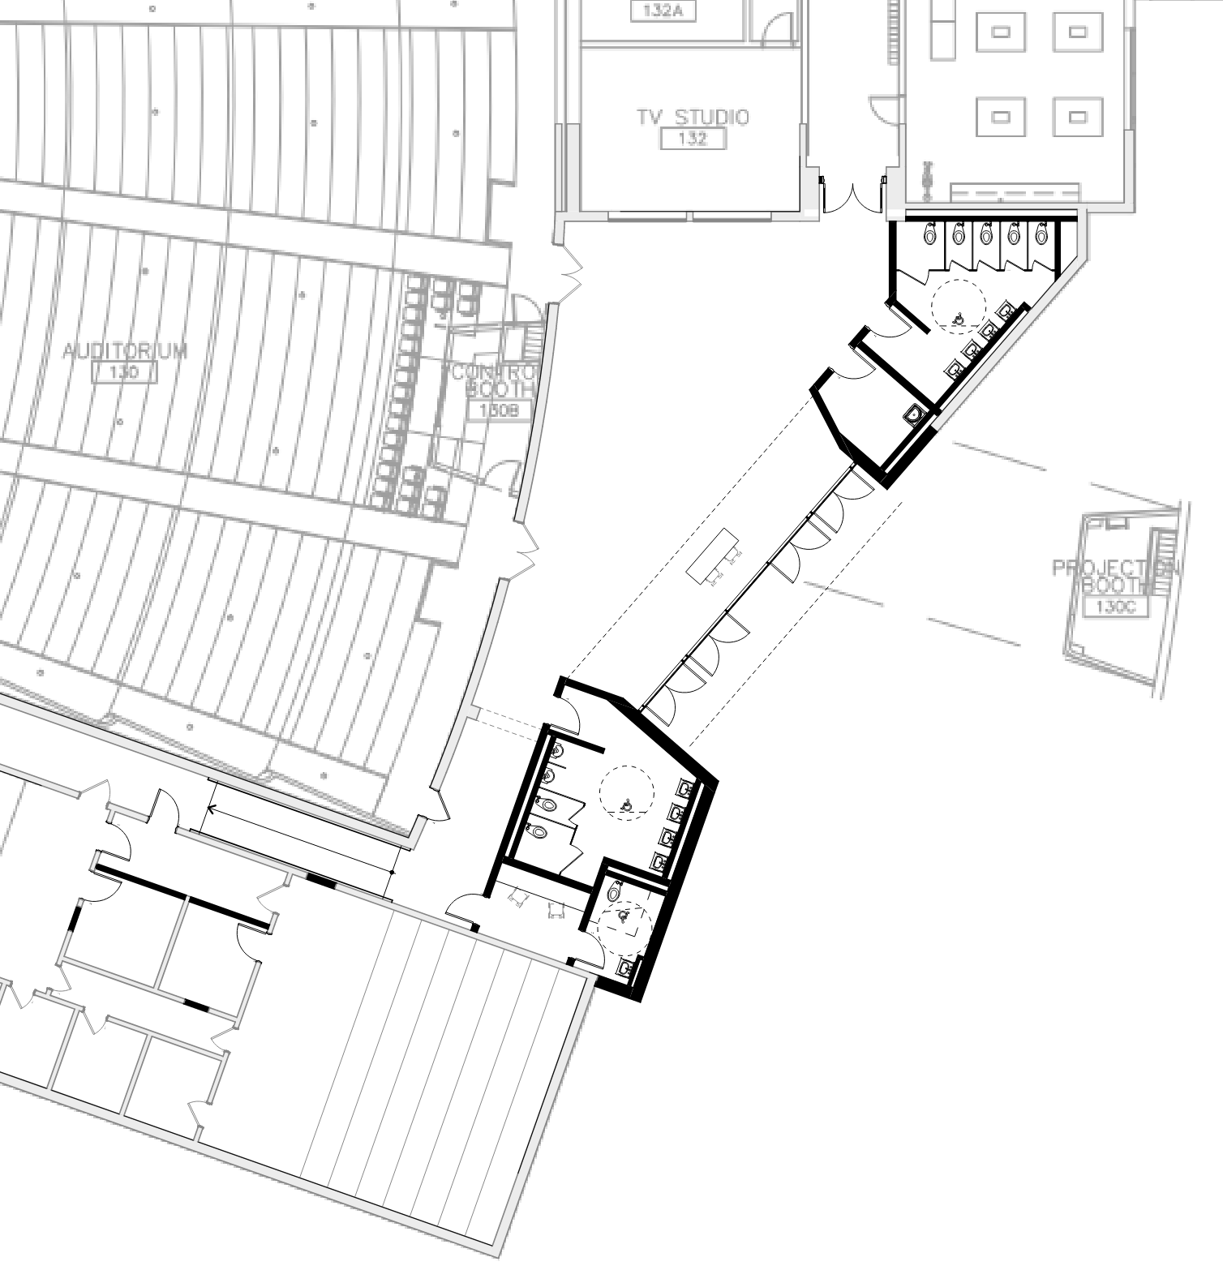
Proposed women’s bathroom - expanded
Proposed Custodial room
Expanded footprint
Concession location
Existing Men’s room
New overhang/entry and doors; both bathrooms expanded
Existing Lobby
Proposed men’s bathroom – expanded
Expanded footprint
Proposed
Proposed dressing area w/ bathroom
Access & Arts
High/Middle School – Entry drive EXISTING

Slide 12
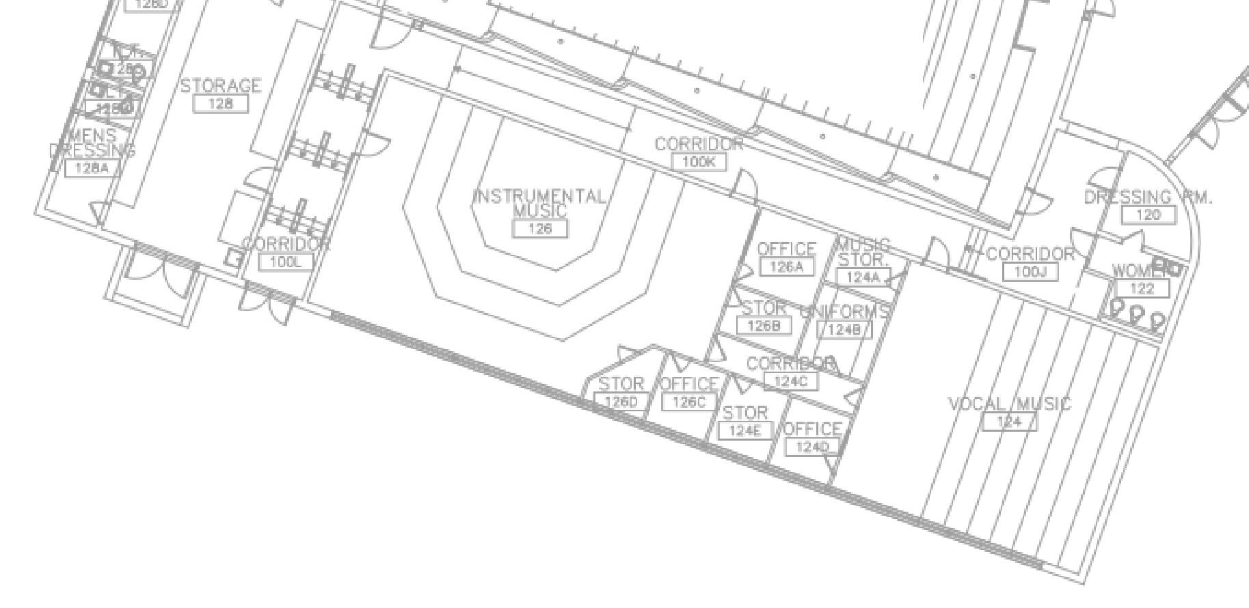
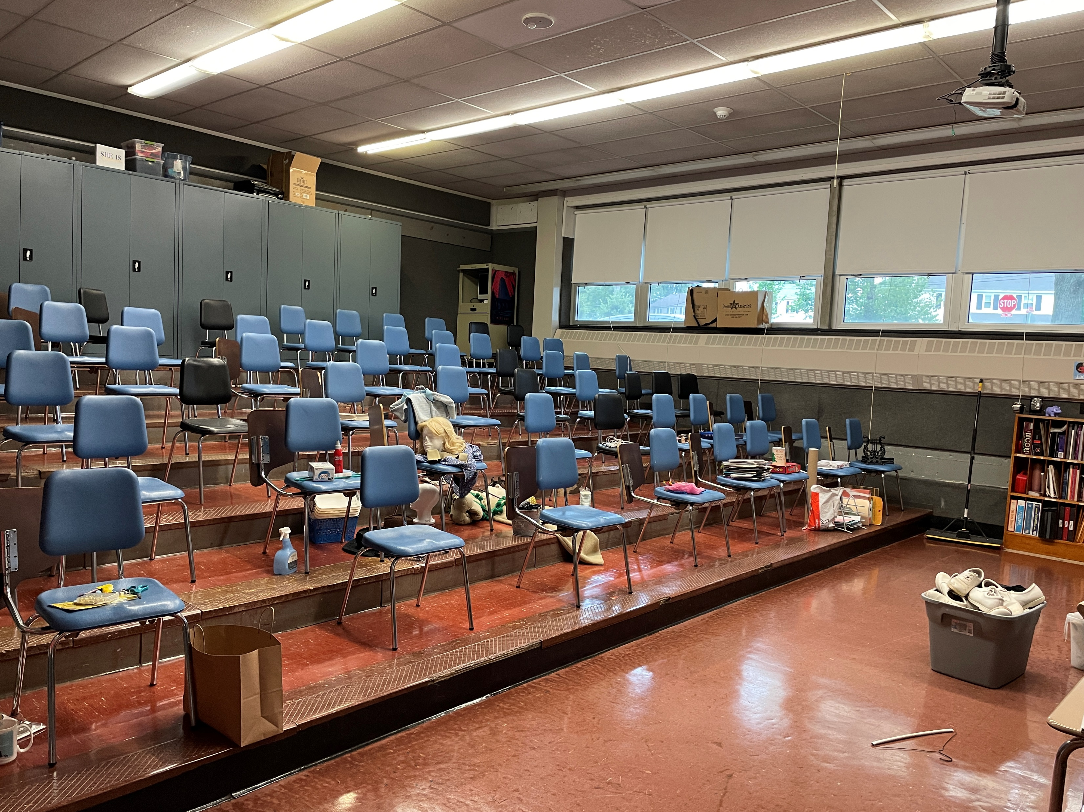
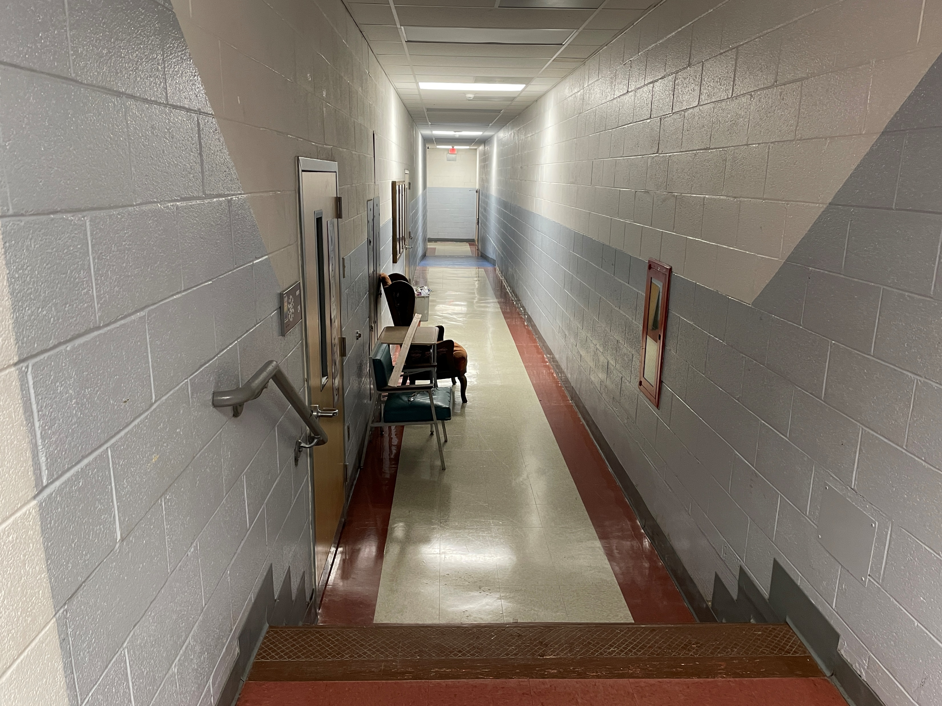
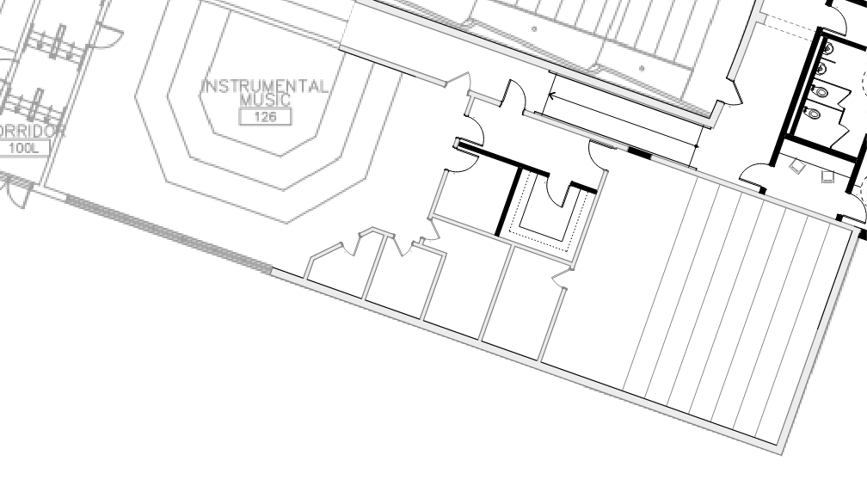
Existing stairs. Current IMR/VMR are not accessible
Existing office
Existing Storage
Existing VMR
Existing
Existing Corridor/stair
ADA ramp to access IMR/VMR
Reconfigure storage to provide room access
Reconfigure Office to provide access
Reconfigure practice & storage rooms
Proposed
Upgrade IMR/VMR rooms
Access & Arts
High School – HS Music Wing upgrades and ADA Accessibility

Slide 13
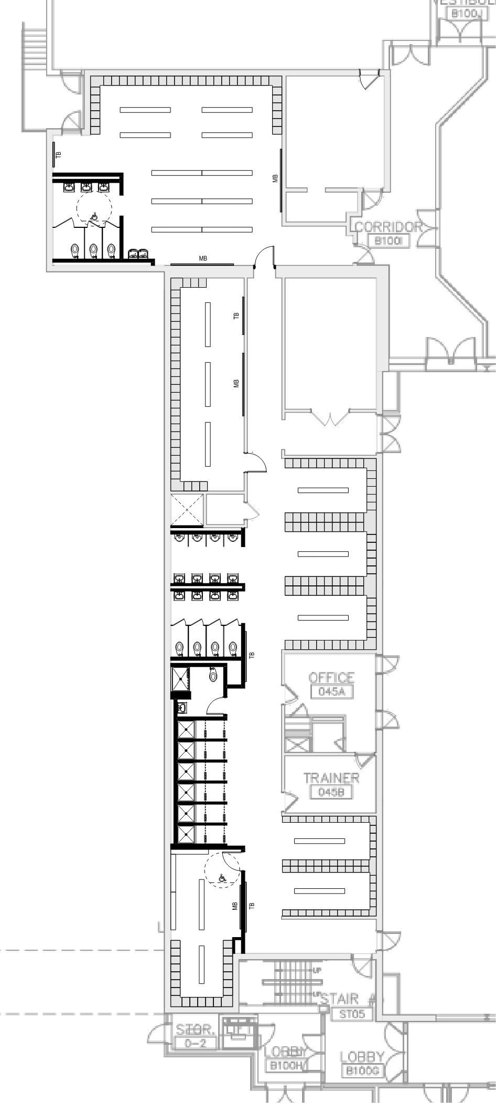
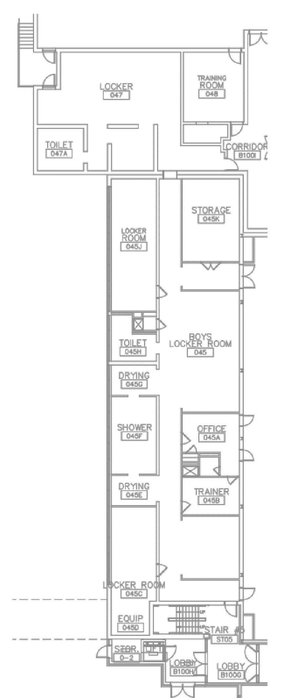
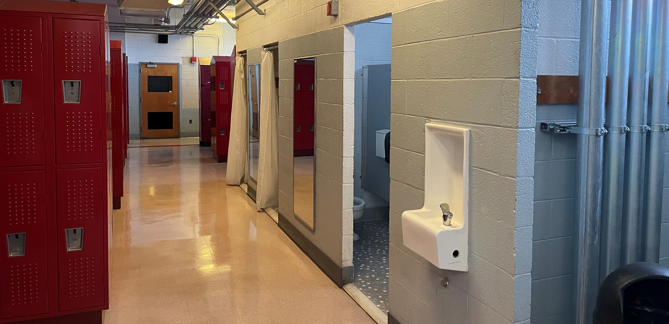
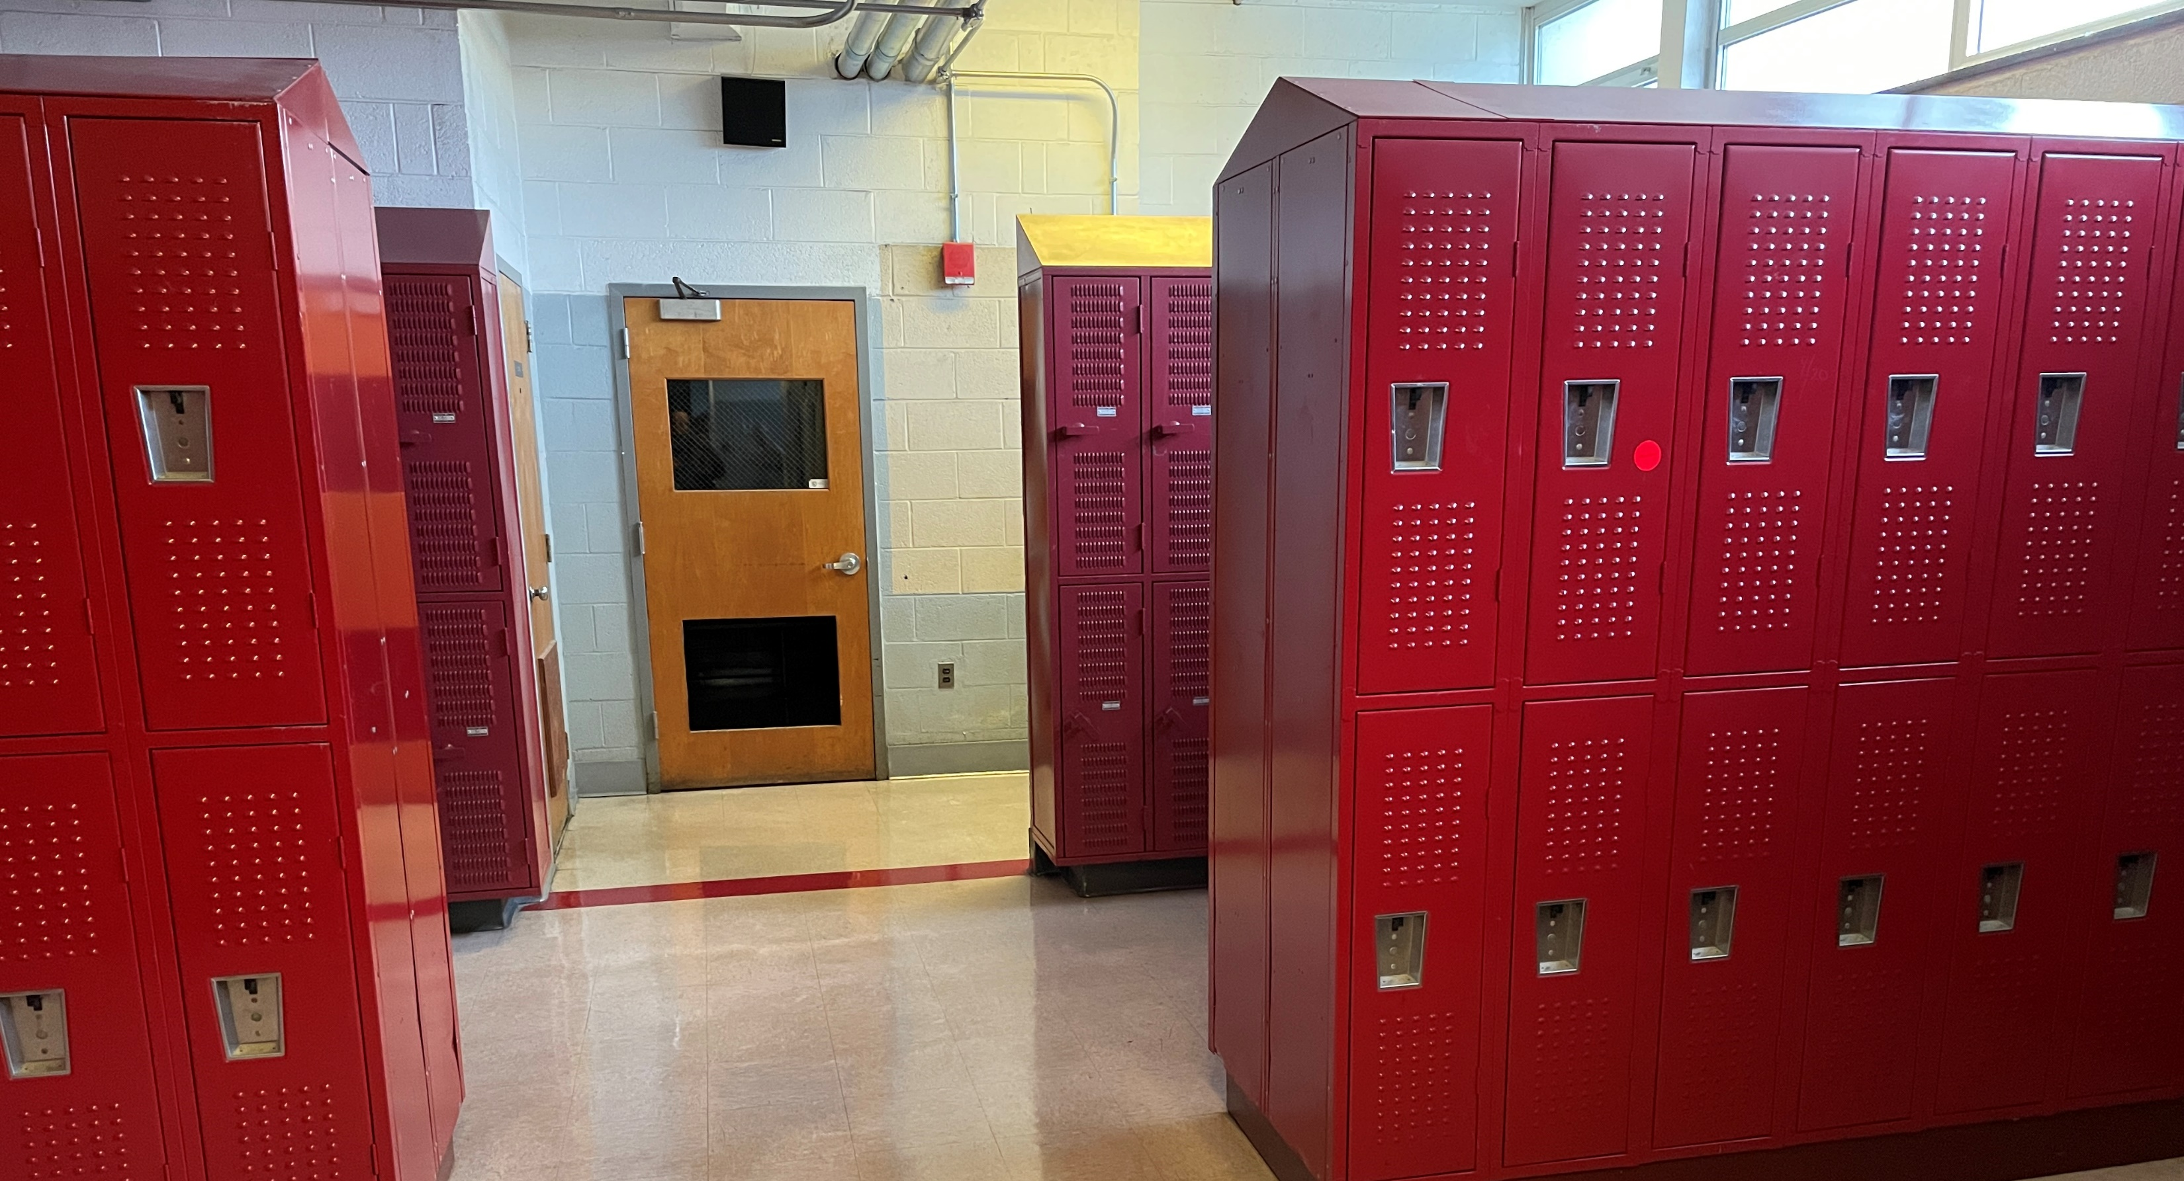
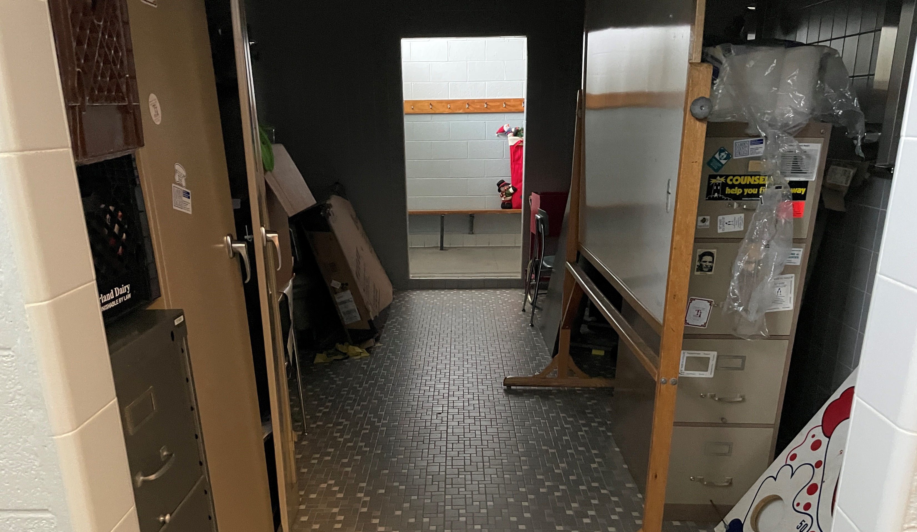
Home team room
Renovated locker areas; MEP, Lights, bottle fillers, benches (some lockers)
Existing locker room
Expanded upgraded bathrooms
General renovations: incl. finishes and mech-elec for new layouts
Cust
Accessible toilet and shower
Existing lockers
Individual shower areas
Renovated locker areas & added benches
Existing shower area
Existing
Proposed
Access & Athletics
High School – HS/MS Locker Rooms – First Floor (Boys)

Slide 14
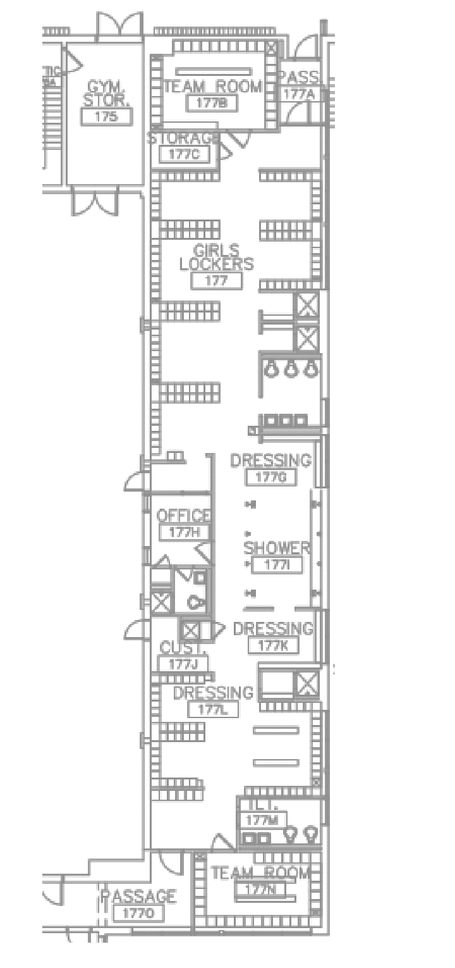
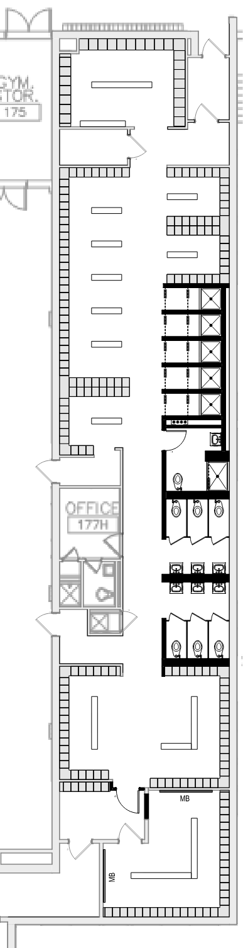
Renovated locker areas; MEP, Lights, bottle fillers, add benches (selective locker replacements)
Existing locker room
Individual shower areas
General renovations: incl. finishes and mech-elec for new layouts
Accessible toilet and shower
Existing lockers
Expanded upgraded bathrooms
Expanded team room
Existing shower area
Existing
Proposed
Access & Athletics
High School – HS/MS Locker Rooms – Second Floor (Girls)

Slide 15
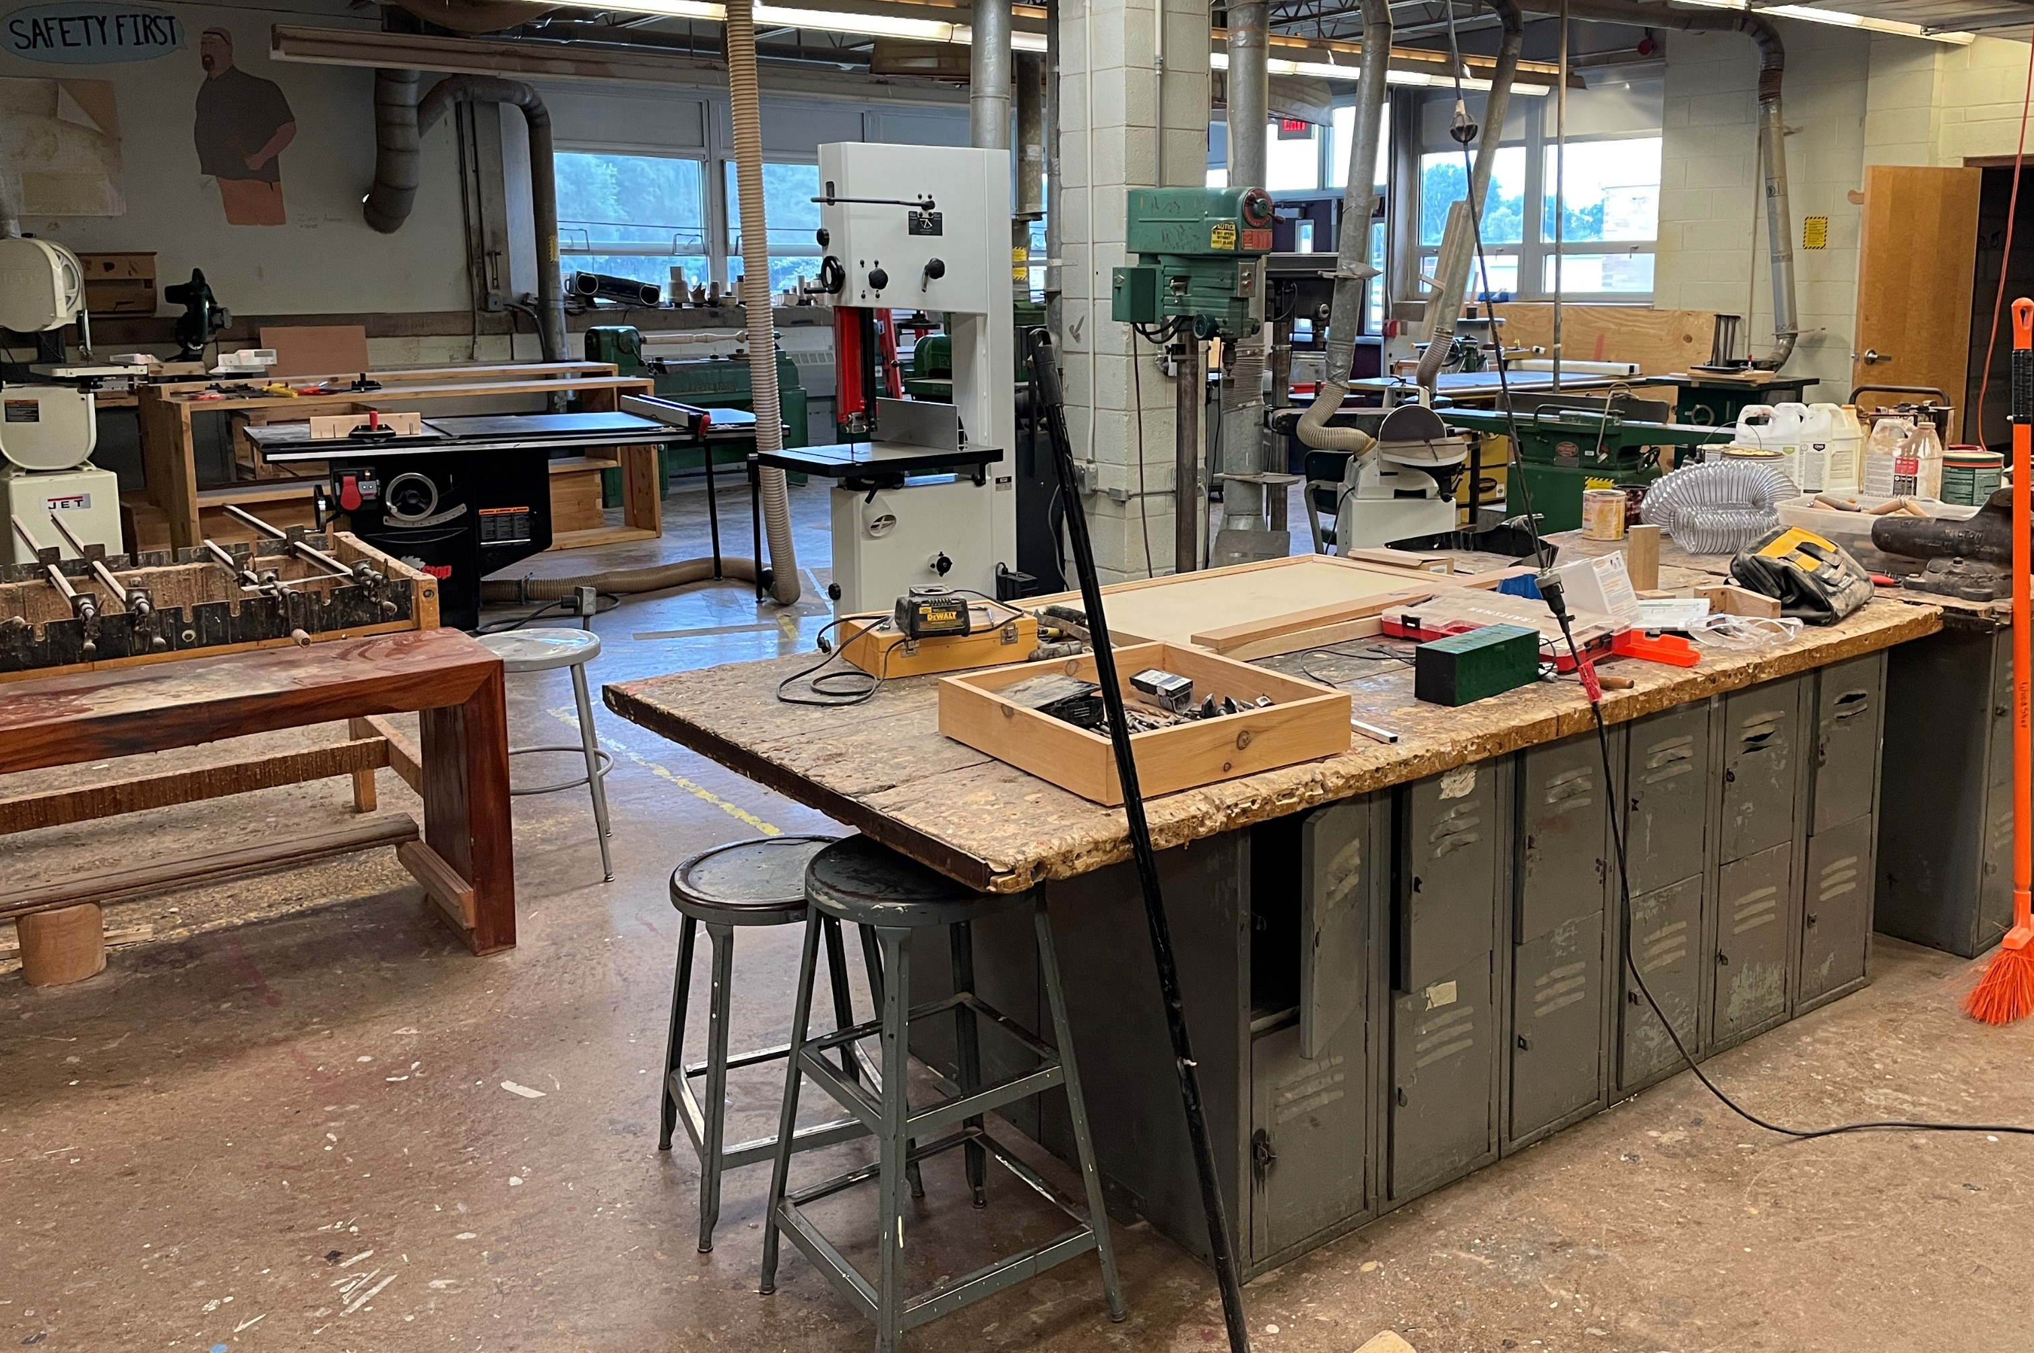
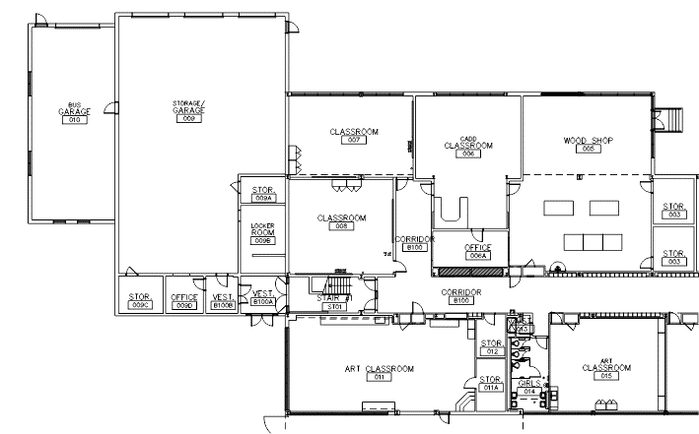
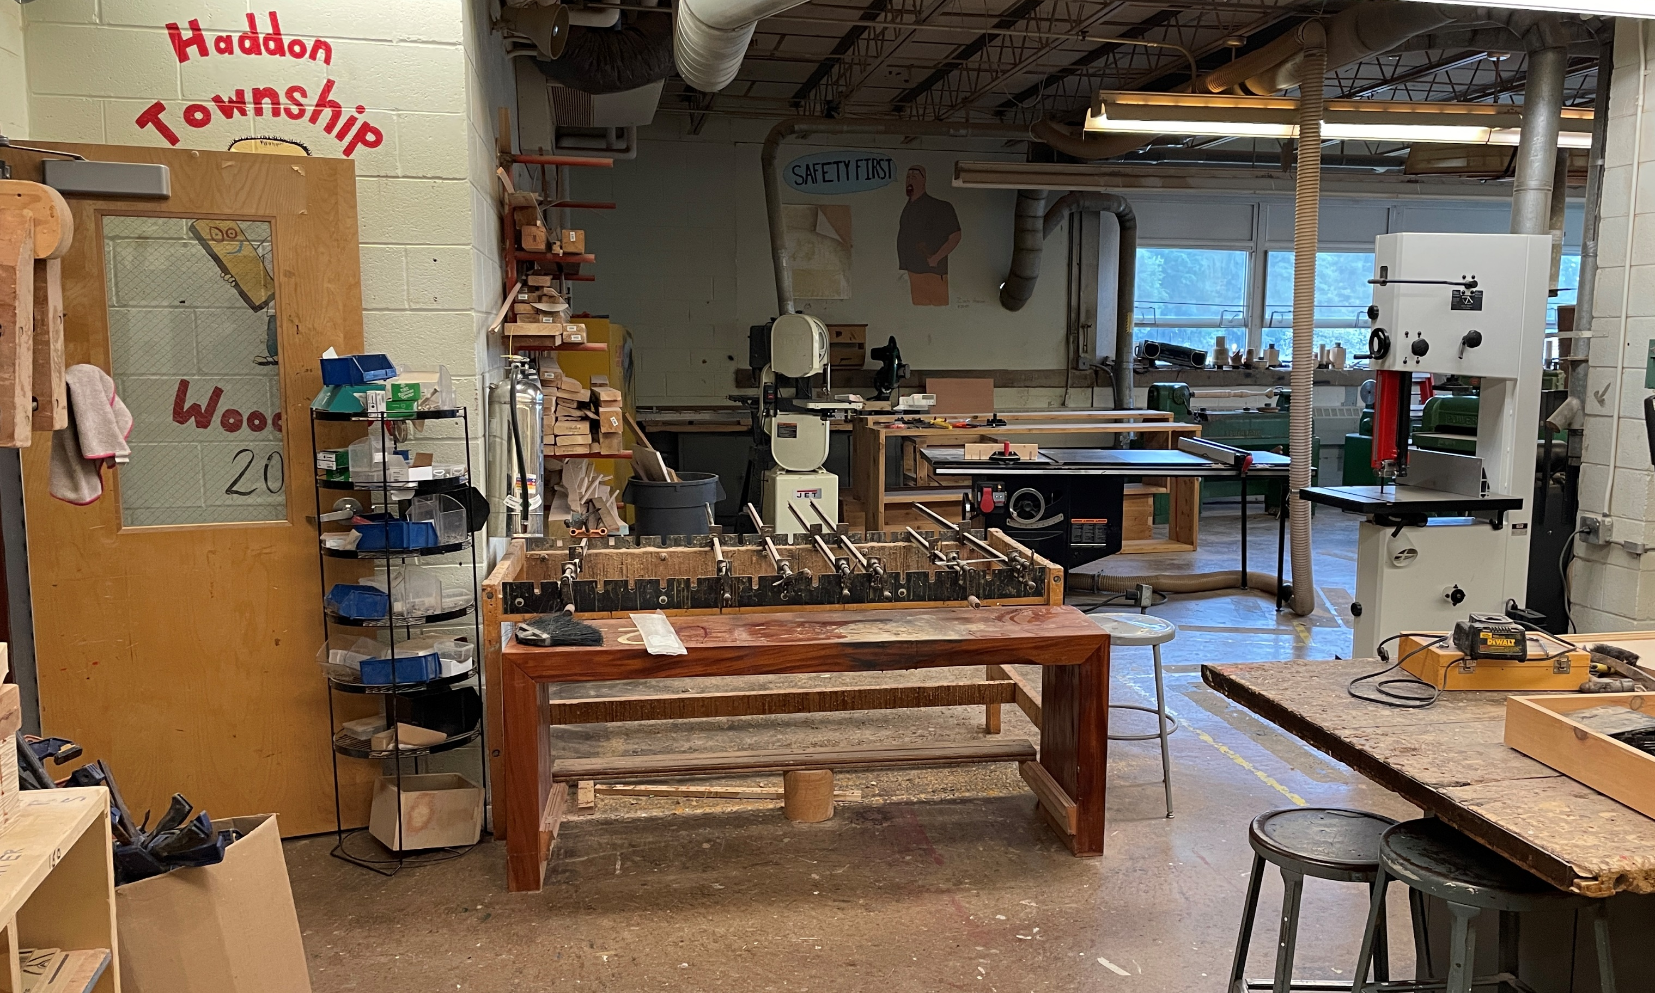
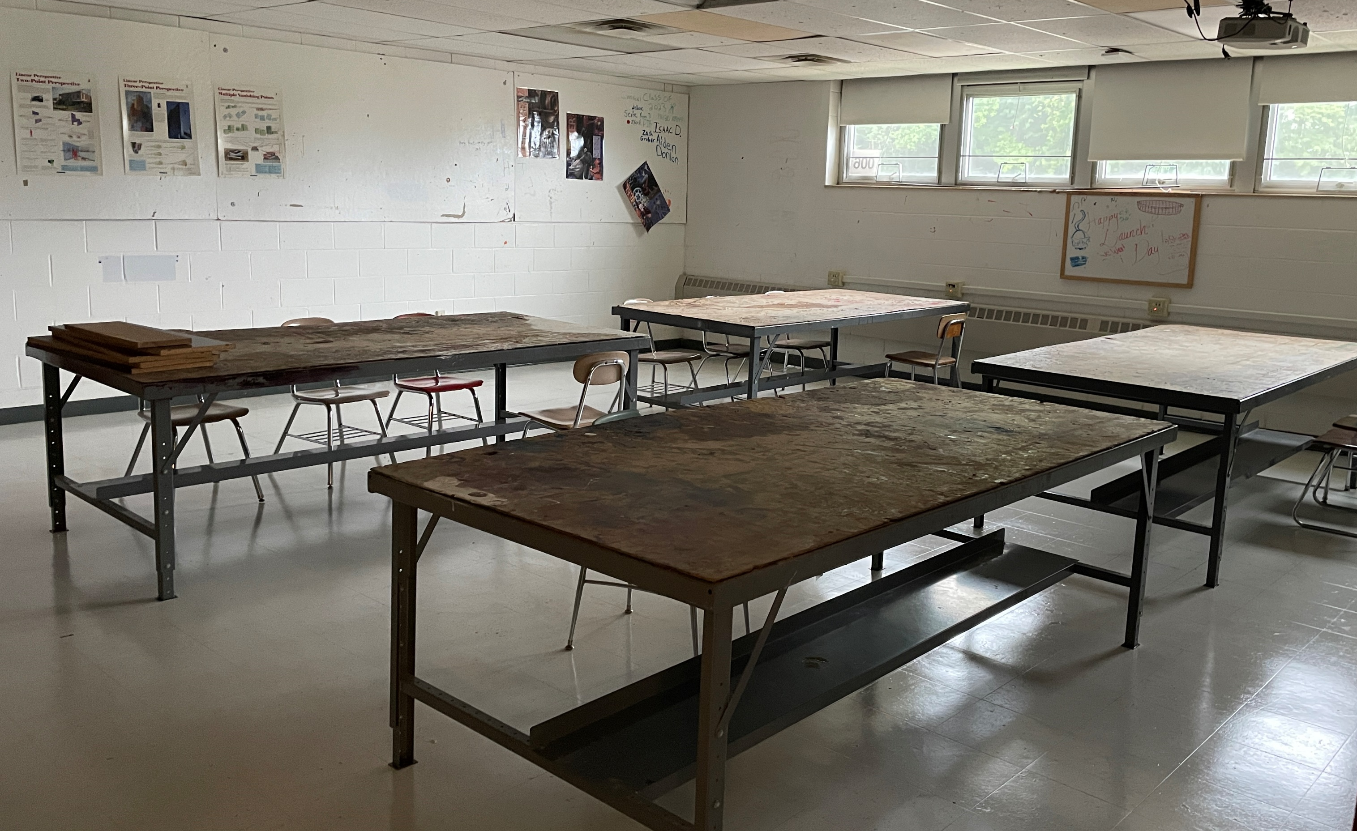
Existing auto shop
Robotics room
Existing CADD room
Existing Auto Shop
Wood shop
Existing Bus Garage
Wood shop
CADD lab
Existing wood shop
Existing office/storage
Tech & Arts
High School – Wood / CADD / Robotics / Auto shop areas (existing)

Slide 16
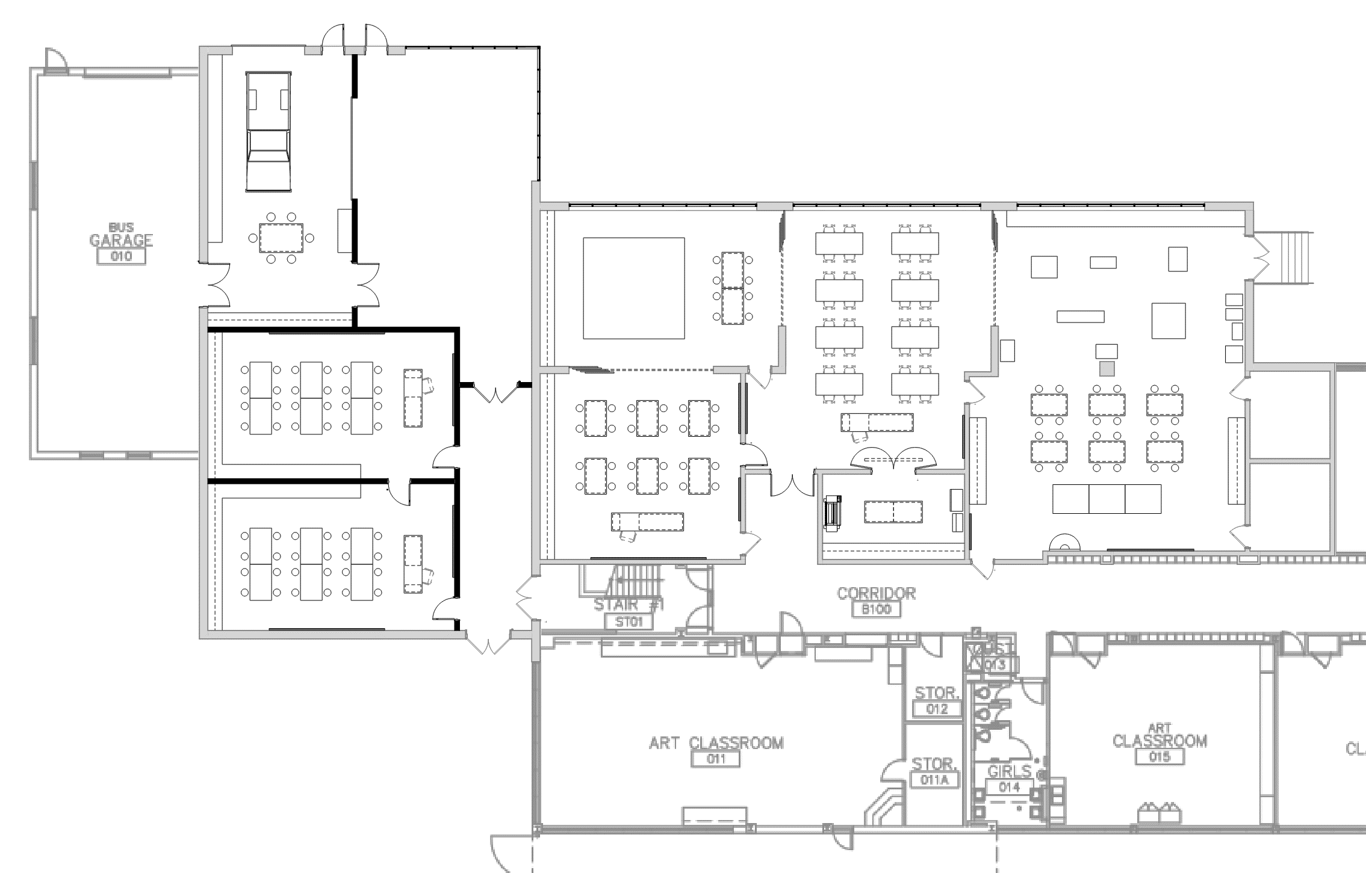
Vocational educational space
Movable glass walls between spaces
Multi-use athletic/wellness space
Robotics room
Shared “clean” CADD, computer, CNC, printing area for Tech Ed spaces
Existing Bus Garage
Classroom
Shared print, CNC/3D print area
Classroom
Wood shop, fabrication area
New Classrooms
Replace sinks in Art Room
Art/STEAM Room
Tech & Arts
High School – Emerging Tech/Shops/Vocational and Fitness/Wellness

Slide 17
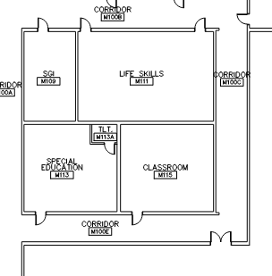
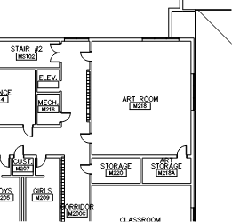
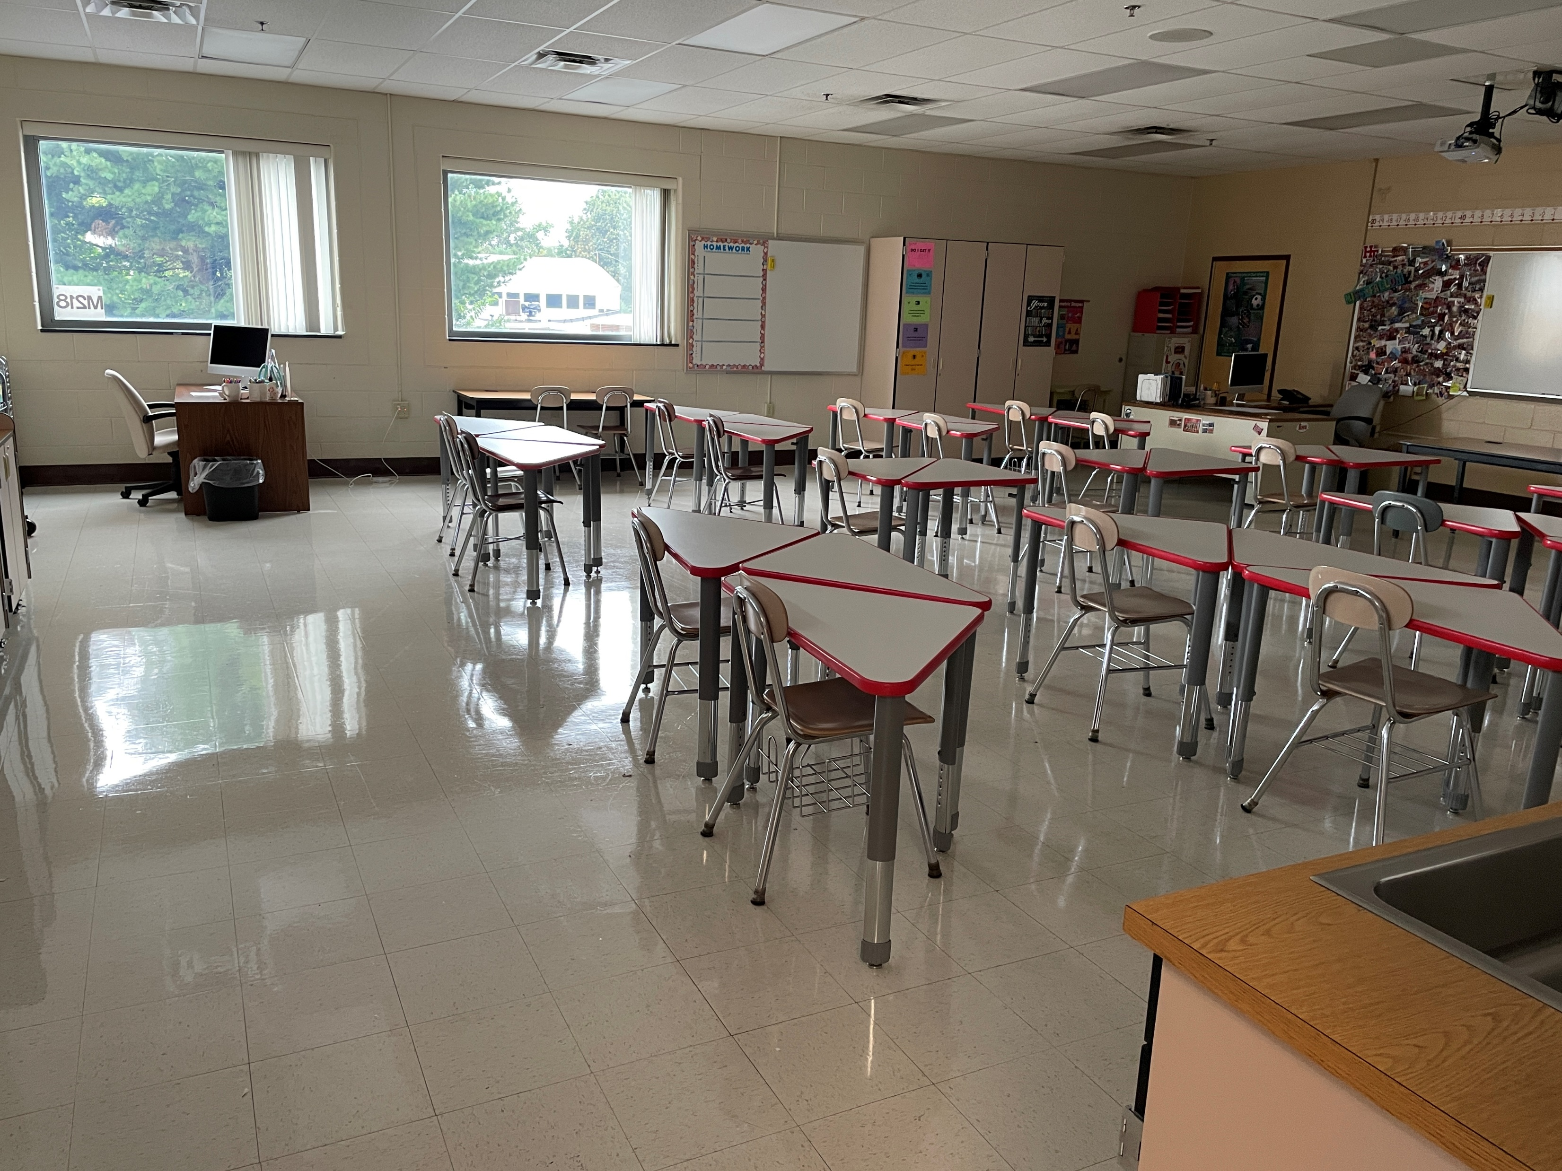
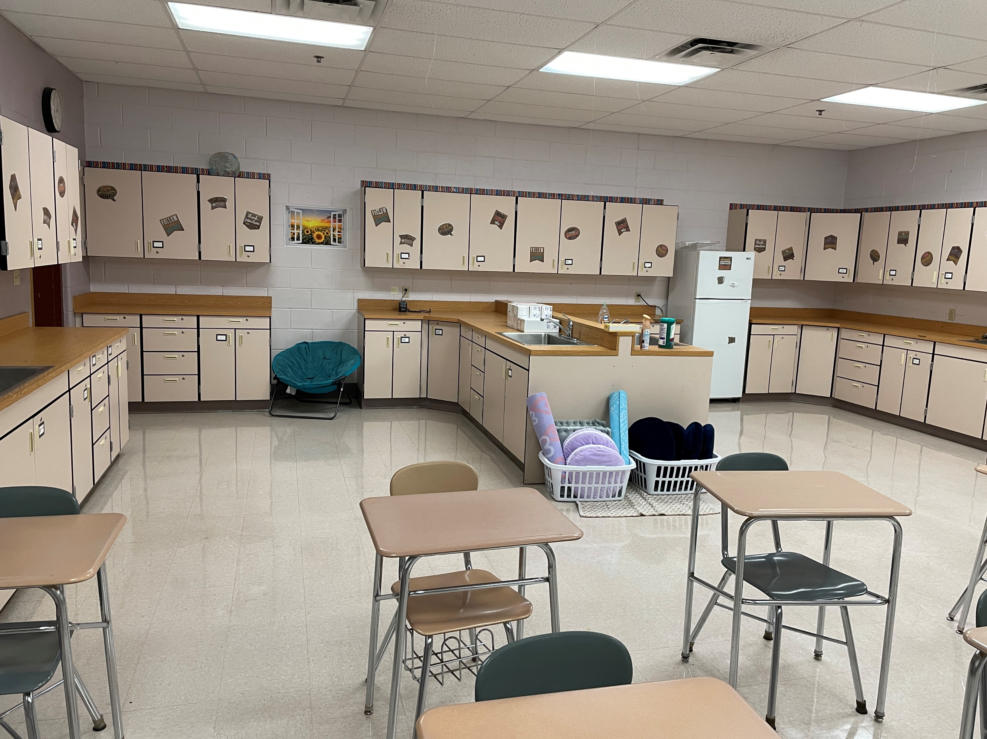
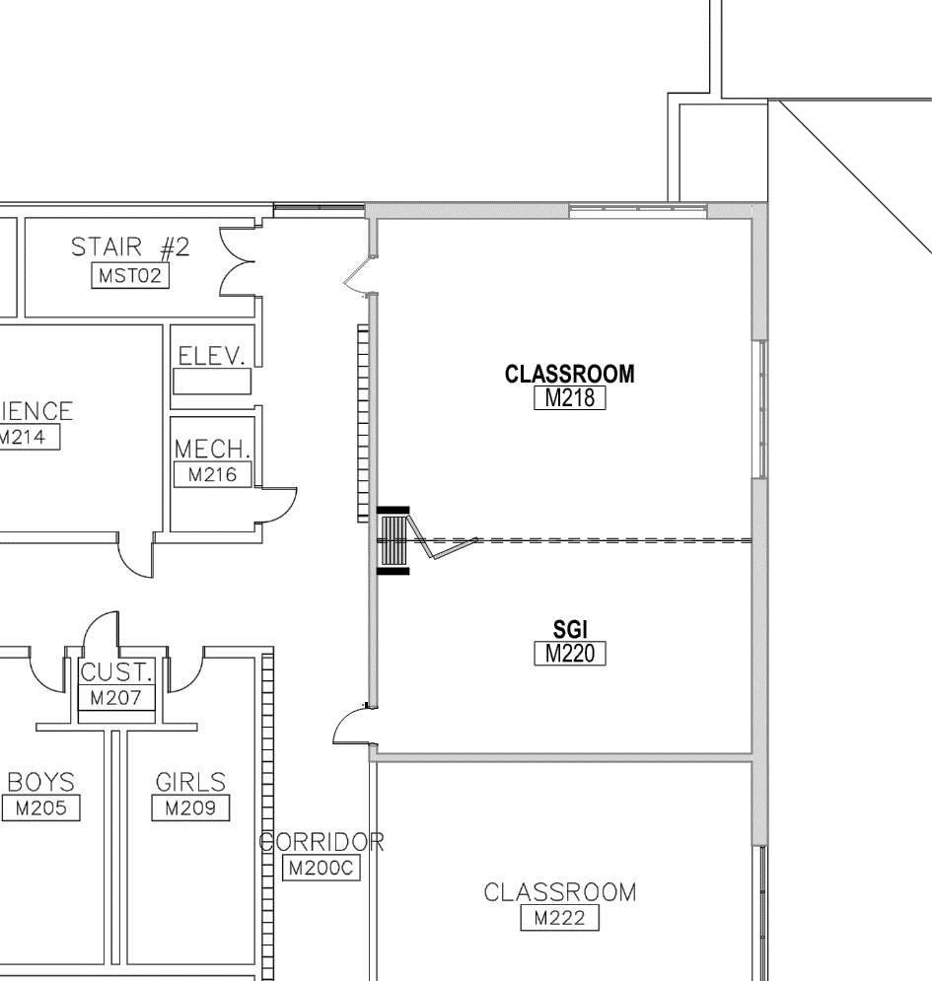
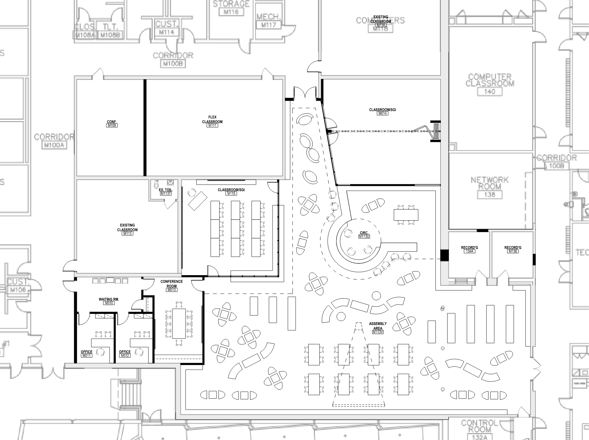
Conf
Sci
M111
Math M218
Oversized room
Math (M118)
CADD lab
Main Floor
Near Library
Upper Floor
Life Skills
Create
(1) clrm +
(1) SGI
Conf. Rm
Classroom w/science counters
Efficiency
Middle School – Classroom re-configurations to gain MS stations

Slide 18
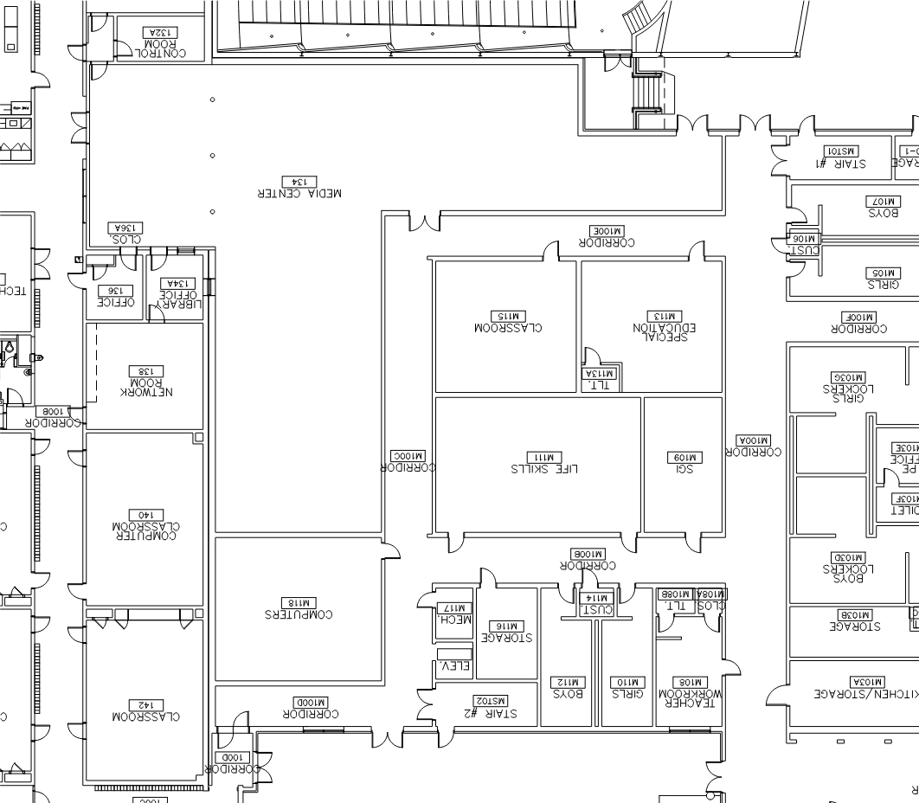
To/From HS
Assembly Area
Ofc
Ofc
New MS Counseling center
Conf
Waiting
CADD lab
AV
Ofc
Desk
Classroom
Existing Paul Gilligan Media Center
New Paul Gilligan Media Center
Diverse, mobile furniture
Mobile bookshelves that can flow into school
Multiple projection areas & schedulable rooms
Group/Individual work areas
AV/Recording room
New MS Counseling Center
Classroom/Study Cntr
To/From MS
Media Center
NEW Paul Gilligan Media Center Concept – Expansion/Renovation

Slide 19
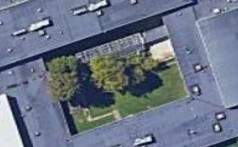
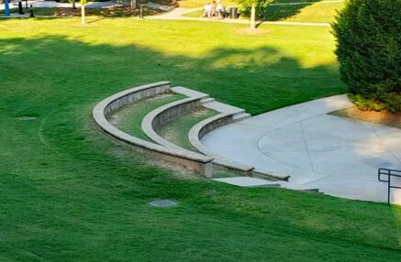
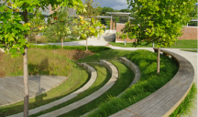
Existing Greenhouse in courtyard
Amphitheater example
Proposed fabric cover at existing outdoor paved area with tables
Existing covered drive/walk area - repave
Amphitheater example
Proposed grass and concrete step amphitheater at existing sloped grass area
Arts & Outdoor Classrooms
Courtyard Program Enhancements

Slide 20
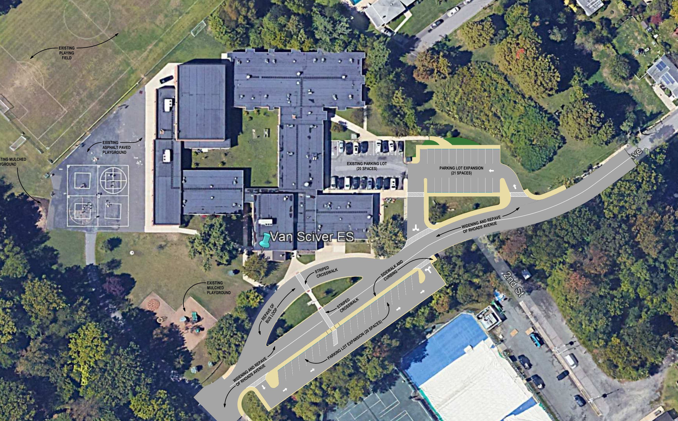
Add parking (20+/-) replacing loop drive
Repave roadway/drives
Redo parking (20+/-) and create accessible parking/entry area
Safety & Access
Van Sciver Elementary – Parking and Paving

Slide 21
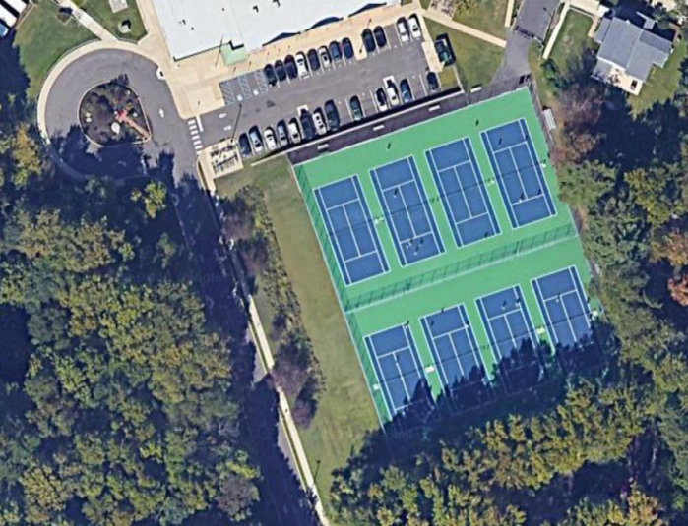

Added perimeter drainage and inlet system – tie into existing inlets at MS parking area
Remove courts. Replace with reinforced concrete base construction, surface, fencing, etc. to restore courts
(2) Courts dual use tennis and pickleball
Athletics & Community
High/Middle School – Tennis court reconstruction

Slide 22
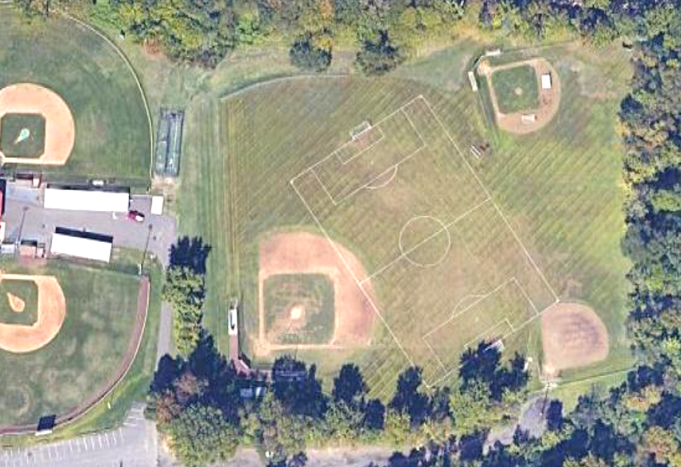
New accessible walkway and landing/portable bleacher pads
Regrade and augment soil in area or fields to improve drainage
New accessible ramp from parking area to connect to pathways
Lower Recchino Fields
Provide accessibility
Address water problems to enable more scheduling. Fields can’t be used at times due to water issues
Provide bleacher pads and walkways
Improves opportunities for sport programs and community uses
Athletics & Community
High/Middle School – Lower Recchino Fields

Slide 23
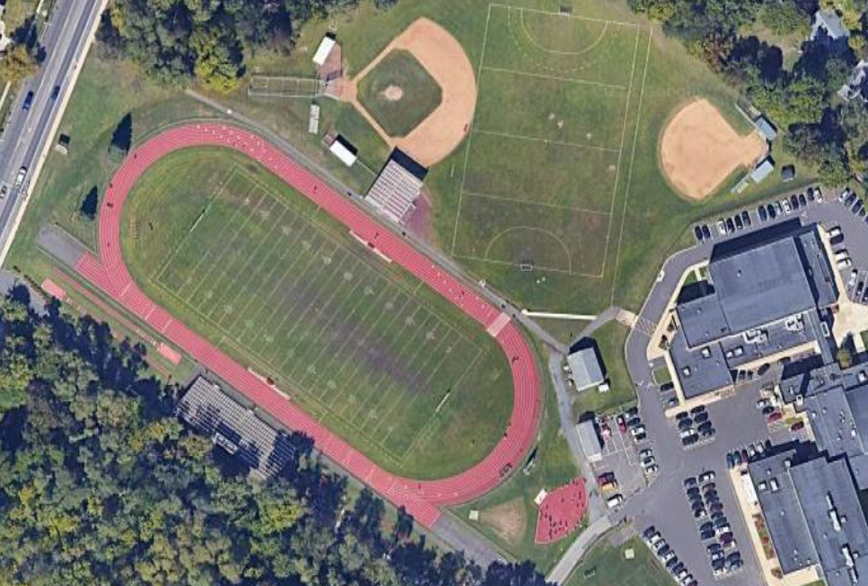
Turf field for various sports (football, soccer, etc.) within existing track including underdrainage and lighting
With Turf, track events moved inside track to end zone areas
Home bleachers: repair, renovation of team and concession spaces below bleachers
Turf Field – Increases Use
Grass cannot be well maintained under needed use schedule
Turf reduces maintenance and increases use time
Field to support multiple sports
Athletics & Community
High/Middle School – Athletic complex

Slide 24
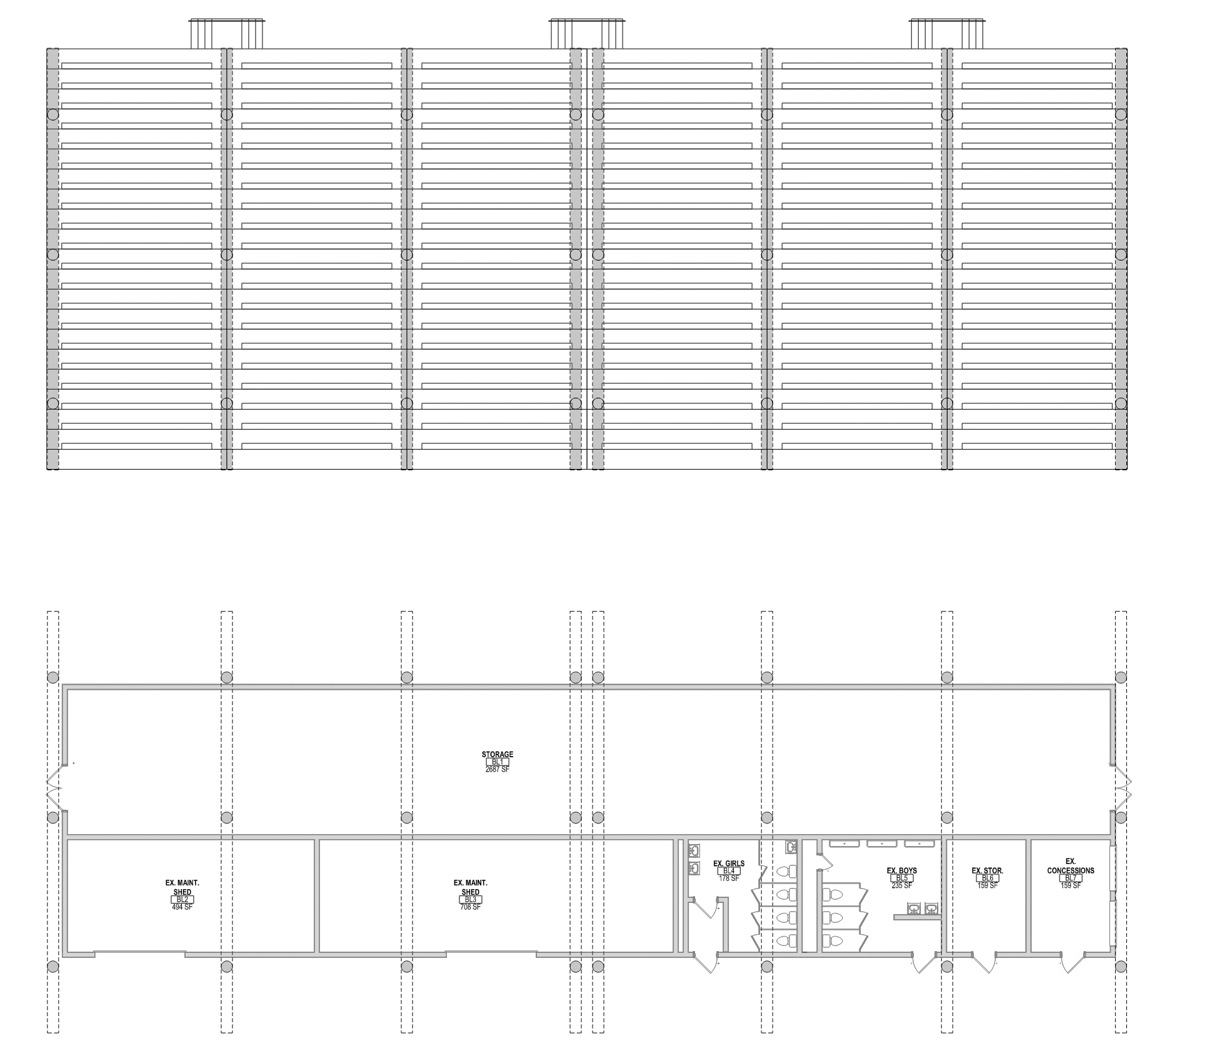
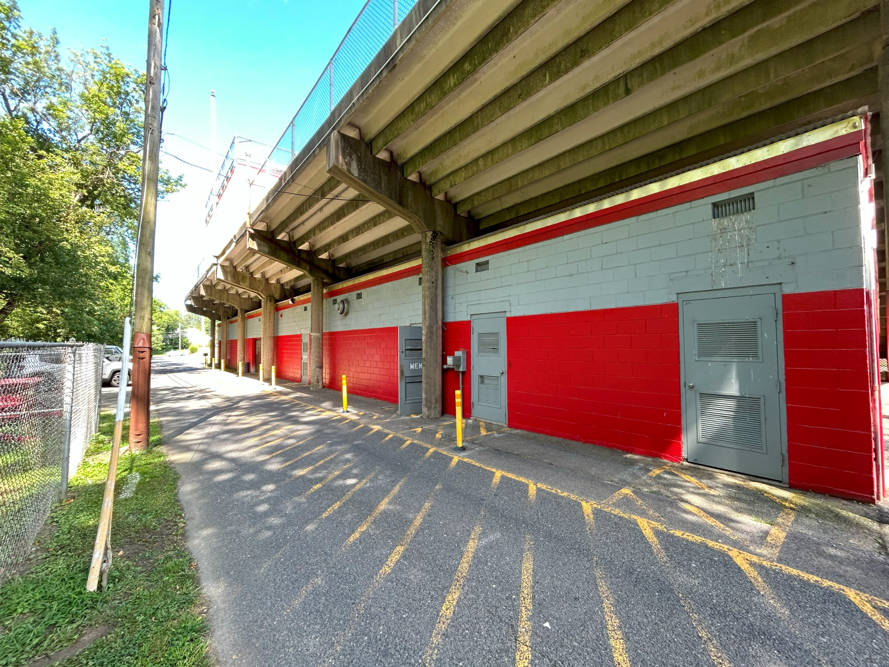
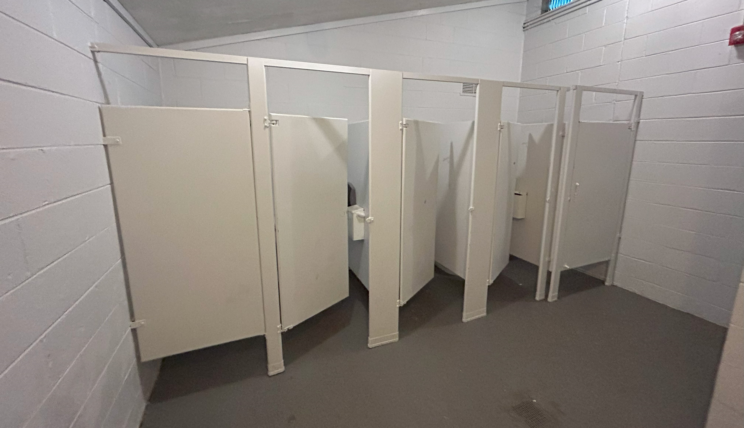
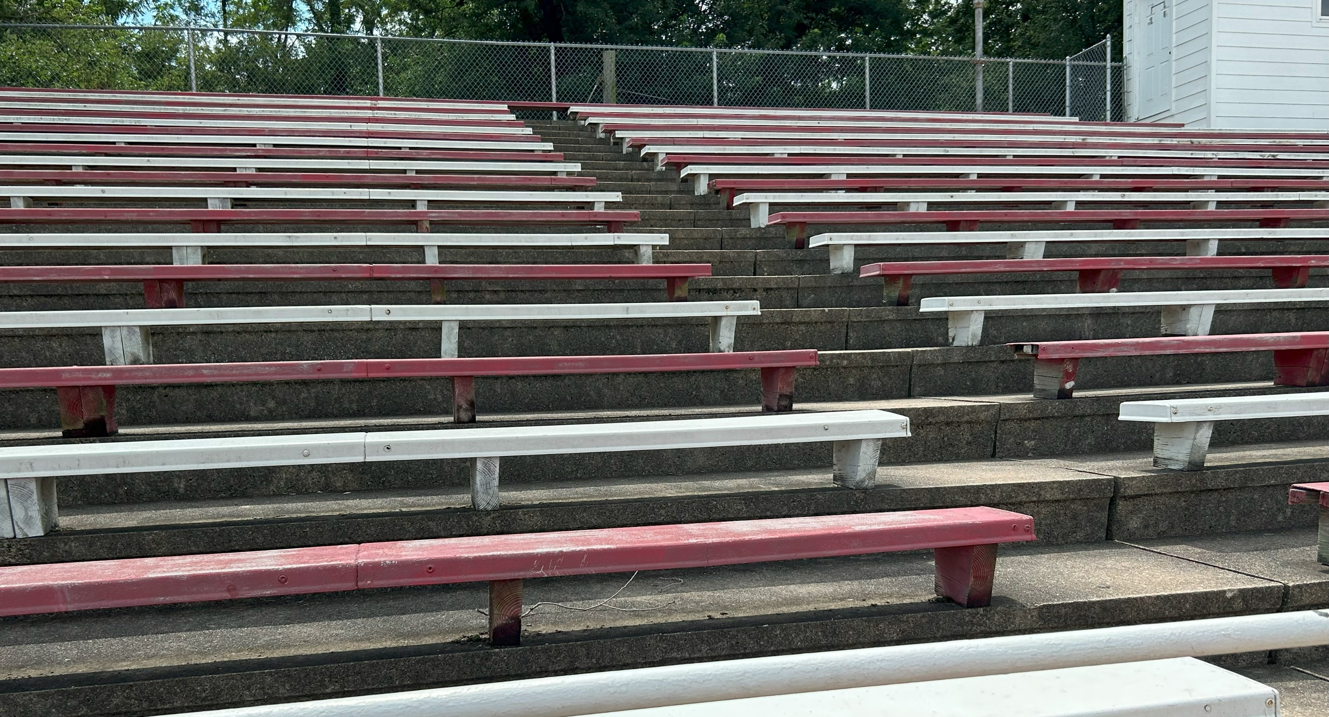
Existing home bleachers: repair and replace bench seating with new
Existing storage: renovate to team rooms below bleachers
Rear of Bleachers
Existing bathrooms: renovate
Existing storage to remain
Bathrooms
Add small storage shed/pole barn nearby
Bleachers
Existing concession: renovate
Athletics & Community
High/Middle School – Athletic complex

Slide 25
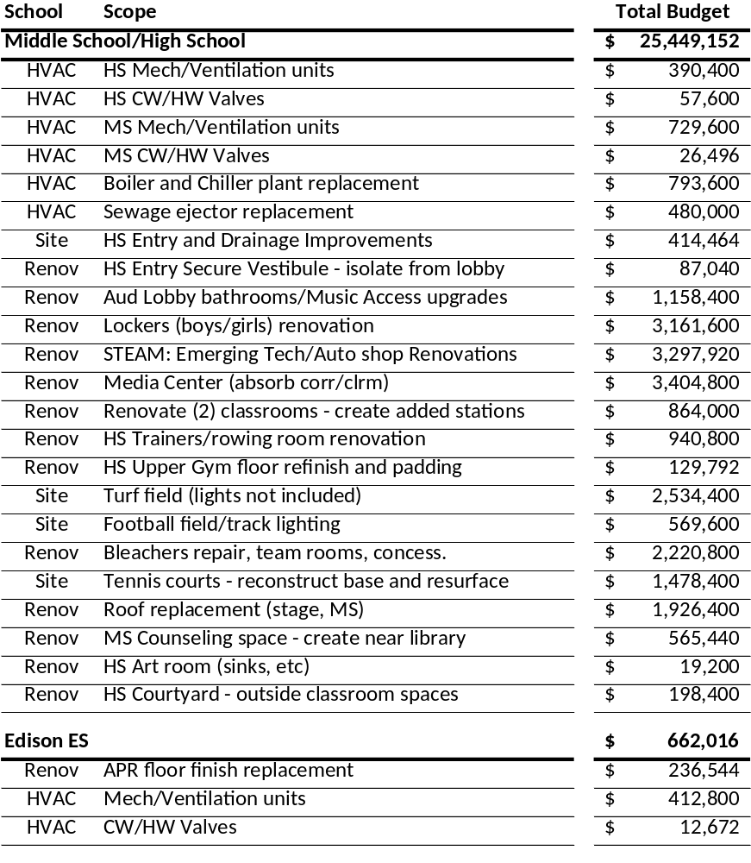
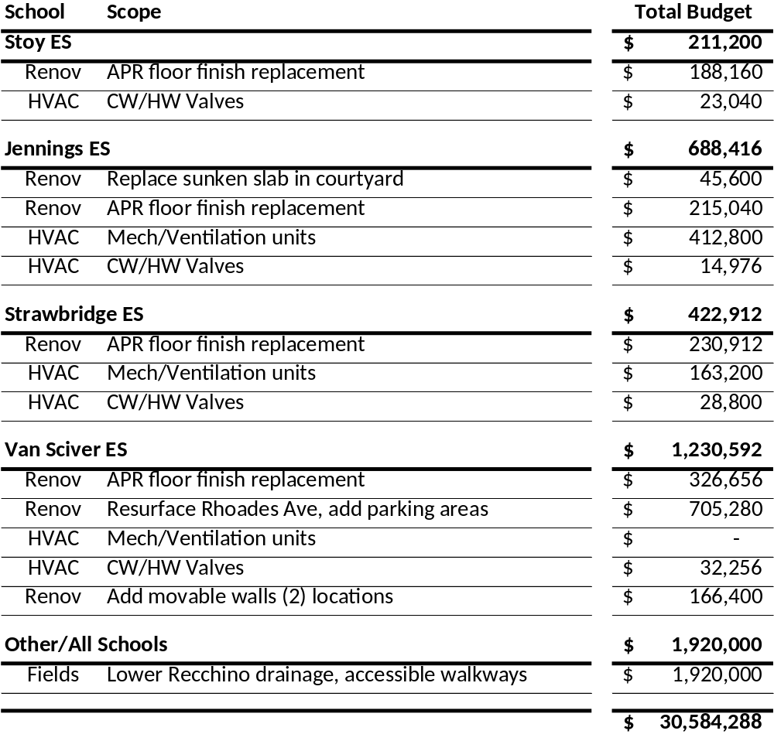
NJDOE State Debt Service Aid – estimated at 26%
Budgets include: estimated hard costs, contingency (10%), escalation (3%), other soft costs (15%)
Budget
Budget Summary

Slide 26
Schedule Overview
Understanding of Process & Schedule
09/07/23 Board session was held to confirm included projects and budgets
09/21/23 *Board passed resolution authorizing NJDOE submissions
10/04/23 Submission made to NJDOE (approx. 6 months prior to referendum date)
Early Jan 24 *NJDOE approval and Board action to accept approvals by this date +/-
Early Jan 24 *Referendum question to board of elections (45-60d prior)
03/12/24 March Referendum Date
BOLD indicates pending event/deadline * Indicates Board action date
Approximate Referendum Approval and Milestone Schedule

Slide 27
Scope Overview
Middle School
Mechanical/ventilation improvements
Boiler, Chiller, and sewage plant upgrades
Roof replacements
Counseling space improvements
Other classroom renovations to add MS stations
Tennis courts – rebuild
High School
Mechanical/ventilation improvements
Site and site drainage improvements
Athletic facility improvements incl. lockers, team rooms, bleachers, turf, lights, outdoor fields
Auditorium lobby upgrades
Emerging technology spaces
IMR/VMR accessibility improvements
Media center (HS/MS) expand/renovate
Upper gym refinish and padding
Security improvements at entry
Van Sciver ES
Mechanical improvements
APR floor finish upgrade
Movable partitions at 2 rooms
Rhoads Ave repaving and parking improvements
Strawbridge ES, Edison ES, Stoy ES
Mechanical improvements
APR floor finish upgrade
Jennings ES
Mechanical/ventilation improvements
APR floor finish upgrade
Sunken courtyard slab replacement
Lower Recchino
Field drainage, path, and access improvements
Overview of Potential Scope

